Slide 1
The SPEEDY-NEMO-LIM coupled model
Atlantic Pacemaker experiments

Slide 2
SPEEDY v41
T30 (3.75x3.75 deg)
8 levels
NEMO v3.0
2/0.5deg.
31 levels
+
LIM1 sice
OASIS3
Ens. generation
Pertur. Init. Cond.

Slide 3
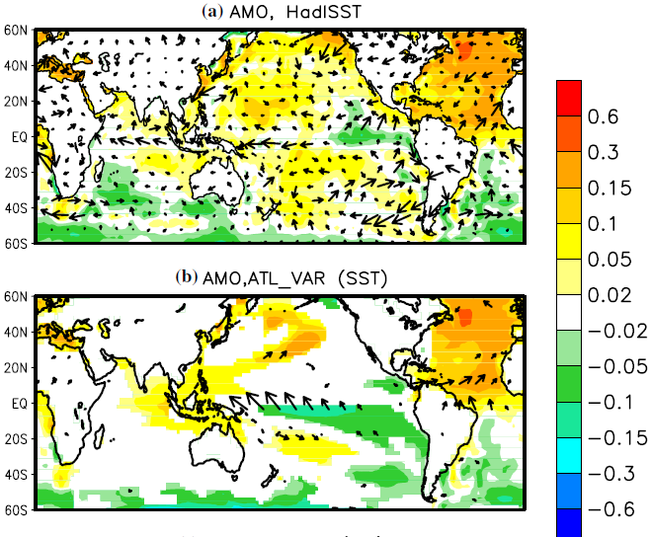
Atlantic Pacemaker experiments
Prescribed
Observed
SSTs in Atlantic
Fully coupled in
Indo-Pacific

