Slide 1
Investigation of Ion Irradiation Induced Damages in Iron Phosphate Glasses:
Role of Electronic and Nuclear Losses in Glass Network Modification
Dr. Charu L. Dube, Dr. Martin C. Stennett, Dr. Amy S. Gandy, Prof. Neil C. Hyatt
Immobilisation Science Laboratory, Department of Materials Science and Engineering,
University of Sheffield, United Kingdom
Joint ICTP-IAEA Workshop on Radiation Effects in Nuclear Waste Forms and their Consequences for Storage and Disposal, 12-16 September 2016, Trieste, Italy.

Slide 2
Iron Phosphate Glasses for HLW
At present, borosilicate glass is the generally accepted wasteform for the immobilisation of high level radioactive waste, the emergence of new sources of radioactive materials has renewed interest in alternative candidates.
Iron phosphate glasses are being considered as candidate material for immobilisation of high level radioactive waste due to excellent chemical durability and high waste loading ability.
1

Slide 3
Radiation damage due to alpha decay of actinides
The actinides undergo α-decay with the formation of α-particles and energetic (~100 keV) daughter recoil nuclei.
The alpha-decay of actinides lead to
  Ballistic elastic collisions (due to energetic recoil)
  Radiolysis (due to energetic alpha particles)
Both the processes are responsible for displacement damages inside matrix, which will potentially affect the structural integrity of immobilisation matrix.
2

Slide 4
Motivation for the present study
The focus of our work is to understand the effect of radiation induced effects on glass network.
(i) Due to ballistic elastic collisions (energetic recoil)
(ii) Due to radiolysis (energetic alpha particles).
Strategy of the study
Ion irradiation technique is employed as surrogate method to study radiation induced effects on glass network
3

Slide 5
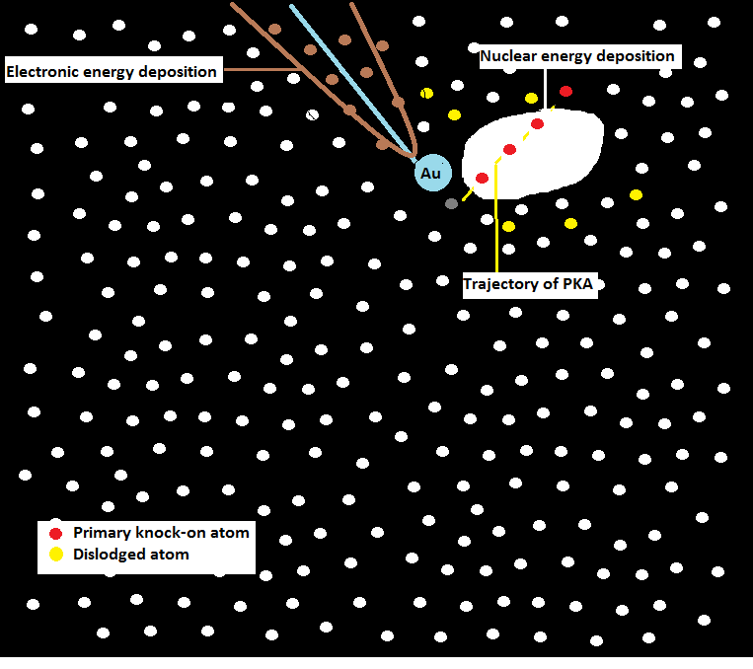
Ion-Solid interactions
Nuclear stopping (S_{n})
Electronic stopping (S_{e})
4

Slide 6
Energy selection of ions
III
To investigate the role of nuclear and electronic energy deposition during alpha decay of actinides in iron phosphate glass matrix, ion energy in different loss regime is selected
II
I
4

Slide 7
Fluence selection of ions
Weber et al.J. Mater. Res., Vol. 12, No. 8, Aug 1997
Representative damage ~ 1 dpa is chosen and corresponding fluence of 2*10¹⁴ ions/cm² have been taken for irradiation experiments
5

Slide 8
Experiment details
Composition | Ion/Energy/Fluence (2E14 ion/cm²) | Remark | Facility used
IPG6040 (P₂O₅: 60 mol%, Fe₂O₃: 40 mol% ) | Au/750keV/2E14 | Nearly pure nuclear loss regime | Ion beam centre, HZDR, Germany
 | Au/5MeV/2E14 | Intermediate loss regime
 | Au/10MeV/2E14
 | Au/20MeV/2E14
 | Au/100MeV/2E14 | Nearly pure electronic loss regime | IUAC, Delhi, India
 | Au/120MeV/2E14
6

Slide 9
Fe L-edge XANES study
The first near edge peak for the obtained spectrum is characteristic of Fe²⁺ ions
At low (750keV) energy, iron reduction is not significant. Nuclear losses alone can not induce iron reduction.
The observed significant iron reduction at intermediate energy regime (5-20MeV) can be attributed to synergetic effect of nuclear and electronic losses.
7
UGC-DAE Consortium for Scientific Research, RRCAT, Indore, India.

Slide 10
Raman spectroscopic measurements
Ion energy 750keV: Appearance of broad peaks at lower wavenumber side indicates probable formation of nanocrystallites.
Ion energy 5MeV-20MeV :
  Sharp peaks at lower wavenumber side indicates crystallization in samples; crystallization can be driven by induced stress.
8

Slide 11
Raman spectroscopic measurements
High energy irradiation:
  Important shoulder at ~1550 cm⁻¹ : stretching vibration of molecular O₂.
  Asymmetry around 1150 cm⁻¹ : indicates presence of O=P₃²⁻ end groups.
Ollier et al. Journal of Non-Crystalline Solids 323 (2003) 200–206.
9

Slide 12
Electron microscopic investigation
IPG6040: Pristine glass
IPG6040: 750 KeV
IPG6040: 5 MeV
IPG6040: 10MeV
IPG6040: 20 MeV
Crystallite formation is seen
10

Slide 13
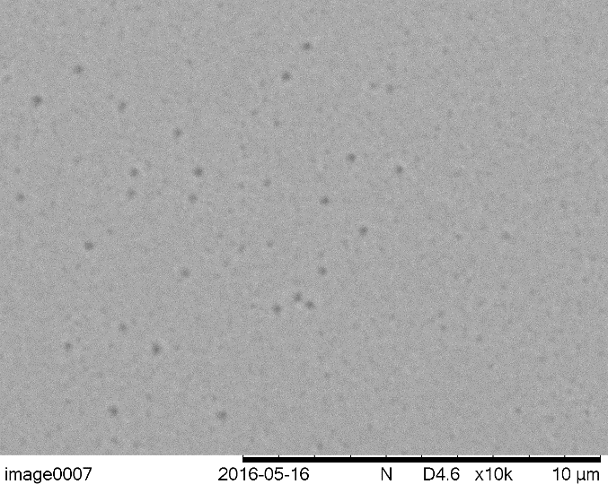

Electron microscopic investigation
IPG6040: Au/100 MeV
IPG6040: Au/120 MeV
Observed features may be due to oxygen bubble formation
Further investigation needs to be carried out.
11

Slide 14
XRD measurements
X-ray diffraction patterns show irradiation induced crystallisation
12

Slide 15
Hardness measurements
Low energy: 26 % decrease in hardness
Intermediate energy : Decrease in hardness < 25 %
High energy: 36 % decrease in hardness
13

Slide 16
Conclusions
Low energy
Iron reduction is not significant.
Intermediate energy
Iron reduction is significant and crystallisation is taking place.
High energy
Formation of crystallites and formation of dissolved oxygen above threshold S_{e}.
14

Slide 17
Acknowledgements
This work was supported by EPSRC and we are grateful to The Royal Academy of Engineering and Nuclear Decommissioning Authority for financial support
Dr. S. Akhmadaliev, HZDR Germany
Dr. D. K. Shukla, RRCAT Indore, India
Dr. P. K. Kulriya, IUAC Delhi, India
Dr. J. G. Shah from BARC Mumbai for fruitful discussions.
Immobilisation Science Laboratory group members
Thank you for kind attention
15

