Slide 1
Wasteform Science II
Radiation Effects in Nuclear Waste Forms and their Consequences for Storage and Disposal

Slide 2
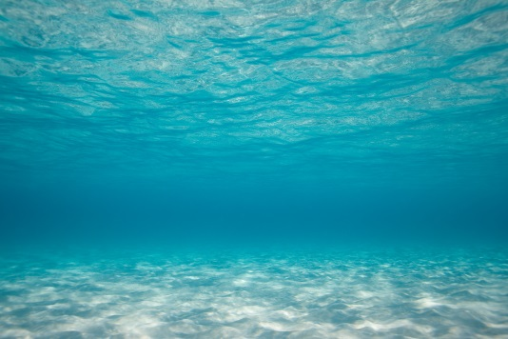
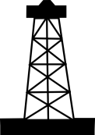
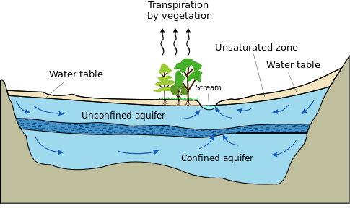
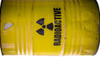
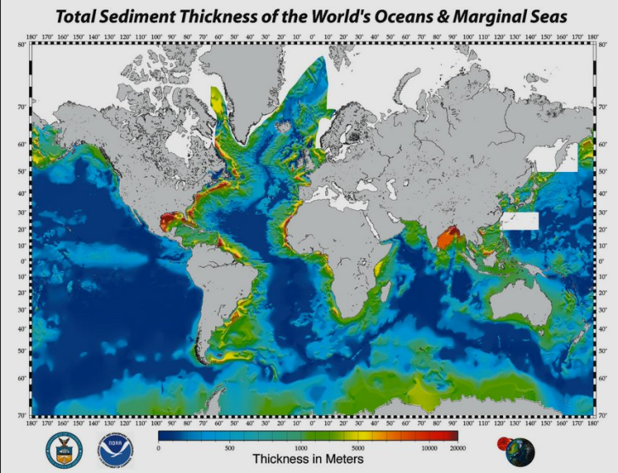
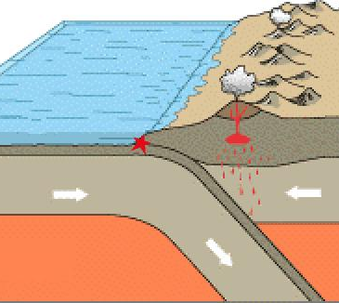
Alternative disposal suggestions
Seafloor disposal
Practiced 1946-1993
Blast into space/sun
Injection of into confined aquifer
(practiced USA, USSR)
Subduction zone disposal
Drop a dart into the pelagic sediment

Slide 3
Geological storage

Slide 4
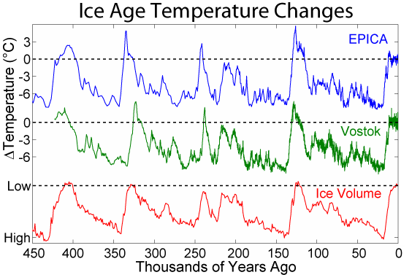
Geological Repository: a Question of Time
Oldest manmade
structure ~4800 BC
No manmade structure has ever existed over such a timescale
Barnenez, Brittany, France
NewPapillon CC BY-SA 3.0, https://commons.wikimedia.org/w/index.php?curid=315515
NWMO goal: 400,000 years
(several glaciations)
CC BY-SA 3.0, https://commons.wikimedia.org/w/index.php?curid=466270

Slide 5
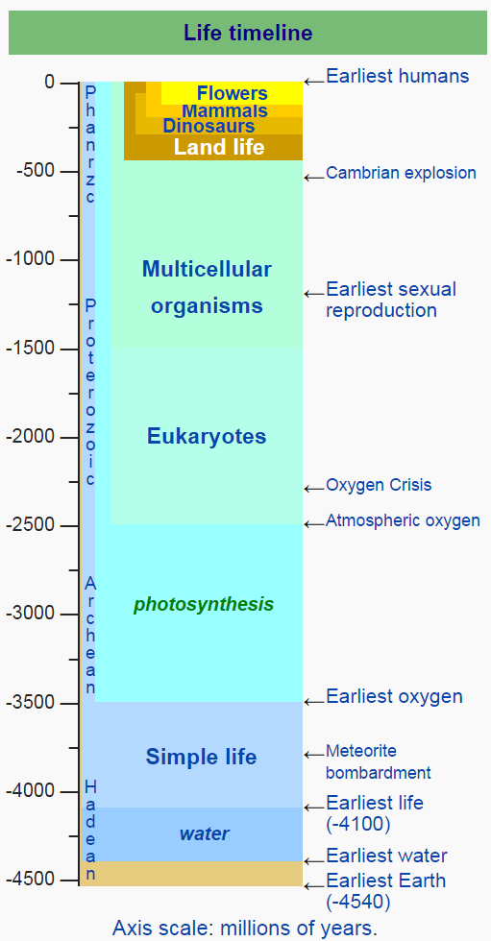
…on the other hand
400,000 years is nothing in geological time.
Can look to geological formations that are stable
Can look to geological phases that are stable
Oklo Reactor
Oldest Rock

Slide 6
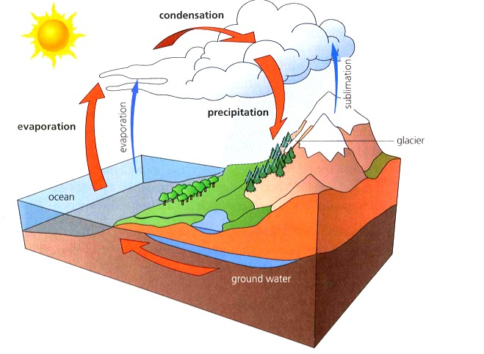
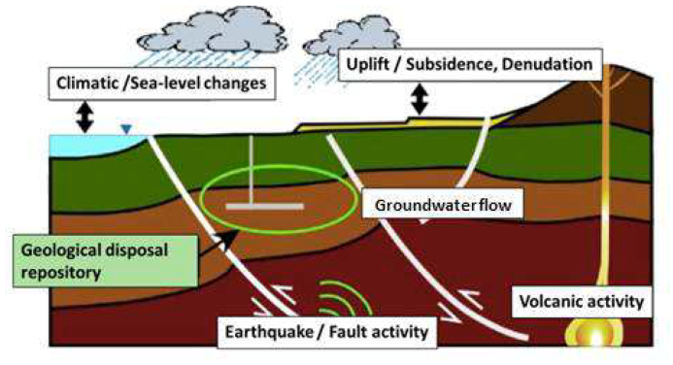
Geosphere–Biosphere
Aim of geological storage: Isolate nuclear waste deep in the geosphere
Principal geosphere–biosphere coupler: groundwater
No such thing as a sealed system, but aim for τ_{RN} ~ 10t_{1/2} for most RNs

Slide 7
Geological Storage Criteria
Geologically stable
Unlikely to be disturbed by future mining
Very low groundwater circulation
Groundwater chemistry favourable wrt corrosion: salinity, Eh
Designed with multiple features to retard corrosion and transport of RNs, particularly toxic Act
Designed to ensure heat flow from HLW does not affect the bariers
Sufficient surface access in a willing community

Slide 8
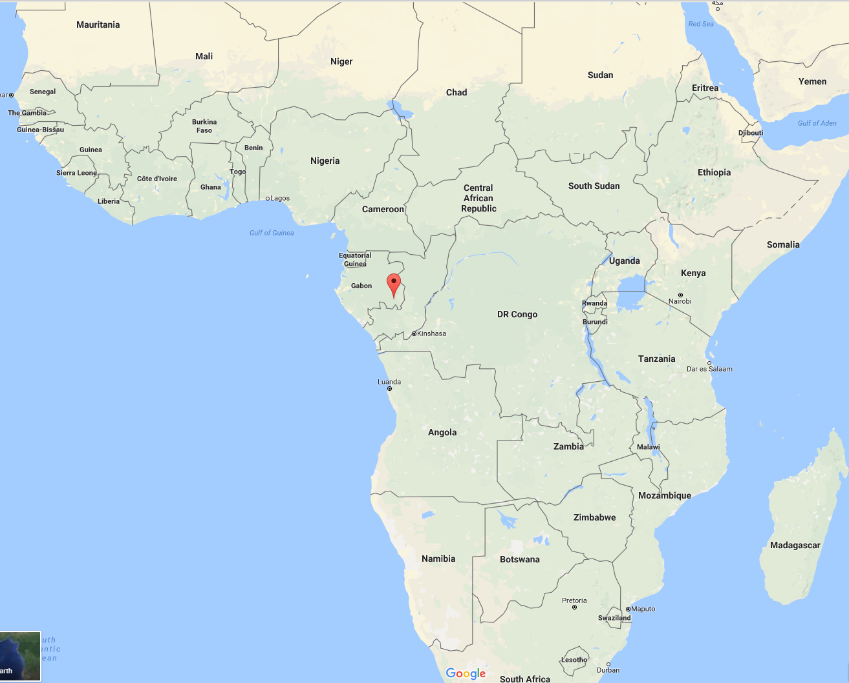
The Oklo Natural Reactors

Slide 9
Oklo: the Reactor Design
Fuel Design
Fuel phase: uraninite: UO₂–U₃O₈
Fuel type: ~25–75% dispersion in porous SiO₂
Enrichment: (@1940±40Ma) ²³⁵U/²³⁸U ~ 3.7% (~modern LEU fuel)
Cladding: None
Reactivity and Coolant
Moderator: Light water
Coolant: Pressurized light water (P = 3–5 km, natural circulation)
Reactivity: Negative void, temperature coefficients (passively safe)
Absorbers: Concentration low. Slow ingrowth of neutron poisons
CR Physique 3 2002 839-849
http://arxiv.org/pdf/hep-ph/0506186.pdf
Bruno & Ewing Elements 2:343-349 (2006)

Slide 10
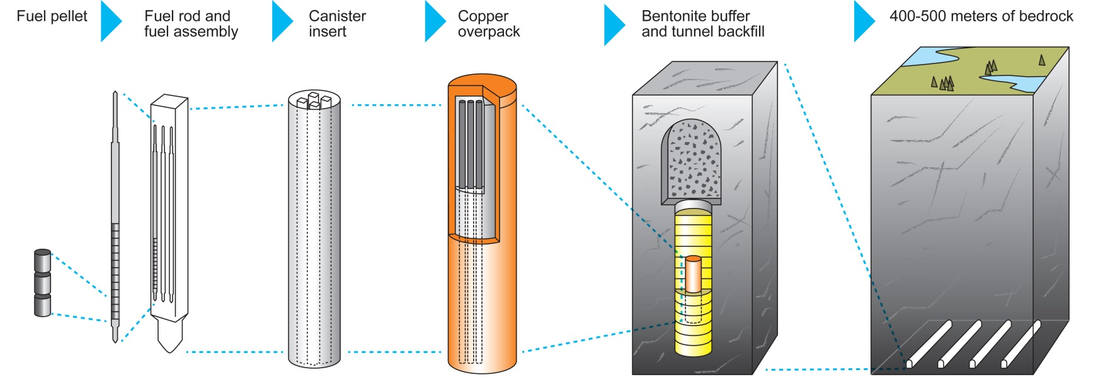
Fate of Radionuclides. Oklo: Geological Repository Design
No cladding = 100% “fuel failure”
Cs, Sr liberated to the environs by groundwater
Pu tended to be trapped in apatite (phosphate)
REE tended also to be trapped in UO₂, coffinite, phosphates
Some retained in “fuel” and fission product metals trapped in the clays.
Graphite, Fe²⁺ mineral buffers kept fO₂ low

Slide 11
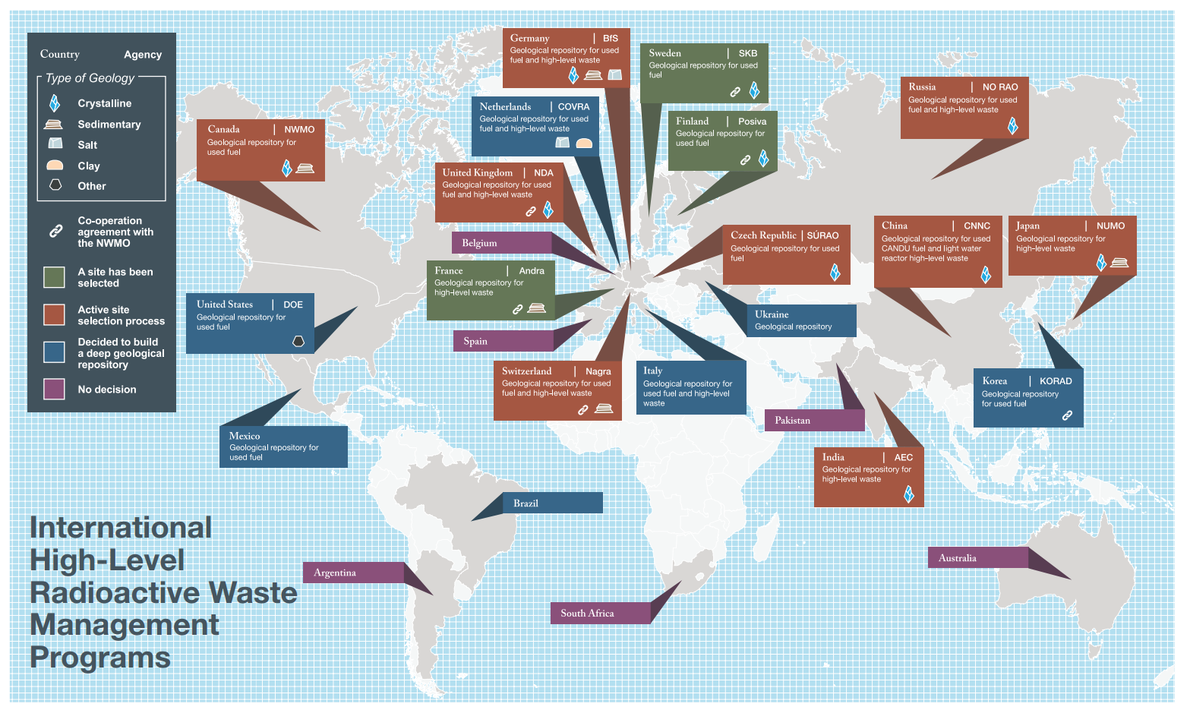
Nuclear Waste Management Organization (NWMO) Canada
Programs Around the World for Managing Used Nuclear Fuel
https://www.nwmo.ca/~/media/Site/Files/PDFs/2015/11/16/10/46/2766_programs_around_the_world_web.ashx?la=en

Slide 12
Crystalline rock

Slide 13
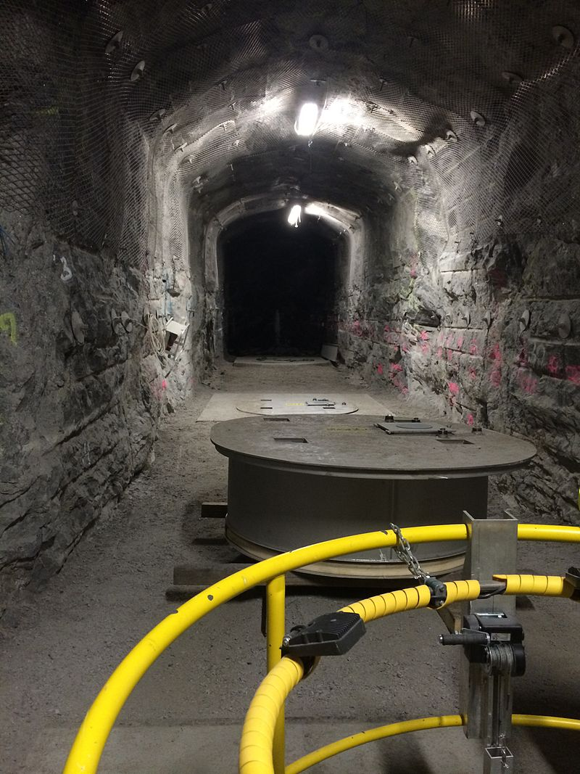
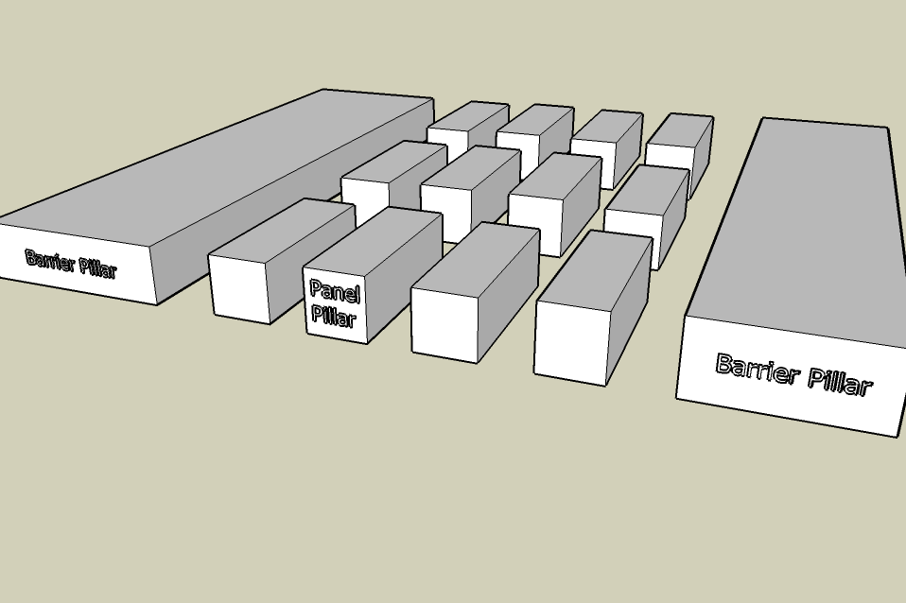
Crystalline Rock
Onkalo, Finland
Large caverns can be excavated using modified hard-rock mining techniques
Caverns are strong enough to maintain their shape, which can be supported by pillars
By kallerna - Own work, CC BY-SA 3.0, https://commons.wikimedia.org/w/index.php?curid=32382738
By Swinsto101 - Own work, CC BY-SA 3.0, https://commons.wikimedia.org/w/index.php?curid=4545004

Slide 14
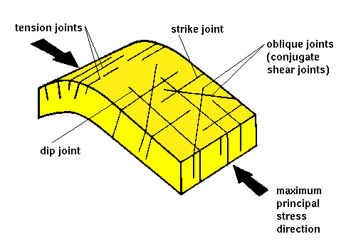
Permeability
Anisotropic, joints and fractures may exist over many length scales.
Highly dependent on rock type and local tectonic history
Depending on degree of connectedness, large fractures can cause large hydraulic conductivity
Excavated caverns can modify the strain distributions
Local and global stress field orientations through time need to be considered, including possible reglaciation in some areas.

Slide 15
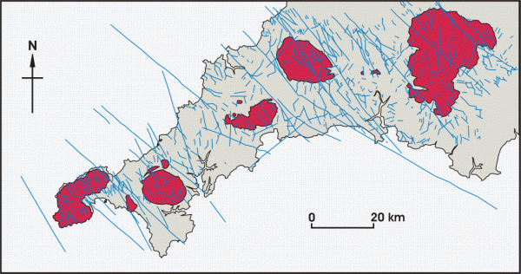
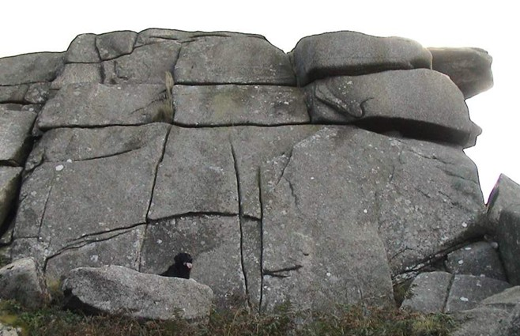
Fractures/joints etc
SW England:
fracture scale ~km-~100km
Major Origin: Variscan Orogeny
Granite exposure
Scale: one dog
Major origins:
Vertical: cooling
Horizontal: cooling
+ overburden relief Exacerbated by freeze-thaw
Polarizing microscope:
Scale: ~10 μms
Fractures cover many length scales.
The largest fractures must be avoided during siting.
Fractures close up under pressure (over burden), reducing hydraulic conductivity.
Fractures are not neutral pipes. At the pore scale, there is potential for considerable reaction between mineral surfaces and radionuclide-bearing fluids in solution or colloidal suspension

Slide 16
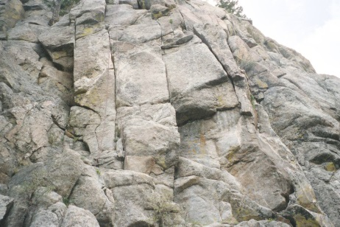
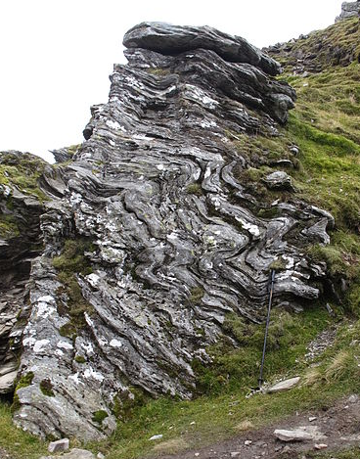
Rock strength
Rock is inhomogeneous and usually anisotropic
Rock strength is length scale dependent for several reasons: the probability of intersecting a critical defect increases with sample size
Mechanical properties of selected rock are strongly affected by the excavation for the site.
Mechanical properties in the repository will be modified by heat load from the waste over time; e.g. change in creep behaviour.

Slide 17
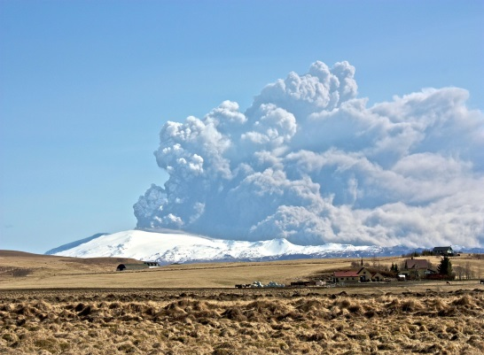
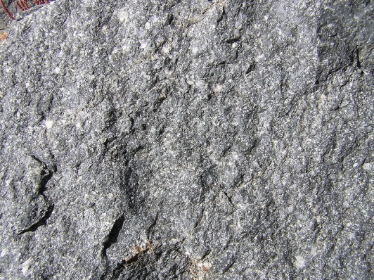
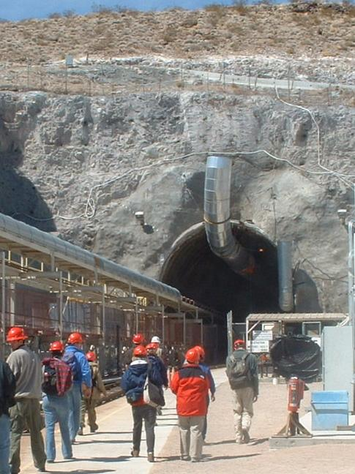
Welded Tuff
By Bjarki Sigursveinsson - http://www.flickr.com/photos/bjarkis/4530958802/in/photostream, CC BY-SA 3.0, https://commons.wikimedia.org/w/index.php?curid=10346663
By Graeme Bartlett (Own work) [GFDL (http://www.gnu.org/copyleft/fdl.html), CC-BY-SA-3.0 (http://creativecommons.org/licenses/by-sa/3.0/) or CC BY 3.0 (http://creativecommons.org/licenses/by/3.0)], via Wikimedia Commons
Tuff origin: volcanic pyroclastic ash flow (e.g. Pompeii) or fall-out from ash cloud
In some cases: grains can welded together due to T and P => reduced permeability.
Yucca Mountain Site, Nevada, USA (above water table, but moderate permeability)
Desert environment, generally arid
10% failure of waste packages in 1 million years
By Image by Daniel Mayer taken on 2002-03-25 © 2002 and released under terms of the GNU FDL. - http://en.wikipedia.org/wiki/Image:Tour_group_entering_North_Portal_of_Yucca_Mountain.jpg, CC BY-SA 3.0, https://commons.wikimedia.org/w/index.php?curid=100567

Slide 18
salt
WIPP, NM

Slide 19
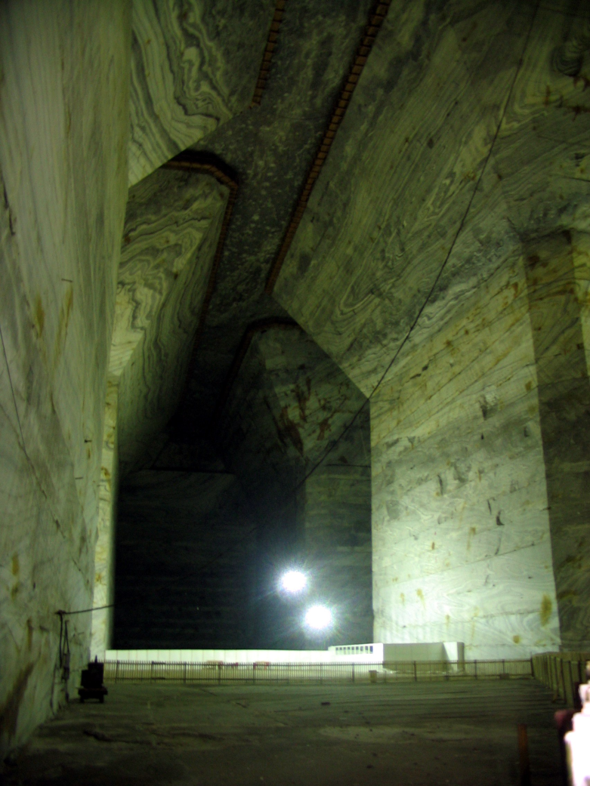
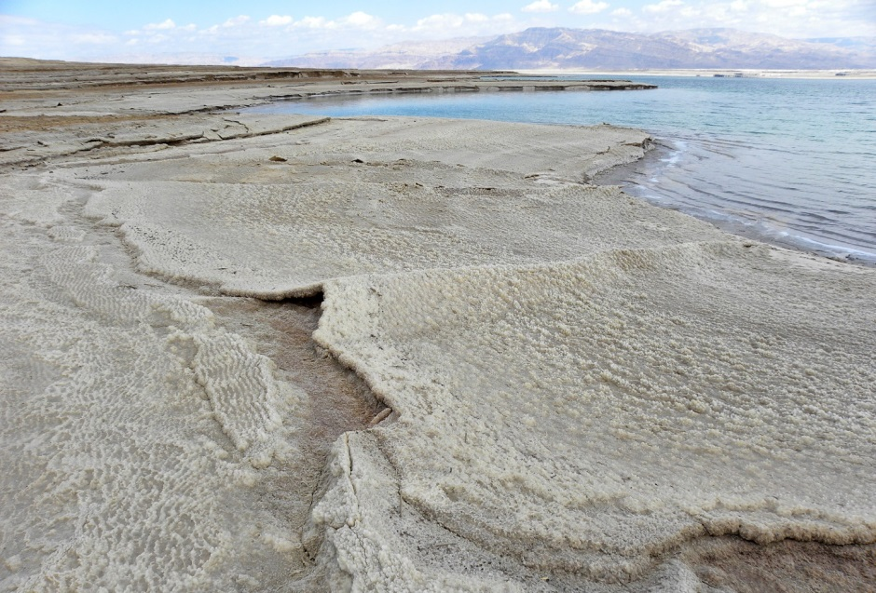
Salt
Major thicknesses (100’s m) of salt not uncommon
It is possible to excavate huge cavities
Mechanical strength almost independent of scale
Slănic, Prahova, Romania.
Dead Sea, modern evaporitic basin
By Wilson44691 - Own work, CC BY-SA 3.0, https://commons.wikimedia.org/w/index.php?curid=18790421
By Andrei Stroe - Image taken by Andrei Stroe, CC BY-SA 2.5, https://commons.wikimedia.org/w/index.php?curid=883430

Slide 20
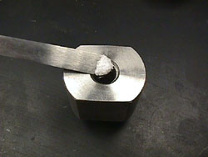
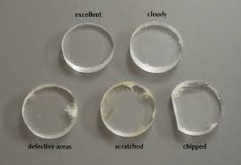
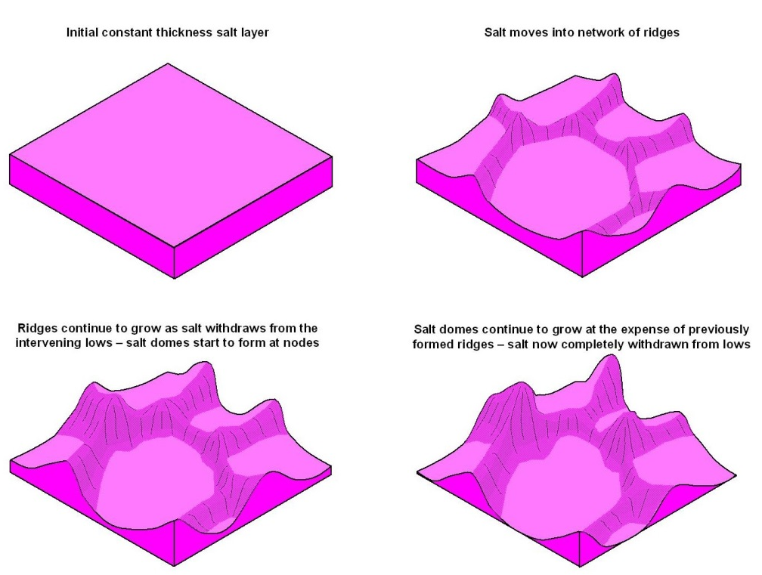
Salt: ductility
Use of alkali halides for IR spectroscopy
Formation of salt domes
Uneven loading causes flow of salt: “salt tectonics”.
Ductility eliminates porosity and permeability (interconnecting cracks)=>Pure salt is impermeable
Mechanical properties almost scale-independent
Will eventually cause cavern to close itself in.
CC BY-SA 3.0, https://en.wikipedia.org/w/index.php?curid=14244918

Slide 21
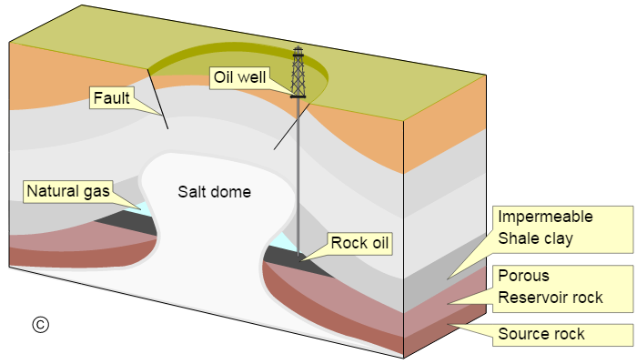
Forms of salt deposits
Bedded Salt
Domed salt
Bedding can also include thin layers of sand/silt that potentially allows ingress of water.
Ductility allows flow into domes (creep)
Flow disrupts any beds and percolation pathways
By MagentaGreen (Own work) [CC BY-SA 3.0 (http://creativecommons.org/licenses/by-sa/3.0)], via Wikimedia Commons
By NASA - http://earthobservatory.nasa.gov/Newsroom/NewImages/images.php3?img_id=17245, Public Domain, https://commons.wikimedia.org/w/index.php?curid=736715

Slide 22
Salt
Caverns formed easily
Impermeable when pure and densified
Ductility closes caverns
Problem for decay gases generating high pressure within such a structure?
Caverns can be backfilled with crushed salt on closure.
No free water, therefore minimal transport of radionuclides possible.

Slide 23
CLays
Cigéo: Centre industriel de stockage géologique

Slide 24
Clay Definitions
Clay
Clay minerals
Clay particle size
a rock composed of clay minerals
a class of minerals consisting of hydrous aluminosilicates sheets, loosely bound together by cations and water
typically < 2 μm

Slide 25
Clay
Disadvantages
Advantages
Low mechanical strength
Concrete tunnels and mine reinforcements required
Strongly anisotropic medium
Often available in tectonically stable areas
Low hydraulic conductivity
Cracks self heal in swelling clays
Similar to salt
High absorption capacity particularly for cations

Slide 26
Clays
low mechanical strength means tunnels need support and lining with metal or concrete
low hydraulic conductivity retards transport of RNs
diffusion of most cations strongly retarded by interaction with negative charges on clay surfaces

Slide 27
Multiple Barriers

Slide 28
Multiple Barrier Concept: e.g. crystalline rock
Posiva, Finland
http://www.posiva.fi/en/final_disposal/basics_of_the_final_disposal#.V6wxyfl95aQ

Slide 29
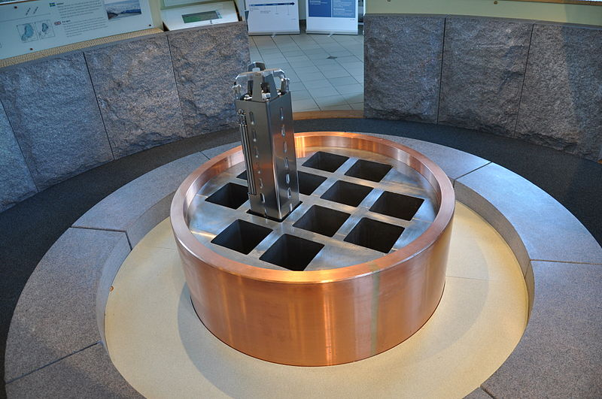
Multiple barrier model for crystalline repositories
Swedish spent nuclear fuel storage concept KBS-3, Uranium in steel rigs, inside a copper canister, bentonite, and 500m bedrock. Picture from exhibition at Äspö Hard Rock Laboratory. Similar concept in Finland, Canada.
By Karrock (Own work) [CC BY-SA 3.0 (http://creativecommons.org/licenses/by-sa/3.0)], via Wikimedia Commons

Slide 30
Smectite Group as a Barrier Layer
A “swelling clay”: volume expands many-fold as they are hydrated, improving sealing and becoming more impervious
Readily exchange cations: many RN cations can be absorbed in the event of a breach
Can swell up to 20-fold
No hydrogen bonding between the TOT layers
Soil Science Association of America

Slide 31
Swelling Pressure
As ground water gradually enters the repository:
The bentonite buffer will swell
P ~ 4-7 MPa (40-70 atm) can result
This further seals the canisters and ensures RN transport is limited to diffusion, not flow
Soil Science Association of America

Slide 32
Percolation
Given sufficient density, the isolated damaged states in a solid start to intersect
Percolation theory can predict the probability/certainty of a percolating path through a given lattice
What proportion of conducting rods must be placed in the square lattice to guarantee conduction?
+
−
By de:Benutzer:Erzbischof - Own work, CC BY-SA 3.0, https://commons.wikimedia.org/w/index.php?curid=655409

Slide 33
long-term processes in nuclear waste
Other than direct radiation damage…

Slide 34
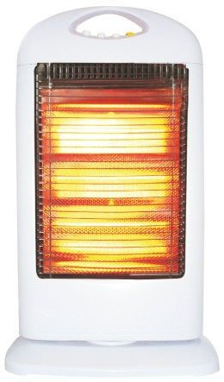
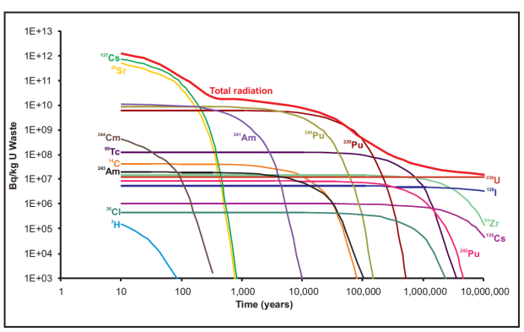
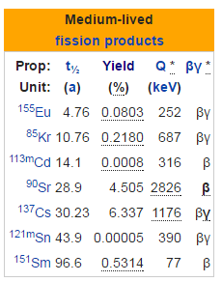
Temperature Effects of HLW
=
1800 W/ canister (peak)
Peak decay heat during peak fission (β-decay) product decay.
100-150°C
t_{1/2}~30 y,
high fission yield
high decay energy
50-100°C
T→geotherm
SKB buffer temperatures

Slide 35
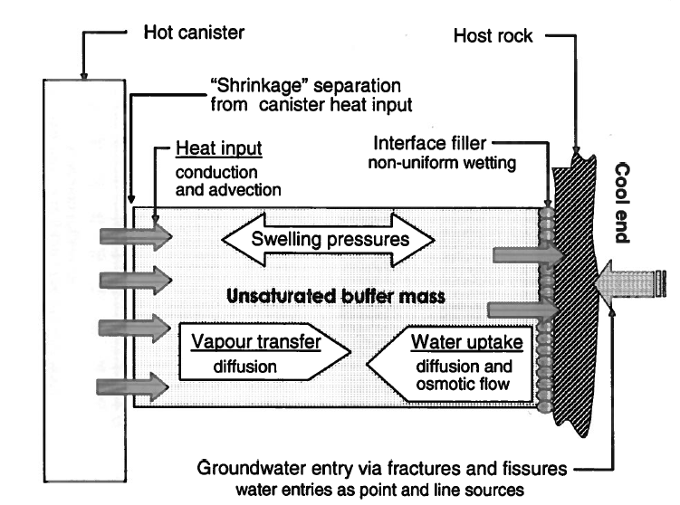
Temperature Effects on Repository
Drives water way, but could
accelerate certain corrosion reactions
increase transport of corrosion products
=
Fig 3.28. Geological Storage of Radioactive Waste. R Pusch, Springer
Could transform smectite (bentonite) to illite (non-expanding) where present
Could affect rock /backfill mechanical properties (e.g. creep; esp. of NaCl)

Slide 36
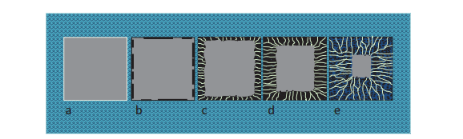
Corrosion of glass
Once the steel canisters are breached by corrosion and pressure, the glass will make contact with water.
Corrosion of glass/crystalline solid results in secondary products, some crystalline, some gel-like.
A gel typically forms directly on the surface of the corroding medium
Microfracturing from radiation damage could increase corrosion
Generally found that hydrous gel limits rate of corrosion: local equilibrium between water and gel and not water and glass.
Corrosion takes 100,000’s years and even then Act and Tc largely remain immobilized in alteration products
Putnis: Transient Porosity Resulting from Fluid–Mineral Interaction and its Consequences.
Reviews in Mineralogy and Geochemistry 80 pp. 1-23, 2015

Slide 37
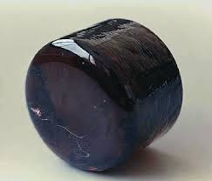
Corrosion of Glass
Glass corrosion:
essentially independent of Eh.
alkalis/alkaline earths [¹³⁷Cs, ⁹⁰Sr, Na, Ca] ⇔ H⁺ (+H₂O) [leach and replace]
protons weaken glass framework.
dependent on a_{SiO2} in sol’n
corrosion slows as [SiO₂] in near fluid increases and a hydrated gel forms on the surface
Fate of RNs:
many cations retained in gel/alteration products
Some soluble ions react with iron corrosion phases (e.g Sr)
next trap is the clays, particularly for cations
less effective scavenging of anions: e.g. ¹²⁹I⁻, ³⁶Cl⁻, ⁷⁹Se²⁻
Vitrified Waste

Slide 38
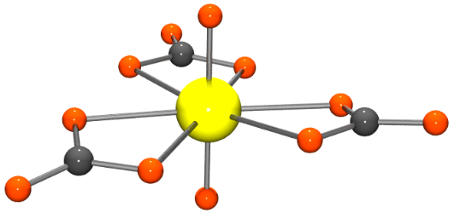
SNF corrosion
First: activation/transmutation products in cladding and structural materials, and then the fuel phases
UO₂
predominant phase in which Act and fission products are (mostly) in solid solution
U^{VI} highly soluble, U^{IV} not.
U^{VI} complexes readily e.g. UO₂(CO₃)₂²⁻
Groundwater usually expected to be reducing
Radiolysis can generate free O₂
Counteracted by H₂ from Fe corrosion
UO_{2+x}
Radiation damaged uraninite UO_{2+x} becomes coffinitized (alteration to coffinite USiO₄ in presence of groundwaters)
↕

Slide 39
Container corrosion and near-field transport
steel, stainless steel container corrodes at 1−0.01 μm/year by water, generating H₂ in anoxic conditions
copper canisters corrode with sulfide
bentonite absorbs many RN ions and has very low permeability 10⁻¹¹ to 10⁻¹³ m/s
concrete plug to entrance has high fluid pH favouring Act retention
coprecipitation of RNs with calcite and other alteration products of cement

Slide 40
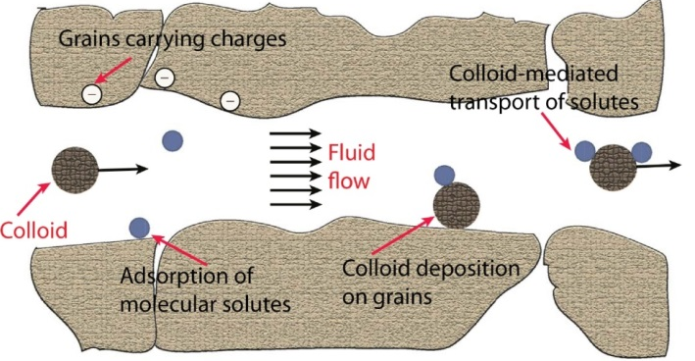
Potential far-field transport
Colloids (e.g. silica, clay, DOC) can be a rapid means of far-field transport. Depends on host medium.
low ionic strength favours colloid transport
e.g. Pu mobility in the Nevada Test site is attributed to colloidal transport (>1 km in <30 years via groundwater). (But flow rates very low through bentonite, and extremely fine pores act as colloidal filters.)

Slide 41
Importance of redox control
Most actinides have multiple ionization states, and the reduced forms are generally less soluble U(VI) typically as uranyl ion UO₂²⁺ complexes vs. relatively insoluble U(IV).
This is true of some fission products Tc(VII) as pertechnetate TcO₄⁻ vs. Tc(IV)
Elements such as Cs, Co, Sr, I, C, Cl are relatively insensitive.
Anions are harder to retain: long term dose in reducing conditions dominated by Cl, I, Se etc.

Slide 42
Precipitation, co-precipitation, sorption
RNs can precipitate out in phases in which they are a major component as the solution reaches saturation with respect to them
RNs/products can be co-precipitated out as:
An inclusion (a minor substituent in a solid solution); e.g. Eu for Sr/Ca; Ra for Ba/Sr in MSO₄
An occlusion: physically trapped inside
RNs can be sorbed onto the surface of a precipitate. Effect proportional to available surface area.

Slide 43
Processes: (ab)adsorption-desorption
Sorption onto mineral surfaces. Can be good or bad:
“FIXED”: Fine pores, and high surface-area minerals (e.g. clays minerals)
RETARDED: repeated adsorption-desorption of ions means they frequently move more slowly than the flow rate
MOBILE: Colloids (particles < 1μm), may be transported by flow (if exists)

Slide 44
Transport of radionuclides
Transport of RNs in groundwater:
Flow in channels (current) can be minimized by
Reducing channel width
Tortuous pathways
Reducing connectivity of cracks
In the absence of flow;
transport is by molecular diffusion driven by chemical gradients (potentials); i.e. slow
Pick rock type,
location carefully

Slide 45
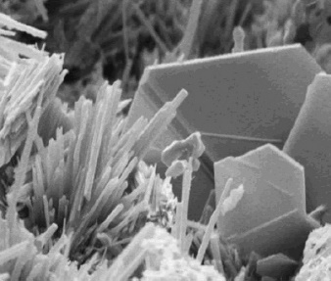
Cement/Concrete degradation
Concrete = cement + water + aggregate + additives
A variety of chemical attacks causing mostly expansive pressures leading to failure and more attack by water:
sulphate attack:
sulphate-resistant cements exist but they are not sulphate-proof
precipitation of ettringite generates pore pressure
Mine paste backfill failure in sulphide mines
chloride attack: brines
carbonatation: CO₂
ASR: reaction between silica in aggregates and alkalis within cement porewater causes aggregate expansion and failure of matrix
Effects:
RNs in groundwater can copreciptate in cement alteration products from structural concrete (plugs etc)
RNs can be leached from cemented waste into groundwater

