Slide 1
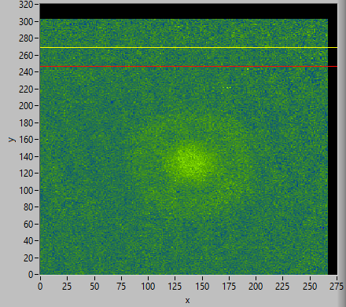
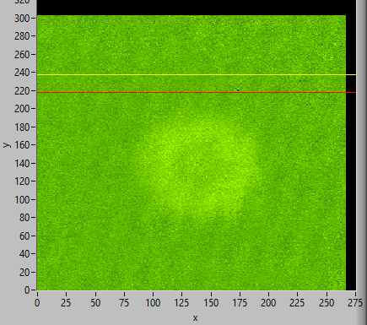
Selim Jochim, Universität Heidelberg
High temperature pairing in a
strongly interacting two-dimensional Fermi gas

Slide 2
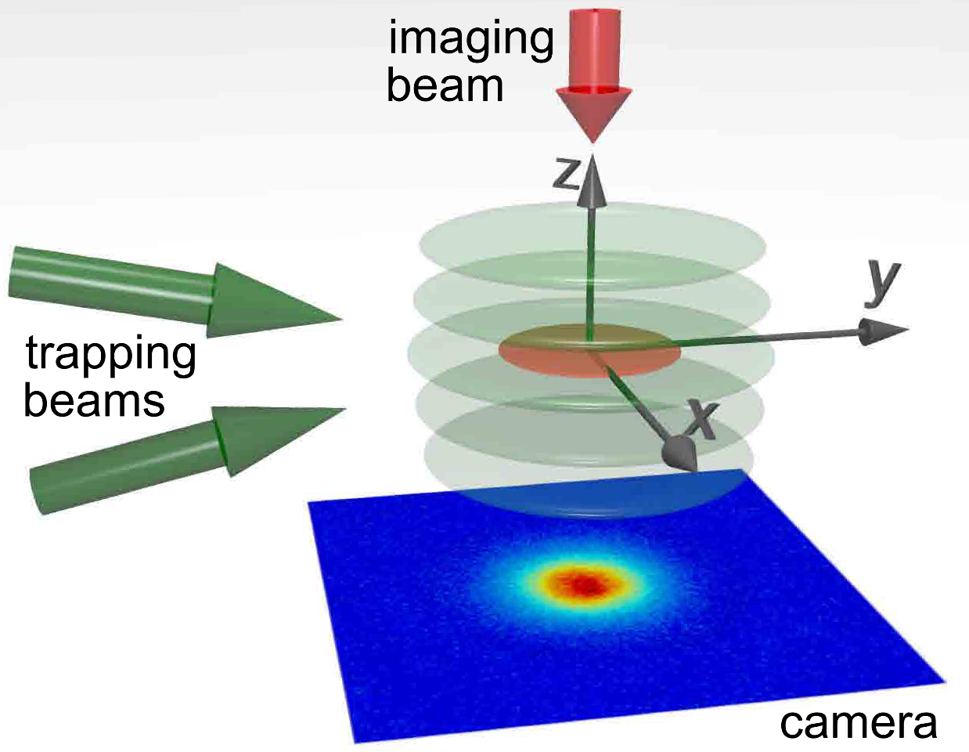




Our strongly interacting 2D gas
$$ω_{z}\sim 2π×7kHz$$
$$ω_{r}\sim 2π×22Hz$$
$$\frac{ω_{z}}{ω_{r}}\sim 300$$
$$N_{2D}\sim 45000$$
4µm distance between 2D layers:
Fill only one layer with atoms

Slide 3


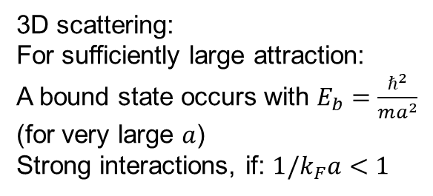
⁶Li: interactions and bound states
3D scattering:
For sufficiently large attraction:
A bound state occurs with $E_{b}=\frac{ℏ^{2}}{ma^{2}}$
(for very large $a$)
Strong interactions, if: $1/k_{F}a<1$

Slide 4
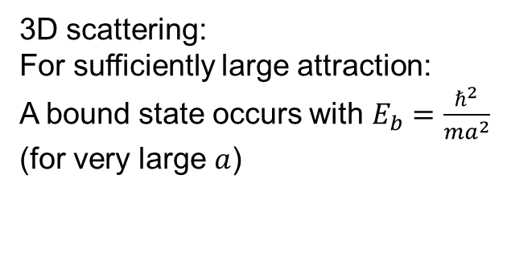
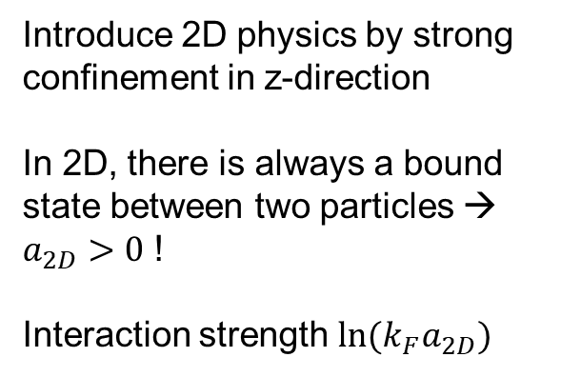
⁶Li: interactions and bound states
3D scattering:
For sufficiently large attraction:
A bound state occurs with $E_{b}=\frac{ℏ^{2}}{ma^{2}}$
(for very large $a$)
Introduce 2D physics by strong confinement in z-direction
In 2D, there is always a bound state between two particles → $a_{2D}>0$ !
Interaction strength $ln⁡(k_{F}a_{2D})$
confinement induced state

Slide 5
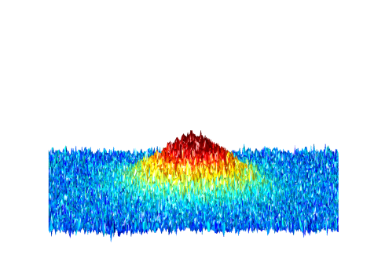
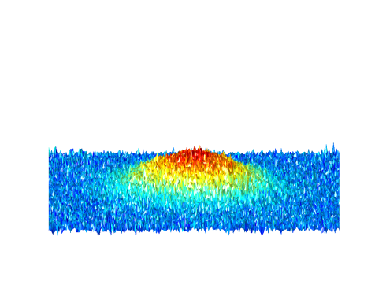
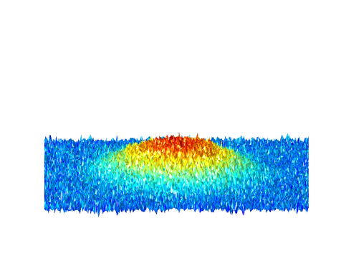
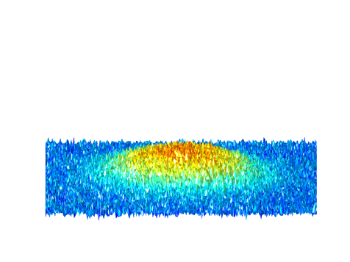
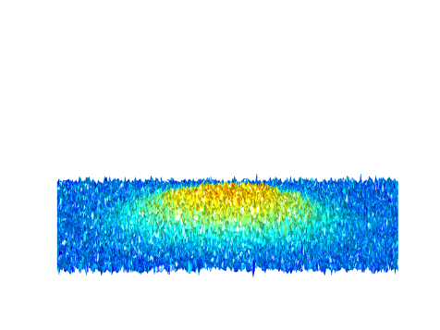
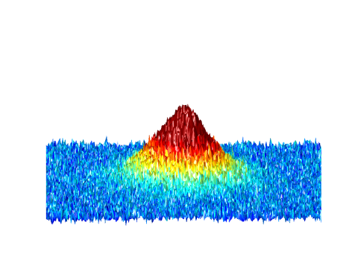
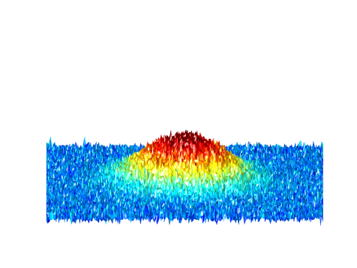
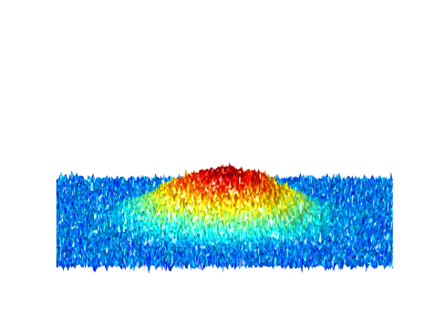
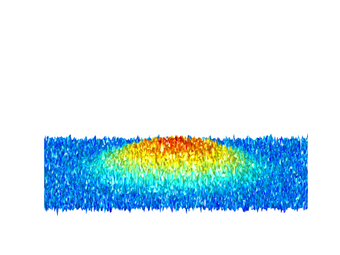
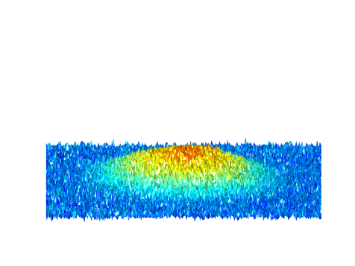
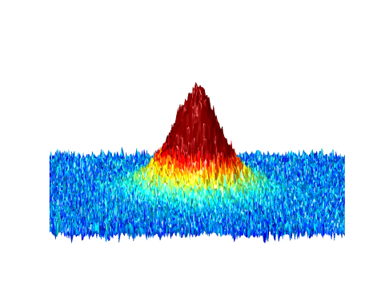
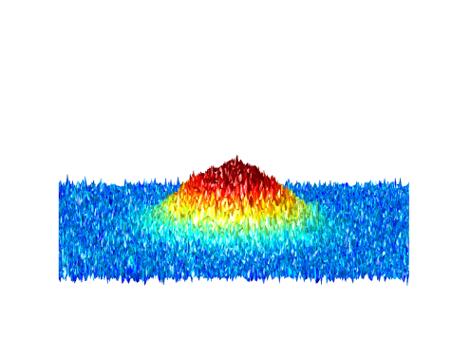
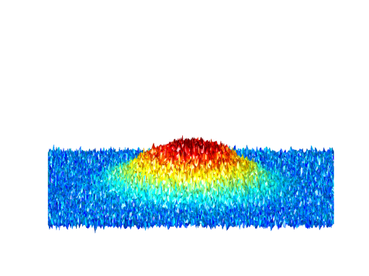
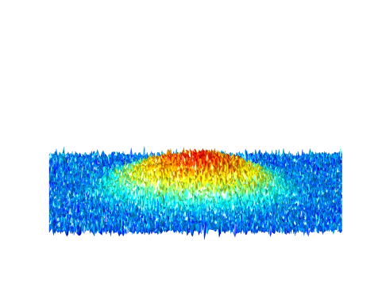
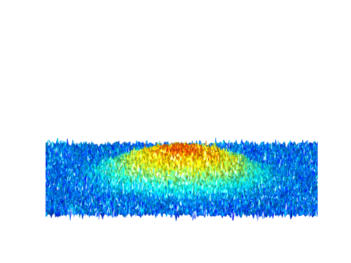
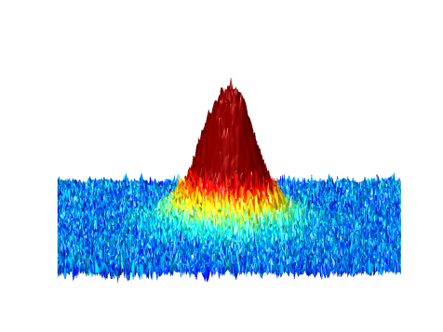
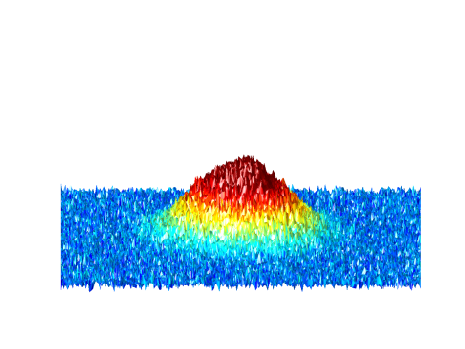
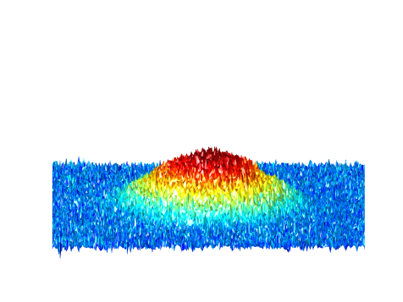

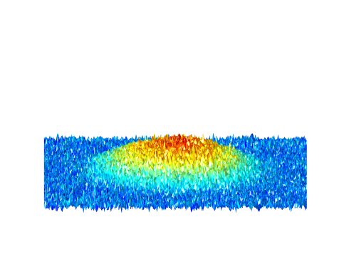
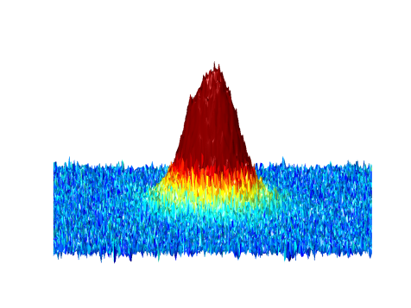
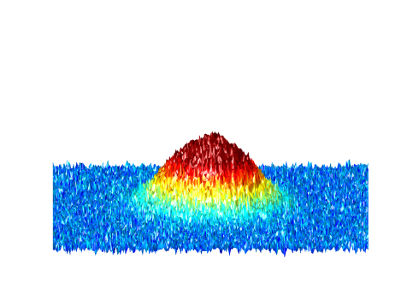
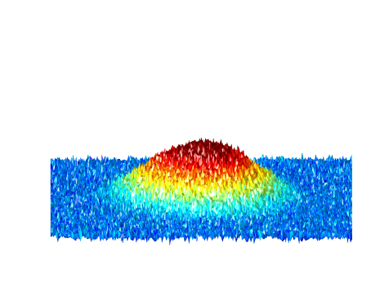

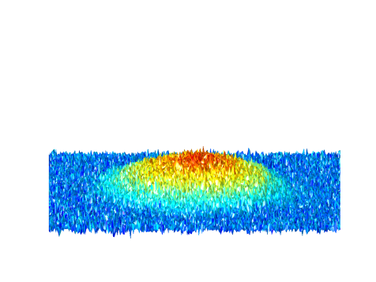
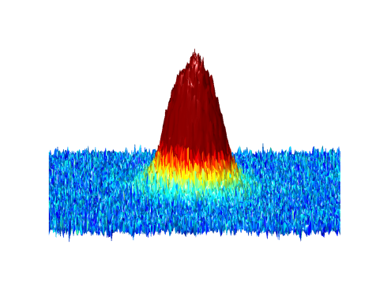


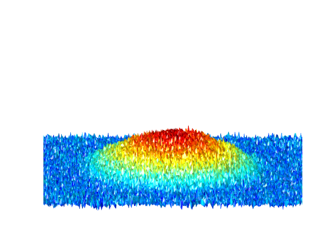
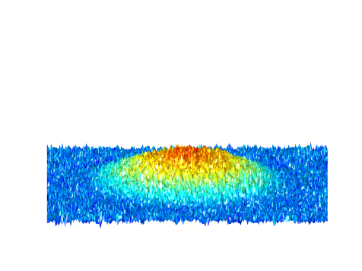
In situ density in the crossover
hot
692G
782G
832G
892G
952G
temperature dependence
cold
BEC
BCS
Equation of state: I. Boettcher et al. PRL, 116, 045303 (2016)

Slide 6
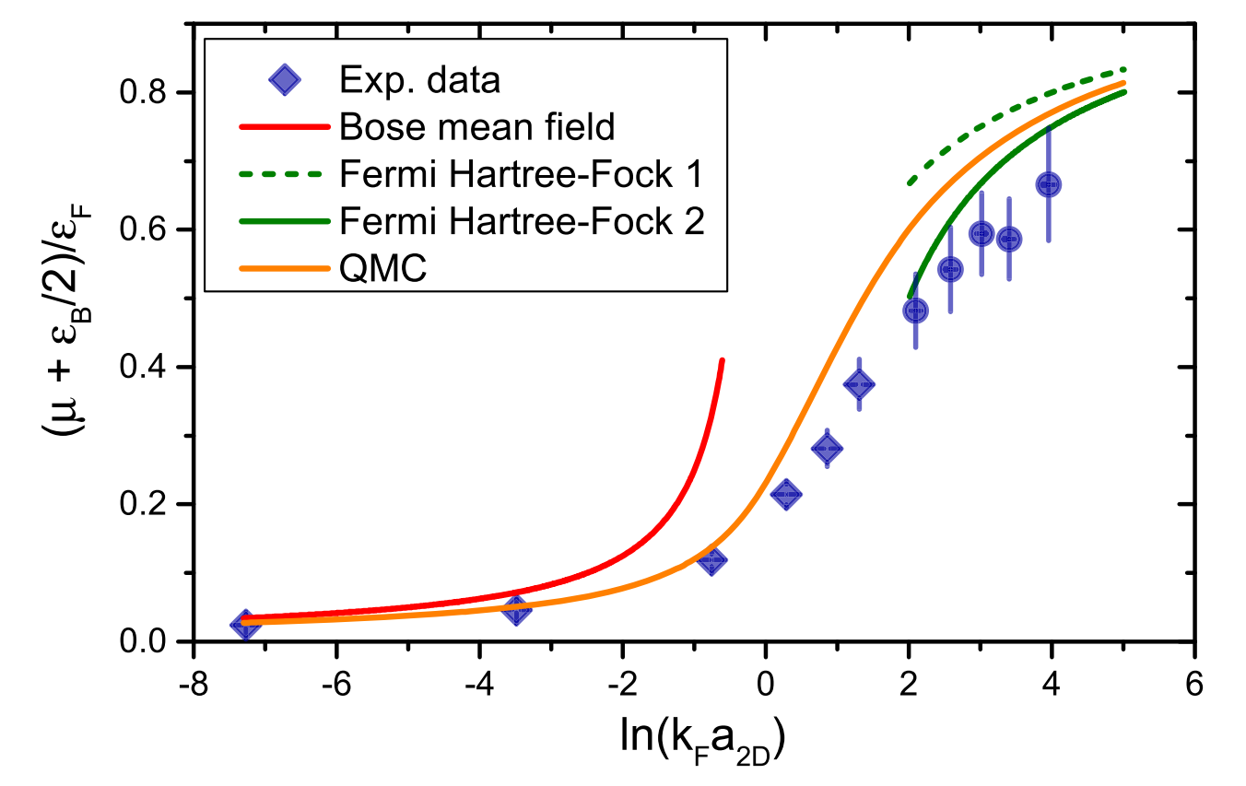

Low-temperature equation of state …
… from Thomas-Fermi fit to cloud size
BEC
BCS
Equation of state: I. Boettcher et al., PRL 116, 045303 (2016)
See also: K. Fenech et al., PRL, 116, 045302 (2016) (Vale group)
  Viewpoint: M.Parish, Physics 9,10 (2016)

Slide 7
In situ density in the crossover
hot
692G
782G
832G
892G
952G
No signature of a phase transition!
temperature dependence
cold
BEC
BCS

Slide 8
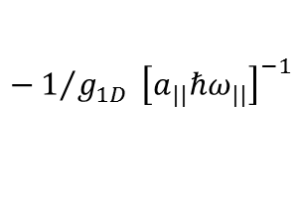
Obtaining the momentum distribution
→Measure first order coherence
Ballistic evolution for T/4 in a harmonic potential:
„Matter wave focusing“:
Amsterdam, JILA, Paris
$$\vec{k}=0$$
P. Murthy et al., PRA 90, 043611 (2014)

Slide 9


Obtaining the momentum distribution
→Measure first order coherence
Ballistic evolution for T/4 in a harmonic potential:
$$\vec{k }$$
$$x_{T/4}=\frac{v}{ω}$$
P. Murthy et al., PRA 90, 043611 (2014)

Slide 10
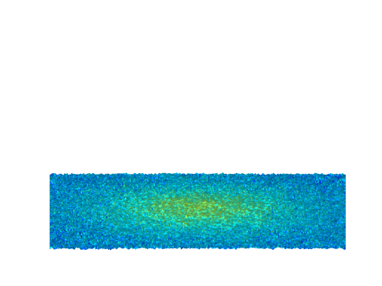
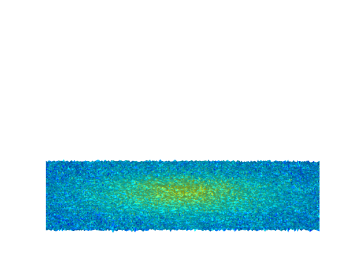
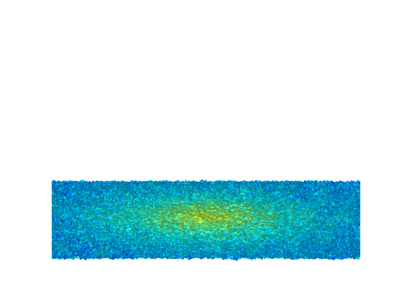

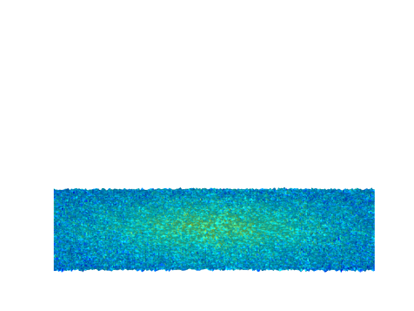
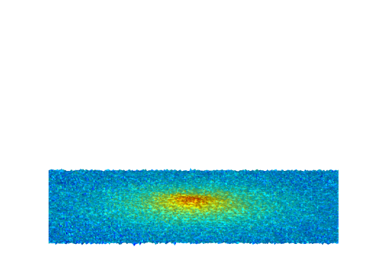
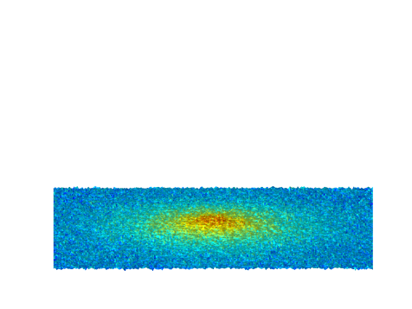








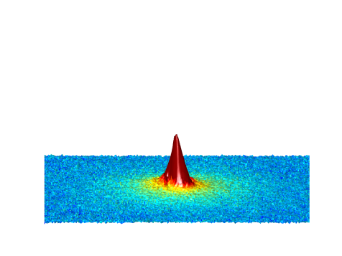
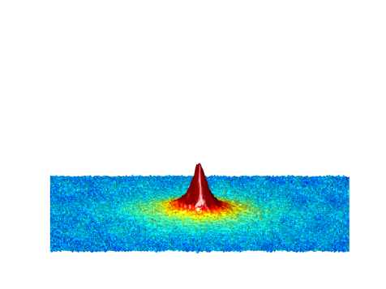
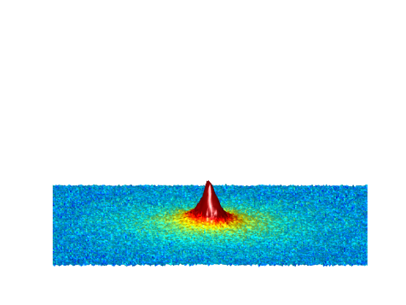
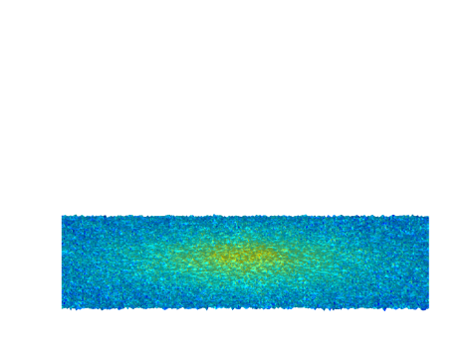
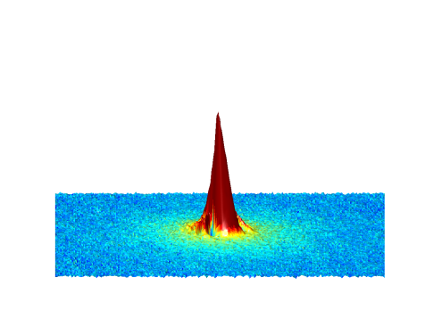
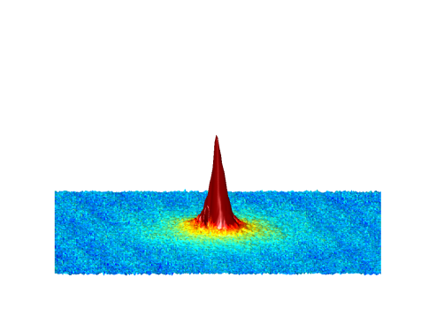
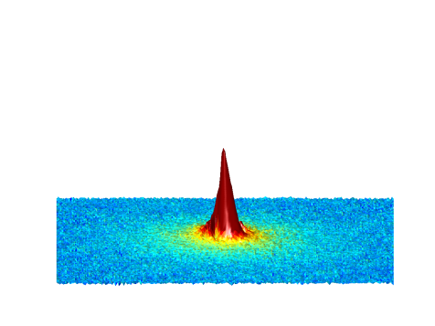


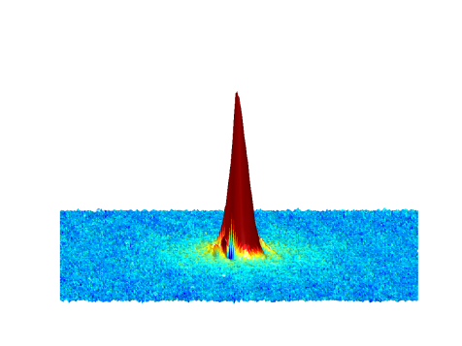
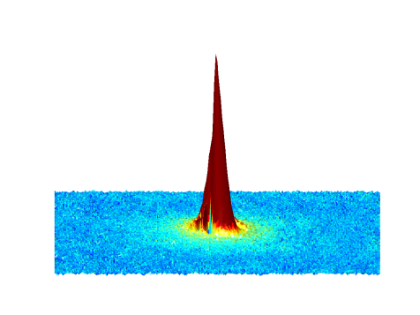



Momentum distributions
hot
692G
782G
832G
892G
952G
temperature dependence
cold
BEC
BCS
P. Murthy et al.,Phys. Rev. A 90, 043611 (2014)

Slide 11

Phase Diagram
Non-Gaussian
fraction
exp.: T_{c}/T_{F}
M. Ries et al., PRL 114, 230401 (2015)
Notes:
Measured phase diagram: x-axis normalized interaction strength in 2D relevant parameter ln(kf a2d) where kf is the fermi wavevector ( related to the sqrt of density)
Y-axis temperature normalized by the central density ( in units of temperatur Tf=2pi hbar^2 n0/2mk_b)
Colorscale gives fraction of non gausan quasi condensate fraction.
Black line position where we expect the phase transition from above analysis. Again see quasicondensate fraction non zero before transition
Critical temperature on bosnic side ( as expected) realtively high and constant
White line ( weakly interacting) bosonic theory phase transition : good agreement exp data little bit higher but within systematic and statstical errors agreement
Bosnic theory works well until ln kf a zero also expected as in 2D there is a bound state for all interaction strengths ( on 3D reonance still 2D bosons pressent).
Compare to theory: matches relatively well. Bump in the center expected as one has to match the two limiting cases.
Central part significantly higher than theroy expection for true 2D but maybe due to residual influence of 3rd dimension ( biger to the BCS side for our experiment) also predicted by some theorists that in crossing to 3D critical temperature might be higher
On Bcs side not cold enqough to measure significant quasi condensate fraction can not determine critical temperature there but expect to go down ( also seen from upper bound from our data) towards bcs limit

Slide 12

Investigating the phase coherence of these “condensates” reveals
Beresinskii-Kosterlitz-Thouless phase
P. Murthy et al., PRL 115, 010401 (2015)

Slide 13
Is it sufficient to think of pairs?

Slide 14


Beyond Pairs?
So far almost all data presented are near the „BEC-regime“: Essential physics is a two-body phenomenon
Here: Pairing occurs when $kT\sim EB$
BCS: Pairing is inherently many-body, associated directly with superfluidity.
But: „Bosonic“ behavior is observed very far into the crossover to the BCS regime, what‘s the nature of pairing there?
Mean field BCS in 2D: Predicts many body
pairs have the same energy as 2-body
binding energy?!
Let‘s do RF spectroscopy!
Sommer et al., PRL 108, 045302 (2012)
Also: Feld et al., Nature 480, 75 (2011)

Slide 15



RF spectroscopy
$$|3⟩$$
$$|2⟩$$
$$|1⟩$$
A challenge: Final state interactions! Overlapping Feshbach resonances complicate the situation

Slide 16
RF spectroscopy – a first impression
Remaining atoms after an RF pulse: In the 2D gas we resolve the density dependence of the signal
Challenges:
Short pulses are required for spatial resolution
High spectral resolution is required, especially on BCS side
Manage/understand final state interactions
Note: No access to momentum distribution possible ☹

Slide 17



Density dependence of RF response
$$\ln\left(k_{F} a\right)=−0.5$$
$$\ln\left(k_{F} a\right)=+1$$
P. Murthy et al.: arxiv:1705.10577

Slide 18


Pairing energy vs. temperature
We see dimer-like spectra up to
$ln⁡(k_{F} a)\sim 0.5$
We observe molecules up to very high temperatures
P. Murthy et al.: arxiv:1705.10577

Slide 19


Many body pairing!
Note:
$E_{B}<<E_{F}$in many body regime
Compare interparticle spacing $k_{F}=\sqrt{4πn}$ with size of molecules $a_{2D}$
Size of molecules equals interparticle spacing
P. Murthy et al.: arxiv:1705.10577

Slide 20
Small excursion: Observe a quantum anomaly
Major ingredients:
exact symmetry in classical consideration
divergence in quantum version
weak violation of the original symmetry through regularization of the quantum theory.
Theory prediction for cold atom system: Olshanii et al. PRL 105, 095302 (2010)
Interactions should lead to a tiny upshift of the breathing mode frequency of an interacting 2D gas

Slide 21


Small excursion: Observe a quantum anomaly
Normalized by dipole frequency of noninteracting Fermi gas

Slide 22

Small excursion: Observe a quantum anomaly
Uuups: dipole mode frequency of an interacting gas seems to be larger???

Slide 23


Small excursion: Observe a quantum anomaly
Preliminary result!
Compare with theory and previous experiment:
Hofmann: PRL 108, 185303 (2012)
Vogt et al.,PRL 108, 070404 (2012)

Slide 24


Small excursion: Observe a quantum anomaly
Cross checks: Particle number, temperature dependence, what did we miss?
Superinteresting new results on collective motion:
See Puneet Murthy‘s poster!

Slide 25

Imaging of free atoms …
… detect cold atoms in free space, after time-of-flight or in-situ
EM-CCD:
10% of all scattered photons are detected
5x I_{sat} for ≈20 μs
Atom diffuses 3μm RMS
Scatter ≈150 photons/atoms
EMCCD camera to count photons
Collect ≈15 photons on CCD
Challenge: Few photons vs noise
Optimize EMCCD performance
Close transitions with B > 900G
Notes:
We have during the past months achieved great progress in this direction. What you see here on the left is an image of a single, free lithium atom imaged for about 8µs through a high-numerical aperture objective, resulting in the collection of about 10% of all scattered photons. The short exposure time employed here provides us with the opportunity to image the atoms, in a spin selective way, either in real space of after time of flight, with the spatial resolution being limited to a few microns due to diffusion. The absolutely magnificent aspect of this is that we are confident that what is demonstrated here to work with one atom will also work with about 100 atoms, allowing for the determination not only of simple coherence properties, but also higher order correlation functions, something that will be excessively hard in our hardcore many body systems due to imaging noise.

Slide 26

Single-atom detection

Slide 27

Spin-resolved detection
Three-component system
state 1
time of flight
state 2
state 3

Slide 28




A single atom in a double well
Insitu:
Momentum
Space:
x₁
Notes:
Aussage: - Expansion in large dipole trap -> mapping momentum space to position
- Result: Double slit experiment for positive symmetry
- shifted interference pattern for negative symmetry
- read off lattice momentum
- visibility of ...%
----
Lets look at the simplest system that we can prepare: single atom trapped in a double well potential
With this imaging technique we first investigate the simplest state, we can prepare.
We prepare a single atom in the ground state of the double well potential which is the symmetric superposition of the atom being left and right.
Now, if you measured the prob dist insitu
For this state, measuring the atom distribution insitu results in an even distribution of the atom on either side.
However, if you measure momemtum space -> youngs double slit experiment
We can access the momentum distribution by performing the single-atom imaging after an expansion in time-of-flight.
This is nothing but a double-slit experiment where the distance of the minima is given by the lattice momentum. (inversly prop to double well distance)

Slide 29






A single atom in a double well
$$ψ_{+}=\frac{1}{\sqrt{2}}(\left.|L\right\rangle +\left.|R\right\rangle )$$
$$ψ_{−}=\frac{1}{\sqrt{2}}(\left.|L\right\rangle −\left.|R\right\rangle )$$
Notes:
Aussage: - Expansion in large dipole trap -> mapping momentum space to position
- Result: Double slit experiment for positive symmetry
- shifted interference pattern for negative symmetry
- read off lattice momentum
- visibility of ...%
---
Preparing the symmetric state and measuring the position of the atom after the expansion for 4000 realizations results in the following probability distribution which shows constructive interference at the center.
Perfoming the same expansion with an atom prepared in the antisymmetric state show destructive interference in the center.
So, by measuring the system in momentum space we are sensitive on the symmetry of the spatial wave function.
Until now, we only looked at single-particle physics. To demonstrating correlations, we study systems with two fermions.

Slide 30





Two identical fermions
-
x₁
x₂
Notes:
Aussage: - Two-particle
- Quantum mechanics!
- density distribution does not show fringes
- two-particle distribution shows correlations along diagonal
--
The simplest correlated system is two identical fermions in the double-well potential.
The spin wave function of the quantum state is symmetric and consequently the spatial wave function has to be antisymmetric.
Like before, we let the system expand and detect the positions of the single particles.
as the Pauli exclusion principle leads to a pure single occupancy of the two wells.
Plotting the density distribution after tof does not show fringes but only the single particle wave function,
However, there is more information in this system! We know that the system is correlated by looking at the wave function.
To make this visible, we plot every position combination that we detect into a diagram that shows the positions x1 and x2.
While, before we observed a featureless distribution, we now observe fringes along the diagonal

Slide 31



$$C\left(Δk\right)=\frac{\int{\left\langle n\left(k_{1},k_{2}\right)\right\rangle }\text{d}(k_{1}+k_{2})}{∫\left\langle n(k_{1})\right\rangle \left\langle n(k_{2})\right\rangle \text{d}(k_{1}+k_{2})}$$
Two-particle correlations
Two-particle probability distribution
One-dimensional correlation function
bunching
anti-bunching
This is the Hanbury Brown and Twiss effect, with fermionic atoms!
Notes:
Aussage: - quantify correlations
- calculate uncorrelated part
- subtract uncorrelated from correlated part
- one-dimensional correlation
- observe antibunching at integer lattice momenta
- observe bunching at half integer lattice momenta
- 70%
- trivial correlations
--
Taking more data and normalizing it leads to the following distribution, where we can clearly see fringes along the diagonal.
There is no additional structure along the fringes, so, we can integrate along that direction and calculate the one-dimensional correlation function of the quantum state.
It shows fringes with a periodicity of one lattice momentum and oscillates around 0.5 which we expect for a non-correlated state.
We observe a low probabiltiy to find the two fermions at momentum difference of integer lattice momenta
Significant suppression of the correlation function for momentum differences of integer …
Well known effect of anti-bunchin
This corresponds to the expectation of anti-bunching of two identical fermions.
Additionally, we observe a high contrast of this correlation.

Slide 32

More than two particles
→ Beyond two-particle correlations
Notes:
Aussagen: -

Slide 33







Thank you for your attention!
Philipp Preiss
Ralf Klempt
Benjamin Claßen
Mathias Neidig
Alexander Müller
Vincent Klinkhamer
Andrea Bergschneider
Marvin Holten
Michael
Dehabe
Jan-Hendrik Becher
Gerhard Zürn
Rodrigo
Rosa-Medina Pimentel
Puneet Murthy

