Slide 1

BOLIVIA: MAIN DEVELOPMENT CHALLENGES AND SYSTEM MODELLING EXPERIENCES
Trieste, June 2017

Slide 2
OUTLINE
BASIC INFORMATION.….……………………………………...……………3
CLIMATE AND GEOGRAPHY..………………………………..….……….. 4
ENERGY ……………………………..……….……………..………….……. 7
LAND …………………….…………………………………........……..……. 8
WATER AVAILABILITY .….………………………..………......…………….9
SECTORIAL POLICIES (PDES)…………………………………….......…10
MODELLING EXPERIENCES………………………………….…....…….15

Slide 3
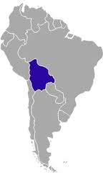
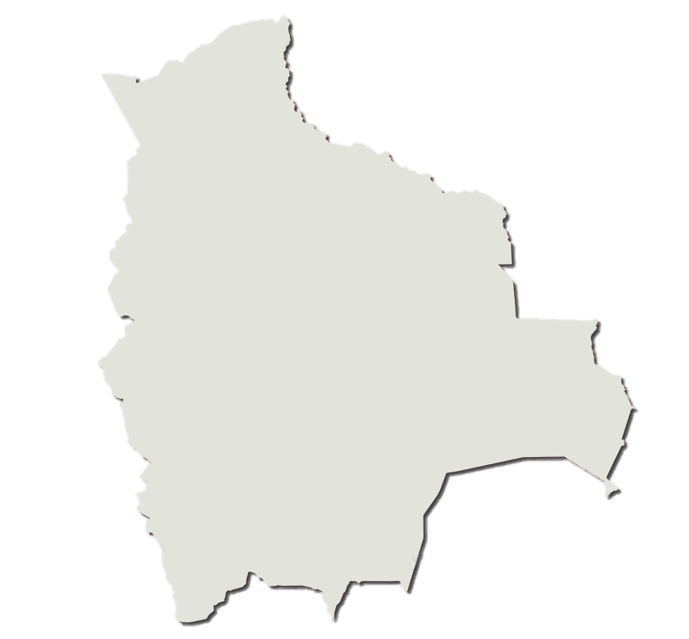
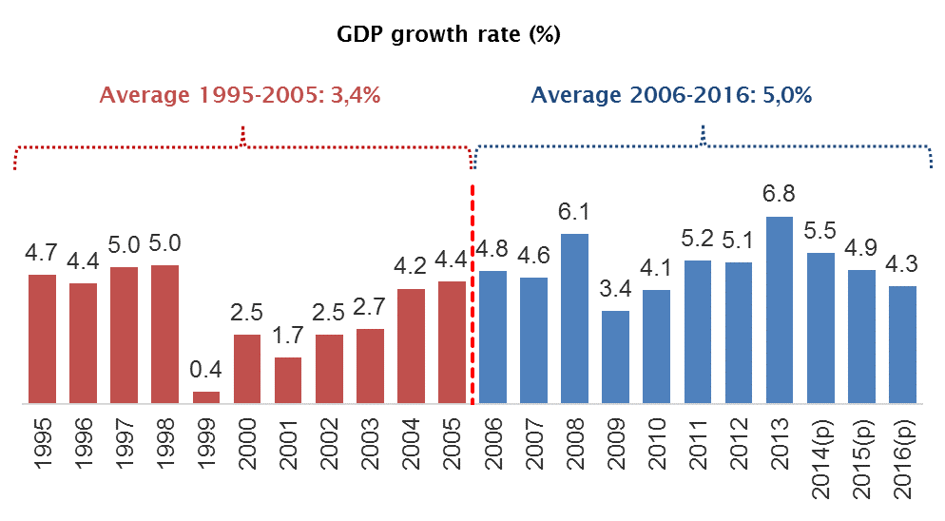
BASIC INFORMATION
2016 estimates:
Population: 10,985,059 people
Density: 10 persons per square kilometer
Scarcity of water: low to medium
2016:
GDP growth in 2016: 4.26%
Per capita GDP: USD3.100
Natural Gas in Total Exports: Aprox. 45%
201:
Poverty-Inequalities
Moderate Poverty Rate: 38.6%
Extreme Poverty Rate: 16,8%
Gini: 0,46
Source: Statistic National Institute, UDAPE.

Slide 4
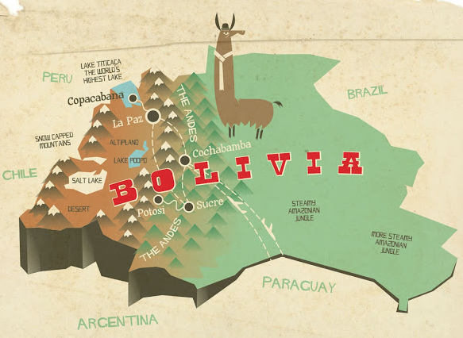
GEOGRAPHY
Landlocked country
Rugged Andes Mountains
Highland plateau
Hills
Lowland plains

Slide 5
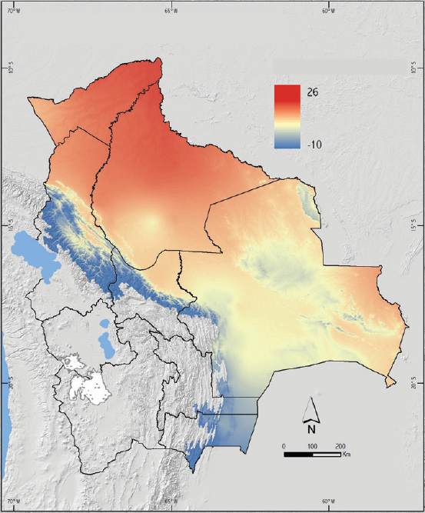
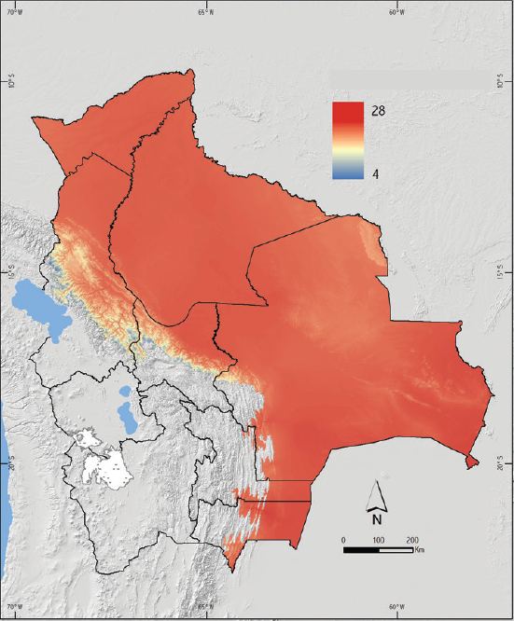
CLIMATE: TEMPERATURE
DRY SEASON
(June, July, August)
B. HUMID SEASON
(December, January, February)
Average Temperature (°C)
Average Temperature (°C)
Source: SENAMHI

Slide 6
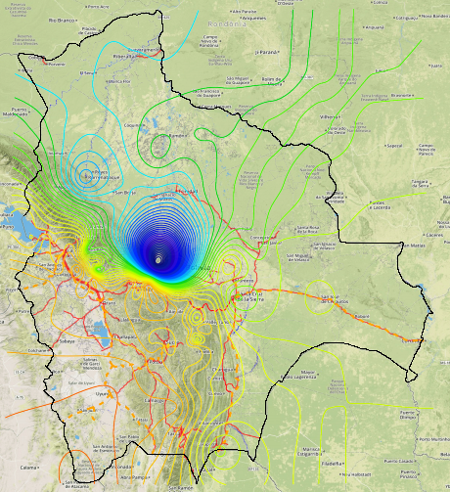
CLIMATE: RAINFALL
AVERAGE ANUAL RAINFALL
Valleys and tropical areas.
Northwest and northern regions
More chance to experience floods (northern Bolivia)
More chance to experience droughts (southern regions)
Average Temperature (°C)
Source: GeoBolivia

Slide 7
ENERGY
Power Supply and demand
(Megawatts)

Slide 8
LAND USAGE
(SQUARED KILOMETERS)
COVERAGE | AREA | %
Dense forest | 527.083 | 48,8
Thin forest | 64.459 | 6,0
Shrubbery | 66.921 | 6,2
Herbaceous vegetation | 190.362 | 17,6
Scattered vegetation | 132.871 | 12,3
Anthropic area | 56.273 | 5,2
Uncovered area | 26.977 | 2,5
Water bodies and streams | 14.861 | 1,4
Snowfields | 568 | 0,1
TOTAL | 1.080.375 | 100

Slide 9

WATER AVAILABILITY
High
Drinking water coverage (2014):
Urban 92%
Rural 66%
Low

Slide 10
SECTORIAL POLICIES – NATIONAL DEVELOPMENT PLAN
Main objectives:
2014
2020
DRINKING WATER:
Urban: 92%
Rural: 66%
DRINKING WATER:
Urban: 95%
Rural: 80%
SEWERAGE AND SANITATION:
Urban: 63%
Rural: 42%
SEWERAGE AND SANITATION:
Urban: 70%
Rural: 60%
ELECTRICITY COVERAGE:
National: 85,7%
Urban: 96,7%
Rural: 64,4%
ELECTRICITY COVERAGE:
National : 97%
Urban: 100%
Rural: 90%

Slide 11
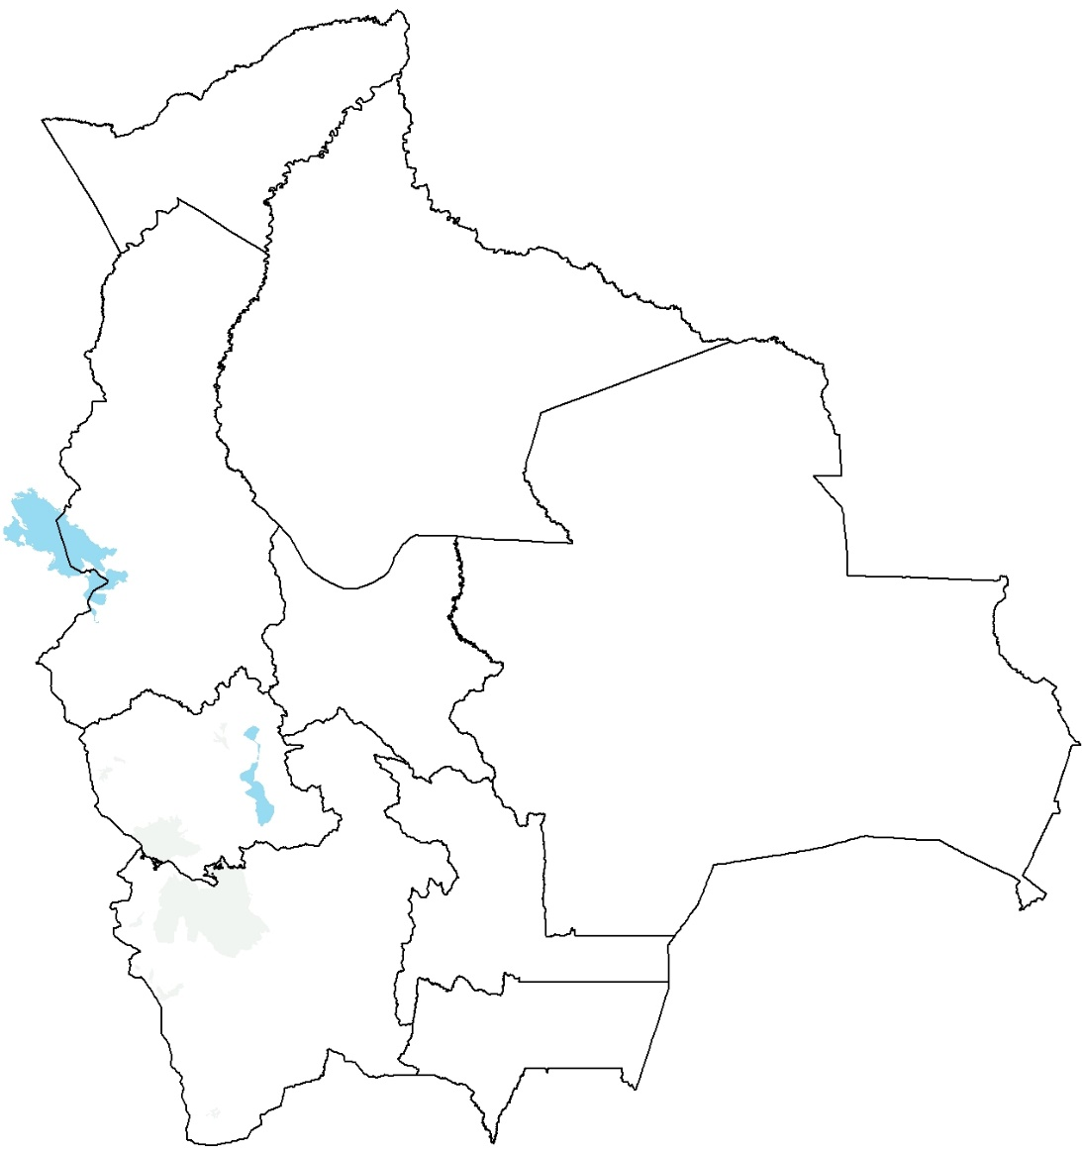















SECTORIAL POLICIES – NATIONAL DEVELOPMENT PLAN
ENERGY PLANTS
LOCAL DEMAND
EXPORTS
BY 2020 4.878 MW ELECTRIC POWER
2.592 MW
2.286 MW
Hydro
Thermo
Biomass
Wind
Solar
Geothermal

Slide 12
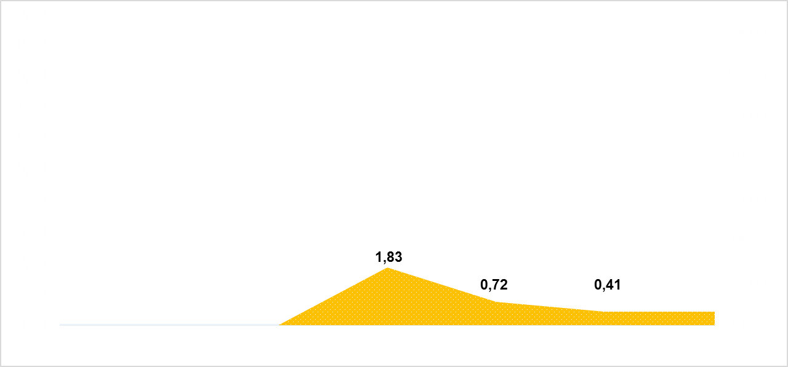
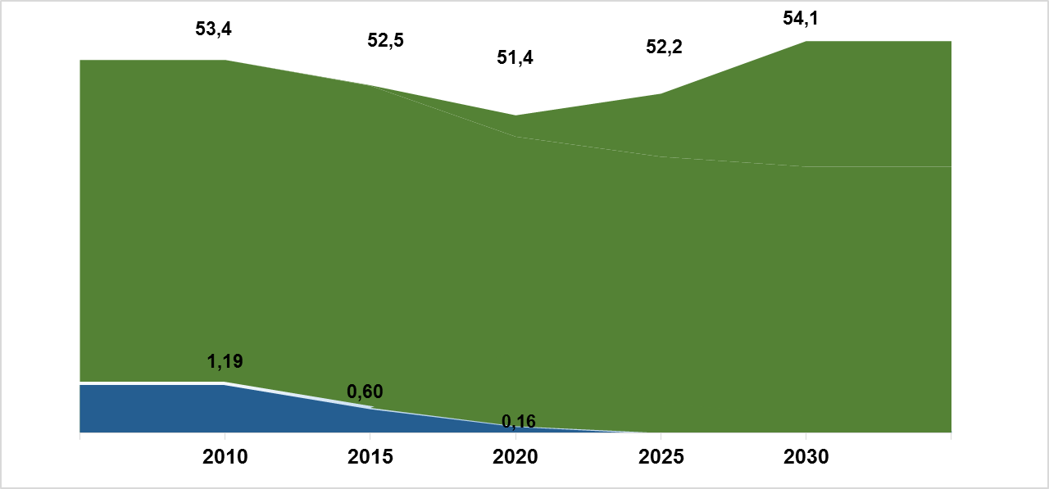
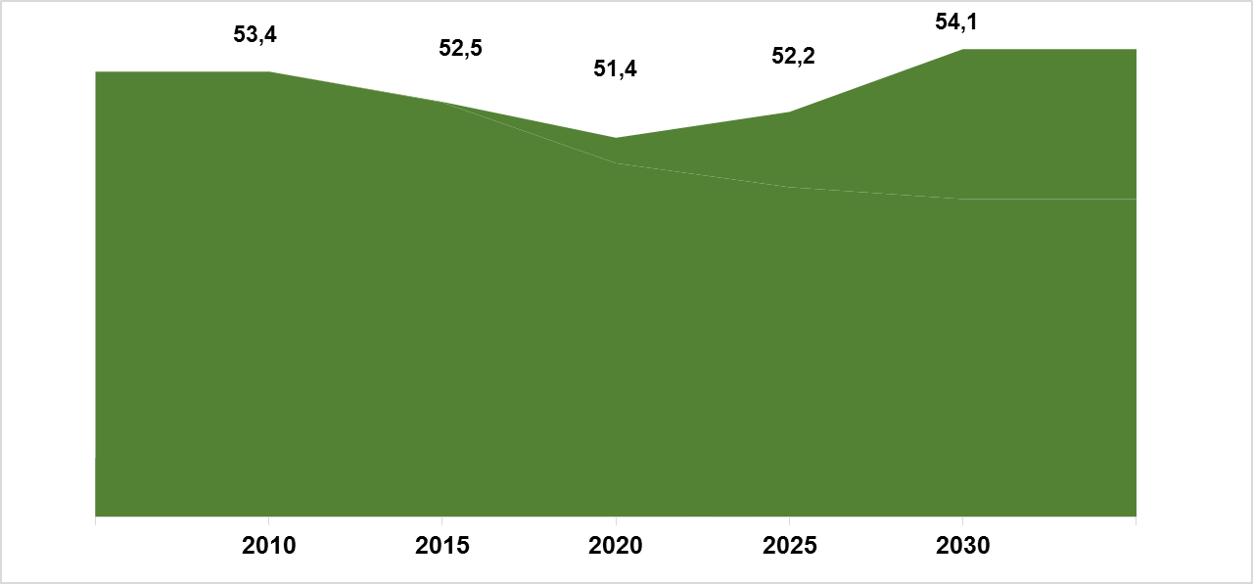
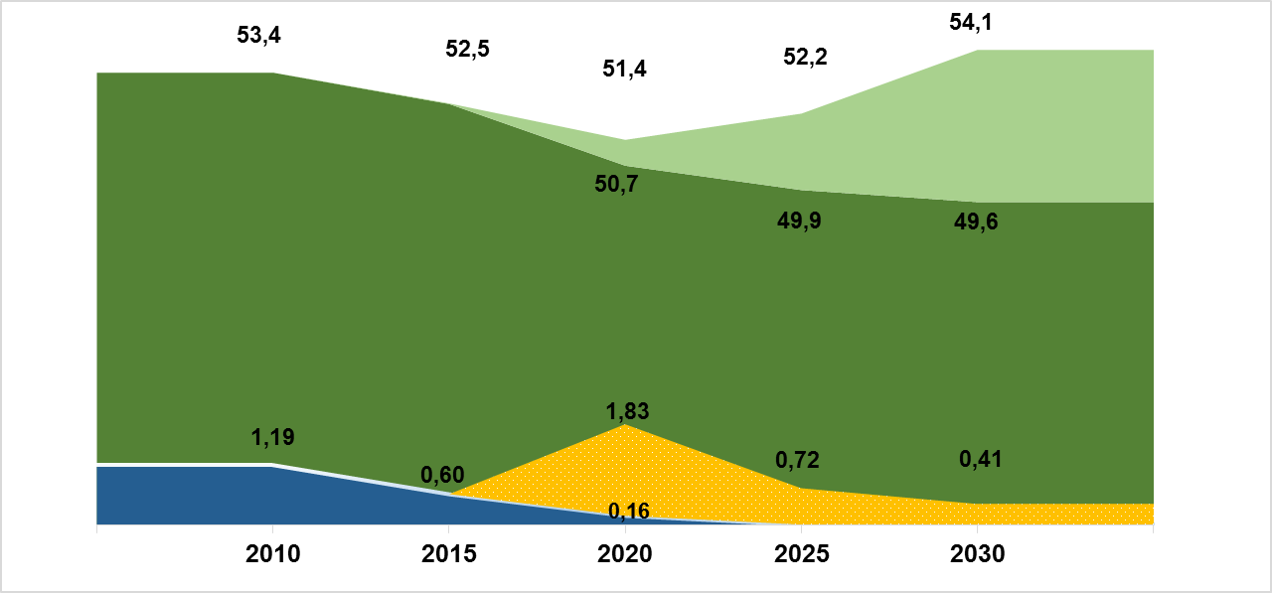
LAND USAGE
(MILLION HECTARES)
4,5 MM Ha
Forest coverage
Illegal deforestation
Expanded cultivated and livestocking areas
Reforestation

Slide 13
SECTORIAL POLICIES – NATIONAL DEVELOPMENT PLAN
Main objectives:
Area devoted to main crops production
(Million Hectares)
Source: Ministerio de Desarrollo Rural y Tierras
Unidad de Análisis de Políticas Sociales y Económicas - UDAPE

Slide 14
SECTORIAL POLICIES – NATIONAL DEVELOPMENT PLAN
Main objectives:
Main crops production
(Thousand metric tonnes)

Slide 15
MODELLING EXPERIENCES
Project | MAMS I (CGE) | MACEPES (CGE) | MAMS II (CGE) | CGE-OSEMOSYS/LEAP
# Workshops | 3 | 3 | 4 | 9
# people trained | 3 | 3 | 11 | 16
Invited Institutions | UDAPE | UDAPE | UDAPE | UDAPE, BCB, MEFP, INE, MHE, CNDC, YPFB
Outputs | MDGs Chapter Book: “Análisis de simulaciones ODM” | Book | 3 Policy Notes | 4 Policy Notes (Drafts)

