Slide 1
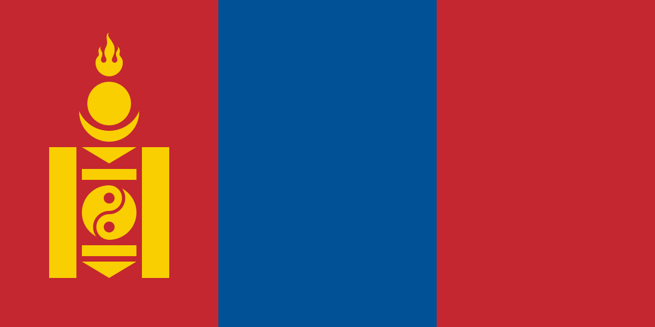
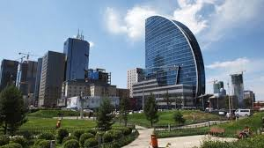
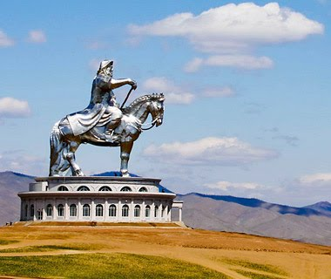
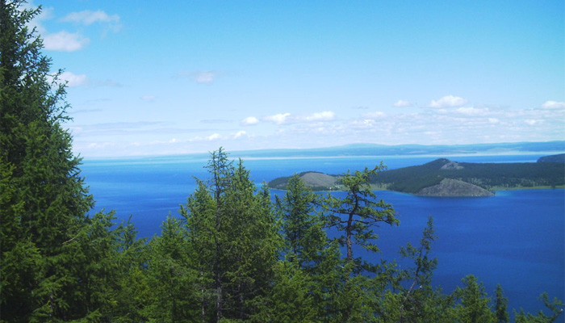
MONGOLIA
10 JUNE, 2017

Slide 2
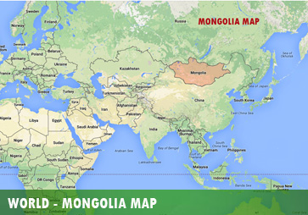
BASIC IMFORMATION
Population: 3 million
Huge territory: 1.56 mln.sq.km (11 times bigger than Nefal, 4 times bigger than Japan);
Rich of natural resources – Coking Coal, Copper, Gold, Uranium…
Average life expectancy: 70.9 in 2015
Poverty: 21.6% in 2014
literacy rate: 97.6% in 2015
GDP per capita: 3,603.7 in 2016
Real GDP growth: 17.3% in 2011, 1.0 % in 2016

Slide 3
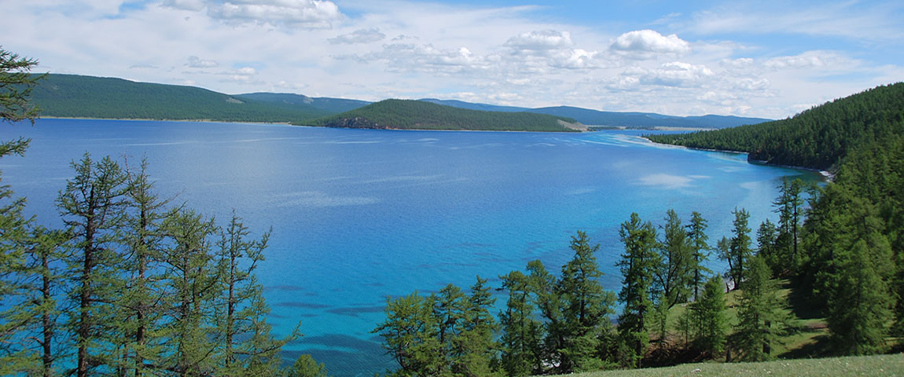
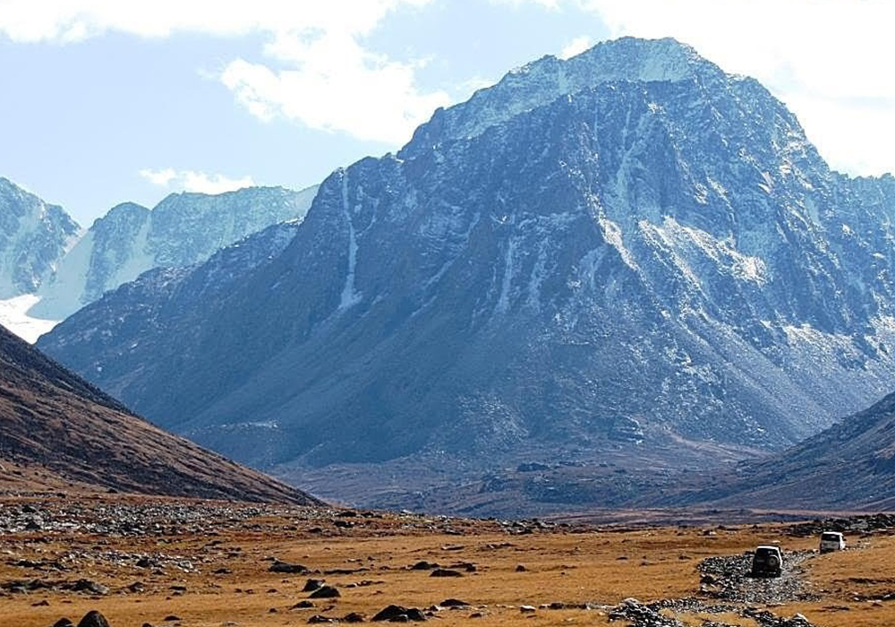
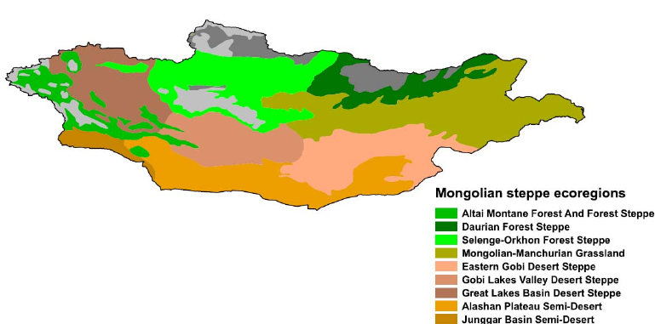
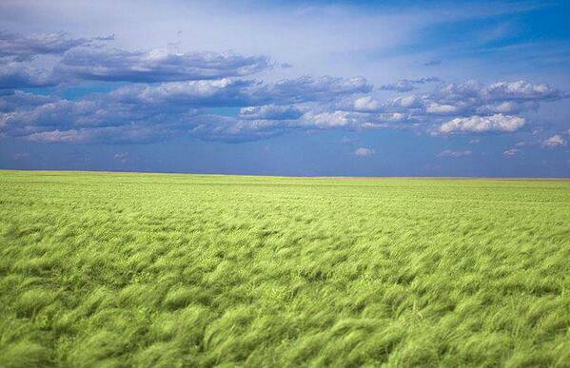
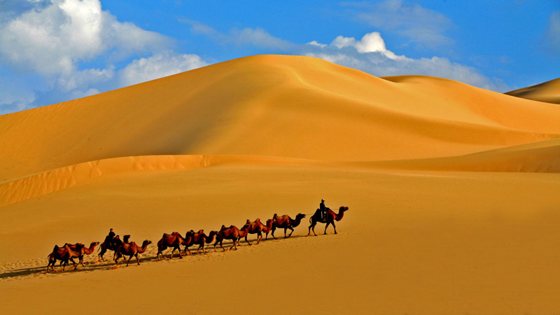
Geography

Slide 4
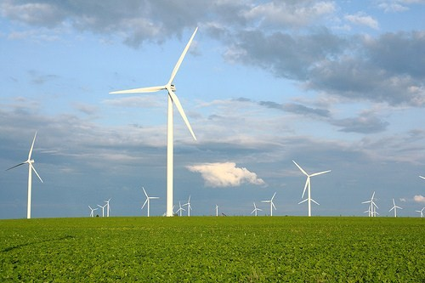
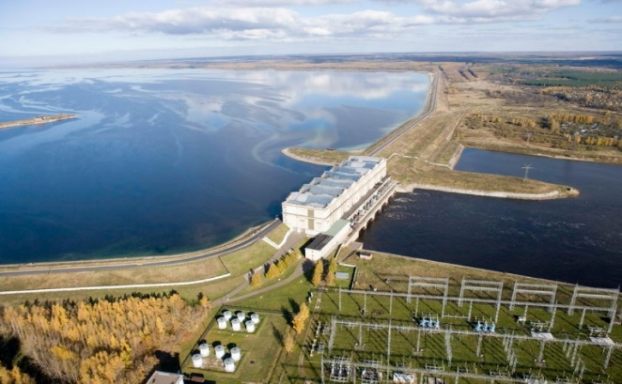
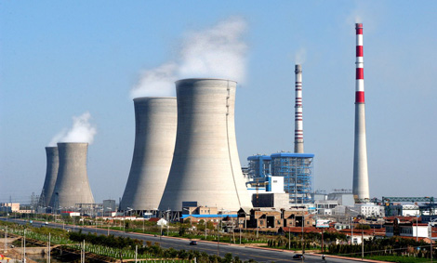
Power source structure
ENERGY RESOURCES
Electrical energy consumption structure

Slide 7
TERM
DEVELOPMENT CONCEPT OF MONGOLIA
(15-20 YEARS)
LONG TERM
20
STATE LEVEL
LOCAL LEVEL
MID TERM
4
-
10
POLICY OF STATE
(8-10 YEARS)
REGIONAL DEVELOPMENT POLICY
COUNTRY DEVELOPMENT POLICY
GOVERNMENT ACTION PLAN (4 YEARS)
LOCAL GOVERNMENT ACTION PLANS
(4 YEARS)
BUDGET FRAMEFORK (3 YEARS)
MID-TERM INVESTMENT PROGRAMM (4 YEARS)
NATIONAL PROGRAMM (4 YEARS)
SHORT TERM
1
SOCIAL AND ECONOMIC GUIDELINE
SOCIAL AND ECONOMIC GUIDELINE OF LOCAL GOVERNMENT
MONETARY POLICY GUIDELINE
STATE BUDGET
LOCAL BUDGET

Slide 8
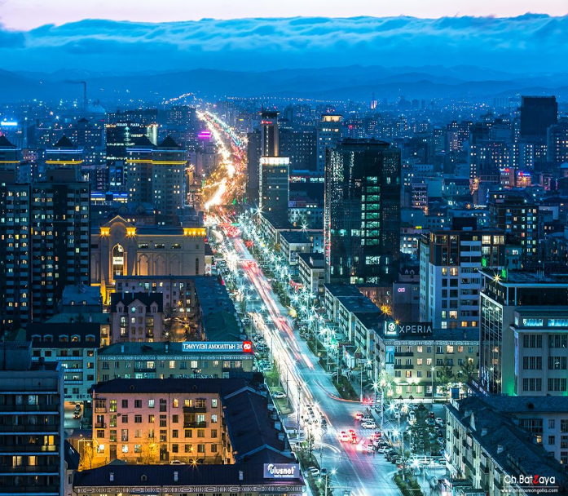
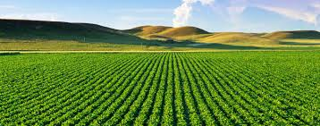
MONGOLIA’S DEVELOPMENT VISION
By 2030, Mongolia will
Become one of the leading MICs by per capita income
Have diversified sustainable economy
Eradicate income inequality and have a majority of population with average and higher level of income
Maintain virgin nature and sustainable ecology
Promote sustainable democratic governance

Slide 9
MODELS FOR ECONOMIC POLICIES
THRESHOLD 21 MODEL;
CGE MODEL;
FINANCIAL PROGRAMM;
MNT MODEL FOR EXCHANGE RATE;
SVAR MODEL FOR INFLATION;

Slide 10
THANK YOU FOR YOUR ATTENTION

