Slide 1
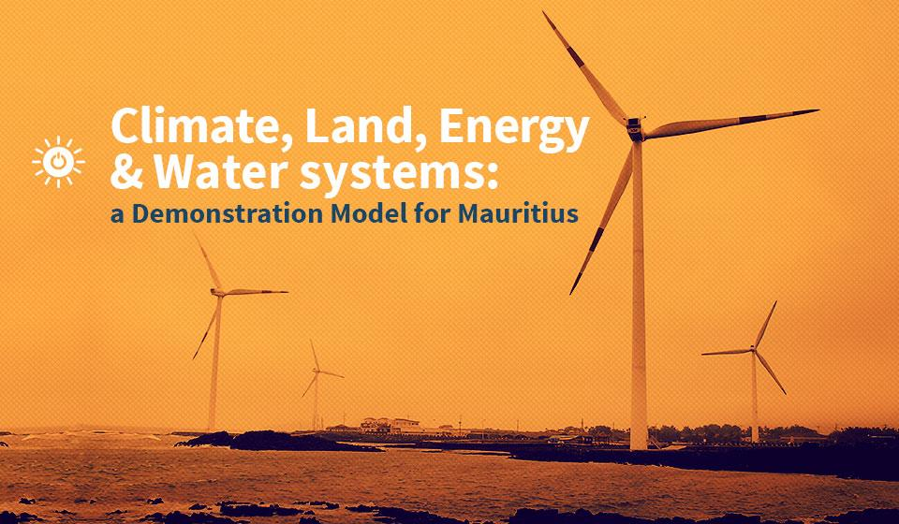

https://un-desa-modelling.github.io/

Slide 2
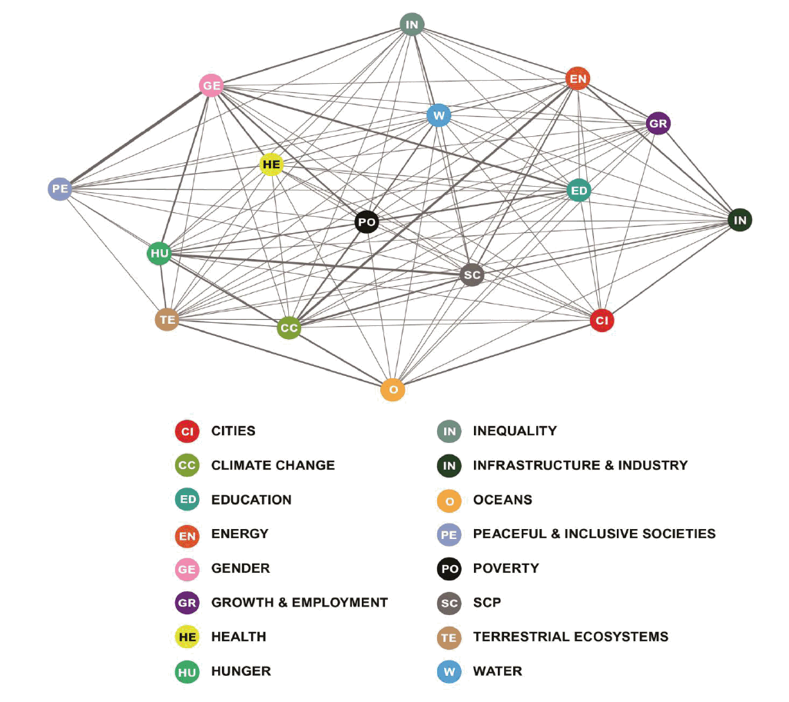
Agenda 2030 for sustainable development
A plan of action for people, planet and prosperity
Provides a powerful aspiration for improving our world – laying out where we collectively need to go and how to get there
The SDGs are not 17 separate ambitions, but highly interlinked challenges that require coordinated action

Slide 3
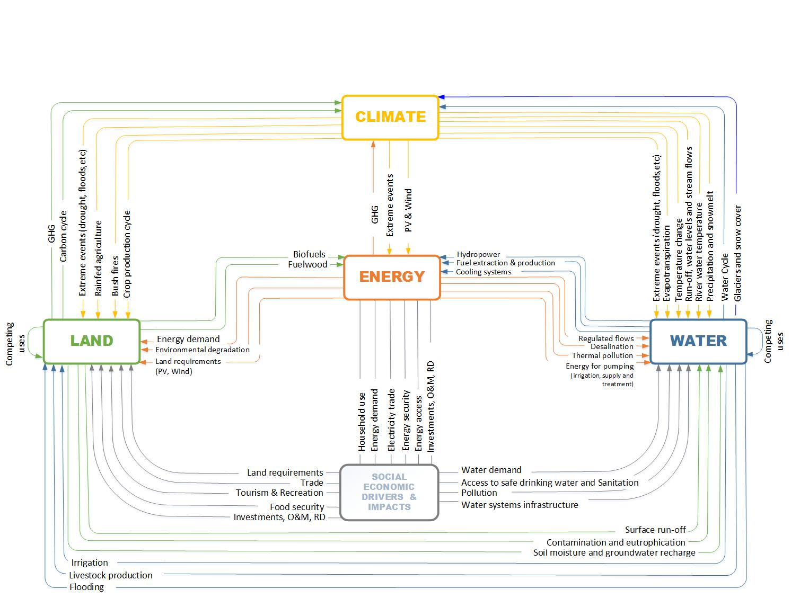
The CLEWs framework and interlinkages ….

Slide 4
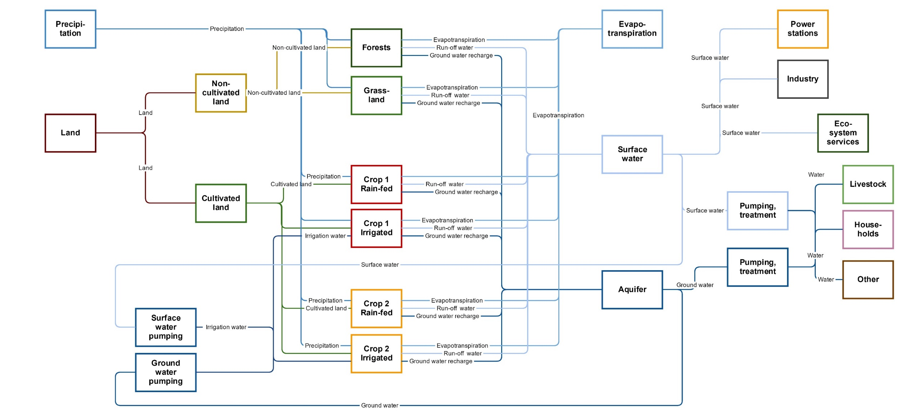
Water in detail ….

Slide 5
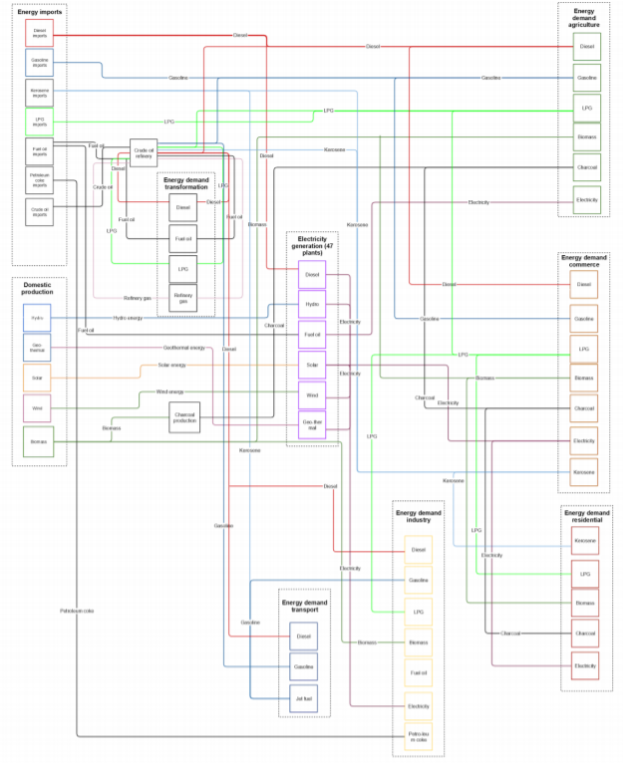
Energy in detail ….

Slide 6



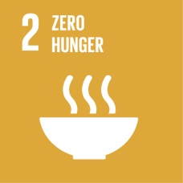

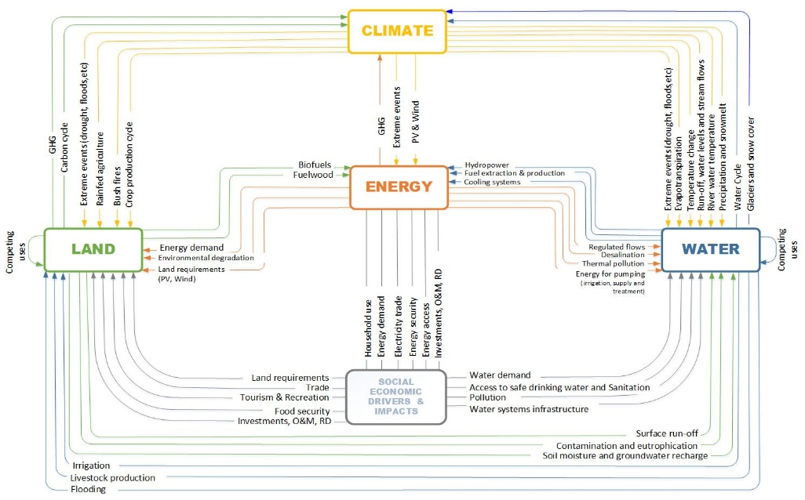






CLEWs and the SDGs
Housing (rural & urban)
Increased income, energy use & material consumption
Growth scenarios
Demand for food
Demand & source of energy
Industrial production
Assess alternative technologies & consumption patterns
Demand for clean water
Technology and investment options
Accounts for Carbon emissions
Deforestation & land use

Slide 7
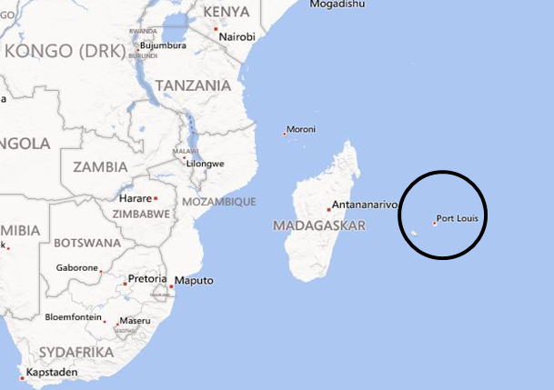
Mauritius
Main revenue has been tourism and sugar exports
  Expiration of EU agreement and collapse of revenue from the latter.
Diversification away from sugar cane to food crops and vegetables
Sugar cane production and refining – staple industry
Bagasse from refining – cogeneration of heat and electricity
  Reduction in sugar production led to lower electricity generation from bagasse
Consequent increase in fuel imports – coincided with increase in international fuel prices
Irrigation requirements higher for food crops-vegetables than for sugar cane
  Increased water demand

Slide 8
Impact of shifting two major sugar refineries to produce 2nd generation ethanol

Slide 9
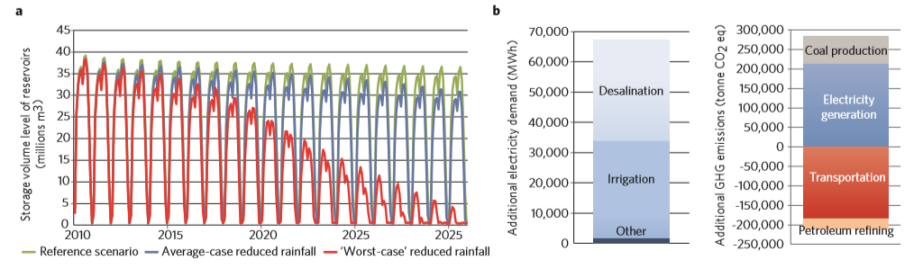
Impact of climate change in a CLEWs framework

Slide 10
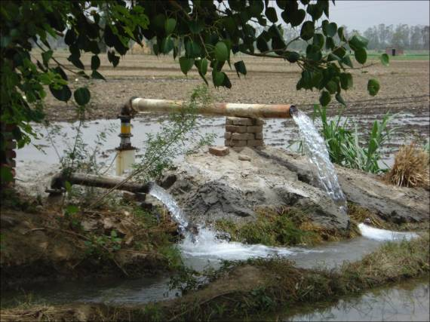
Punjab, India
Punjab has only 1.5% of India’s land, but its rice and wheat production accounts for 50% of the grain the government purchases and distributes to feed more than 400 million poor Indians.
Groundwater is being withdrawn faster than it can be replenished
  No restriction on landowners’ rights to pump water on their own land.
  Government-set prices incentivises planting of water-intensive crops
  Electricity is provided for free to farmers
Water levels drop and increased pumping is putting additional stress on an already fragile and overtaxed electricity grid.
  Excessive pumping not only leads to over-exploitation of aquifers it also leads to high electricity demand.
  Irrigation accounts for about 15–20% of India’s total electricity use.
Notes:
A key driver for water depletion is food demand (i.e. 1.2 billion mouths to feed).
As the law stands, landowners have the right to draw as much as they see fit from their wells. A system of government-set prices encourages farmers to plant water-intensive crops such as sugarcane and rice. And state governments provide electricity to farms at no charge or at heavily subsidized flat rates, making the water completely free to pump in many areas (as long as the water level doesn’t drop so low that you need a new well or a new pump).

Slide 11
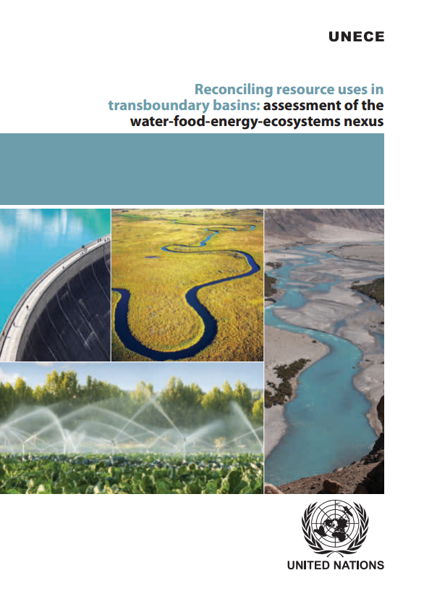
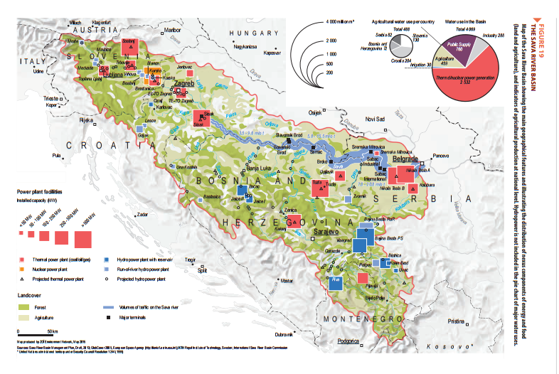
Alazani River Basin

Slide 12
Burkina Faso
Aim: to quantitatively demonstrate the added value of an integrated CLEWS assessment.
How: by deriving conclusions derived from an agricultural model (“Current Practice Approach”) with those of an integrated “CLEWS approach”.
Where: Burkina Faso
Why: Fuel wood, energy security, food security:
Deforestation, loss of CO2 sink and fuel source
Agriculture is extensive and expanding
Fuel imports are expensive
Fuel security is impacted as BKF is land-locked
Integrated agricultural and energy policy

Slide 13
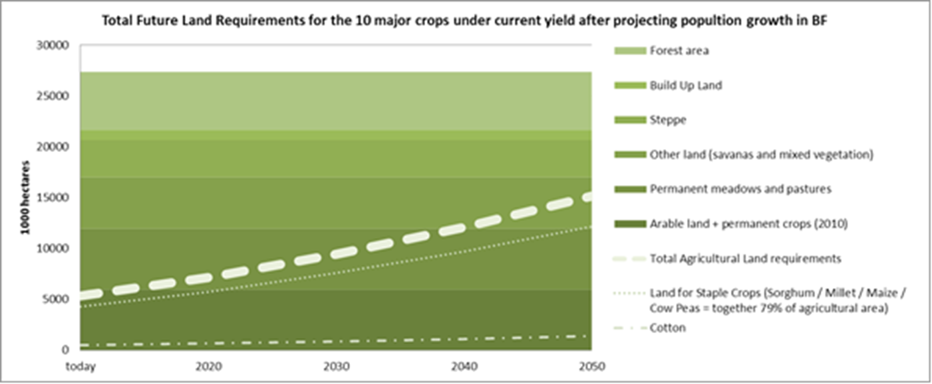
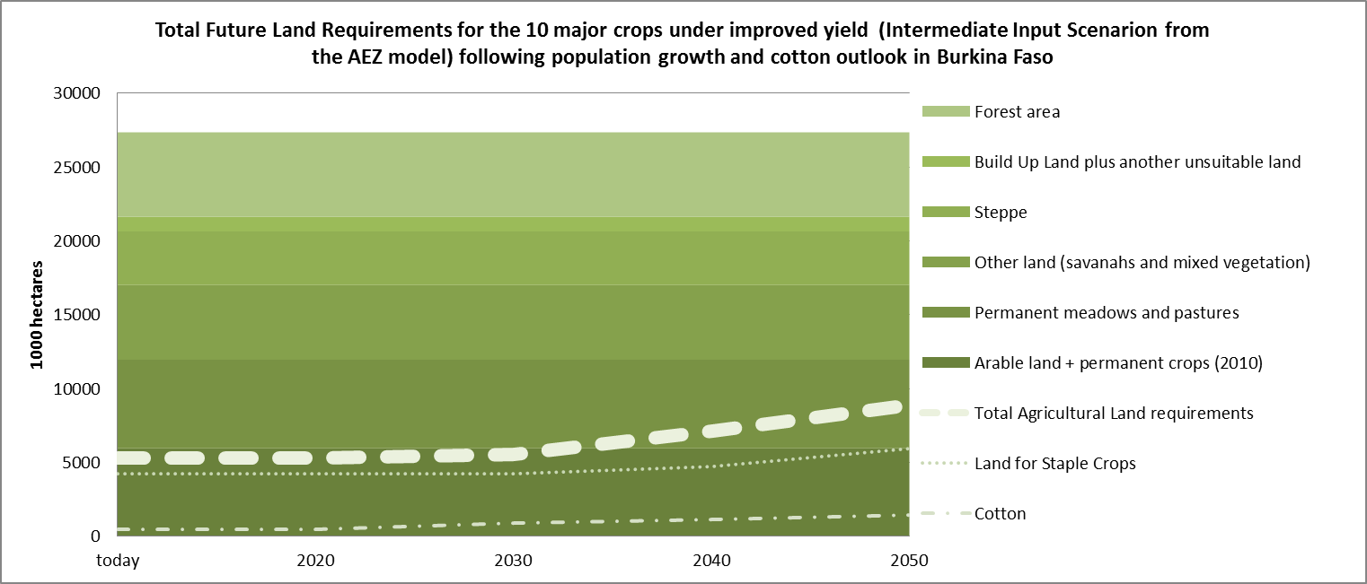
Burkina Faso

Slide 14
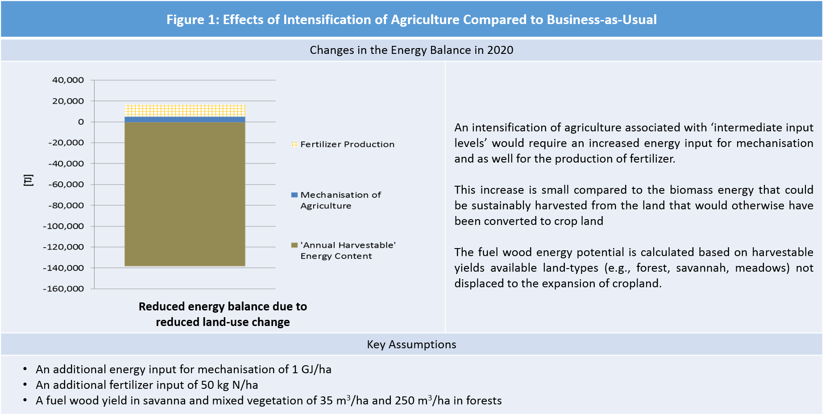
Insights from Burkina Faso

Slide 15
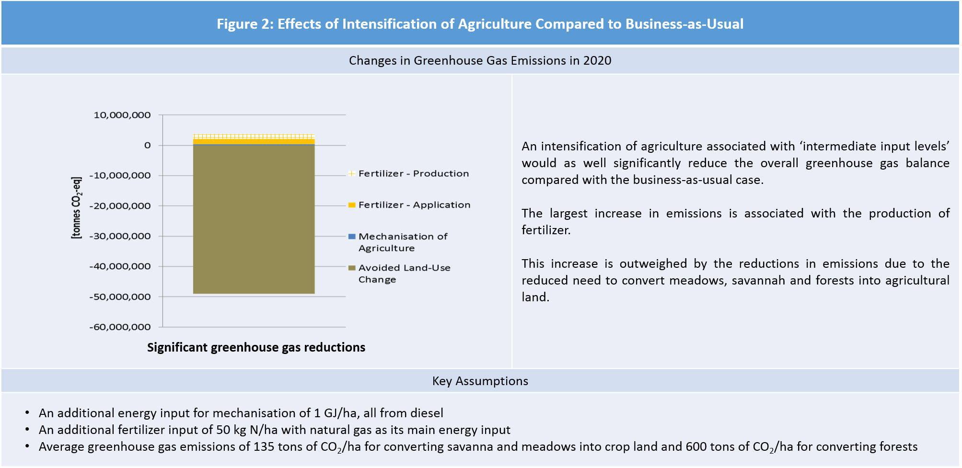
Insights from Burkina Faso

Slide 16
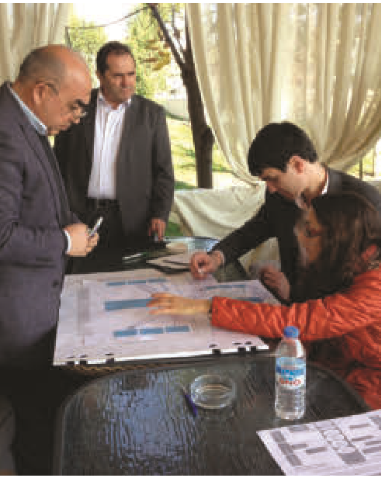
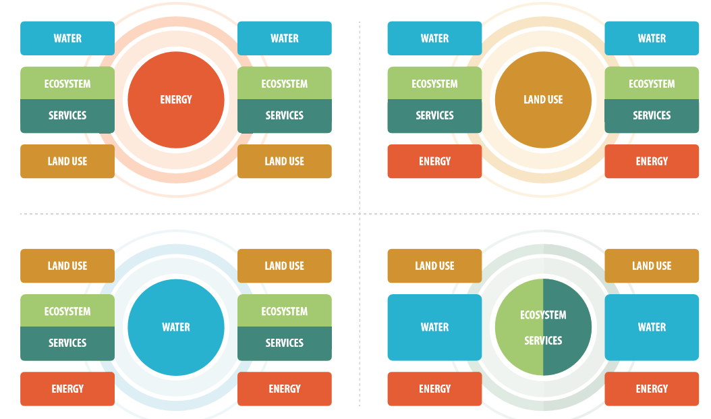
Capacity building and communication ….

