Slide 1
Managing and Sharing Research Data
Sarah Jones
Digital Curation Centre, Glasgow
sarah.jones@glasgow.ac.uk
Twitter: @sjDCC
CODATA Research Data Science School, 10 August 2018, Trieste #DataTrieste

Slide 2
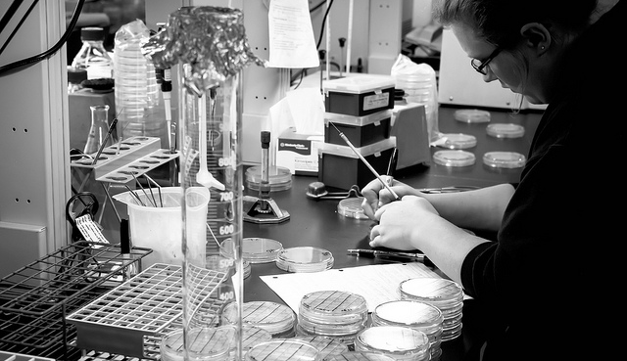
Creating data
Image CC-SA-ND by Bill Dickinson www.flickr.com/photos/skynoir/8270436894

Slide 3
Data creation tips
Ensure consent forms, licences and agreements don’t restrict opportunities to share data
Choose appropriate formats
Adopt a file naming convention
Create metadata and documentation as you go

Slide 4
Ask for consent for data sharing
If not, data centres won’t be able to accept the data
– regardless of any conditions on the original grant.
www.data-archive.ac.uk/create-manage/consent-ethics/consent?index=3

Slide 5
Choose appropriate file formats
Different formats are good for different things
open, lossless formats are more sustainable e.g. rtf, xml, tif, wav
proprietary and/or compressed formats are less preservable but are often in widespread use e.g. doc, jpg, mp3
One format for analysis then
convert to a standard format
Data centres may suggest preferred formats for deposit
www.data-archive.ac.uk/create-manage/format/formats-table
BioformatsConverter batch converts a variety of proprietary microscopy image formats to the Open Microscopy Environment format - OME-TIFF

Slide 6
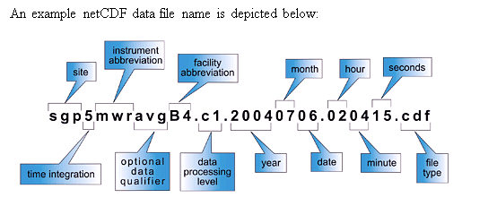
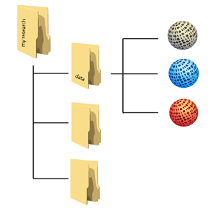
How will you organise your data?
Example from ARM Climate Research Facility www.arm.gov/data/docs/plan
Keep file and folder names short, but meaningful
Agree a method for versioning
Include dates in a set format e.g. YYYYMMDD
Avoid using non-alphanumeric characters in file names
Use hyphens or underscores not spaces e.g. day-sheet, day_sheet
Order the elements in the most appropriate way to retrieve the record
www.jiscdigitalmedia.ac.uk/guide/choosing-a-file-name

Slide 7
What is metadata?
Metadata
Standardised
Structured
Machine and human readable
Metadata helps to cite & disambiguate data
Documentation aids reuse
Documentation
Metadata

Slide 8
Metadata standards
These can be general – such as Dublin Core
Or discipline specific
Data Documentation Initiative (DDI) – social science
Ecological Metadata Language (EML) - ecology
Flexible Image Transport System (FITS) – astronomy
Search for standards in catalogues like:
http://rd-alliance.github.io/metadata-directory

Slide 9
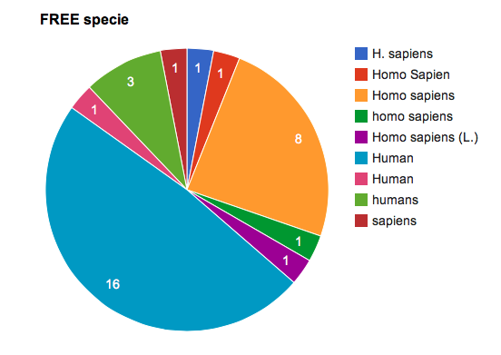
“MTBLS1: A metabolomic study of urinary changes in type 2 diabetes in……”
Why are ontologies important?
Example courtesy of Ken Haug, European Bioinformatics Institute (EMBL-EBI)
Notes:
From Cambridge University workshop, 33 participants
Asked what species the study was on and a range of answers denoting humans were provided
Humans can see these all mean the same things but computers can’t

Slide 10
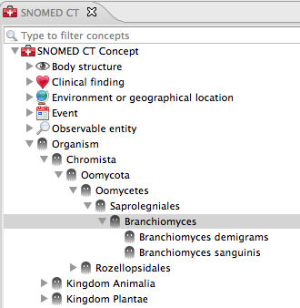
Controlled vocabularies
E.g. SNOMED CT (clinical terms) or MeSH
Include ontologies as well
Defined terms + taxonomy
Useful for selecting keywords to tag datasets

Slide 11
Documentation
Think about what is needed in order to evaluate, understand, and reuse the data.
Why was the data created?
Have you documented what you did and how?
Did you develop code to run analyses? If so, this should be kept and shared too.
Important to provide wider context for trust

Slide 12
ReadMe files
We recommend that a ReadMe be a plain text file containing the following:
for each filename, a short description of what data it includes, optionally describing the relationship to the tables, figures, or sections within the accompanying publication
for tabular data: definitions of column headings and row labels; data codes (including missing data); and measurement units
any data processing steps, especially if not described in the publication, that may affect interpretation of results
a description of what associated datasets are stored elsewhere, if applicable
whom to contact with questions
http://datadryad.org/pages/readme
Example template: https://www.lib.umn.edu/datamanagement/metadata

Slide 13
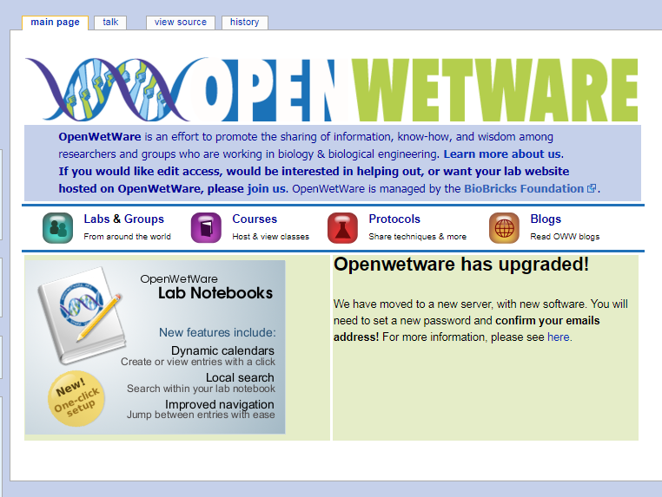
Useful tools for documentation
E-lab notebooks, wikis etc
Record experiment procedures and results
Share protocols
http://openwetware.org
Notes:
Jupyter is an open-source web application that allows you to create and share documents that contain live code, equations, visualizations and narrative text.
Openwetware is an effort to promote the sharing of information, know-how, and wisdom among researchers and groups who are working in biology & biological engineering.

Slide 14
Workflow tools e.g. MyExperiment
www.myexperiment.org/workflows/16.html

Slide 15
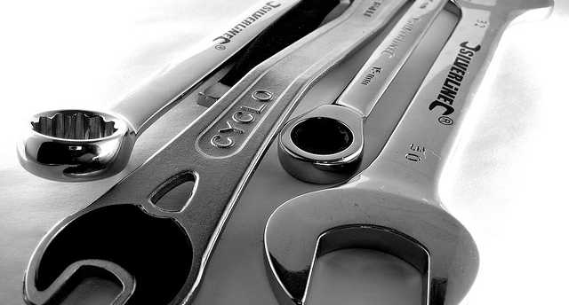
Managing data
Image ‘tools’ CC-BY by zzpza www.flickr.com/photos/zzpza/3269784239

Slide 16
Where will you store the data?
Your own device (laptop, flash drive, server etc.)
And if you lose it? Or it breaks?
Departmental drives or university servers
“Cloud” storage
Do they care as much about your data as you do?
The decision will be based on how sensitive your data are, how robust you need the storage to be, and
who needs access to the data and when

Slide 17
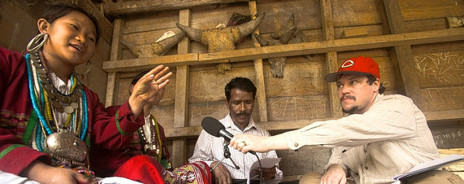
How to keep your data secure?
Develop a practical solution that fits your circumstances
Store your data on managed servers
Restrict access to collaborators or smaller subset
Encrypt mobile devices carrying sensitive information
Keep anti-virus software up-to-date
Use secure data services for long-term sharing
www.wsj.com/articles/SB10001424052748703843804575534122591921594

Slide 18
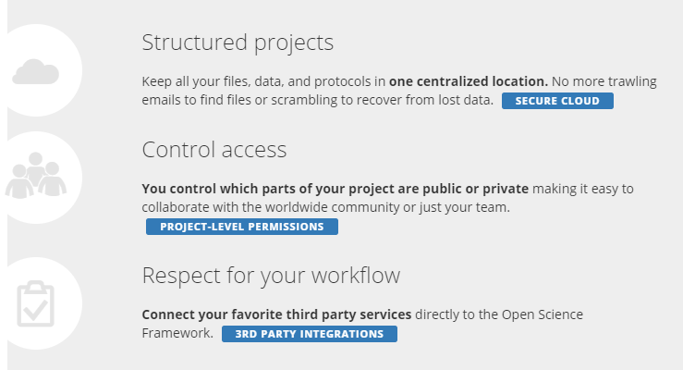
Collaborative platforms e.g. OSF
https://osf.io

Slide 19
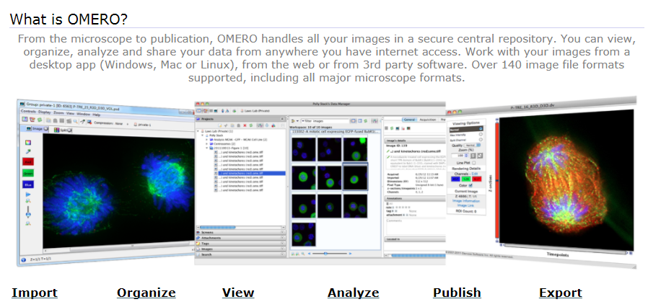
Data-specific platforms e.g. OMERO
Open Microscopy Environment
http://www.openmicroscopy.org/site/products/omero

Slide 20
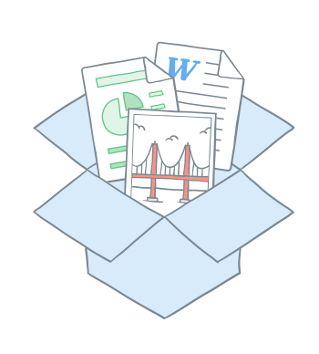
Third-party tools for collaboration
ownCloud
Open source product with Dropbox-like functionality
Used by many unis and service providers to offer ‘approved’ solution
https://owncloud.org
Using Dropbox and other cloud services – LSE guidelines
http://www.lse.ac.uk/intranet/LSEServices/IMT/guides/softwareGuides/other/usingDropboxCloudStorageServices.aspx

Slide 21
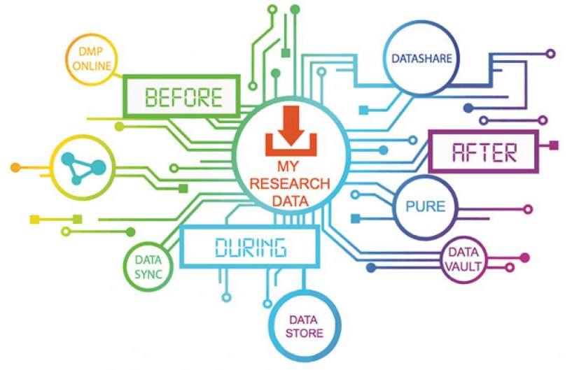
University RDM services e.g. Edinburgh
DataStore
Compute & Data Facility (HPC)
DataSync
Wiki service
Subversion
Electronic Lab Notebook
DataShare repository
DataVault
Pure (research info)
Secure data service
www.ed.ac.uk/information-services/research-support/research-data-service

Slide 22
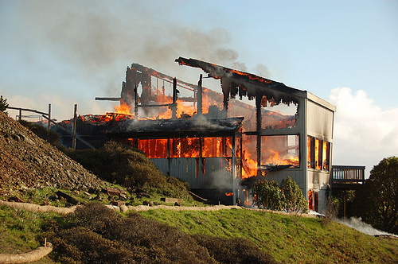
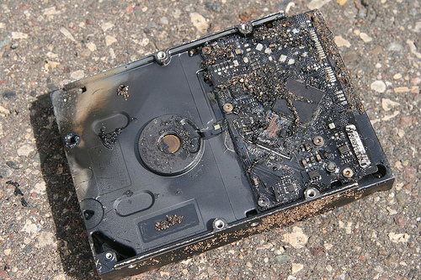
One copy = risk of data loss
CC image by momboleum on Flickr
CC image by Sharyn Morrow on Flickr

Slide 23
Who will do the backup?
Use managed services where possible (e.g. University filestores rather than local or external hard drives), so backup is done automatically
3… 2… 1… backup!
at least 3 copies of a file
on at least 2 different media
with at least 1 offsite
Ask central IT team for advice

Slide 24
Backup and preservation – not the same thing!
Backups
Used to take periodic snapshots of data in case the current version is destroyed or lost
Backups are copies of files stored for short or near-long-term
Often performed on a somewhat frequent schedule
Archiving
Used to preserve data for historical reference or potentially during disasters
Archives are usually the final version, stored for long-term, and generally not copied over
Often performed at the end of a project or during major milestones

Slide 25
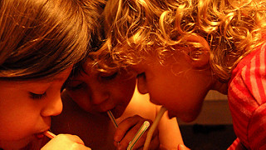
Data sharing and being Open
Image CC-BY-NC-ND by talkingplant www.flickr.com/photos/talkingplant/2256485110

Slide 26
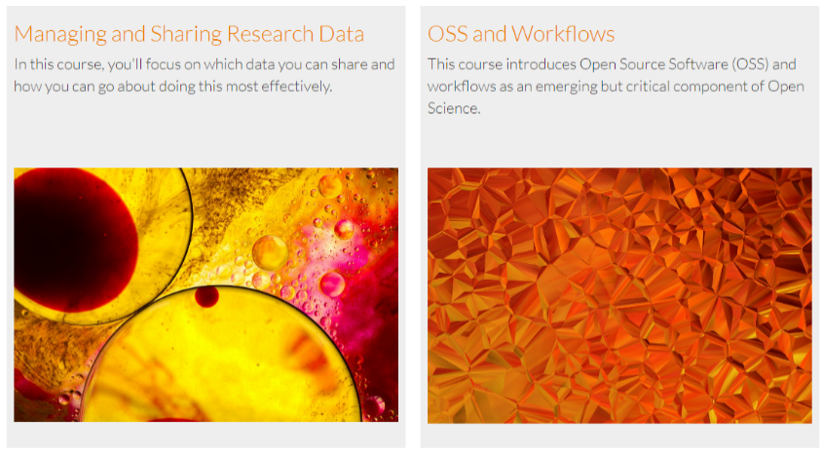
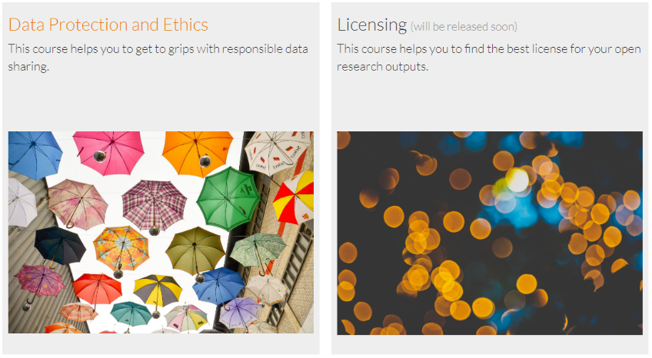
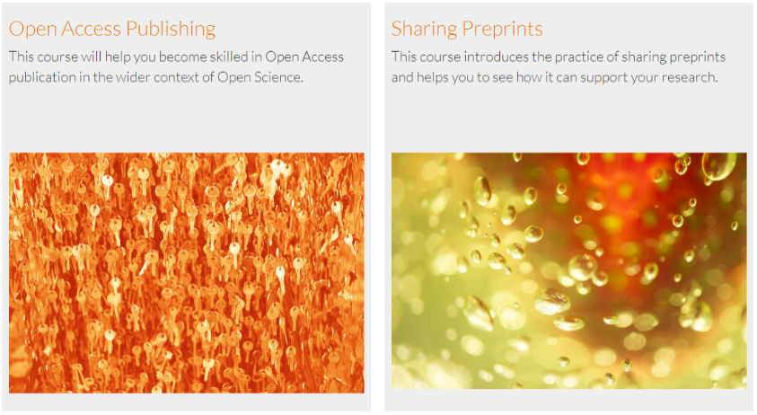
FOSTER Open Science toolkit
https://www.fosteropenscience.eu/toolkit

Slide 27
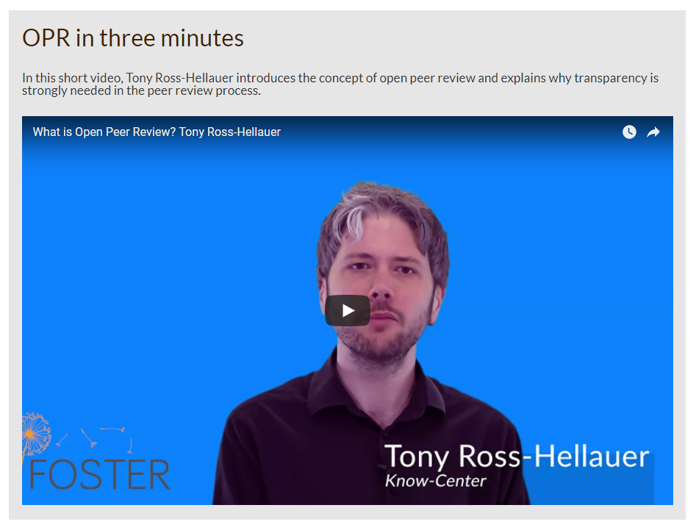
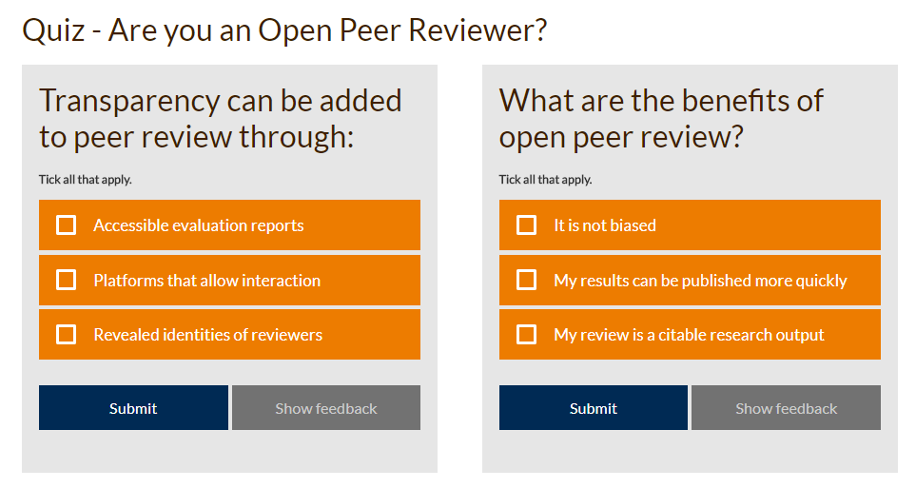
Open Peer Review module example

Slide 28
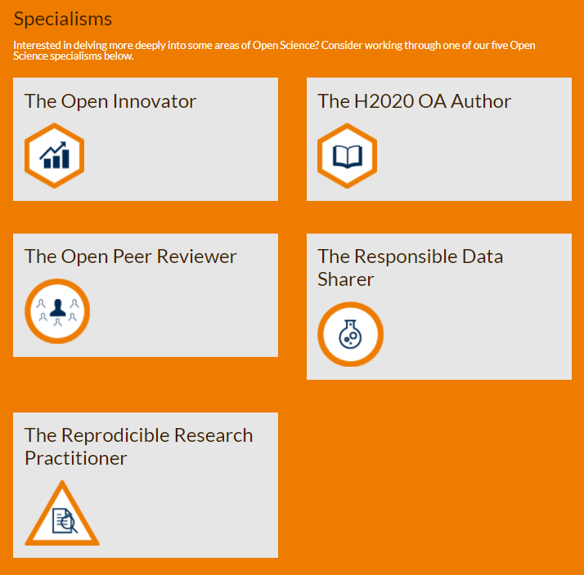
Specialisation pathways
2-4 hours of content
The reproducible research practitioner
The responsible data sharer
The Open Access Author
The open peer reviewer
The open innovator
For more information, see www.fosteropenscience.eu/learning-paths

Slide 29
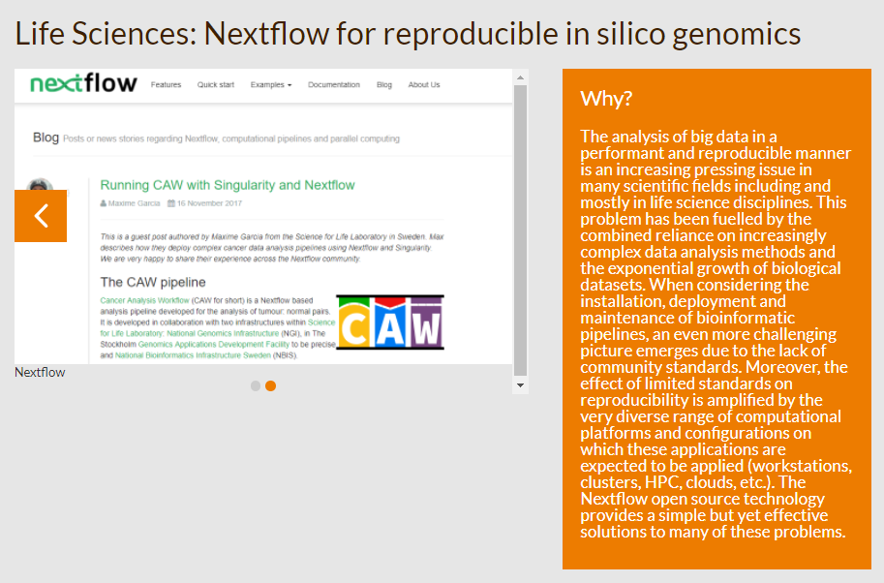
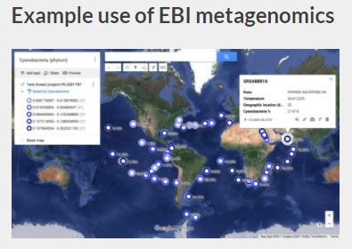
Case study approach
Using the EC Open Science Monitor approach to share practical examples of activity from the Life Sciences, Social Sciences and Humanities.
Open Access
Open Source Licensing
Open Research Data
Open Peer Review
Ethics
Open Innovation

Slide 30
How to make data open?
Choose your dataset(s)
What can you may open? You may need to revisit this step if you encounter problems later.
Apply an open license
Determine what IP exists. Apply a suitable licence e.g. CC-BY
Make the data available
Provide the data in a suitable format. Use repositories.
Make it discoverable
Post on the web, register in catalogues…
https://okfn.org

Slide 31
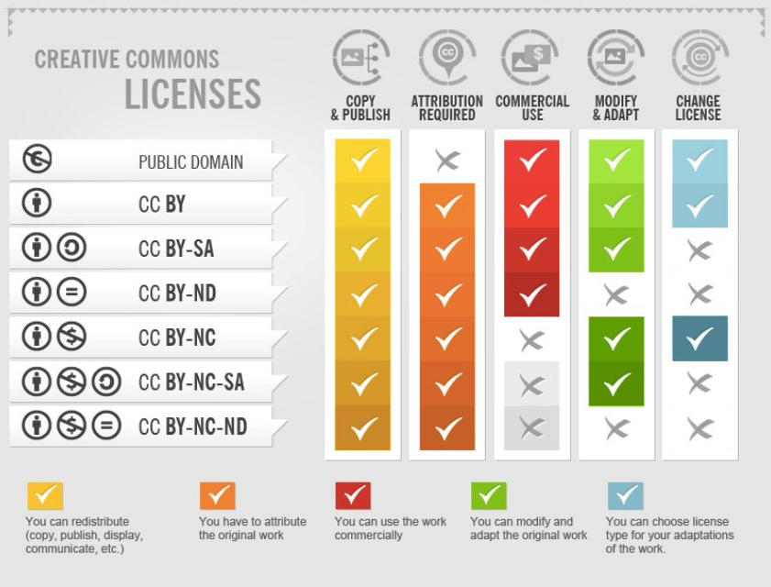
License research data openly
DCC how-to guide: www.dcc.ac.uk/resources/how-guides/license-research-data
Notes:
31

Slide 32
EUDAT licensing tool
Answer questions to determine which licence(s) are appropriate to use
http://ufal.github.io/lindat-license-selector

Slide 33
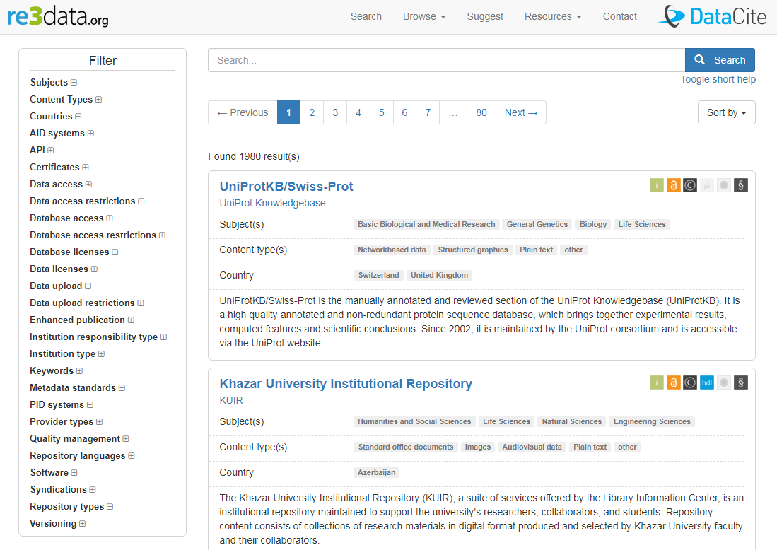
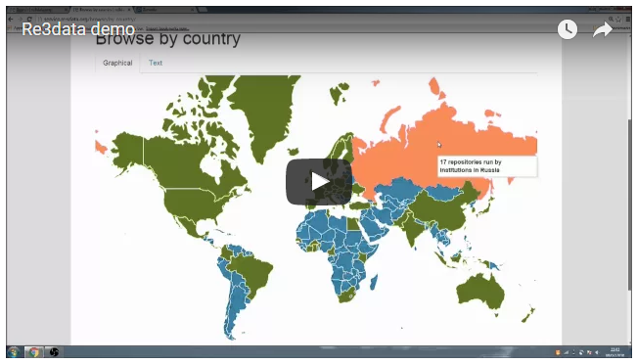
Deposit in a data repository
The Re3data catalogue can be searched to find a home for data
http://databib.org
www.fosteropenscience.eu/content/re3data-demo
www.re3data.org
Notes:
33

Slide 34
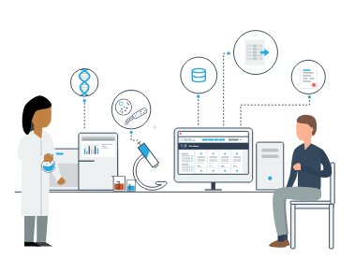
National / domain repositories
BioSharing portal of databases in life sciences
www.re3data.org
https://biosharing.org

Slide 35
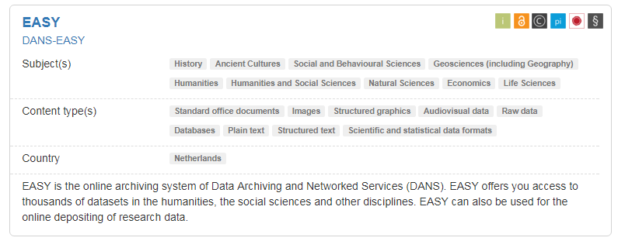
How to select a repository?
Better to use a subject specific repository if available
Check they match particular data needs e.g. formats accepted, mixture of Open and Restricted Access.
Do they assign a persistent and globally unique identifier for sustainable citations and to links back to particular researchers and grants?
Look for certification as a ‘Trustworthy Digital Repository’ with an explicit ambition to keep the data available in long term.
Icons to note open access, licenses, PIDs, certificates…

Slide 36
Zenodo
Zenodo is a multi-disciplinary repository that can be used for the long-tail of research data
An OpenAIRE-CERN joint effort
Multidisciplinary repository accepting
Multiple data types
Publications
Software
Assigns a Digital Object Identifier (DOI)
Links funding, publications, data & software
www.zenodo.org
Notes:
36

Slide 37
Archiving code in Zenodo
Get a DOI for each release
https://guides.github.com/ activities/citable-code

Slide 38
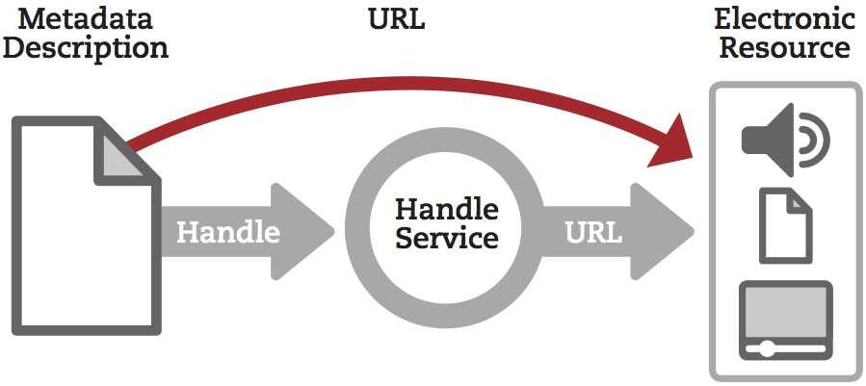
What is a Persistent Identifier?
a long-lasting reference to a document, file or other object
PIDs come in various forms e.g. ARK, DOI, URN, PURL, Handles...
Typically they’re actionable i.e. type it into web browser to access
Many repositories will assign them on deposit

Slide 39
Citing research data: why?
http://ands.org.au/cite-data

Slide 40
How to cite data
Key citation elements
Author
Publication date
Title
Location (= identifier)
Funder (if applicable)
www.dcc.ac.uk/resources/briefing-papers/introduction-curation/data-citation-and-linking

Slide 41
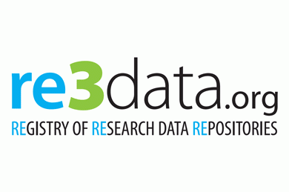
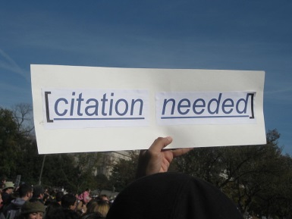
How do you share data effectively?
Use appropriate repositories, this catalogue is a good place to start
http://www.re3data.org
Document and describe it enough for others to understand, use and cite
http://www.dcc.ac.uk/resources/how-guides/cite-datasets
Licence it so others can reuse
www.dcc.ac.uk/resources/how-guides/license-research-data

Slide 42
Using Re3data to find a repository
Review the Open Access Journal DMP and identify what should be kept for the long term (10 mins).
https://repositorian.github.io/DOAJ_Exercise
Using Re3data, search for appropriate repositories (25 mins) considering:
Data type(s)
Discipline
Repository features
Decide what to keep and where to deposit this.
Record your decision by filling in section 7 (15 mins)
http://www.re3data.org
Notes:
[hand out the template]

