Slide 1
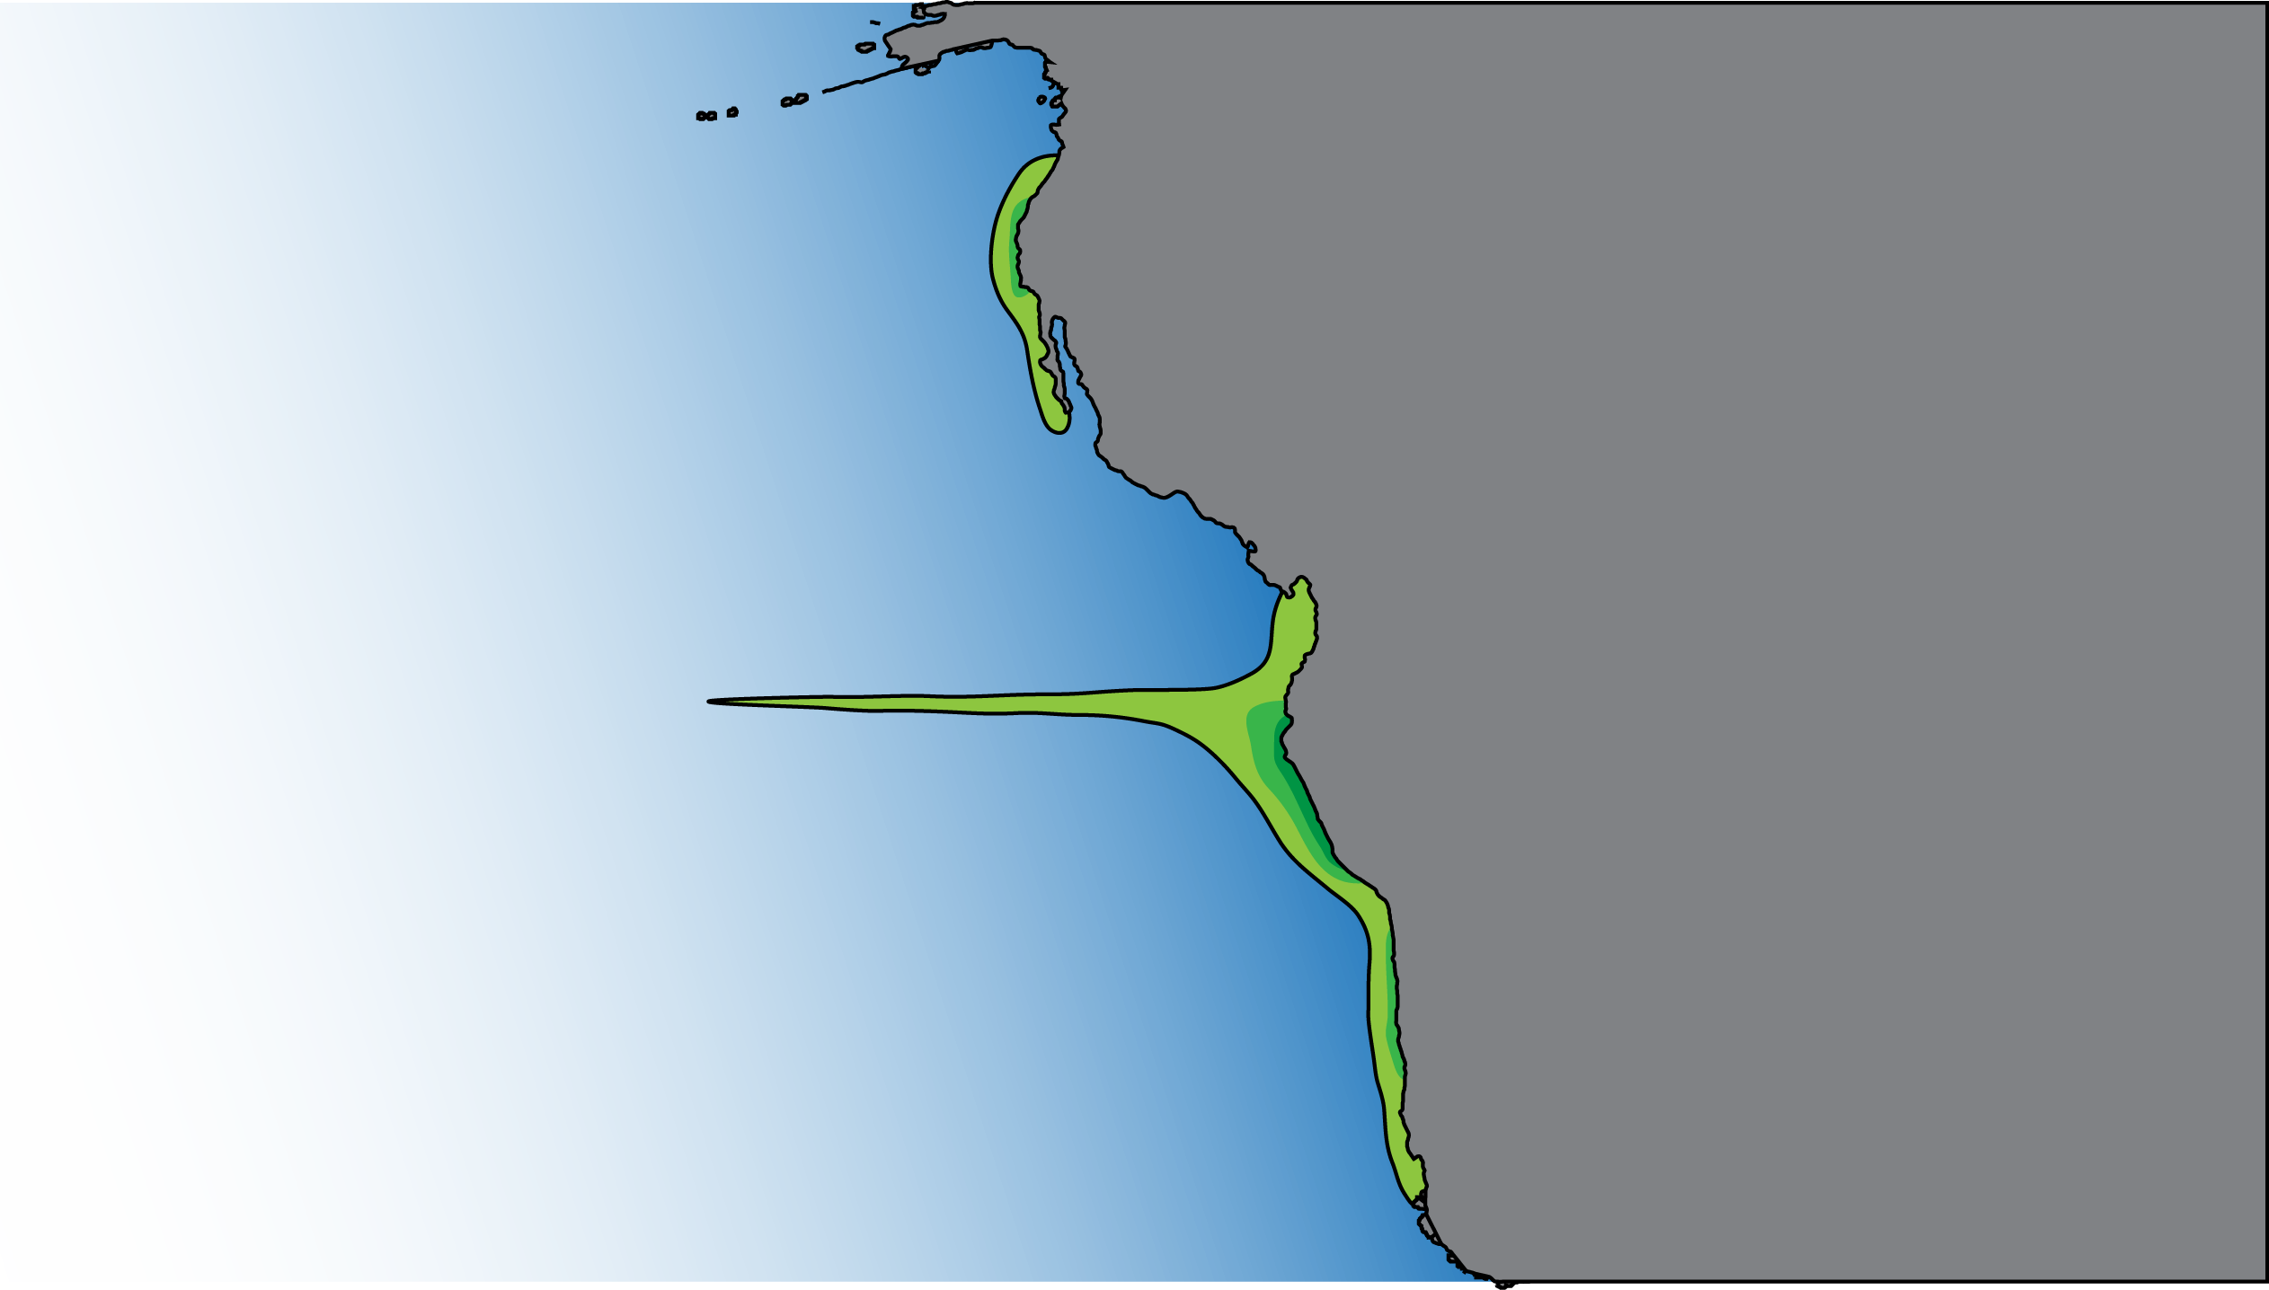
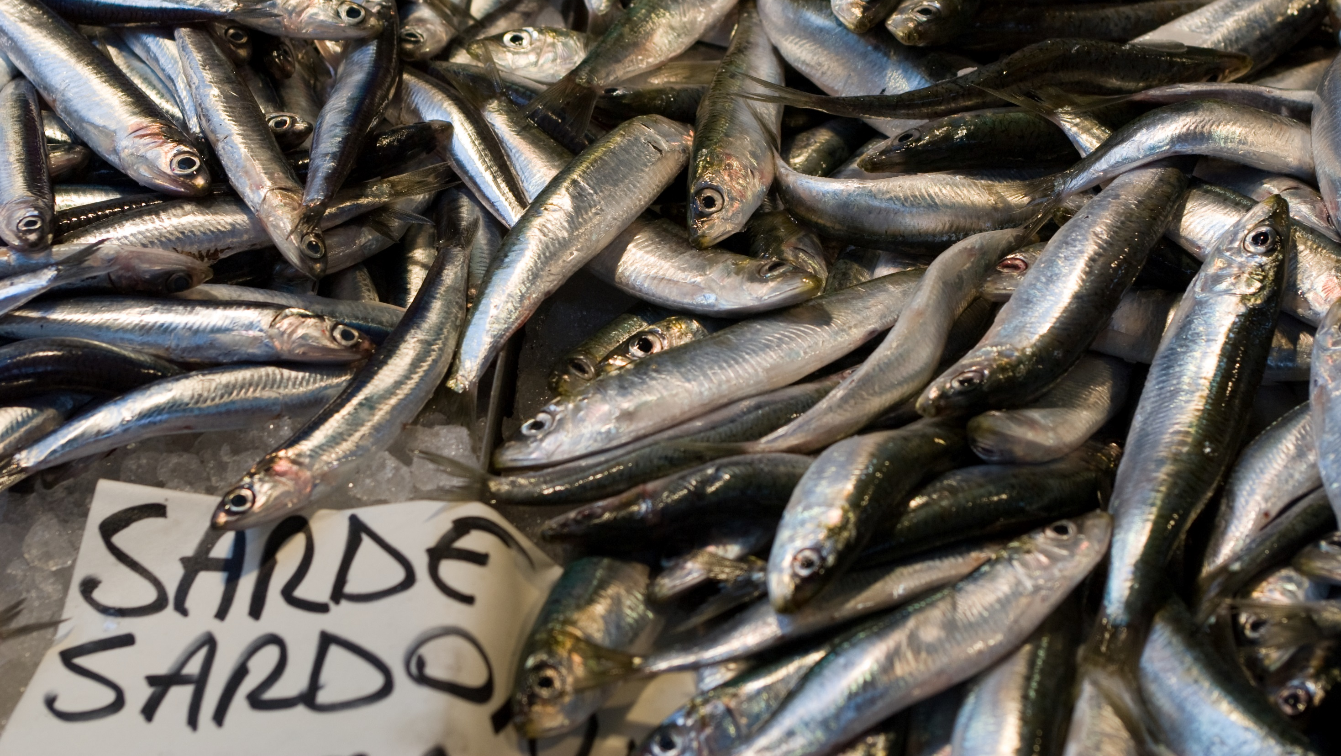


Large-scale biogeochemistry and plankton ecology in EBUS
Ryan Rykaczewski
University of South Carolina

Slide 2
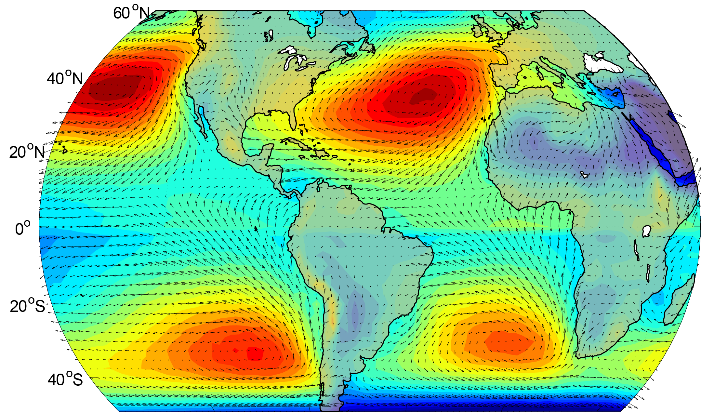
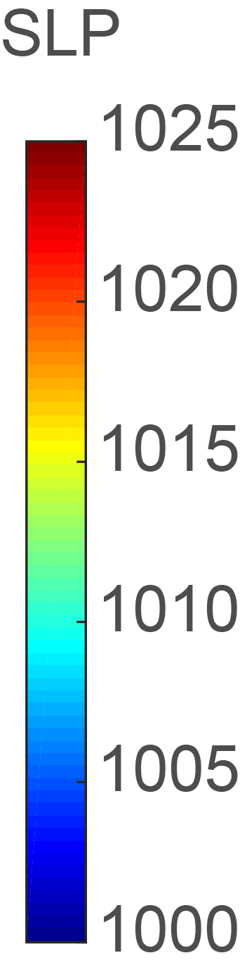
Eastern Boundary Upwelling Systems (EBUS)
California Current
Canary Current
Humboldt Current
Benguela Current

Slide 3

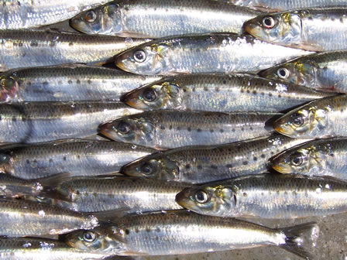
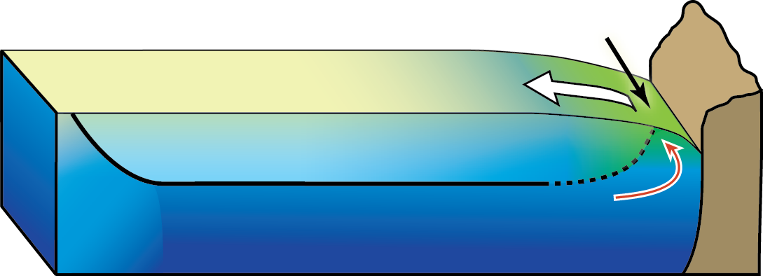
How do we get from the atmosphere and ocean physics to the fish (or fisheries)?
Physics happen.
Deep waters are brought to the surface.
Fisheries production is high.
If only it were so easy…

Slide 4
How do we get from the atmosphere and ocean physics to the fish (or fisheries)?

Slide 5
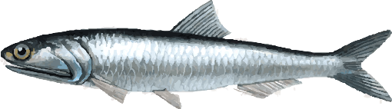

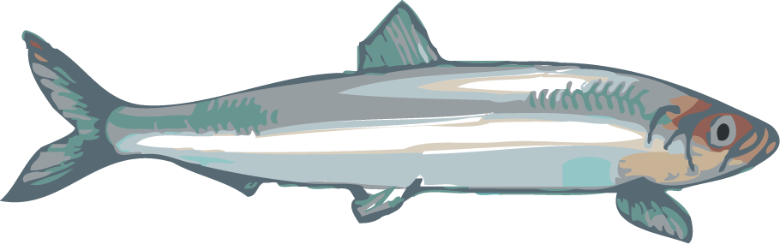
How do we get from the atmosphere and ocean physics to the fish (or fisheries)?

Slide 6
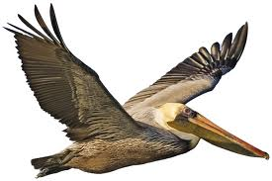

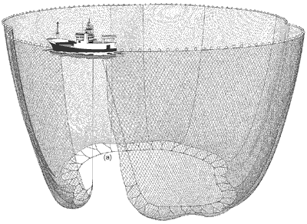
How do we get from the atmosphere and ocean physics to the fish (or fisheries)?

Slide 7
How do we get from the atmosphere and ocean physics to the fish (or fisheries)?

Slide 8

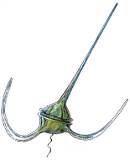
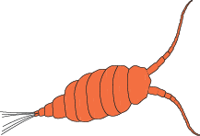


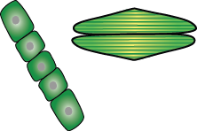
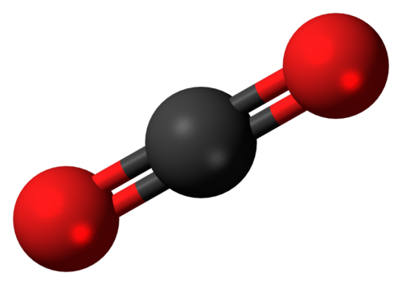

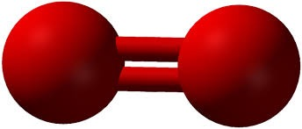
How do we get from the atmosphere and ocean physics to the fish (or fisheries)?
Fe

Slide 9
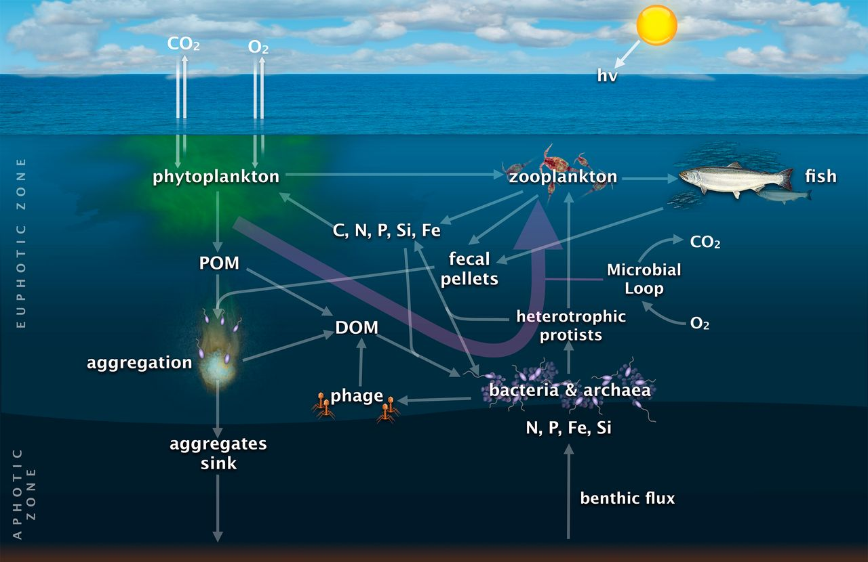
Worden et al. (2013)

Slide 10
How do we get from the atmosphere and ocean physics to the fish (or fisheries)?
Element | Forms in Ocean | Major Cellular Role
Carbon | CO₂, HCO₃⁻, CO₃²⁻ | energy storage, structure, everything
Nitrogen | NO₃⁻, NO₂⁻, NH₄⁺ | proteins
Phosphorus | PO₄³⁻ | nucleic acids, membrane lipids
Silicon | Si(OH)₄ | diatom frustules
Iron | Fe(OH)_{x}, Fe_{org} | photosynthetic and respiratory proteins
Other metals: Zn, Co, Mn, Cu |  | various proteins
“macronutrients”
“micronutrients”

Slide 11
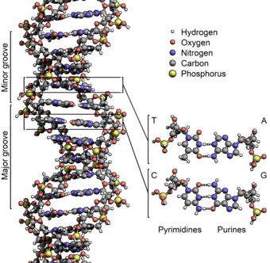
Nitrogen (and specifically nitrate) gets the most attention, at least classically…
Nitrogen
  Nitrogen is a fundamental constituent of proteins, nucleic acids, enzymes, cofactors.

Slide 12
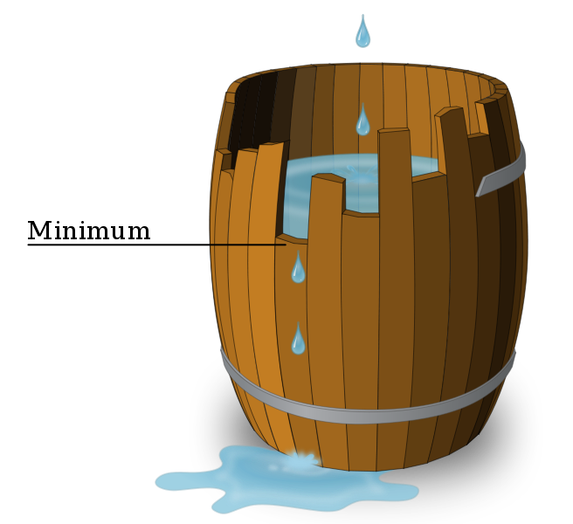
Nitrogen (and specifically nitrate) gets the most attention, at least classically…
Nitrogen
  Nitrogen is a fundamental constituent of proteins, nucleic acids, enzymes, cofactors.
  Nitrogen limits phytoplankton growth in much of the ocean (rate of demand often exceeds rate of supply).
Growth is controlled not by the total amount of resources available, but by the scarcest resource.
Further, it is not the amount of a resource that needs to be considered, but rather the demand relative to the supply.

Slide 13
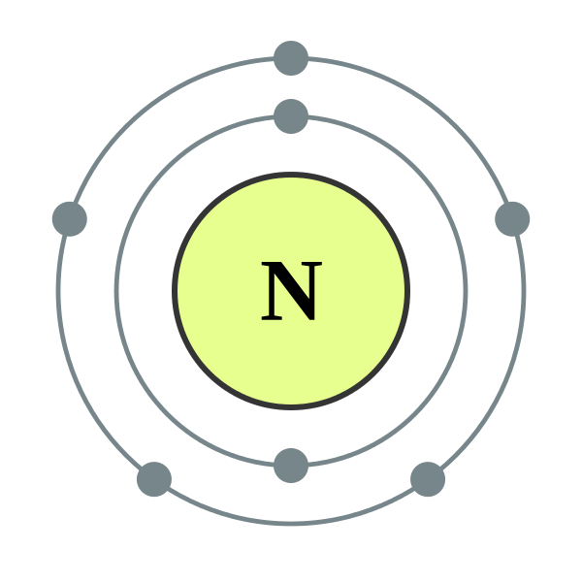
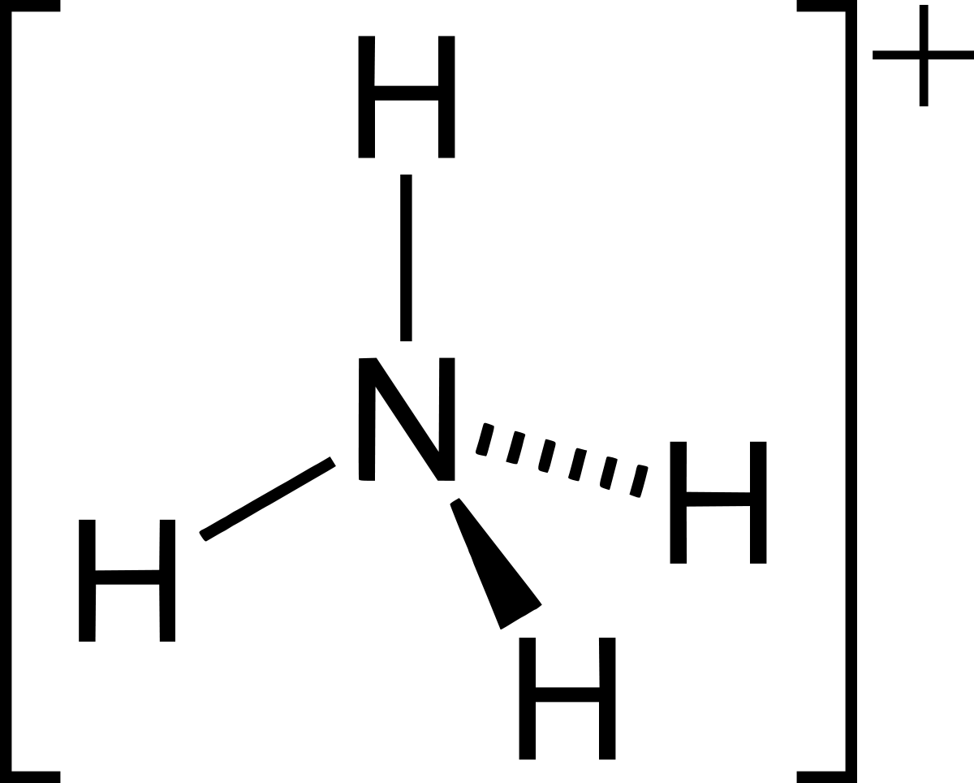
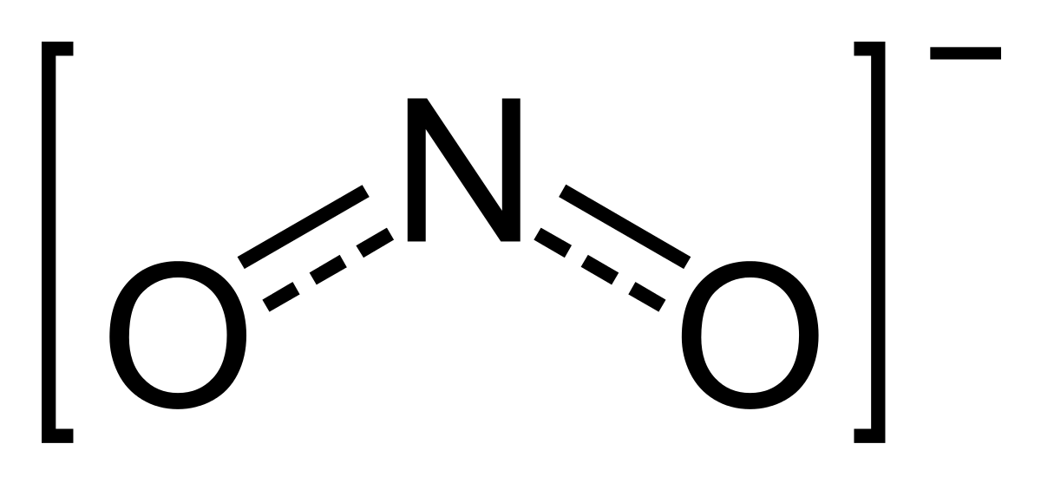
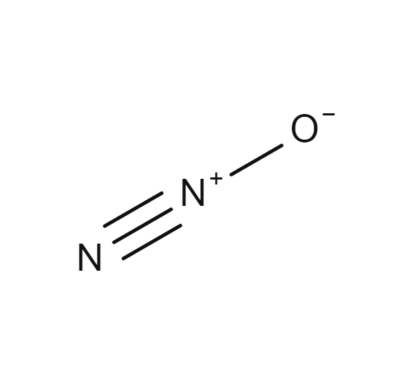
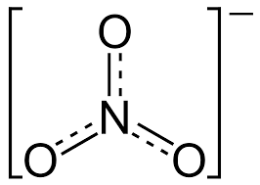
Nitrogen (and specifically nitrate) gets the most attention, at least classically…
Nitrogen
  Nitrogen is a fundamental constituent of proteins, nucleic acids, enzymes, cofactors.
  Nitrogen limits phytoplankton growth in much of the ocean (rate of demand often exceeds rate of supply).
  Phytoplankton grow mainly on nitrate and ammonium (ammonium is energetically favored, but most have the capacity to take up nitrate as well).

Slide 14
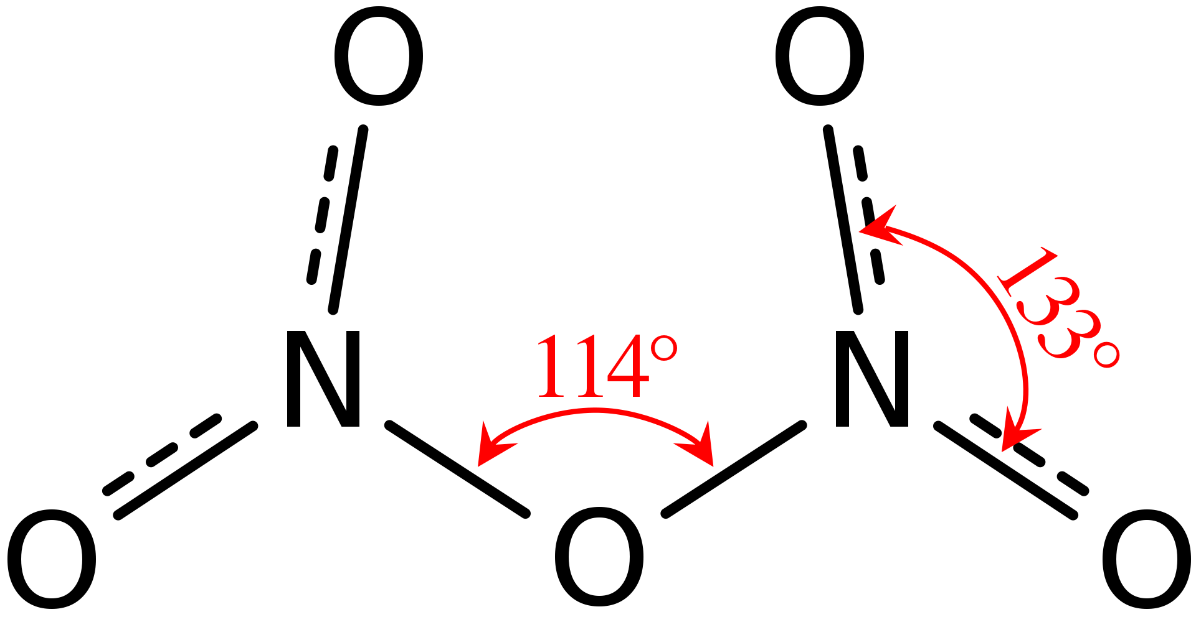
Nitrogen (and specifically nitrate) gets the most attention, at least classically…
Nitrogen
  Nitrogen is a fundamental constituent of proteins, nucleic acids, enzymes, cofactors.
  Nitrogen limits phytoplankton growth in much of the ocean (rate of demand often exceeds rate of supply).
  Phytoplankton grow mainly on nitrate and ammonium (ammonium is energetically favored, but most have the capacity to take up nitrate as well).
  Some bacteria are capable of fixing N₂ gas from the atmosphere or ocean (abundant).

Slide 15
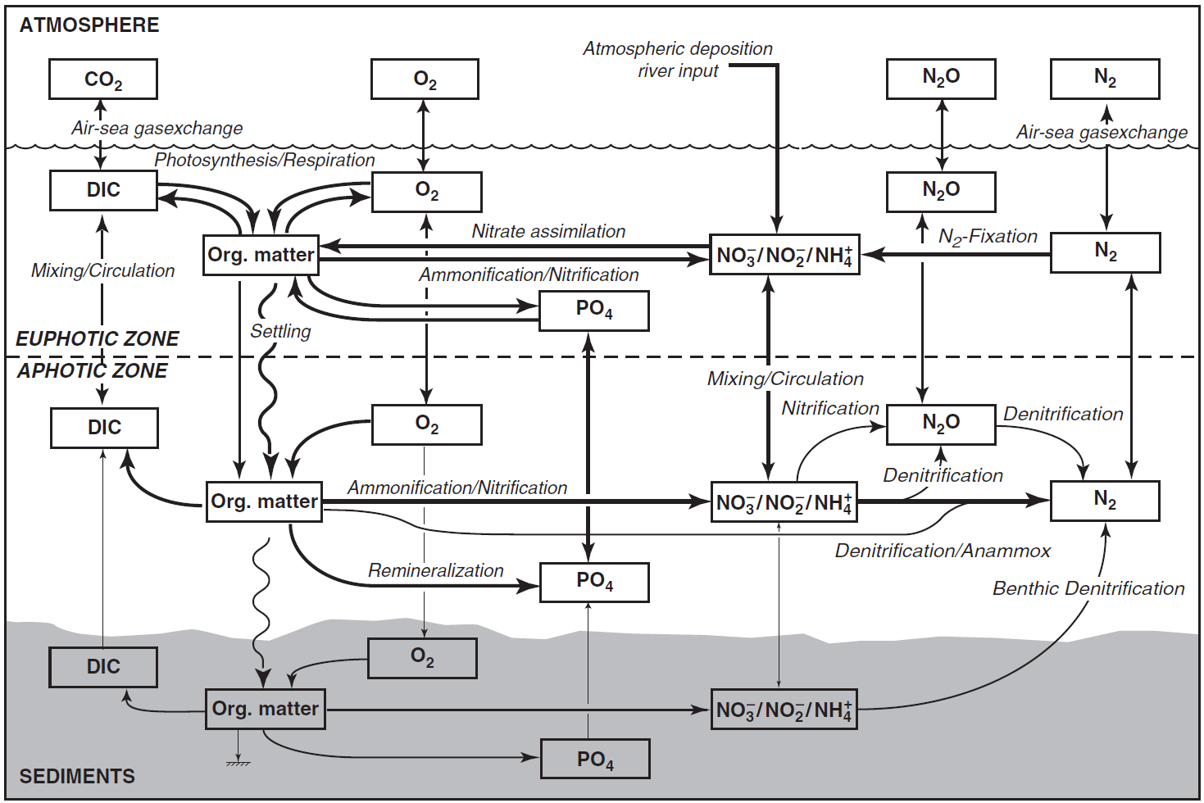
Nitrogen (and specifically nitrate) gets the most attention, at least classically…
Schematic of the marine nitrogen cycle and its coupling to the marine cycles of oxygen, phosphorus, and carbon.
Gruber (2008)

Slide 16
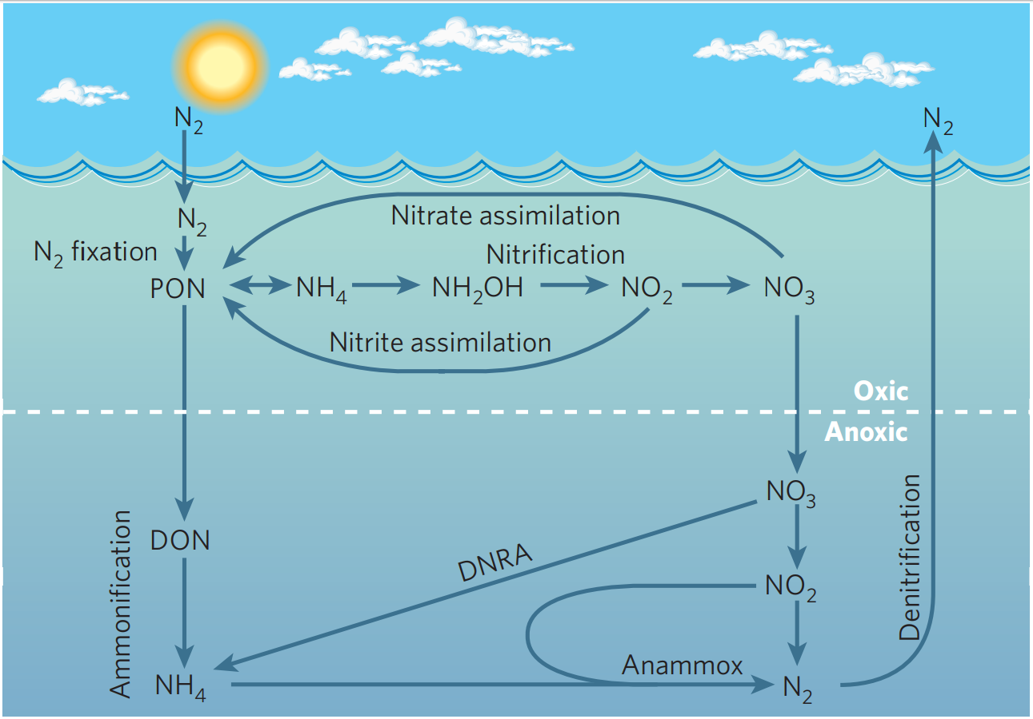
Nitrogen (and specifically nitrate) gets the most attention, at least classically…
Arrigo (2005)

Slide 17
Photosynthesis and respiration govern stoichiometric relationships in the ocean
The transformation of macronutrients and organic matter is governed by the processes of photosynthesis and respiration. This provides a stoichiometric formula for the average macronutrient composition of phytoplankton organic matter in the ocean:
106 CO₂ + 16 HNO₃ + H₃PO₄ + 78 H₂O
C₁₀₆H₁₇₅O₄₂N₁₆P + 150 O₂
Photosynthesis
Respiration
Photosynthesis uses inorganic molecules (CO₂ and nutrients) to build organic matter using energy from the sun.
Respiration (or “remineralization”) breaks down this organic matter to create energy while returning the nutrients and CO₂ to their inorganic forms.

Slide 18
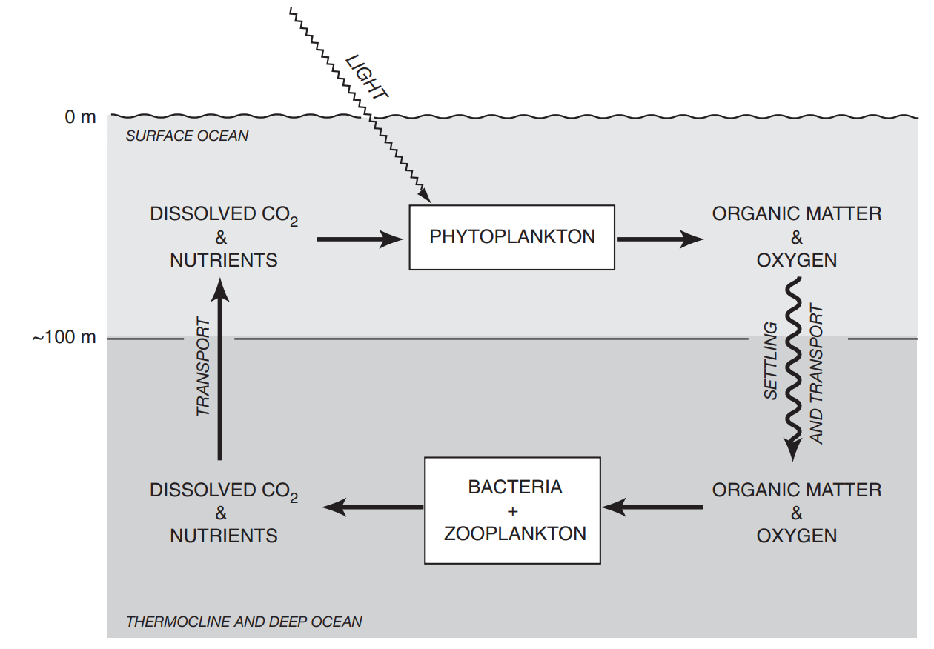
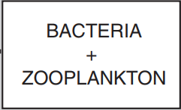
This can be further generalized…
The primary chemical consequence of photosynthesis is the conversion of inorganic nutrients and carbon in the surface ocean into organic material.
Most of this organic matter is respired within the surface mixed layer.
A small fraction is transported to the deep via sinking (known as the “biological pump”).
euphotic
aphotic
Sarmiento & Gruber (2006)

Slide 19
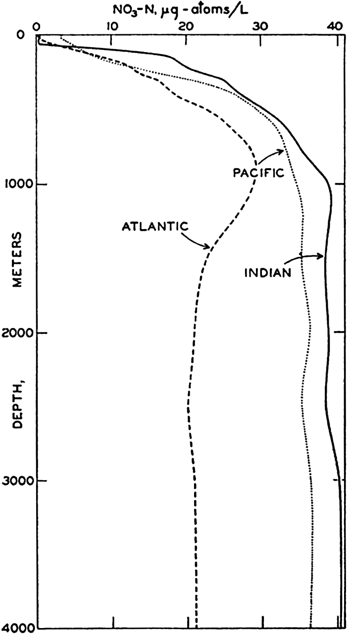
What I understand boils down to these three statements…
Just a handful of factors can explain the large-scale horizontal and vertical distributions of macronutrients…
Phytoplankton take in nutrients and CO₂ when light is abundant.
Organic matter sinks (with rates dependent on size, composition, aggregation, and repackaging).
Heterotrophs (bacteria and zooplankton) remineralize organic matter back into the inorganic nutrients and CO₂.
Consequently, surface nutrients are near zero just about everywhere that light is available. Eastern Boundary Upwelling Systems are exceptional with their combination of relatively abundant nutrients and light!
Sverdrup et al. (1942)

Slide 20
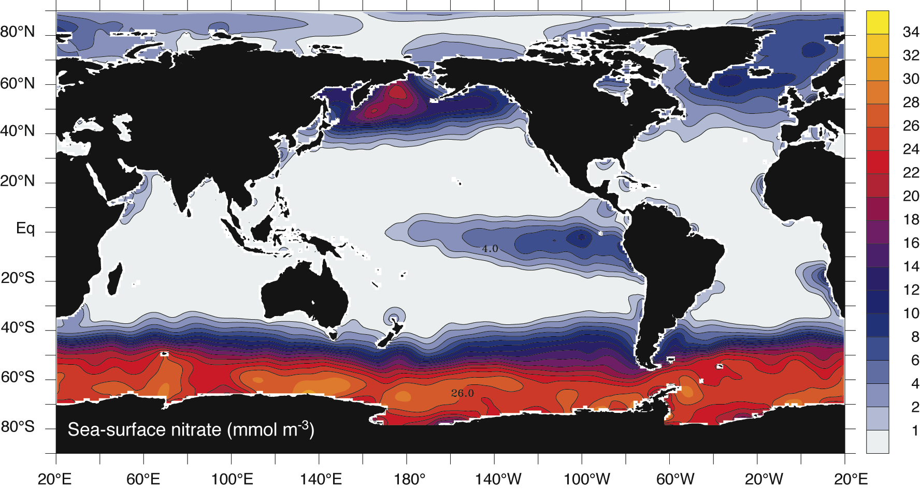
Surface nitrate distribution
The biological pump depletes macronutrients over all the subtropical gyres (most of the ocean!). Only areas of strong upwelling and deep mixing (or light limitation) have surface nitrate.
Sarmiento & Gruber (2006)

Slide 21
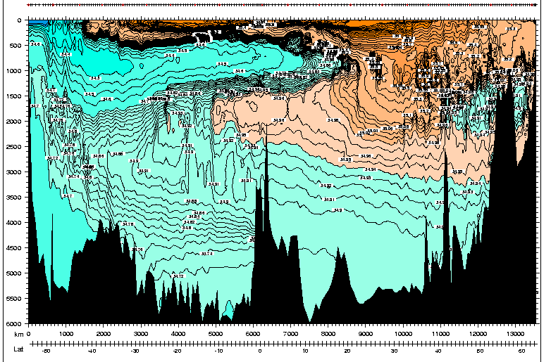
Meridional Cross Section of the Atlantic – 25 W
Antarctic Intermediate Water
North Atlantic Deep Water
Antarctic Bottom Water
60°S
Equator
60°N

Slide 22
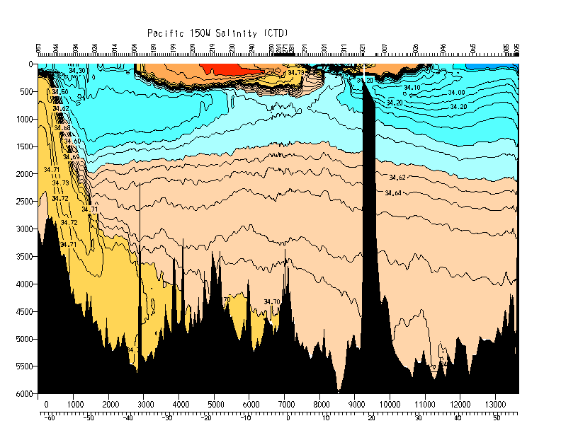
Meridional Cross Section of the Pacific
Antarctic Intermediate
Water
North Pacific Intermediate
Water
North Pacific Deep Water
Antarctic Bottom Water
60°S
Equator
50°N

Slide 23
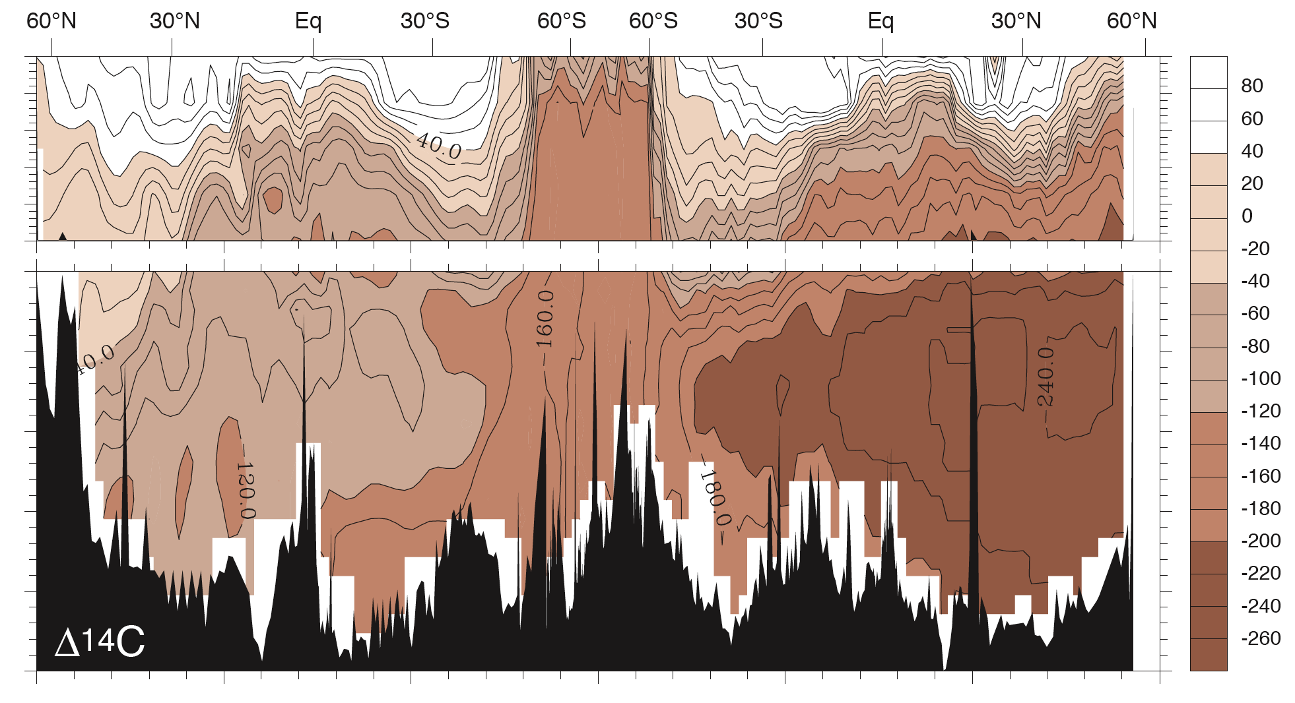
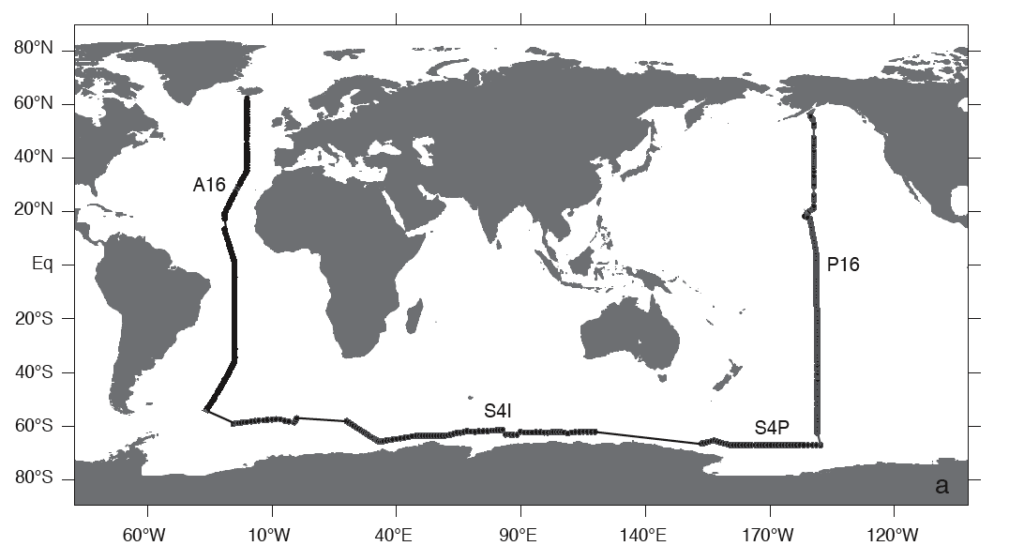
Interbasin differences in subsurface biogeochemistry are associated with the THC
Atlantic
Pacific

Slide 24
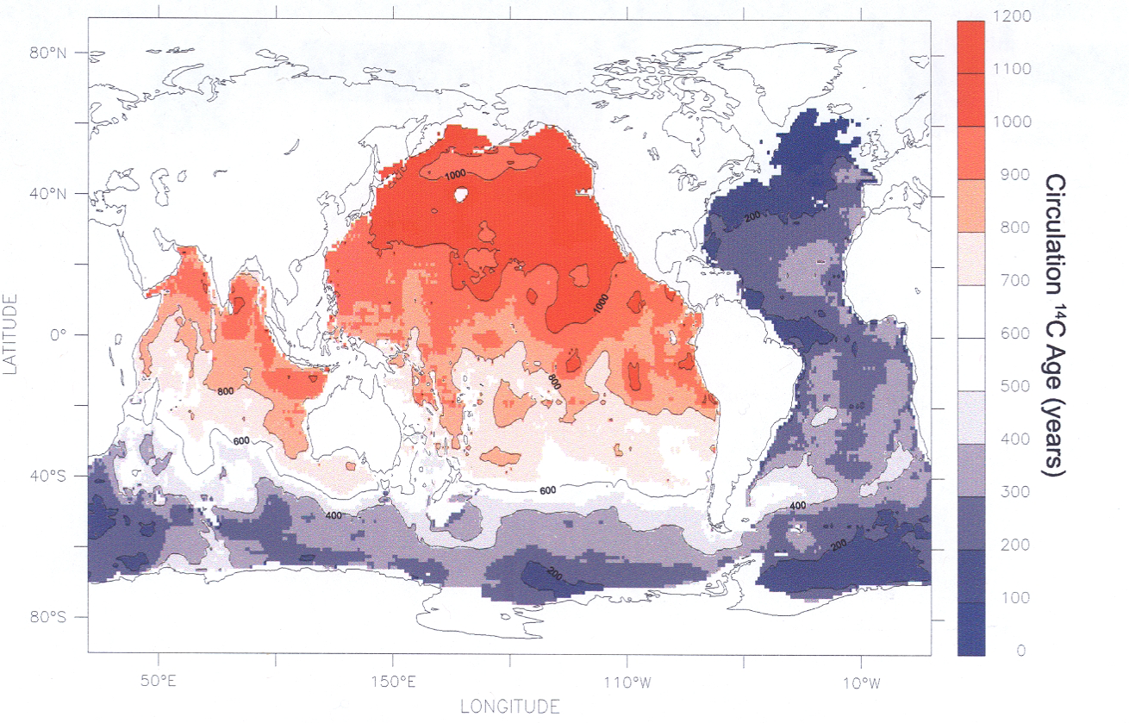
Interbasin differences in subsurface biogeochemistry are associated with the THC
<200 years
>1000 years
<200 years
Matsumoto (2007)

Slide 25
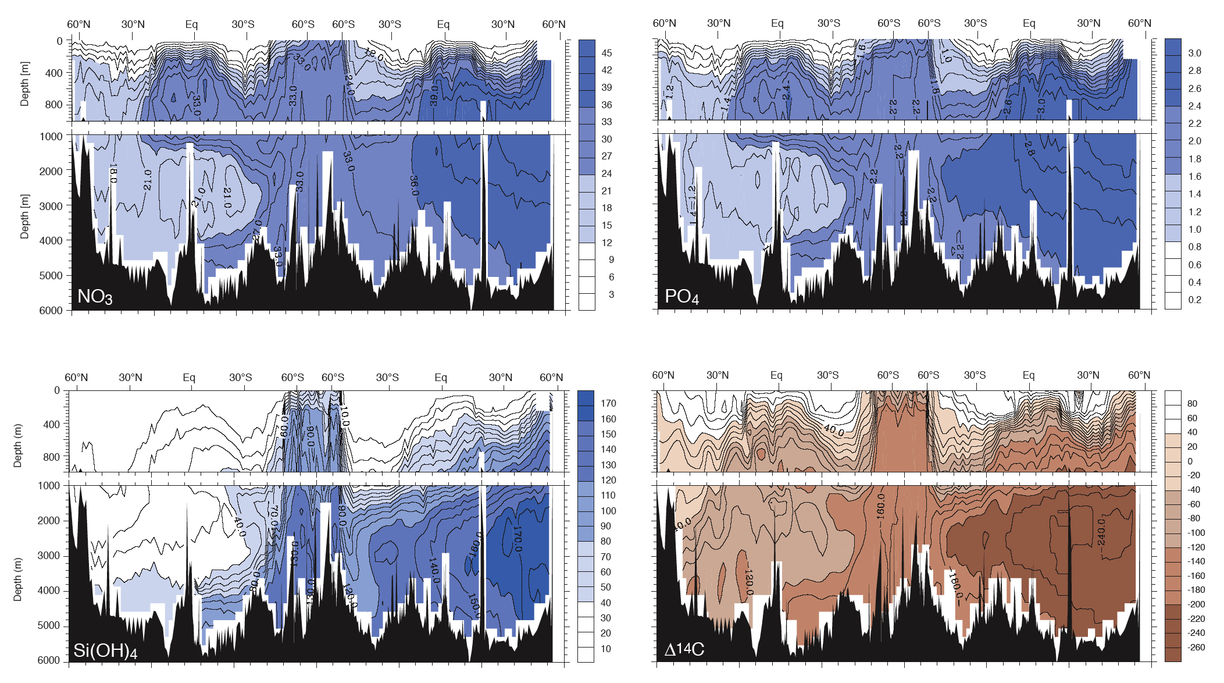
The deep Pacific has greater nutrient concentrations and lower oxygen concentrations than the Atlantic
Atlantic
Southern
Pacific

Slide 26
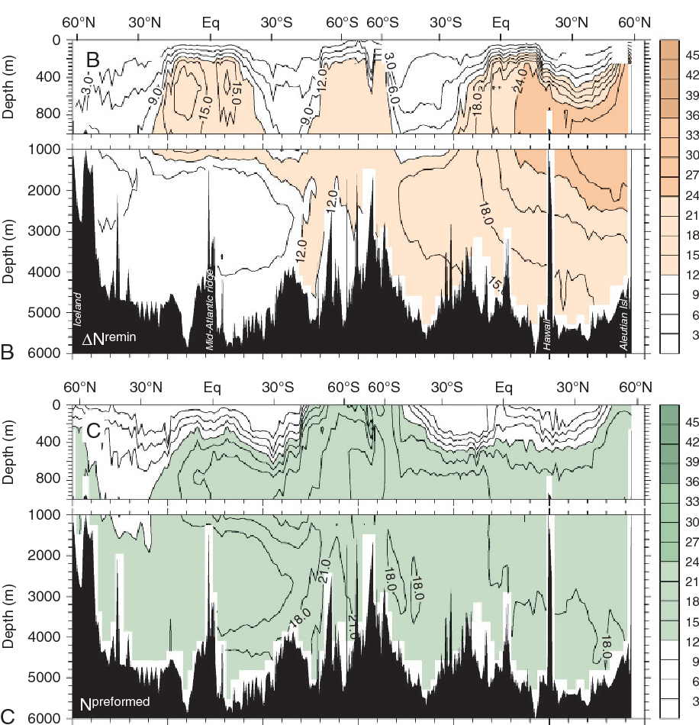
Subsurface nitrate concentrations can be fractioned into:
a remineralized portion
and
a preformed portion
using apparent oxygen utilization.

Slide 27
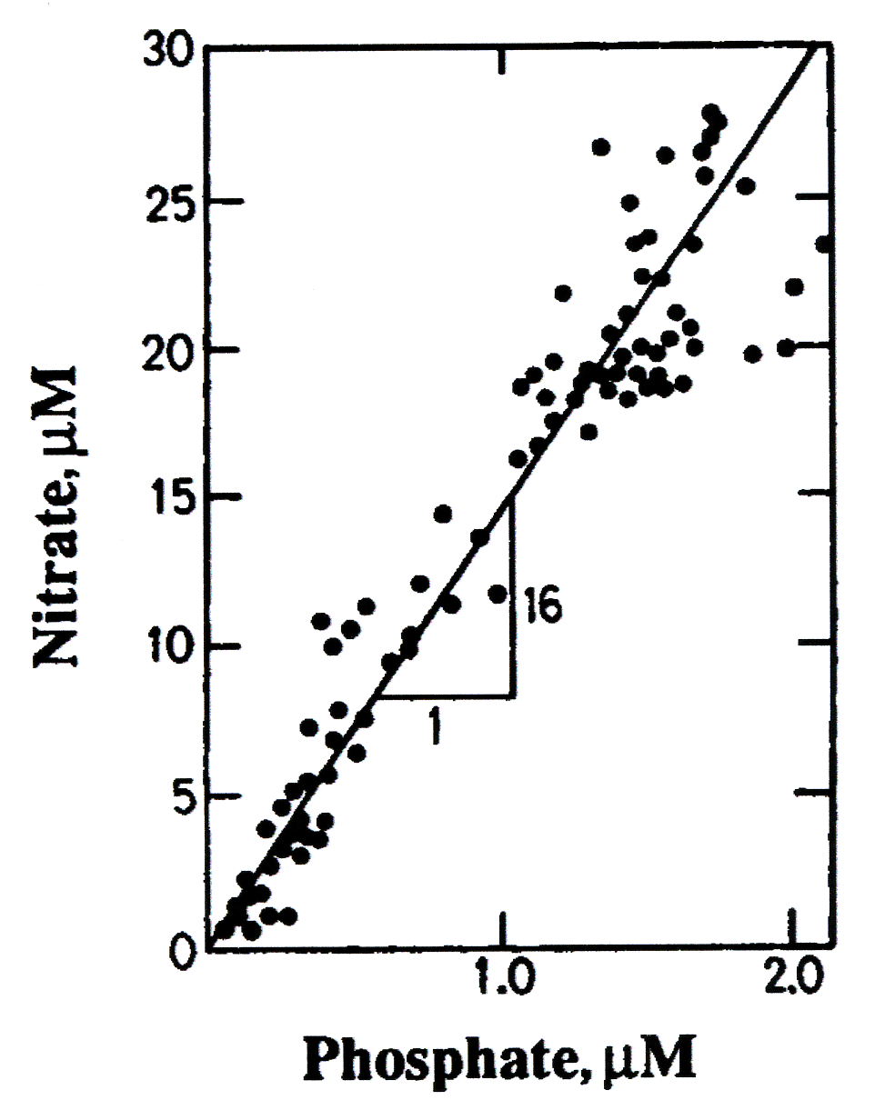
The deep Pacific has greater nutrient concentrations and lower oxygen concentrations than the Atlantic
Coupling of carbon, nitrogen, phosphorous, and oxygen through photosynthesis and respiration acts to maintain changes in macronutrient concentrations near the Redfield ratio.
106 CO₂ + 16 HNO₃ + H₃PO₄ + 78 H₂O
C₁₀₆H₁₇₅O₄₂N₁₆P + 150 O₂
Redfield (1958)
106: 16 : 1 : -150
C : N : P : O

Slide 28
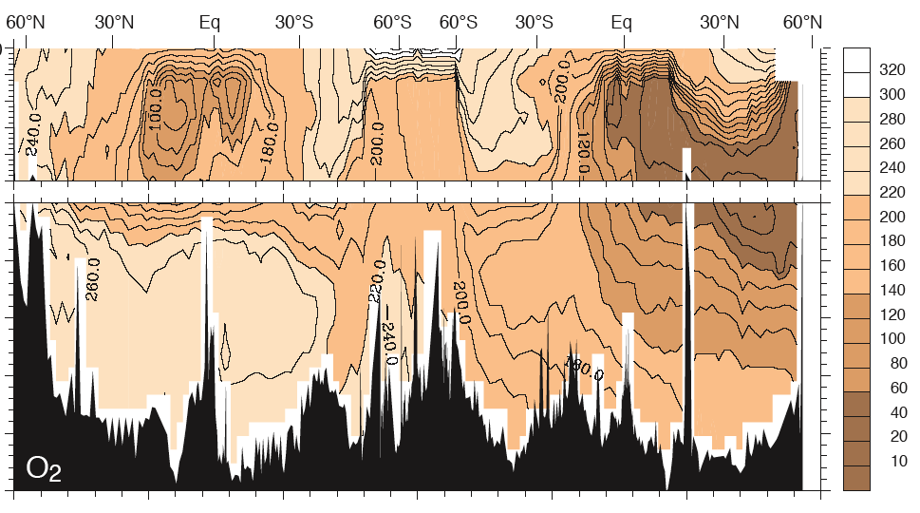
Atlantic
Southern
Pacific
Atlantic
Southern
Pacific

Slide 29
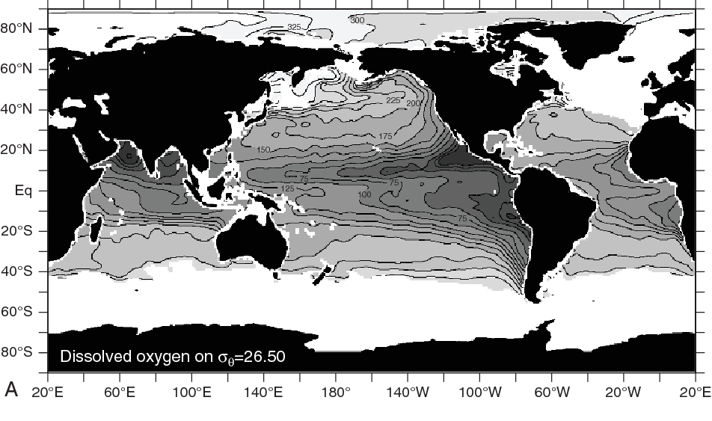

Slide 30
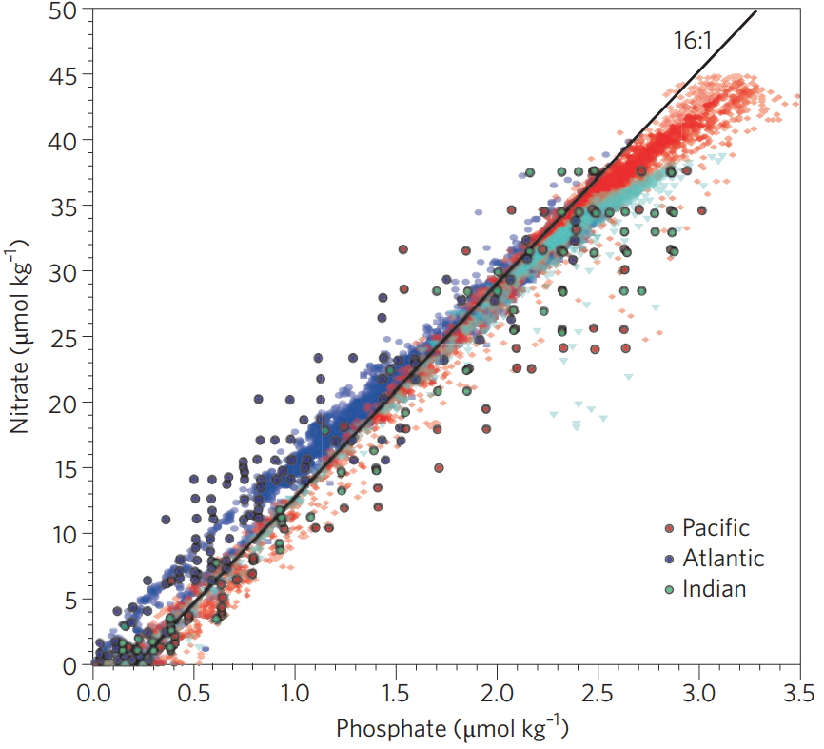
Denitrification in the Pacific removes NO₃ from the system (relative to PO₄)
The Redfield Ratio and displacement off the regular 16:1 line can tell us something about the processes that are occurring in a region…
A better way to look at this deviation from the 16:1 relationship is called N*.
Gruber and Deutsch (2014)
Nitrogen fixation in the Atlantic adds NO₃ to the system (relative to PO₄)

Slide 31
N*, a synthetic tracer that illustrates the biological processes that are influencing the nitrogen cycle
N* = ([NO₃] – 16 * [PO₄] + 2.9) * 0.85
Note: That 2.9 accounts for residual surface concentrations of phosphate. The 0.85 accounts for the fact that denitrification uses the N in dissolved NO₃ in the water column, but also the N in the organic matter.
Q: If we want to predict what this N* looks like globally, what do we need to know?
A: Areas of denitrification and nitrogen fixation.
And those are dependent on?
Areas of low oxygen (which is the result of high remineralization).
And areas where you have some Fe at the surface.
Gruber & Sarmiento (1997)

Slide 32
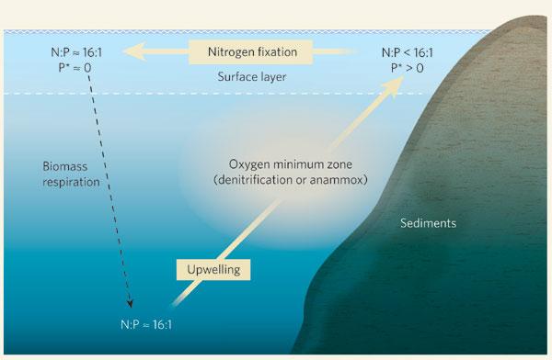
N* processes on a simple plot
N* ≈ 0
N* is increasing back towards 0
N* < 0
N* ≈ 0

Slide 33
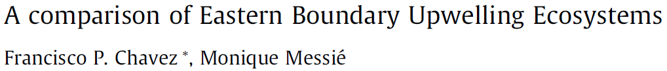
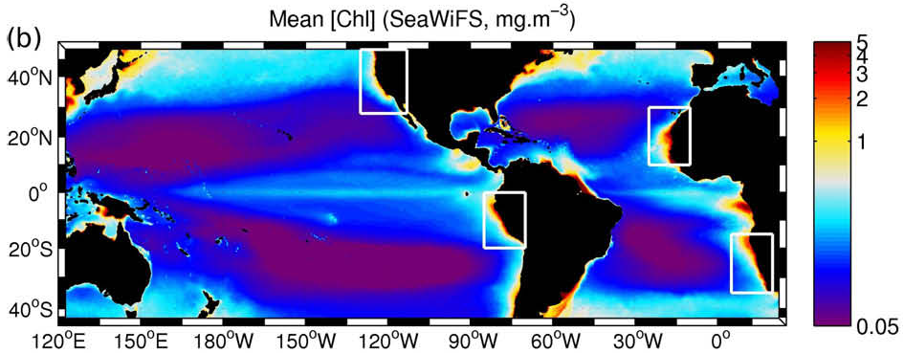
Chavez and Messié (2009)

Slide 34
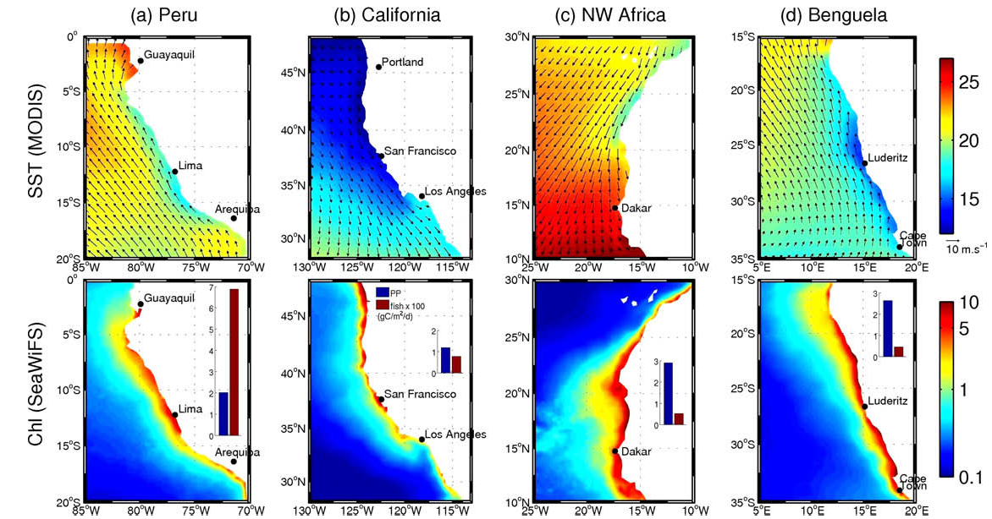
Chavez and Messié (2009)

Slide 35
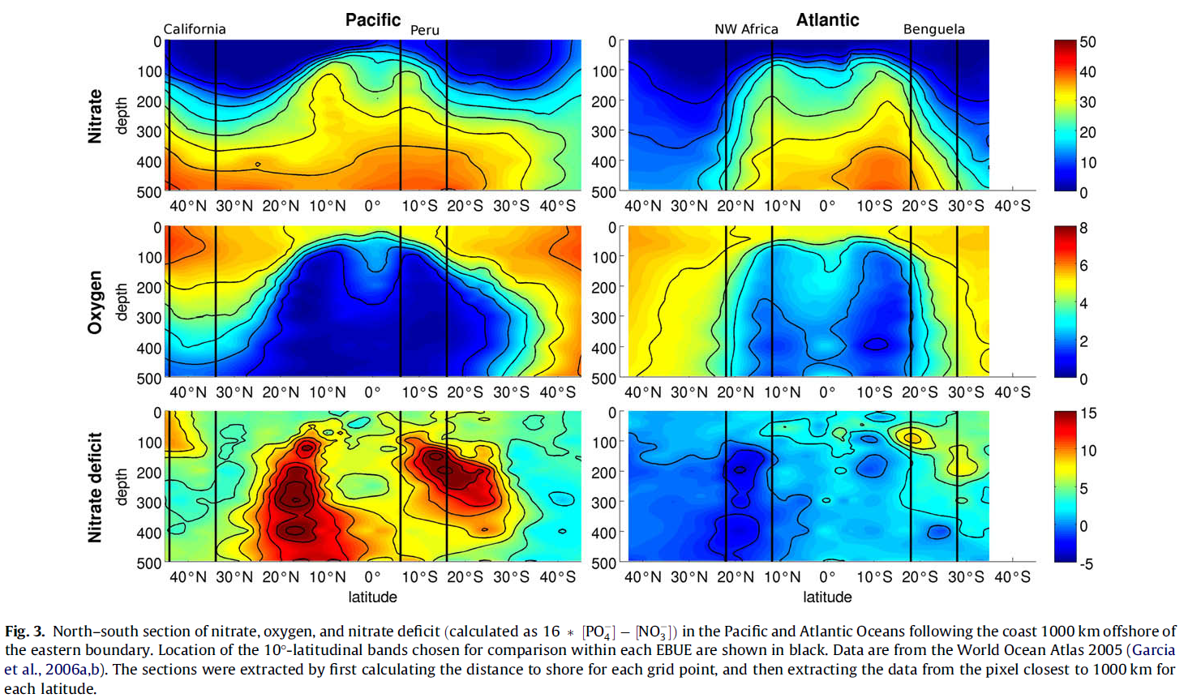
Chavez and Messié (2009)

Slide 36
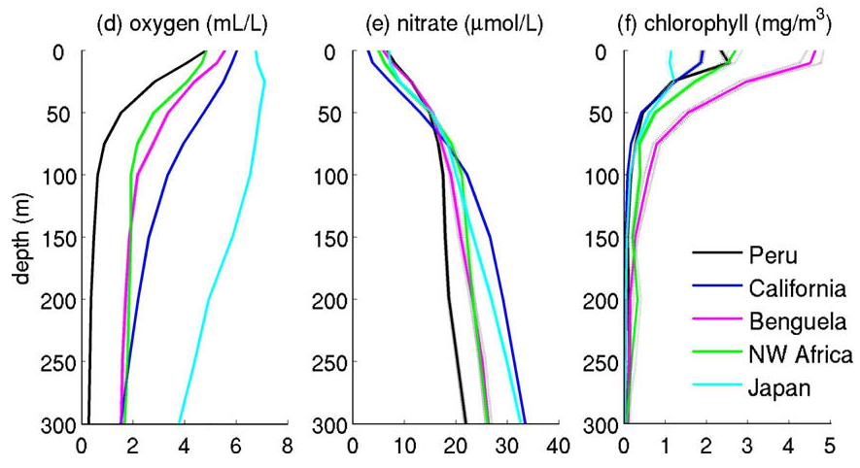
Chavez and Messié (2009)

Slide 37
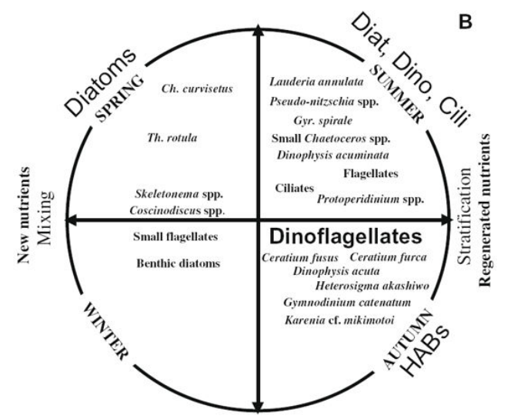
What are the implications of nutrient supply for plankton communities?
Phytoplankton are taxonomically diverse, with adaptations and acclimation abilities to take advantage of changing nutrient and light availability, mixing, predation, and buoyancy.
These factors vary at the event, seasonal, and intrannual time scales.
Perhaps one of the most popular strategies to simplify the complexity of planktonic ecosystems is to organize trophic interactions by size.
Figueiras et al. (2002)

Slide 38
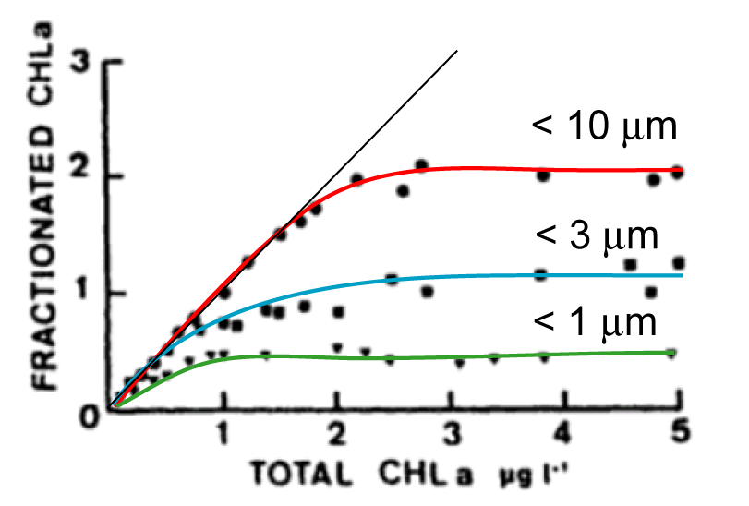
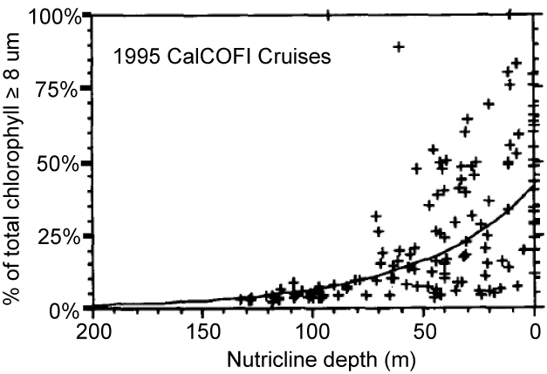
The great the availability of nutrients, the larger the phytoplankton
Nutrient demand by phytoplankters is a function of their volume, while supply depends on their surface area. Hence, larger cells are competitive only when nutrient availability is not the factor limiting growth.
Raimbault et al.
(1988)
Mullin (1998)
The contribution of large phytoplankters increases as nutrients and total chlorophyll increase. How do these changes affect higher trophic levels?

Slide 39



Conceptually, changes in the size structure of the phytoplankton influences the structure of the zooplankton assemblage
There is evidence of optimal predator-to-prey size ratios for broad categories of marine taxa.
Question:
Is such variation in zooplankter sizes evident across a trophic gradient in the California Current?

Slide 40


Oceanographic conditions during sampling cruises (spring 2006 and 2007)
oligotrophic
eutrophic
Rykaczewski (2019)

Slide 41



Oceanographic conditions during sampling cruises (spring 2006 and 2007)
dry-weight analysis

Slide 42




Oceanographic conditions during sampling cruises (spring 2006 and 2007)
dry-weight analysis
Zooscan analysis

Slide 43


Phytoplankter sizes
Phytoplankter sizes:
A more negative slope indicates a greater contribution of small individuals relative to larger individuals.
Rykaczewski (2019)

Slide 44

Zooplankter sizes
Zooplankter sizes:
A more negative slope indicates a greater contribution of small individuals relative to larger individuals.
Rykaczewski (2019)

Slide 45

Comparison of phytoplankton and zooplankton sizes
Zooplankter sizes increase with increases in phytoplankter sizes.
Sizes are smaller offshore where nutrient supply and concentration are reduced.
r = 0.66
p < 0.05
Rykaczewski (2019)

Slide 46






Wind-driven upwelling processes and the food web
curl-driven upwelling
coastal upwelling
+
Fe
Fe
Fe
Fe
sardine
anchovy
= macronutrients
Rykaczewski and Checkley (2008)
Notes:
Different rates of nutrient supply lead to the production of different size classes of plankton… Show Figure 1, now including the coastal plankton, then anchovy… then including offshore plankton and sardine

Slide 47
Summary
When considering changes in the biogeochemistry of EBUS, at least four factors ought to be considered
What are the contributions of different source waters to the region, and do they vary?
What are the properties of those source waters, and might they be expected to change over time (preformed nutrients, remineralized nutrients, ventilation history)?
What local processes can influence the efficacy of upwelling (density stratification, shifts in location of upwelling cells, changes in winds and their variability, nutrient or freshwater runoff)?
What local biological processes might affect the biogeochemistry (changes in export and remineralization, shifts in species distribution, HABs)?

Slide 48


