Slide 1

Strategies for GW Science above 1GHz
Mike Cruise

Slide 2
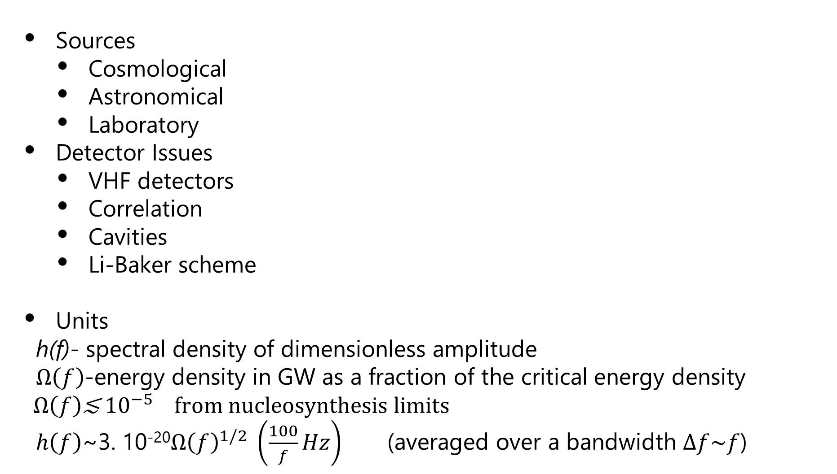
Overview
Sources
  Cosmological
  Astronomical
  Laboratory
Detector Issues
  VHF detectors
  Correlation
  Cavities
  Li-Baker scheme
Units
h(f)- spectral density of dimensionless amplitude
$Ω\left(f\right)$-energy density in GW as a fraction of the critical energy density
$Ω\left(f\right)$≲ ${10}^{−5}$from nucleosynthesis limits
$h\left(f\right)$~3. 10⁻²⁰${Ω\left(f\right)}^{1/2} \left(\frac{100}{f}Hz\right)$ (averaged over a bandwidth $∆f\sim f$)

Slide 3
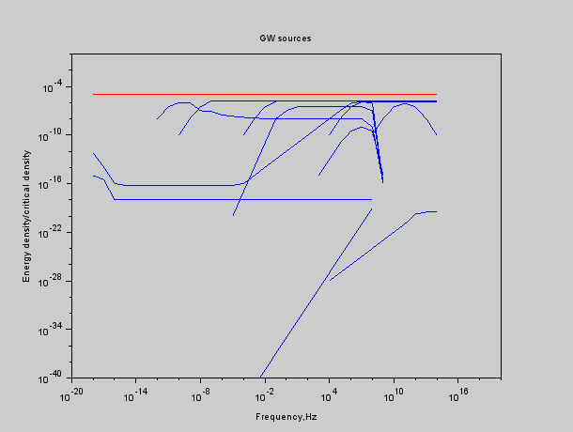
Cosmology at High Frequencies in Ω

Slide 4
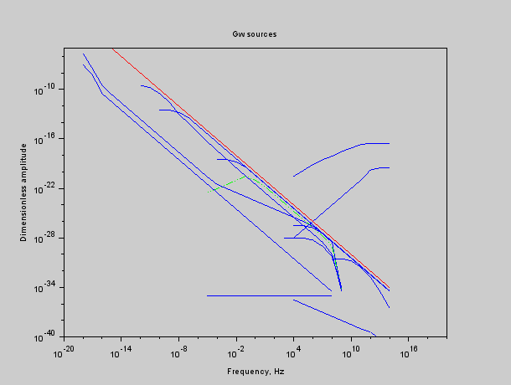
Cosmology at High Frequencies in h

Slide 5
Sources- Philosophy
These are inevitably speculative at this moment because:
  Objects naturally emit radiation efficiently when the wavelength is ~ the same size as the emitter
  For frequencies above 1GHz this means objects of a few cm in size or less
  Such objects would have limited gravitational energy if they are to be found amongst classical astronomical objects
HOWEVER
  We don’t know everything that exists
  We don’t understand why gravity is so weak
  We may use VHF GW upper limits to discount new, proposed particles, fields, etc.

Slide 6
Source Characteristics
Different sources waveforms may need different detectors.
  Monochromatic sources
    Transient sources
    Transient sources with prior warning
    Long lasting
    With frequency known a priori
    With frequency unknown until observation
  Stochastic sources
    But you can’t switch them off!
    They are very similar to thermal noise

Slide 7
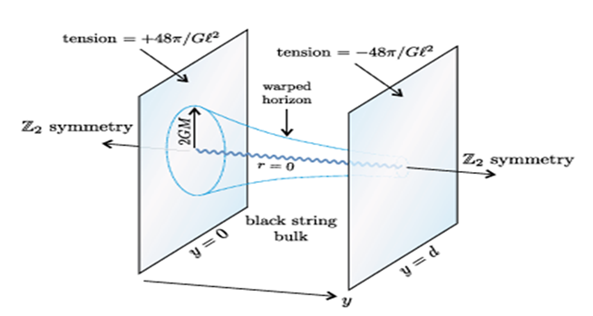

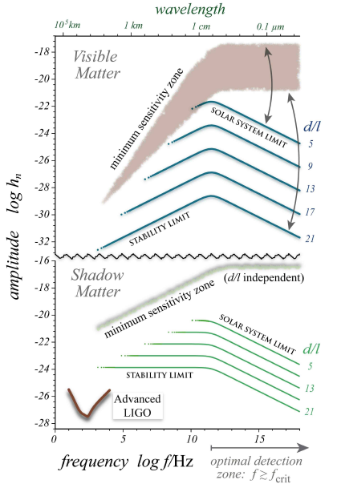
Higher Dimensional Gravity
Clarkson and Seahra 2007, CQG

Slide 8
Primordial Black Holes
Dolgov and Ejlli 1105.2303

Slide 9
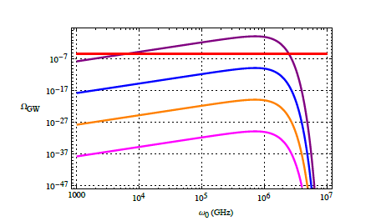
Gravitational Atoms
Nielsen, Palessandro and Sloth 1903.1216

Slide 10
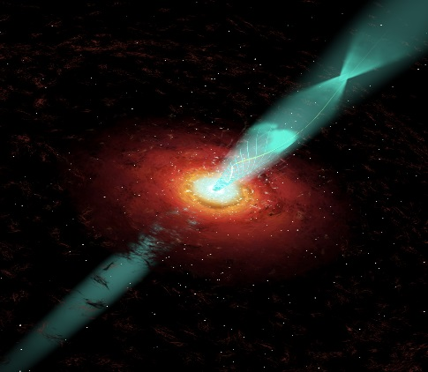
Plasma-EMW instabilities
Increased charge density contributes to stress energy tensor
Tidal forces affect charge
density
Servin and Brodin
Phys Rev 2003

Slide 11
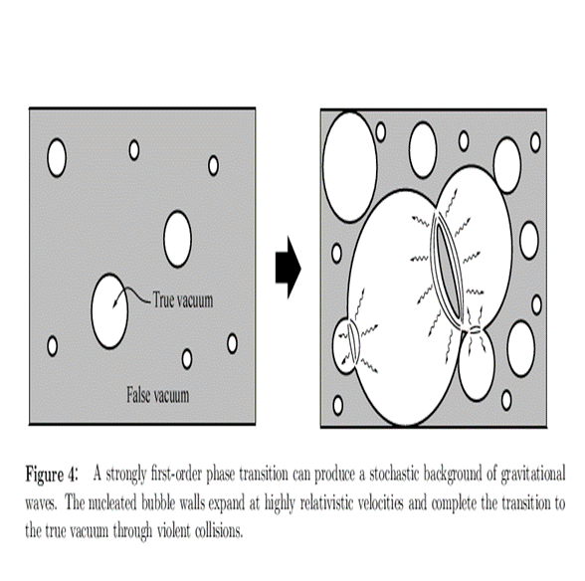
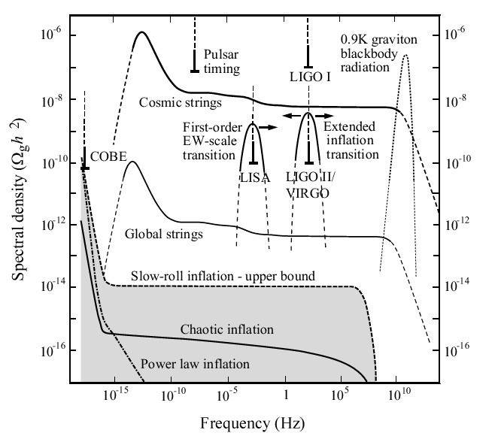
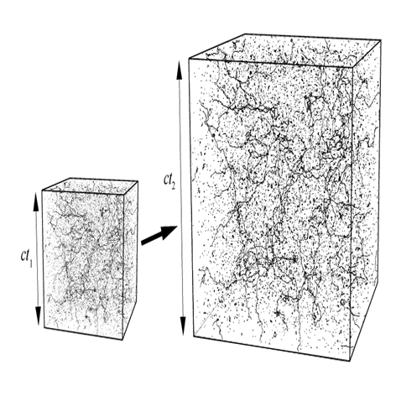
Cosmological Processes
Many, many , many

Slide 12
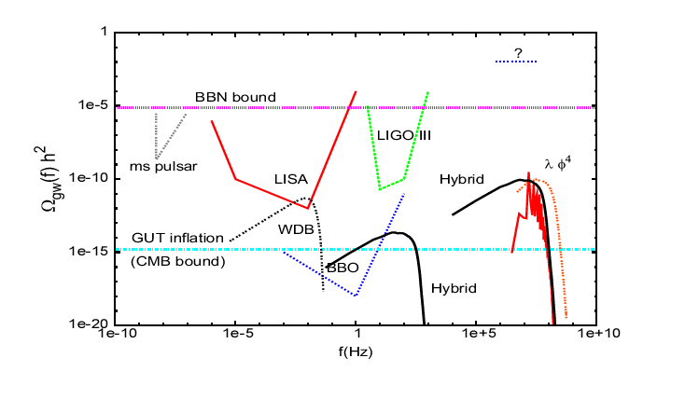
Different forms of inflation
Garcia-Bellido and Figueroa, Phys Rev Letts 2007

Slide 13
Cosmology at High Frequencies in h

Slide 14
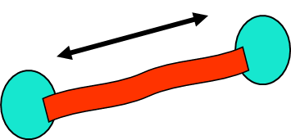
Laboratory sources
GW losses in from quadrupole systems go as ω^{6,} hence interest in the move to high ω.
High ω means small size of oscillator
Small size means dense packing of oscillators is possible
Many oscillators means that coherent beaming is possible
See reviews by Grishuk, Rudenko et al
Assuming GR and conventional physics
results in P=10⁻¹⁸ W at ν=10¹⁰ Hz h~10⁻³⁶ ⁻ 10⁻³³

Slide 15

The power supply
note that Pin = 2.2 10¹⁰ watts

Slide 16
Detector Concepts

Slide 17
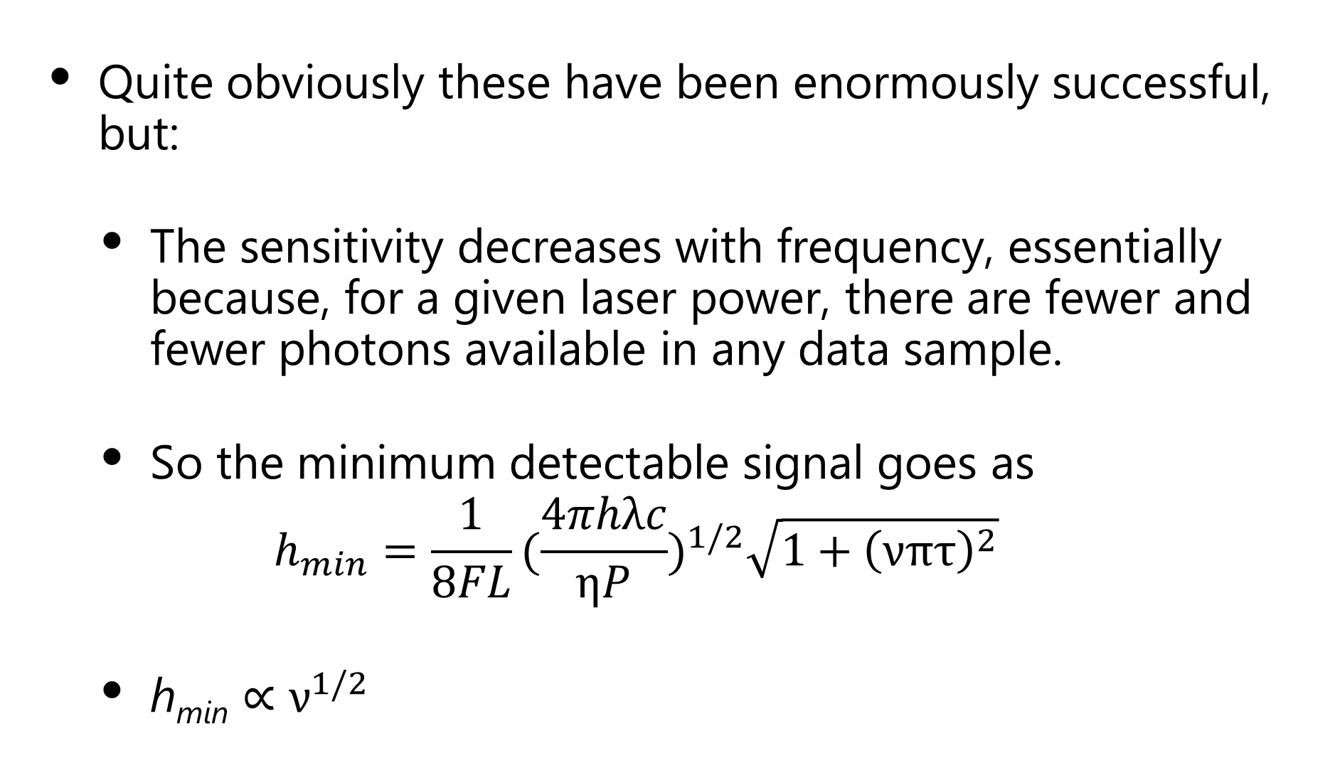
Laser Interferometers
Quite obviously these have been enormously successful, but:
  The sensitivity decreases with frequency, essentially because, for a given laser power, there are fewer and fewer photons available in any data sample.
  So the minimum detectable signal goes as
    $$h_{min}=\frac{1}{8FL}{(\frac{4πhλc}{ηP})}^{1/2}\sqrt{1+{\left(νπτ\right)}^{2}}$$
  h_{min} $∝ν^{1/2}$

Slide 18
Possibilities above 1 GHz
GW Effect on EMW Direction ( Fakir, Labeyrie & Bracco )
GW Effect on EMW Frequency ( Baierlein )
GW Effect on EMW Amplitude ( Zipoy )
GW Effect on Polarisation ( Cruise )
GW Resonant Effect on EMW Polarisation (Cruise )
Conversion of GW to EMW in static Magnetic Field ( Gershenstein )
Conversion of GW to EMW in static Electric Field
( Lupanov )
Bulk accoustic wave resonator ( Goryachev & Tobar )
Superconducting rings/Sagnac effect ( Anandan and Chiao )
Heterodyne amplification of magnetic conversion signals ( Li )

Slide 19
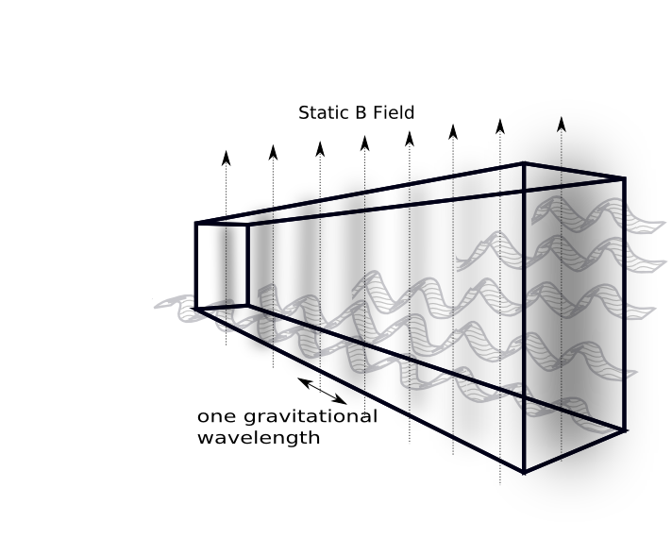
Magnetic Conversion
GW

Slide 20
How does a GW interact with a magnetic field?
Photon
Graviton
Transition rate For one incoming
graviton per second
Virtual Photon
( Static Magnetic Field )
Spin states of g, B and n
De Logi and Mickelson
Phys Rev D 1977
16, 2915
Cruise CQG
2012, 29, 095003

Slide 21
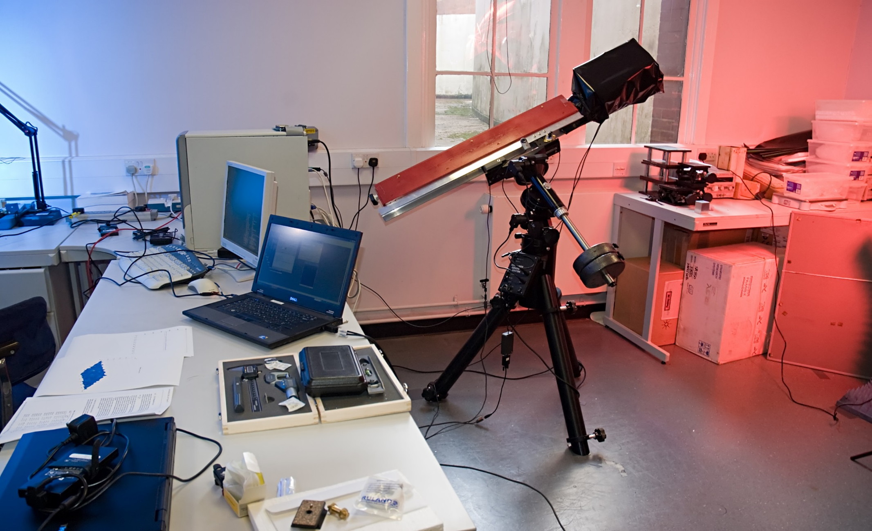
An Example

Slide 22
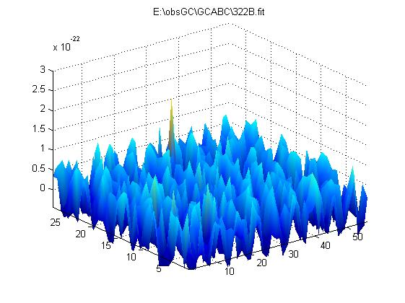
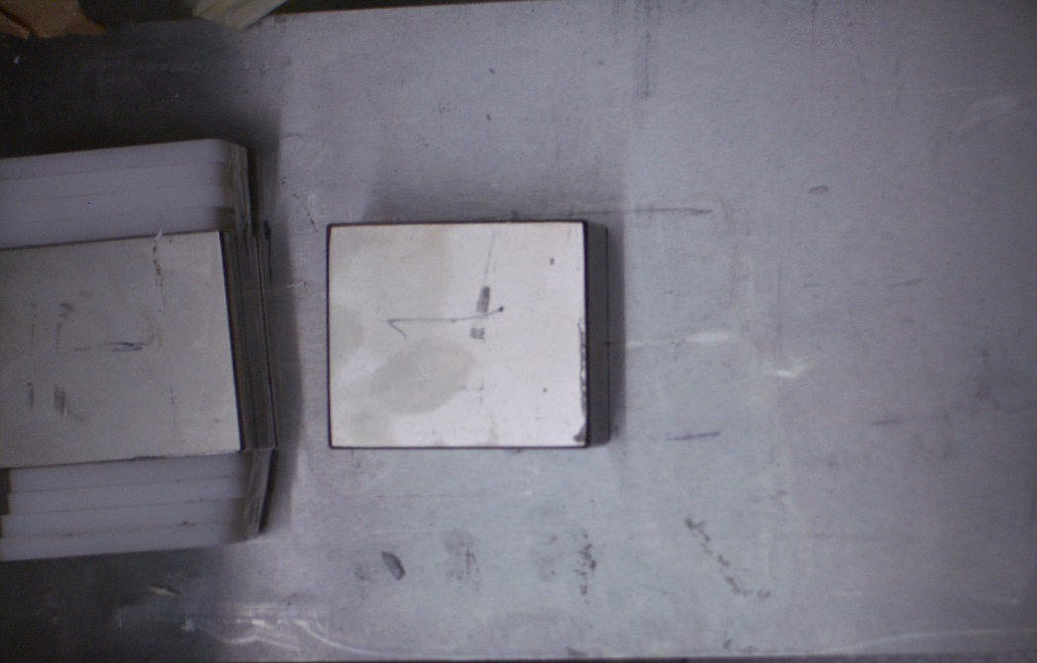
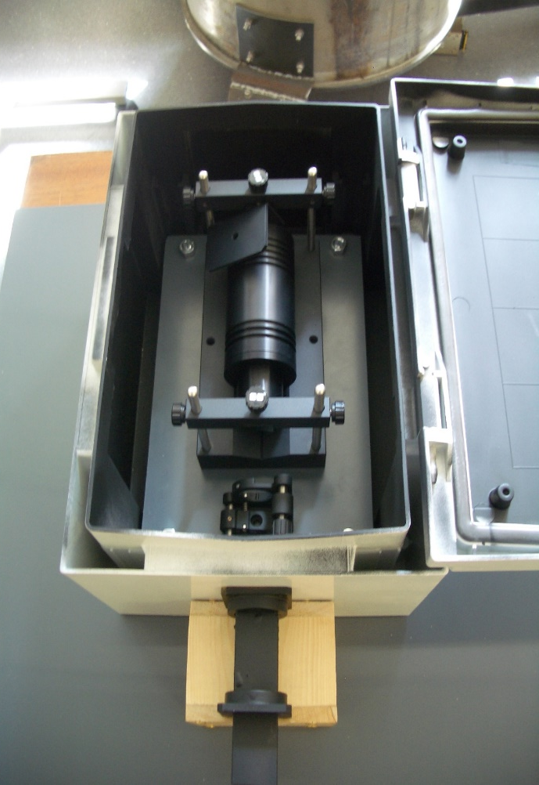

Slide 23
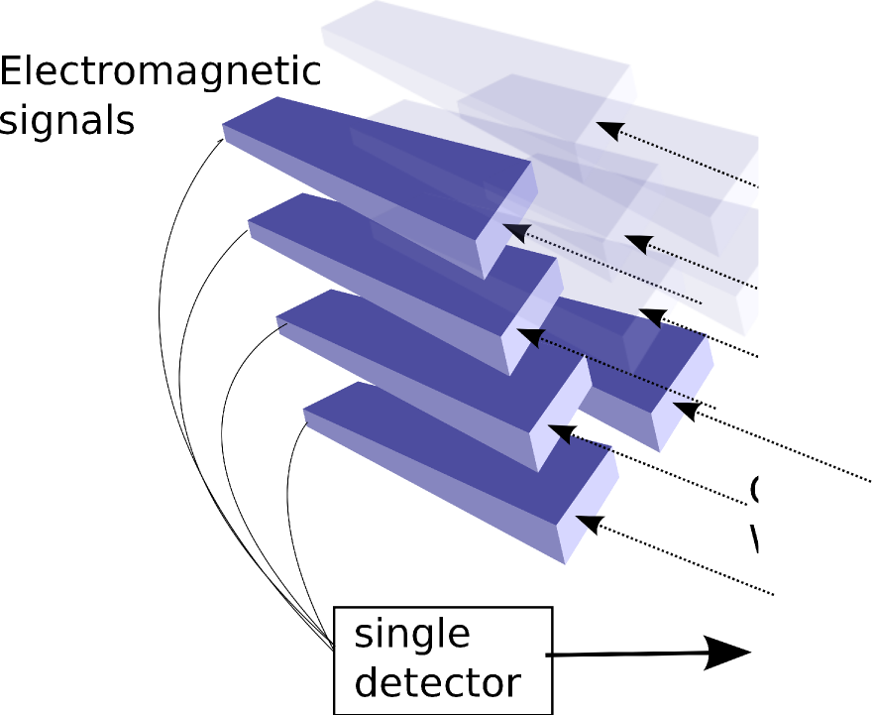
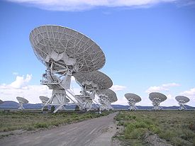
Futuristic Possibility

Slide 24
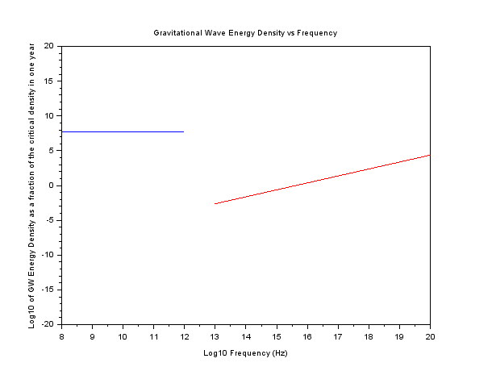
Best possible Magnetic Conversion detector: Ω
Specification
Length 100M, B Field 5.6 T
Detector noise:
Thermal up to 100microns
with T=100mK
Photon limited at higher frequency
with noise= 1 photon per Tobs
Tobs= 1year

Slide 25
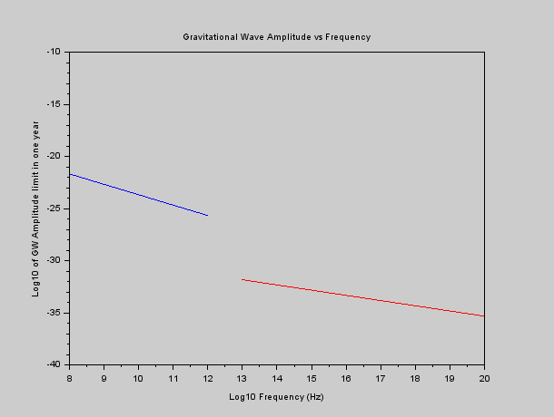
Best possible Magnetic Conversion detector: Amplitude
Specification
Length 100M, B Field 5.6 T
Detector noise:
Thermal up to 100microns
with T=100mK
Photon limited at higher frequency
with noise= 1 photon per Tobs
Tobs= 1year

Slide 26
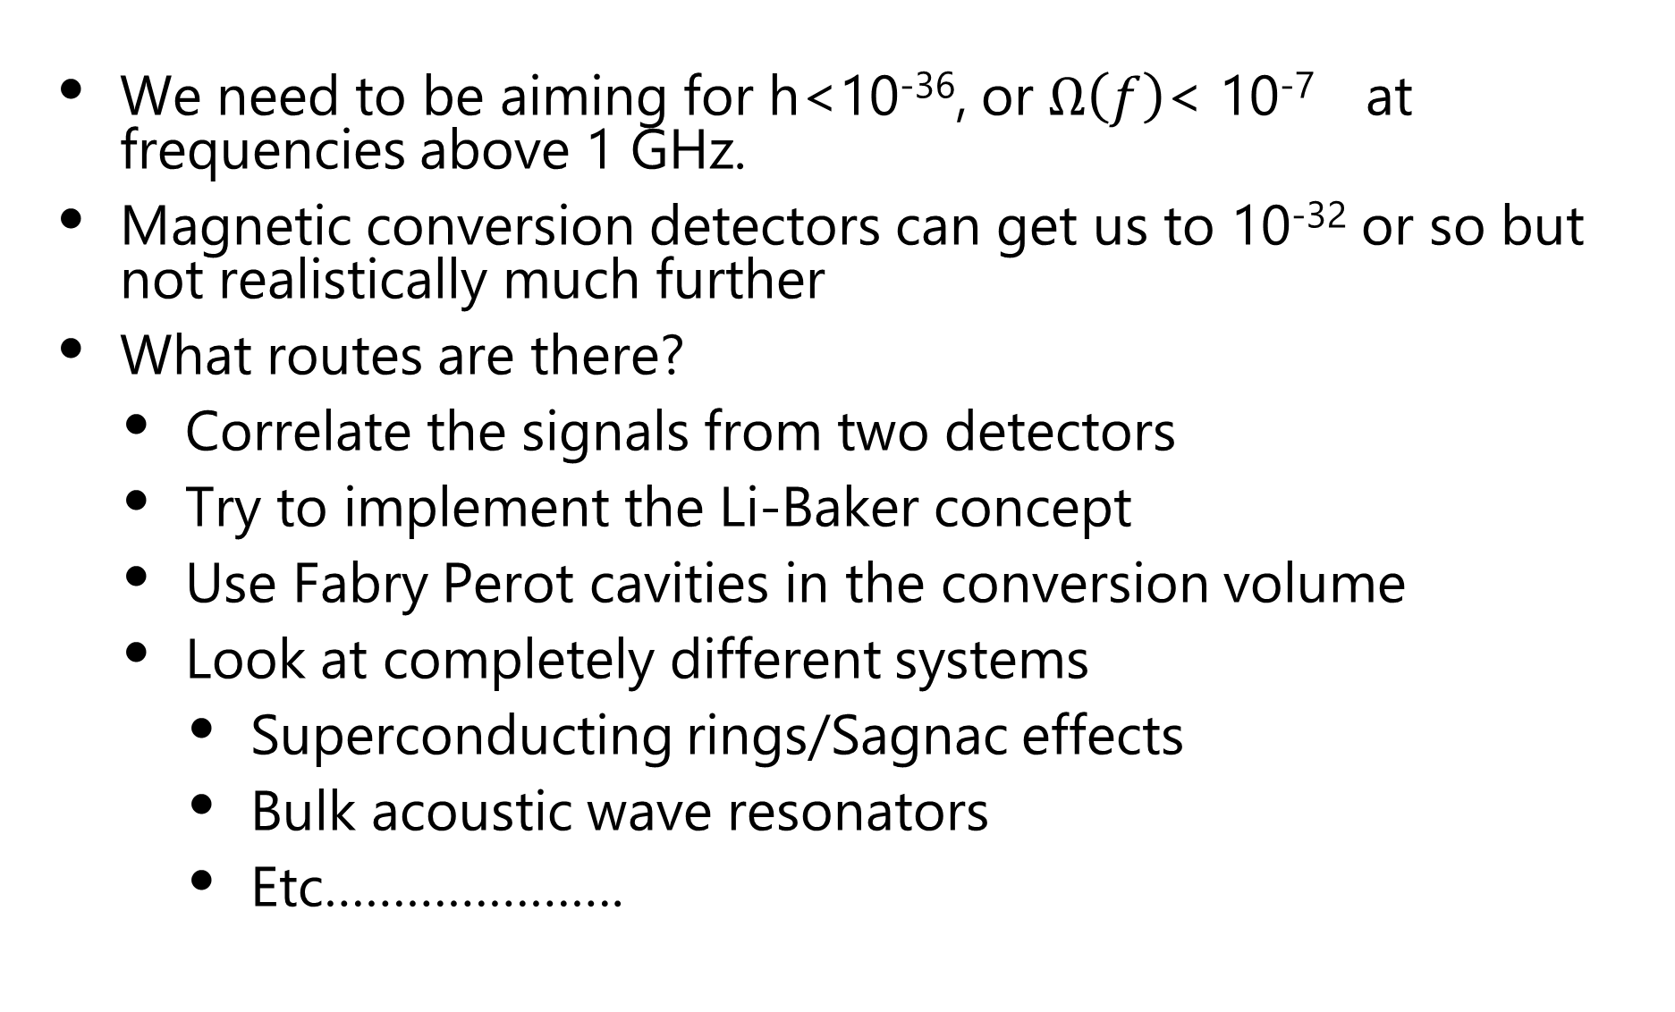
Strategy
We need to be aiming for h<10⁻³⁶, or $Ω\left(f\right)$< 10⁻⁷ at frequencies above 1 GHz.
Magnetic conversion detectors can get us to 10⁻³² or so but not realistically much further
What routes are there?
  Correlate the signals from two detectors
  Try to implement the Li-Baker concept
  Use Fabry Perot cavities in the conversion volume
  Look at completely different systems
    Superconducting rings/Sagnac effects
    Bulk acoustic wave resonators
    Etc………………….

Slide 27
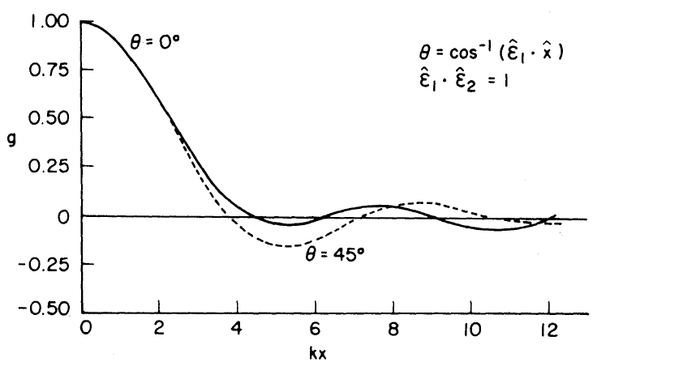
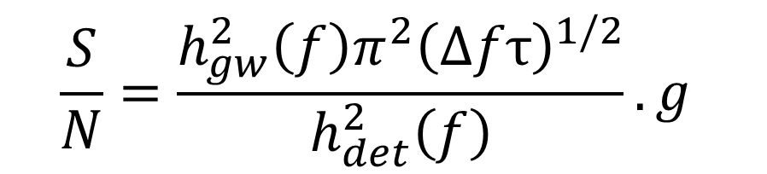
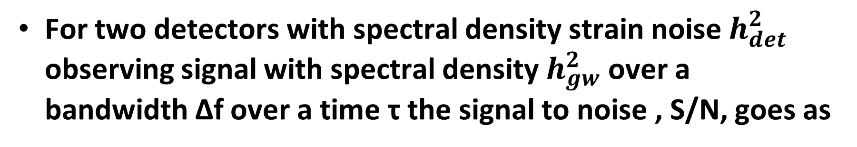
Correlation
For two detectors with spectral density strain noise $h_{det}^{2}$ observing signal with spectral density $h_{gw}^{2}$ over a bandwidth Δf over a time τ the signal to noise , S/N, goes as
$$\frac{S}{N}=\frac{h_{gw}^{2}{\left(f\right)π}^{2}{\left(Δfτ\right)}^{1/2}}{h_{det}^{2}\left(f\right)}. g$$

Slide 28
Li-Baker detector

Slide 29
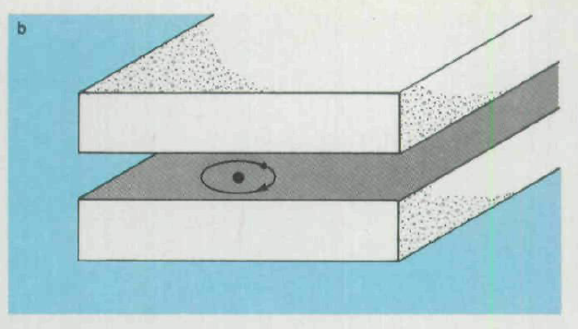

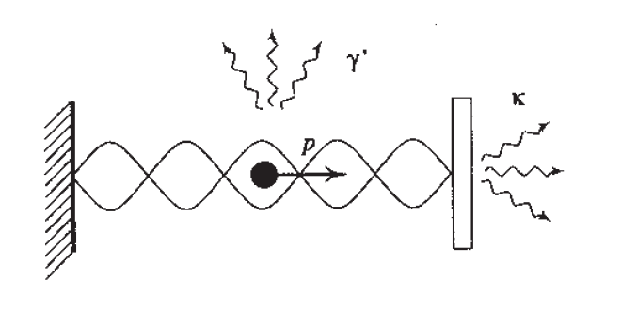
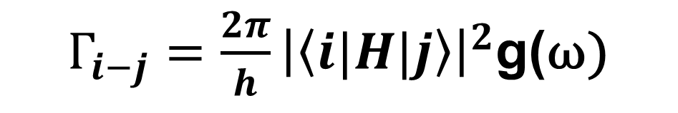
The Cavity effect
$Γ_{i−j}=\frac{2π}{h}{\left|\left\langle i|H|j\right\rangle \right|}^{2}$g(ω)

Slide 30
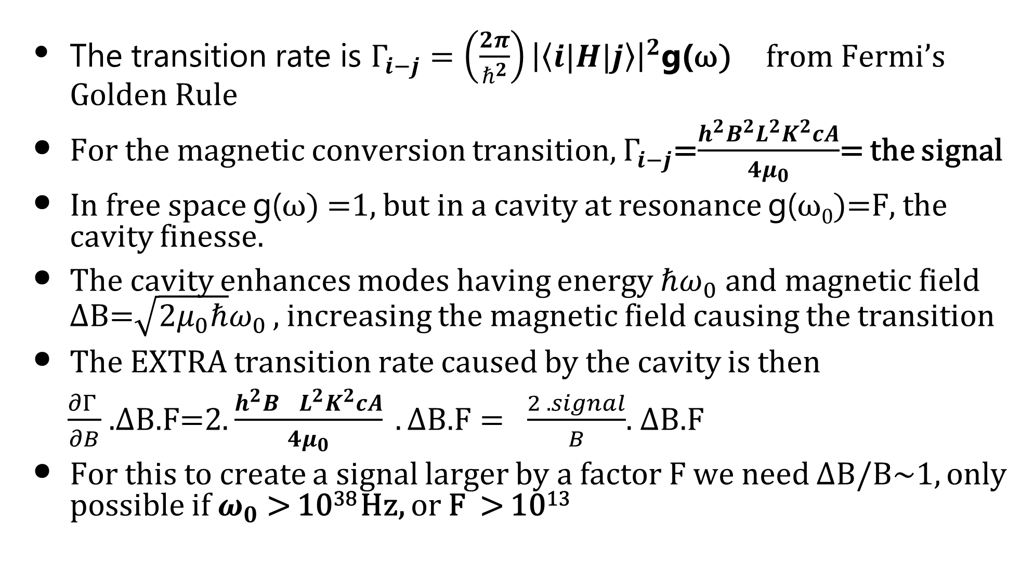
Will the cavity effect work with magnetic conversion?
The transition rate is $Γ_{i−j}=\left(\frac{2π}{ℏ^{2}}\right){\left|\left\langle i|H|j\right\rangle \right|}^{2}$g(ω) from Fermi’s Golden Rule
For the magnetic conversion transition, $Γ_{i−j}$=$\frac{h^{2}B^{2}L^{2}K^{2}cA}{4μ_{0}}$= the signal
In free space g(ω) =1, but in a cavity at resonance g(ω₀)=F, the cavity finesse.
The cavity enhances modes having energy $ℏω_{0} and magnetic field$ ΔB=$\sqrt{2μ_{0}ℏ}ω_{0}$ , increasing the magnetic field causing the transition
The EXTRA transition rate caused by the cavity is then
$\frac{∂Γ }{∂B}$ .ΔB.F=2. $\frac{h^{2}B^{}L^{2}K^{2}cA}{4μ_{0}} .\text{Δ}\text{B}\text{.}\text{F}= \frac{2 .signal}{B}$. ΔB.F
For this to create a signal larger by a factor F we need ΔB/B~1, only possible if $ω_{0}$ > 10³⁸ Hz, or F > 10¹³

Slide 31

The Basic problem
Atom in Cavity
Interaction
Storage time
GW in Cavity
Interaction
Storage time

Slide 32
Conclusions
Astronomical and Cosmological sources are speculative
-BUT EXTREMELY INTERESTING
Laboratory sources look very difficult but they would generate controllable, predictable single frequency signals.
At present, the magnetic conversion detectors seem to be the simplest to understand and might reach 10⁻²⁴ at 10¹⁰ Hz.
This is a factor of a million too insensitive.
Correlation looks difficult because the signal wavelength is much smaller than the detector and so there is no overlap.
The Li-Baker scheme requires huge separation of heterodyne pumping photons and the generated photons- by a factor of 10²⁷ or more
Can Fabry Perot cavities enhance the sensitivity of magnetic conversion detectors sufficiently?
Could other detector concepts be more relevant?
Thank you

