Slide 1
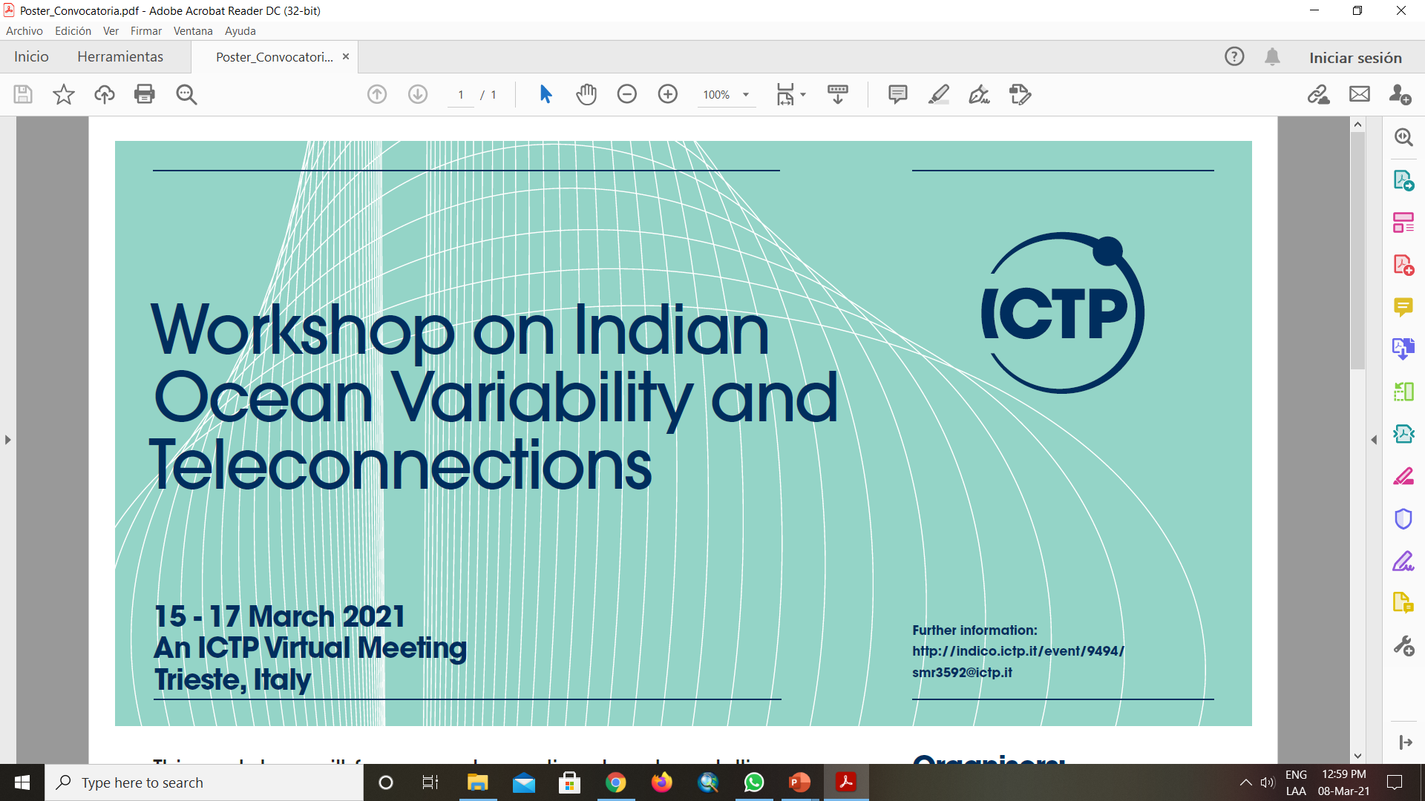
RELATIONSHIP BETWEEN THE INDIAN OCEAN AND ENSO WITH PRECIPITATION IN THE CARIBBEAN OF COSTA RICA. APPLIED TO THE PINEAPPLE AND BANANA CROPS
Autors:
Orozco-Montoya, Ricardo. A. ^{1, 2}
Penalba, Olga.C. ¹
Institutions:
¹Department of Atmospheric and Ocean Sciences, University of Buenos Aires, Argentina.
² School of Geographical Sciences, Universidad Nacional, Costa Rica.

Slide 2
INTRODUCTION
In the framework of the doctoral research, one of the goals is to improve the knowledge of the physical mechanisms responsible for the spatio-temporal variability of the occurrence of extreme rainfall events in the Caribbean region of Costa Rica with focus in pineapple (ananas comosus) and banana (musa spp,) main crops exported in the country.
The Caribbean region of Costa Rica presents the agricultural sector more vulnerable to changes in the climate (Bouroncle et al., 2015; Giorgi, 2006).
Due to the relative predictability of the Indian Ocean Dipole (IOD) episodes and El Niño-Southern Oscillation (ENSO) (Saji et al., 1999; Saji & Yamagata, 2003), the aim of this research is to understand the teleconnectivity of the Dipole Mode Index (DMI) and the Oceanic Niño Index (ONI) with the rainfall in December, critical month for pineapple and banana crops.

Slide 3
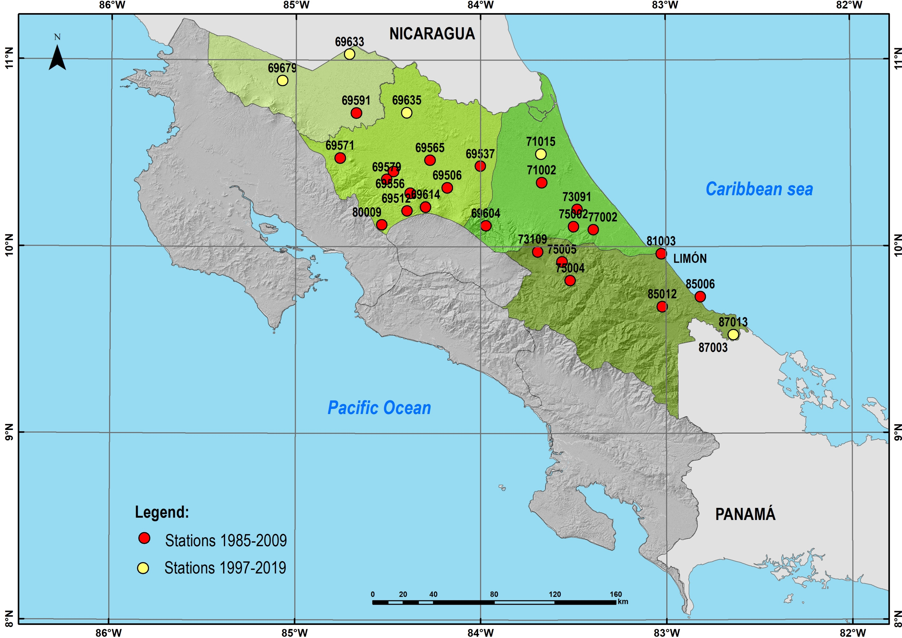
METHODOLOGY
28 monthly rainfall series located in the Caribbean region of Costa Rica were analyzed in 2 periods: 1985-2009 (23 stations) and 1997-2019 (5 stations, strategically located for crop analysis) (Figure 1).
For each period, the correlation between December rainfall and the DMI for October, November and December (PSL-NOAA, 2021), and correlation between December rainfall and ONI in ASO, SON and OND were analyzed (CPC-NOAA, 2021). In some stations, as the case of Limón, it was possible to analyze both periods in order to perform if the teleconnection change in time.
Figure 1. Stations analyzed in study area by station number

Slide 4
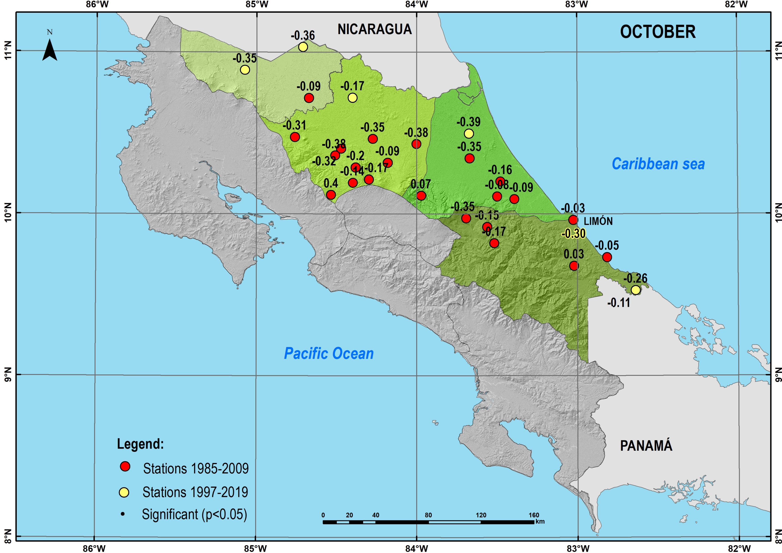


RESULTS
The correlation analysis for the DMI highlighted that for the months of October and November, most of the stations of the 1985-2009 period (between 20 and 21) and all those of the 1997-2019 period show an inverse relationship, while for December there are a sign change in half of the stations for the first period, however, these correlations are only significant in 3 stations for November (Figure 2, center) and 2 for December (Figure 2, right).
Figure 2. Correlation between December rainfall and October DMI (left), November DMI (center) and December DMI (right)

Slide 5
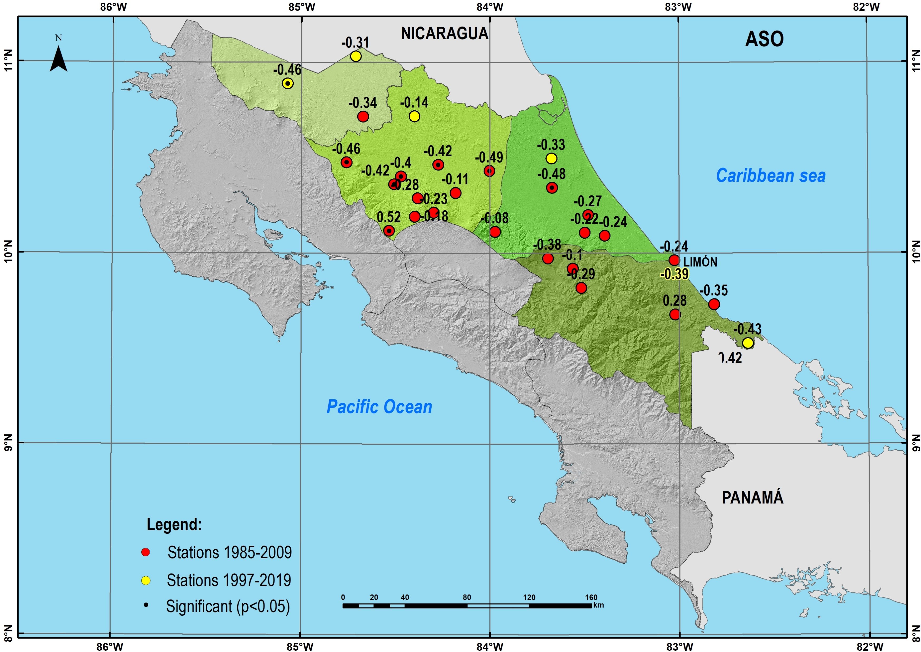


RESULTS
Regarding the ONI, correlations with a negative sign are obtained for 21 stations in the period 1985-2009 and all those of the most current period for the 3 quarters analyzed. The correlations are mostly significant for October and December for the first period, usually the same seasons. For the most recent period, only the Upala station is significant for the 3 related ONI quarters.
Figure 3. Correlation between December rainfall and ONI-ASO (left), ONI-SON (center) and ONI-OND (right)

Slide 6
RESULTS
The teleconnection analysis shows an inverse relationship between DMI of October and November and December rainfall. The significant signal is located in the southern of the study area and to the north close to the coast (Figure 2). The correlation associated with the ONI is also present in the region mainly in SON in the southern (Figure 3, center).
The Limón station shows changes in the correlations between both periods, being higher for the most recent period in both indices.
CONCLUSIONS
The correlations with the ONI show greater significance than with the DMI, being these significant towards the interior, that is, further from the coast and close to mountainous areas. In general, the signal with a negative sign is preserved for both indices in the 2 analysis periods. The Limón station shows higher correlations for the most recent period, which shows a change in variability over time, this change being more evident with the DMI than with the ONI.
The results indicate a potentially relationship between IOD and rainfall in Caribbean region of Costa Rica, which will contribute to improve its predictability in the study region.

Slide 7
REFERENCES
Bouroncle, C; Imbach, P; Läderach, P; Rodríguez, B; Medellín, C; Fung, E; Martínez-Rodríguez, M.R; Donatti, C.I. 2015. La agricultura de Costa Rica y el cambio climático: ¿Dónde están las prioridades para la adaptación? CGIAR Research Program on Climate Change, Agriculture and Food Security (CCAFS). Copenhague, Dinamarca.
CPC-NOAA. 2021. Historical El Nino / La Nina episodes. Disponible: https://origin.cpc.ncep.noaa.gov/products/analysis_monitoring/ensostuff/ONI_v5.php
Giorgi F (2006) Climate change hotspots. Geophys Res Lett 33:1–4. doi:10.1029/2006GL025734
PSL-NOAA. 2021. Dipole Mode Index. Time-series. Disponible en: https://psl.noaa.gov/gcos_wgsp/Timeseries/DMI/
Saji, N. J., Goswami, B. N., Vinayachandran, P. N., Yamagata, T. 1999. A dipole mode in the tropical Indican Ocean. Nature (401), 360-363.
Saji, N. J. & Yamagata, T. 2003. Possible impacts of Indian Ocean Dipole mode events on global climate. Climate Research, 25, 151-169.

