Slide 1

The subsurface temperature variability
in the Tropical Indian Ocean
Rashmi Kakatkar, C. Gnanaseelan and J. S. Chowdary
Indian Institute of Tropical Meteorology, Pune
Presented by:
Rashmi Kakatkar
ICTP workshop on “Indian Ocean Variability and Teleconnections”

Slide 2
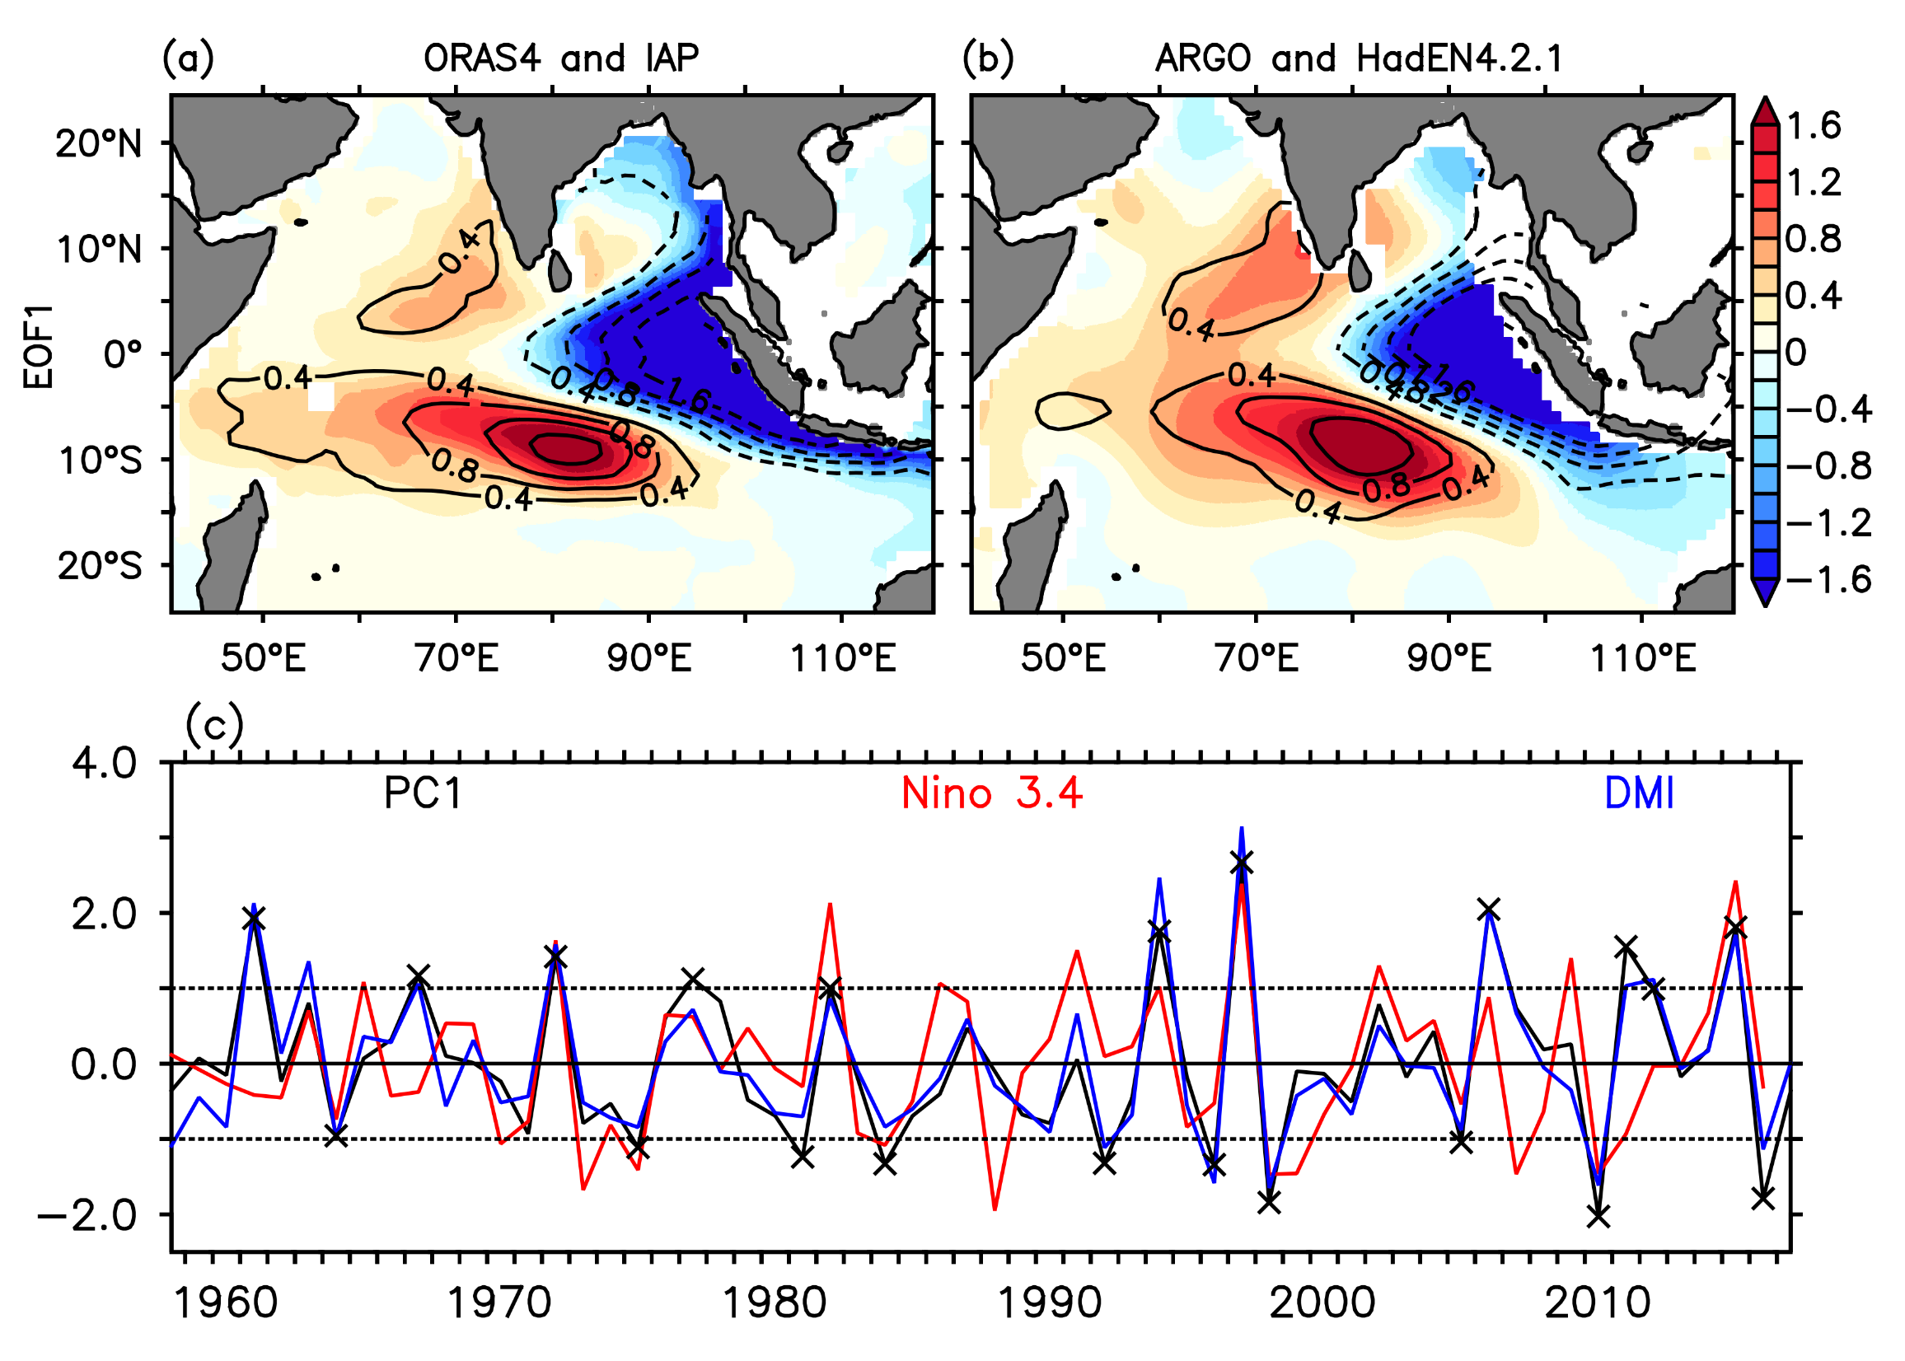
Subsurface Mode (SSM) in the Tropical Indian Ocean
EOF1 of detrended 100m temperature anomalies averaged over SON season
The interannual subsurface temperature variability in the TIO displays a dominant north-south SSM of variability, which evolves during SON due to IOD forcing and intensifies in DJF season.
PSSM years: PC1 ≥ 1
NSSM years: PC1 ≤ 1
Kakatkar et al., 2020

Slide 3
Asymmetry in PSSM and NSSM years
Composites for PSSM and NSSM years
SON(0)
DJF(0/1)
PSSM
Positive and Negative phases of ENSO and IOD
IOD
ENSO
Co-occurrence
SON(0)
SON(0)
NSSM
DJF(0/1)
DJF(0/1)
PSSM+NSSM

Slide 4
Surface wind forcing during PSSM and NSSM years
surface wind stress curl anomalies (shaded, 10⁻⁷ N/m³)
wind stress anomalies (vectors, 10⁻² N/m²)
SON(0)
DJF(0/1)
Rotational component of surface wind anomalies
PSSM
PSSM
PSSM
NSSM
NSSM
NSSM
Composite of surface zonal wind stress anomalies (10⁻² N/m²) for SON(0) averaged over 2°S to 2°N.

Slide 5
Subsurface-surface Interaction
Regression coefficient
Regression coefficient (no ENSO)
SON
DJF
DJF

Slide 6
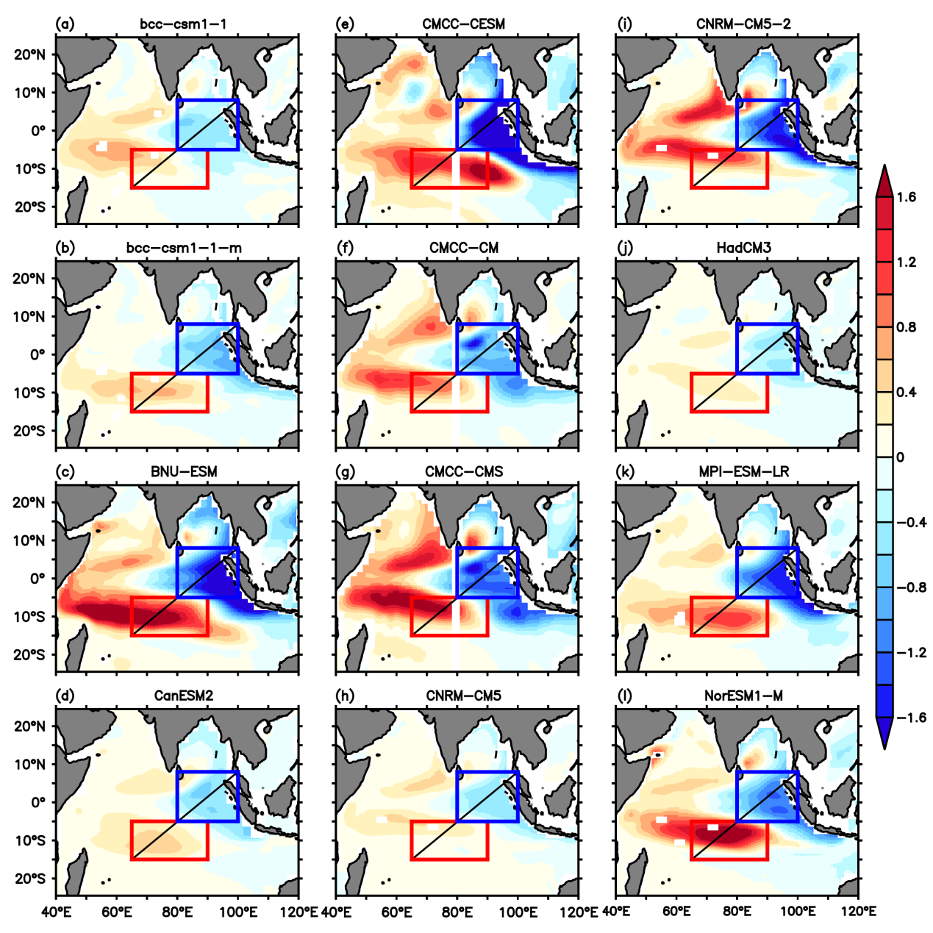
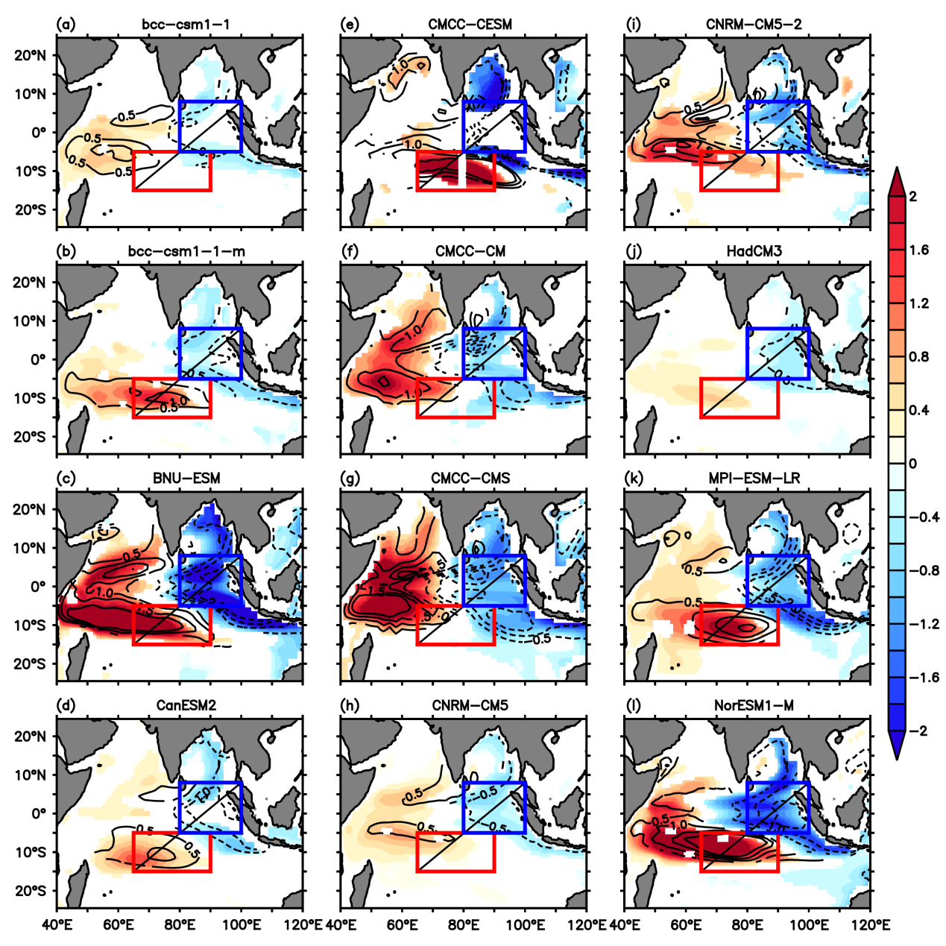
PSSM evolution in coupled models
CFSv2
EOF1
CFSv2
2
1
Composites
0
CMIP5
-1
-2
CMIP5
Kakatkar et al., 2019

Slide 7
Correlation between PC1 and different indices
Model | ENSO (NDJ) | IOD (SON) | Coupling Index (JJA) | Coupling Index (SON) | Coupling Index (DJF) | EQWIN (JJA) | EQWIN (SON) | EQWIN (DJF)
ORAS4/ERA | 0.56 | 0.93 | 0.70 | 0.95 | 0.60 | 0.65 | 0.87 | 0.43
CFSv2freerun | 0.44 | 0.83 | 0.57 | 0.95 | 0.17 | 0.71 | 0.85 | -0.001
BCC(bcc-csm-1-1) | 0.54 | 0.82 | 0.61 | 0.93 | 0.66 | 0.67 | 0.93 | 0.22
BCC(bcc-csm-1-1-m) | 0.51 | 0.82 | 0.71 | 0.93 | 0.63 | 0.74 | 0.882 | 0.43
BNU(BNU-ESM) | 0.67 | 0.85 | 0.74 | 0.94 | 0.82 | 0.72 | 0.94 | 0.67
CCCma(CanESM2) | 0.29 | 0.88 | 0.71 | 0.91 | 0.17 | 0.62 | 0.86 | 0.12
CMCC(CMCC-CESM) | 0.40 | 0.85 | 0.64 | 0.96 | 0.22 | 0.55 | 0.88 | -0.16
CMCC(CMCC-CM) | 0.29 | 0.82 | 0.76 | 0.95 | 0.56 | 0.82 | 0.92 | 0.56
CMCC(CMCC-CMS) | 0.62 | 0.94 | 0.77 | 0.98 | 0.86 | 0.85 | 0.97 | 0.79
CNRM-CERFACS(CNRM-CM5) | 0.75 | 0.89 | 0.80 | 0.98 | 0.70 | 0.85 | 0.96 | 0.47
CNRM-CERFACS(CNRM-CM5-2) | 0.71 | 0.93 | 0.80 | 0.96 | 0.59 | 0.83 | 0.96 | 0.47
MOHC(HadCM3) | 0.50 | 0.71 | 0.76 | 0.90 | 0.46 | 0.79 | 0.86 | 0.36
MPI-M(MPI-ESM-LR) | 0.62 | 0.93 | 0.78 | 0.98 | 0.65 | 0.83 | 0.92 | 0.44
NCC(NorESM1-M) | 0.82 | 0.94 | 0.77 | 0.97 | 0.89 | 0.72 | 0.94 | 0.76
Coupling Index = {(sstanom [50E:70E,10S:10N] – 90E:110E,10S:EQ]) - d20anom[90E:110E,10S:EQ] - uanom[60E:90E,2S:2N]}/3
EQWIN = uanom[60E:90E,2.5S:2.5N]*(-1) ; ENSO = Nino3.4 = sst anom [170W:120W,5S:5N] ;
IOD = sst anom [50E:70E, 10S:10N]- sst anom [90E:110E,10S:eq]

Slide 8
Summary
Asymmetry in the evolution of subsurface dipole and associated subsurface-surface interaction is found in PSSM and NSSM years
Subsurface-surface interaction is strong during PSSM years
Even though El Niño forcing helps to strengthen the PSSM during DJF season, the PSSM can self-maintain in absence of El Niño
The improper representation of the subsurface mode is common in CFSv2 and in many of the CMIP5 coupled models
Proper temporal and spatial evolution of subsurface temperature mode in the coupled models might feedback to surface thereby improving the air–sea interaction
References:
Kakatkar Rashmi, Gnanaseelan C. and Chowdary J. S. (2020) "Asymmetry in the Tropical Indian Ocean subsurface temperature variability", Dynamics of Atmospheres and Oceans, 90, 101142
Kakatkar Rashmi, Gnanaseelan C., Chowdary J. S., Deepa J. S. and Parekh A. (2019) "Biases in the Tropical Indian Ocean subsurface temperature variability in a coupled model", Climate Dynamics, 52(9-10), 5325-5344
Thank You

