Slide 1
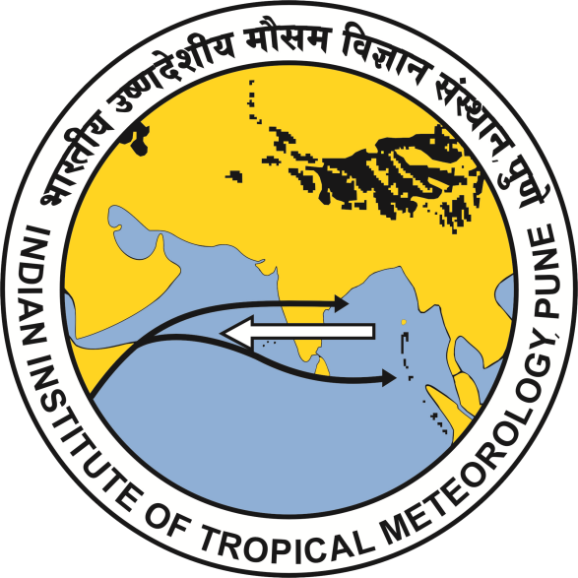
Rapid Drying of Northeast India in the Last Three Decades: Climate Change or Natural Variability?
Workshop on Indian Ocean Variability and Teleconnections
15 - 17 March, 2021
SMR/3592/TA31048910
Presented by:
B. Abida Choudhury^{1,3}
In collaboration with
Subodh Kumar Saha², Mahen Konwar², K. Sujith²,and Atri Deshamukhya¹
¹Department of Physics, Assam University, Silchar, India
²Indian Institute of Tropical Meteorology, Pune, India
³Cotton University, Guwahati, Assam, India
Notes:
We designed this template so that each member of the project team has a set of slides with its own theme. Members, here’s how you add a new slide to just your set:
Mark where you want to add the slide: Select an existing one in the Thumbnails pane, click the New Slide button, then choose a layout.
The new slide gets the same theme as the previous one you selected.
Careful! Don’t annoy your fellow presenters by accidentally changing their themes. That can happen if you choose a theme Variant from the Design tab, which changes all of the slides in the presentation to that look.

Slide 2
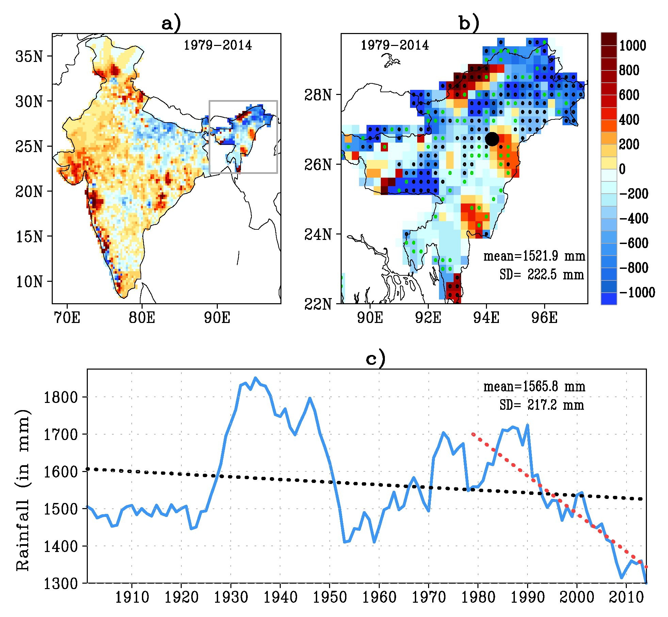
Fig.1: Spatial trend of monsoonal rainfall (June to September) over (a) India and (b) Northeast India (NEI) region during the last three decades (1979-2014). Trends over NEI region significant at 95% level are stippled. (c) Seven-year running mean of area averaged NEI summer monsoon rainfall during 1901-2014. Linear trends in area-averaged NEI summer monsoon rainfall in the last 114 years (1901-2014; black) and in the last 36 years (1979-2014; red).
Whether the rapid decrease in NSMR in the last three decades is a signal of long-term climate change or a part of natural mode of climate variability?
What is the contribution of recycle rainfall to the mean and change of the NSMR in the last three decades?

Slide 3
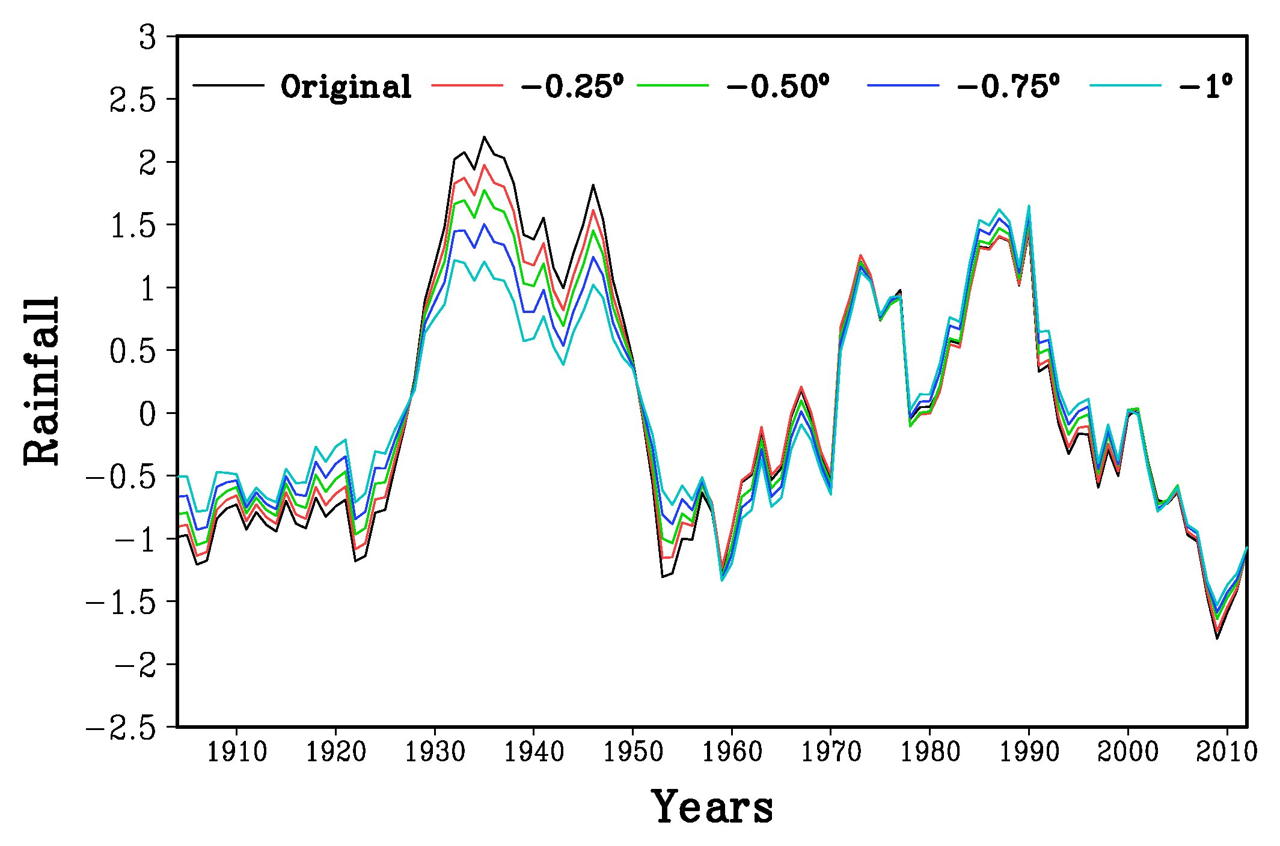
Fig.2: Comparison of variations of Northeast India summer monsoon rainfall by excluding four grid boxes one by one (0.25°) from the extreme northern boundary edges. This suggests that irrespective of the excluded grid boxes over hilly region, the decadal variations are consistent.

Slide 4
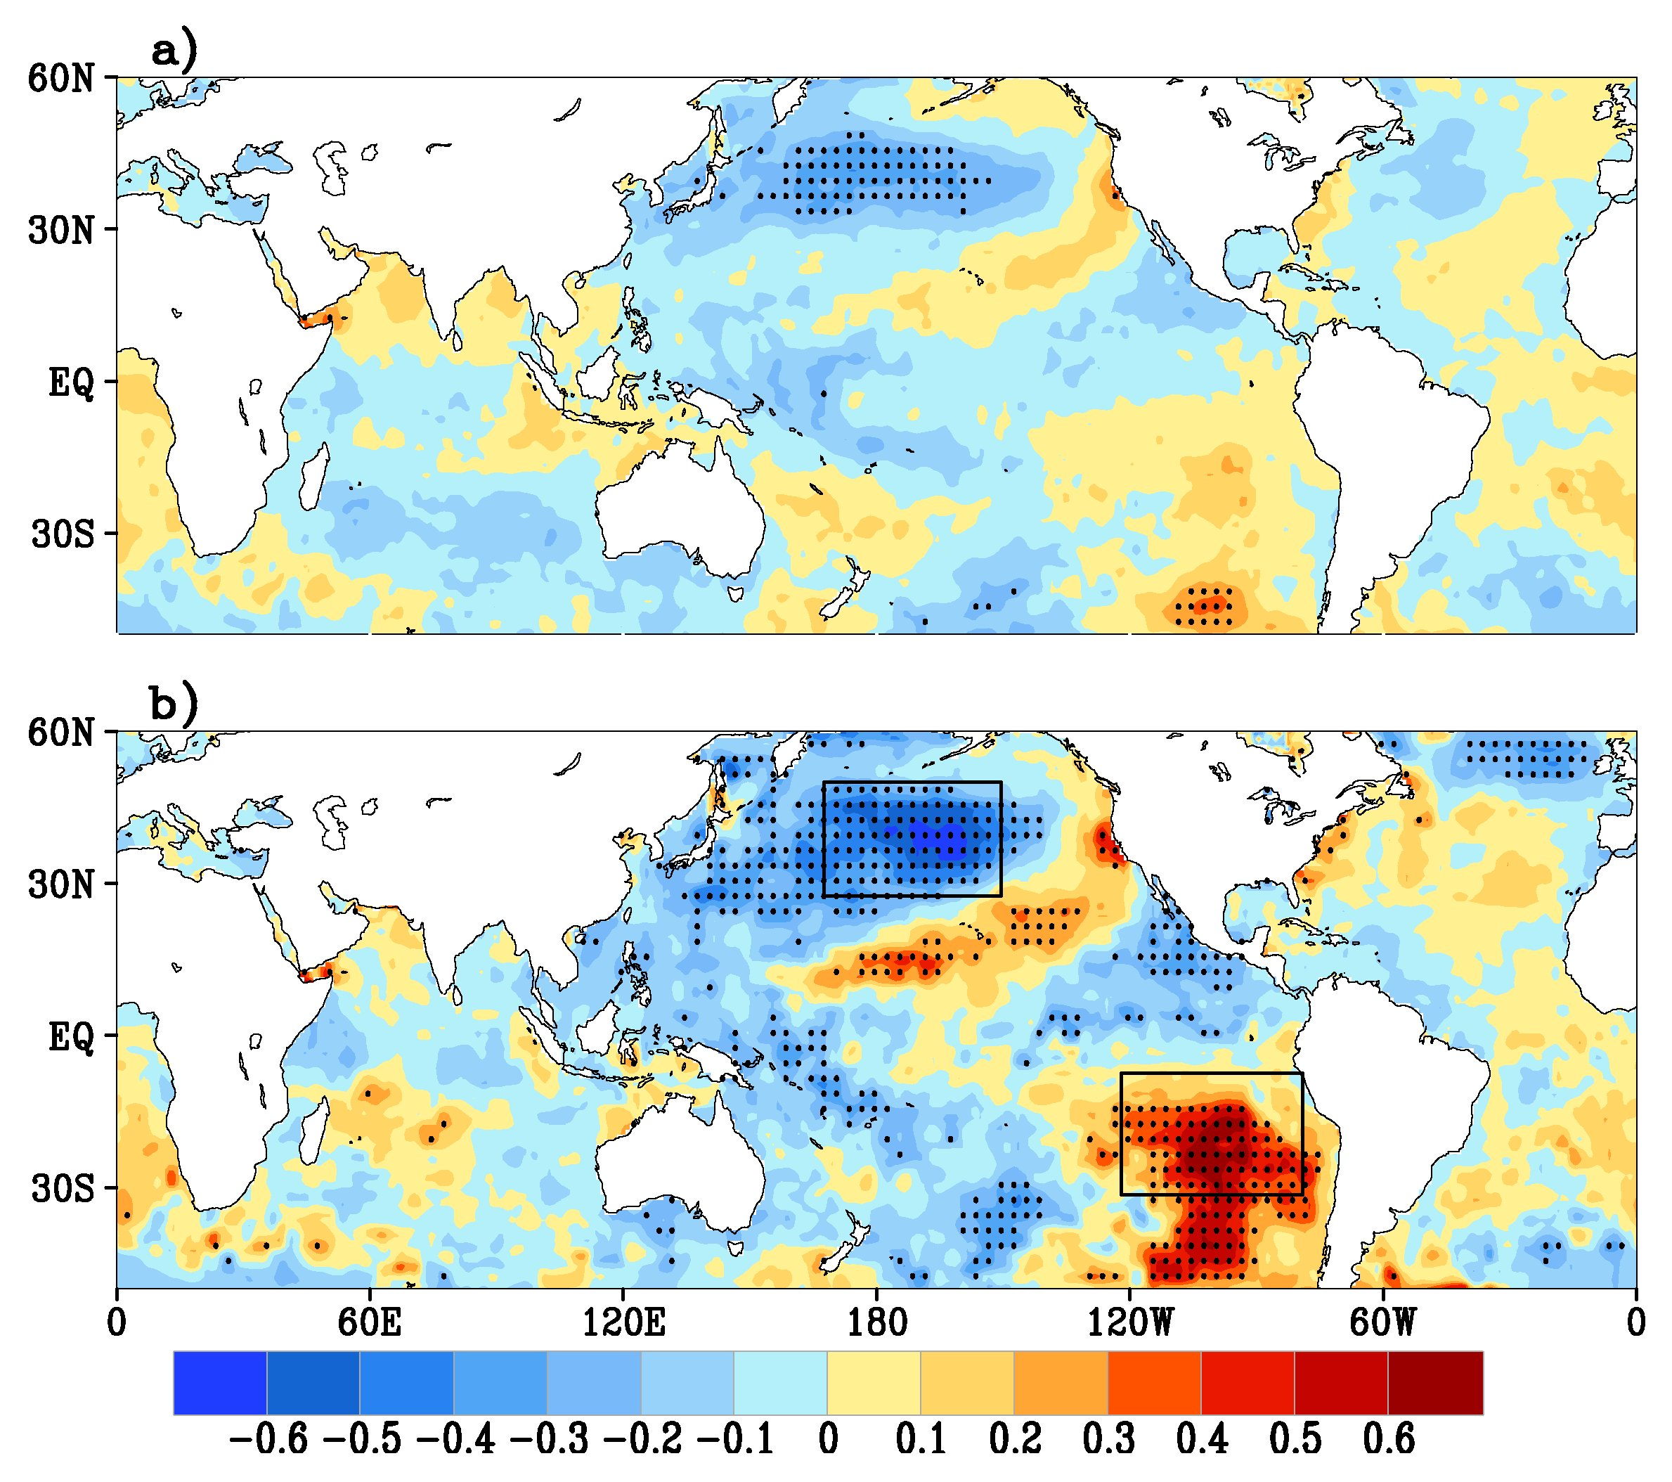
Fig.3: Correlation map of Northeast India summer monsoon rainfall with global sea surface temperature (1901 to 2014) illustrating the interannual and interdecadal relationship.
(a) Area-averaged Northeast India summer monsoon rainfall is correlated with June to September-averaged sea surface temperature at every grid point.
(b) Same as (a) but using 7-year running mean of both time series.

Slide 5
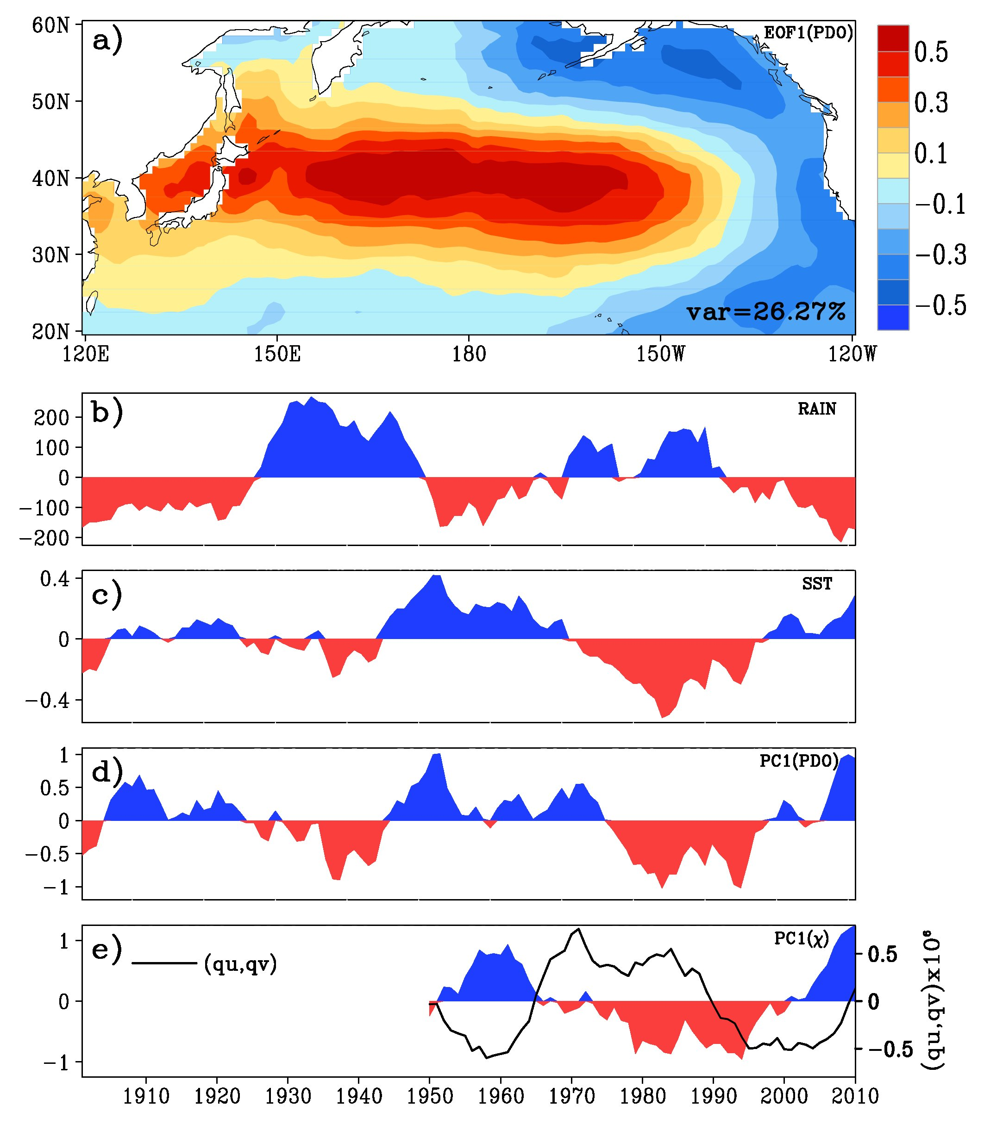
Fig.4: (a) Decadal variation of JJAS-averaged anomalies. (a) First EOF of detrended SST anomaly over the North Pacific domain (120ºE to 120ºW to 20-60ºN). Seven-year running mean of the detrended area-averaged (b) NSMR anomaly (in mm/season), (c) North Pacific domain SST anomaly, (d) first principal component of North Pacific domain SST anomaly (corresponding to EOF-1 shown in [a]), and (e) first principal component of global χ anomaly, shown by filled plot and magnitude of vertically integrated moisture flux anomaly of NEI region, shown by black solid line (kgm⁻¹s⁻¹).

Slide 6
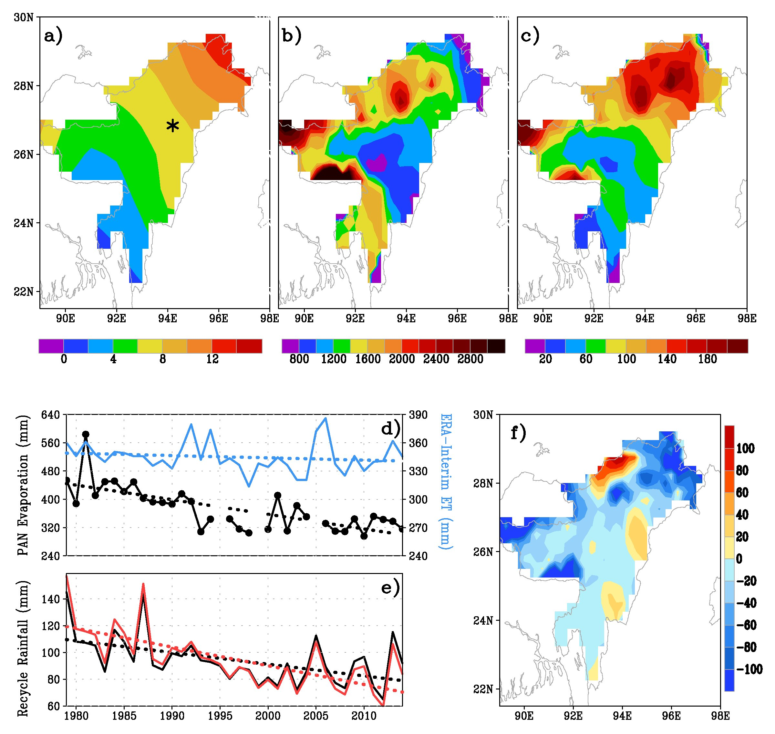
Fig.5: The estimated seasonal (June to September) climatological mean, 1979-2014,
recycling ratio (ρ) in percentage,
advected rainfall (mm), and
recycled rainfall (mm).
Area-averaged evapotranspiration over NEI using ERA-Interim reanalysis (blue line) and observed pan evaporation from the station Jorhat in NEI (star marked in [a]) shown by solid black line. The dotted lines show the linear trend.
NEI-averaged seasonal recycled rainfall (mm) with original evapotranspiration data (black line) and decreasing the slope by 20% (red line).
Linear trend of the seasonal recycled rainfall (mm) during the last 36 years (1979-2014).

Slide 7
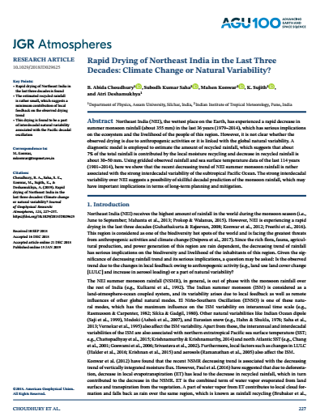
Conclusion
The Rapid drying of NEI since the last three decades is a part of an interdecadal natural variability of monsoonal rainfall persisting over this region. This interdecadal variability, in turn, is found to be strongly associated with the PDO.
The decreasing trend in NSMR is found to have a major contribution from the global phenomenon than the local alterations such as LULC. About 7% of the total rainfall is contributed by the local moisture, and decrease in recycled rainfall is about 30-50 mm over three decades.
The implication of this study is that the strong interdecadal variability of NSMR may point toward a possible skillful decadal prediction of the monsoon rainfall.
Choudhury, B. A., Saha, S. K., Konwar, M., Sujith, K. and Deshamukhya, A. (2019) Rapid drying of Northeast India in the last three decades: climate change or natural variability?. Journal of Geophysical Research, 124, 227-237. https://doi.org/10.1029/2018JD029625

Slide 8
Acknowledgement
The authors are thankful to
The organizing committee, ICTP for providing the platform to present the work.
All the data sources that has been used for this analysis.
And finally the host institutes of the authors for the encouraging research environment.
Thank you all !!

