Slide 1
Indian Ocean Dipole and ENSO,
and their teleconnection to
extreme rainfall events in South America
M. Florencia Iacovone,
Olga C. Penalba, Vanesa C. Pántano
fiacovone@at.fcen.uba.ar
Departamento de Ciencias de la Atmósfera y los Océanos. Universidad de Buenos Aires.
Consejo Nacional de Investigaciones Científicas y Técnica, CONICET. Argentina
March 2021

Slide 2
Objective
In view of the relative predictability of El Niño-Southern Oscillation (ENSO) and Indian Ocean Dipole (IOD) episodes, the aim of this research is to understand the spatial relationship between IOD and ENSO with two rainfall indices: maximum number of consecutive dry days (CDD) and wet days (CWD), in South America.
Period: trimester October-December, 1979-2005.

Slide 3
Data and Methodology
IOD index
CDD & CWD
CPC Global Unified Precipitation data del National Center for Environmental Prediction (NCEP)
https://psl.noaa.gov/gcos_wgsp/Timeseries/DMI/
ENSO
El Niño 3.4 region (5° N–5° S, 120°–170° W)
ONI
SST NOAA Extended Reconstructed Sea Surface Temperature (ERSST), Version 5, National Center for Atmospheric Research (NCAR)
EMI = |SSTA|A – 0,5*|SSTA|B
– 0,5*|SSTA|C
EMI (Ashok et al. 2007)
C
A
B

Slide 4
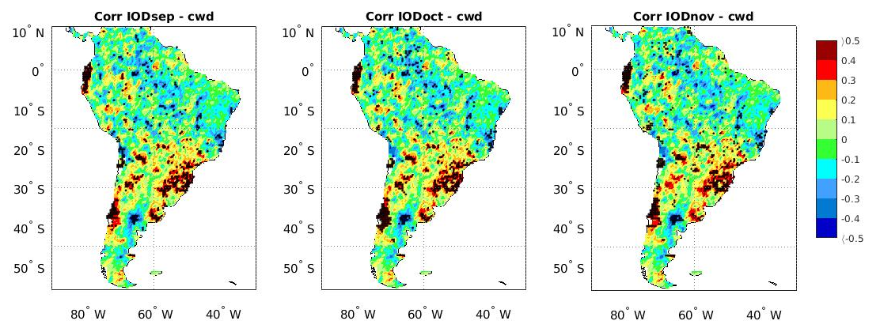
Results
Corr IOD_{sep}- CWD Corr IOD_{oct}- CWD Corr IOD_{nov} - CWD
Significant positive correlation of IOD-CWD and ONI-CWD, over Buenos Aires and Mesopotamia of Argentina, north of Uruguay and south of Brazil
Corr EMI - CWD Corr ONI - CWD
The strongest signal is between IOD-CWD and ONI-CWD

Slide 5
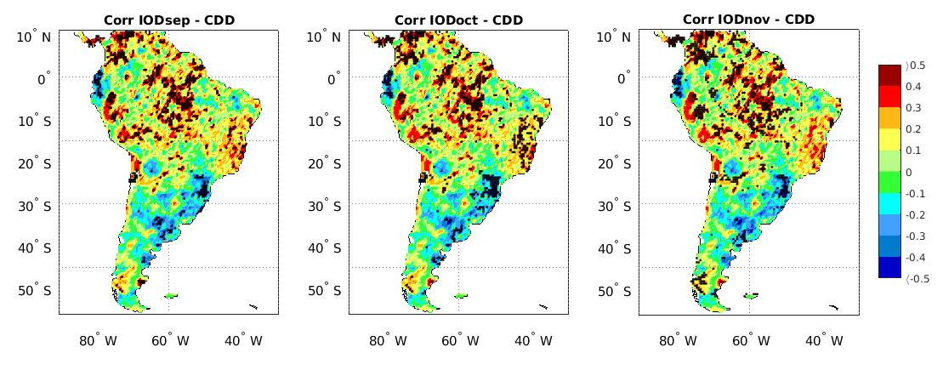
Results
Corr IOD_{sep}- CDD Corr IOD_{oct}- CDD Corr IOD_{nov} - CDD
Significant negative correlation of IOD-CDD, EMI-CDD and ONI-CDD over Buenos Aires and Mesopotamia of Argentina, north of Uruguay and south of Brazil
Corr EMI - CDD Corr ONI - CDD
The strongest signal is between ONI-CDD

Slide 6
Conclusions
Significant positive correlation of IOD-CWD suggests that positive (negative) IOD index are associated with longer (shorter) consecutive wet days in Southeastern South America.
Significant negative correlation of IOD-CDD suggests that positive (negative) IOD index are associated with shorter (longer) consecutive dry days in Southeastern South America.
The strongest signal is between IOD-CWD and ONI-CWD and between ONI-CDD.
These results indicate a potentially strong relationship between IOD and South American extreme rainfall, which will contribute to improve the predictability of extreme indices in the study region.

