Slide 1
Workshop on Indian Ocean Variability and Teleconnections
(from 15 March 2021 to 17 March 2021)
IMPACT OF INDIAN OCEAN DIPOLE ON RAINFALL VARIABILITY
OVER CENTRAL AFRICA
Moihamette Foupouapegnigni^{1*}, W.M. Pokam², R. Washington³ and I. Diallo⁴
¹Laboratory for Environmental Modelling and Atmospheric Physics (LEMAP), University of Yaounde 1, Yaounde, Cameroon
²Department of Physics, Higher Teacher Training College, University of Yaounde 1, Yaounde, Cameroon
³School of Geography and the Environment, University of Oxford, Oxford, UK
⁴Department of Geography, University of California, Los Angeles (UCLA), Los Angeles, CA 90095, USA
*e-mail: hmoihamette@yahoo.fr

Slide 2
Aim, Data and Methodology
Aim
The aim of this study is to assess the possible link between the IOD and Central Africa rainfall
Data
Precipitations : (GPCC) Full data (Schneider et al. 2014), (CRU TS4.04; Harris et al. 2020) at 0.5°×0.5°,
MERRA-2 (Gelaro et al. 2017) at 0.5°×0.625° resolution and ERA5 (Hersbach et al. 2020) is on a 0.25°×0.25° spatial grid.
Sea Surface Temperature (SST) : ERA5 (Hersbach et al. 2020) is on a 0.25°×0.25°
Dynamic variables : MERRA-2 (Gelaro et al. 2017) at 0.5°×0.625° resolution and ERA5 (Hersbach et al. 2020) at 0.25°×0.25°
Climatology : 1980-2016 from Septembre to December
Methodology
-An IOD event is detected using Dipole Mode Index (DMI) which is defined as the difference in SST anomalies between western(10°S–
10°N, 50°–70° E) and eastern (10°S–0°, 90°–110°E) equatorial Indian Ocean (Saji et al. 1999). DMI is expected to be higher
than one standard deviation and should remain so for 3 to 4 months, in an IOD year (Vinayachandran et al., 2009).
- Use composite and statistical analysis to study rainfall and moisture flux patterns

Slide 3
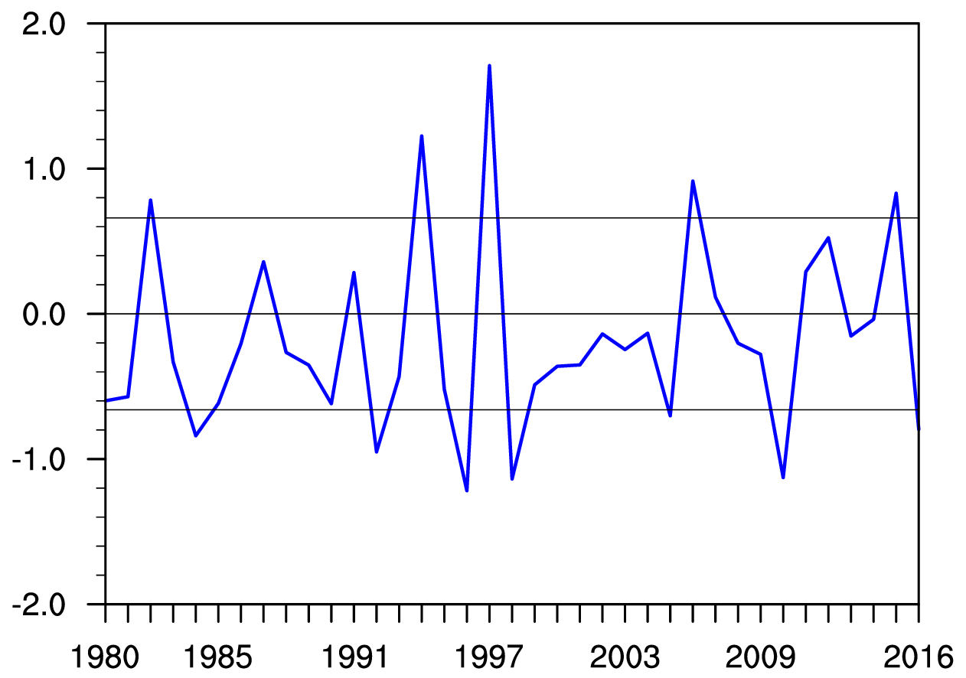
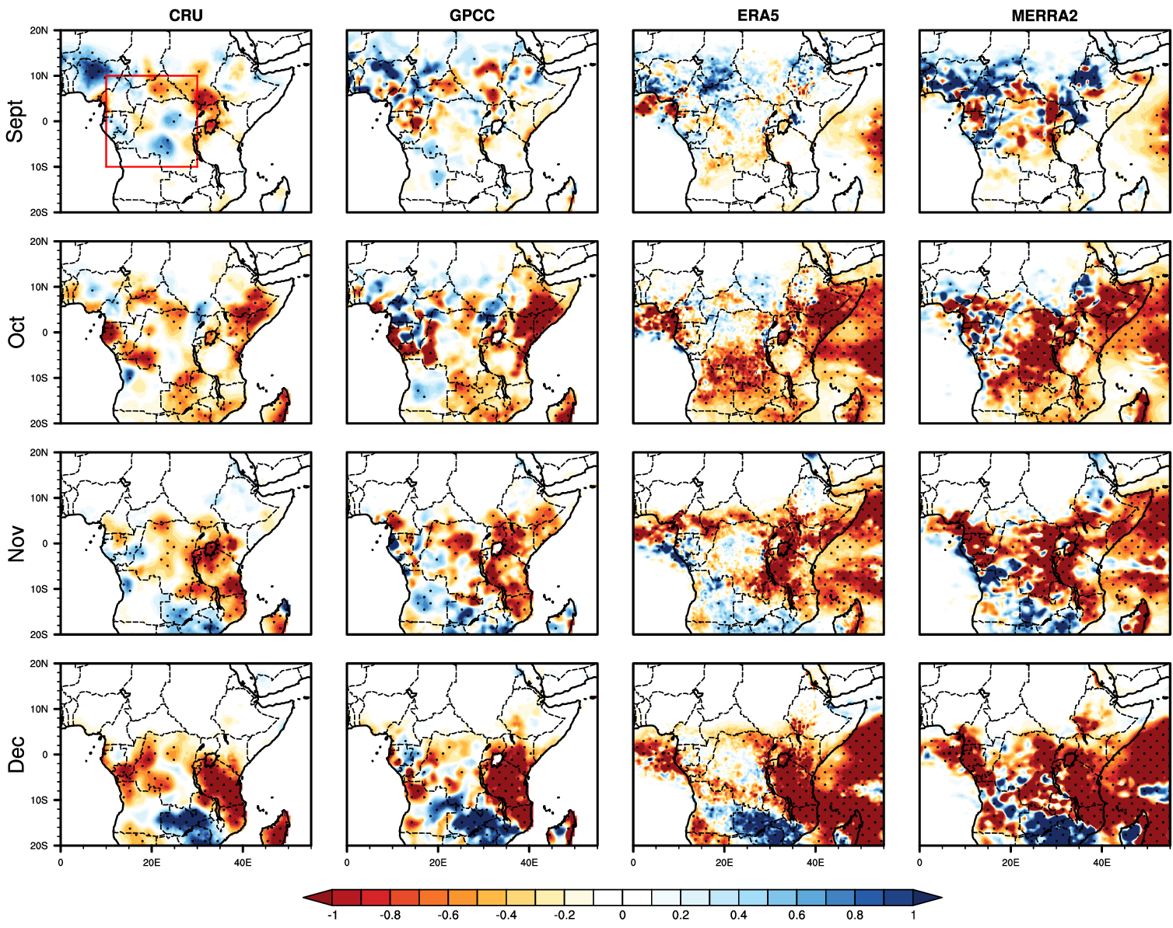
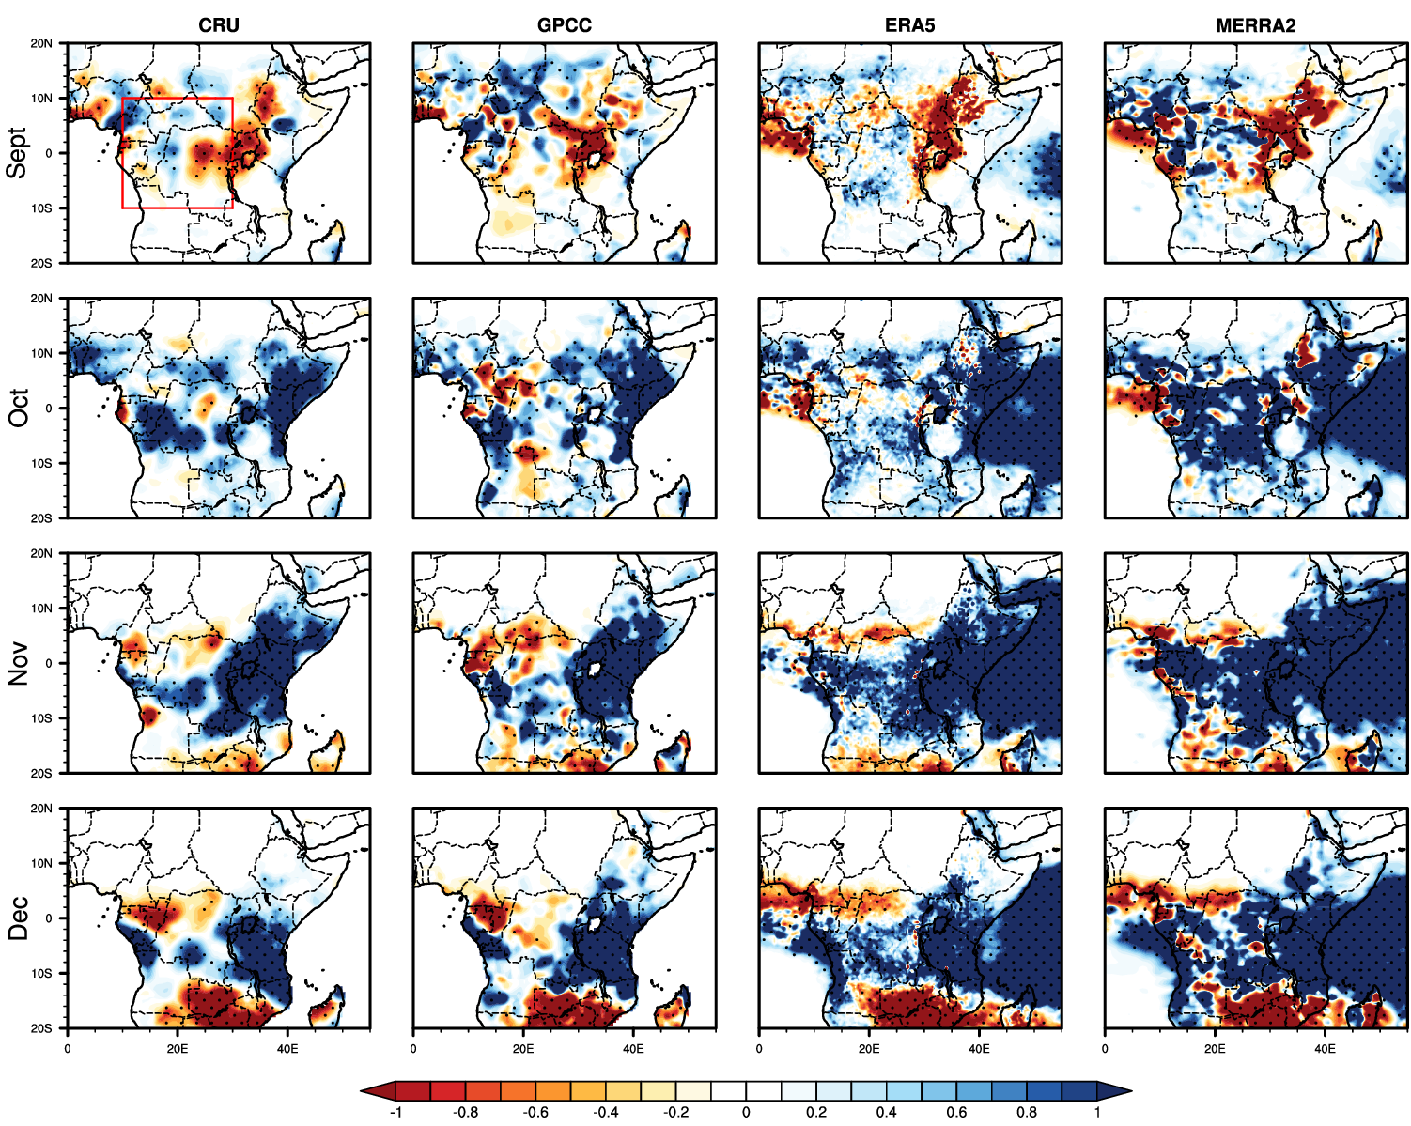
Response of precipitation to IOD events
SON DMI (°C)
It results in 12 IOD years including :
5 positives IOD (pIOD) events (1982, 1994, 1997,
2006, 2015)
7 negatives IOD (nIOD) events (1984, 1992, 1996,
1998, 2005, 2010, 2016)
Anomalous Precipitation
Composites (mm/day)
Stippling indicates statistically
significant at the 95% level
using t-test
nIOD events
pIOD events

Slide 4
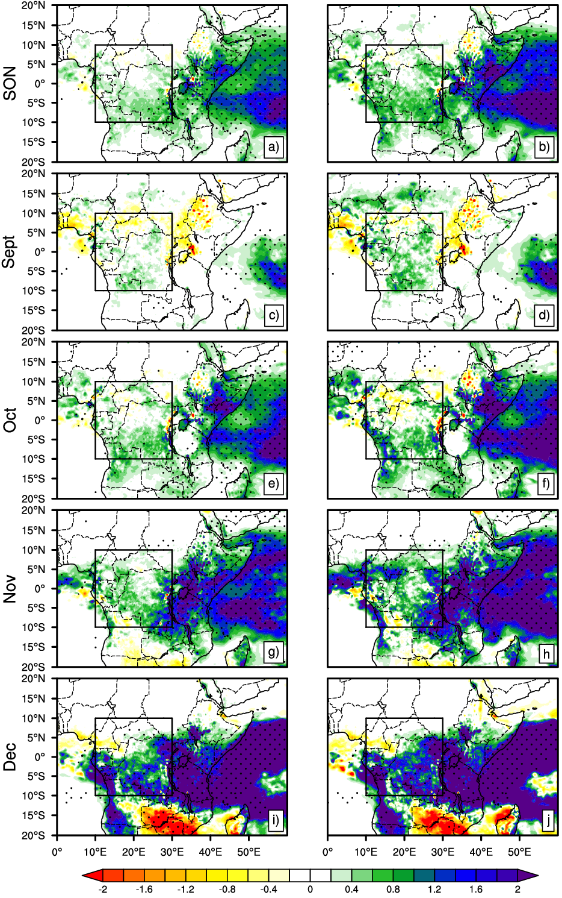
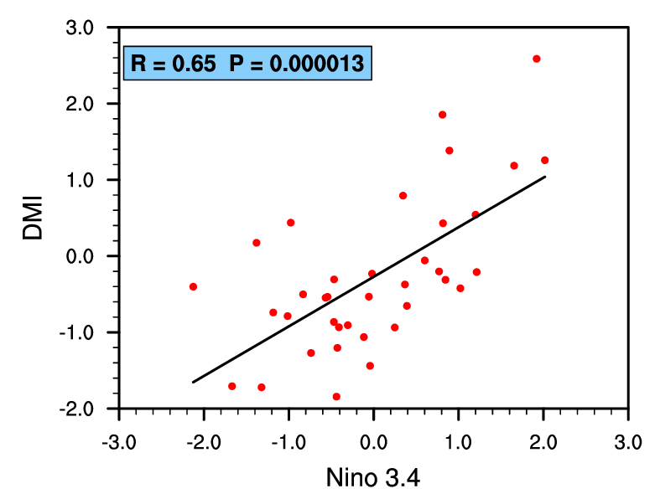
Impact of
IOD+ENSO vs IOD-ENSO
IOD+ENSO
IOD-ENSO
(DMI with Nino-3.4 included)
(DMI with Nino-3.4 removed)
In general, rainfall increases
with the intensity of DMI.
This increase is strengthened by
removing the effects of ENSO.
Scatter diagram revealing relationships between
DMI and Niño 3.4 during the SON season.
Regressions of Central Africa
rainfall onto DMI.
Stippling indicates statistically
significant at the 90% level
ERA5

Slide 5
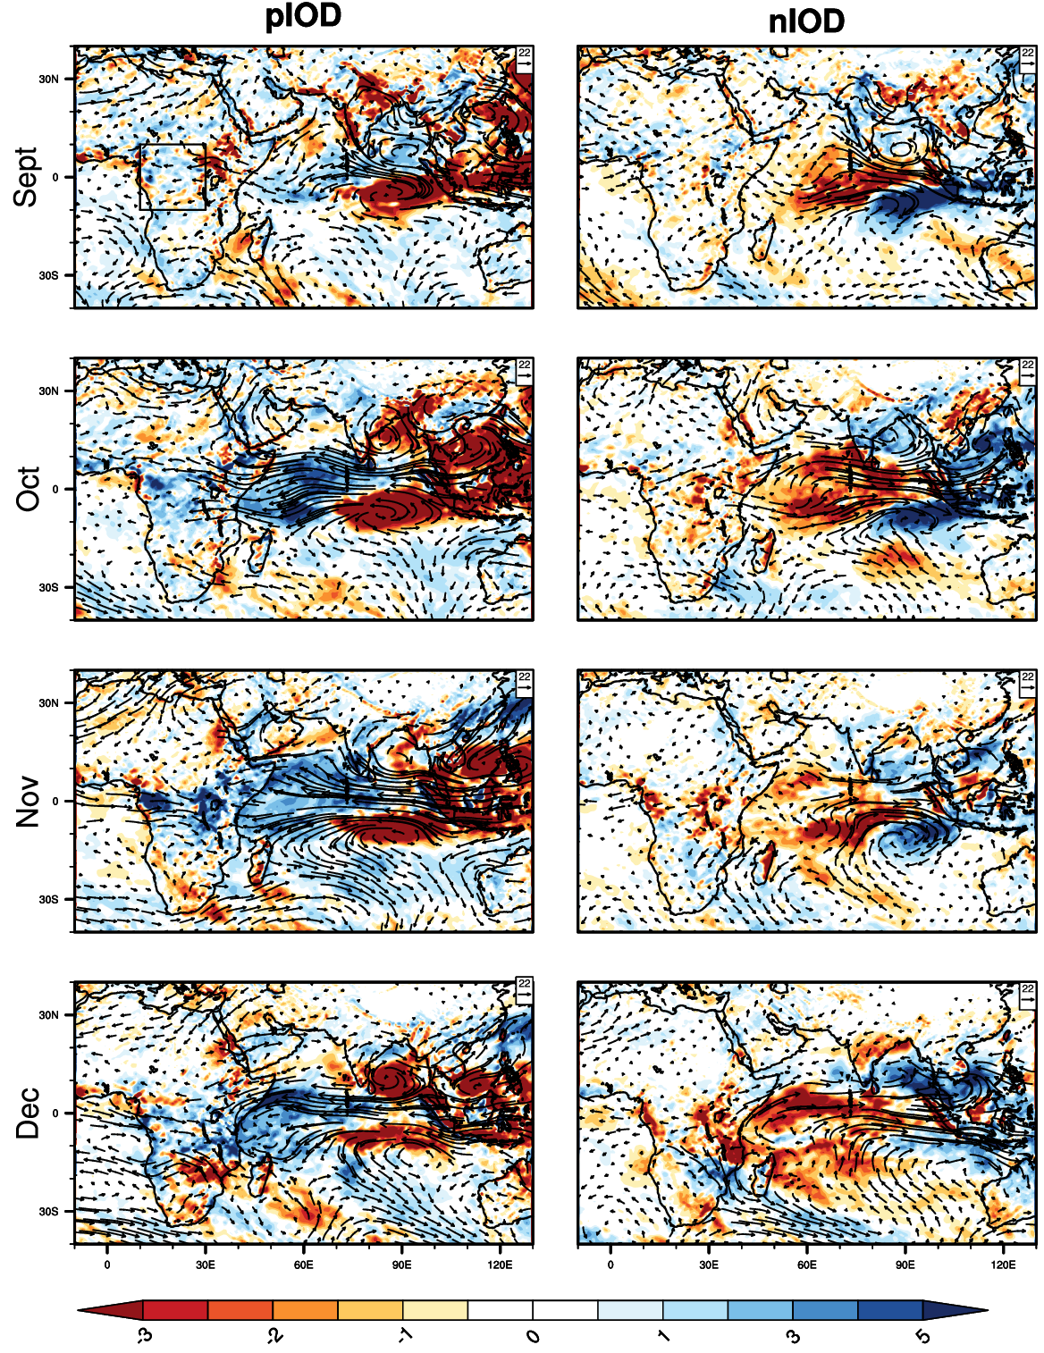
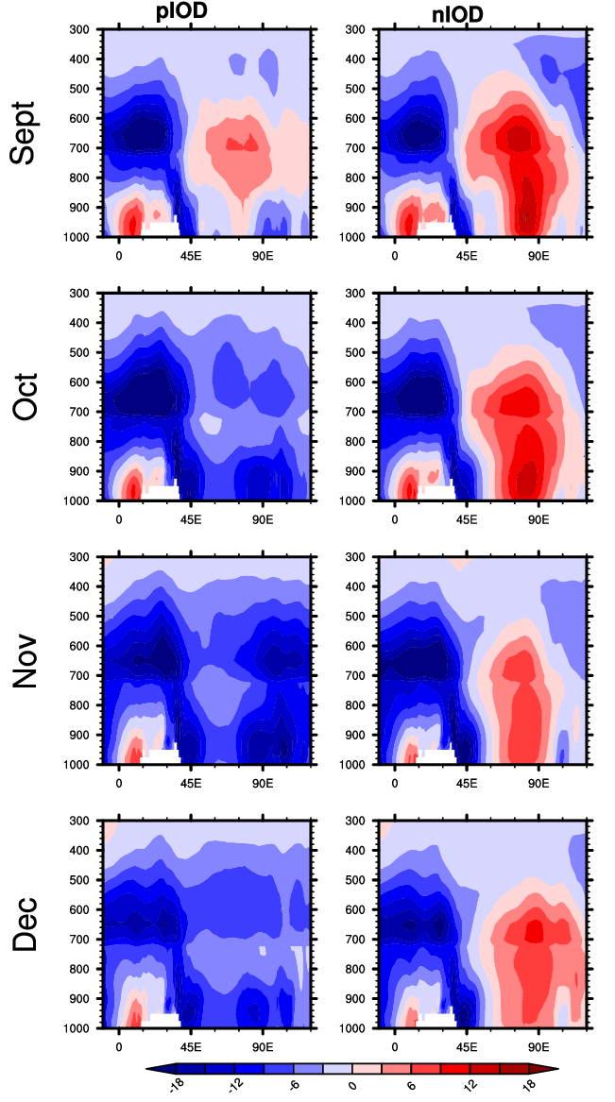
Response of moisture
transport to IOD events
Moisture flow advection is greater during pIOD
than nIOD events and it is maximum between
600 and 700 hpa over CA
Composite anomaly of vertically integrated moisture flux(vectors: kg m⁻¹ s⁻¹)
and vertically integrated moisture flux convergence (shading: 10⁵ kg kg⁻¹ s⁻¹)
Only vectors significant at 95% are represented.
Longitude-height Cross-section
(10°S-10°N) of Zonal moisture flux

Slide 6
Summary
• Central Africa (CA) rainfall exhibits an opposite pattern between pIOD and nIOD events. Indeed, both observational and reanalysis
data reveal that pIOD events are associated with above-normal rainfall while nIOD events result in a rainfall deficit over CA.
• Rainfall intensity increases with the strength of the DMI, although some regions show the opposite pattern.
The relationship between CA rainfall and IOD is stronger after removing the ENSO signal from the IOD.
• Transport of the moisture flux shows a strengthening (weakening) of the moisture flux convergence over the entire troposphere.
Rainfall variability during both phases appears to be influenced by changes in circulation, with moisture flux from the equatorial
and the eastern Indian Ocean above (below) normal during pIOD (nIOD) events.
• Anomalous patterns are more evident in October and November with an asymmetry in the magnitude of the anomalies of the two
phases of the IOD characterised by stronger pIOD events anomalies.

Slide 7
Thank you for your kind attention

