Slide 1
Spatial extent of extreme precipitation systems over the Indian summer monsoon region
Anu Gupta
Hiroshi G. Takahashi
Department of Geography,
Tokyo Metropolitan University
Tokyo, Japan

Slide 2
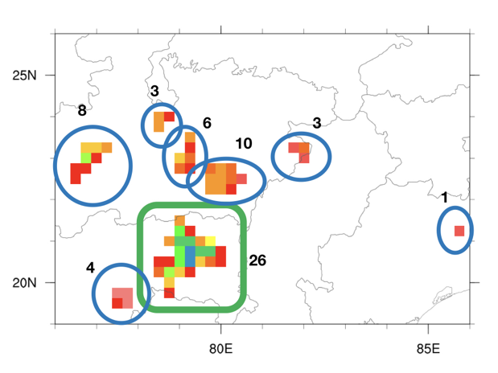
Introduction
a)
This study examines extreme rainfall events (ERE) over central India during the summer monsoon season, focusing on their spatial characteristics.
ERE frequency based on conventional grid approach (hereafter referred as Grid-based study) is equivalent to the total number of grids.
However, Extreme rainfall events usually occurs on a spatial extent, which is associated with many coherent precipitation systems.
The analysis based on the Grid-based approach is not able to provide the information on spatial extent of EREs, hence could not distinguish small and large scale EREs as shown in figure a) and b), which is associated with different physical phenomena.
b)
ERE Frequency (Grid-based approach) = 62 (8+3+6+10+3+4+26+1)
ERE Frequency (Precipitation system Approach; PSA)= 8

Slide 3
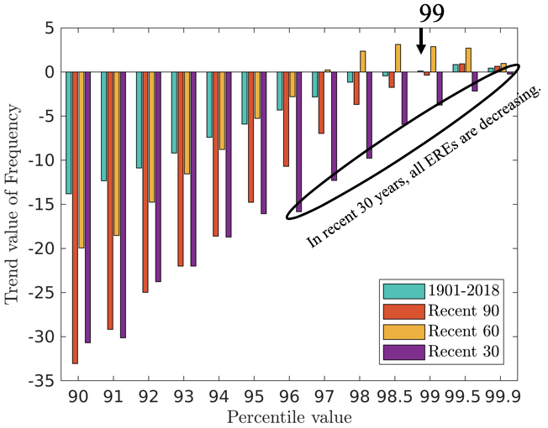
Data and Methodology
Rainfall Dataset
Indian Meteorological Department dataset (IMD)
Time Interval - 1901-2018
Spatial resolution - 0.25º x 0.25º
a)
Figure : a) Long term trends of the different percentile rainfall frequency over central India computed by using the India Meteorological Department (IMD) dataset. Four different periods (recent 30, 60, 90, and 118 years) were used to calculate. b) 99th percentile extreme rainfall event (ERE) rainfall (mm/day) using the IMD dataset. The black box is central India (19º-26ºN and 76º-86º E), a region of interest.

Slide 4
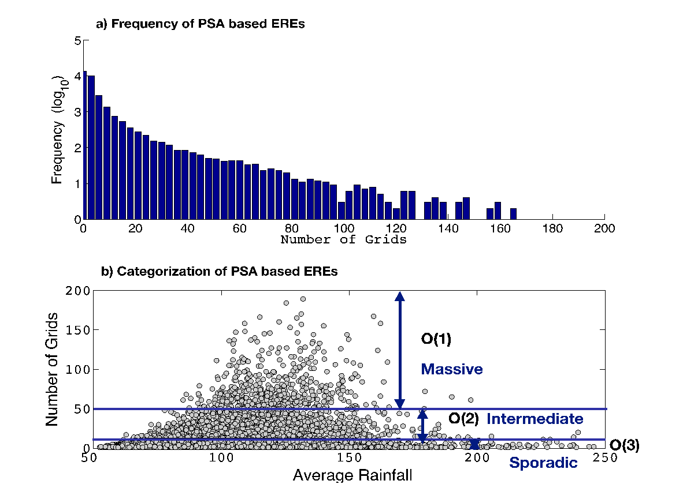
Methodology: Distribution of Number of grids
The frequency of EREs has a logarithmic distribution. The number of EREs decreases as their size increases.
The EREs with small spatial extent has high frequency and EREs with large spatial extent has low frequency.
Based on the size, frequency and number of grids of EREs, extreme events were categorized into three parts : sporadic(1-10grids; <6000 km²), intermediate(10–50 grids; 6000–30,000 km²) and massive (>50 grids; >30,000 km²).
Figure : a) Relation between extreme rainfall event (ERE) frequency based on the precipitation-system approach (PSA) and the number of grids in each ERE system. b) Categorization of PSA-based EREs into large (massive EREs), medium (intermediate EREs), and small (sporadic EREs) based on spatial average rainfall (mm/day) and the number of grids.
.

Slide 5
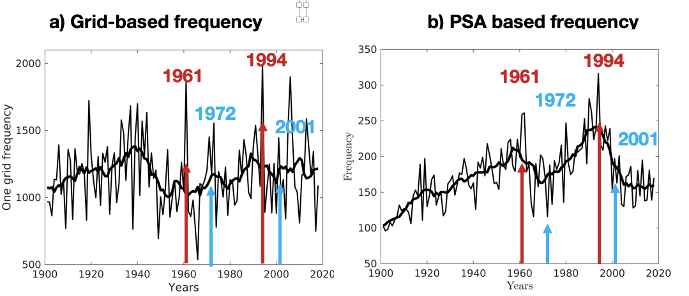
Results
PSA – Precipitation System based Approach
Figure : Long term changes in the frequency of the EREs computed by a) grid-based approach and b) precipitation system approach (PSA).
In long-term Grid-based EREs frequency is not showing much change, while PSA-based EREs are increasing.
It means that the number of precipitation are increasing, while the total number of grids are not showing much variation.
Two high peaks (1961 and 1994) in Grid-based frequency and PSA based frequency shows that these two frequency are not in proportion rather they are independent.
In 1972 and 2001, opposite peaks can be seen in both approaches.

Slide 6
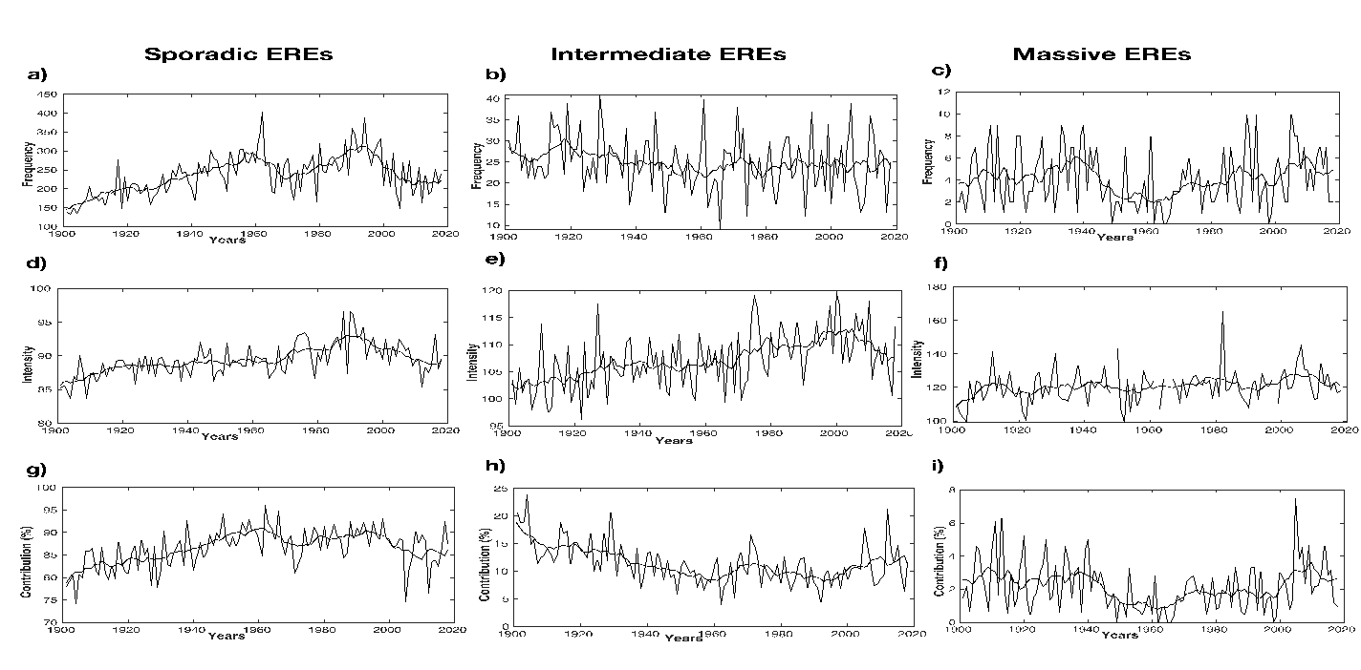
Results: ERE spatial characteristics
Figure : Time series of characteristics of extreme rain events for sporadic (column I), intermediate (column II), and massive (column III) systems in the time interval 1901-2018. Trend plot of frequency (a-c) and intensity (d-e) of extreme events. The smoothed blue line represents the 11-year running mean.

Slide 7
Summary
In previous analysis, it is studied that extreme rainfall events are increasing (specifically after 1950). This increasing trend signal in frequency of EREs is not consistent in different time domains (as shown on 3rd slide). However, the trend in frequency of EREs is dependent on time domain considered. The longer time-series of EREs frequency shows that extreme rainfall events were high in past as well.
If we get an increasing trend signal by grid-based analysis, it could be either because of increasing frequency of EREs or increasing the number of grids corresponding to EREs. However, PSA can provide physically explainable information.
In long term analysis, grid-based doesn’t show much change in EREs frequency, whereas PSA shows an increasing long-term pattern. Which means number of precipitation systems are increasing while total number of grids with extreme rainfall are not changing much.
Events with the smallest spatial extent have the highest frequency, whereas massive EREs have the least frequency.
Most of the contribution to the frequency of EREs comes from sporadic events. Therefore, sporadic and PSA-based EREs have the same pattern in EREs frequency.
In long-term, massive EREs are not increasing in frequency and intensity. However, the sporadic and intermediate EREs are getting intensified.

