Slide 1
Investigating the effects of the extratropical transition of North Indian Ocean Cyclones over Iran in four case studies
IGUT
Institute of Geophysics, University of Tehran
Milad Behravesh
milad.Behravesh@ut.ac.ir
+98 911 140 6318
ICTP online workshop on Indian Ocean Variability and Teleconnections
15 to 17 March 2021

Slide 2
Extratropical transition of NIOC
IGUT
Chapala
27 Oct to 3 Nov 2015
post-monsoon-season cyclones
Megh
4-10 Nov 2015
Phet
30 May to 7 June 2010
monsoon-season cyclones
Ashobaa
6-12 June 2015
From zoom.earth by permission

Slide 3
Extratropical transition of NIOC
IGUT
WRF model
Some physical schemes:
PBL: YSU
Convection: Kain-Fritsch
Microphysics: Purdue Lin
Grid length in x-direction 30 km with 360 grid points
Grid length in y-direction 30 km with 165 grid points

Slide 4
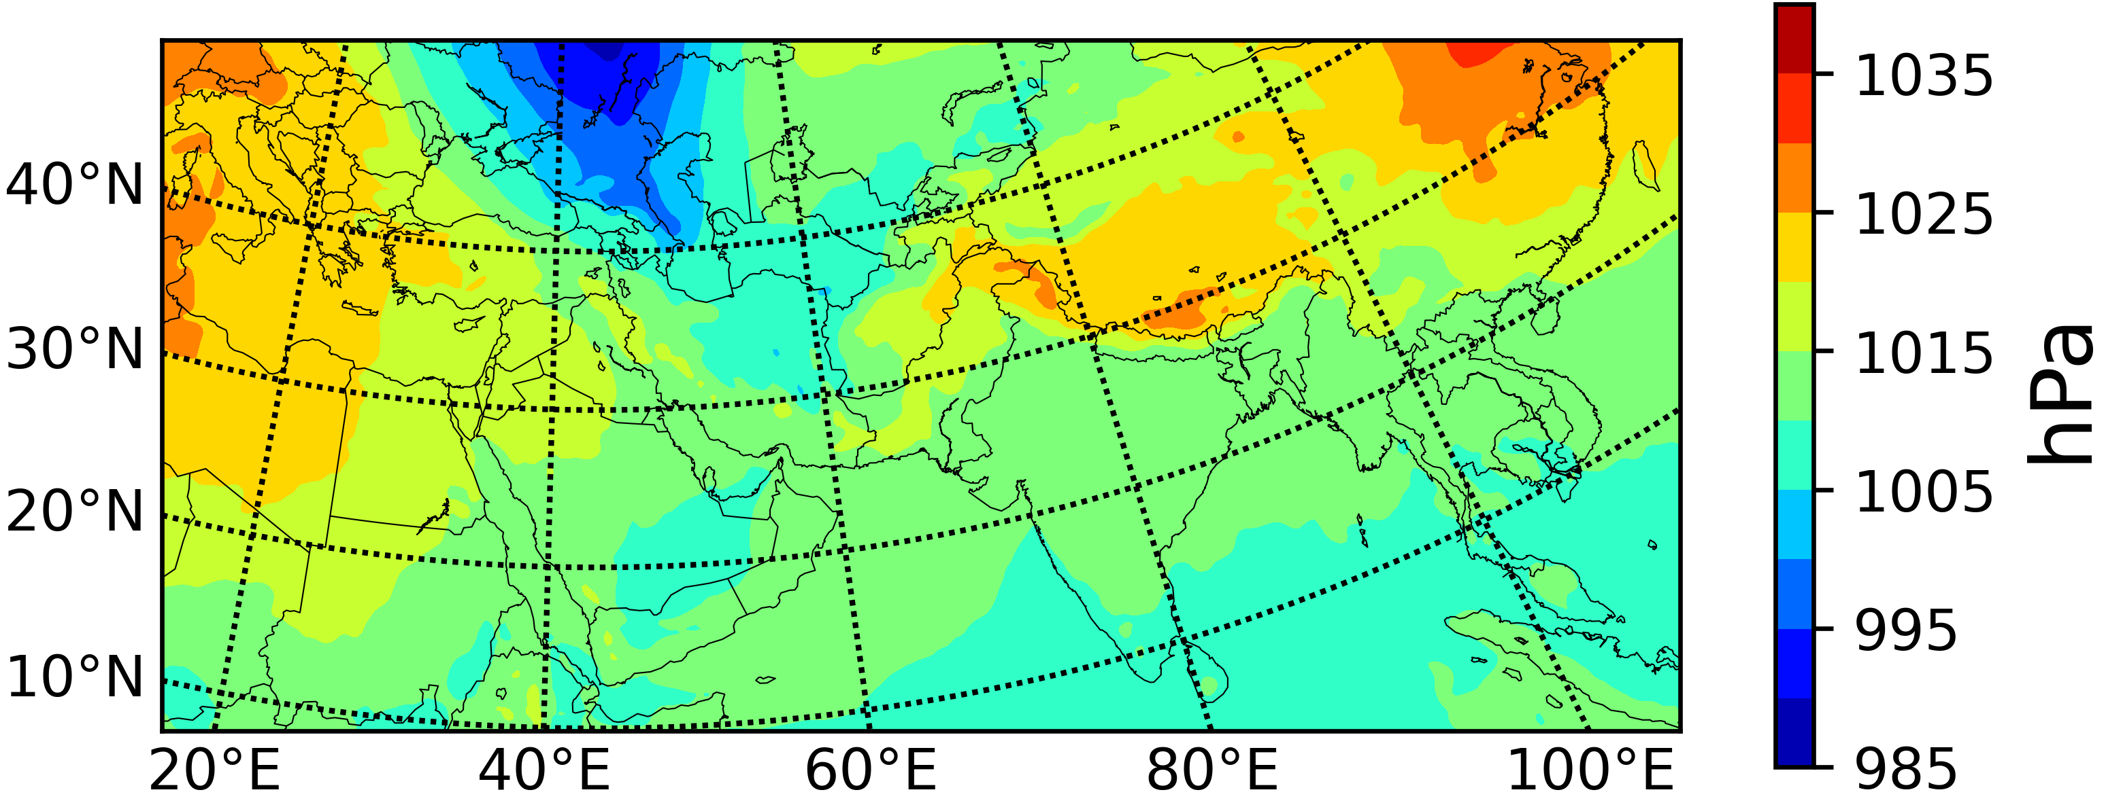
Extratropical transition of NIOC
IGUT
Megh: slp-during the activity
Megh: slp-after the activity
8 Nov-12UTC
11 Nov-12UTC
Chapala: 500 hPa gph and wind-during the activity
Chapala: 500 hPa gph and wind-after the activity
1 Nov-12UTC
4 Nov-18UTC

Slide 5
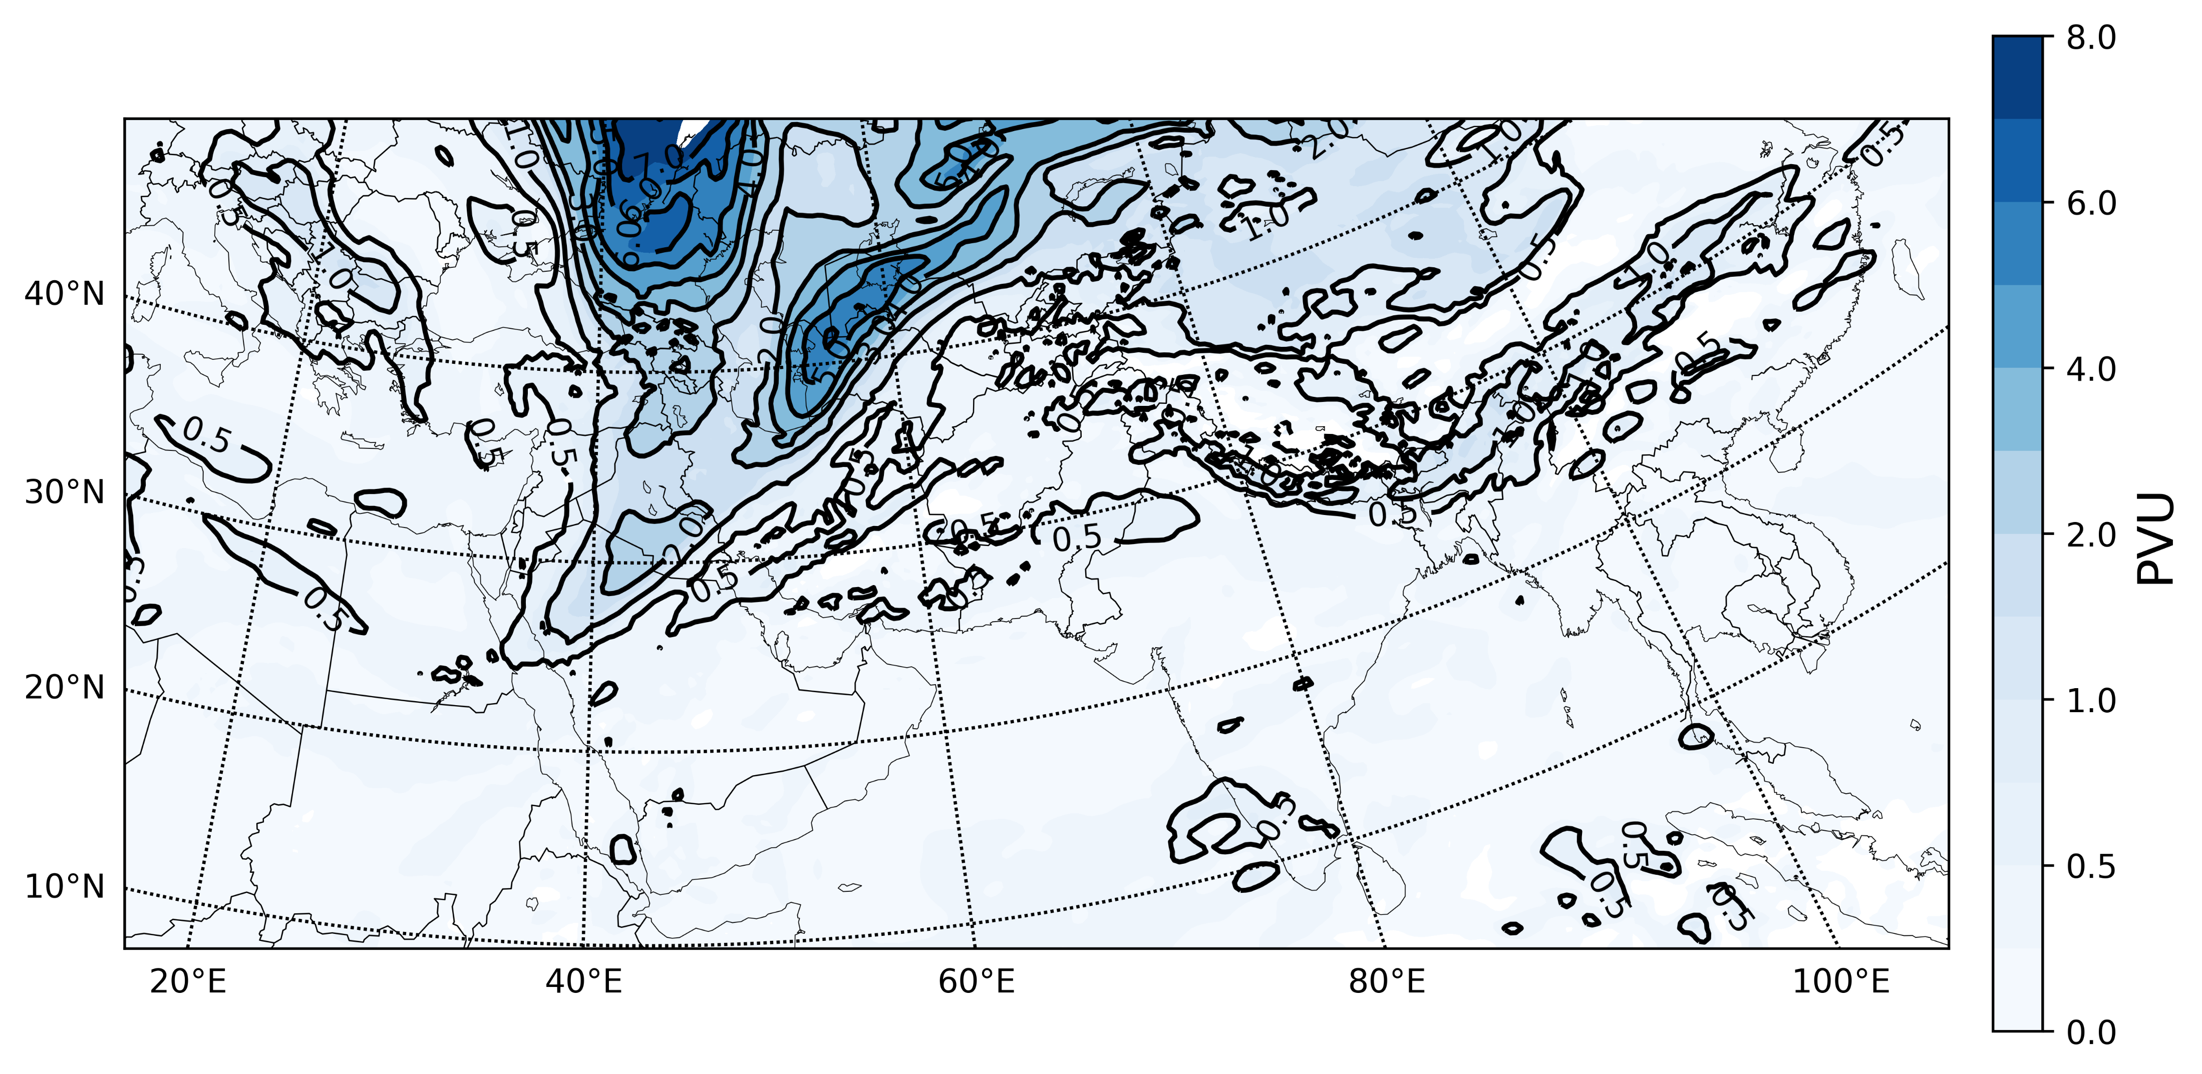
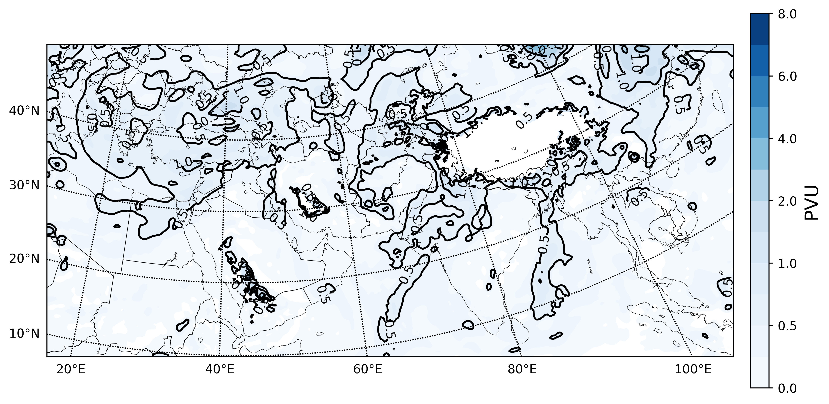
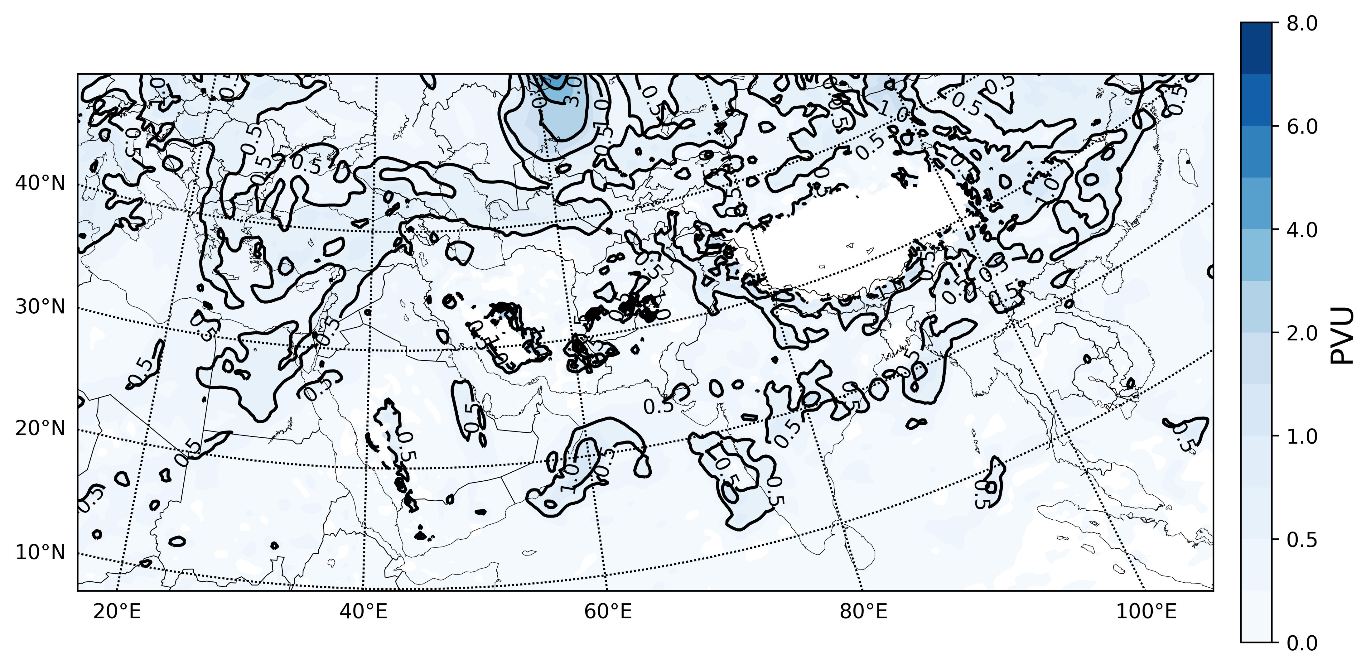
PV on 320 K isentropic surface
IGUT
Chapala: PV-after the activity
Megh: PV-after the activity
4 Nov-18UTC
11 Nov-12UTC
Phet: PV-after the activity
Ashobaa: PV-after the activity
8 June-18UTC
13 June-18UTC

Slide 6
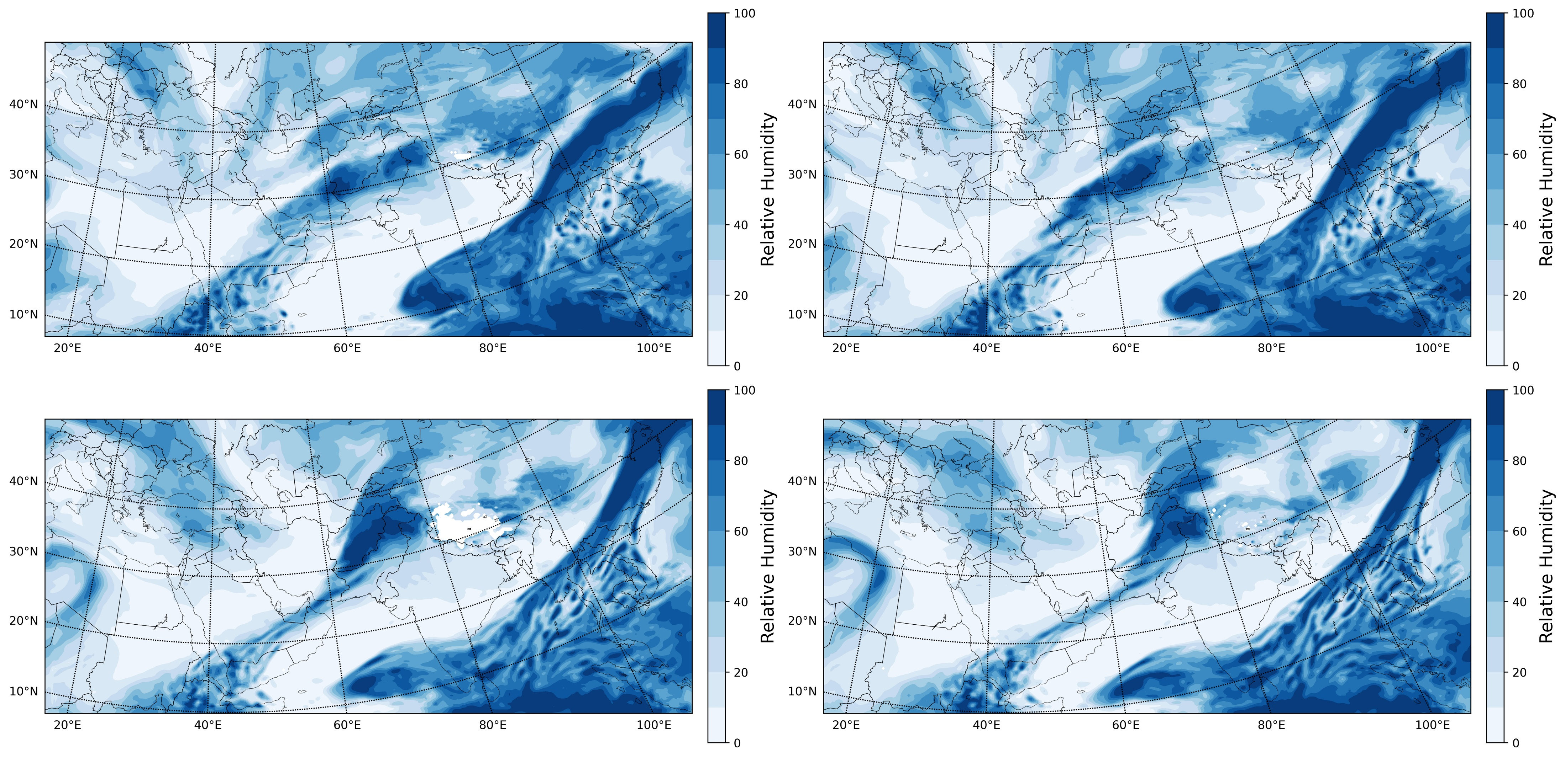
RH on 320 K isentropic surface
IGUT
Chapala
Megh

Slide 7
Conclusions
IGUT
In all simulations, the surface pressure at higher latitudes has decreased after finishing the cyclones activity, especially over some parts of Europe and Russia.
Changes in the maximum wind speed location in the post-monsoon season cyclones have been noticed in the 500 hPa trough from downstream to upstream. Also, a similar wind speed pattern displacement was noticed at 300 hPa jet-stream.
All simulations have proved the transfer of the potential vorticity (small amounts up to 0.5 PVU) into the midlatitudes by ascending on the 320 K isentropic surface. Moreover, a similar pattern was noticed in the relative humidity by ascending on the 320 K isentropic surface into the midlatitudes, especially towards the west of Iran in Chapala and south of Iran in Megh.
It seems that post-monsoon season cyclones with the westward movement toward the coast of Yemen (considering the topography of that region) have more indirect impacts on Iran.

