Slide 1
Information entropy as quantifier of potential predictability in the tropical Indo-Pacific basin
Olawale J. Ikuyajolu, Fabrizio Falasca, Annalisa Bracco

Slide 2
Tropical Indo-Pacific Basin
Wang et al 2019
ASON SST EOFs (1980 – 2018)

Slide 3
predictability potential? ReCURRENCE PLOT and Information EnTROPY
Given a trajectory 𝒙_{i} of a dynamical system in a 𝑑-dimensional state space at time 𝑖, a RP is an 𝑁 × 𝑁 matrix of 1 and 0 such that:
ε : threshold distance and defines the neighborhood of a state 𝒙,
Ѳ : Heaviside function
‖ ‖ : norm and 𝑁 is the number of states considered
The entropy of a time series can be computed by the probability of occurrence of microstates in its RP.
A microstate of size M is defined as an M × M matrix inside the RP. The total number of configurations of 1 and 0 in a microstate of size M is M* = 2^{M x M}
Probability of occurrence
Information entropy

Slide 4
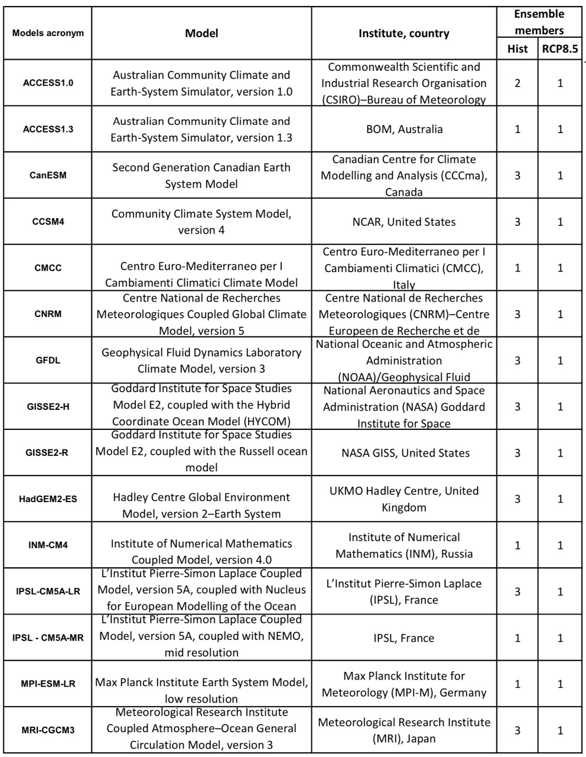
DATA
Simple Ocean Data Assimilation (SODA) version 3.4.2
ERA-Interim
15 CMIP5 models
We focus on Extended boreal fall season in 1967–2005 for models and 1980–2018 for reanalysis.

Slide 5
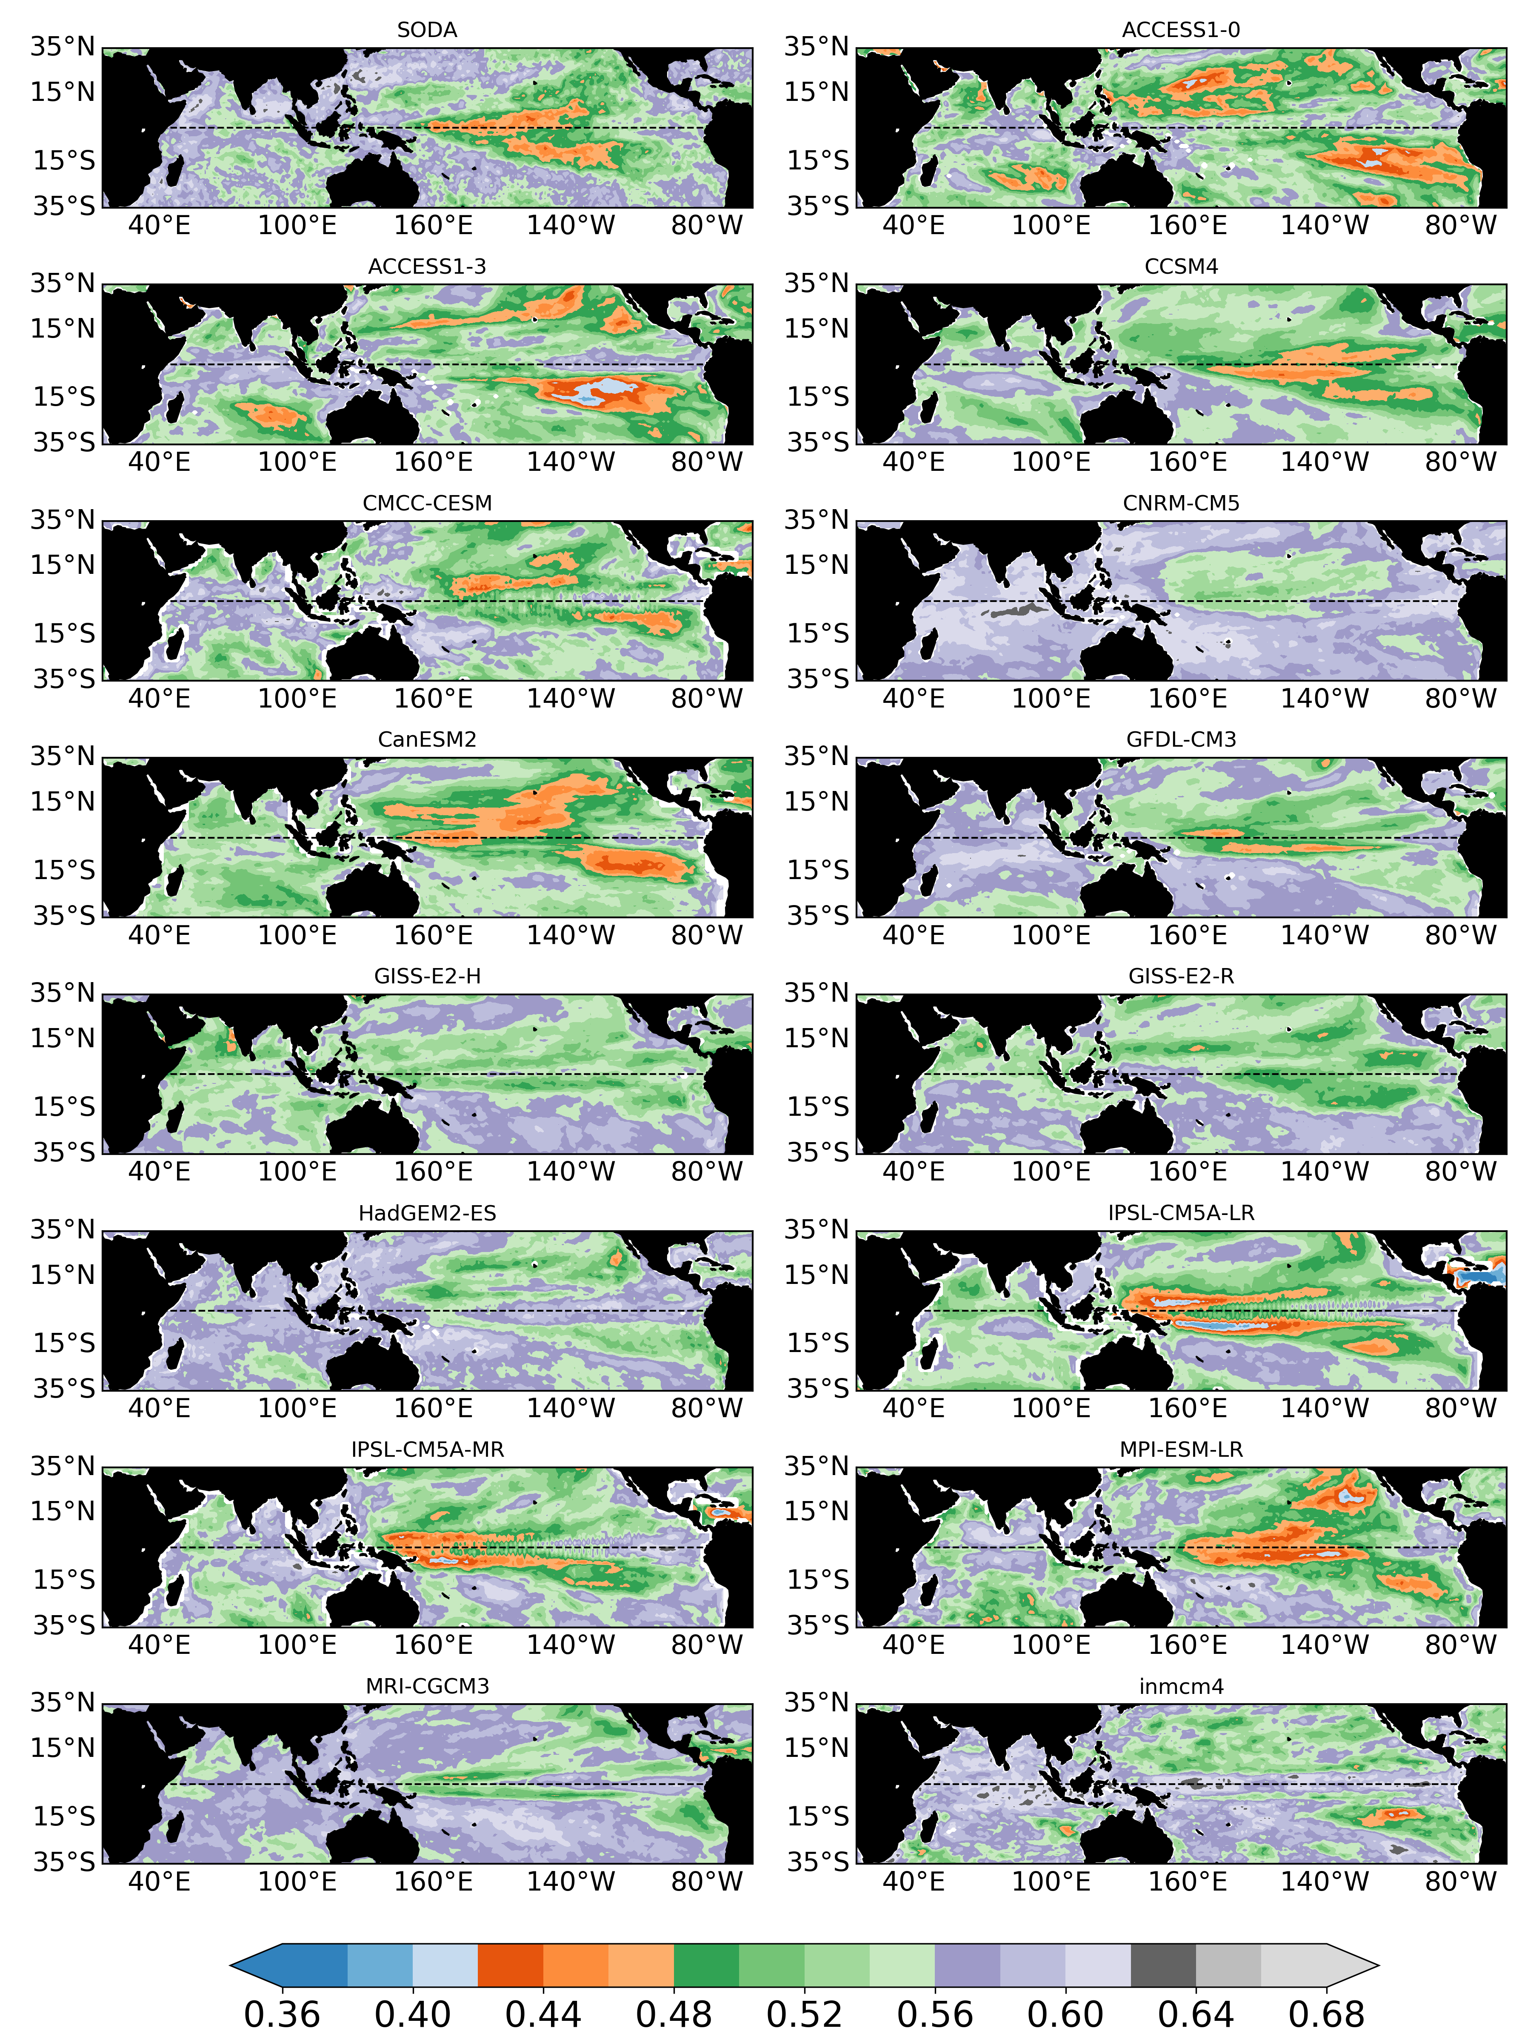
Spring (MAM) entropy fields (M = 3)

Slide 6
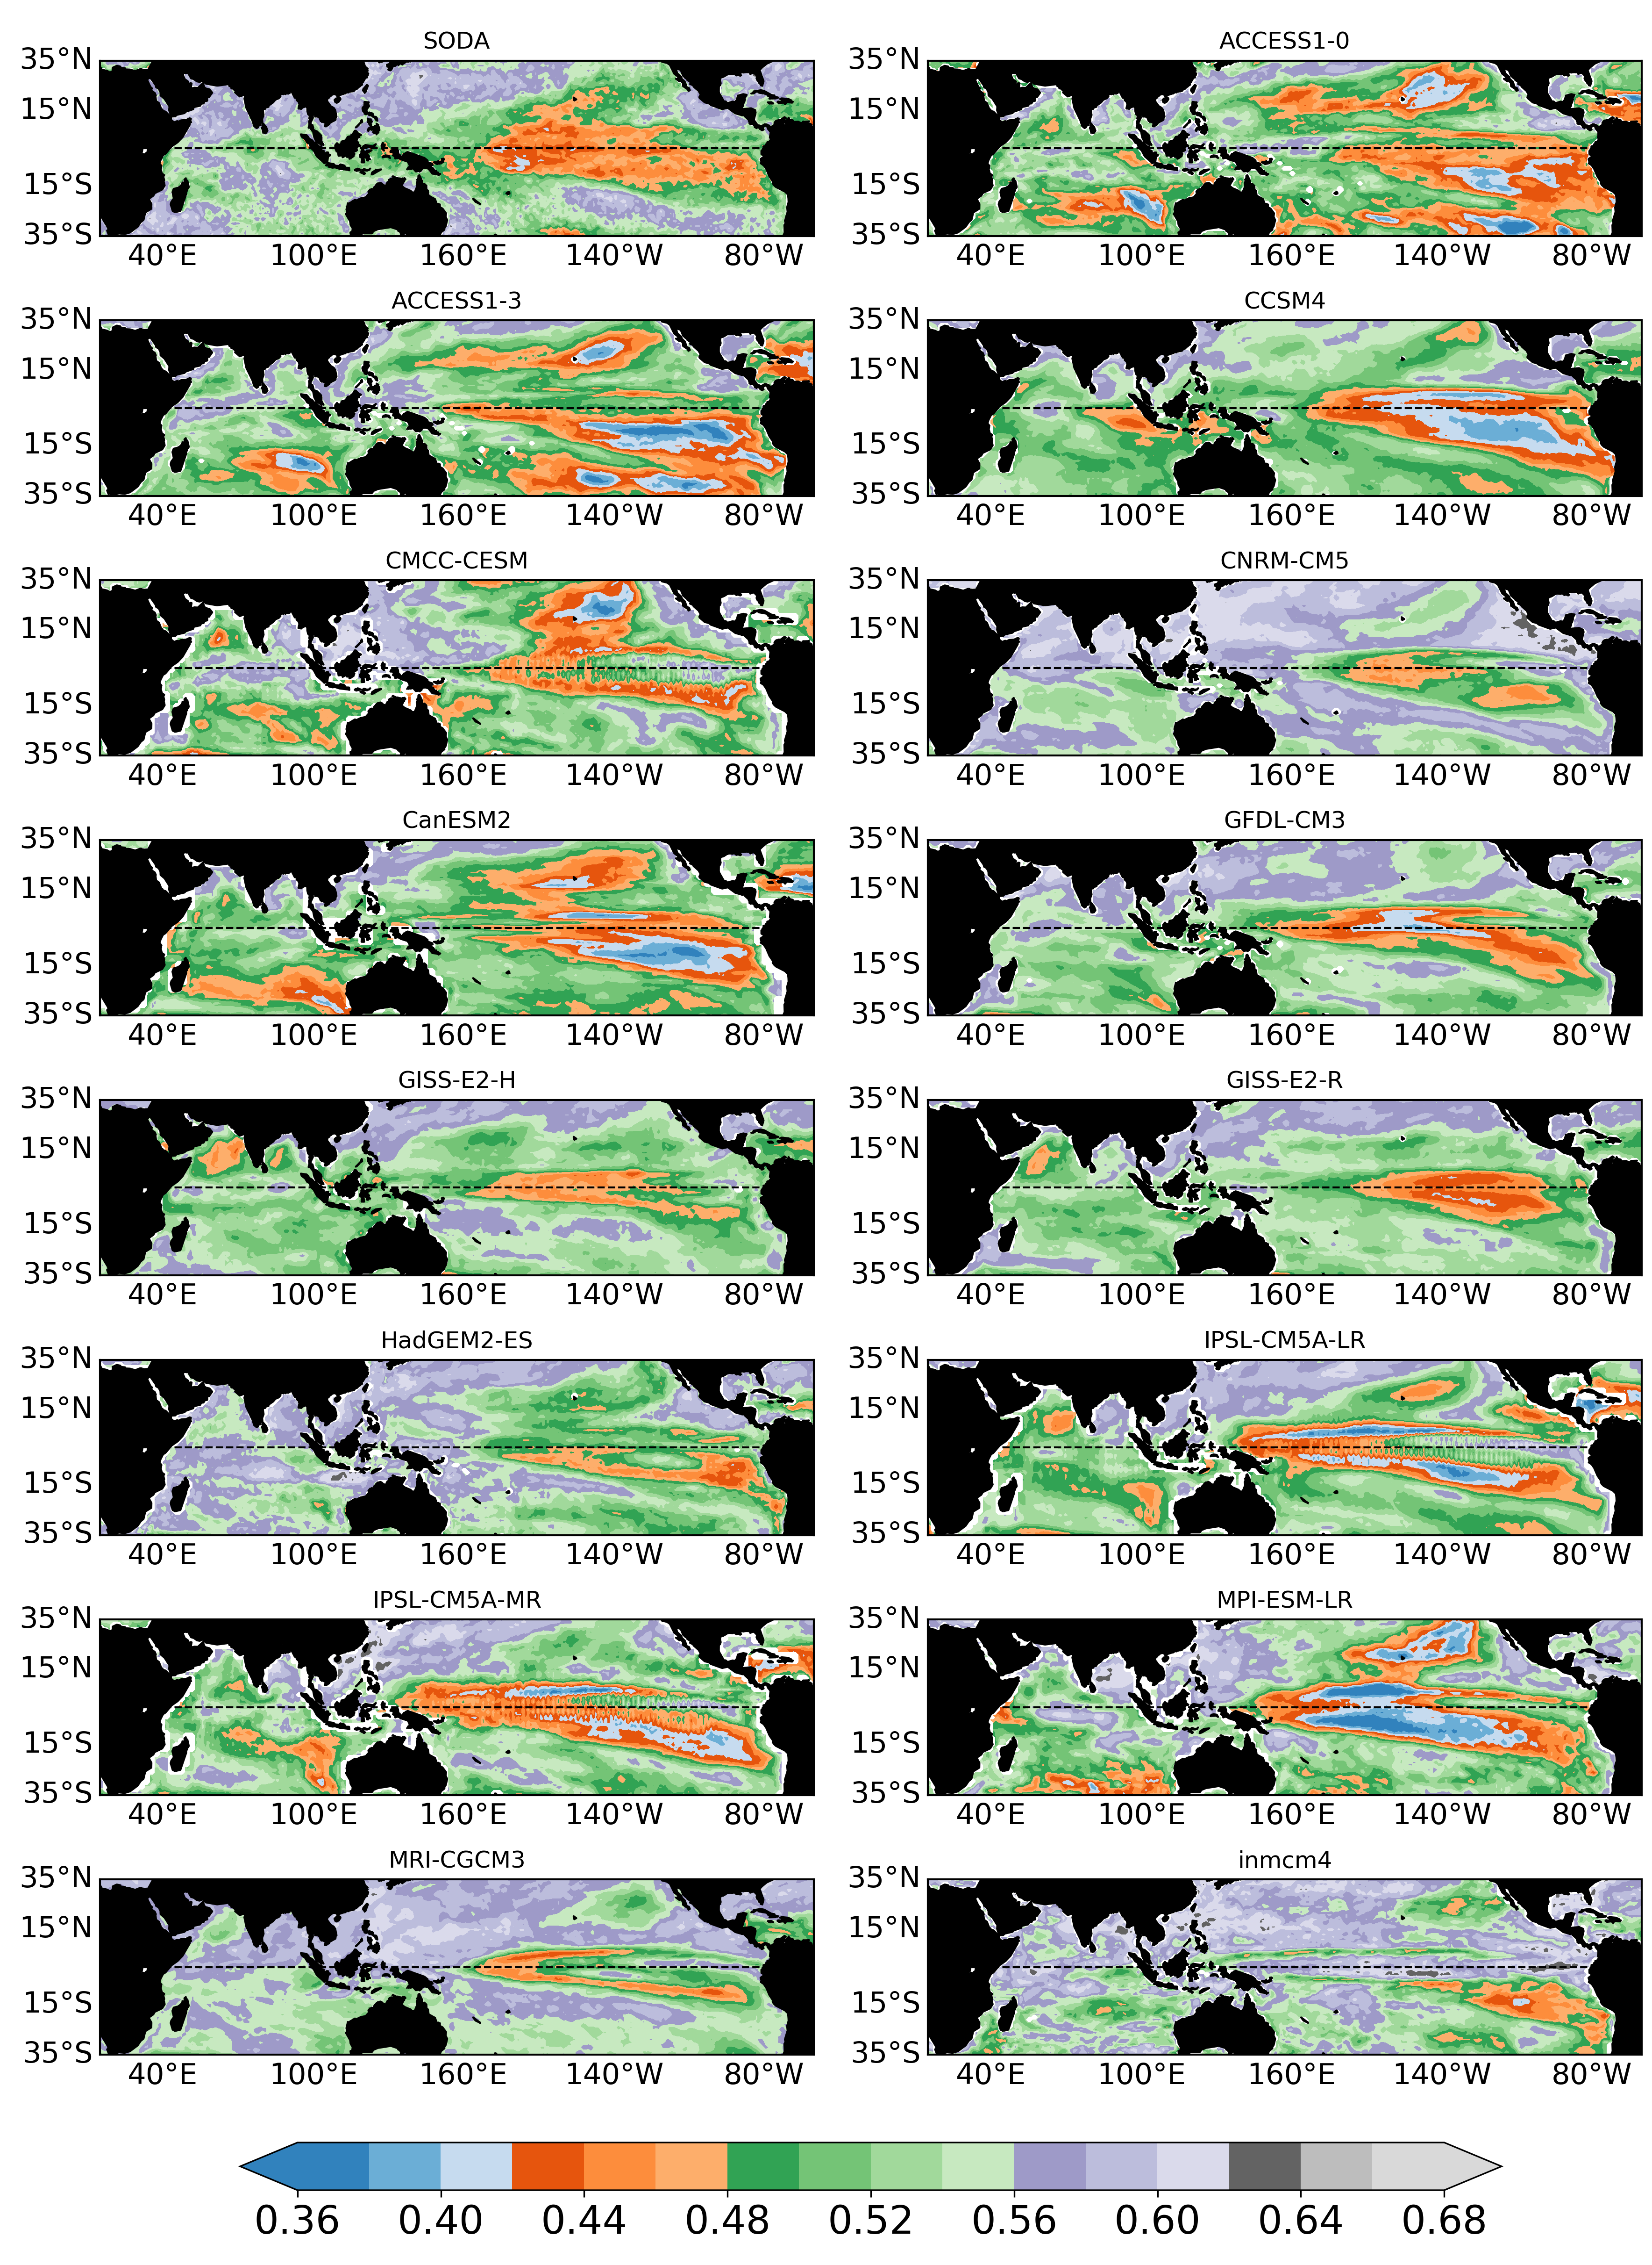
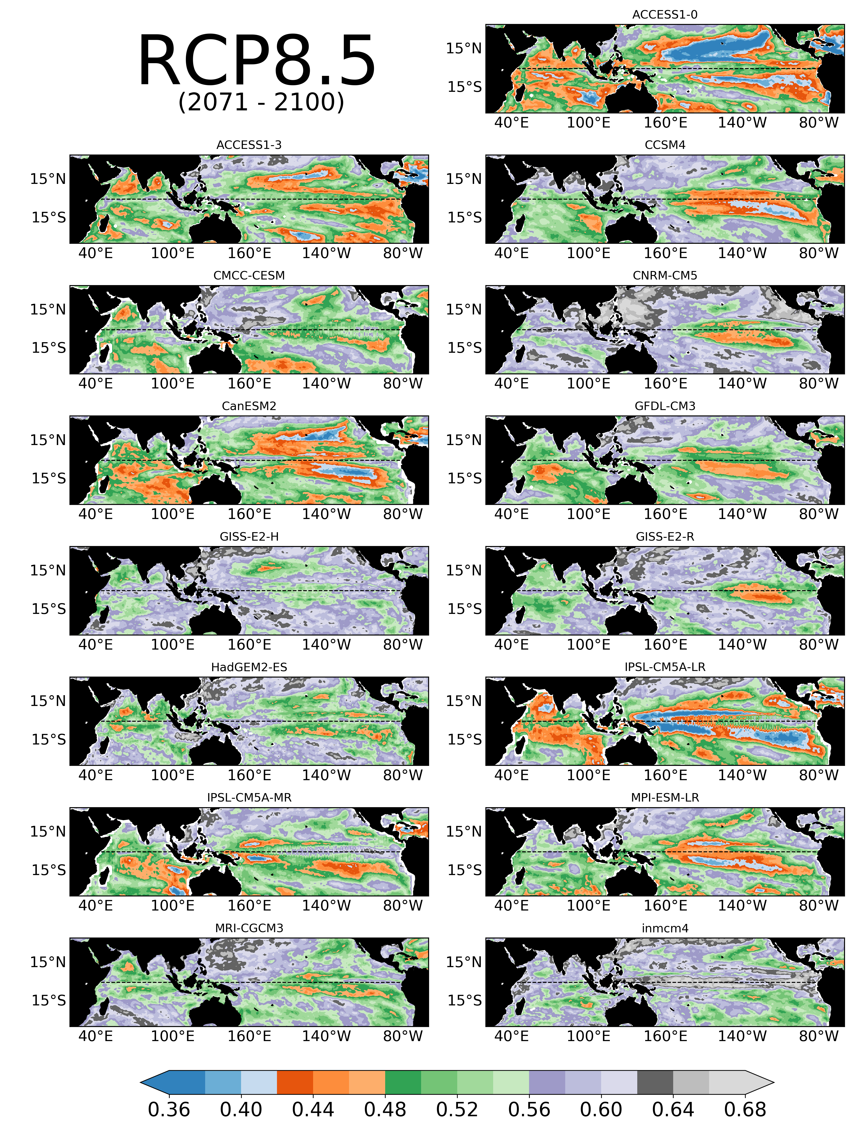
FALL (ASON) entropy fields (M = 3)
Historical (1967 – 2005)

Slide 7
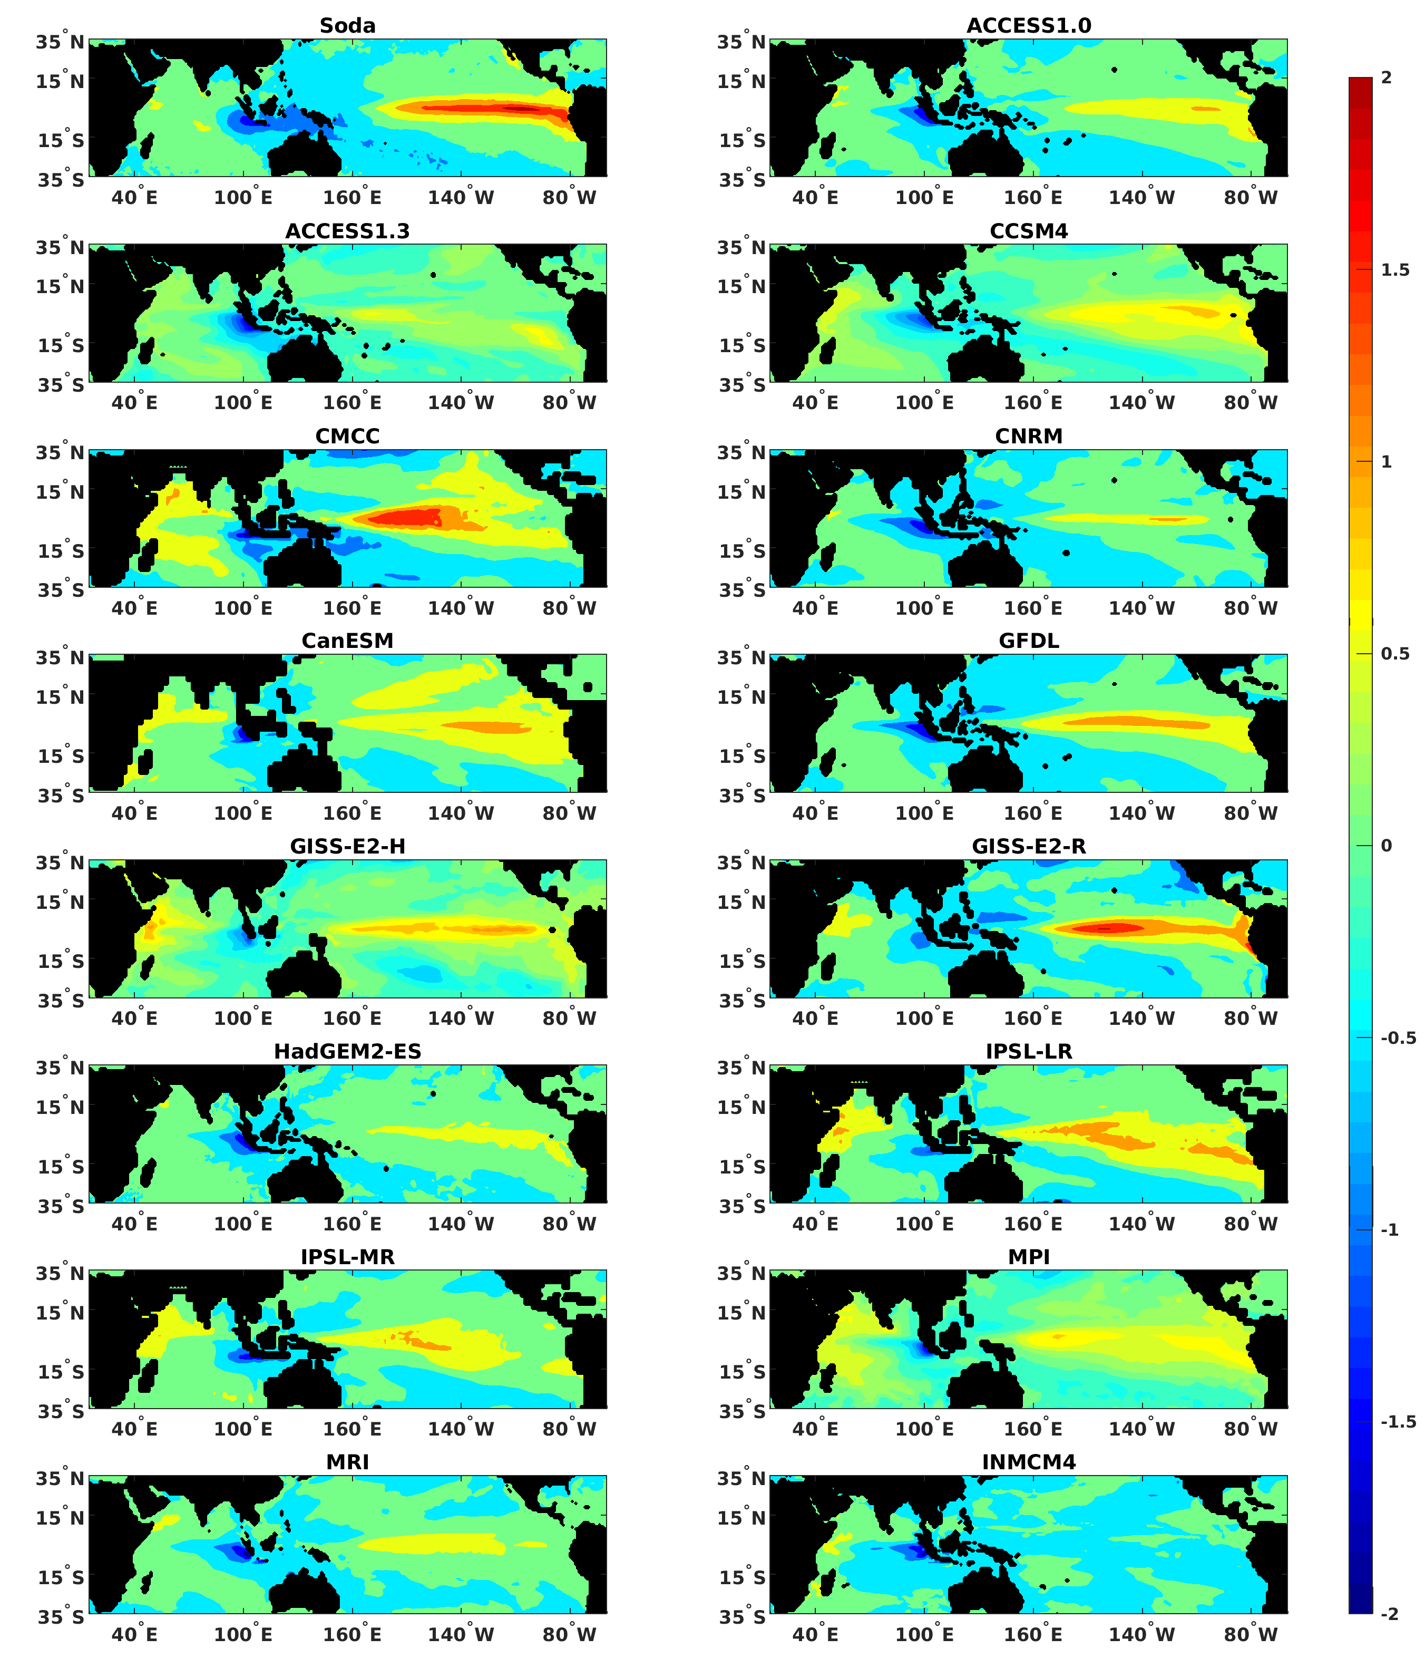
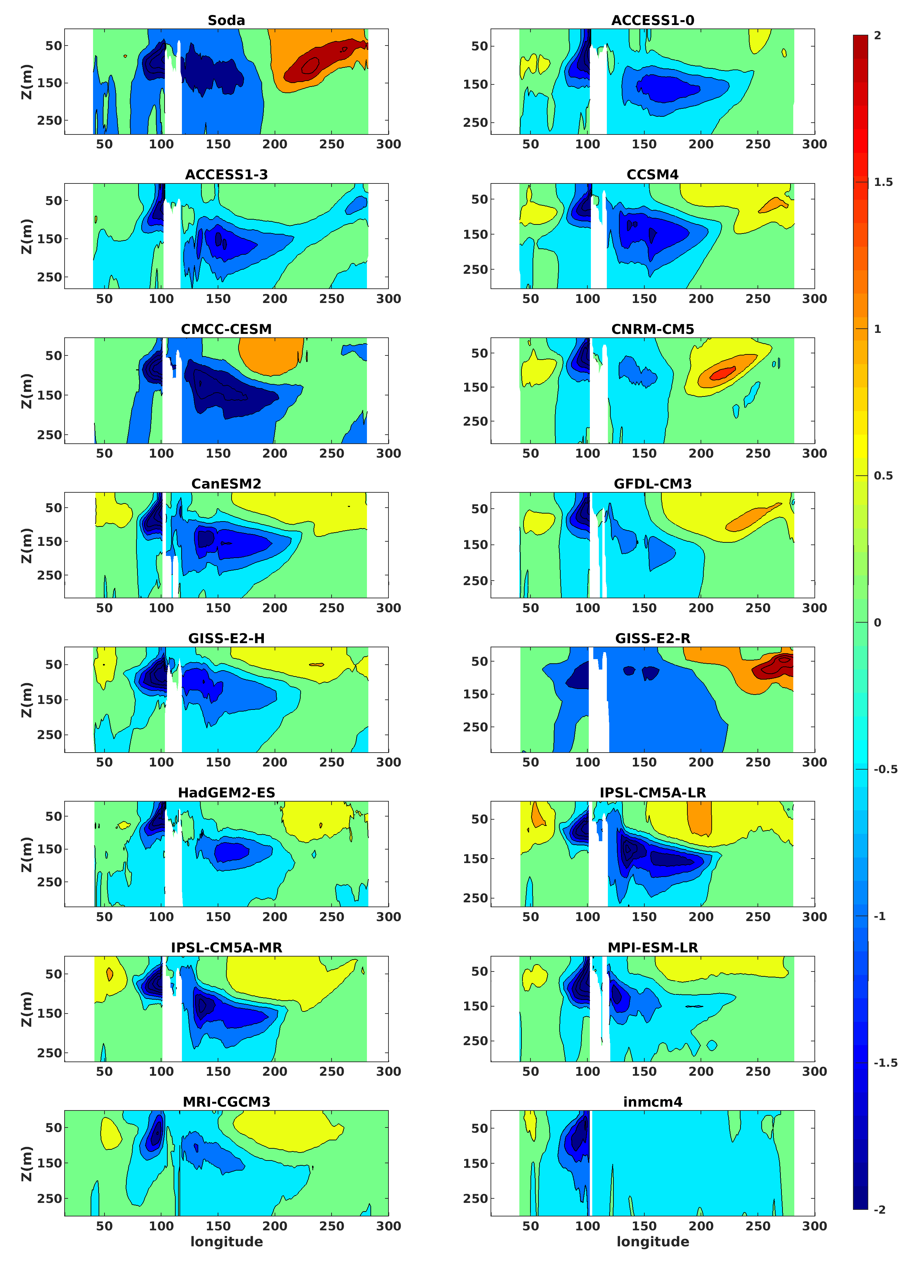
Tropical INDO-pacific OCEANIC BRIDGE
Regression maps of the tropical Indo-Pacific sea surface temperatures onto the IOD.
Regression maps of the tropical Indo-Pacific sea subsurface temperatures averaged between 5°N-5°S onto the IOD.

Slide 8
SUMMARY
Our analysis highlights the limitations that coupled climate models still face in addressing predictability and its potential changes.
In the historical period, very few models capture both pattern and intensity of the entropy signal of the reanalysis.
Overall, many models struggle at the equator, in both basins, and display unrealistic regular dynamics in the IO, especially south of the equator and/or in the Arabian Sea.
Biased representation of coupled equatorial dynamics and of the atmospheric and subsurface oceanic bridge between the Pacific and Indian Oceans via the ITF contribute to the poor representation of the Indo-Pacific entropy in fall
No robust signal is found in the models, in both basins, as to how predictability will evolve in the future.
Our results exemplify how information entropy may contribute a new powerful tool to investigate the potential predictability of the climate system.

