Slide 1


Molecular Dynamics Simulations of Sodium Borosilicate Glasses for
Nuclear Field Applications
Pooja Sahu
psahu@barc.gov.in
Chemical Engineering Division
Bhabha Atomic Research Centre
Department of Atomic Energy
India

Slide 2
Outline
Glass in Nuclear Industries
Nuclear Waste management and glass vitrification
Microscopic glass structure
Network formers, network modifiers and intermediate oxides
Computational Protocols
Software, Interaction potential and simulation methodology
MD simulated glasses
Mono-oxide, binary and tertiary glass mixtures
Conclusion

Slide 3
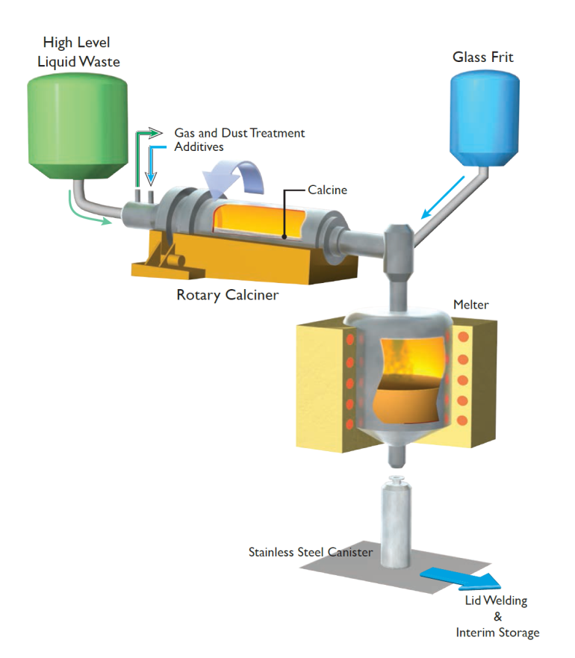

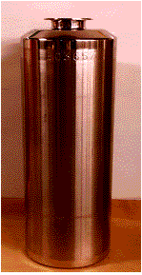
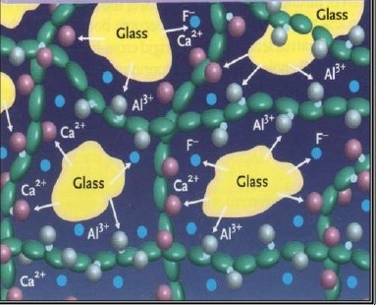
Glass in Nuclear Industries
Treatment and Conditioning of HLW
Source
Spent fuel from commercial/research reactors,
Liquid waste from the reprocessing of spent fuel
Waste from the nuclear weapons and propulsions industry
Treatment
Long term storage : converting into relatively insoluble, compact solids and then eventual deposit into a geological repository
Need of Computer simulations
Handling of Radioactive Materials
High Temperature Process
Long term activities: leaching, chemical reactivity and
mechanical disintegration
Understanding of the process

Slide 4
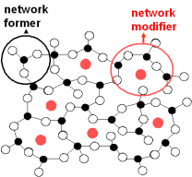
Microscopic Glass Structure
Network Former
Oxides of P-block elements : Si, B, P, Ge
Strong bonds to oxygen
Coordination is sharply defined
Network Modifier
Oxides of S block elements : Na, Ca
Weak, non-directional bonds to oxygen
Flexible coordination geometries
Broad distribution over bond lengths, and coordination
Intermediates
Oxides of Al, Ti, V and Mo participate as network former in presence of other oxides
Depending on composition may act either as network former or as network modifier.
Notes:
B4 going into details I would like to present a brief overview about basic structure of glass ..

Slide 5
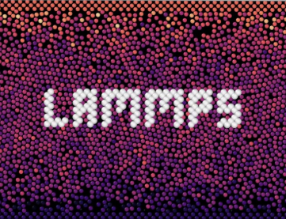
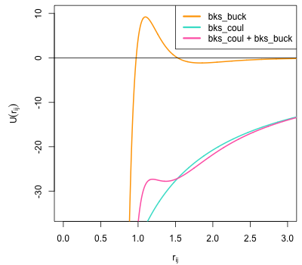
Computational Protocols
Melt: Heated @ 5000 K to remove associated memory effects
Quench: Quenched @ 0.4K/ps to create amorphous system.
Equilibration and Data Collection: equilibrate to room conditions and analyzed the data collected.
Interaction Potential
BKS Potential: (Parameterized by combining microscopic (ab initio computations) and macroscopic (experimental) data
This potential better-models the repulsive Interaction at modest nuclear distances

Slide 6
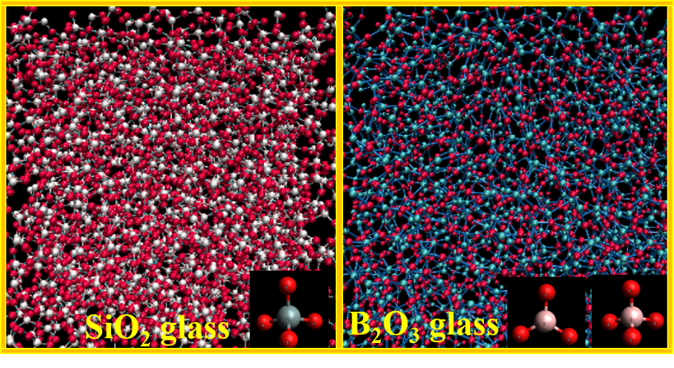
Mono-oxide Glasses
SiO₂ and B₂O₃
LO-Si-O = 109.47º
LO-B-O = 120º
Tetrahedral coordination of Si
three-fold coordination of B
2.38 g/cm³
1.82 g/cm³
SiO₂ show a flat peak at 200-600 cm⁻¹ and another peak at high frequencies ~1050-1070 cm⁻¹
B₂O₃, shows four characteristic peaks at 130 cm⁻¹ , 670 cm⁻¹ , 960 cm⁻¹ and 1180 cm⁻¹
FSDP at 1.2-1.3 Å⁻¹ for SiO₂ and 1.45-1.65 Å⁻¹ for B₂O₃
first peak at ~2.15-2.25 Å⁻¹ and second peak at around 5.45 Å⁻¹ for SiO₂, first peak at 2.4-2.45 Å⁻¹ and negative dip at 3.0 Å⁻¹ for B₂O₃

Slide 7
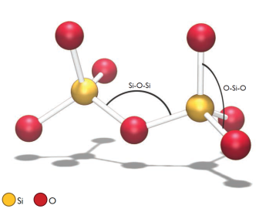
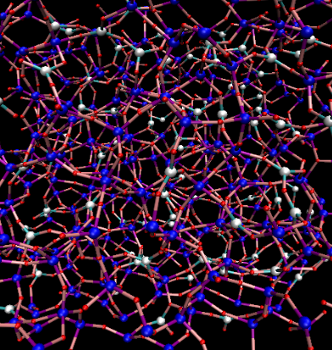
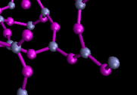
Binary-oxide Glasses
Borosilicate
Tetrahedral coordination of Si
Three and four fold coordination of B
LO-Si-O = 109.47º
LO-B-O = 120º
Si
B
O
Increasing density and
enhanced network connectivity with increasing SiO₂

Slide 8
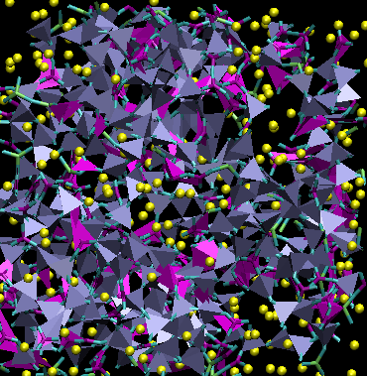
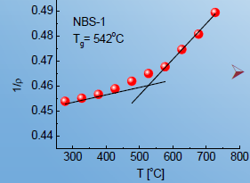

Ternary Sodium-borosilicate (NBS) glass
[106Na₂O.123B₂O₃.370SiO₂]
2.42 g/cm³
T_{g} = 542ºC
Average CN of O atoms:
Si=4, B=3.8 and Na=10.28
RDF peak position:
Si=1.62, B=1.48 and Na= 2.55Å
Maximum density and BO₄ fraction at 40% Na₂O

Slide 9
Effect of Composition : NBS glass
_{SiO2}
_{B2O3}
_{Na}
Composition of NBS glasses
 | N_{SiO2} | N_{B2O3} | N_{Na2O} | R (N_{Na2O}/ N_{B2O3}) | K (N_{SiO2}/ N_{B2O3})
NBS1 | 55% | 20% | 25% | 1.25 | 2.75
NBS2 | 60% | 20% | 20% | 1 | 3
NBS3 | 53% | 27% | 20% | 0.75 | 2
Density → SiO2 content
NBO → Na2O and then SiO2
BO4 → Na2O and then SiO2 content
 | Density [g.cm⁻³] | % NBO | % B4
NBS1 | 2.273(*2.42) | 19.77 | 58.44
NBS2 | 2.275(*2.43) | 16.23 | 57.26
NBS3 | 2.269(*2.38) | 17.57 | 48.42

Slide 10
Short Range Order : Bond/Angle distribution
Average Coordination Number
Pairs | NBS1 | NBS2 | NBS3
Si-O | 4.00 | 4.00 | 4.00
B-O | 3.67 | 3.63 | 3.56
Na-O | 5.67 | 6.00 | 5.54
Si-Si | 1.77 | 2.03 | 1.15
Si-B | 1.94 | 1.82 | 2.81
B-B | 1.22 | 1.23 | 1.47
No effect on SiO4 tetrahedrals
B-O CN as per BO4 content
Na as charge compensator have lower CN
X-X CN as per SiO2 and B2O3 content

Slide 11
Medium Range Order : Structure Factor
The major differences are noticed in position and shape of the peaks/dips at lower k i.e. 1-10 Å⁻¹, which are related with the medium range structure of the glass
Overlapped peaks/dips for NBS1 and NBS2
Splitting of FSDP for NBS1 and NBS3

Slide 12
Medium Range Order : Network connectivity
Probability of connection between structural units
 | Si-O-Si | Si-O-B3 | Si-O-B4 | B3-O-B3 | B3-O-B4 | B4-O-B4
NBS1 | 20.73 | 8.87 | 34.41 | 0.89 | 4.875 | 4.30
NBS2 | 23.68 | 9.90 | 30.55 | 1.09 | 4.54 | 3.30
NBS3 | 12.49 | 16.97 | 39.79 | 2.21 | 7.55 | 4.85
NBS3: Si-O-B4 > Si-O-B3 > Si-O-Si > B3-O-B4 > B4-O-B4 > B3-O-B3
NBS1 & NBS2 : Si-O-B4 > Si-O-Si > Si-O-B3 > B3-O-B4 > B4-O-B4 > B3-O-B3
Si-O-B4 favored over Si-O-Si
The intermixing of B3 and B4 i.e. B3-O-B4 connections preferred over either of B3-O-B3 or B4-O-B4 connections
On Contrary to ”B[4] avoidance” rule, the present study showed abundant presence of B4-O-B4 units

Slide 13
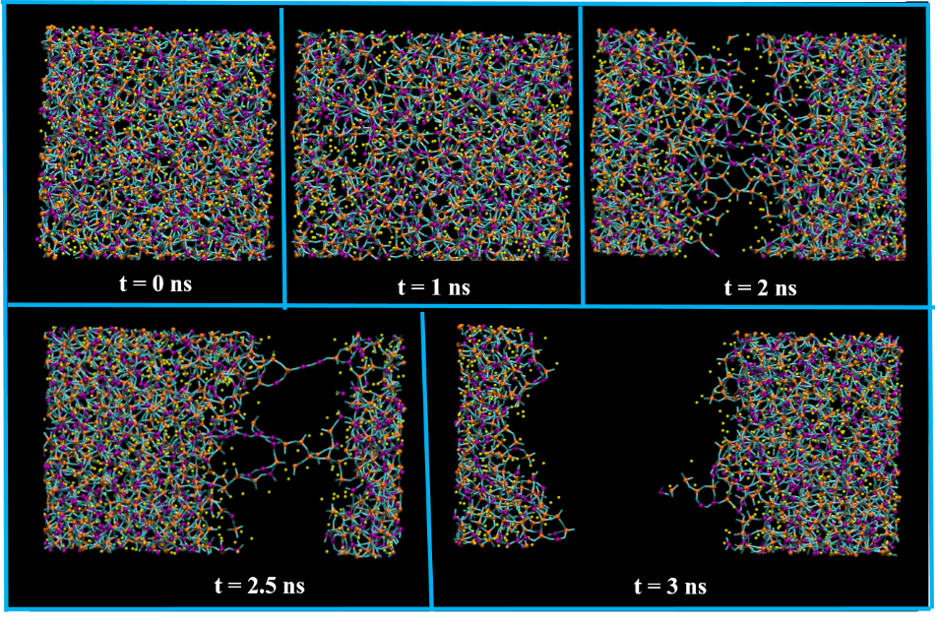
Mechanical Strength : Stress-strain analysis
Plastic like deformation prior to brittle fracture
Deformation achieved via opening of angles
Young Modulus → SiO2 content
Yield & Intrinsic strength → primary by B2O3 then secondary by Na2O content
 | NBS1 | NBS2 | NBS3
Young Modulus (GPa) | 40.65 | 42.74 | 39.66
Intrinsic strength (GPa) | 2.5 | 3.25 | 3.4
Yield Strength (GPa) | 1.92 | 2.15 | 2.51

Slide 14
Chemical Durability : Diffusivity
Diffusivity of sodium ions (D_{Na}) and boron atoms (D_{B}) [unit ˣ10⁻⁷ cm²/sec] at 600K
Glass | D_{Na} | D_{B}
NBS1 | 0.374±0.012 | 0.359±0.016
NBS2 | 0.235±0.009 | 0.221±0.013
NBS3 | 0.190±0.011 | 0.182±0.007
D of Na higher than B
D maximum for NBS1(high Na2O) and minimum for NBS3 (lower SiO2)
Increasing D with temperature

Slide 15
Thermal Stability
Glass Transition temperature Tg & Thermal Expansion Coefficient (TEC)
 | NBS1 | NBS2 | NBS3
Tg [⁰C] | 567.63 (*518) | 572.31 (*537) | 481.79 (*489)
TEC [x10⁻⁵] /⁰C | 1.13 (*1.05) | 0.73 (*0.88) | 1.05 (*0.89)
Highest SiO₂ in NBS2 corresponded to maximum T_{g}
Highest B₂O₃ in NBS3 lead to lowest T_{g}
NBS1 showed the highest TEC due to the highest Na₂O content
Lower SiO2 responsible for a higher TEC of NBS3 than NBS2

Slide 16
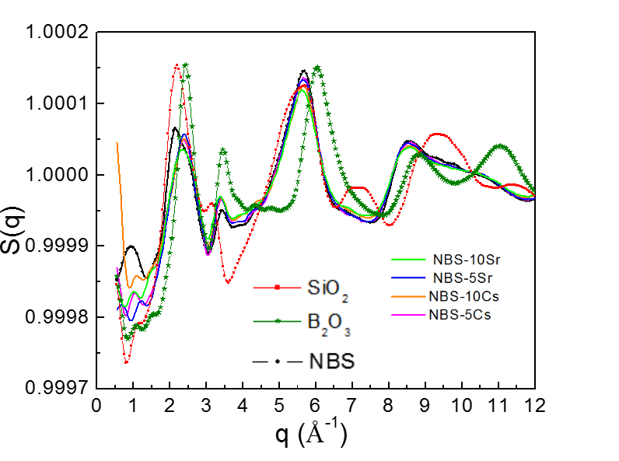
Cs/Sr doped NBS glasses
Concentration 5% and 10% (by mass) of base NBS
Glass | Density(*exp) [g/cm³] | Tg (*exp) [K]
NBS | 2.42 (*2.4) | 590 (*560)
NBS-5Cs | 2.49
NBS-10Cs | 2.56 (*2.5) | 545 (*532)
NBS-5Sr | 2.49
NBS-10Sr | 2.55 (*2.6) | 540 (*526)
 | CN [Na-O] R_{cut}=3.75 Å | CN [Cs-O] R_{cut}=4.05 Å | CN [Sr-O] R_{cut}=4.05 Å
NBS | 10.28
NBS-5Cs | 9.48 | 13.08
NBS-10Cs | 8.47 | 12.82
NBS-5Sr | 9.51 |  | 9.04
NBS-10Sr | 8.77 |  | 9.06
BO, related with charge and ionic radius (1.69Å for Cs⁺ and 1.33Å for Sr⁺⁺) of dopants
Effects similar as network modifiers
Order of diffusion: Si < O < B < dopant < Na

Slide 17

CONCLUSIONS
B-K-S potential model can be applied to study a wide range glass composition
The results well capture the boron anomalies for varied concentration of network formers and network modifiers
Results provide a microscopic understanding of the glass structure and phenomena associated with the change in the glass composition
The macroscopic observable properties can be explained from microscopic structure and dynamics of glasses
The present work will hence have great academic as well as technological significance for further guidance in the selection of suitable glass composition for vitrification.

Slide 18
Future Objectives
Understanding the Leaching and Chemical Reactivity of glasses
Effect of Radiation damage in vitrified glasses
Effect of Doping glasses with various Actinides and other fission Products

Slide 19
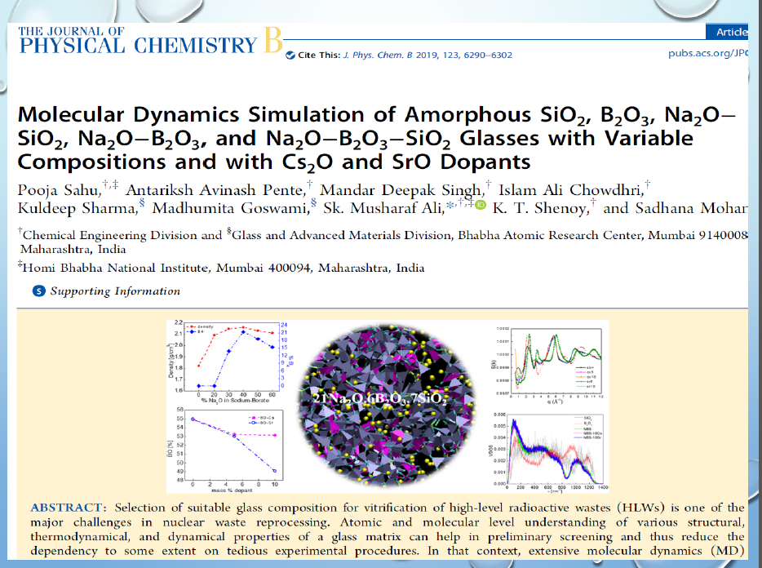

Slide 20
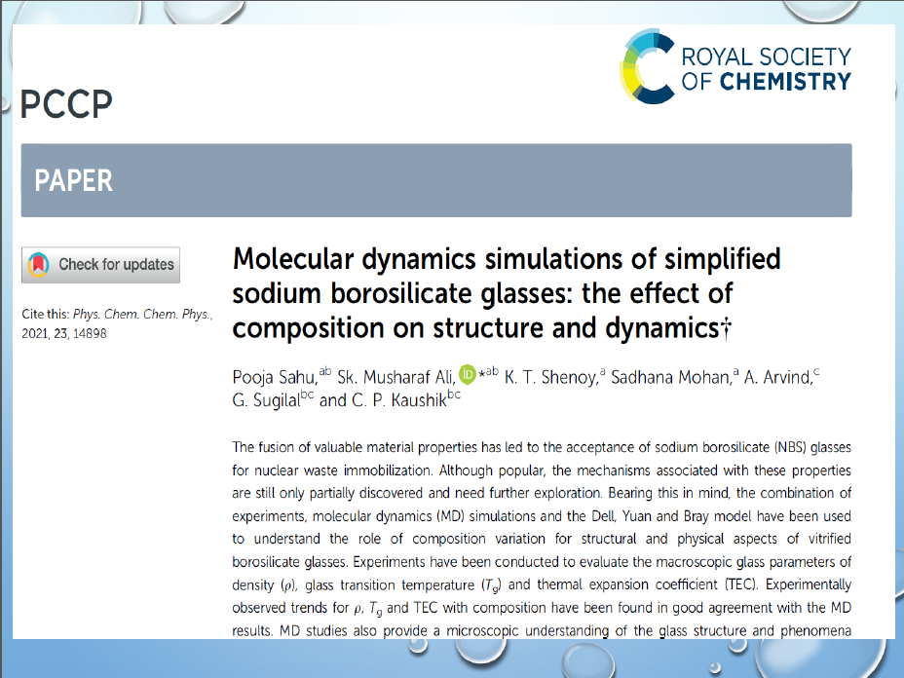

Slide 21

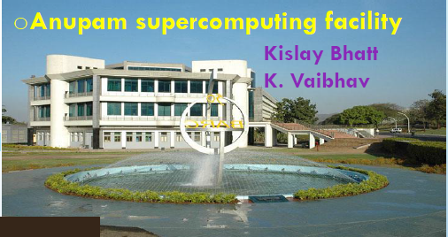
Acknowledgement
Dr. Sk. Musharaf Ali
Head, LSS, BARC, India
K.T. Shenoy, Group Director, ChEG
▪S. Mukhopadhyay, Head, ChED
ANUPAM Super Computing Facility, BARC, India
Kislay Bhatt and K. Vaibhav
BARC, India
Arvind, G. Sugilal, and C. P. Kaushik
BARC, India
Computational collaborators
UK-India Civil Nuclear Collaboration (EP/T016337/1)

Slide 22
Thank You

Slide 24
2.2.6 Glass transition temperature (T_{g})
The glass transition temperature of the constructed glass matrix was determined from the plot of inverse density vs. temperature over a range of temperature corresponding from glass state to melt state. The data points of both the zones were fitted to straight line using least square method, and intersection point of the fitted lines to glass zone and melt zone were used to determine the glass transition temperature⁴⁴.

