Slide 1
Lecture 2:
Basic principles of soil moisture measurements using Cosmic Ray Neutron Sensor (CRNS) - Part 2
Trenton Franz
Assoc. Professor of Hydrogeophysics
School of Natural Resources
Faculty Fellow at the Daugherty Water for Food Global Institute
University of Nebraska-Lincoln

Slide 2
Review
In lecture 1, reviewed the basic principles of CRNS for soil moisture estimation, the support volume of the instrument, and the transfer function to convert neutrons to soil moisture information

Slide 3
Review
In lecture 1, reviewed the basic principles of CRNS for soil moisture estimation, the support volume of the instrument, and the transfer function to convert neutrons to soil moisture information
Epithermal neutrons are most sensitive to changes in hydrogen mass inside the support volume!

Slide 4
Review
In lecture 1, reviewed the basic principles of CRNS for soil moisture estimation, the support volume of the instrument, and the transfer function to convert neutrons to soil moisture information
Epithermal neutrons are most sensitive to changes in hydrogen mass inside the support volume!
The support volume fluctuates, most notably the vertical depth

Slide 5
Review
In lecture 1, reviewed the basic principles of CRNS for soil moisture estimation, the support volume of the instrument, and the transfer function to convert neutrons to soil moisture information
Epithermal neutrons are most sensitive to changes in hydrogen mass inside the support volume!
The support volume fluctuates, most notably the vertical depth
There are many forms of hydrogen but soil moisture is the largest in most environments

Slide 6
Review
In lecture 1, reviewed the basic principles of CRNS for soil moisture estimation, the support volume of the instrument, and the transfer function to convert neutrons to soil moisture information
Epithermal neutrons are most sensitive to changes in hydrogen mass inside the support volume!
The support volume fluctuates, most notably the vertical depth
There are many forms of hydrogen but soil moisture is the largest in most environments
Variations in air pressure, high-energy neutrons, water vapor, soil chemistry, and vegetation need to be considered

Slide 7

Overview of Equations
Neutron correction factors

Slide 8
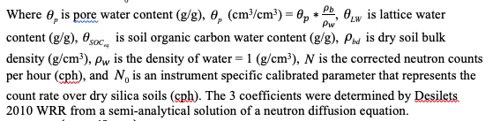
Overview of Equations
Neutron correction factors
Calibration/Transfer Function

Slide 9
Probe calibration function, need at least 1 known pore water content, lattice water, soil organic carbon, and neutron count rate (Desilets et al., 2010)

Slide 11
What about vegetation
How do we account for changes in vegetation?
Do we correct the neutron counts or do we include it as a pool of hydrogen in the calibration function?
Does the geometry/structure of the vegetation matter?
Can the CRNS measure vegetation?

Slide 12
Biomass
Amazon Rain Forest
Can compare with allometry and gravimetric sampling of biomass
West Coast US Forests
Eastern US Forests
Maize

Slide 13
The problem with 1 N₀
Does it vary over time?

Slide 14
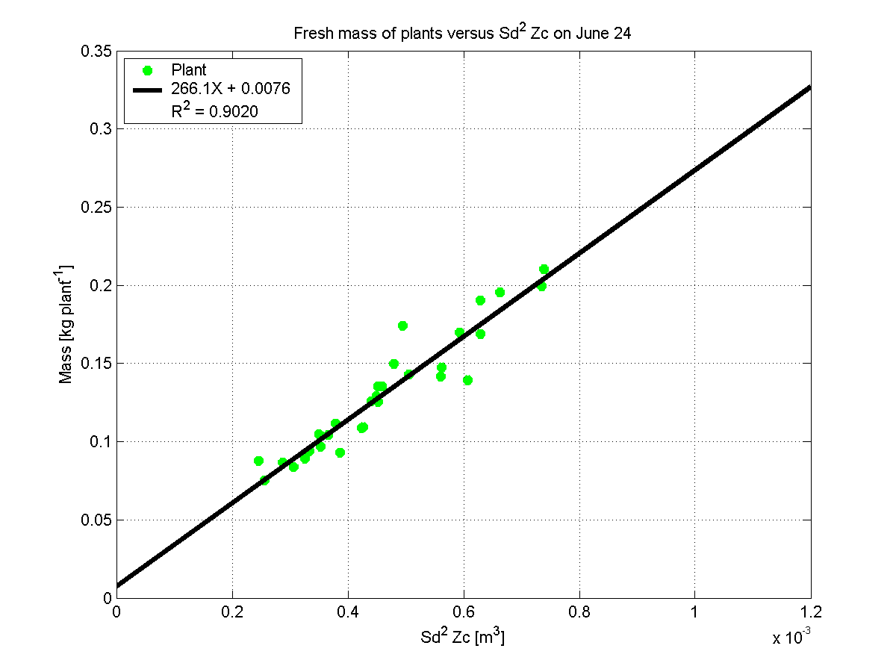
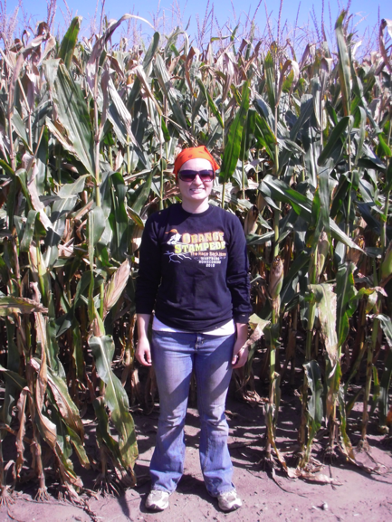
Biomass of Maize
Hornbuckle et al., 2012 and Franz et al. 2013b
Iowa St. Univ. B. Hornbuckle and S. Irvin

Slide 15
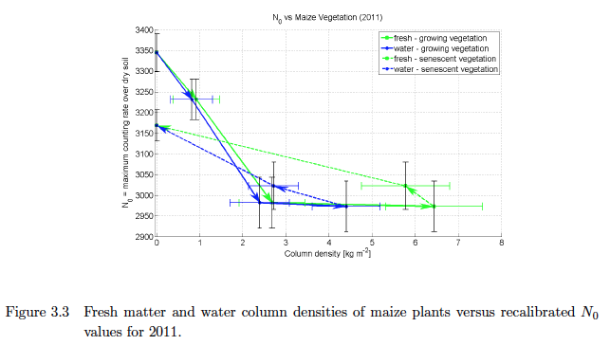
Biomass of Maize
Irvin 2013 MS Thesis ISU
Iowa St. Univ. B. Hornbuckle and S. Irvin

Slide 16
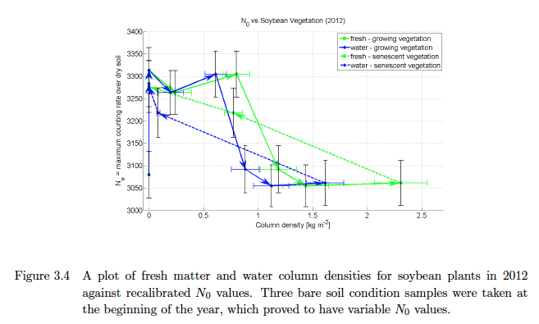
Biomass of Maize
Irvin 2013 MS Thesis ISU
Iowa St. Univ. B. Hornbuckle and S. Irvin

Slide 17
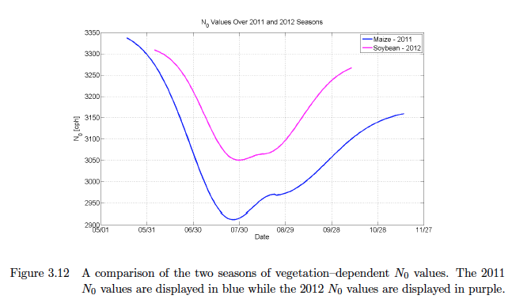
Biomass of Maize
Irvin 2013 MS Thesis ISU
Iowa St. Univ. B. Hornbuckle and S. Irvin

Slide 18
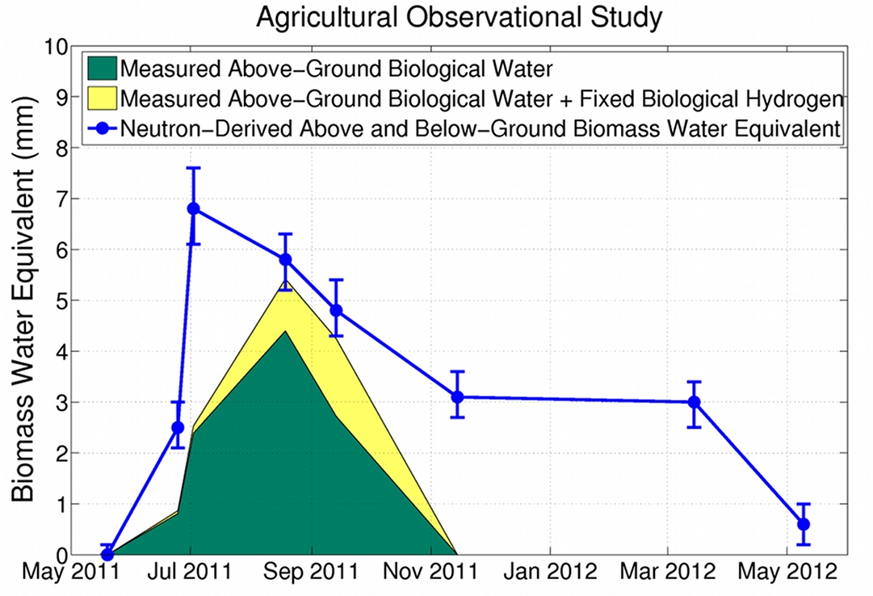
Biomass of Maize
Crop Harvest
Soil Tilled
Franz et al. 2013b, uncertainty bars are SM observations propagated through calibration function

Slide 19
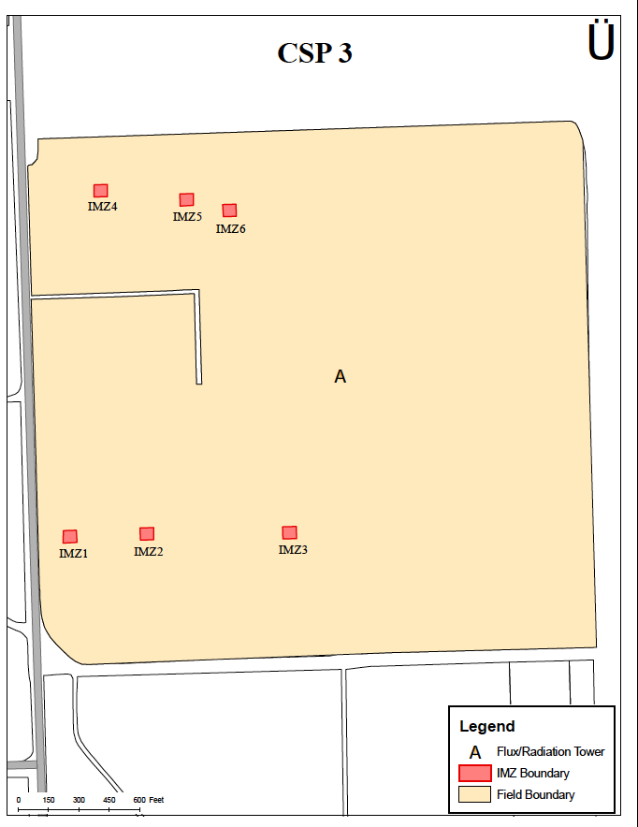
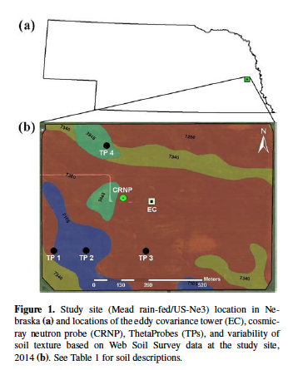
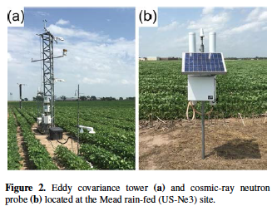
Long-term Monitoring in NE
Figure 2. Layout of EC tower, IMZ zones, and access road.
Foolad et al. 2017

Slide 21
Biomass of Maize

Slide 22
Biomass of Maize
Linear trend? slope is about 1% reduction in N0 for every 1 mm of BWE

Slide 23
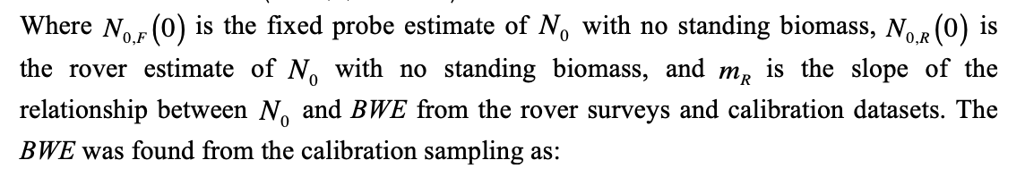
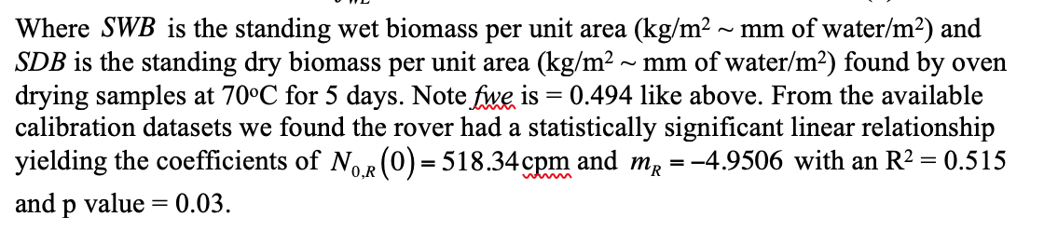
N₀ corrections for Corn and Soybean
Franz et al. 2015

Slide 24
What about forests
Hydrogen in trees is clumpy not in a layer like row crops

Slide 25
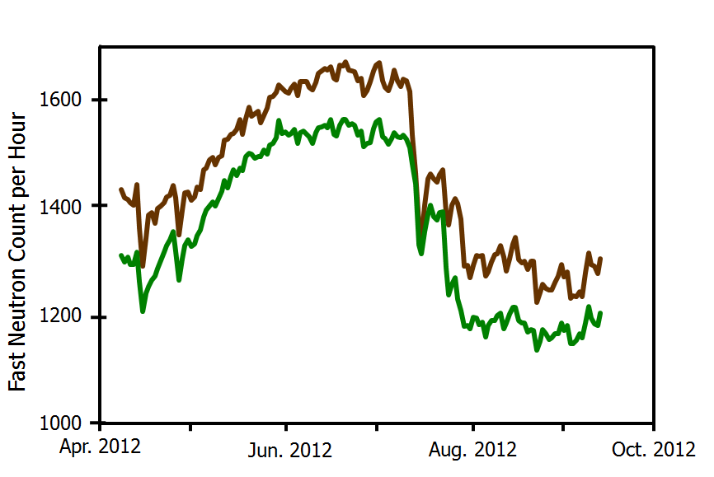
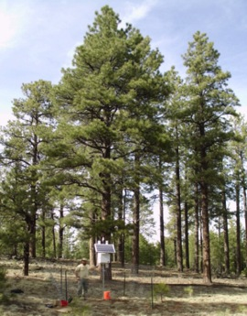
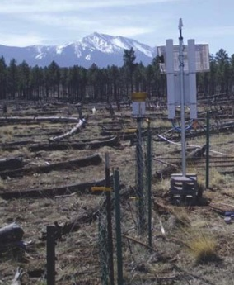
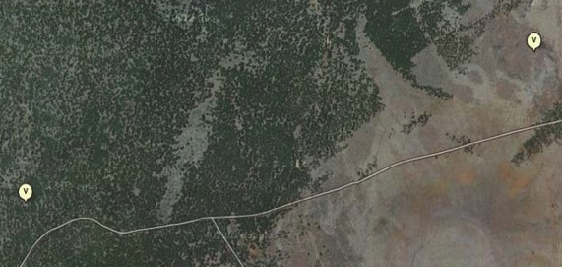
Biomass of Forests
~ 100
Soil Drying
Soil Wetting
Wildfire
Ponderosa Pine
Nearby Wildfire Site
Pine
Monsoon
~ 3 km
H. Adams Los Alamos, T. Kolb NAU
The reduction of ~100 counts is due to the forest canopy and corresponds to a biomass water equivalent of 27.6 ± 0.8 mm
Three different allometric estimates give biomass water equivalents in the range 22-32 mm
Franz et al. 2013b

Slide 26
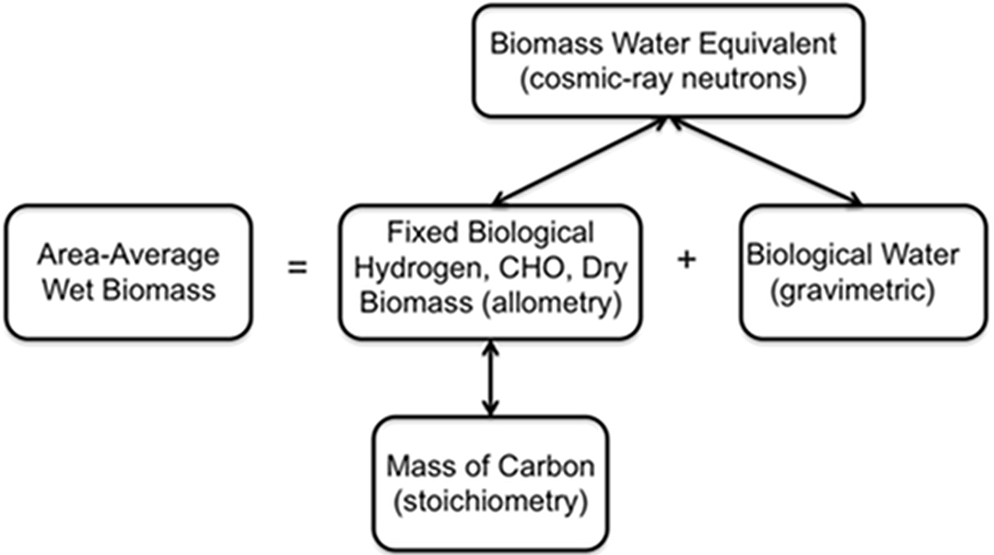
Pools of Hydrogen in Biomass
Potential for unique observations to help constrain energy and carbon budgets
Franz et al. 2013b

Slide 27

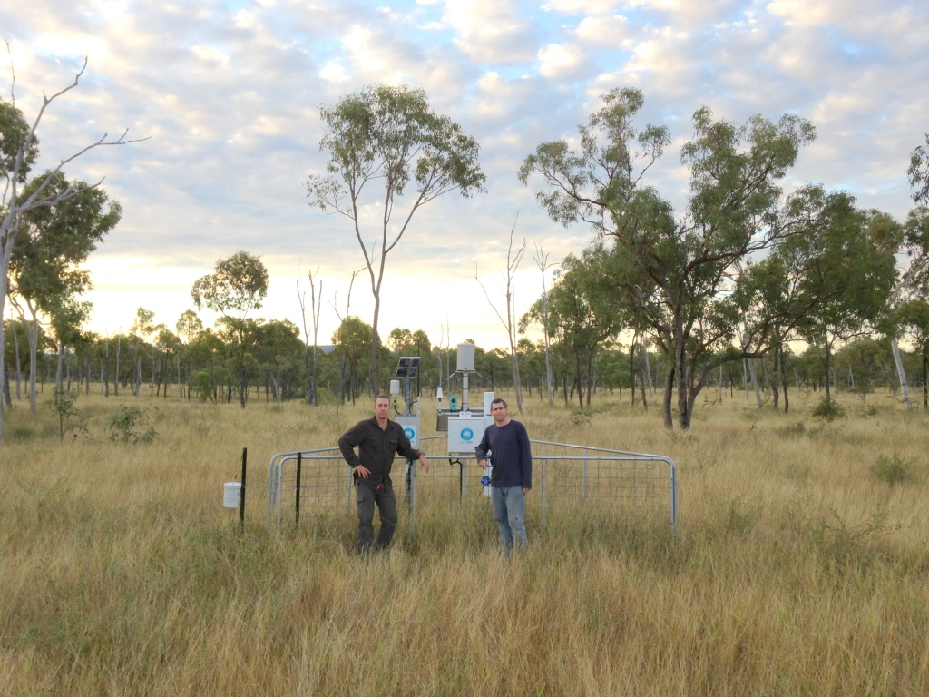
Let’s take a trip down under to Australia to visit the CosmOz Network
David McJannet and Aaron Hawdon

Slide 28
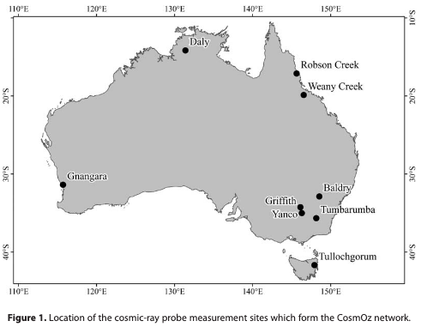
Hawdon 2014

Slide 29
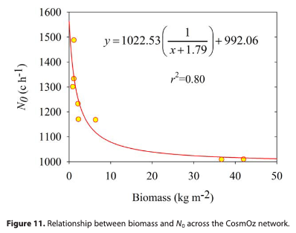
Relative Contributions of Water
Low biomass and shrubby vegetation appears to have a linear relationship with N₀, consistent with USA studies and others
Unclear about forests, but certainly not as efficient at removing neutrons due to clumpy hydrogen distribution
Hawdon 2014

Slide 30
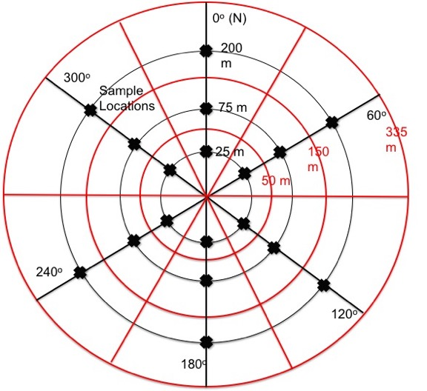
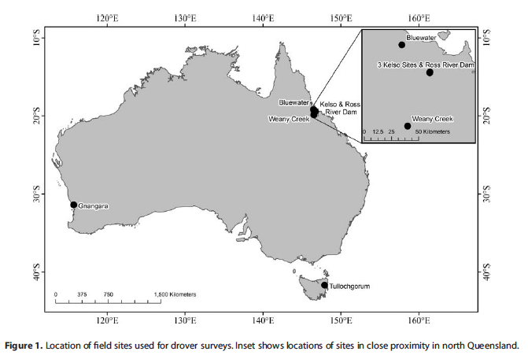
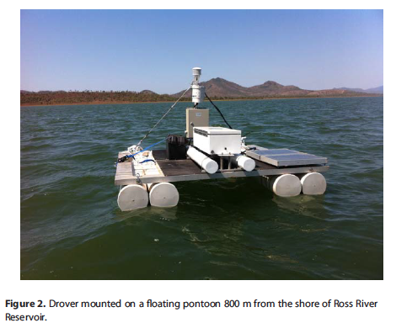
A dedicated field campaign to understand pools of water with a single detector “the drover”
Note recent work has shown samples should be taken at ~10, 50, 125 m
McJannet et al. 2014 WRR

Slide 31
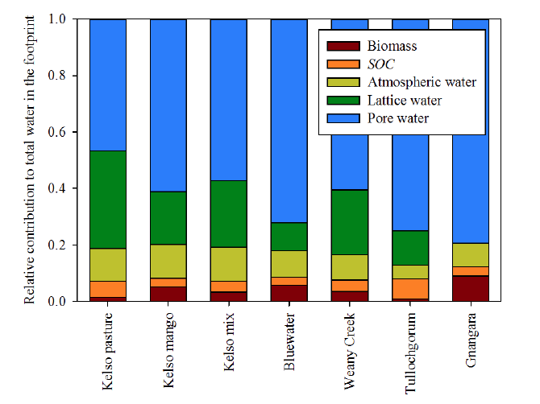
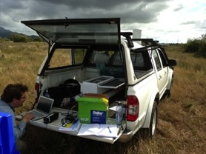
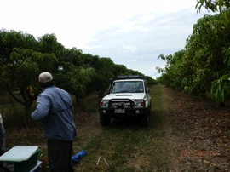
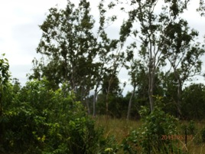
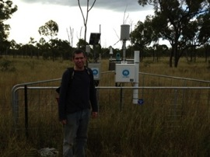
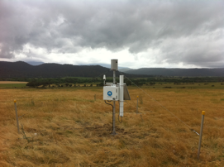
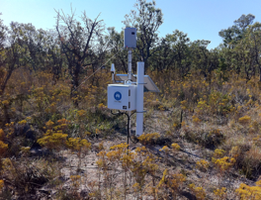
Relative Contributions of Water
From 7 sites in Australia
McJannet et al. 2014

Slide 32
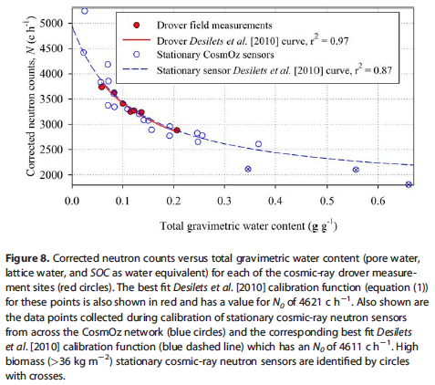
Relative Contributions of Water
(McJannet et al. 2014 WRR)

Slide 33
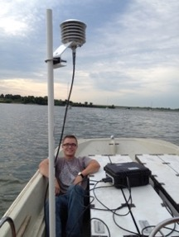
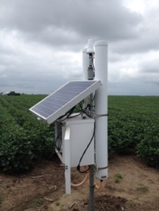
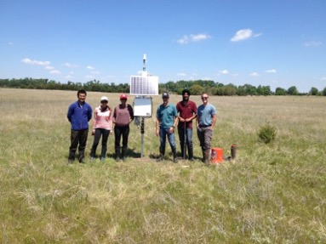
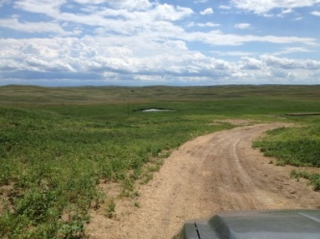
Rover Calibration Across Nebraska, USA

Slide 34
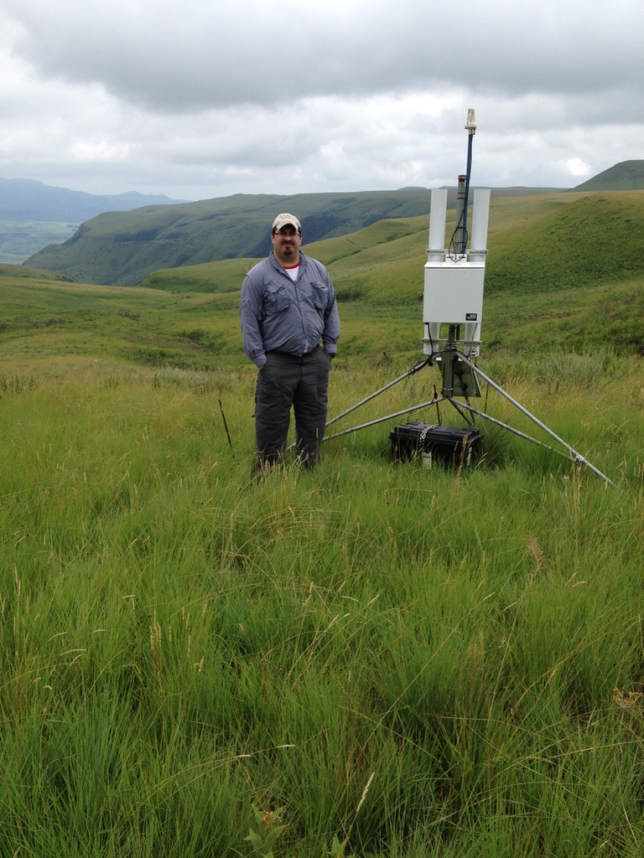
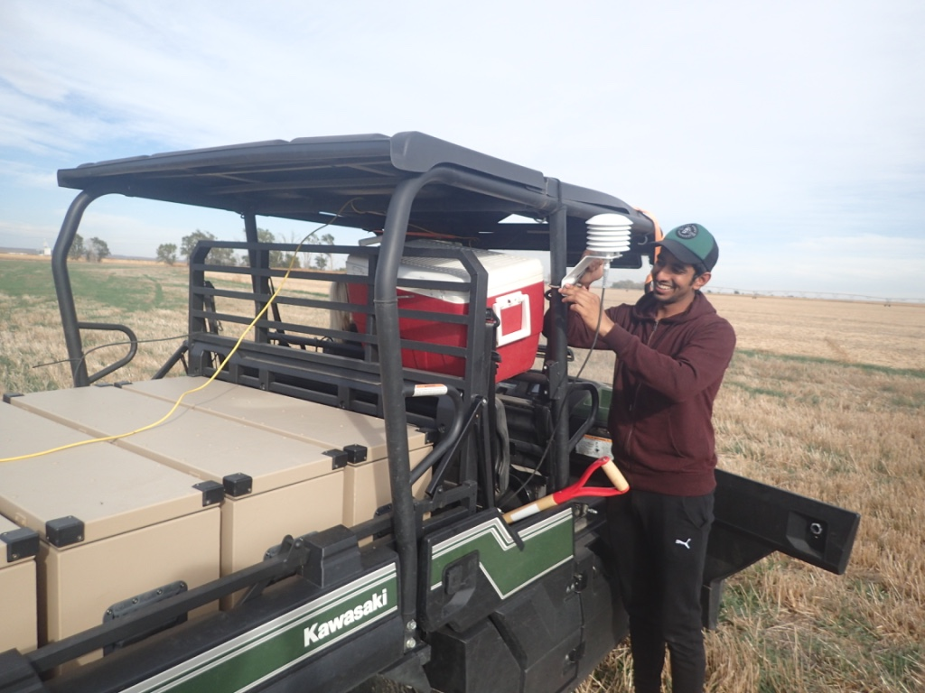
Let’s revisit the influence of forests from a South African study
Can we use both thermal and epithermal neutrons to simultaneously measure vegetation and soil moisture?
Thigesh Vather UKZN

Slide 35
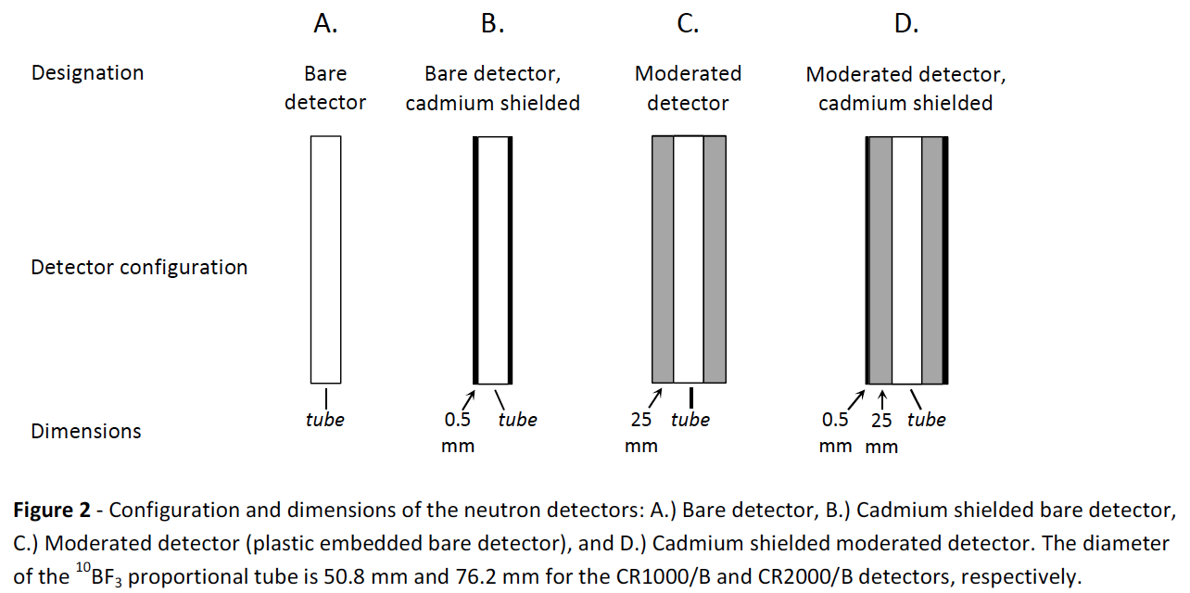
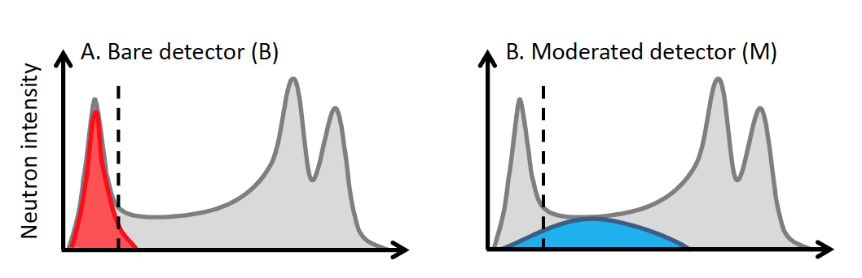
Simultaneous Detection of Vegetation and Soil Moisture
Andreasen 2016, 2017 Dissertation Univ. of Copenhagen

Slide 36
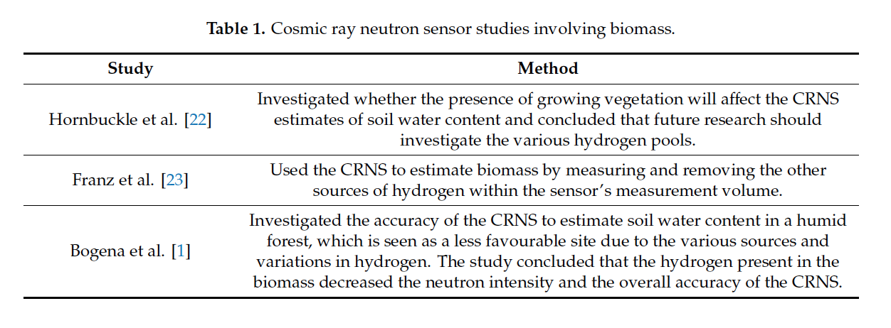
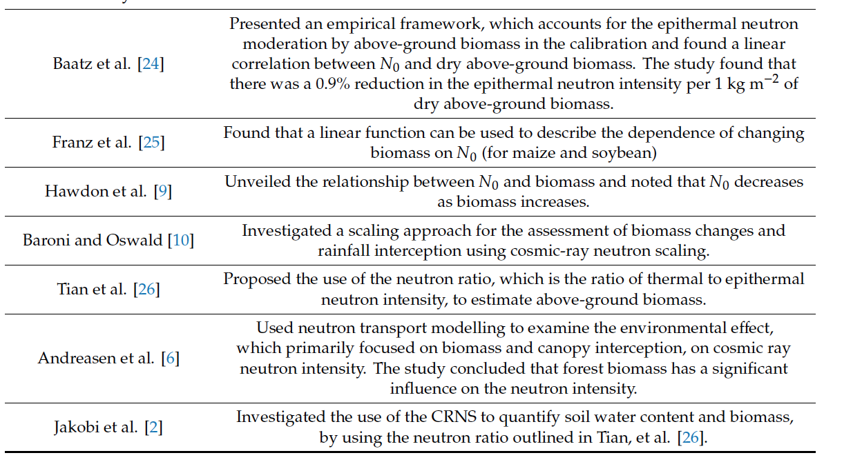
Simultaneous Detection of Vegetation and Soil Moisture
Vather et al. 2020

Slide 37
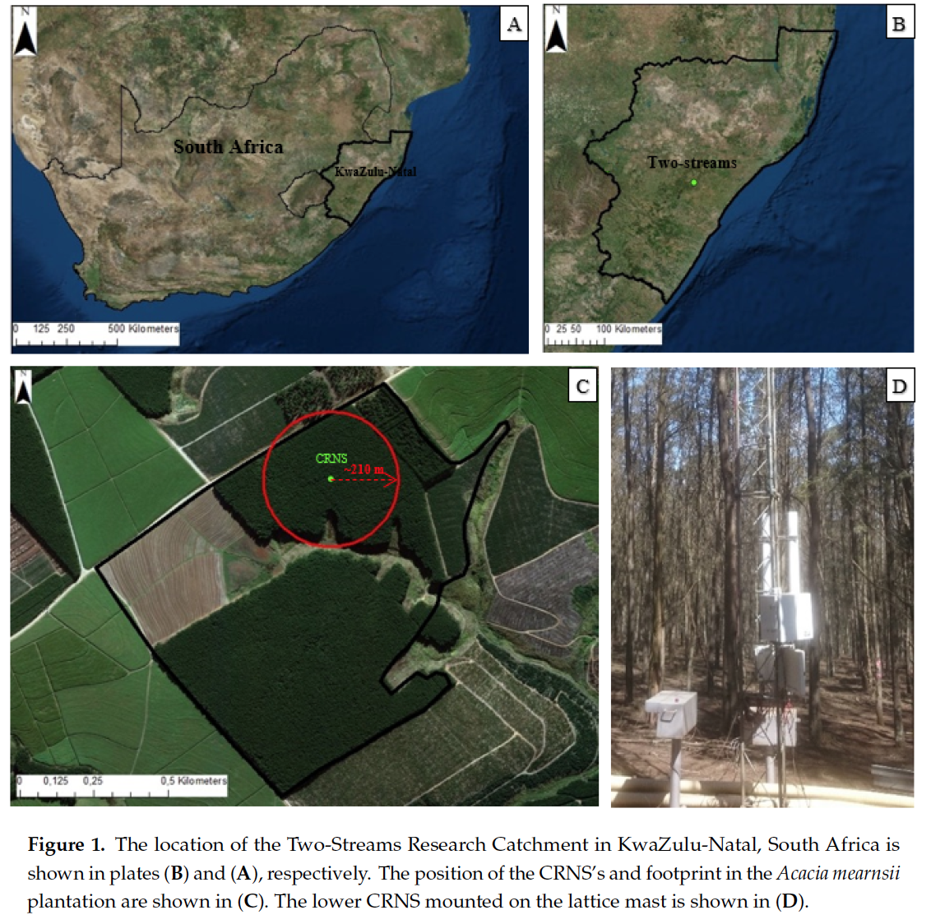
Simultaneous Detection of Vegetation and Soil Moisture
Vather et al. 2020

Slide 38
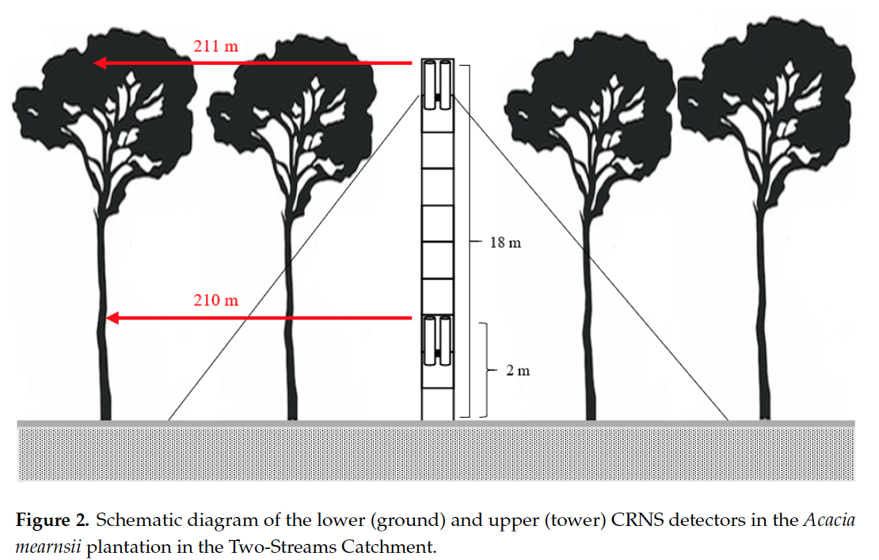
Simultaneous Detection of Vegetation and Soil Moisture
Vather et al. 2020

Slide 39
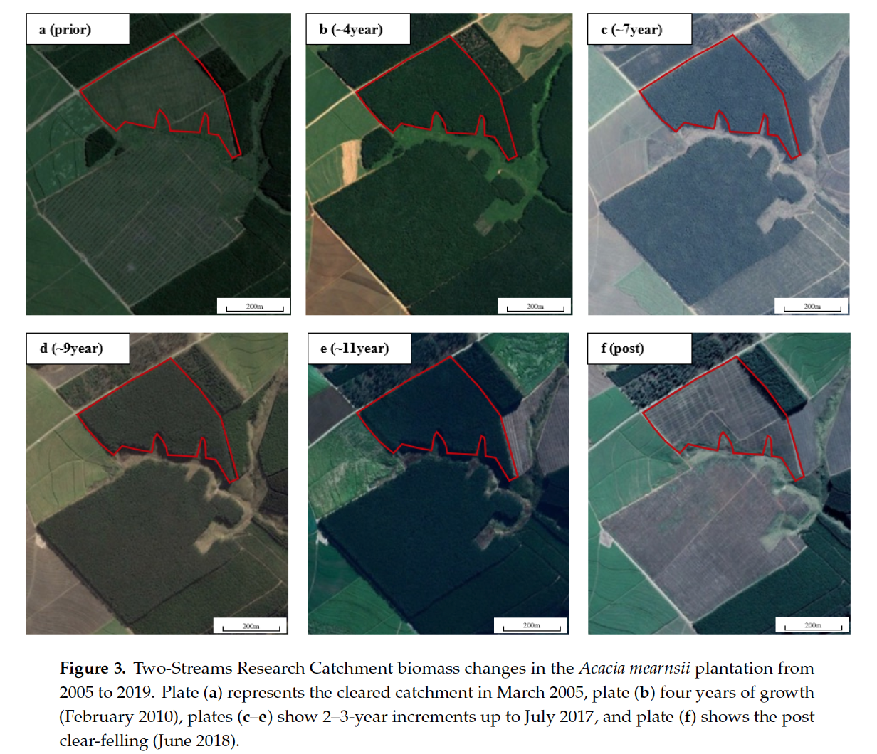
Simultaneous Detection of Vegetation and Soil Moisture
Vather et al. 2020

Slide 40
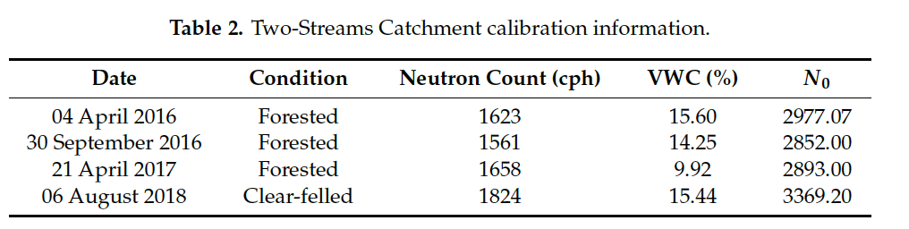
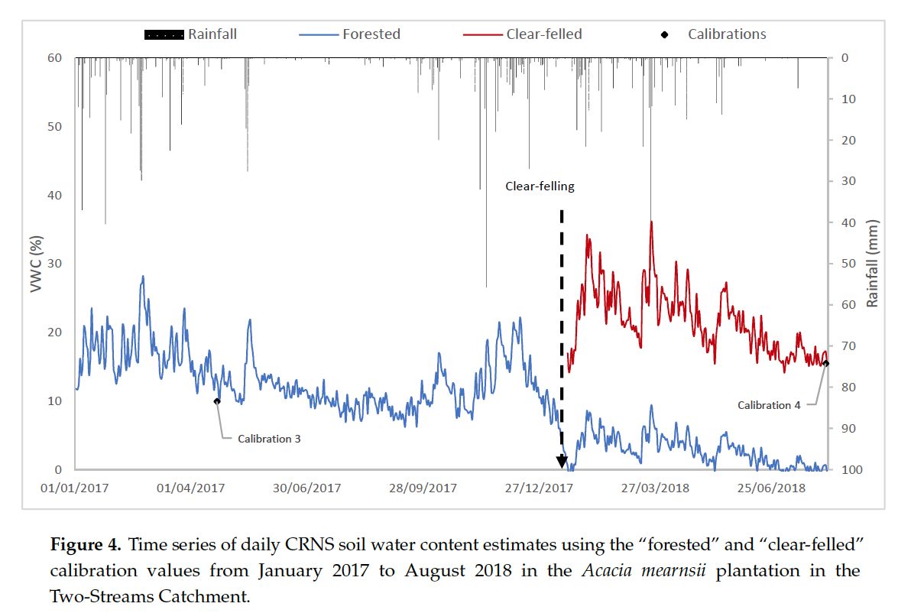
Simultaneous Detection of Vegetation and Soil Moisture
Vather et al. 2020

Slide 41
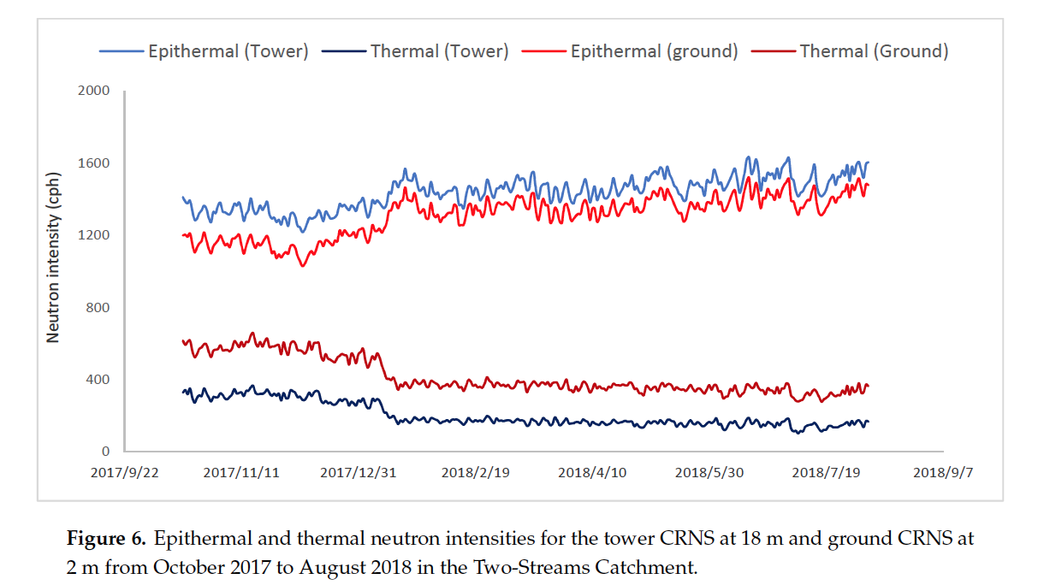
Simultaneous Detection of Vegetation and Soil Moisture
Vather et al. 2020

Slide 42
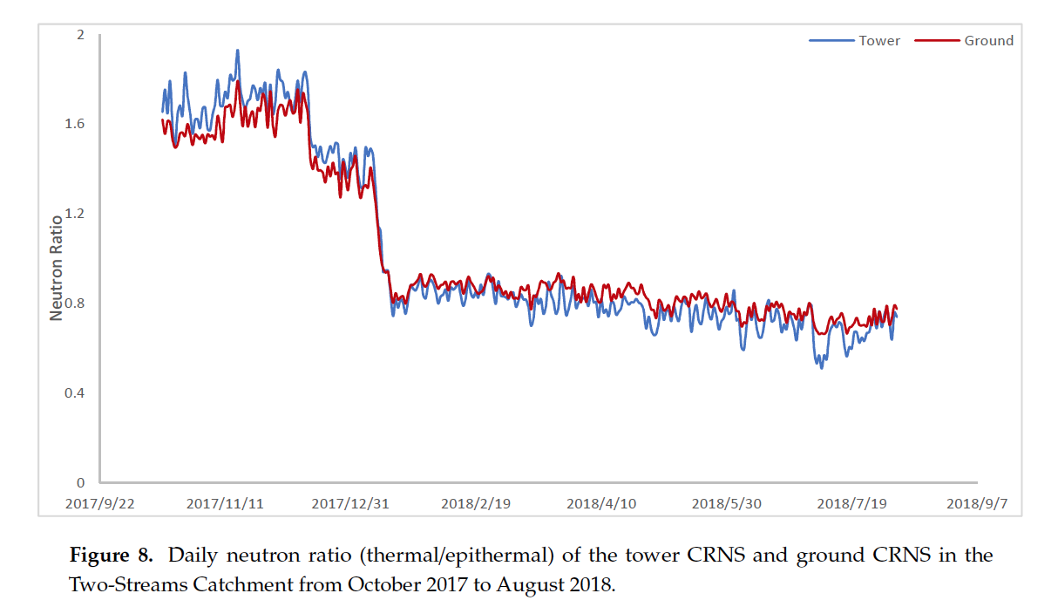
Simultaneous Detection of Vegetation and Soil Moisture
Vather et al. 2020

Slide 43
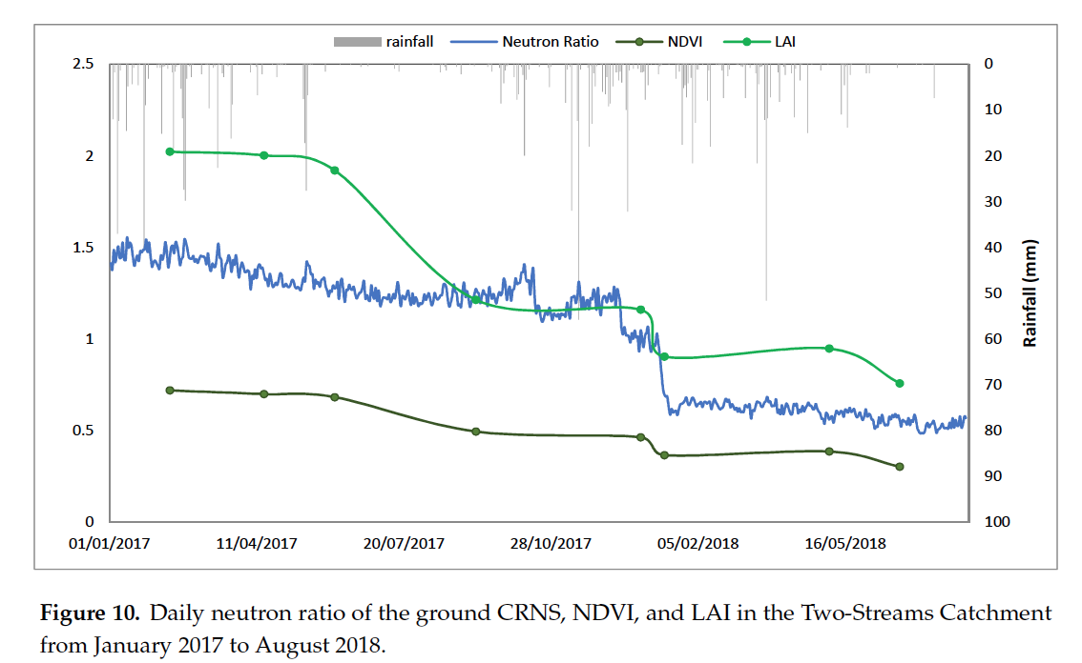
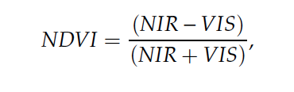

Simultaneous Detection of Vegetation and Soil Moisture
NIR and VIS layers acquired from Landsat 8 30 m data every ~16 days
Vather et al. 2020

Slide 44

Simultaneous Detection of Vegetation and Soil Moisture
Vather et al. 2020

Slide 45

Simultaneous Detection of Vegetation and Soil Moisture
Vather et al. 2020

Slide 46


Simultaneous Detection of Vegetation and Soil Moisture
Vather et al. 2020

Slide 47

How do CRNS perform in alpine environments with challenging soil profiles?
Study from Austrian Alps
William Avery

Slide 48


Calibration in Austria
Note recent work has shown samples should be taken at ~10, 50, 125 m
TECDOC 1845

Slide 49

Calibration in the Alps
TECDOC 1845

Slide 50
Calibration in the Alps
Spatial mean +/- 1 s.d.
TECDOC 1845

Slide 51
Calibration in the Alps
Spatial mean +/- 1 s.d.
TECDOC 1845

Slide 52
Calibration in the Alps
TECDOC 1845

Slide 53
Summary
From observations and numerical modelling additional corrections factors have been developed for removing or detecting vegetation signal in CRNS observations

Slide 54
Summary
From observations and numerical modelling additional corrections factors have been developed for removing or detecting vegetation signal in CRNS observations
Row crops appear to have a linear dependence on N₀ (~1% reduction for every 1 kg/m^2 of BWE)

Slide 55
Summary
From observations and numerical modelling additional corrections factors have been developed for removing or detecting vegetation signal in CRNS observations
Row crops appear to have a linear dependence on N₀ (~1% reduction for every 1 kg/m^2 of BWE)
Use of bare and moderated (thermal and epithermal) are promising for simultaneous detection of vegetation and soil moisture

Slide 56
Summary
From observations and numerical modelling additional corrections factors have been developed for removing or detecting vegetation signal in CRNS observations
Row crops appear to have a linear dependence on N₀ (~1% reduction for every 1 kg/m^2 of BWE)
Use of bare and moderated (thermal and epithermal) are promising for simultaneous detection of vegetation and soil moisture
Additional modelling and experiments are still needed to fully understand bare detector
  Same support volume? Same correction factors?

Slide 57
Key References
Andreasen, M., K. H. Jensen, M. Zreda, D. Desilets, H. Bogena, and M. C. Looms (2016), Modeling cosmic ray neutron field measurements, Water Resources Research, 52(8), 6451-6471. doi:10.1002/2015wr018236.
Desilets, D., M. Zreda, and T. P. A. Ferre (2010), Nature's neutron probe: Land surface hydrology at an elusive scale with cosmic rays, Water Resources Research, 46. doi:10.1029/2009wr008726.
Franz, T. E., M. Zreda, R. Rosolem, and P. A. Ferre (2013), A universal calibration function for determination of soil moisture with cosmic-ray neutrons, Hydrology and Earth System Sciences, 17, 453-460. doi:10.5194/hess-17-453-2013.
Franz, T. E., M. Zreda, R. Rosolem, B. Hornbuckle, S. Irvin, H. Adams, T. Kolb, C. Zweck, and W. J. Shuttleworth (2013), Ecosystem scale measurements of biomass water using cosmic-ray neutrons, Geophysical Research Letters, 40, 3929-3933. doi:10.1002/grl.50791.
Franz, T. E., T. Wang, W. Avery, C. Finkenbiner, and L. Brocca (2015), Combined analysis of soil moisture measurements from roving and fixed cosmic ray neutron probes for multiscale real-time monitoring, Geophysical Research Letters, 42, 3389–3396. doi:10.1002/2015GL063963.
Hawdon, A., D. McJannet, and J. Wallace (2014), Calibration and correction procedures for cosmic-ray neutron soil moisture probes located across Australia, Water Resources Research, 50(6), 5029-5043. doi:10.1002/2013wr015138.
Hornbuckle, B., S. Irvin, T. E. Franz, R. Rosolem, and C. Zweck (2012), The potential of the COSMOS network to be a source of new soil moisture information for SMOS and SMAP, paper presented at Proc. IEEE Intl. Geosci. Remote Sens. Symp., Munich, Germany. doi:10.1109/IGARSS.2012.6351317.
Hornbuckle, G., S. Irvin, and J. Patton (2011), Impact of Rapidly Growing Vegetation On COSMOS Measurements., Abstract 243-4 presented at 2011 ASA, CSSA, SSSA Annual Meeting, San Antonio, Texas, 16-19 Oct.
Irvin, S. L. (2013), Correction for rapid-growth vegetation and testing of an upscaling method with a COSMOS probe, 105 pp, Iowa State University, Ames, IA.
Kohli, M., M. Schron, M. Zreda, U. Schmidt, P. Dietrich, and S. Zacharias (2015), Footprint characteristics revised for field-scale soil moisture monitoring with cosmic-ray neutrons, Water Resources Research, 51(7), 5772-5790. doi:10.1002/2015wr017169.
McJannet, D., T. E. Franz, A. Hawdon, D. Boadle, B. Baker, A. Almeida, R. Silberstein, T. Lambert, and D. Desilets (2014), Field testing of the universal calibration function for determination of soil moisture with cosmic-ray neutrons, Water Resources Research, 50(6), 5235-5248. doi:10.1002/2014wr015513.
Rosolem, R., W. J. Shuttleworth, M. Zreda, T. E. Franz, X. Zeng, and S. A. Kurc (2013), The Effect of Atmospheric Water Vapor on the Cosmic-ray Soil Moisture Signal, J. Hydrometeorol. doi:10.1175/JHM-D-12-0120.1.
Vather, T., C. S. Everson, and T. E. Franz (2020), The Applicability of the Cosmic Ray Neutron Sensor to Simultaneously Monitor Soil Water Content and Biomass in an Acacia mearnsii Forest, Hydrology, 7(3), 48.

