Slide 1
Results from the Nicoya, Costa Rica, Geodynamic Monitoring System SISMOGENICO
Víctor González, Marino Protti
OVSICORI-UNA
Susan Schwartz
UCSC
Tim Dixon
USF
Andy Newman
Georgia Tech
MartinT horwart
CAU

Slide 2
THE MIDDLE AMERICAN TRENCH

Slide 3
Tectonic Setting of Costa Rica
1992
Nicaragua
.
.
200
Hess
11
o
Nicaragua-Papagayo
Escarpment
segment
1916
40
100
QSC
Costa
Caribbean
1900
100
Rica
Sea
10
o
1853
1939
Limon
1950
1916
Nicoya
Nicoya Gap
Panama Thrust
segment
1990
Belt
86 mm/yr
1991
ODP
Talamanca Cordillera
Pacific
Leg 170
9
o
Ocean
Middle
Cobano-Herradura
1916
segment
Quepos-Sierpe
North
American
segment
1941
Panama
American
Trench
1904
Plate
1983
Osa-Burica
segment
8
o
Caribbean Plate
Cocos
92 mm/yr
Cocos Plate
?
Ridge
Panama
Nazca
Fracture
Panama
Block
Plate
100 km
Zone
87
o
86
o
85
o
84
o
83
o
82
o

Slide 4
BATHYMETRY OF THE SUBDUCTING PLATE

Slide 5
Seismicity and sections across
Costa Rica

Slide 6
Segmentation of the subduction zone
.
1992
Nicaragua
.
.
.
200
Hess
11
o
Nicaragua-Papagayo
Escarpment
segment
1916
40
100
QSC
Costa
Caribbean
1853
100
Rica
Sea
1900
10
o
1853
1939
Limon
1950
1916
Nicoya
Nicoya Gap
Panama Thrust
segment
1990
Belt
86 mm/yr
1991
ODP
Talamanca Cordillera
Pacific
Leg 170
9
o
Ocean
Middle
Cobano-Herradura
1916
segment
Quepos-Sierpe
North
American
segment
1941
Panama
American
Trench
1904
Plate
1983
Osa-Burica
segment
8
o
Caribbean Plate
Cocos
92 mm/yr
Cocos Plate
?
Ridge
Panama
Nazca
Fracture
Panama
Block
Plate
100 km
Zone
87
o
86
o
85
o
84
o
83
o
82
o

Slide 7
NICARAGUA-PAPAGAYO SEGMENT
Low degree of coupling. Earthquakes on this segment are very frequent and of moderate size (several events per year with Mw ≥ 5); large events here have slow rupture velocities.
Relatively old and smooth subducting plate.
Thin upper plate makes the elastic coupling area narrow.
Steep angle of Wadati-Benioff zone.
Earthquakes of different sizes in 1750, 1840, 1844, 1863, 1881, 1889, 1901, 1916, 1921, 1956 and 1992.

Slide 8
NICOYA SEGMENT
Relatively old and smooth subducting plate.
Steep angle of Wadati-Benioff zone.
Thick upper plate increases the width of the seismogenic zone.
The Nicoya peninsula in this segment applies an important lithostatic load on the plate interface increasing the normal stress and therefore the coupling between the plates.
Large earthquakes and low background seismicity level during the interseismic periods.
Large earthquakes have occurred here in 1853, 1900 and 1950.

Slide 9
CÓBANO-HERRADURA AND QUEPOS-SIERPE SEGMENTS
Young and rough plate with small seamounts. When subducting, seamounts reduce the coupling area to small asperities that rupture frequently with moderate size events.
The Cóbano-Herradura segment produced earthquakes of Mw~7 in 1882, 1939 and 1990.
The Quepos-Sierpe is the weakest and generates only earthquakes with Mw<7; some of these occurred in 1940, 1941, 1952, 1974, 1982, 1990, 1996, 1999 and 2010.
These two segments fail every time the neighboring segments of Nicoya to the NE and Osa-Burica to the SE, break with earthquakes of Mw>7;
These segments tend to break with duplets, like the August -September, 1996, the August, 1999 and the 2010, pairs.

Slide 10
OSA SEGMENT
Very young and thick subducting lithosphere (the Cocos ridge).
The buoyant effect of both, young lithosphere and the Cocos ridge, increases the coupling along the plate interface; the lithostatic weight of the Osa peninsula also helps increase this coupling.
For these reasons this segment is capable to generate large (Mw>7) earthquakes: 1867, 1904, 1941 and 1983.

Slide 11
The Nicoya Seismic Gap
.
1992
Nicaragua
.
.
.
200
Hess
11
o
Nicaragua-Papagayo
Escarpment
segment
1916
40
100
QSC
Costa
Caribbean
1853
100
Rica
Sea
1900
10
o
1853
1939
Limon
1950
1916
Nicoya
Nicoya Gap
Panama Thrust
segment
1990
Belt
86 mm/yr
1991
ODP
Talamanca Cordillera
Pacific
Leg 170
9
o
Ocean
Middle
Cobano-Herradura
1916
segment
Quepos-Sierpe
North
American
segment
1941
Panama
American
Trench
1904
Plate
1983
Osa-Burica
segment
8
o
Caribbean Plate
Cocos
92 mm/yr
Cocos Plate
?
Ridge
Panama
Nazca
Fracture
Panama
Block
Plate
100 km
Zone
87
o
86
o
85
o
84
o
83
o
82
o

Slide 12
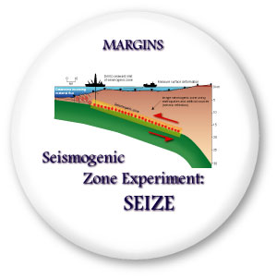
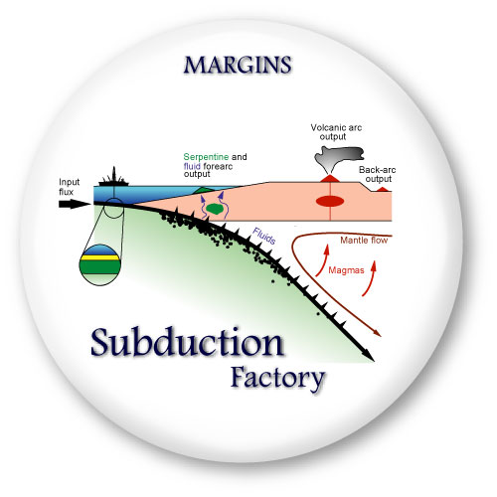
Kona, Hawaii, June 1997
La Jolla, California, June 1998
Nicoya
Costa Rica-Nicaragua
Nankai
Izu-Bonín-Marianas

Slide 13
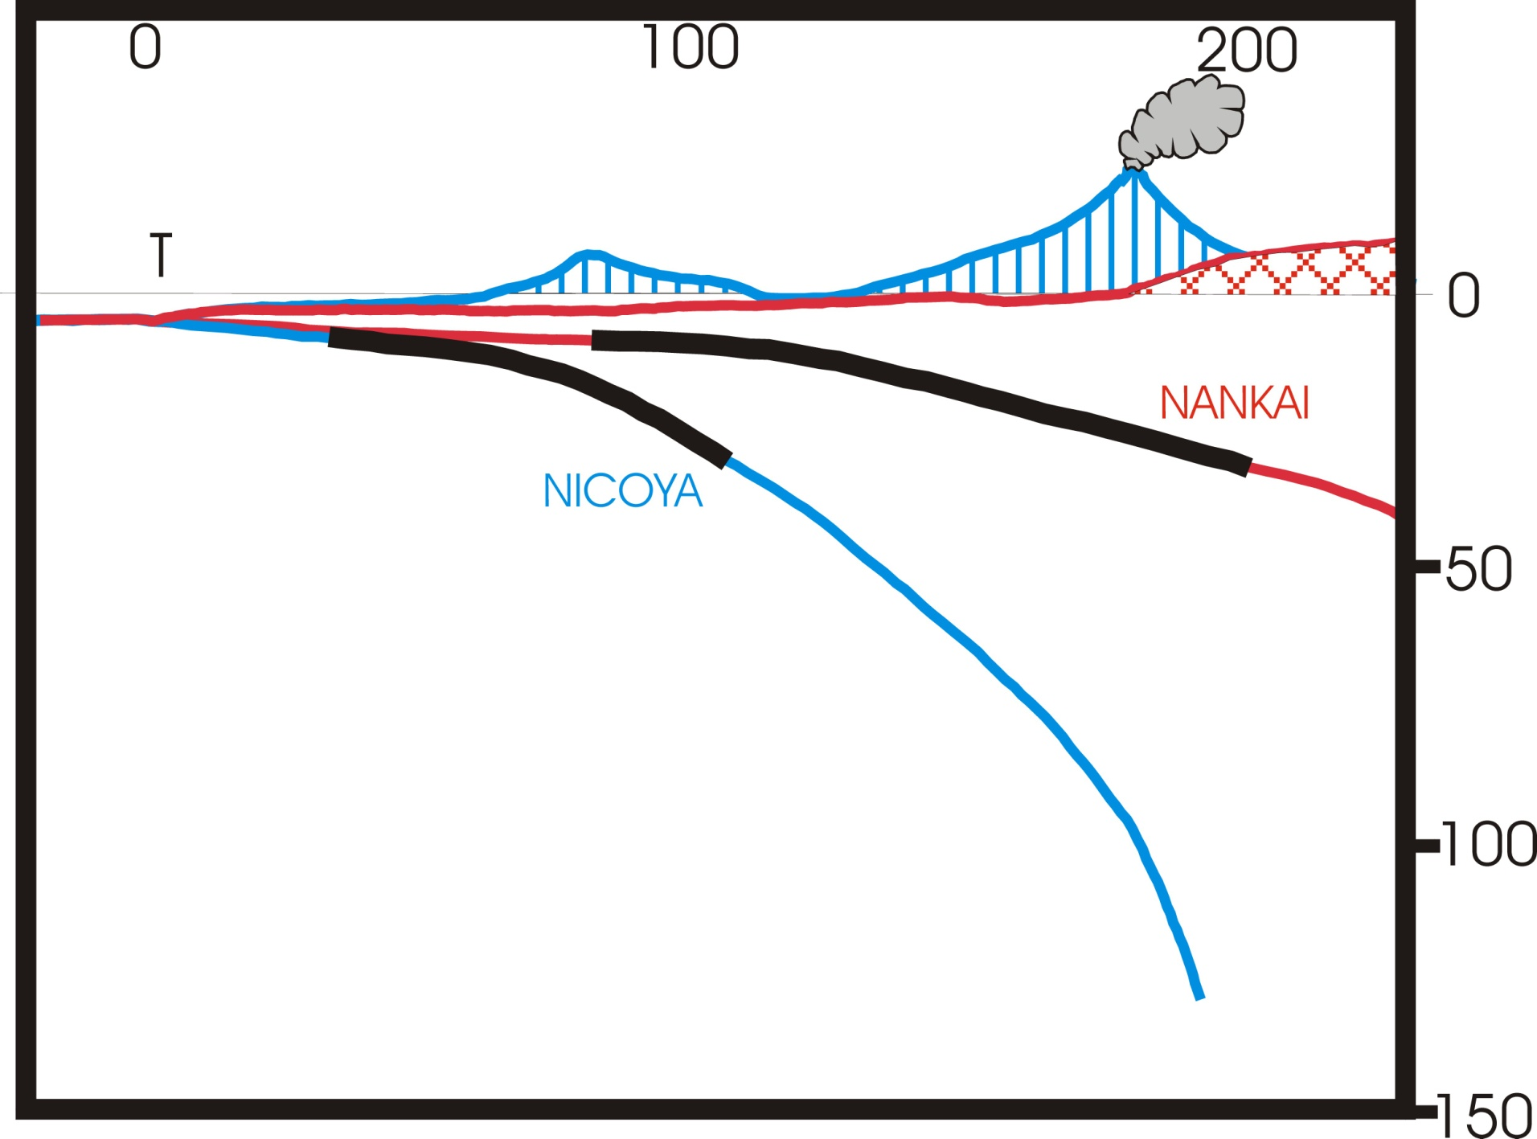
NICOYA and NANKAI
Nicoya

Slide 14
CR-SEIZE RESULTS (seismic vs GPS)
Norabuena et al., 2004

Slide 15
Mw vs date

Slide 16
Playa Guiones (2001)

Slide 17
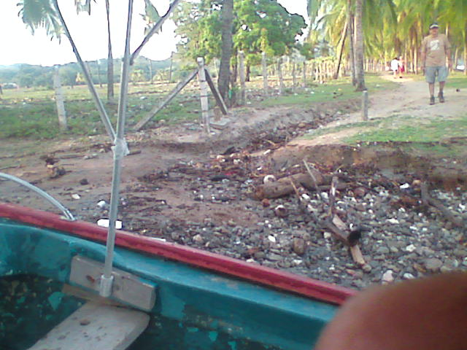
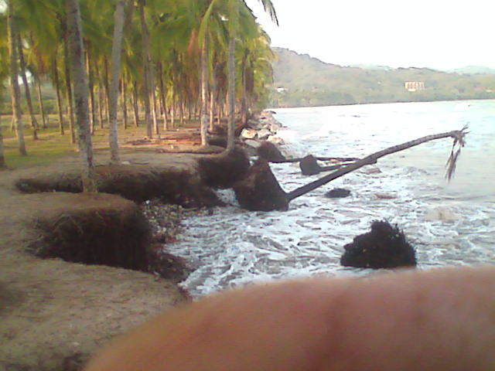
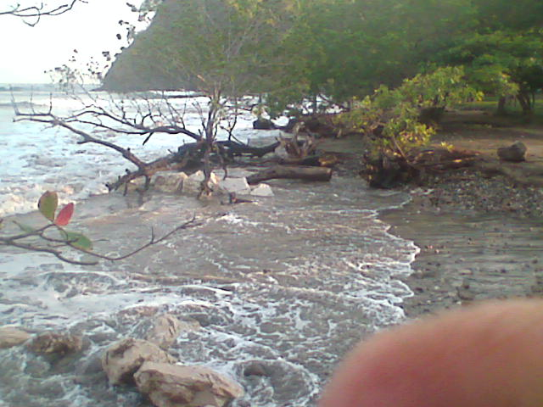
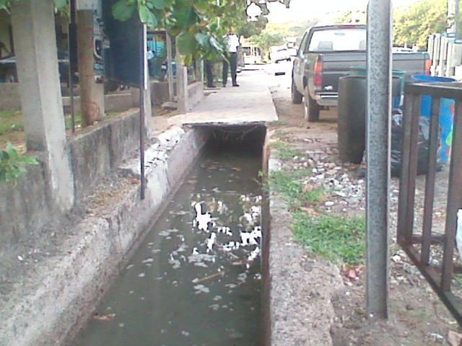
Sámara, mayo 2008
hotel
mojón
rompeolas
¿Drenaje?
almendros

Slide 18
Deformación sísmica
M
E
T
R
O
S
Sismo Mw 7.8

Slide 19
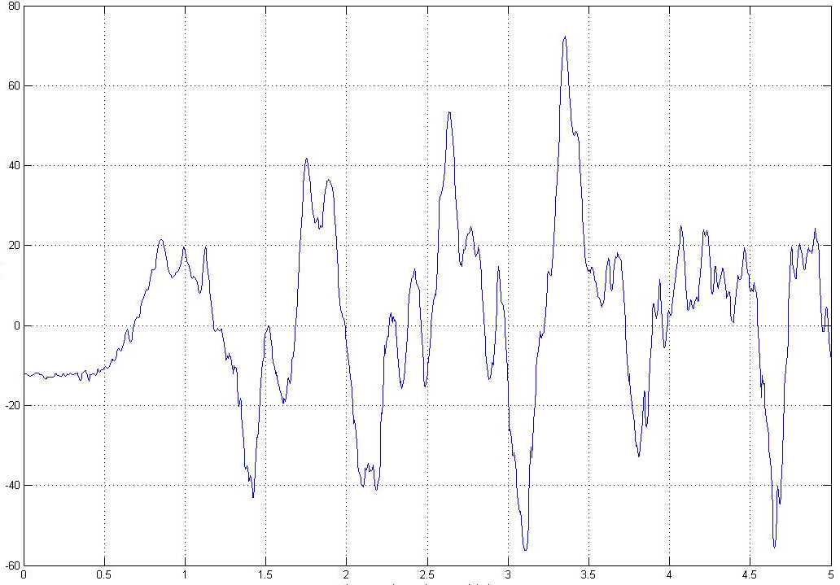
Para el extremo del muelle más cercano a la playa
Aprox. 3h20min después del sismo
Aprox. 90cm
Altura en centímetros
Tiempo en horas después del sismo

Slide 20
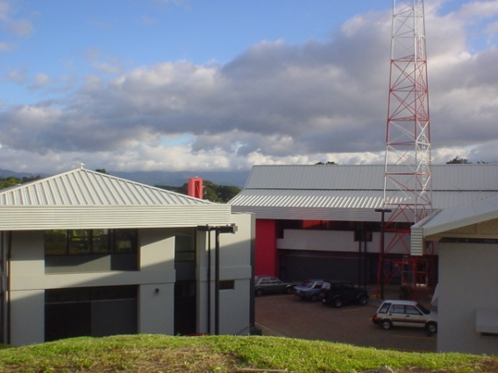
GPS continuo

Slide 22
FUTURE CGPS NETWORK
50 km
Continuous GPS stations
in and around Nicoya península

Slide 23
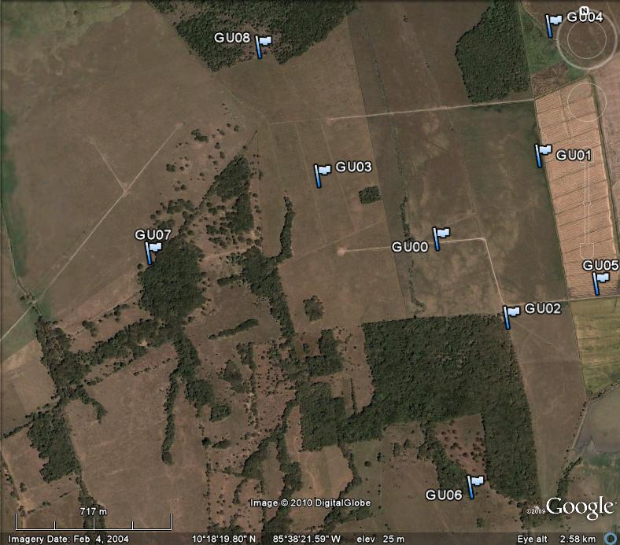
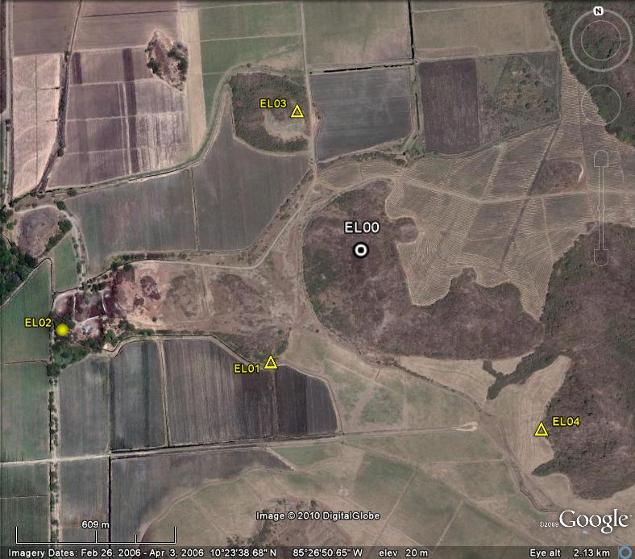
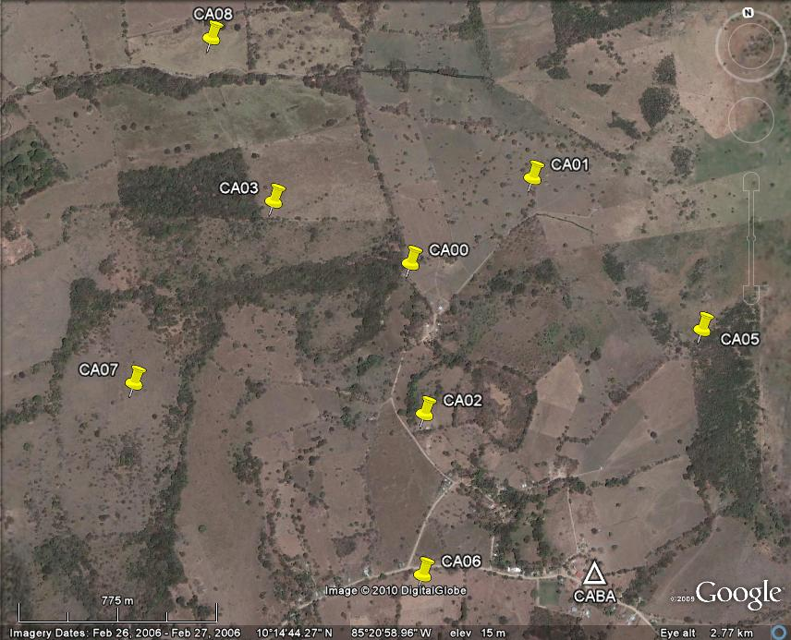
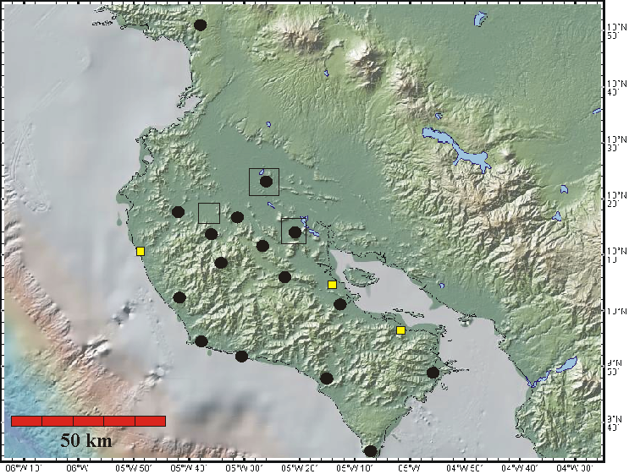
THE NICOYA SEISMIC NETWORK

Slide 24
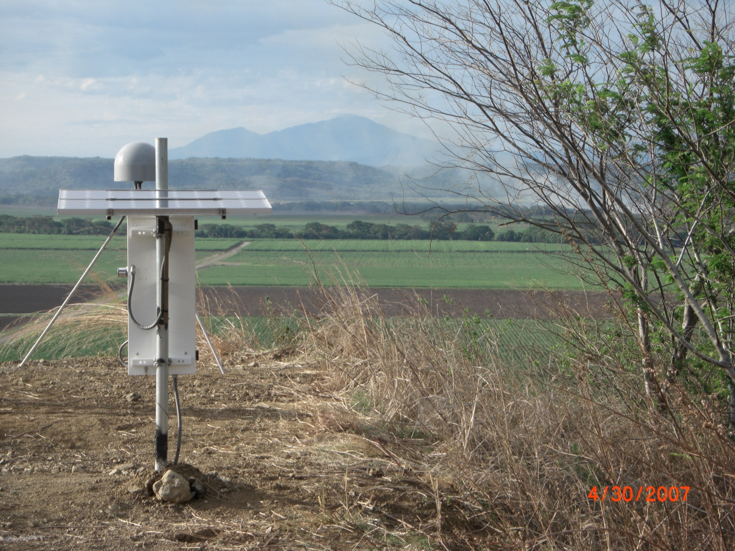
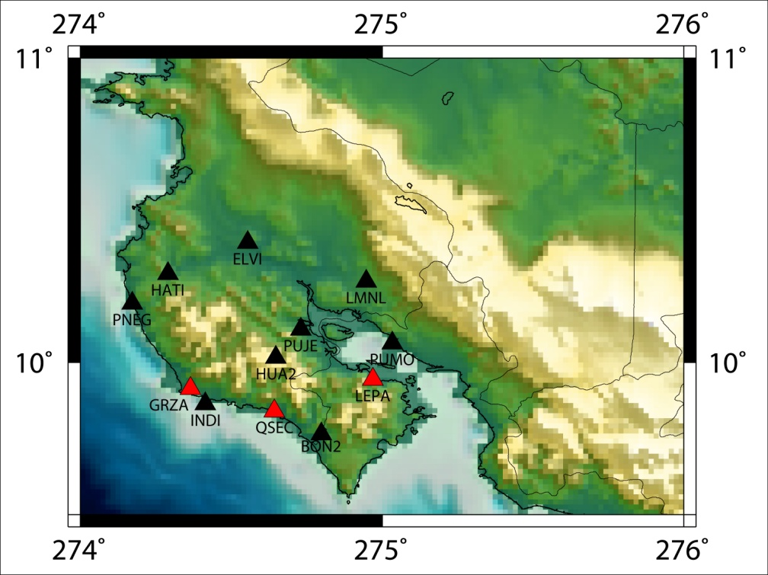
Transient Found!!
Baseline to MANA
12 stations recording
Seen in 3 of 4 stations processed for this time period thus far
Notes:
In order to confirm that transients we may have seen in the raw time series were real we calculated baselines to MANA and we were able to see a transient in 3 of the 4 stations that have been processed thus far for this time period, which is summer of 2007. All 12 of the network stations were recording at the time. As you can see from the map, where red triangles are stations that show the event, so far we already have a preliminary indication of the down dip and along strike character of the event.

Slide 25
Minutes of tremor recorded by the Nicoya Seismic Network for 2007 time correlated with the North Component of GPS station GRZA
Kim Psencik (UM)(AGU2008)

Slide 26
Inversion results: Max Slip on the fault plane: ~10 cm Depth of Max slip: ~27 km
Kim Psencik (UM)(AGU2008)

Slide 27
Noise, earthquakes and tremor (1 day)

Slide 28
4 years of tectonic tremor

Slide 29
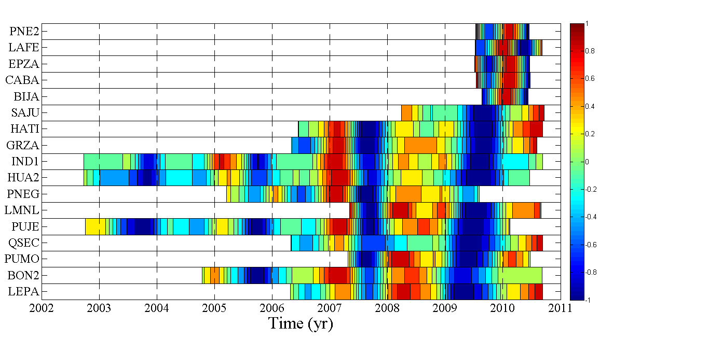
Costa Rica Network Positionogram
East Component
4 events detected
Recurrence interval ~2 years

Slide 30
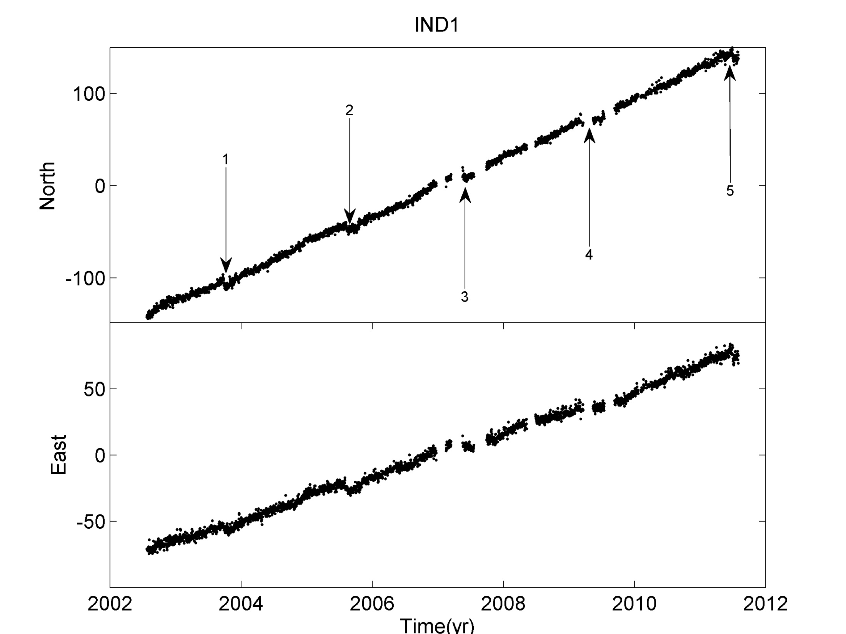

Slide 31
CONCLUSION
A dense geodynamic monitoring system is Nicoya is capturing deformation associated with non-homogeneous coupling along the Nicoya seismogenic zone.

Slide 32
THANK YOU

