Slide 1
Hybrid systems for enhanced
CO₂ conversion into energy products and chemicals
NUS
Interuniversity
Consortium
CHEMICAL REACTIVITY and CATALYSIS
I S
C M
T R
P
2
5
8
2
W
O
R
K
S
H
O
P
Michele Aresta
CIRCC, via Celso Ulpiani 27, 70126 Bari
michele.aresta@uniba.it
ChBE Department, NUS, Singapore
cheam@nus.edu.sg
Trieste, May 21st, 2014

Slide 2
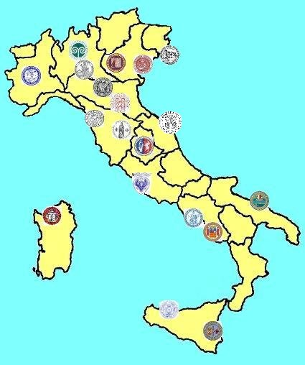
Where we are, what we do…..
Director:
Prof. A. Dibenedetto
R&D Manager:
Prof. M. Aresta
www.circc.uniba.it
19 Universities
73 Research Units
Over 350 permanent staff

Slide 3

People working on
Innovative Catalysis for Carbon Recycling
The Team in Bari
  Prof. Angela Dibenedetto Carbonates, Aquatic Biomass
  Prof. Eugenio Quaranta Carbamates, Depolymerization
  Carlo Pastore, PD Ligno-cellulosic materials
  Antonella Angelini, PD Heterogeneous catalysts s&c
  Cristina Roth, PD Innovative Syntheses
  Tomasz Baran, PhD CO₂₋reduction, Photocatalysis
  Luigi Di Bitonto, PD Synthesis of cyclic carbonates
  Antonella Colucci, MSc Water-free trans-esterification of bio-oils
  - Guendalina Galluzzi,MSc Single pot Extraction/conversion of bio-oils
  Sheila Ortega, MSc Hybrid-polymers
  Stefania Fasciano, MSc Alcoholysis of urea
  Daniele Cornacchia Hydrogenation
  The NUS Group
  Prof. Sibudjin Kawi Reactive membranes, DRM
  The Krakow Group
  Prof. Wojciek Macyk Photocatalysis
EU FP7 IP,
ERANET CAPITA
EU FP6 IP TOPCOMBI, FP4 RUCADI Project
MiUR PRIN, FIRB, PON 2010, Technological Clusters
ENI, FCRP, TOTAL
€

Slide 4
Agenda
The linear C-based economy
The role of CCU in CO₂ emission reduction
CO₂ conversion into energy products
Man-made photosynthesis: hybrid systems
From CO₂ to methanol
The “co-factor” issue
A photochemical approach to NAD⁺ reduction to NADH and the integrated system
Photocatalytic carboxylation of organics
Conclusions

Slide 5
The linear C-economy
Fossil-C → Thermal Energy + CO₂
Mechanical → Kinetic
28<η<50
Electric
Chemical
CO₂-emission control technologies
Efficiency in the production and utilization of energy ←
Fuel shift
Use of renewables (biomass: not ubiquitary and limited)
Use of perennial sources: SWGH
CO₂ capture followed by
  Disposal-CCS→ cost, permanence, site specificity…
  Utilization-CCU → Technological, Enhanced Biological, Chemical

Slide 6
Maximization of C-utilization
Carbon Utilization Fraction: CUF < 1
C_{products}/C_{raw materials}
Carbon Footprint: CF → very high
E_{factor}: Waste/Product → very high
(up to > 100)
Energy Consumption Ratio: ECR>1
E_{in}/E_{out}

Slide 7
CCU: benefits and challenges
Affords added value products from a waste
  Fine chemicals, bulk chemicals, materials, fuels
Reduces fossil fuels extraction and dependence on natural reserves of carbon
Reduces the CO2 net immission into the atmosphere
Makes use of perennial energy sources for CO₂ valorisation, mimicking Nature
May contribute to develop a
CO2/H2O-economy

Slide 8
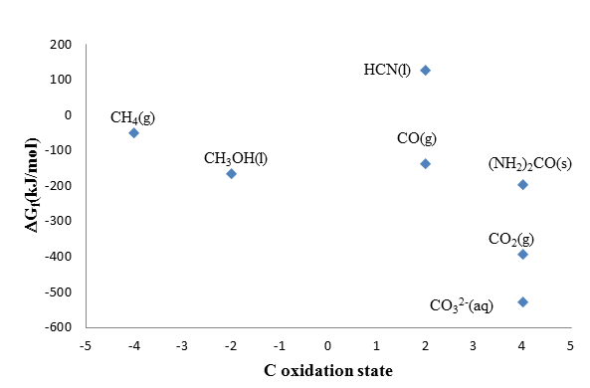
Gibbs standard free-energy
O

Slide 9
Sources of CO₂ (Except Power stations)
Industrial Sector | Mt_{CO2}/y produced
Oil Refineries | 850-900
Ethene and other Petrochemical Processes | 155-300
LNG Sweetening | 25-30
Ethene oxide | 10-15
Ammonia | 160
Fermentation | >200
Iron and steel | ca. 900
Cement | > 1000
3300-3500 Mt/y
CO2
Concentration
may
considerably
vary
1040-1245
ca. 2260

Slide 10
CO₂ separation technologies 1
Solid phases: CaO, MgO → Ca(Mg)CO₃
←
Liquid phases: MEA, HOCH₂-CH₂NH₂
HOCH₂CH₂NHCOO⁻ ⁺H₃NCH₂CH₂OH
Silylamines: (RO)₃Si-CH₂CH₂NHCH₂CH₂NH₂
₊
(RO)₃Si-CH₂CH₂NH₂CH₂CH₂NHCOO⁻
NH
CH₂ COO⁻
CH₂
NH₂⁺
R

Slide 11
CO₂ separation technologies 2
Membranes (cost, space saving)
Ionic liquids (safety, cost, large volumes)
Combined systems
Cryogenic (cost, emissions of electricity)

Slide 12
Actual use of CO₂: 172 + 28 Mt/y Perspective use of CO₂ to Chemicals
Compound | Formula C_{oxstate} | Market 2016 Mt/y | CO₂ Use Mt/y | Market 2030 Mt/y | CO₂ use Mt/y
Urea | (H₂N)₂CO +4 | 180 | 132 | 210 | 154
Carbonates linear | OC(OR)₂ +4 | >2 | 0.5 | 10 | 5
Carbonates cyclic | +4
Polycarbonates | -[OC(O)OOCH₂CHR]-n +4 | 5 | 1 | 9-10 | 2-3
Carbamates | RHN-COOR +4 | >6 | 1 | 11 | ca. 4
Acrylates | CH₂=CHCOOH +3 | 5 | 1.5 | 8 | 5
Formic acid | HCO₂H +2 | 1 | 0.9 | >10 | >9
Inorganic carbonates | M₂CO₃ +4 M’CO₃ | CaCO₃ 250 | 70 | 400 | 100
Methanol | CH₃OH -2 | 60 | 10 | 80 | 28
Total |  |  | 207 |  | 332

Slide 13
CO₂
Polymers
Carbamates
New chemicals
Fuels additives
Solvents
Pharmaceuticals
Polymers…..
RCH=CHCOOH
H₂NCONH₂
ROC(O)OR
ROH
RCH=CH₂
NH₃
RNH₂
Molecular carbonates
RNCO
RNHCOOR
Poly-carbonates
Water or waste
organics as H-source
Poly-urethans
Perennial Energy
HCs
HCOOH
CO
CH₂O
CH₃OH
CH₄
C₂, C₄, Cn, C-O
MTO, MTP, FUEL Cells
Syngas
Resins
MTBE
TAME
DME
Methyl-derivatives:
-amines
-acrylates
-halides
CH₃COOH
Chemicals
CH₂O

Slide 14
Dark Chemistry
Chemicals
Fuels
Light Chemistry
Use of
Low-entropy C
and Visible Light

Slide 15
Energetics of CO₂ reduction
Process | Potential
CO₂ + e⁻ → CO₂^{•−} | E◦ = −1.90V (-2.10 V in anhydrous media)
CO₂ + 2H⁺ + 2e⁻ → CO + H₂O | E◦ = −0.53V,
CO₂ + 2H⁺ + 2e⁻ → HCO₂H | E◦ = −0.61V
CO₂ + 6H⁺ + 6e⁻ → CH₃OH + H₂O | E◦ = −0.38V
CO₂ + 8H⁺ + 8e⁻ → CH₄ + 2H₂O | E◦ = −0.24V
Multi-electron
Multi-photon

Slide 16
Short term:
Use of excess electric energy
Use of off-peak production of electric energy for CO₂ conversion into chemicals or fuels
  Fossil-C or Wind or Solar as primary sources
Option for the efficient storage of electric energy (still an open issue: batteries have a low energy to V or mass ratio, like H₂!)
Use of fuels for transport or production of electric energy

Slide 17
Volume energy density
Batteries 0.33 > 2.8
Liquid fuels as electricity storage: easily portable,
high energy density, use of existing infrastructures

Slide 18
Short to Medium term: use of PV
Production and Use of PV
20 (40)% η StE
70-80% EtH (14 → 32% η in StH)
80-90% HtF (11 → 29% η in StF)
Mature technologies, ready to use!
Large volume electrolyzers, long-living electrodes
Plants: 1.2-1.8 % η StB
Algae: 6-10 (PBR)% η StB

Slide 19
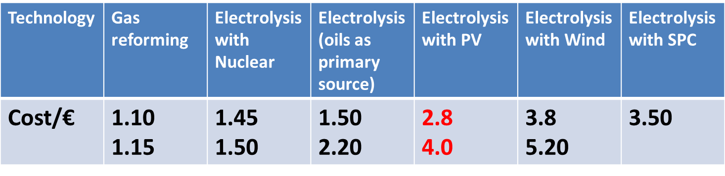
Cost of PV-H₂ (and CH₃OH)
Cost in € of 1 kg_{H2}
3H₂ + CO₂ → CH₃OH + H₂O
Cost of CH₃OH 0.3 €/kg vs 0.08 €/kg BAU
But, if we consider the «carbon tax» then the cost of methaol would be around 0.16 €/kg

Slide 20
PV Utilization
H₂ production or direct electro catalytic reduction of CO₂ in water?
Technology | H₂ from H₂O electrolysis followed by the catalysed reaction with CO₂ to CH₃OH | Direct (photo)electro-chemical reduction of CO₂ in water
Solar light conversion efficiency, % | ca. 20 Expected 40% | ca. 20
Electrolysis Efficiency | 70-80 | 60-70
P_{H2}/MPa in the electrolyzer | 0.1 | Not applicable
P_{H2}/MPa in the chemical conversion | 30-50 | Not applicable
Temperature for CO₂ conversion | 423 K | r.t.
Products (selectivity) | CH₃OH (80-100) | H₂-CO (ca. 20) CH₃OH CH₂=CH₂ (ca. 80)

Slide 21
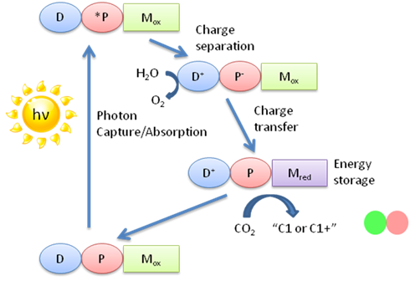
Long Term: Photochemical reduction of CO₂

Slide 22
Natural systems for CO₂ reduction
Enzymes
Co-factors
ATP → ADP, AMP…; NADH → NAD⁺;
Fd_{red} → Fd_{ox};…
Oxidized co-factors need to be reduced back to the energy rich form
Solar energy as primary source and secondary enzymes or other systems

Slide 23
Mimicking Nature

Slide 24
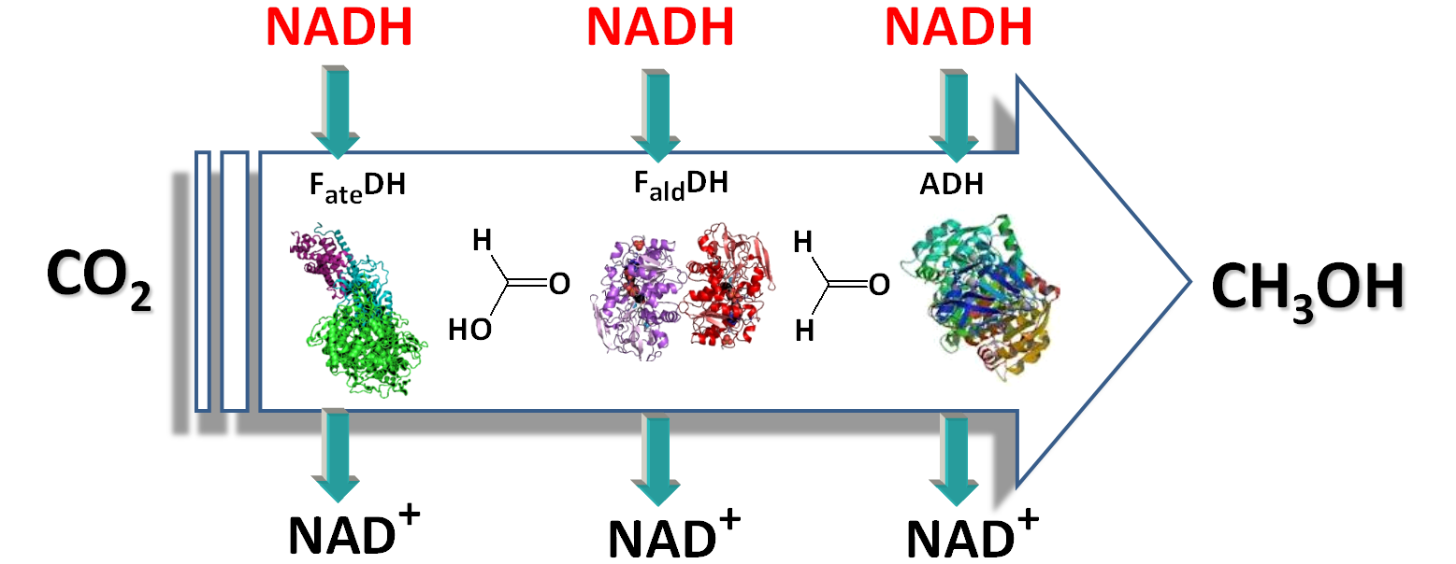
CO₂ reduction to methanol
Exploit the fast rate and selectivity of enzymes
Stabilization of enzymes
Reduction of oxidized co-factor

Slide 25
Hybrid systems: enzymes plus electrons and H⁺
Enzymes as catalysts
Co-factor is oxidized in the reduction of CO₂
Reduce the oxidized form of the co-factor:
  Chemical systems
  Enzymes, cells
  Photocatalysts that use the solar light

Slide 29
New devices

Slide 30
Hybrid reduction of CO₂
Use of ZnS-A and Ru/ZnS as light harvesting system (Xe)
390 nm
From 3NADH/CH3OH to
>100 CH3OH/NADH
M. Aresta et al, ChemSusChem, 2012

Slide 31
Use of solar light
Photocatalysts that are active in the visible part of the spectrum
Cheap
Resistant
Tunable
Modified TiO₂

Slide 32
Band-Gap Modification
NADH
CB
-
CB
NADH
-
-
NAD+
hv
NAD+
hv
Patent 2013
D
+
D
A_{red}
D_{ox}
+
D_{ox}
VB
VB
Cu₂O
CrF₅(H₂O)²⁻ @TiO₂
NADH
CB
-
CB
NAD+
NADH
hv
D
3d_{Fe}
-
NAD+
+
hv
Rutin
D_{ox}
D
+
VB
D_{ox}
VB
rutin @TiO₂
Fex/Zn_{1-x}S

Slide 33
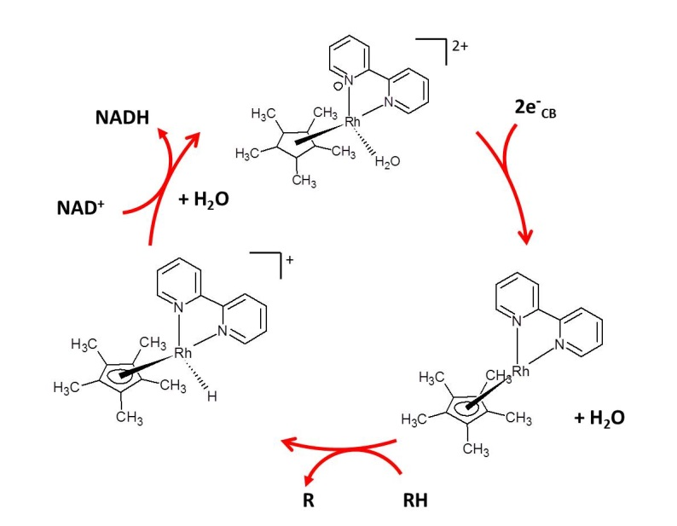

Slide 34
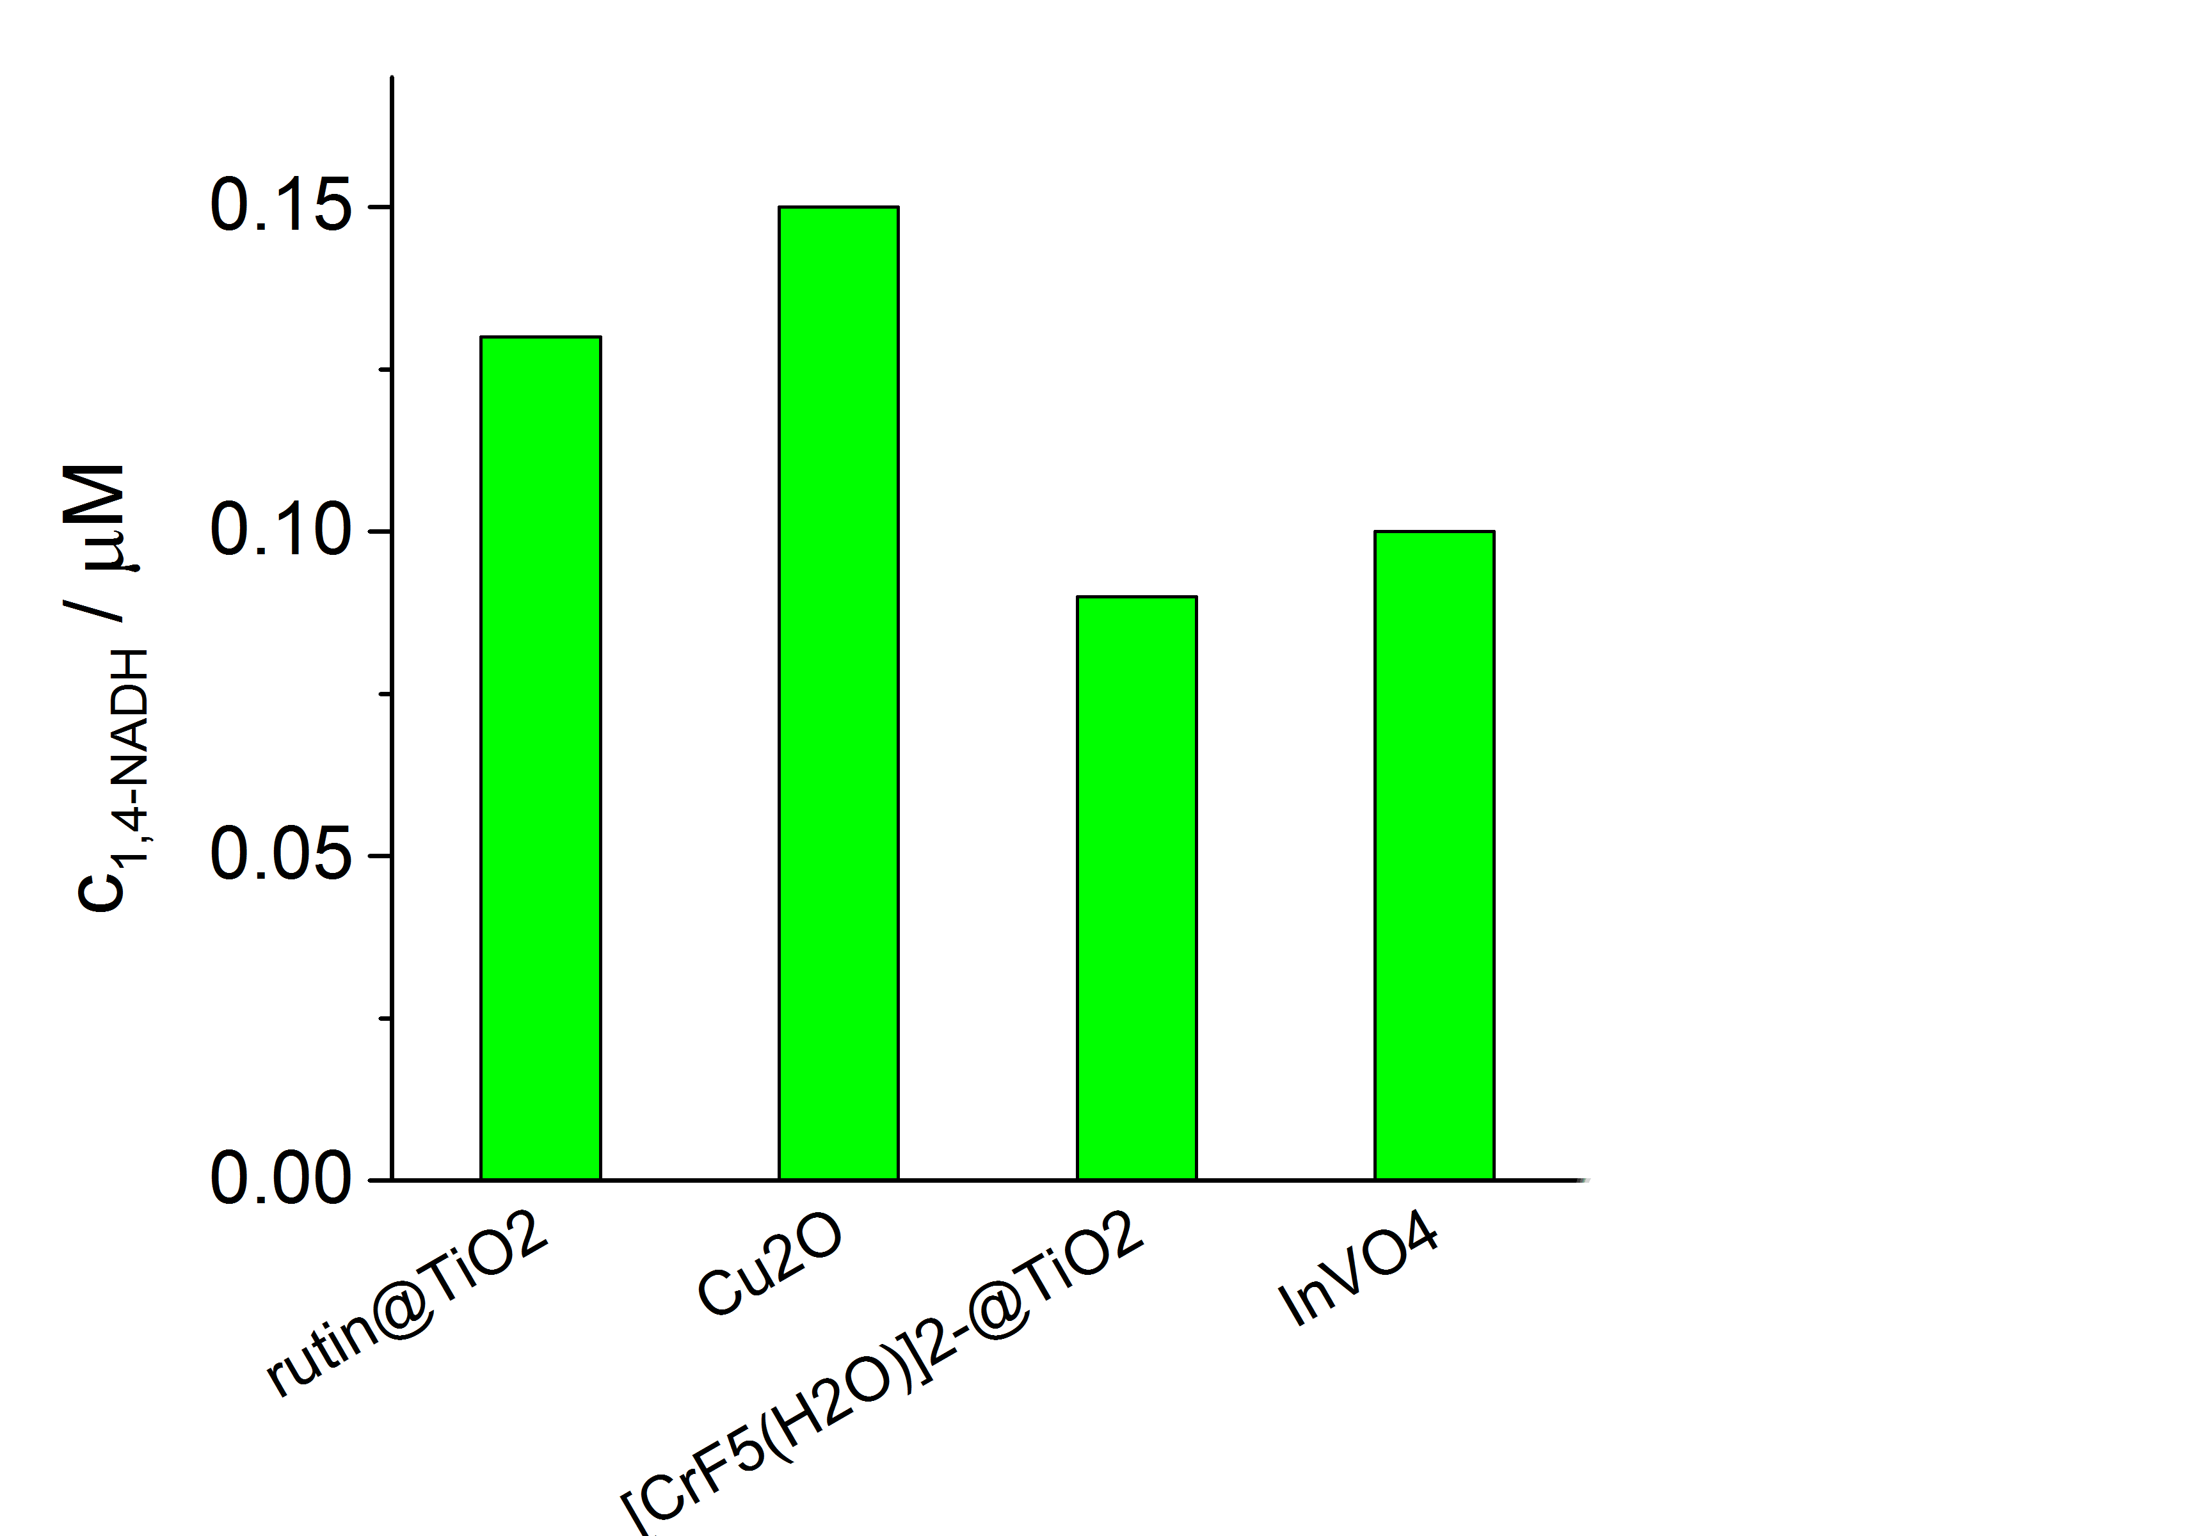
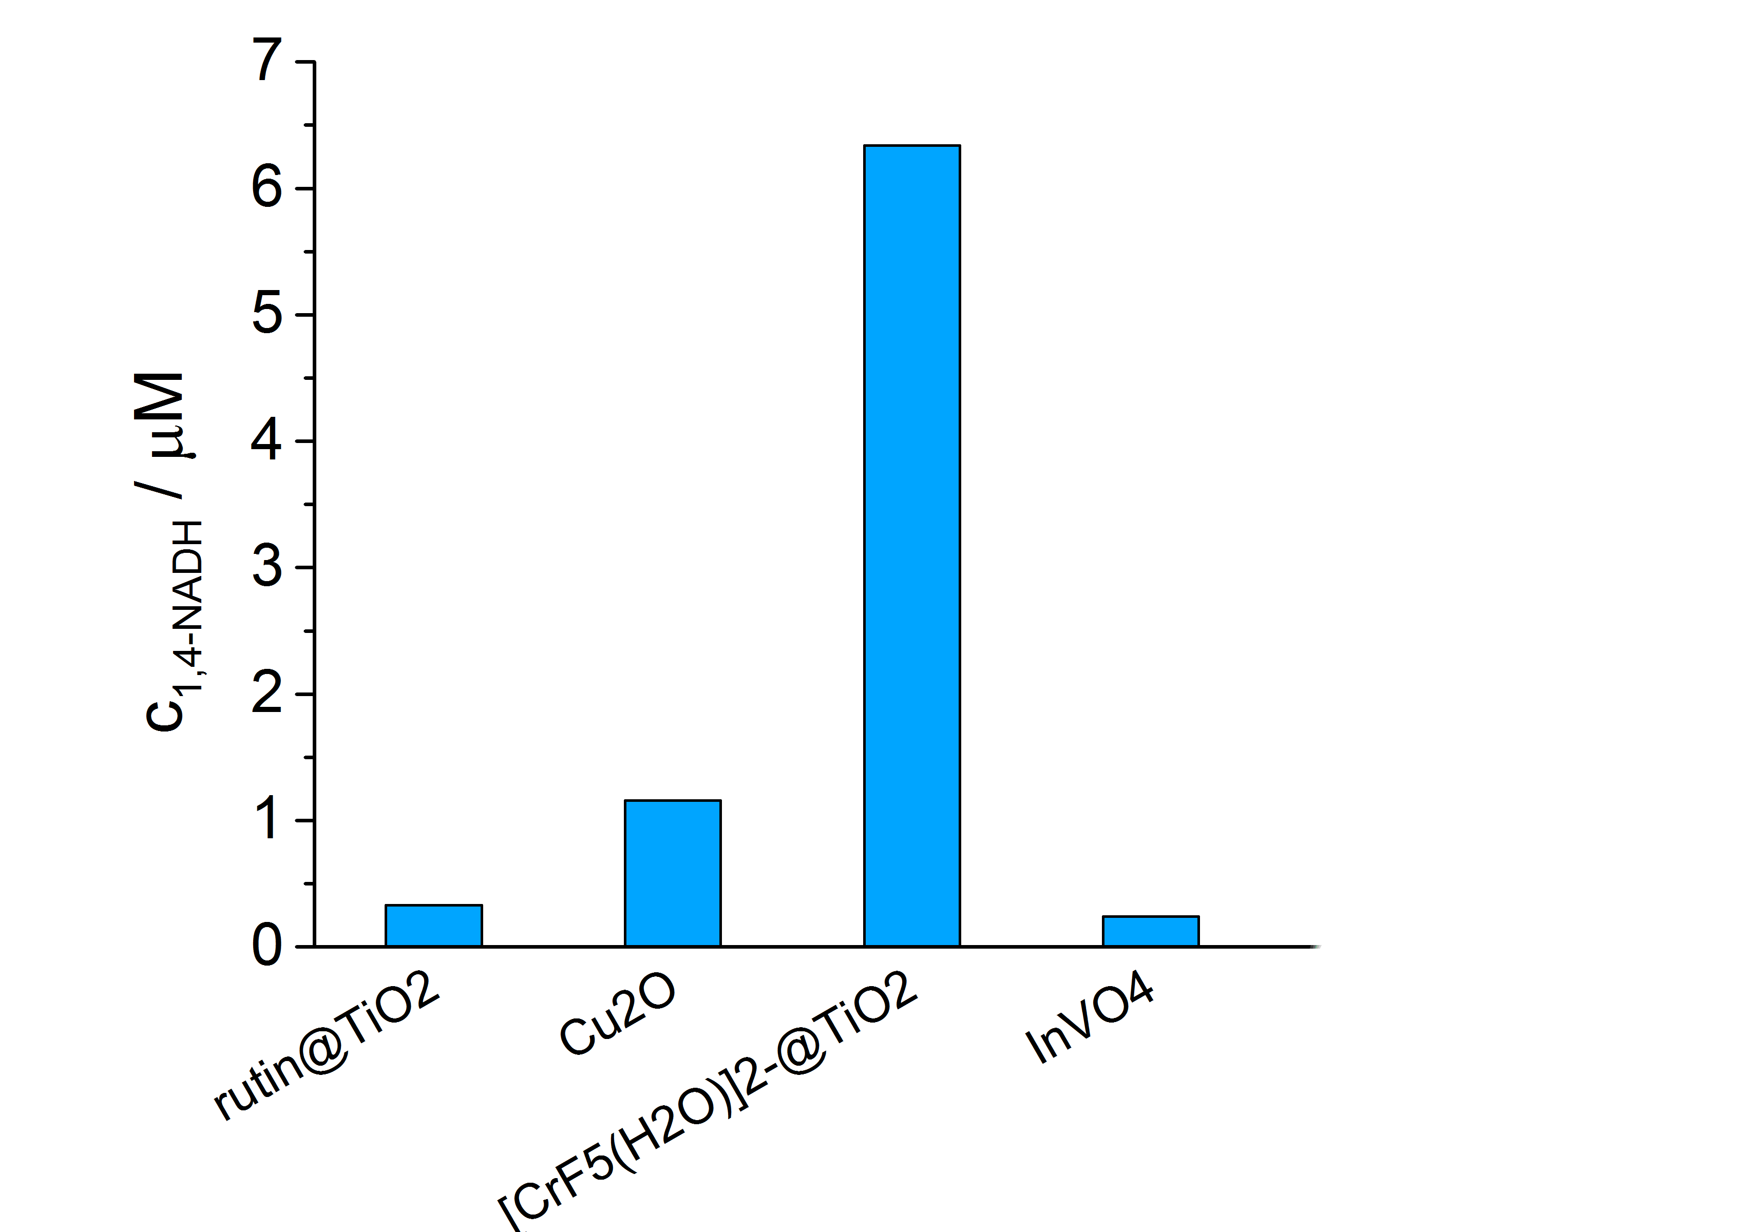
The effect of coupling the photocatalysts to the mediator

Slide 35
Hybrid CO2 Reduction: Electron
cascade in the Vis-Light photochemical regeneration
of NADH using modified TiO₂ as solar energy utilizer
and a Rh complex as e⁻ and H ⁻ transfer mediator
-
CB
CH₃OH + 3NAD⁺
-
-
-
hv →
Rh^{III}/Rh^{I}
F_{ate}DH
F_{ald}DH
ADH
D
Rh^{III}-H
+
H⁺
NAD⁺/NADH
D_{ox}
CO₂ + 3NADH
VB
From 3NADH/CH₃OH to over 100-1 000 CH₃OH/NADH!
M. Aresta, A. Dibenedetto, T. Baran, W. Macyk, Patent 2013

Slide 36
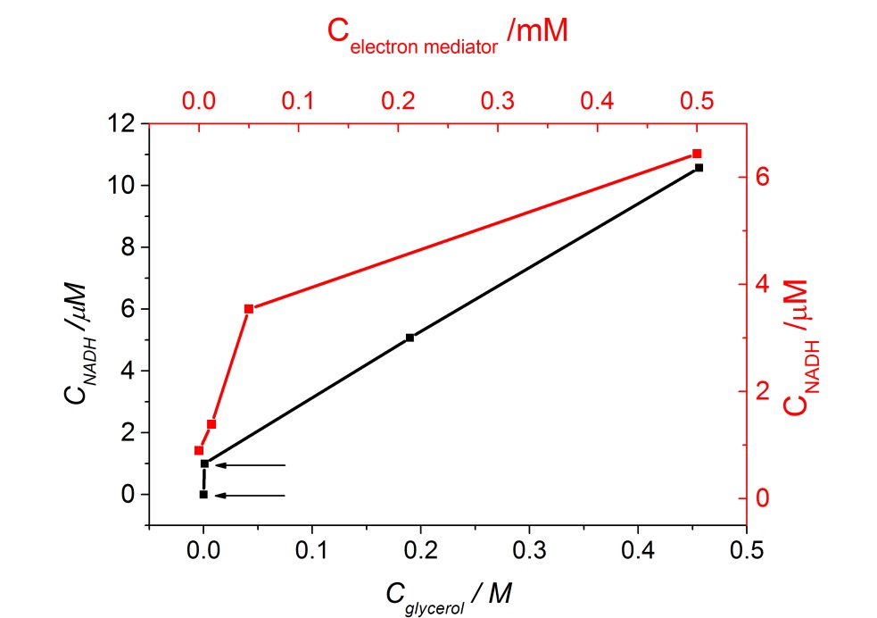
Influence of the components on the production of
NADH from NAD⁺

Slide 37
Device for the hybrid reduction of CO₂
Two compartment A-B cell
A: the enzyme reduces CO₂ to methanol and consumes NADH
B: NAD⁺ is converted back to NADH
Recycling of NADH

Slide 38
Low alkanes valorization
C1-C4 streams from gas and oil processing
  CH₄ → CH₃COOH
C-H activation
  Biological
  Chemical
  Photochemical
sp³ vs sp²

Slide 39
Fate of the tail gas
Ethane extraction by turboexpansion and fractionation without mechanical refrigeration
Cracking → methane, ethane, ethene, propene, propane, butene, butane, and higher HCs
Separation (C1, C2, C2=, C3, C3=; C4, C4=, >C4)
Solvent absorption and hydrogenation

Slide 40
Photochemical conversion of LAs
Cat_{Photo} + hv → h⁺ + e⁻ (1)
CH₄ + h⁺ → •CH₃ + H⁺ (2)
CO₂ + e⁻ → •⁻CO₂ (3)
•CH₃ + •CH₃ → CH₃-CH₃ (4)
CH₄ + •CO₂⁻ → CH₃COO⁻ + •H (5)
CH₃COO⁻ + H⁺ → CH₃-COOH (6)
•CO₂⁻ + •H → HCOO⁻ (7)
HCOO⁻ + H⁺ → HCOOH (8)

Slide 41
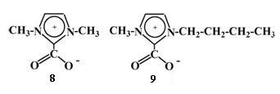
  Carboxylation of activated C-H
  Comparison of chemical and photochemical paths
  CH₃COCH₂COCH₃ → CH₃COCH(COOH)COCH₃
    OH
    CH₃COCH=CCH₃
    R’R”IM=CO₂ + Sub-H + MX ➔ R’R”IMH⁺X⁻ + SUB=CO₂M
    Chiusoli, PhONa, 1960-70
    Aresta et al, 2003
    _{ZnS, hv}
  CH₃COCH₂COCH₃ → CH₃COCH(COOH)HCOCH₃ +
CH₃COCH₂COCH₂-COOH
Aresta et al., ChemPlusChem, 2014

Slide 42
The mechanism?
    OH _{hv} O.
    CH₃COCH=CCH_{3 →} CH₃COCH=CCH₃ + H.
    CH₃COCH₂C=CH₂
    . O O
    CH₃COCH-CCH₃ CH₃COCH₂-C-CH₂.
    .
CH₃COCH₂COCH₃ → CH₃COCHCOCH₃
CH₃COCH₂COCH₂.
O

Slide 43
Work in progress
Photocatalysis Applied to Complex Molecules
Systems bearing sp3 and sp2 C, plus C-O bonds have been used
Interesting information about the order of reactivity of the various bonds
Influence of CO₂ on photochemistry of systems

Slide 44
SPC Thermal Reactions
CO₂ reduction
  MO_{x} → MO_{x-1} + 1/2O₂
  MO_{x-1} + CO₂ → MO_{x} + CO
Water splitting
  H₂O → H₂ + 1/2O₂
Net reaction
  CO₂ + H₂O → CO + H₂ + O₂

Slide 45
Direct carbonation of olefins.
Several issues….
1. The oxidation products distribution is mediated by CO₂
2. An aldehyde is formed that promotes the formation of the epoxide
3. The latter is converted into the carbonate
4. Is it possible to avoid the double bond cleavage?
RHC CH₂
O
Ph
H
O₂ / CO₂
C
C
H
H
O
O
RCH₂CHO
RHC(O)CH₃
C
RCH=CH₂
O
RCHO
RCOOH
O₂
“two oxygen” transfer to the olefin”
“one oxygen” transfer to the olefin”
Detailed study on solvent, pressure of O₂ and CO₂, co-catalysts

Slide 46
Epoxidation and carboxylation of olefins
  _{hv}
  MO_{x} + CH₃CH=CH₂ → MO_{x-1} + CH₃CH-CH₂O
    Aresta-Dibenedetto, CatTod 2005
    MO_{x-1} + 1/2O₂ → M_{ox}
    RCH-CH₂O + CO₂ → RCH-CH₂OC(O)O
    Not only the choice of the metal is crucial but also how the oxide is prepared: propene total oxidation

Slide 47
Feedstocks for the Future Chemicals and Energy
short range
2030
Chemistry
oil and gas dominate
biomass will grow
CO₂ utilization
Energy
mix
middle range
2050
Chemistry
oil and gas
coal
biomass will grow
Energy
switch to perennial
will be important
CO₂ utilization
long range
>2050
Chemistry
Oil and gas
Coal (no CO₂ problems)
Biomass at max
Energy
Substantial switch to perennial, world will go electricity
Large volumes CO₂ used

Slide 48
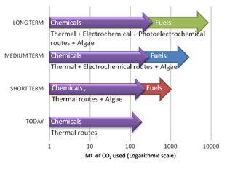
Conclusions
M. Aresta, A. Dibenedetto, N He for The Catalyst Group, 2013

Slide 49

Apulia
V-IV Century b.C.
Key objective:
To reduce the impact on Climate Change.
by reducing the immission of CO₂ (or other species with high CCP) into the atmosphere and the amount of climate alterating species (CAS) that accumulate in the atmosphere.
Question: is it enough to use CO₂ for reaching the above goal?.
  The use of CO₂ is not per se a guarantee that its emission is reduced.
  The new process (conversion or technological use) or product (substitute of existing ones) must minimize the use of materials, the energy consumption and the emission of CO₂
Still
a lot
to think
about, but… I see the light!
Thanks for your attention!

Slide 50
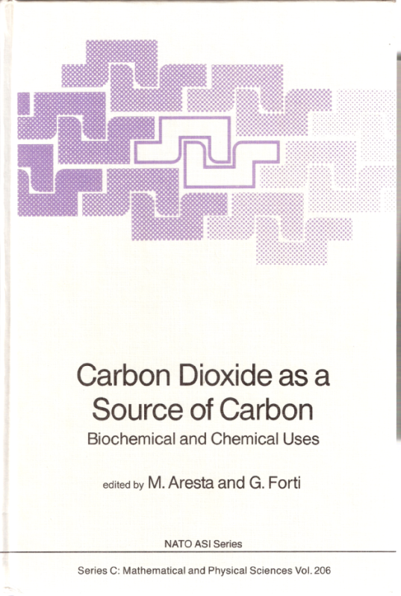
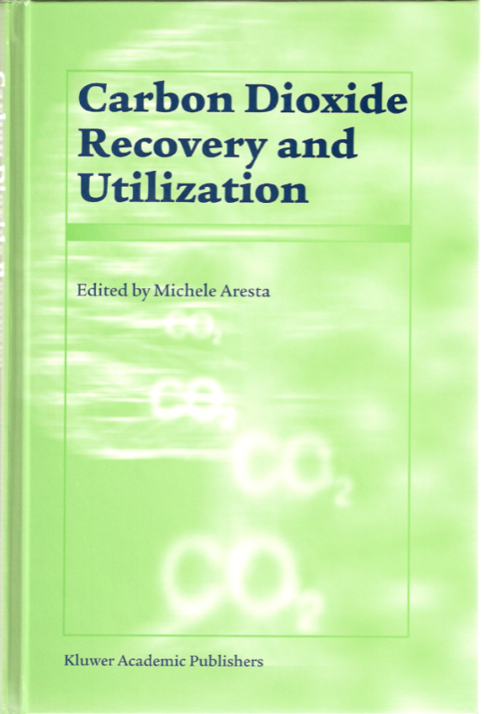
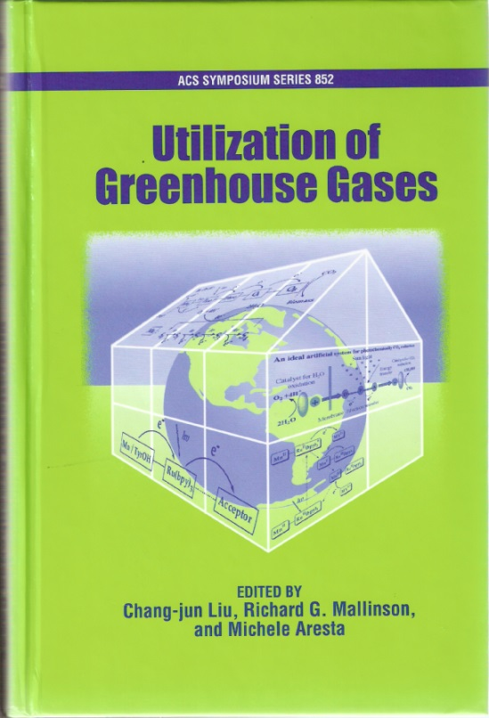
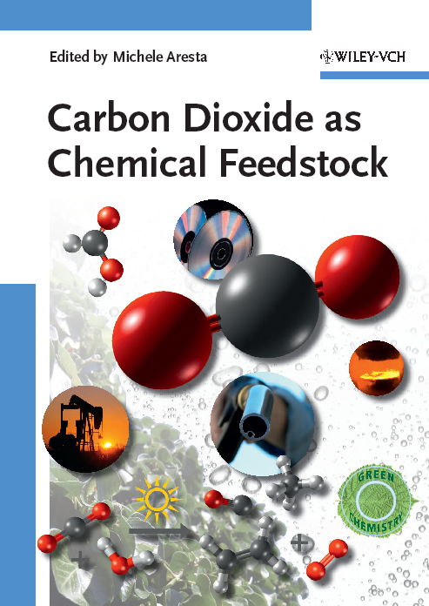
From the basket of published Books…..
1986
1989
2003
2003
M. Aresta et al,
Chemical Reviews 2014
2009
Notes:
50

