Slide 1



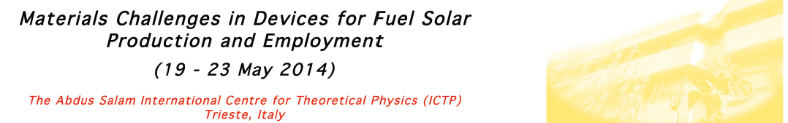
An atomic-level insight into the mechanisms of heterogeneous catalytic reduction of carbon dioxide
E. Vesselli
Physics Dept. and CENMAT, Università degli Studi di Trieste (Italy)
and
Laboratorio TASC IOM-CNR (Italy)
vesselli@iom.cnr.it

Slide 2
About the importance of
CO and CO2 catalytic reduction
in Nature

Slide 3

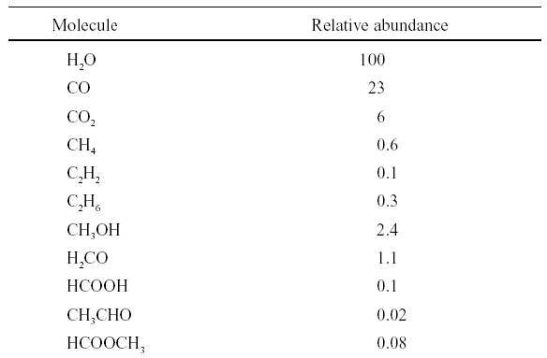
Catalysis in Nature
the origin of life?
Comets
Ice (water) + Fe, Ni, silicates …
Bricks for life?
Catalytic CO2 reduction
J. Llorca, Intern. Microbiol. 8 (2005 ) 5

Slide 4
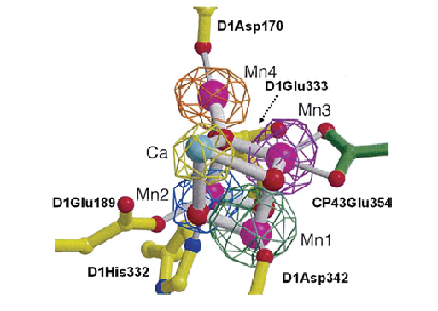
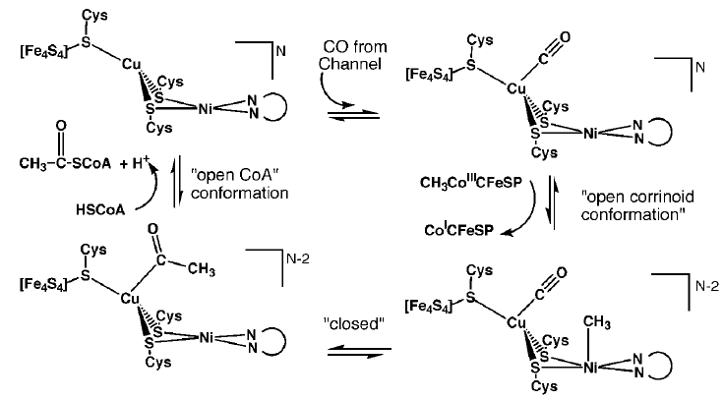
CO2 Catalysis in NATURE
Photosynthesis: catalytic carbon dioxide reduction == chemical energy for life
Acetogenic bacteria
Carbon fixation pathway to convert CO/CO2 to acetyl groups
Ni-Fe-Cu reaction center
Carbon fixation reaction (PS-II):
3CO₂ + 9ATP + 6NADPH + 6H⁺ → C₃H₆O₃-phosph + 9ADP + 8P_{i} + 6NADP⁺ + 3H₂O
PS-II:
Mn₄Ca²⁺O₄
cluster
A 9 atom cluster does the catalysis job!
-> 2.5 billion years old
NANOTECHNOLOGY
K.N. Ferreira, et al. Science. 303 (2004) 1831
Doukov, et al. Science. 298 (2002) 567

Slide 5
… and in industry
CO₂ reduction involved in
MeOH synthesis
Urea synthesis
Methane (tri-)reforming
Dimethylcarbonate production
…

Slide 6
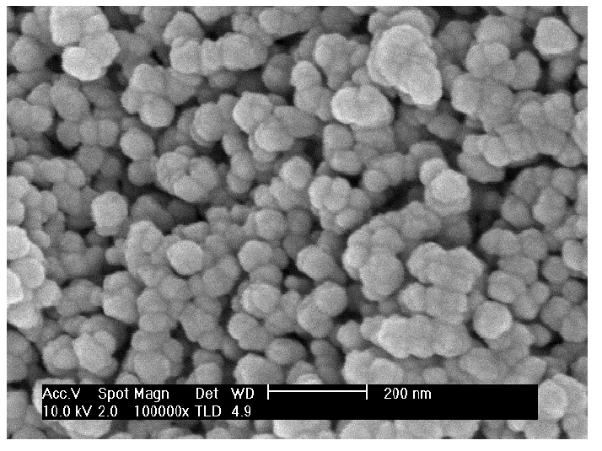
Catalytic carbon dioxide hydrogenation for organic synthesis
MeOH (a chemical & an energy vector)
Industrial catalyst: Cu/ZnO/Al₂O₃
50-100 bar
500-550 K
CO + CO₂+3H₂→ CH₃OH + H₂O + CO
??!
T. Kim, et al. J. Micromech. Microeng. 16 (2006) 1760

Slide 7
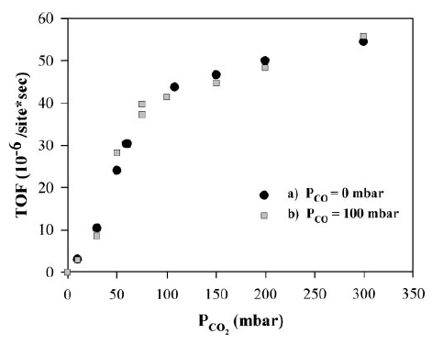
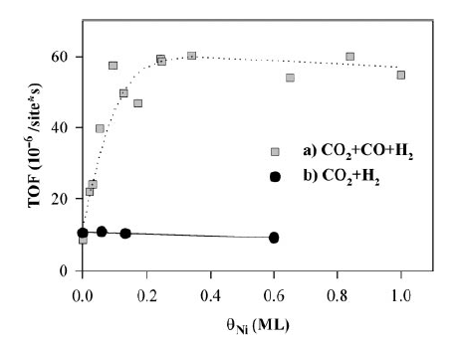
Modeling to understand…
CO₂ hydrogenation to MeOH
Cu(100)
p_{tot}=1.5 bar
T = 543 K
no difference with/without CO in the stream
Ni/Cu(100)
a) p_{CO+CO2+H2}=100+30+1370 mbar
b) p_{CO+CO2+H2}=0+30+1470 mbar
T = 543 K
… and now CO makes the difference !
J. Nerlov, I. Chorkendorff J. Catal. 181 (1999) 271

Slide 8
In our example:
CO₂ hydrogenation to MeOH
Using Ni/Cu alloys:
CO₂ turnover frequency is notably higher at Ni sites with respect to Cu sites
Formate is observed as stable intermediate in situ
MeOH carbon and oxygen atoms come from CO₂, but CO is needed

Slide 9
... WHAT IS HAPPENING THERE ??? ...
… will this talk be about surface science?
…may the latter have anything to do with «real» catalysis?

Slide 10

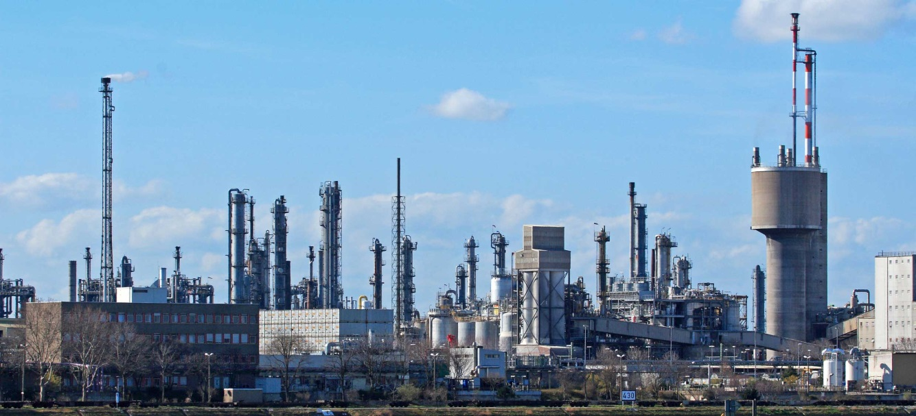
This is how
Chemists see it…
Surface Science
Pressure Gap Material Gap

Slide 11
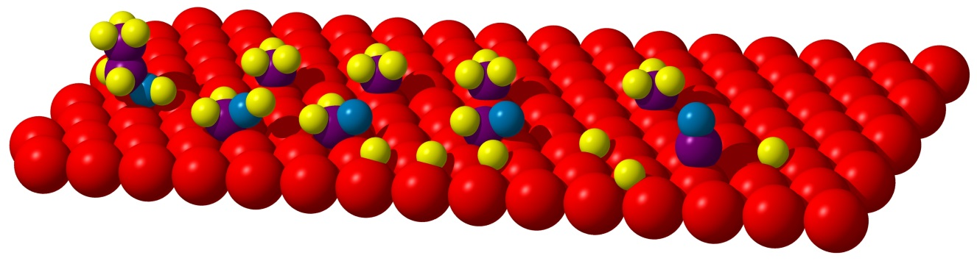

Surface Science
Pressure Gap Material Gap
This is how
Physicists see it…

Slide 12
Going on with our sample reaction…
... let’s dig up
atomic level insight …
1.under model UHV conditions…

Slide 13
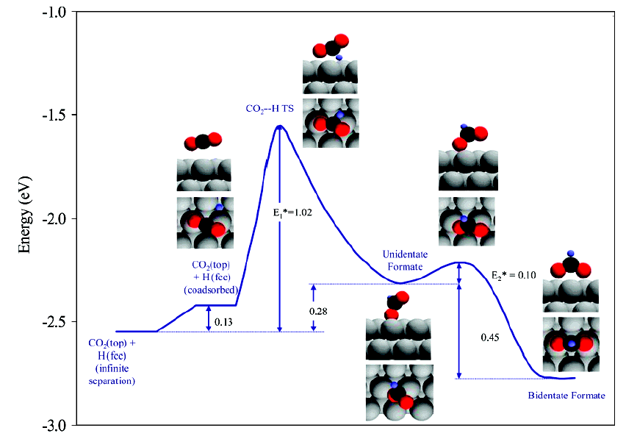
What is known about Cu (DFT):
A.A. Gokhale, J.A. Dumesic, M. Mavrikakis, J ACS 130 (2008) 1402

Slide 14
And What about Ni ?

Slide 15
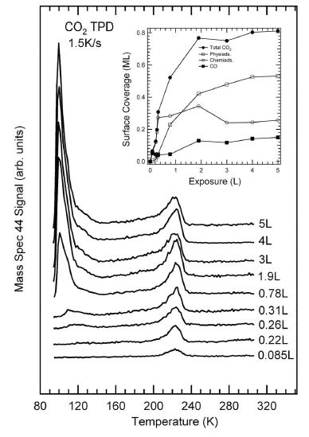
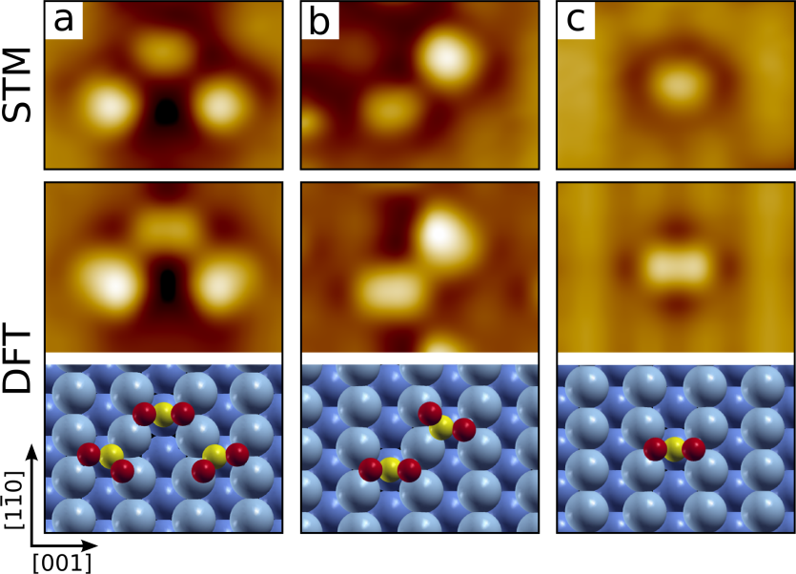
CO₂ adsorption on Ni(110) - UHV
chemisorption states
e⁻ injection -> CO2 bends
activated chemisorbed state
⇩
«seen»for the first time
There is a stable CO₂ species
(16x22 Å²)
PRB 76 (2007) 195425, PRB 82 (2010) 165403; H-J. Freund, M. Roberts Surf. Sci.Rep. 25 (1996) 225.

Slide 16
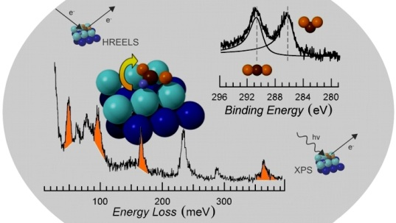
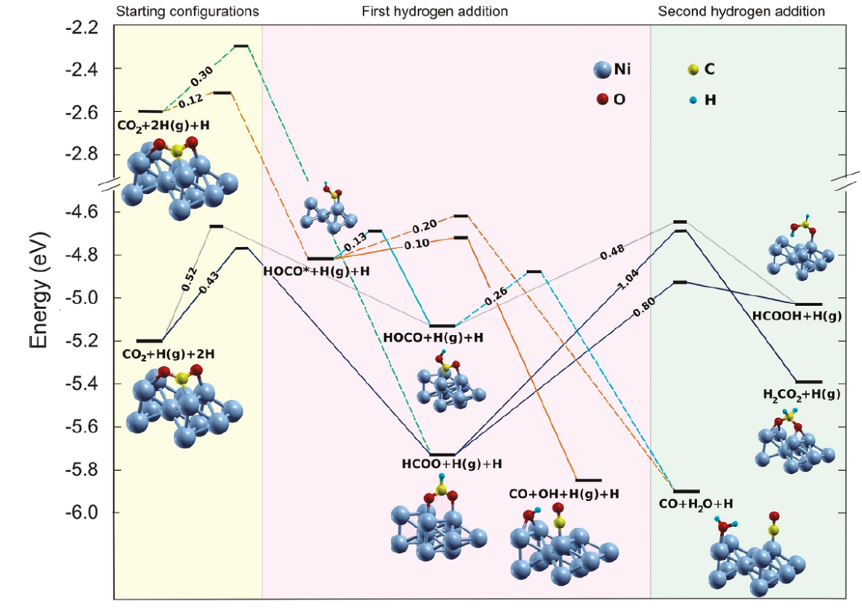
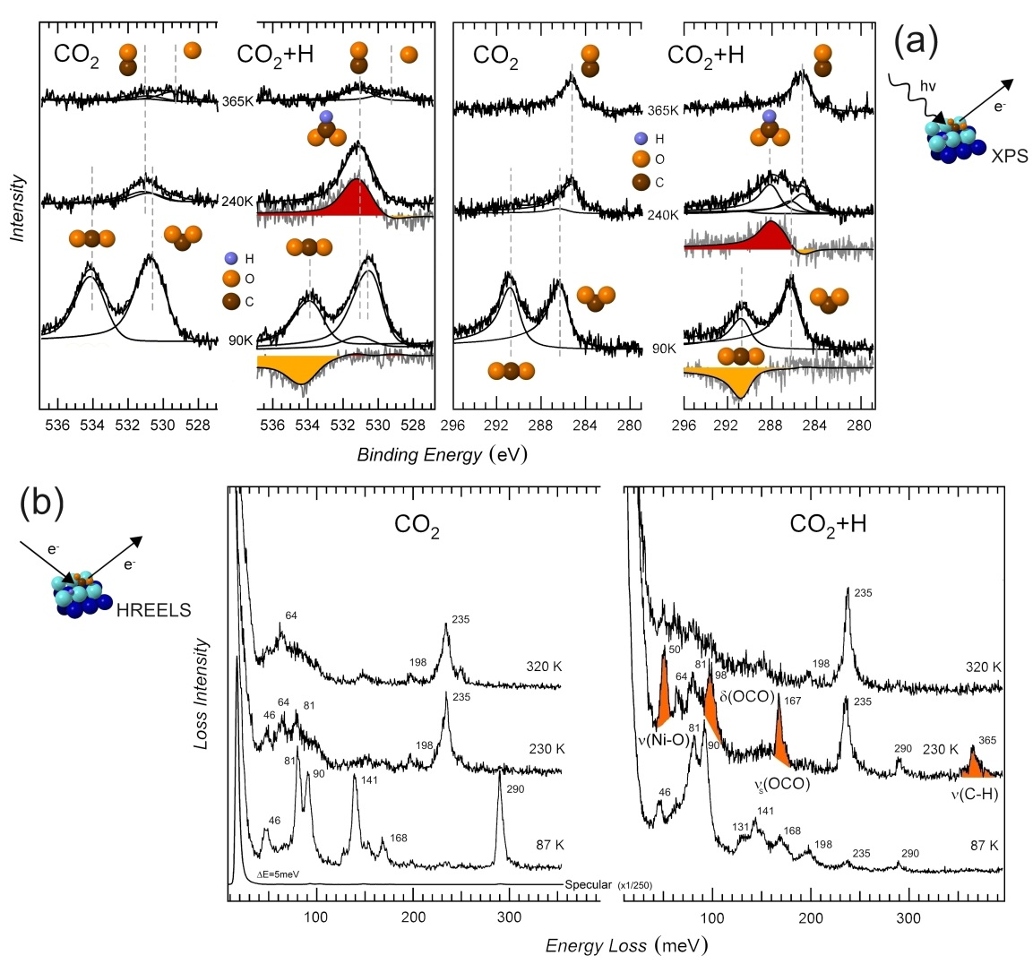
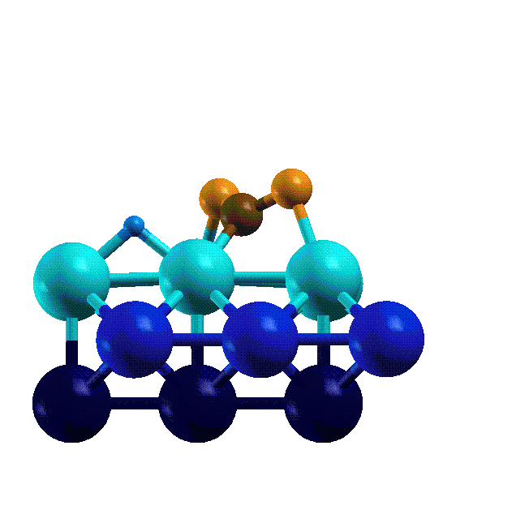
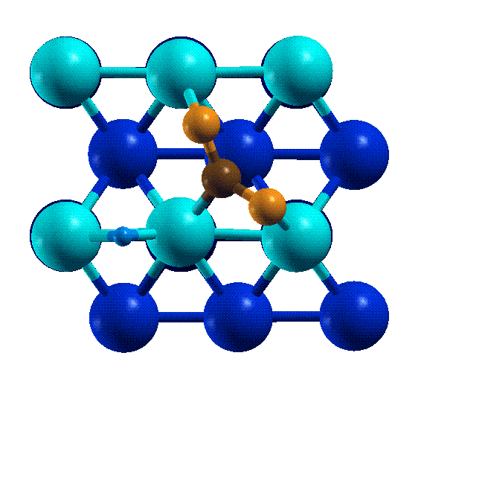
CO₂ reduction on Ni(110) – UHV+DFT
H+CO2
coadsorption:
Formate – similar
to Cu at high
pressure
DFT
H_{gas}+CO2
JACS 130 (2008) 11417, JPCL 1 (2010) 402

Slide 17
What we got up to here about Ni:
Ni activates CO2 for reduction
There are two parallel pathways
  Formate (spectator, slow conversion rate)
  Hydrocarboxyl intermediate (fast reaction)
AND WHAT ABOUT
Ni doping/alloying
The role of CO

Slide 18
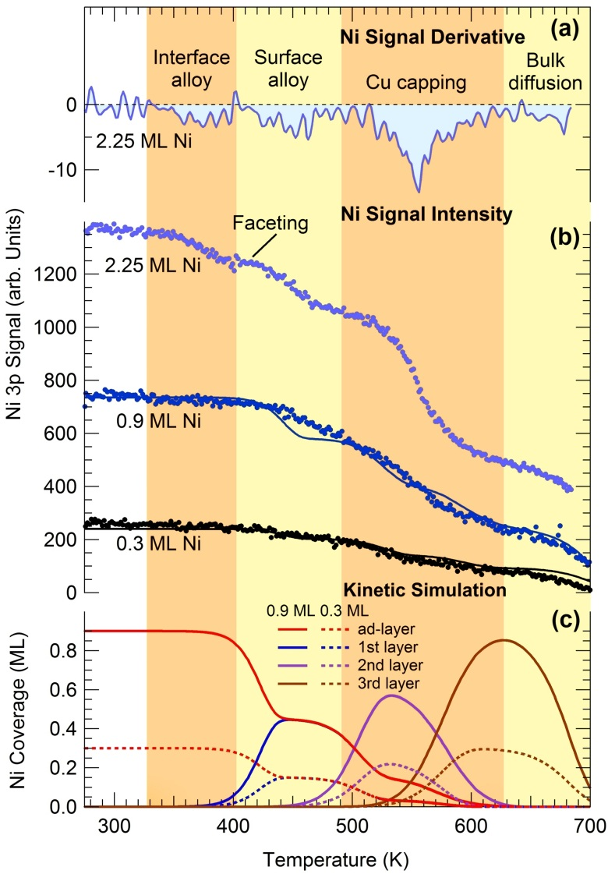
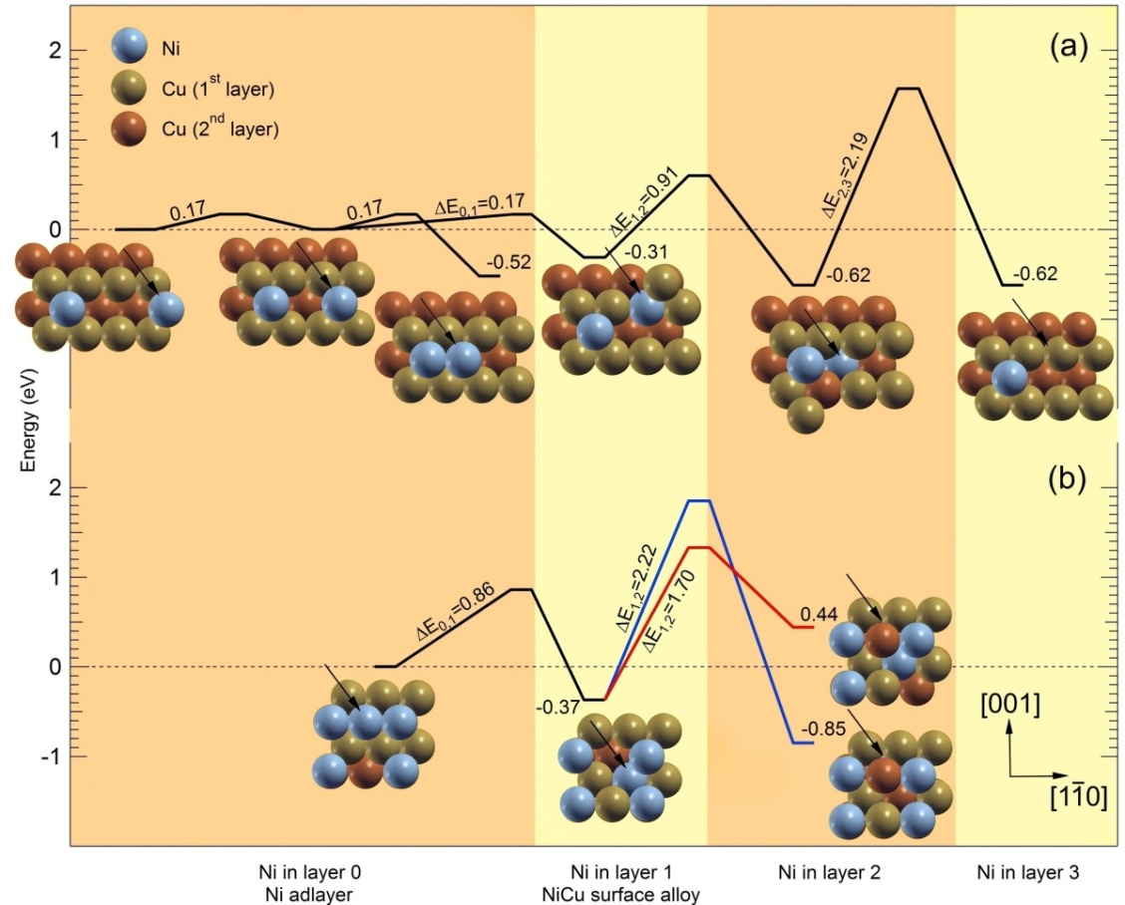
Tailoring bimetallic alloy surface properties:
i) self-diffusion processes
Ni/Cu(110)
Segregation is determined by kinetics !
Synchrotron radiation time-resolved X-ray photoelectron spectroscopy
JACS 134 (2012) 16827

Slide 19
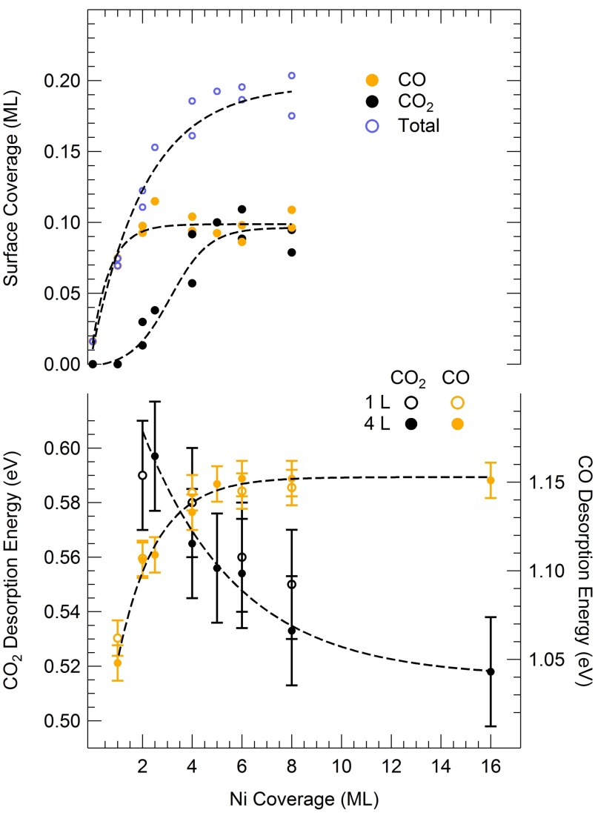
Tailoring bimetallic alloy surface properties:
ii) molecule-metal interaction
CO/CO2/Ni/Cu(110)
Tuning the CO2 dissociation barrier…
… and the adsorption energies.
ACS Catal. 3 (2013) 1555

Slide 20
So in Ni/Cu alloys there is a delicate interplay between
energetics and kinetics
in the Ni/Cu segregation process
+
adsorbate binding, and decomposition !

Slide 21
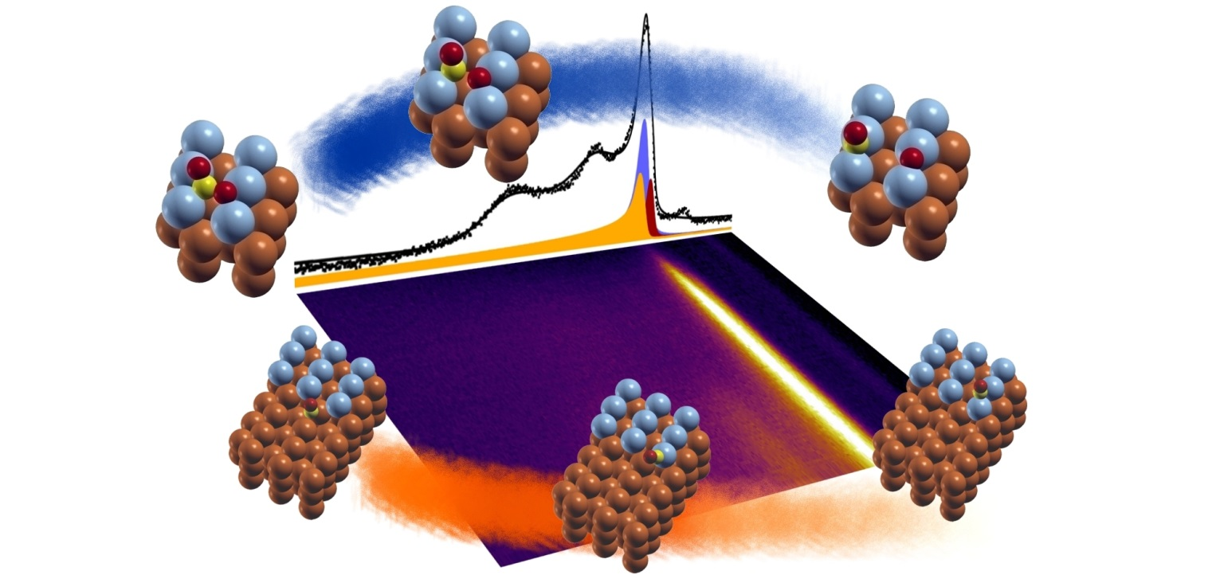
Can we therefore steer the chemistry of carbon oxides on a NiCu Catalyst by controlling Ni concentration?
ACS Catal. 3 (2013) 1555

Slide 22
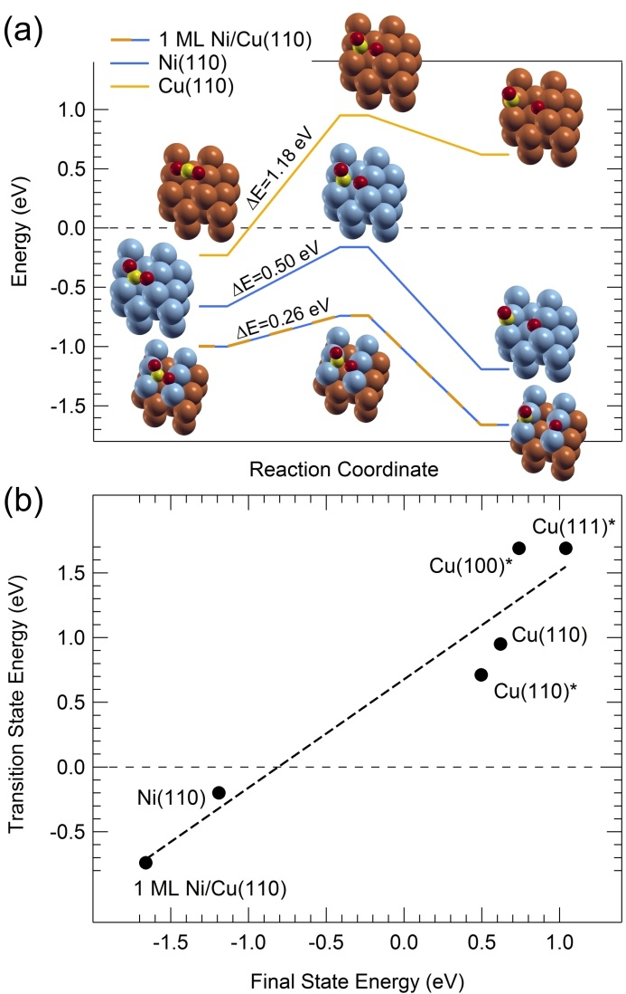
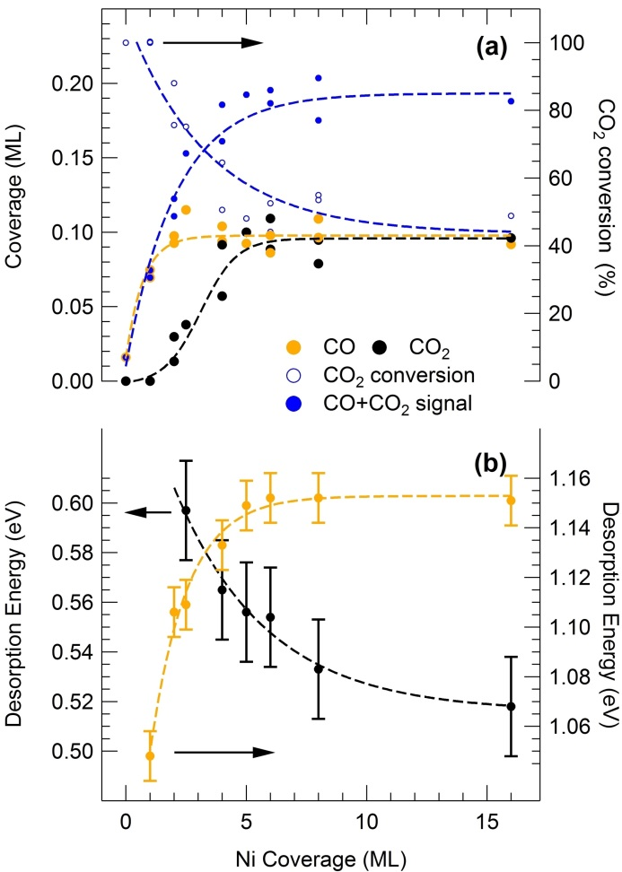
In the case of our model reaction…
CO/CO2/Ni/Cu(110) - UHV
This is here, and not there!
ACS Catal. 3 (2013) 1555

Slide 23
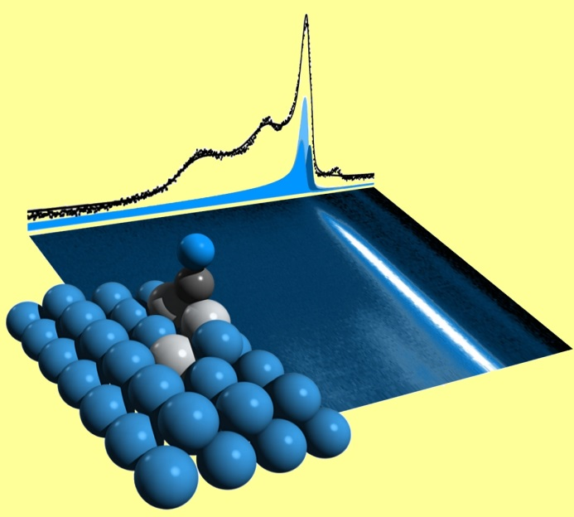
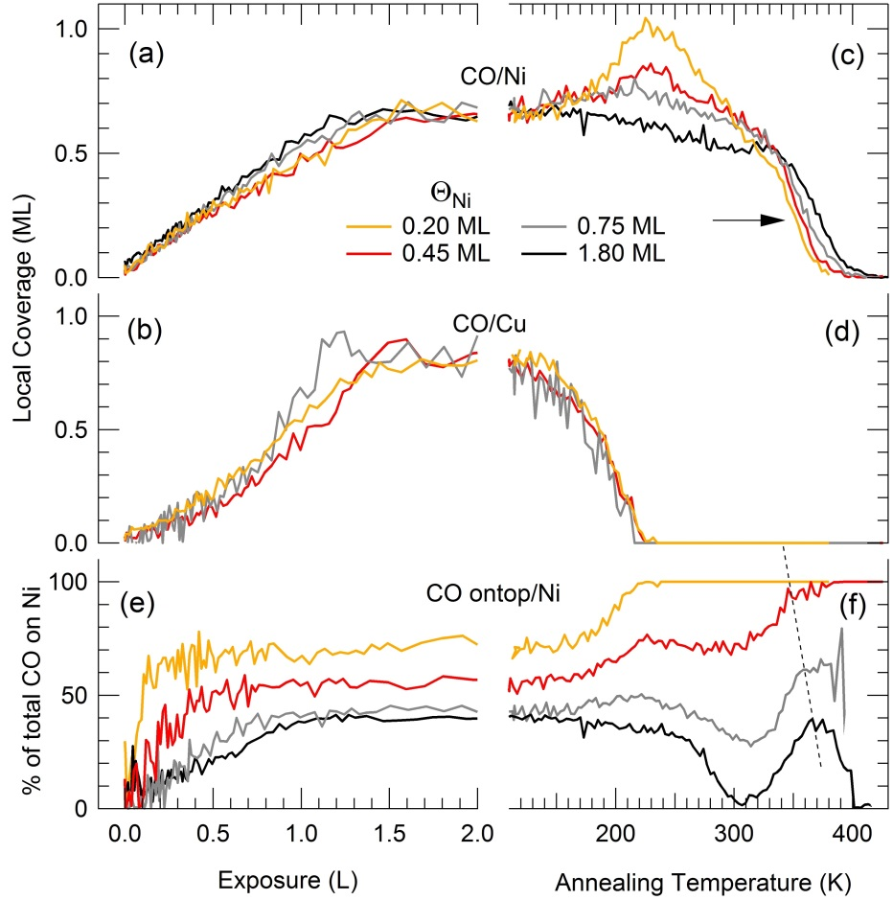
We can also indirectly control the local adsorption sites of CO
CO/CO2/Ni/Cu(110) - UHV
CO adsorption metal: from Cu to Ni as a function of T
Binding
energy
CO adsorption site on Ni: top vs bridge
In preparation.

Slide 24
Summarizing about Ni alloying….
We can influence
CO and CO2 binding energies
CO adsorption sites
Reaction barriers

Slide 25
2.Bridging material gaps…

Slide 26
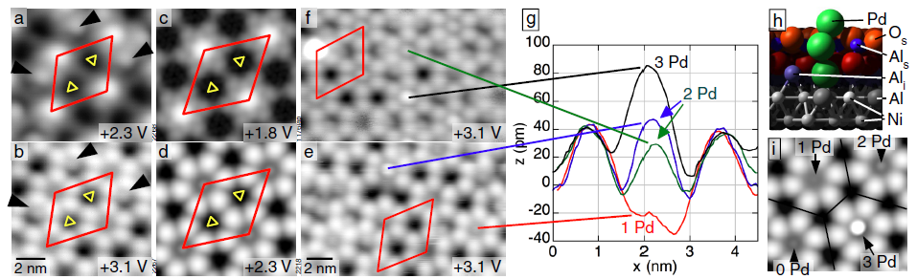
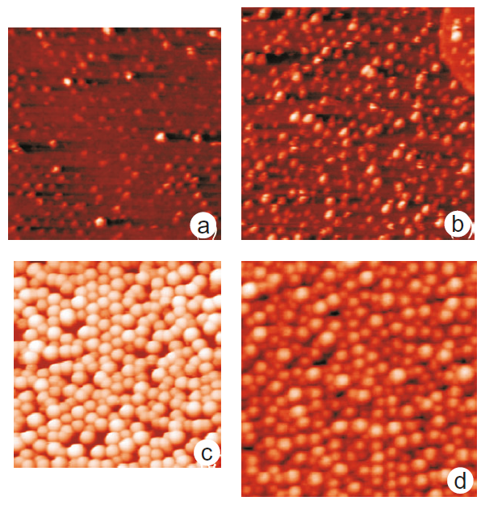
Beyond the material Gap
Cu@Al_{x}O_{y}/Ni₃Al(111)
Schmid et al. PRL 99 (2007) 196104, Becker et al. NewJPhys 4 (2002) 75.

Slide 27
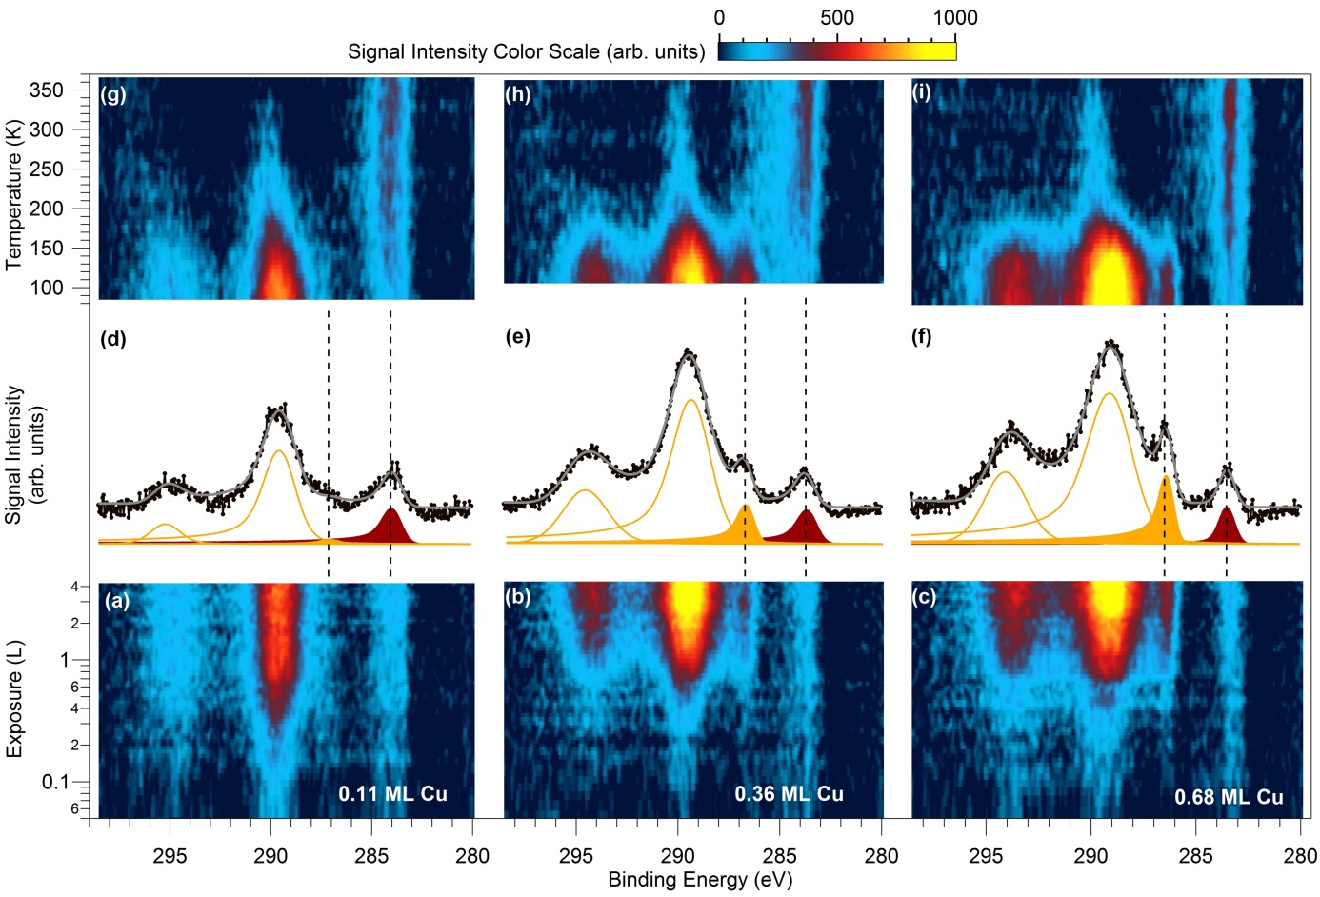
CO/Cu@Al_{x}O_{y}/Ni₃Al(111):
modeling the Boudouard reaction…
2CO→CO2+C
CO
CO
CO
C
C
C
In preparation.

Slide 28
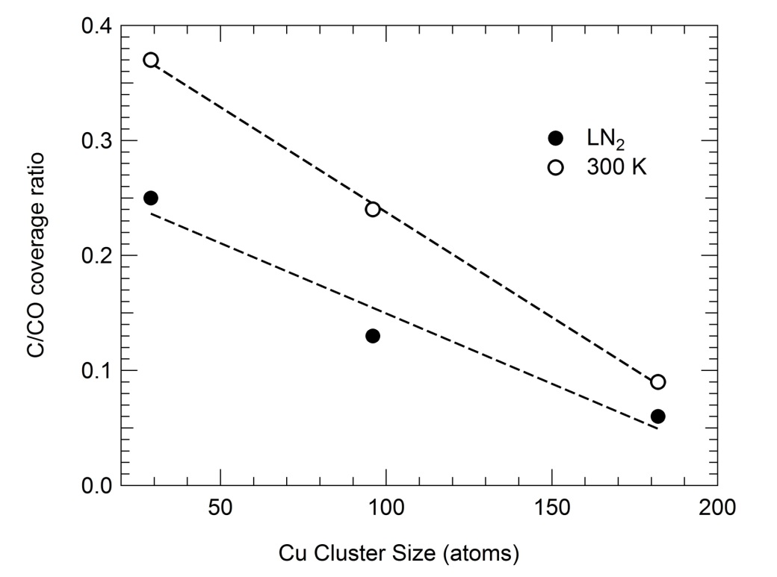
Cluster size effect
The smaller the cluster, the more efficient the conversion
In preparation.

Slide 29
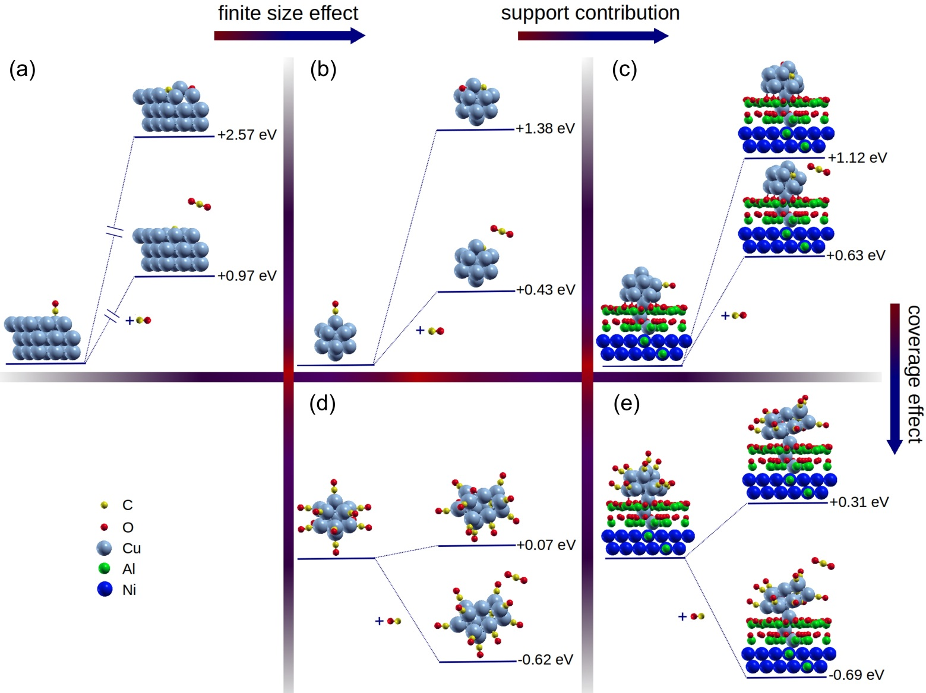
CO/Cu@Al_{x}O_{y}/Ni₃Al(111)
Boudouard reaction: it goes Eley-Rideal
In preparation.

Slide 30
3.Bridging pressure gap…

Slide 31
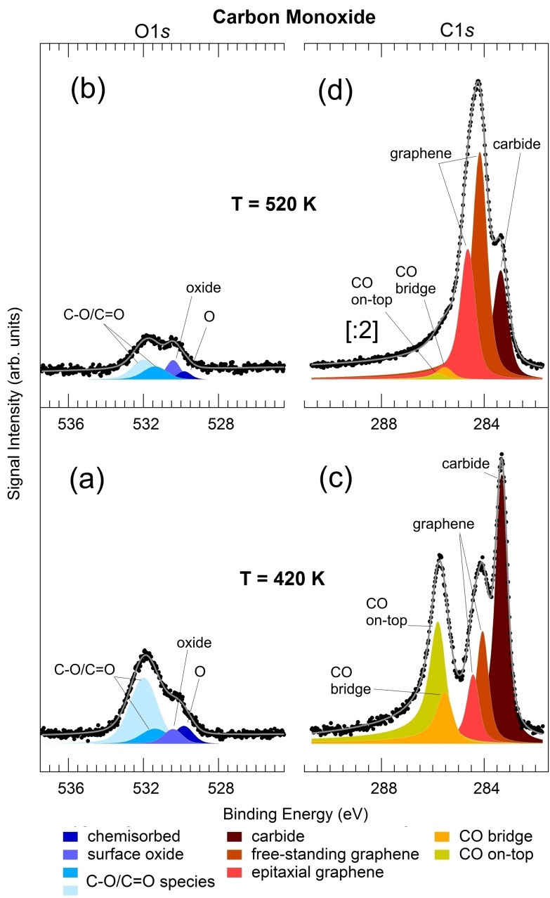
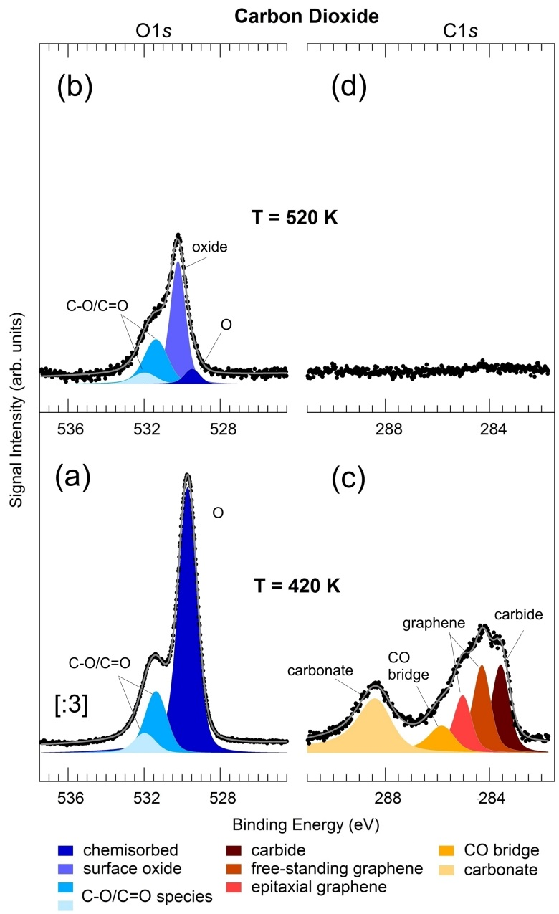
NAP-XPS at Bessy
CO+CO2+H2/Ni(110) @ 0.3 mbar
You end up with carbide and graphene
You end up with oxide
JPCL (2014) DOI: 10.1021/jz5007675.

Slide 32
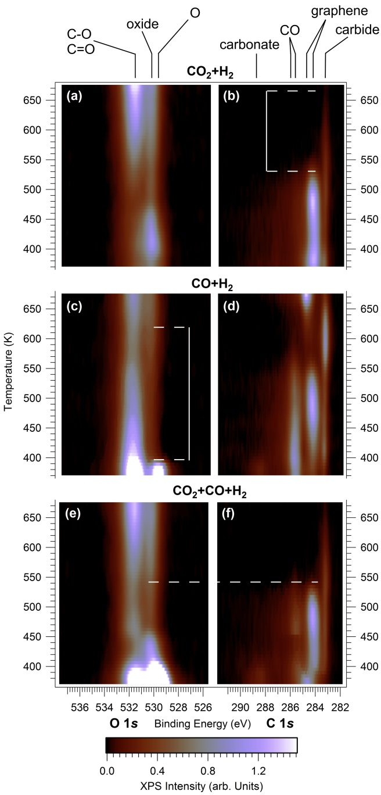

The role of graphene and oxide
CO+CO2+H2/Ni(110) @ 0.3 mbar
Ni oxide
carbide
graphene
Active surface for MeOH synthesis….
JPCL (2014) DOI: 10.1021/jz5007675.

Slide 33
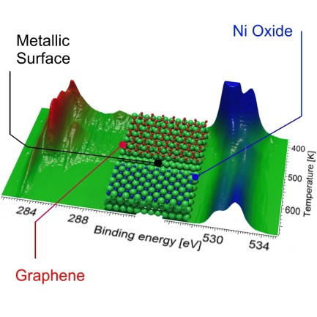
The role of graphene and oxide
CO+CO2+H2/Ni(110) @ 0.3 mbar
CO removes NiO
H₂ removes carbon
↓
Metallic Ni
↓
active phase
JPCL (2014) DOI: 10.1021/jz5007675.

Slide 34
Finally we got some hints about the role of CO
CO influences segregation at the surface of Ni/Cu alloys
CO yields carbide/graphene by Eley-Rideal mechanisms (Boudouard reaction)
CO removes oxygen from Ni, which is hardly removed by hydrogen, yielding metallic, active Ni
CO and CO2 adsorption sites, binding energies, and reaction barriers can be tuned by means of Ni doping
We have evidenced finite size, support, and coverage effects

Slide 35
4.Totally bridging the pressure gap…

Slide 36
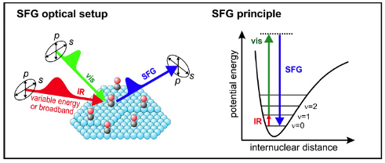
Sum Frequency Generation Vibrational Spectroscopy
Non-linear optical technique intrinsically selective for interfaces

Slide 37
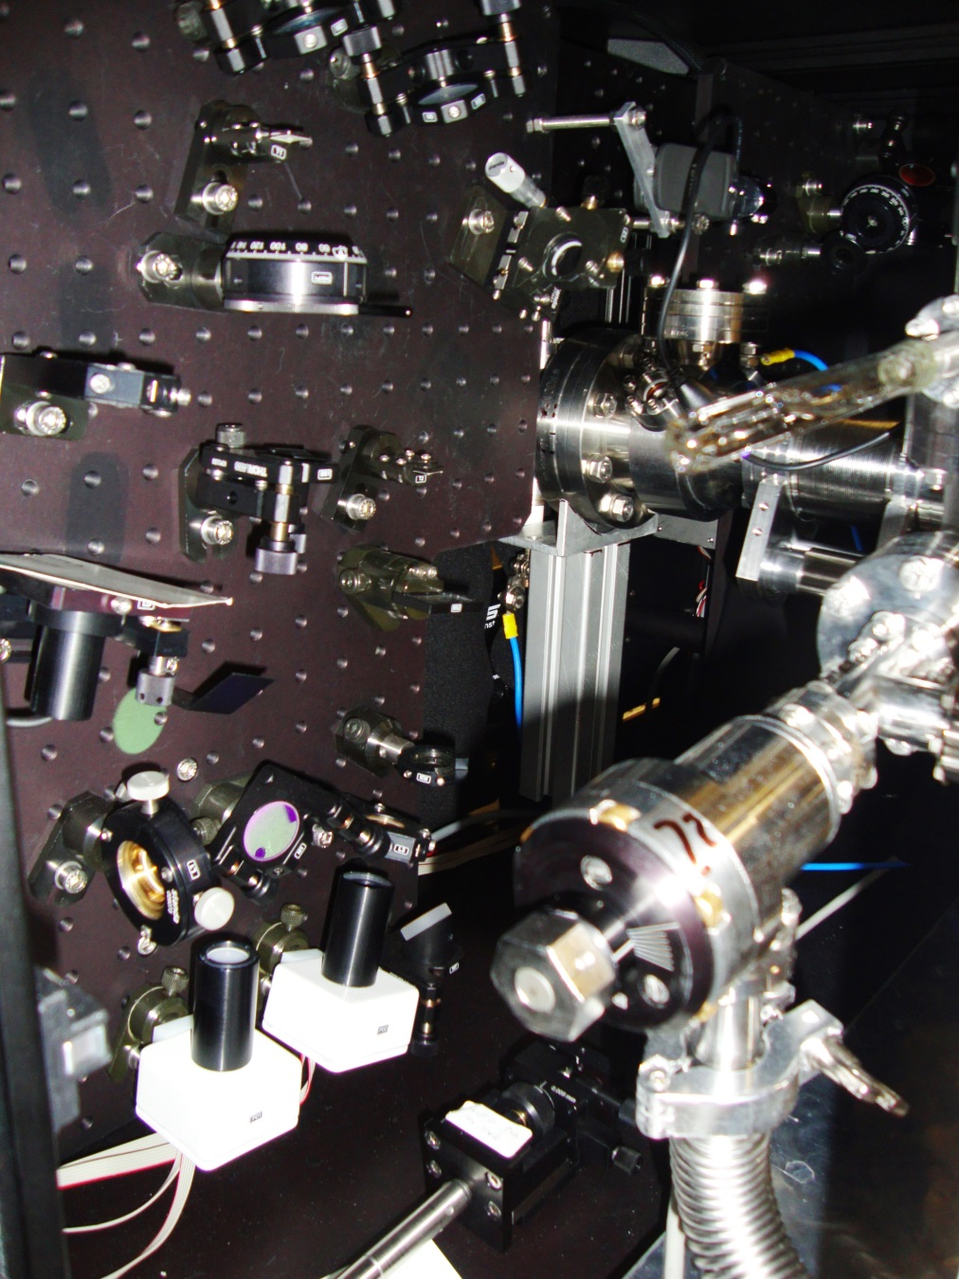
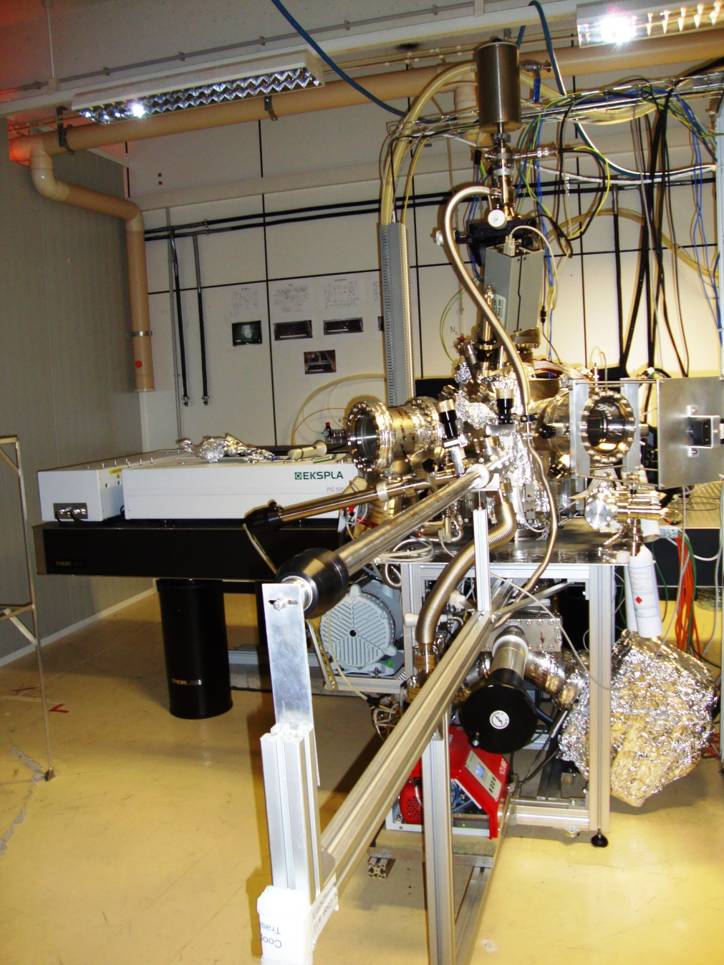
Vis-IR SFG Spectroscopy Lab @ UniTs

Slide 38
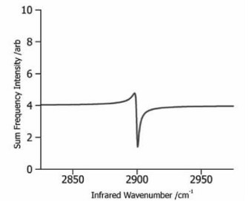



Not only vibrations, but also electronic configuration: the case of CO/Ni(110)
$$I_{SFG}∝{\left|χ_{NR}^{(2)}+χ_{R}^{(2)}\right|}^{2}$$
$$χ_{R}^{(2)}=\sum_{ν}{\frac{A_{ν}e^{iφ_{ν}}}{ω_{ν}−ω_{IR}−iΓ_{ν}}}$$
$$I∝{\left|χ_{NR}^{\left(2\right)}\right|}^{2}+{\left|χ_{R}^{\left(2\right)}\right|}^{2}+2\left|χ_{NR}^{(2)}\right|\left|χ_{R}^{(2)}\right|\cos{∆φ}$$

Slide 39
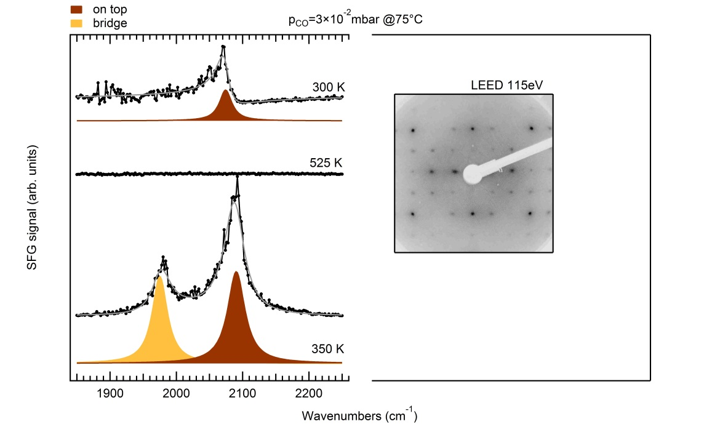
Not only vibrations, but also electronic configuration: the case of CO/Ni(110)
CO+C/Ni
φ = 345°
CO/Ni
φ = 310°
Ni carbide
Unpublished.

Slide 40
5.Towards in situ electrochemistry…

Slide 41
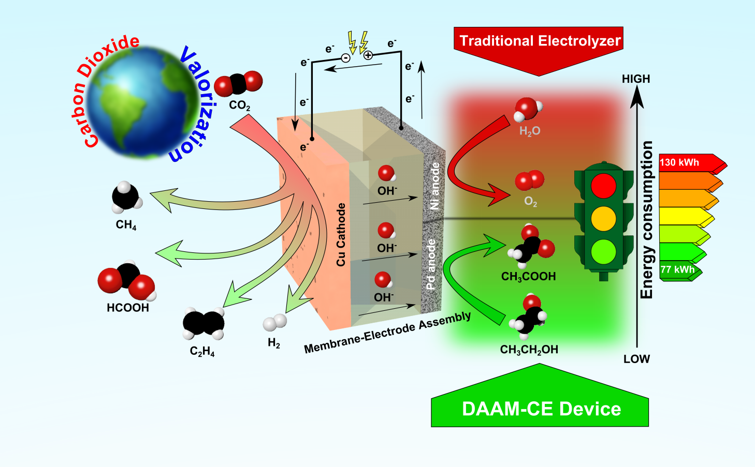
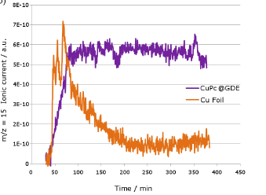
Stability of Cu-PC/C cathode for CO2 electroreduction
Cu-Pc based cathodes
Anodic alcohol oxidation instead of water oxidation → -40% energy consumption
Energy Technology (2014) DOI 10.1002/ente.201402014.

Slide 42
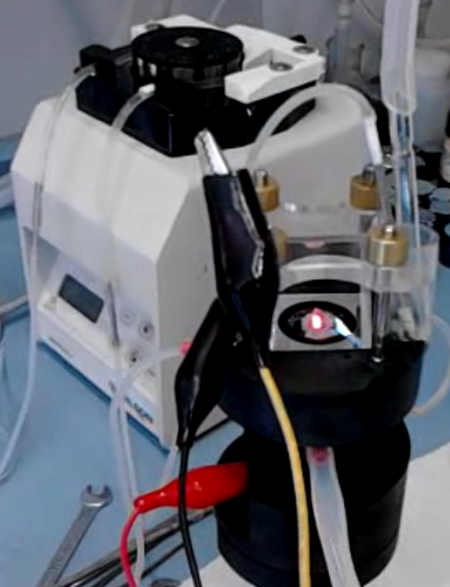
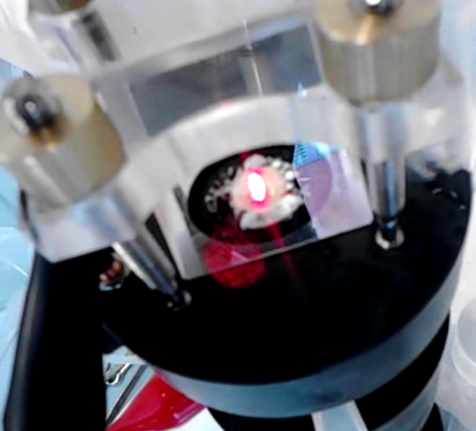
And in situ electrochemistry…. close to come in our lab…

Slide 43
Conclusions - UHV
Cu does not activate CO2
Ni activates CO2 via e⁻ transfer
Formate is a spectator rather than a reaction intermediate on Ni
Hydrocarboxyl intermediates may play a determining role in CO2 conversion on Ni
Ni/Cu alloys show peculiar CO2 reduction activity due to the interplay between diffusion and segregation effects
Surface Ni concentration can be used to taylor the alloy reactivity and the equilibrium between CO2 and CO adsorption energies

Slide 44
Conclusions – beyond the pressure gap
The delicate interplay between graphene, carbide, and oxide phases on Ni can be governed using CO in the gas stream in order to yield an active surface phase

Slide 45
Conclusions – beyond the material gap
Finite size and coverage effects may open unexpected reaction channels like, in the case of CO, decomposition and carbide accumulation at Cu clusters

Slide 46
Conclusions –going liquid…
Will come soon !!

Slide 47


THANK YOU !
FUNDING
Financial support was obtained from
Italian MIUR (FIRB 2010 project RBFR10J4H7)
Fondazione Kathleen Foreman Casali
Beneficentia Stiftung
Consorzio per la Fisica – Trieste
UniTs – FRA 2012
Italian Ministry of Foreign Affairs
PEOPLE
Africh C, Bevilacqua M, Baldereschi A, Bozzini B, Comelli G, De Rogatis L, Dri C, Filippi J, Fornasiero P, Greiner M, Knop-Gericke A, Miller H, Lacovig P, Olmos Asar J, Peressi M, Peronio A, Rizzi M, Rocca M, Savio L, Schlögl R, Vattuone L.
Olmos Asar J, Peressi M

