Slide 1
Solar thermochemical CO₂ and H₂O splitting via metal oxide redox reactions
P. Furlerª, J.R. Scheffeª, D. Marxerª, A. Steinfeld^{a,b}
ª Dempartment of Mechanical and Process Engineering, ETH Zurich, Switzerland
b Solar Technology Laboratory, Paul Scherrer Institute, Switzerland

Slide 2
Outline
Introduction
  Thermochemical fuel production
  2-step CeO₂ cycle
  Solar reactor design
  Experimental setup
Syngas production by splitting of H₂O and CO₂
Reactive CeO₂ structures
Solar fuel synthesis
Summary and conclusions
Perspectives

Slide 3
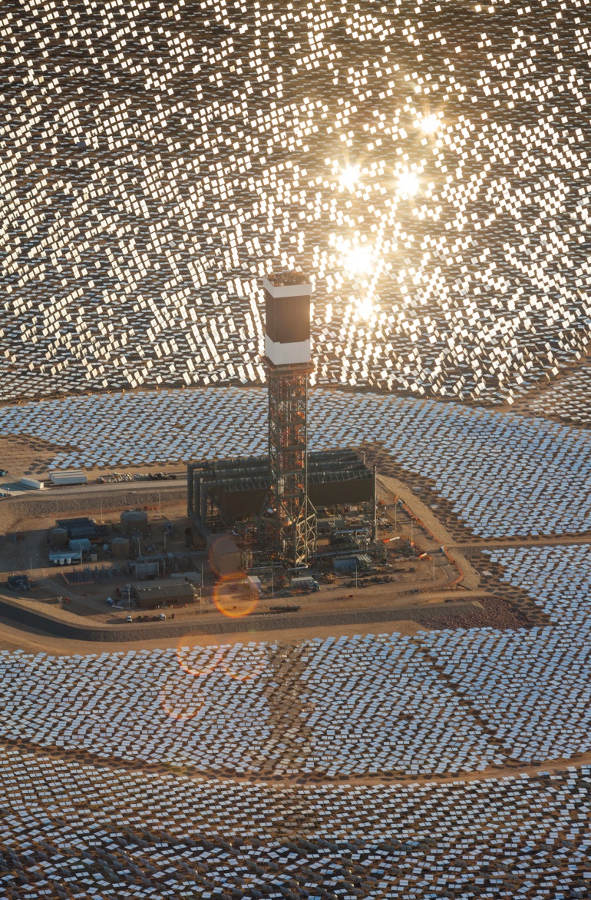

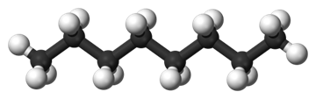



Solar thermochemical fuel production
Solar concentration
H₂O/CO₂
CO₂ capture
H₂O/CO₂dissociation
O₂
$$H_{2}O→H_{2}+0.5 O_{2}$$
Q_{solar}
$${CO}_{2}→CO+0.5 O_{2}$$
Absorber
H₂/CO
Catalytic fuel synthesis
$$nCO+\left(2n\right)H_{2}→C_{n}H_{2n}+nH_{2}O$$
Liquid fuels
(Diesel, Jet fuel,
Ethanol…)
Heliostat array
Image: http://www.brightsourceenergy.com/

Slide 4
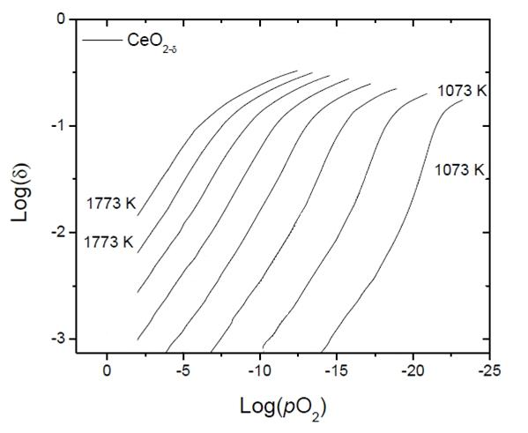




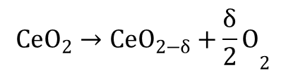


Solar H₂O / CO₂ splitting
2-Step CeO₂ cycle
$${CeO}_{2}$$
1st step : solar reduction
$${CeO}_{2}→CeO_{2−δ}+{\frac{δ}{2}O}_{2}$$
O₂
$${CeO}_{2−δ}$$
2nd step: oxidation
H₂ / CO
H₂O/CO₂
$$CeO_{2−δ}+δH_{2}O→CeO_{2}+{δH}_{2}$$
Ce$O_{2−δ}+δCO_{2}→CeO_{2}+δCO$
recycle
liquid
fuels
(diesel, jet fuel…)
$${CeO}_{2}$$
CO₂ capture
Journal of Physics and Chemistry of Solids, 1975, 36, 1213-1222.

Slide 5
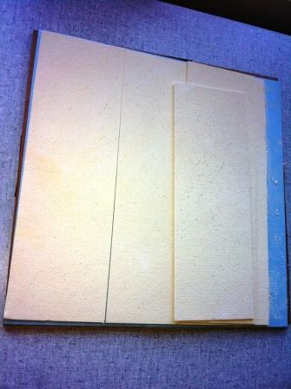
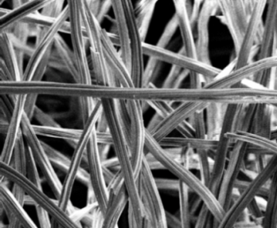
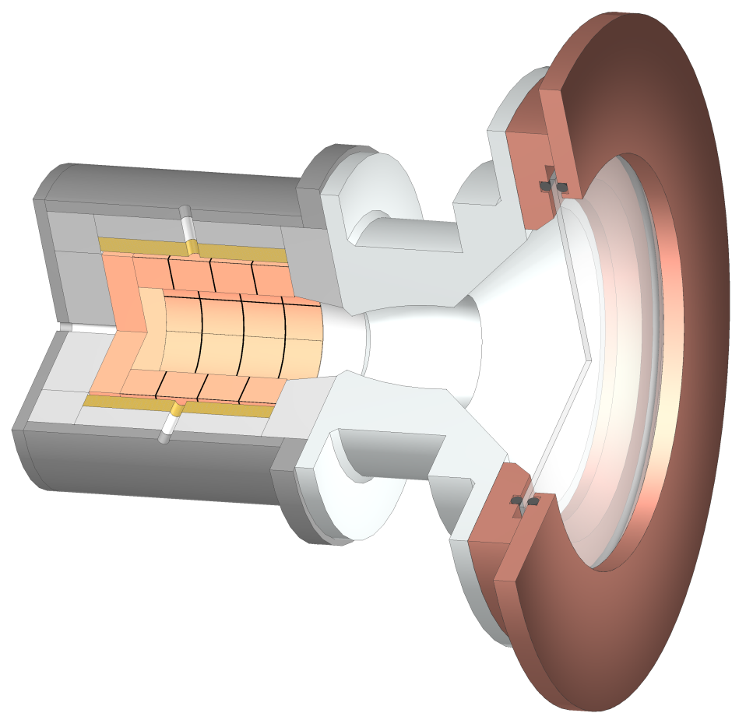

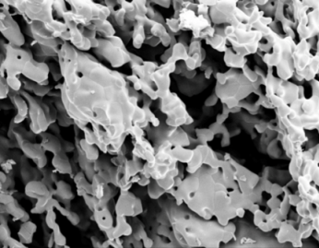
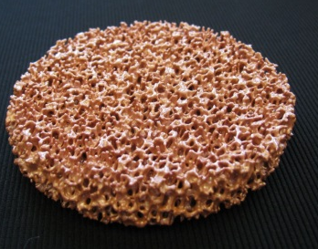
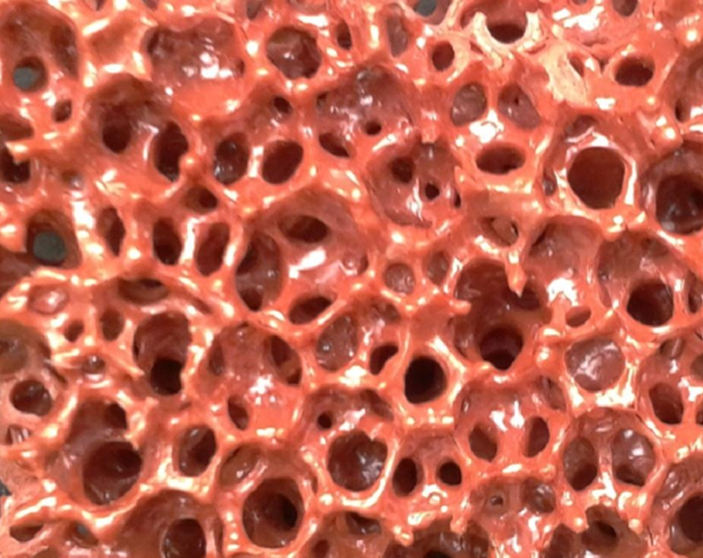
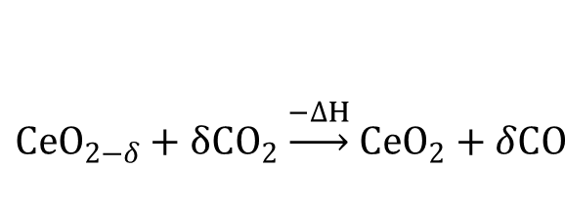
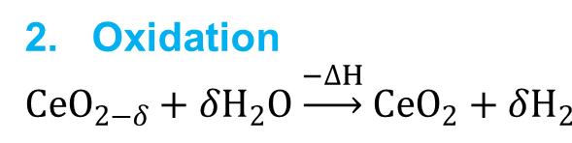
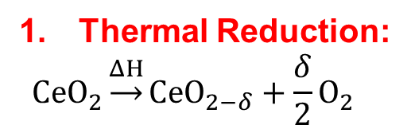
ETH Solar Reactor
$$CeO_{2−δ}+δ{CO}_{2}\underset{→}{−∆H}{CeO}_{2}+δCO$$
2. Oxidation
$$CeO_{2−δ}+δH_{2}O\underset{→}{−∆H}{CeO}_{2}+δH_{2}$$
Thermal Reduction:
$$CeO_{2}\underset{→}{ΔH}{CeO}_{2−δ}+\frac{δ}{2}O_{2}$$
Porous CeO₂
Reactor Front (water-cooled)
Al₂O₃-SiO₂
insulation
Reactor
Inlet
Quartz Window
X 1000 100 μm
Syngas
(H₂ / CO)
O₂
CO
Concentrated
Solar Radiation
Outlet
1500 ° C
900 ° C
O₂
H₂
H₂
O₂
X 1000 100 μm
Inlet
Inconel Shell
H₂O / CO₂
Purge Gas (Ar)
10 mm
Science 2010, 330 (6012), 1797-1801
Energy Environ. Sci. 2012, 5 (3), 6098-6103
Energy Fuels 2012, 26 (11), 7051-7059

Slide 6
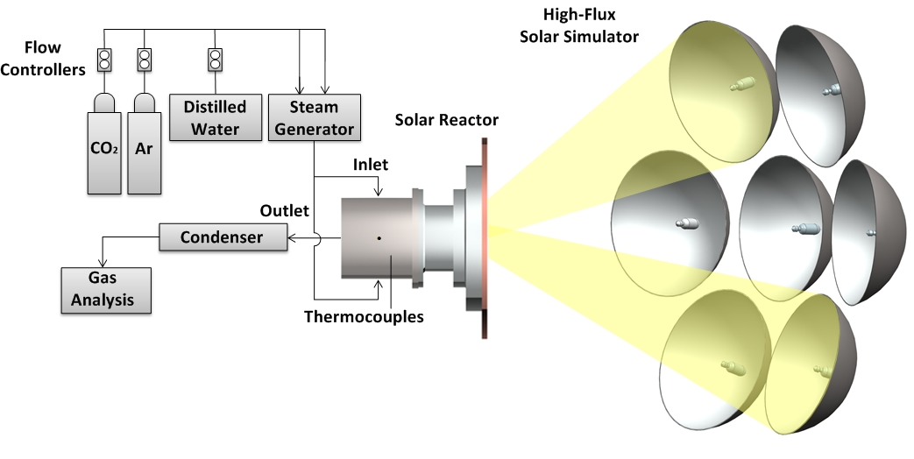
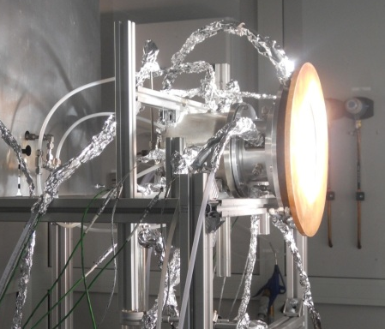
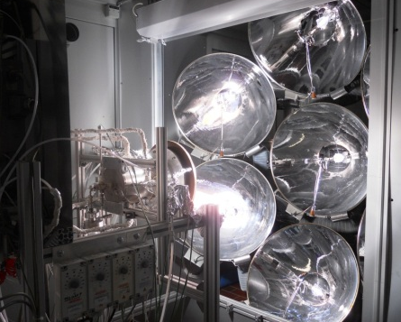
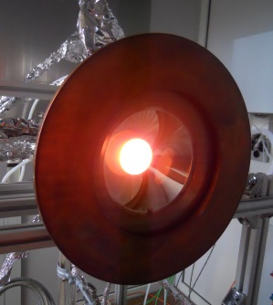
Experimental setup
Energy Environ. Sci. 2012, 5 (3), 6098-6103

Slide 7
Syngas production by simultaneous splitting of CO₂ and H₂O

Slide 8
Experimental results
Simultaneous H₂O / CO₂ splitting
(H₂O:CO₂ = 5.7)
Experimental conditions: | Reduction | Oxidation
Power input: | 3.6 kW | 0.8 kW
Gas flows: | Ar: 2 l min⁻¹ | Ar: 2 l min⁻¹ CO₂: 0.375 l min⁻¹ H₂O: 2.15 l min⁻¹
Ceria structure: | Ceria Felt Total Mass: 127 g
Stoichiometric fuel production as expected (O₂:fuel = 1:2)
(H₂O → H₂ + 0.5 O₂)
(CO₂ → CO + 0.5 O₂)
No gas phase hydrocarbons detected
No C depositions
No impurities detected which could damage catalyst of FT unit
Energy Environ. Sci. 2012, 5 (3), 6098-6103

Slide 9
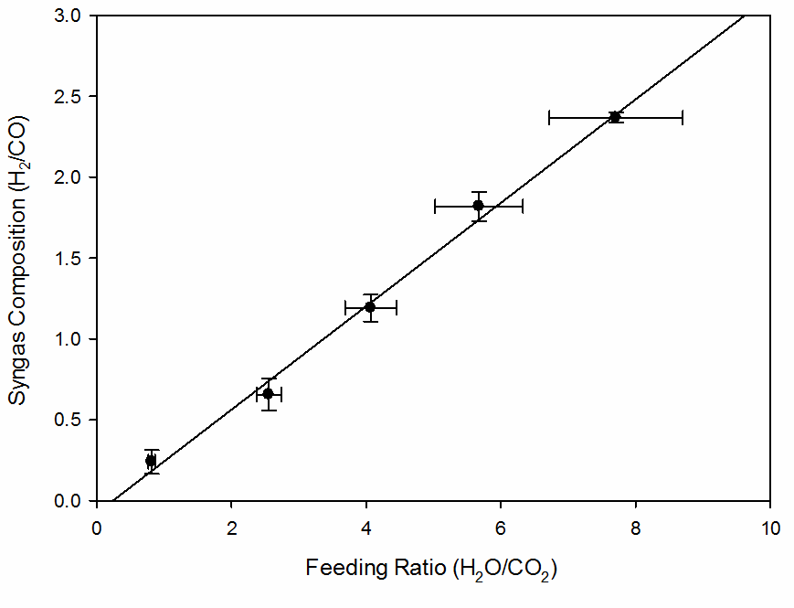
Experimental results
Syngas composition (H₂:CO) vs. co-feeding ratio (H₂O:CO₂)
Experimental conditions: | Reduction | Oxidation
Power input: | 3.6 kW | 0.8 kW
Gas flows: | Ar: 2 l min⁻¹ | Ar: 2 l min⁻¹ CO₂: 0.29 - 1.39 l min⁻¹ H₂O: 1.11 - 2.21 l min⁻¹
Ceria structure: | Ceria felt Total mass: 127 g
Syngas composition (H₂:CO) adjustable
in a wide range (0.25-2.34) by controlling
the co-feeding ration (H₂O:CO₂)
Syngas composition increases linearly with increasing H₂O:CO₂ ratios
e.g. co-feeding with H₂O:CO₂ = 6.5 yields syngas with H₂:CO = 2
Syngas suitable for FT synthesis
Energy Environ. Sci. 2012, 5 (3), 6098-6103

Slide 10
Experimental results
Consecutive H₂O / CO₂ splitting
(H₂O:CO₂ = 6.7)
Experimental conditions: | Reduction | Oxidation
Power input: | 3.6 kW | 0.7 kW
Gas flows: | Ar: 2 l min⁻¹ | Ar: 2 l min⁻¹ CO₂: 0.33 l min⁻¹ H₂O: 2.20 l min⁻¹
Ceria structure: | Ceria Felt Total Mass: 127 g
Energy Environ. Sci. 2012, 5 (3), 6098-6103

Slide 11
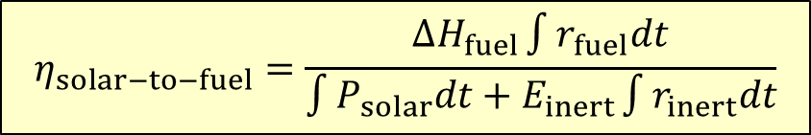
Solar-to-fuel energy conversion efficiency
$$η_{solar−to−fuel}=\frac{ΔH_{fuel}\int{r_{fuel}dt}}{\int{P_{solar}dt+E_{inert}\int{r_{inert}dt}}}$$
Direct impact on fuel production cost
Reactive Structure
η_{solar-to-fuel}
Reactive Material
0.15 %
Doped CeO₂
Other metal oxides
Perovskites
Heat and mass transfer properties
20 %
Reactor technology
Geometry and scale-up
Operating conditions
Heat recovery

Slide 12
Reactive CeO₂ structures

Slide 13

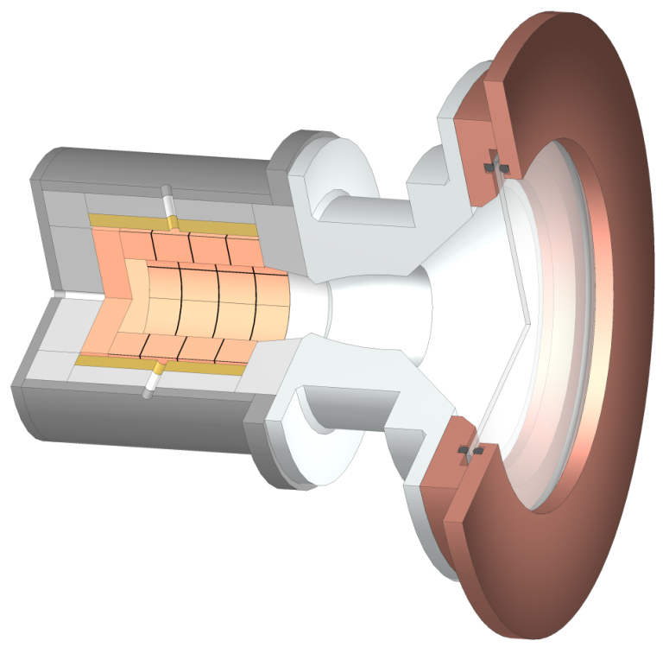
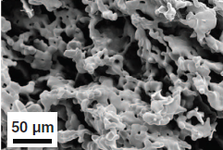


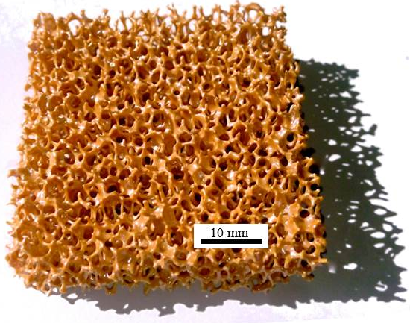
Structural improvements of Ceria
High SSA → rapid oxidation kinetics but low specific mass
HT limited during reduction step
  Limitations:
  HT limited during reduction
  ╚►pores in mm-range
  ╚►vol. absorption → fast heating rates
  ╚► high specific mass → high mass loading
Science 2010, 330 (6012), 1797-1801
Energy Environ. Sci. 2012, 5 (3), 6098-6103
Energy Fuels 2012, 26 (11), 7051-7059

Slide 14


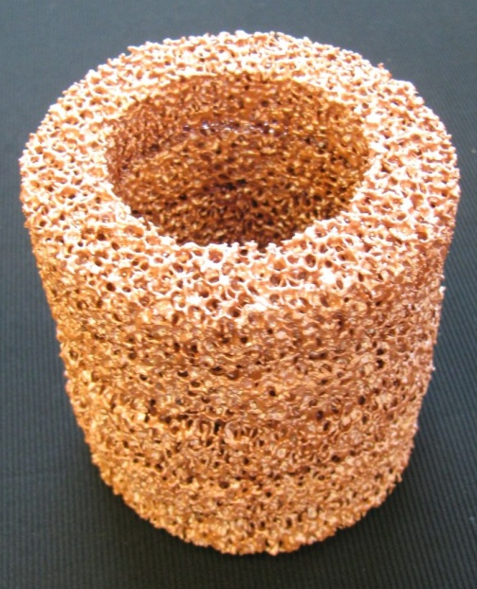
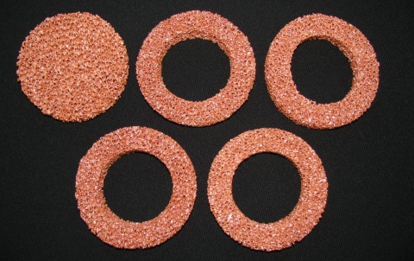
CeO₂ Structure
CeO₂ RPC (Reticulated Porous Ceramic)
Macro-porous structure enables penetration and absorption of concentrated solar radiation
  Faster heating rates
  Temperature gradients minimized
  High mass loading within reactor (~1500 g)
Energy Fuels 2012, 26 (11), 7051-7059

Slide 15

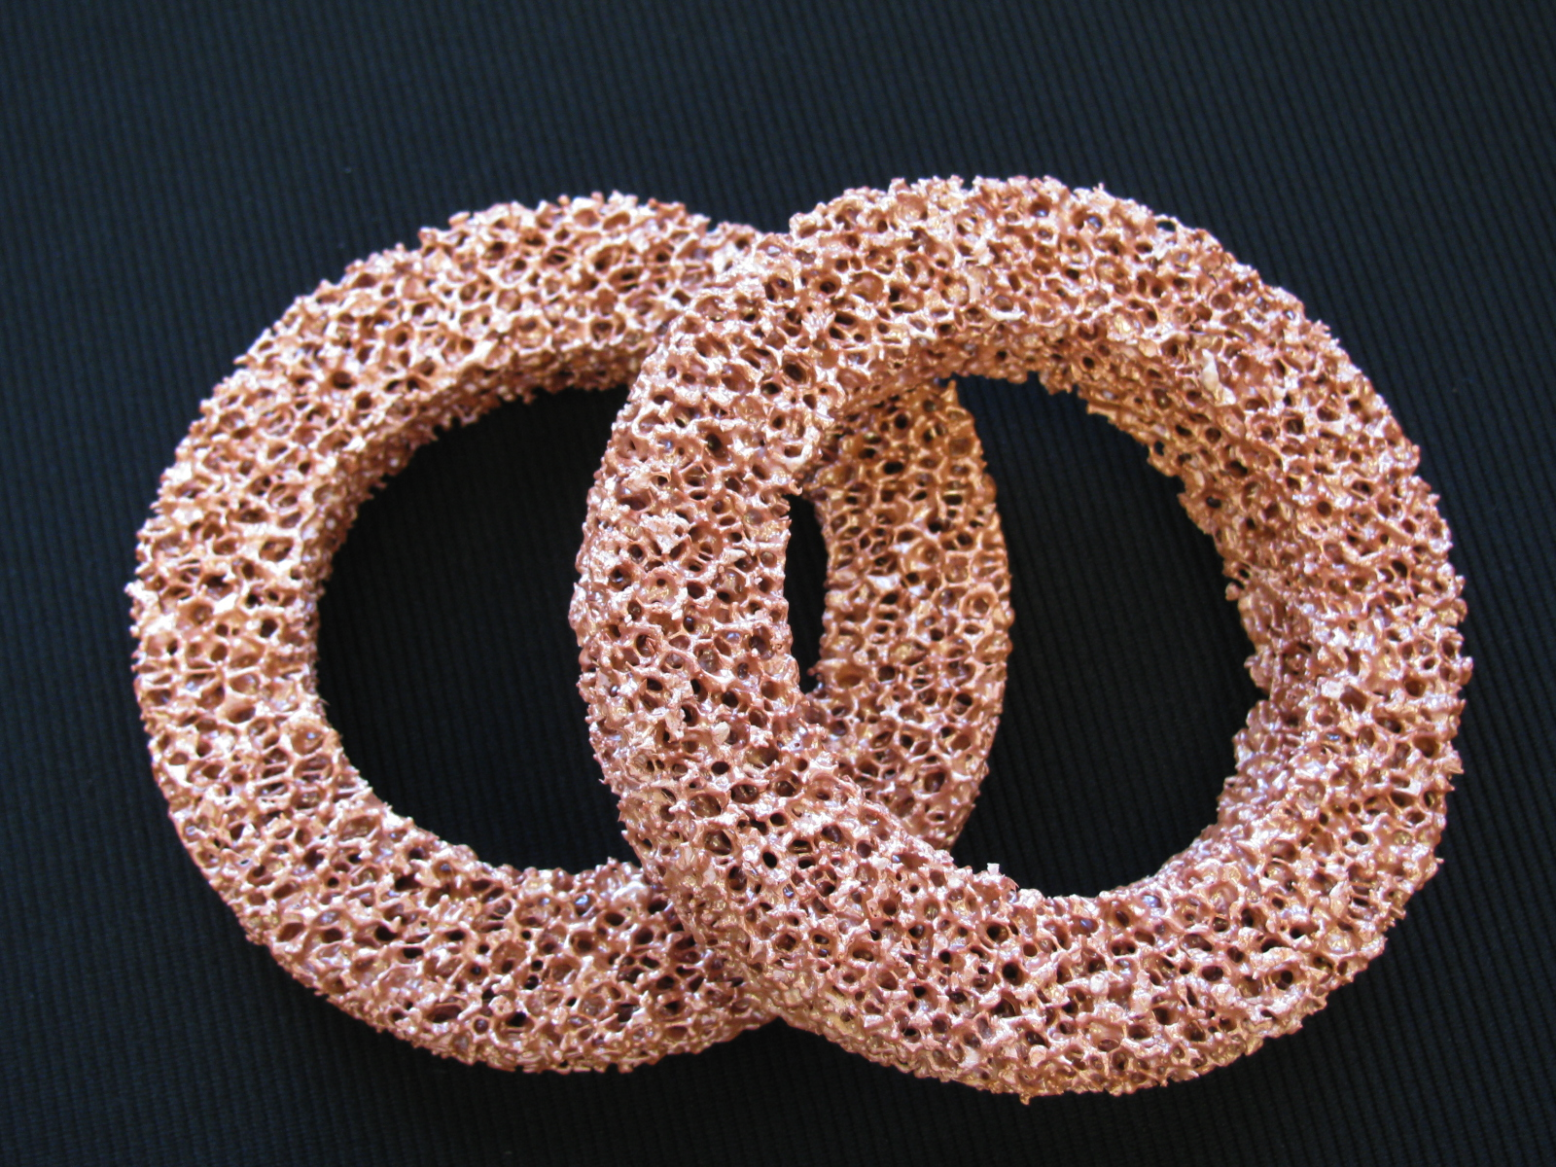
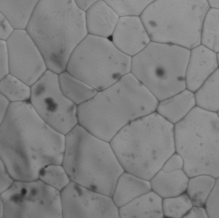

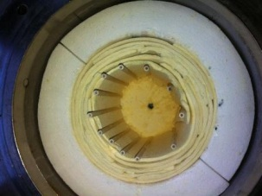
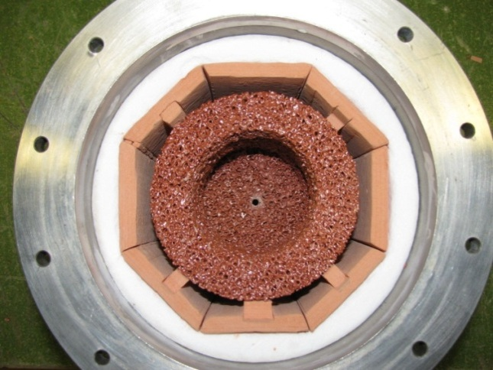
Comparison felt vs. RPC
Experimental Conditions | Reduction | Oxidation
Power Input: | 3.6 kW | 0.7 kW
Gas Flow: | 2 l min⁻¹ Ar | 3 l min⁻¹ CO_{2(g)}
Ceria Structure: | Ceria RPC: 1416 g, Ceria felt; 90 g
CeO₂ felt
CeO₂ RPC
x 1000 100 μm
x 1500 50 μm
x 1000 100 μm
x 1500 50 μm
Overall 17 times higher fuel production per cycle with RPC structure
Energy Fuels 2012, 26 (11), 7051-7059

Slide 16
Experimental results
Conditions | Reduction | Oxidation
Power Input: | 2.8 - 3.8 kW | 0 kW
Gas Flow: | 2 l min⁻¹ Ar | 2 l min⁻¹ CO₂
Mass loading: | 1416 g
Energy Fuels 2012, 26 (11), 7051-7059

Slide 17
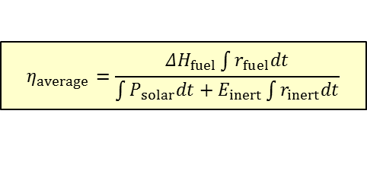
Experimental results
Solar-to-fuel conversion efficiency
$$η_{average}=\frac{ΔH_{fuel}\int{r_{fuel}dt}}{\int{P_{solar}dt+E_{inert}\int{r_{inert}dt}}}$$
=> 12x η _{Felt} (0.15 %)
Improved heat-transfer
Improved specific mass
η _{RPC} = 1.7 %
=> 4 x η _{bricks} (0.4%)
Energy Fuels 2012, 26 (11), 7051-7059

Slide 18
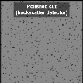
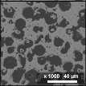
Structural improvements of Ceria
High SSA → rapid oxidation kinetics but low specific mass
HT limited during reduction step
  Limitations:
  HT limited during reduction
  ╚►pores in mm-range
  ╚►vol. absorption → fast heating
  2) SSA limited during oxidation
  ╚►pores in the µm-range
  ╚► increase SSA → fast oxidation
Science 2010, 330 (6012), 1797-1801
Energy Environ. Sci. 2012, 5 (3), 6098-6103
Energy Fuels 2012, 26 (11), 7051-7059
Phys. Chem. Chem. Phys. 2014, 16 10503

Slide 19
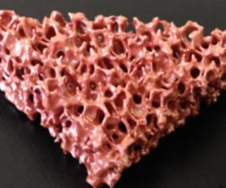
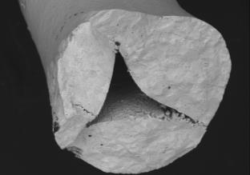
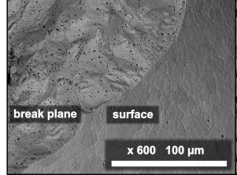
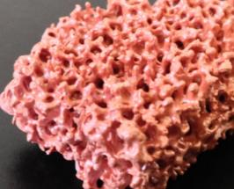
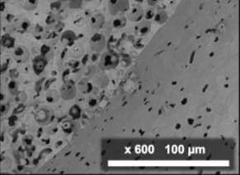
SEM micrographs
single-scale RPC vs. multi-scale RPC
250 µm
250 µm
250 µm
Phys. Chem. Chem. Phys. 2014, 16 10503

Slide 20
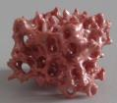

Experimental Setup
Thermo-gravimetric analysis
CeO₂ sample
CO₂ Mixture

Slide 21
Results
TGA - CO₂ splitting cycles
Experimental conditions | Reduction | Oxidation
Gas concentration: | P_{O2}: 1.8*10⁻⁴atm | P_{CO2}: 0.385 atm
Nonstoichiometry δ: | δ_{i} = 0.033 | δ_{f} = 0.0033
Oxidation time decreased from 28min to 3min (to reach 90% re-oxidation)
Phys. Chem. Chem. Phys. 2014, 16 10503

Slide 22
Results
TGA - CO₂ splitting cycles
Experimental conditions | Reduction | Oxidation
Temperature: | 1500 °C | 1000 °C
Gas concentration: | P_{O2}: 1.8*10⁻⁴atm | P_{CO2}: 0.385 atm
Nonstoichiometry δ | δ_{i} = 0.033 | δ_{f} = 0.0033
Phys. Chem. Chem. Phys. 2014, 16 10503

Slide 23
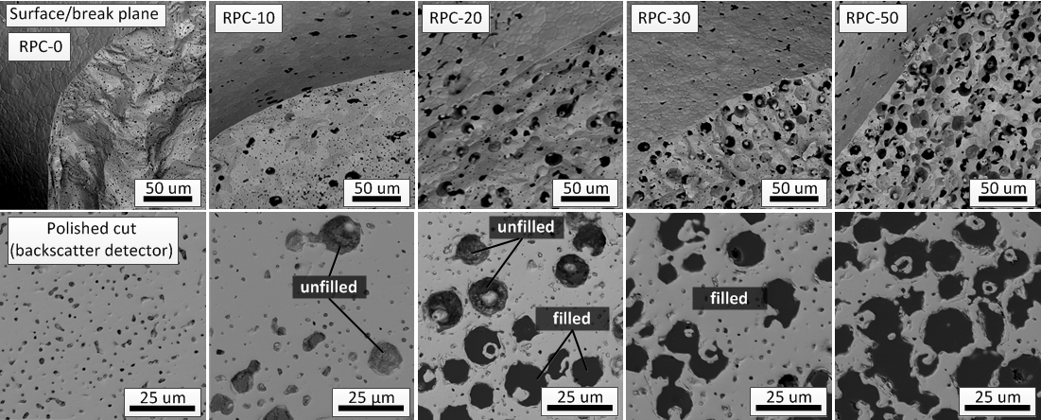
Results
SEM micrographs
Interconnected pore-network
Only closed pores
Transition zone
Phys. Chem. Chem. Phys. 2014, 16 10503

Slide 24
Results
Consecutive CO₂ splitting
Experimental conditions: | Reduction | Oxidation
Temperature: | 1500 °C | 1000 °C
Gas concentration: | P_{O2}: 1.8*10⁻⁴atm | P_{CO2}: 0.385 atm
Nonstoichiometry δ | δ_{i} = 0.033 | δ_{f} = 0.0033
Slightly decreasing rates due to moderate grain growth =► SSA: 0.098 → 0.089 m² g⁻¹
Constant CO-yields
Phys. Chem. Chem. Phys. 2014, 16 10503

Slide 25
Results
Solar reactor experiment
Conditions | Reduction | Oxidation
Power Input: | 3.8 kW | 0 kW
Gas Flow: | 2 l min⁻¹ Ar (single) 6 l min⁻¹ Ar (dual) | 2 l min⁻¹ CO₂ (single) 6 l min⁻¹ CO₂ (dual)
Mass loading: | single: 1416 g, dual: 998 g
Energy Fuels 2012, 26 (11), 7051-7059
Phys. Chem. Chem. Phys. 2014, 16 10503

Slide 26
Solar fuel synthesis

Slide 27

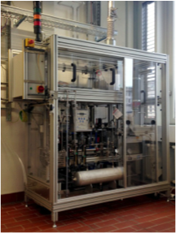
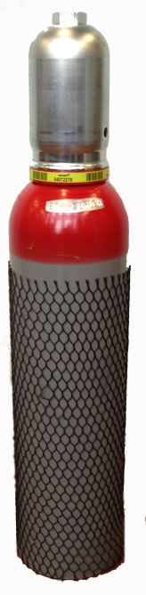
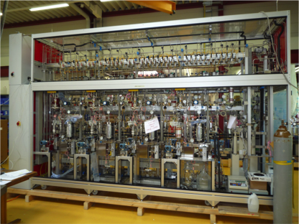
EU FP7 Project – SOLAR-JET
1st solar kerosene from H₂O/CO₂ splitting
290 H₂O/CO₂ splitting cycles
  200 h operation
  750 L syngas
  33.7% H₂, 19.2% CO, 30.5% CO₂, 0.06% O₂, 0.09% CH₄, 16.5% Ar
  No catalyst poisons
Compressor station
FT-unit
(Shell Amsterdam)

Slide 28

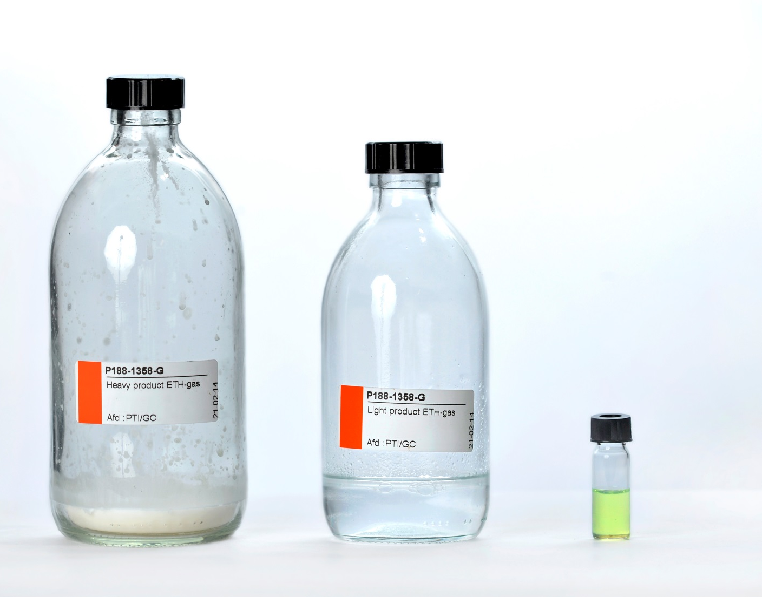
EU FP7 Project – SOLAR-JET
1st solar kerosene from H₂O/CO₂ splitting
40.6 g liquid products
48.1 g solid waxes
  Hydrocracking of waxes (3.5 g):
  17.1 wt% Naphta (boiling range 0-145°C)
  35.6 wt% Kerosene (145-300°C)
  17.1 wt% Gasoil (300-370°C)
  30.2 wt% heavier fractions (>370°C)
World’s first solar kerosene from H₂O and CO₂ splitting

Slide 29
Summary and conclusions
Syngas production by simultaneous splitting of H₂O and CO₂
  Syngas composition can be controlled by the H₂O/CO₂ co-feeding radio
  Syngas is suitable for FT-synthesis (composition, purity)
Heat transfer limitation during thermal reduction:
  RPC structure with pores in the mm-range
    Volumetric absorption => fast / homogenous heating
    Higher specific mass => higher ceria mass loading
Surface limitation during oxidation:
  Dual-scale RPC with pores in the mm-range and µm-range
    Increased SSA => fast oxidation kinetics
RPC structure allowed to enhance:
  the fuel production per unit time
  η_{solar-to-fuel} = 1.7 %
1st solar kerosene from H₂O/CO₂ splitting in a solar reactor

Slide 30
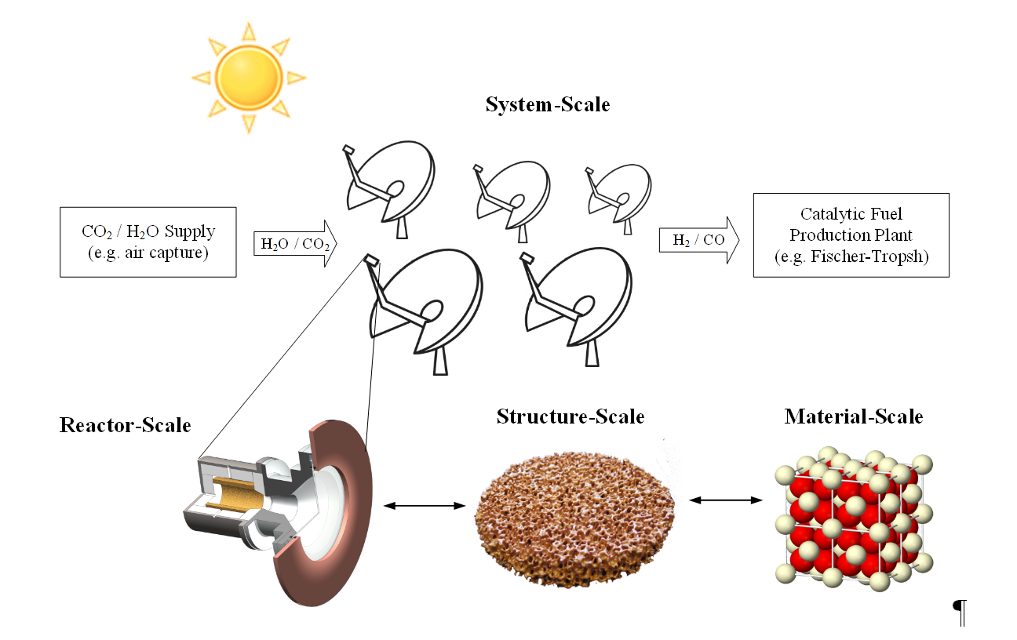
Perspectives
Ongoing work and next steps
System-scale
CO₂ / H₂O
supply
Catalytic fuel production plant
Reactor-scale
Structure-scale
Material-scale
  Material-scale:
    Fundamental understanding of reaction mechanisms during red. / oxid.
    Efficient screening techniques for determining appropriate dopants and materials with the aim:
      Increasing the reduction extend
      Lowering the reduction temperature
operation at lower temperatures

Slide 31
Perspectives
Ongoing work and next steps
  Structure-scale:
    Optimization of pore-sizes for max. Ƞ_{solar-to-fuel}
    Application of multi-scale approach to other structures such as honeycombs
  Reactor-scale:
    Scale-up and testing on solar dish / solar tower
    Optimization of cavity-receiver for max. Ƞ_{solar-to-fuel}
    Alternative operation modes such as isothermal and vacuum operation
    Implementation of heat recuperation strategies
  System-scale:
    Integration and coupling of the individual components
    Assessment of operation modes (24/7 vs. day time operation)
    Economical simulation of the plant to assess production coast and guide development

Slide 32
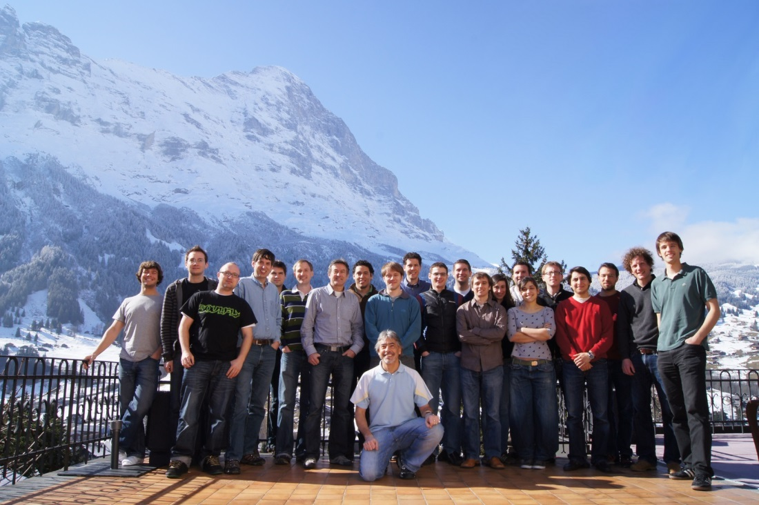


Acknowledgments
PREC ETH & STL PSI
EMPA: Dr. Ulrich Vogt,
Michal Gorbar, Alexander Bonk
Students: Louis Moes, Daniel
Marxer, Lukas Geissbühler,
Adrian Mularczyk
EU-SOLAR-JET
European Commission
Contract No. 285098
CCEM
EU-ERC Advanced Grant
SUNFUELS No. 320541

