Slide 1
Nano tools for macro problems: multiscale molecular modeling of nanostructured polymer systems
Maurizio Fermeglia
MOSE – DIA - University of Trieste
Via valerio 10, 34127 Trieste (Italy)
Maurizio.Fermeglia@di3.units.it
mose.units.it
Notes:
Today, the discovery and optimization of new materials for innovative products is a time-consuming and laborious process, as much a craft practiced by skilled artisans as a science. Expensive trial-and-error-based experimentation is a highly inefficient way to screen potential candidates for a desired new application

Slide 2
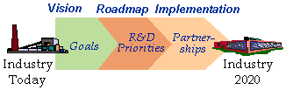
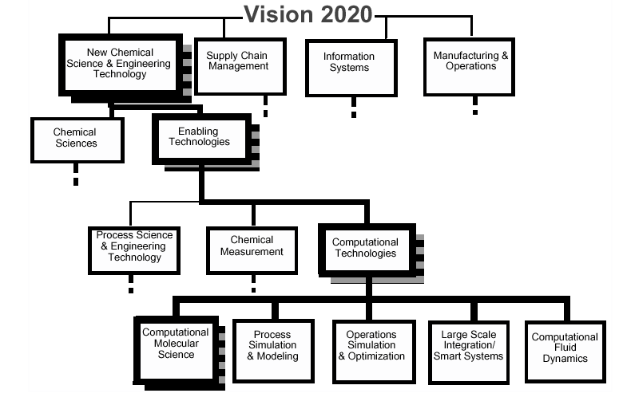
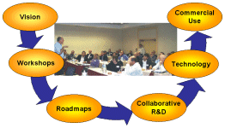
The technology vision 2020

Slide 3
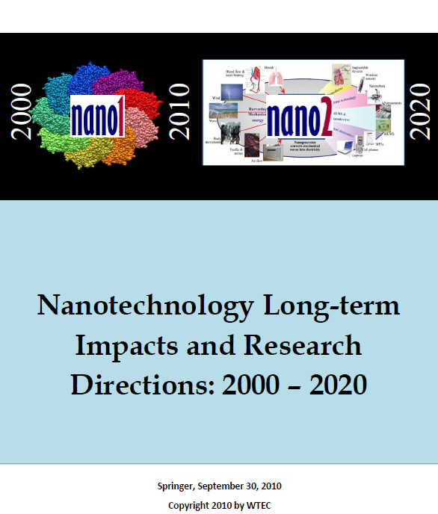
Nanoscale science and engineering
Ability to work at molecular level, atom by atom,
to create large structures with fundamentally
new properties and functions*
  At least one dimension is of the order of nanometers
  Functionality is critically dependent on nanoscale size
Promise of unprecedented understanding and
control over basic building blocks and properties
of natural and man-made objects*
Recent survey: Nanotechnology Long-term Impacts
and Research Directions: 2010 – 2020 **
Theory, modeling and simulation (TMS)
  Expected to play key role in nanoscale science and technology
    INVESTIGATIVE TOOLS: THEORY, MODELING, AND SIMULATION, M. Lundstrom, P. Cummings, M. Alam, M. Ratner, W. Goddard, S. Glotzer, M. Stopa, B. Baird, R. Davis
    Springer, September 30, 2010
      Also available on the web at http://www.wtec.org/nano2/
* M. Roco, FY 2002 National Nanotechnology Investment Budget Request
** M.Roco, FY 2010 WTEC, Inc., 2010

Slide 4
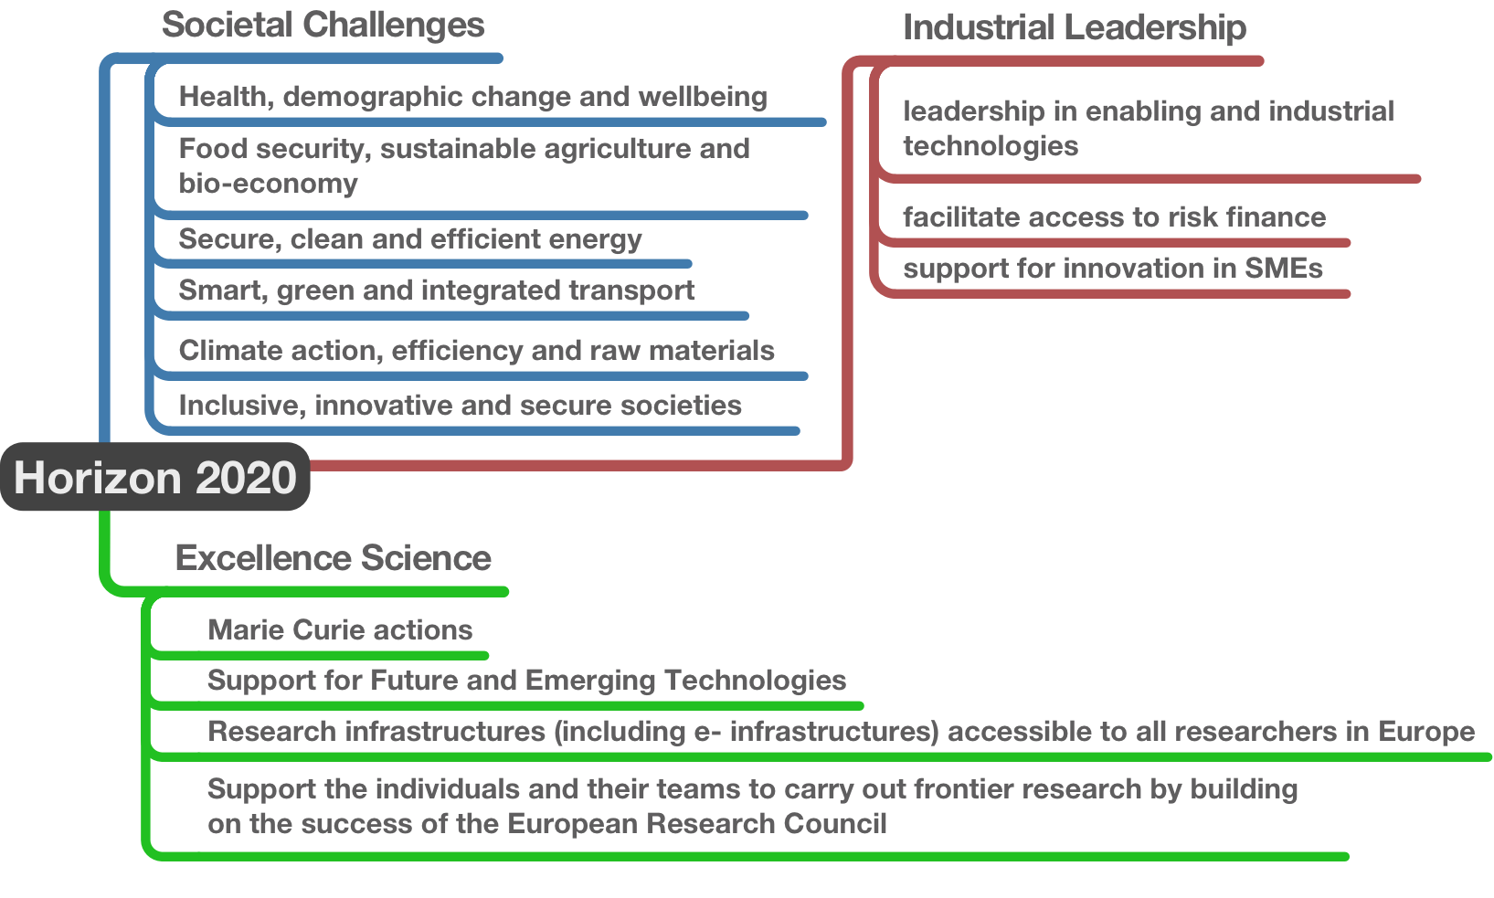
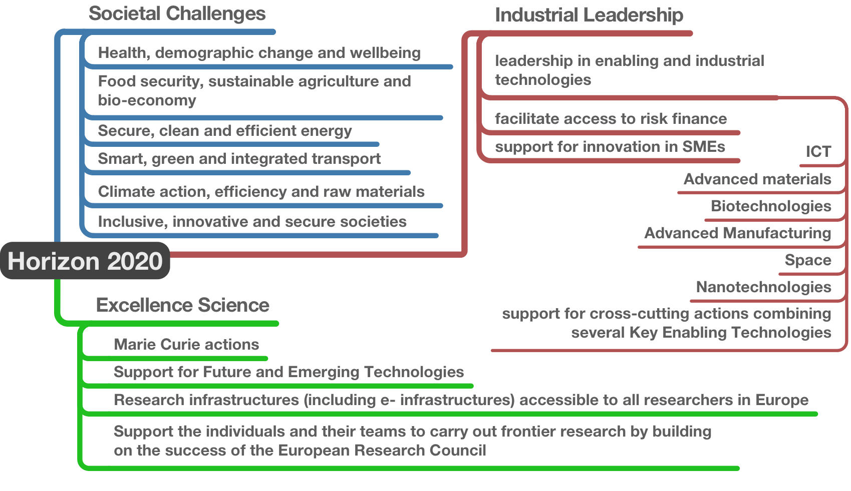
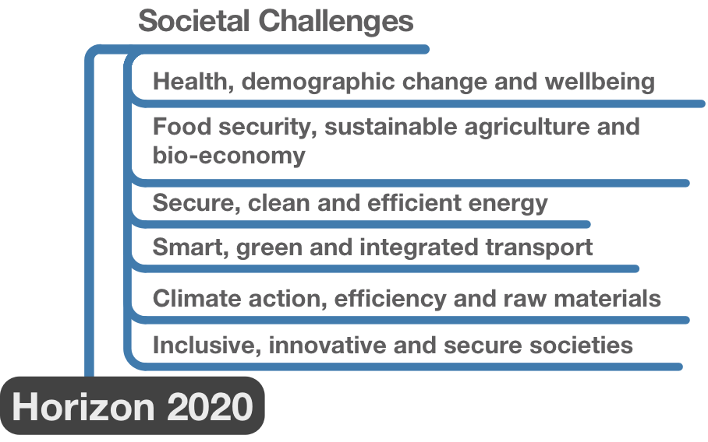
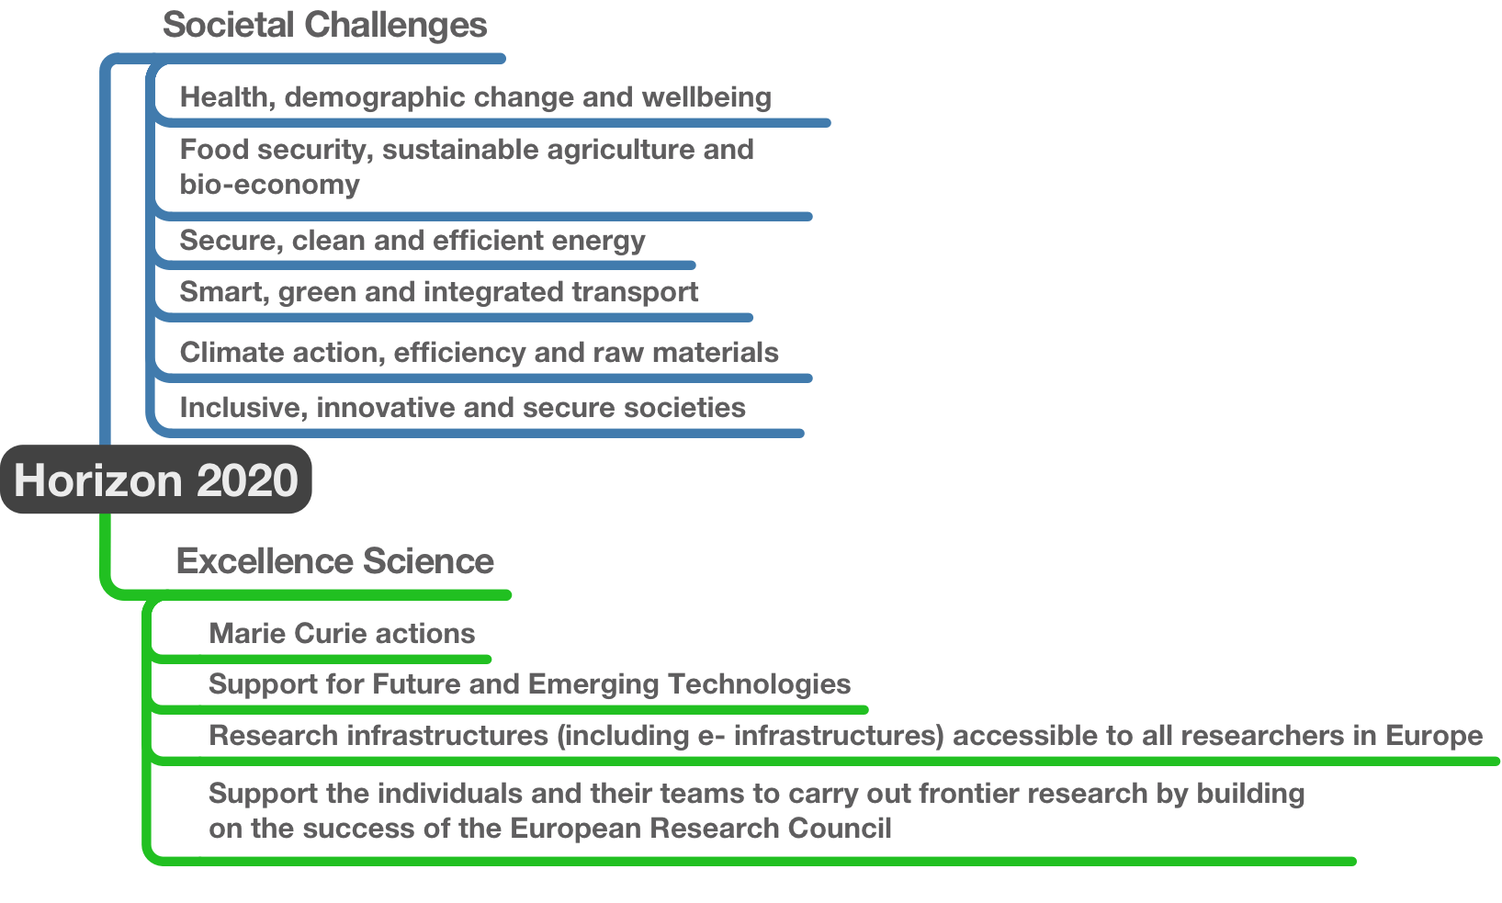
Horizon2020 Structure
KET

Slide 5
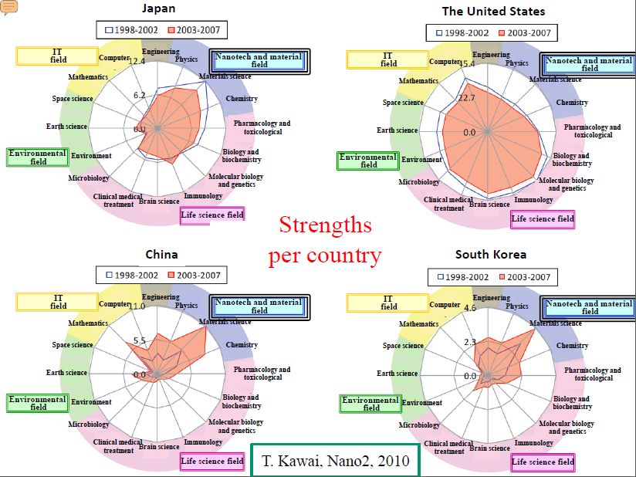
Nanotechnology in different countries

Slide 6
Materials Genome Initiative (MGI)
Developing a materials innovation infrastructure, through advances in and integration of:
  Computational tools
  Experimental tools
  Digital data and informatics
Achieving National goals in energy, security, and human welfare with advanced materials
Equipping the next generation materials workforce
Notes:
Today, the discovery and optimization of new materials for innovative products is a time-consuming and laborious process, as much a craft practiced by skilled artisans as a science. Expensive trial-and-error-based experimentation is a highly inefficient way to screen potential candidates for a desired new application

Slide 7

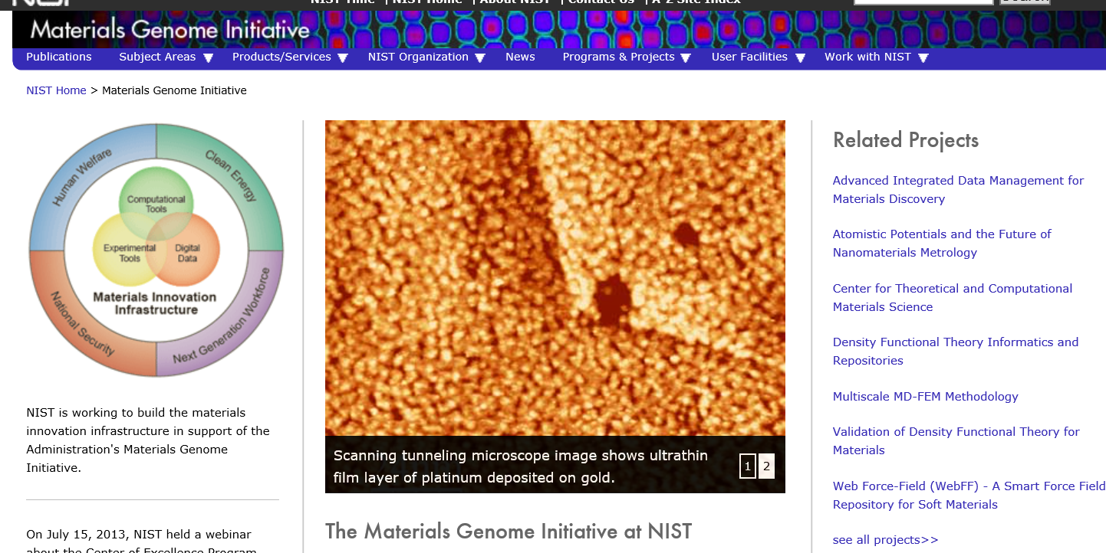

Materials Genome Initiative (MGI)

Slide 8
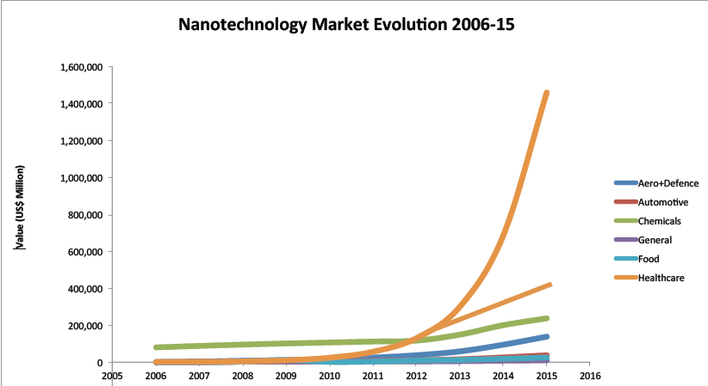
Nanotechnology: global market evolution

Slide 9
Molecular Simulation vs Theory
Advances in computational hardware and algorithms
  Moore’s law
    Gordon Bell Prize: 1Gflop/s in 1988 vs. 27 Tflop/s in 2002
    More than four order of magnitude increase in 14 years
    Add 2-3 orders of magnitude from parallelization (cheap today)
    Costs driven by consumer market
Notes:
9

Slide 10
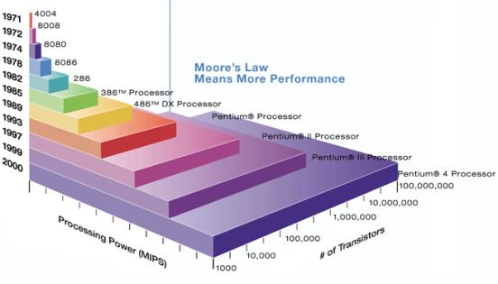
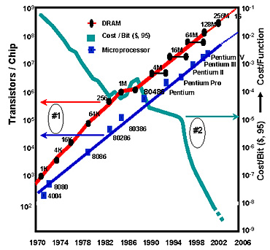
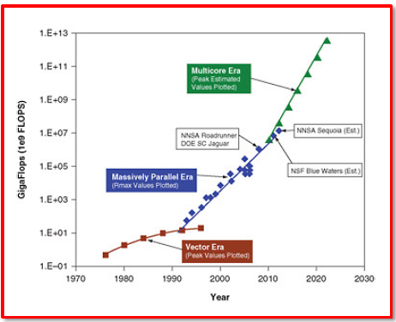
Moore’s law
Number of transistors on a sliver of silicon would double every two years

Slide 11
Molecular Simulation vs Theory
    Do graduate students and/or lab personnel/equipment improve by an order of magnitude every five years?
Advances in computational hardware and algorithms
  Moore’s law
    Gordon Bell Prize: 1Gflop/s in 1988 vs. 27 Tflop/s in 2002
    More than four order of magnitude increase in 14 years
    Add 2-3 orders of magnitude from parallelization (cheap today)
    Costs driven by consumer market
Costs for experiment?
  Labor-intensive, high capital costs
Costs for theory?
  Labor-intensive ²
Notes:
11

Slide 12
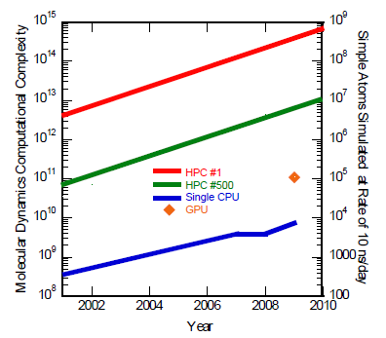
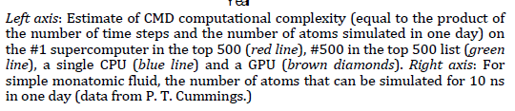
TMS: role of GPUs
Molecular complexity
  N. of time steps * n. atoms simulated in one day
Simple atom simulation
  For a simple monoatomic fluid is the n. of atoms that can be simulated for 10ns in one day

Slide 13
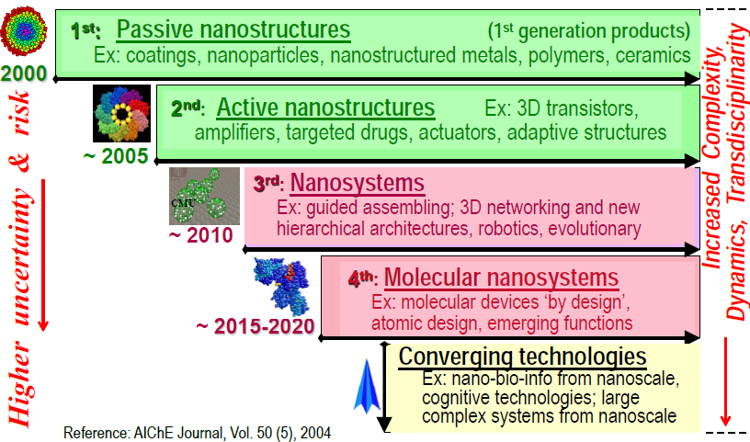
New generation of products and productive processes (2000-2020)
Timeline for beginning of industrial prototyping and nanotechnology commercialization

Slide 14
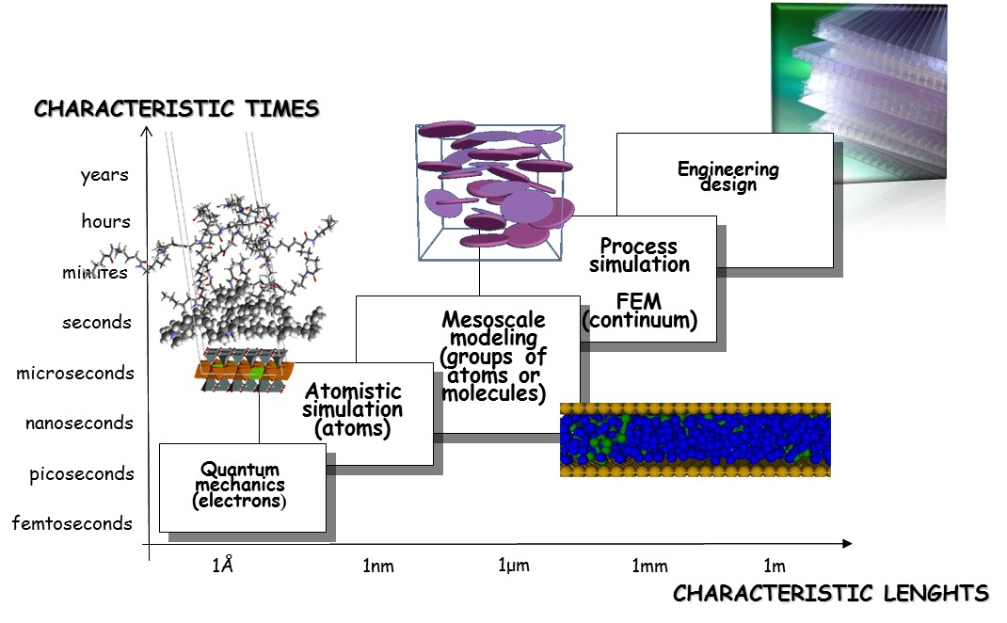
Multiscale Molecular Modeling
Notes:
14

Slide 15
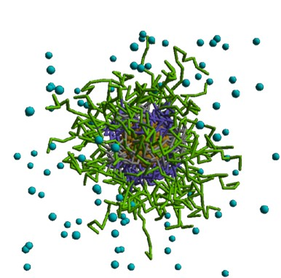
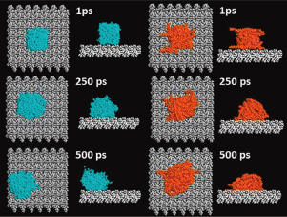
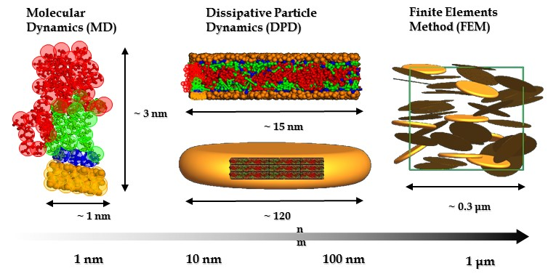
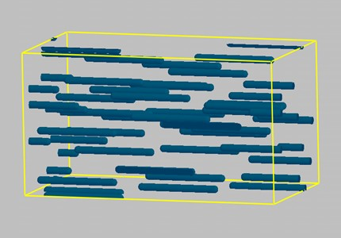
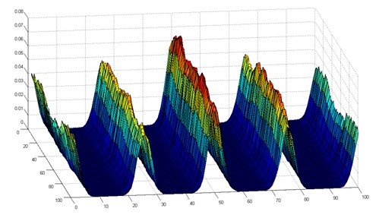
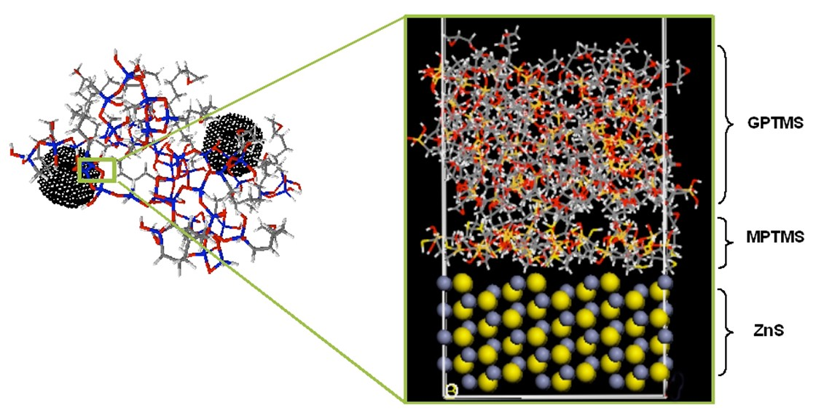
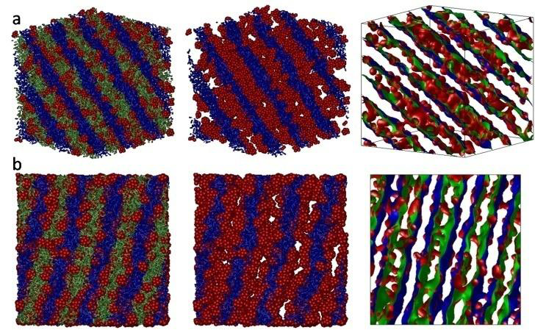
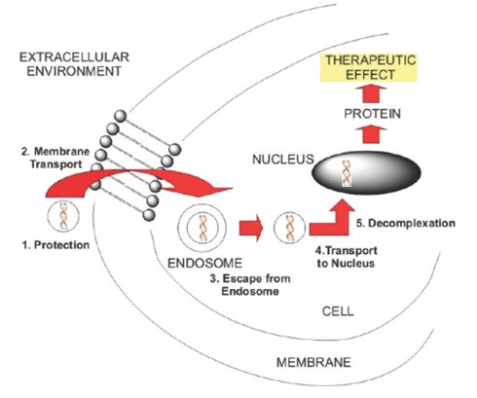
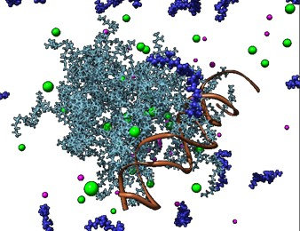
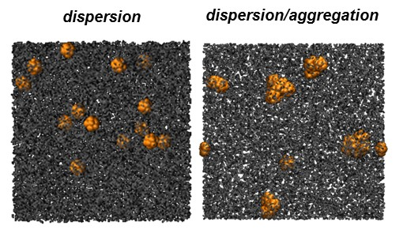
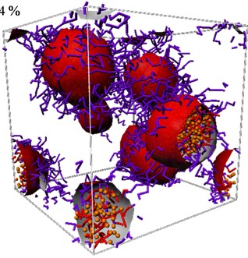
Multiscale Molecular Modeling
J.Multiscale. Mod., 3:151-176(2011)
ACS App.Mat.Int., 2012, 4, 2855–2859
J.Mat.Chem, 2012, 22, 5398-5409.
ACS Nano, 2012, 6(8): 7243-53
Mol. Simulation, 34: 1215-1236 (2008)
Soft Matter, 2013, 9, 2936-2946.
JACS, 133:20288-300 (2011)
J.Mat.Chem, 20:7742-7753 (2010)
Notes:
15

Slide 16
Multiscale Molecular Modeling
J.Multiscale. Mod., 3:151-176(2011)
ACS App.Mat.Int., 2012, 4, 2855–2859
J.Mat.Chem, 2012, 22, 5398-5409.
ACS Nano, 2012, 6(8): 7243-53
Mol. Simulation, 34: 1215-1236 (2008)
Soft Matter, (2013) in press
JACS, 133:20288-300 (2011)
J.Mat.Chem, 20:7742-7753 (2010)
Notes:
16

Slide 17
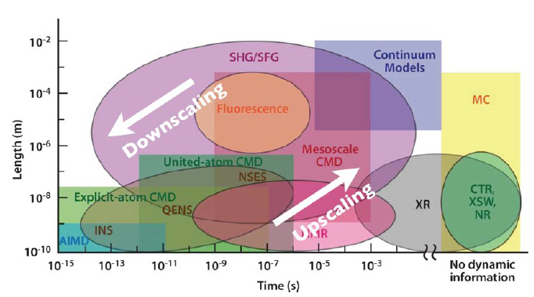

Modelling and experiments

Slide 18
Outline of talk
Introduction
  Multiscale Molecular Modeling
Mapping procedure
  From atomistic simulation to mesoscale
  From mesoscale to micro FEM
Applications to nanostructured polymer systems
  Top down nanostructures
    Classical PCN
  Bottom up design
    Localization of gold nanoparticles in di-block copolymers
    Effect of chain length and grafting density
    Self assembly of nanostructures on gold nanoparticles
  Special applications
    Block copolymers for drug delivery
Conclusions
Notes:
18

Slide 19
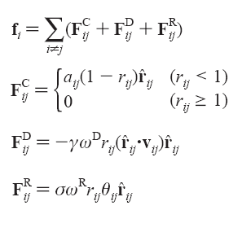
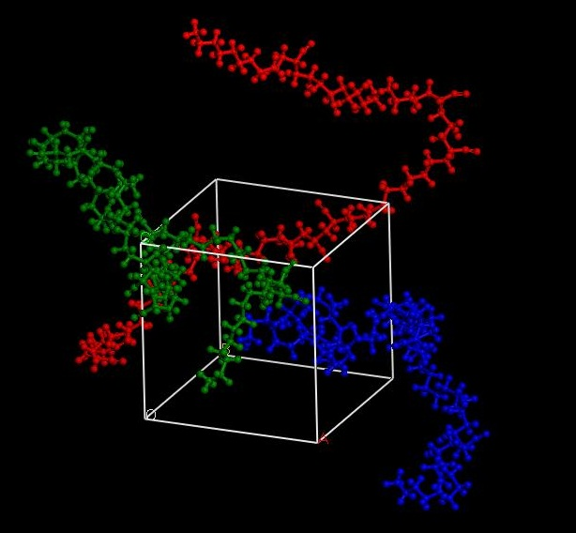
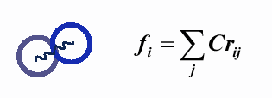
From atoms … to beads
Polymeric materials are modeled
by connecting beads by
harmonic springs
Molecular Dynamics
Dissipative Particle Dynamics
Soft potentials calculations
F_{i} = f (a_{ii}, a_{ij}, …, r_{c} )
ForceField based calculations

Slide 20
Parameters for mesoscale models
bead size and Gaussian chain architecture
  From characteristic ratio (C∞) in terms of Kuhn length
bead mobilities M,
  From bead self diffusion coefficients - MD
effective Flory-Huggins interactions
  Method 1: polymer blends, copolymers, spherical nanofillers
    Differences in non bonded energies between bulk and isolated chain
  Method 2: nanofillers of any size and shape
    From energy distribution in MD considering density distribution around nanofiller
Notes:
Aggiungere il caso di non compatibilizzante

Slide 21
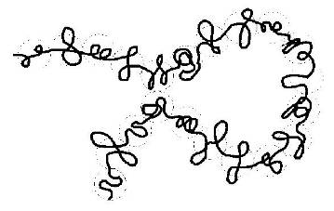
bead size, chain architecture
MD NPT runs on homo polymers
  Monomer length
  C∞ calculation and Kuhn lenght
  Chain architecture
Rotational Isomeric State
C1
C2
C3
C4
Cn
MM minimization and annealing
Change chain lenght
MD - NPT
<r>² – end to end distance
<r>² / n l² = C∞
Fermeglia, M. et al., Polymer, 47:5979-5989 (2006)
C∞

Slide 22
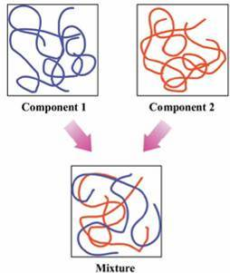
Method 1: F-H interaction parameter chi
Molecular dynamics NPT and NVT runs
Fermeglia, M. and Pricl S., AIChE J., 2619 (45), 1999

Slide 23
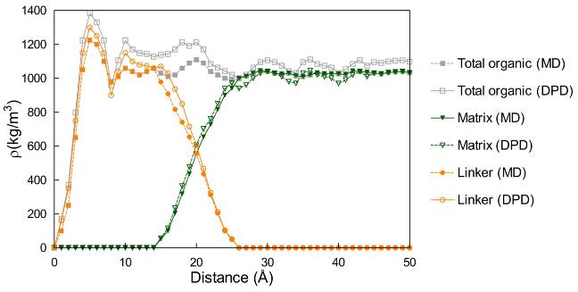
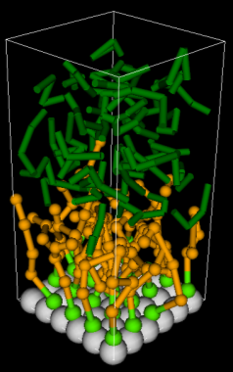
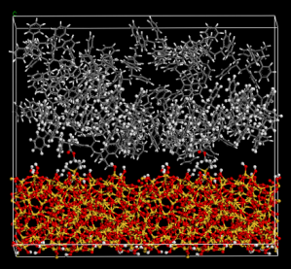
Estimation of DPD parameters from atomistic simulations
Single, binary, ternary
energies from MD
Binding energies are
rescaled considering the
number of contacts
Equal beads aij → 25
Binding energies from MD
(vdW + Coulomb)
References DPD
Interactions are selected
Strong repulsive beads
aij → >25
Define DPD beads
(head, tail, …) and
recalculate energies
DPD matrix parameters
(scaling from references)
Density profiles from MD
Density profiles from DPD
=?
Scocchi et al., J. Phys. Chem. B, (2007), 111, 2143

Slide 24
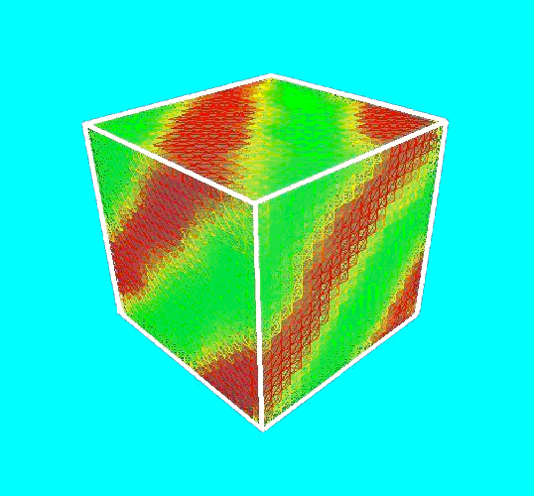
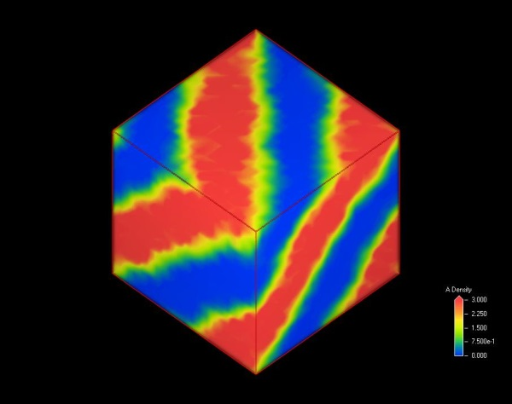
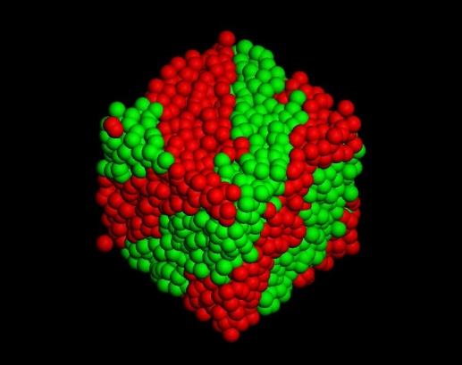
From beads to micro FEM
Dissipative Particle Dynamics
Micro - FEM Simulation
FEM Analysis:
Macroscopic properties
Soft potentials calculations
F_{i} = f (a_{ii}, a_{ij}, …, r_{c} )
Characteristic dimension of mesoscopic system
Toth R., Santese F., Pereira S.P., Romero-Nieto D., Pricl S., Fermeglia M., Posocco, Journal of Materials Chemistry, 22, 5398-5409 (2012)

Slide 25
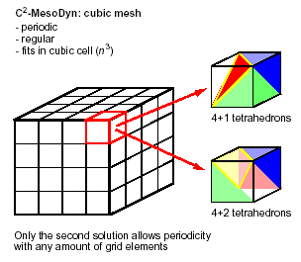


From beads … to micro: fixed grid
Geometry: map cubes to Palmyra tetrahedrons
Laplace equation is solved for electric conductance,
diffusion and permeability
Local deformation allow the calculation of mechanical
properties
Atomistic
Mesoscale
Fixed grid
Variable grid
Physical Prop.
Pereira S.P, Scocchi G., Toth R., Posocco P., Romero-Nieto D., Pricl S., Fermeglia M., Journal of Multiscale Modeling, 3:151-176 (2012)

Slide 26
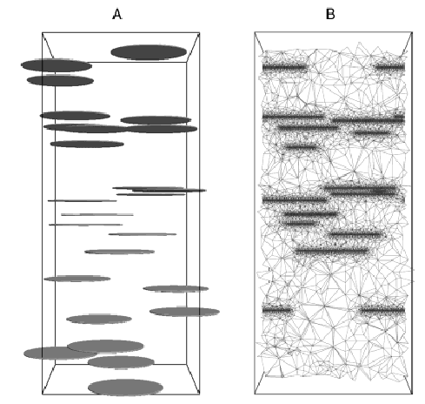
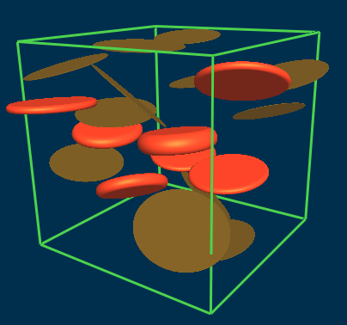
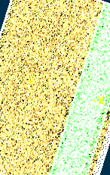
microFEM modelling: variable grid
Platelets orientation
  Alignement is defined and assigned to each platelet
Pure component properties definition
  Properties of the stacks is
  based on mesoscale simulations
  Pure component properties from
  MD or experimental data
Pereira S.P, Scocchi G., Toth R., Posocco P., Romero-Nieto D., Pricl S., Fermeglia M., Journal of Multiscale Modeling, 3:151-176 (2012)

Slide 27
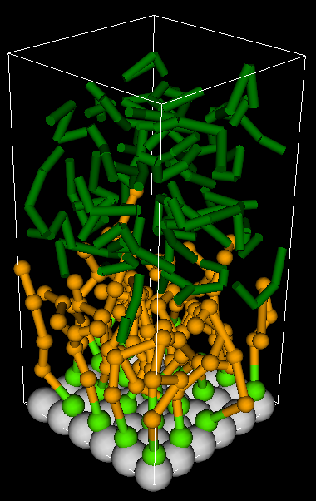
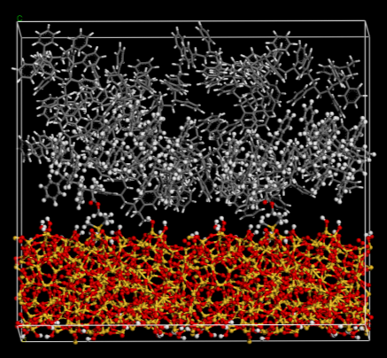
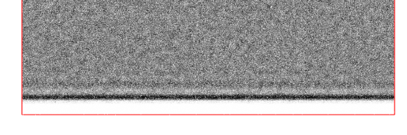
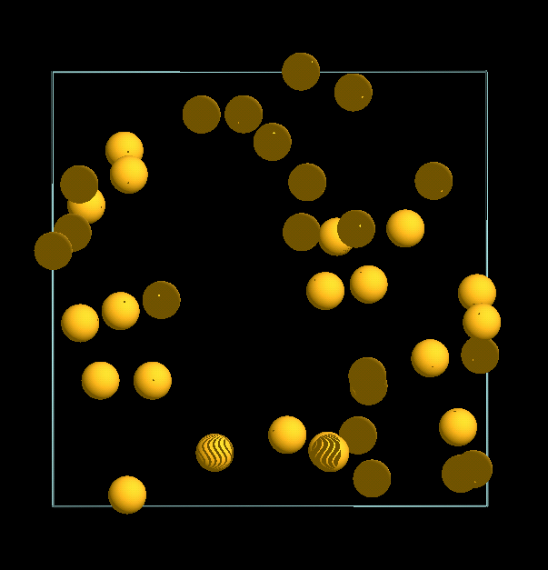
Simulation protocol for core-shell nanoparticles
Density profile
of the interface
(DPD)
Atomistic interface
mesoscale interface
Mechanical properties
of the interface
(Mesosprop)
Volumetric average
of properties
Palmyra
filler
Mechanical properties
of the pure filler
Palmyra
simulation
Notes:
DPD density profiles: sviluppato per sistemi senza compatibilizer, ma valido per sistemi grafted. Approccio è di calcolare le proprietà sulla zona di interfaccia e poi mappare il tutto in palmyra
Fatto con Accelrys MS, applicabile ai nostri sistemi se CULGI fornisce la conversione dei dati da coordinate in densità.

Slide 28
Outline of talk
Introduction
  Multiscale Molecular Modeling
Mapping procedure
  From atomistic simulation to mesoscale
  From mesoscale to micro FEM
Applications to nanostructured polymer systems
  Top down nanostructures
    Classical PCN
  Bottom up design
    Localization of gold nanoparticles in di-block copolymers
    Effect of chain length and grafting density
    Self assembly of nanostructures on gold nanoparticles
  Special applications
    Block copolymers for drug delivery
Conclusions
Notes:
28

Slide 29
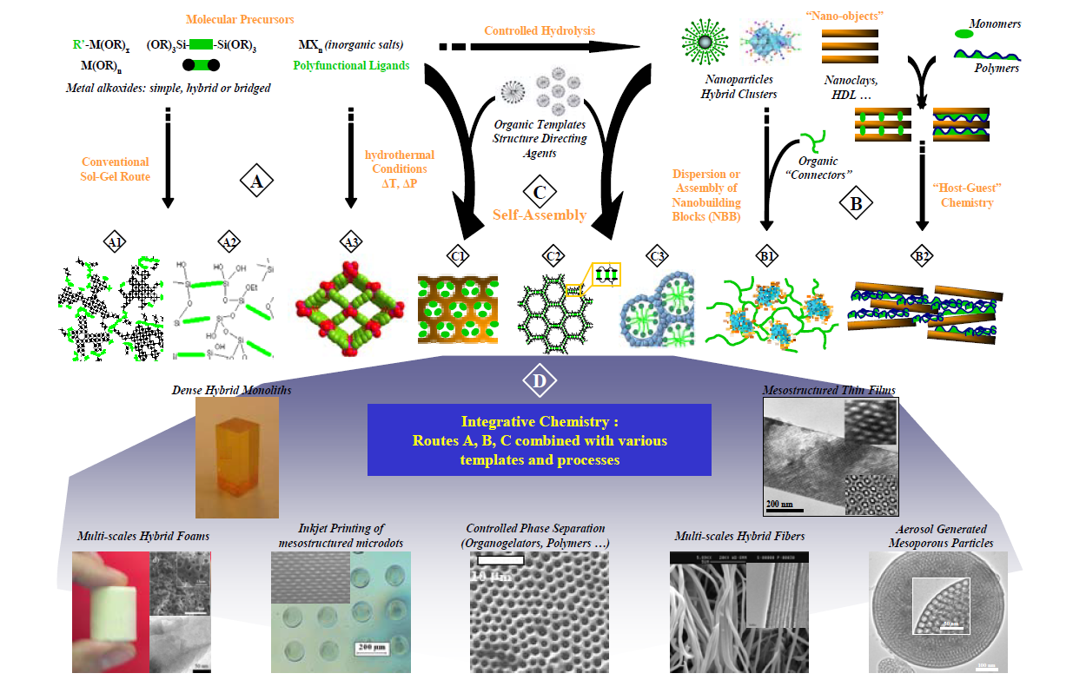
Nano-structured materials

Slide 30








  Polymer clay nanocomposites
Molecular Dynamics (MD)
Dissipative Particle Dynamics (DPD)
Finite Elements Method (FEM)
~ 1 nm
100 - 500 nm
~ 3 nm
~ 15 nm
~ 1 nm
~ 120 nm
~ 0.3 μm
1 nm
10 nm
100 nm
1 μm
Notes:
30

Slide 31

Summary of the results
  The chemical/physical characteristics of the different surface modifiers does not affect the macroscopic properties
  The size and shape of the filler and the properties of the pure nanocomposite components have a big impact on overall material properties.
Fermeglia et al., J. Mater. Chem. 2012, 22, 5398; Fermeglia et al., J. Multiscale Model. 2012, 3,1; Fermeglia et al., Chem. Eur. J. 2009,15,7586; Fermeglia et al., Macromolecules 2009, 42, 21, 8260; Fermeglia et al. J. Phys. Chem B 2007, 111, 2143

Slide 32




Macro level: nylon6+MMT
M3C18
C20A
 | EXPERIMENTAL (4.5%) | EXPERIMENTAL (7.1%) | CALCULATED (4.6%)
 | E_{c}/E_{m} | E_{c}/E_{m} | E_{c}/E_{m}
PA6+C20A | 1.57 |  | 1.61
PA6+C30B | 1.62 | 1.72 | 1.57
PA6+M3C18 | 1.69 | - | 1.60
Fornes, T.D., et al., Effect of organoclay structure on nylon 6 nanocomposite morphology and properties. Polymer, 2002. 43(22): p. 5915-5933.
Notes:
Papers in fodelr references
Data 7.1 % from deliverable MH

Slide 33



Hydrotalcite + FA + PP
 | EXPERIMENTAL (5%) | CALCULATED (4.6%)
 | E_{c}/E_{m} | E_{c}/E_{m}
PP + FA +HT | 1.11 | 1.12
 | Tabuani et al. (2011)
Experimental data from Tabuani et al., Macromol. Symp. 2011, 301, 114–127
Pereira S.P., Scocchi G., Toth R., Posocco P., Nieto D.R., Pricl S., Fermeglia M., Journal of multiscale modelling, 3,1-28 (2012)

Slide 34
TPU+MMT: thermal conductivity
Wai K. Ho, Joseph H. Koo, and Ofodike A. Ezekoye, “Thermoplastic Polyurethane Elastomer Nanocomposites: Morphology, Thermophysical, and Flammability Properties,” Journal of Nanomaterials, vol. 2010, Article ID 583234, 11 pages, 2010. doi:10.1155/2010/583234
 | EXPERIMENTAL (5%) | CALCULATED (4.6%)
 | k_{c}/k_{m} | k_{c}/k_{m}
TPU+C30B | 1.18 | 1.14
Pereira S.P., Scocchi G., Toth R., Posocco P., Nieto D.R., Pricl S., Fermeglia M., Journal of multiscale modelling, 3,1-28 (2012)
Notes:
Comparison for the lowest T
34

Slide 35


Permeability: PP + C20A
Osman, M. A., et al., Poly(propylene)-Layered Silicate Nanocomposites: Gas Permeation Properties and Clay Exfoliation. Macromolecular Chemistry and Physics, 2007. 208(1): p. 68-75.
 | EXPERIMENTAL (6 wt%) | CALCULATED (4.6 wt%)
 | P_{c}/P_{m} | P_{c}/P_{m}
PP+MMT | 0. 78 | 0.75
6 wt% corresponds to 2 vf%
Same basal spacing
Pereira S.P., Scocchi G., Toth R., Posocco P., Nieto D.R., Pricl S., Fermeglia M., Journal of multiscale modelling, 3,1-28 (2012)
Notes:
Permeability careful that the comaptibilizer is different …. Consider only the MMT calcualtion is doen with C20A (same basal spacing)

Slide 36



Influence of the degree of exfoliation
PP+PPgMA+C20A
Scocchi G., 2009, Multiscale Simulation of Polymer-Clay Nanocomposites, phd Thesis, University of Trieste

Slide 37


PA6 – M2(C18)2 – CEC90
PA6
M2(C18)2
Cation Exchange Capacity: 90 meq/100g
T.D Fornes et al., Polymer 42 (2002) 5915
Scocchi G., 2009, Multiscale Simulation of Polymer-Clay Nanocomposites, phd Thesis, University of Trieste
Notes:
37

Slide 38

PP – M2(C18)2 – CEC90
PP
M2(C18)2
Cation Exchange Capacity: 90 meq/100g
M. T. Ton-That et al., Polym Eng Sci 44 (2004) 1212
Scocchi G., 2009, Multiscale Simulation of Polymer-Clay Nanocomposites, phd Thesis, University of Trieste
Notes:
38

Slide 39



Dogbone ASTM D638 samples at a strain rate of 5 mm/min
2-PP+PPgMA+C20A nanocomposite
3-PP+Hydrotalcite nanocomposite

Slide 40



Uniaxial compression at a constant strain rate
(5 mm/min) of the demonstrators
Deformed shape and force/displacement curves for PP+PPgMA+C20A nanocomposite Bottle.
Deformed shape and force/displacement curves for PA6+C30B nanocomposite glass.

Slide 41
Outline of talk
Introduction
  Multiscale Molecular Modeling
Mapping procedure
  From atomistic simulation to mesoscale
  From mesoscale to micro FEM
Applications to nanostructured polymer systems
  Top down nanostructures
    Classical PCN
  Bottom up design
    Localization of gold nanoparticles in di-block copolymers
    Effect of chain length and grafting density
    Self assembly of nanostructures on gold nanoparticles
  Special applications
    Block copolymers for drug delivery
Conclusions
Notes:
41

Slide 42
Nano-structured materials

Slide 43
  Self assembly of nanoparticles in block copolymers
Organic polymer and inorganic particles mixing (PPNs)
  PPNs fabrication process via self-assembly
  By dispersion of particles in diblock copolymers
Predicted microstructure morphology depends on
  nature of the system
    chemistry and architecture of the blocks
    volume fraction of the nanoparticles
    strength and type of interactions
  process conditions
    temperature
    shear
SCOPE: model the
system morphology
Experimental evidence
by Chiu et al.
  poly styrene-2 vinyl pyridine
Applications:
  Opto electronic industry
Chiu, J.J, Bumjoon J.K., Kramer E.J. Pine, D.J., JACS, 2005, 127, 5036

Slide 44



Lamellae: A (or B) covering
segregation in the center of the corresponding domain;
perfect agreement with experimental evidences.
Density
Distance
Maly M., Posocco P., Pricl S., Fermeglia M.. IEC, 47: 5023-5038 (2008)
Posocco P., Posel Z., Fermeglia M., Lísal M., Pricl S., J. Mater. Chem., 20:10511-10520 (2010)
Posel Z., Posocco P., Fermeglia M., Lisal M., Pricl S., Soft Matter, DOI: 10.1039/c2sm27360h (2013)
Notes:
44

Slide 45



Lamellae: A and B covering (A₆B₆)
nanoparticles at the interfaces between the A-B blocks
  Agreement with experiments
Density
Distance
Notes:
45

Slide 46





PS grafting only: loading: φ_{p} = 0.05
Migration to the interface (from a to d) for decreasing PS grafting density
  1D density profiles:
    a, PS4Au8;
    b, PS3Au9;
    c, PS2Au10,
    d, PS1Au11.
  Line legend:
    (green), PS;
    (blue),PVP;
    (red), Au.
Posocco P., Posel Z., Fermeglia M., Lísal M., Pricl S., J. Mater. Chem., 20:10511-10520 (2010)

Slide 47



PS grafting only: loading: φ_{p} = 0.2
PS4Au8
For PS4Au8 system, large regions of nanoparticles (red) – exp. evidence
Same tendency to migrate to the interface as the PS grafting density decreases
  Line legend:
    (green), PS;
    (blue),PVP;
    (red), Au.
Kim et al., Macromolecules, 39, 4198, 2006
PS1Au11
Posocco P., Posel Z., Fermeglia M., Lísal M., Pricl S., J. Mater. Chem., 20:10511-10520 (2010)
Posel Z., Posocco P., Fermeglia M., Lisal M., Pricl S., Soft Matter, DOI: 10.1039/c2sm27360h (2013)

Slide 48




  Grafted silica nanoparticles in polymers
Particles embedded in a polymer matrix and grafted with polymer chains.
  Matrix: polydispersity, molecular weight
  Particles: size, chemical nature, surface treatment
  Grafting agents: chemical nature, grafting density, molecular weight, polydispersity
Grafted nanoparticles and semi crystalline polymers
  Core: amorphous SiO₂ 5-10 nm diameter
  Linker: Si based component
  Grafted polymer chains: polystyrene 2k – 20k
  Polymer: amorphous polystyrene 100k

Slide 49



The model System
Grafted nanoparticles and semi crystalline polymers
  Core: amorphous SiO₂ 5-10 nm diameter
  Linker: Si based component
  Grafted polymer chains: polystyrene 2k – 20k
  Polymer: amorphous polystyrene 100k
BrC(CH₃)₂CO₂(CH₂)₃SiMe₂Cl
Carved Sphere
Etched Sphere
Grafted Sphere

Slide 50




A general view of the project
Polystyrene – silica grafted nanoparticles: different scales:
Single nP MC
MD & Cg MD
DPD 1:1
DPD 1:n
DPD 1:many
Parameters from: COSMO-RS or MD
Increasing time and length

Slide 51




Brush thickness: effect of grafted density
existence of a critical radius r_{DC}
for h + r < r_{DC}, → Concentrated Polymer Brush (CPB) regime
  dry brush - autophobic dewetting, particle aggregation;
for larger h +r → Semidilute Polymer Brush (SDPB) regime
  wet brush, good dispersion

Slide 52



Aggregation vs. dispersion: effect of loading and grafting density
Increasing grafted chains density leads to aggregation
Increasing nP concentration does not alter dispersion
Fixed grafted chain length (20k) in PS 100k

Slide 53








Comparison with experiments – CG level II
dispersion
dispersion/aggregation
0.5% wt and 0.31 chains/nm²
0.5% wt and 0.82 chains/nm²
Concentration
5.0% wt and 0.31 chains/nm²
5.0% wt and 0.82 chains/nm²
dispersion
aggregation
Grafting density

Slide 54



Aggregation vs. dispersion: effect of grafted chain lenght
2.5k Da and 0.51 chains/nm²
aggregation
21.3 k Da and 0.31 chains/nm²
dispersion
Increasing grafted chain length favors uniform distribution of nP in the matrix
103.7 k Da and 0.53 chains/nm²
dispersion
Chain
length
Fixed grafted density and PS matrix 100k

Slide 55
Comparison with experiments – CG level II
2k and 0.4 chains/nm²
aggregation
dispersion
dispersion/aggregation
18k and 0.31 chains/nm²
18k and 0.82 chains/nm²
Grafting density
dispersion
Chain
length
100k and 0.53 chains/nm²

Slide 56


Lliterature

Slide 57



Silica nP – Grafting density 0.5 chains/nm² 20kDa PS
1% v/v
5% v/v
10% v/v
Isolated Particles
Primary Aggregates
Long Strings
% NP | E_{C} (GPa) | E_{C}/E_{M} | h (nm)
1 | 2.59 (2.60) | 1.03 | 7.5
5 | 2.94 (2.82) | 1.17 | 9.3
10 | 3.45 | 1.37 | 10.2

Slide 58



Silica nP – Grafting density 0.7 chains/nm² 20kDa PS
1% v/v
5% v/v
10% v/v
Isolated Particles
Primary Aggregates
Sheet Like
% NP | E_{C} (GPa) | E_{C}/E_{M} | h (nm)
1 | 2.62 | 1.04 | 10.7
5 | 3.07 | 1.22 | 10.3
10 | 3.55 | 1.41 | 11.0

Slide 59


Silica nP – Grafting density 1.0 chains/nm² 20kDa PS
1% v/v
5% v/v
Isolated Particles
Long Strings
% NP | E_{C} (GPa) | E_{C}/E_{M}
1 | 2.62 (2.75) | 1.04
5 | 3.34 (2.87) | 1.33

Slide 60
Summary of the mechanical properties
% NP | E_{C} (GPa) | E_{C}/E_{M}
Grafting density 0.5 chains/nm²
1 | 2.59 | 1.03
5 | 2.94 | 1.17
10 | 3.45 | 1.37
Grafting density 0.7 chains/nm²
1 | 2.62 | 1.04
5 | 3.07 | 1.22
10 | 3.55 | 1.41
Grafting density 1 chains/nm²
1 | 2.62 | 1.04
5 | 3.34 | 1.33
LOW % NPs
ISOLATED NPs
E_{C}/E_{M} ≠ f(d_{g})

Slide 61
Summary of the mechanical properties
% NP | E_{C} (GPa) | E_{C}/E_{M}
Grafting density 0.5 chains/nm²
1 | 2.59 | 1.03
5 | 2.94 | 1.17
10 | 3.45 | 1.37
Grafting density 0.7 chains/nm²
1 | 2.62 | 1.04
5 | 3.07 | 1.22
10 | 3.55 | 1.41
Grafting density 1 chains/nm²
1 | 2.62 | 1.04
5 | 3.34 | 1.33
INCREASING % NPs
DIFFERENT NPs MORPHOLOGIES
E_{C}/E_{M} = f(%NP)
Notes:
Dati sperimetnali:
Grafting density

Slide 62
Summary of the mechanical properties
% NP | E_{C} (GPa) | E_{C}/E_{M}
Grafting density 0.5 chains/nm²
1 | 2.59 (2.60±0.1) | 1.03
5 | 2.94 (2.81±0.2) | 1.17
10 | 3.45 | 1.37
Grafting density 0.7 chains/nm²
1 | 2.62 | 1.04
5 | 3.07 | 1.22
10 | 3.55 | 1.41
Grafting density 1 chains/nm²
1 | 2.62 (2.75±0.2) | 1.04
5 | 3.34 (2.87±0.1) | 1.33

Slide 63





Self assembly of nanostructures on gold nanoparticoles
F8 ~ 1.2+ 3.1 nm
C8 ~ 1.3+ 1.9 nm
1
Color legend:
solvent=turquoise
TEG/PEG=green
C8=grey
F8=purple
gold=brown
1
Stripes
Stripe thickness ~ 0.65-0.7 nm
Posocco P, Gentilini C, Bidoggia S, Pace A, Franchi P, Lucarini M, Fermeglia M, Pricl S, Pasquato L., ACS Nano, 2012, 6(8):7243-53
Notes:
Il grafico ti riporta una della rdf, quella per il florurato. Tieni presente che la rdf è fatta a partire dal CENTRO della nanoparticella. Per cui, ai valori, devi sottrarre il raggio della stessa (in questo caso, per sistema 1, è 1.1. nm). Come vedi, la curva viola è quella totale, e, prendendo il massimo del secondo picco, hai la dimensione più probabile della intera particella (core + shell) (raggio = 3.75 nm). Lo strato di florurato ha un’altezza più probabile di 1.2 nm, laddove la sua lunghezza fully stretched è 1.4 nm. Per il pezzo di peg attaccato, invece, come vedi una piccola parte si intrufola nel monolayer (primo picco verde puntinato a 1.1 nm), ma il grosso, come deve, sta fuori. La estensione dello strato di peg più probabile coincide con la parte viola, e quindi a 2.65nm, ma ci sono anche catene fully stretched (guarda la il modello della particella in alto a sinistra), che arrivano a 4.6 nm.

Slide 64







Self assembly of nanostructures on gold nanoparticoles
2: effect of core size
Janus
nanoparticle
3: effect of grafted composition
Stripe-like pattern
2: effect of core size
Color legend:
solvent=turquoise
TEG/PEG=green
C8=grey
F8=purple
gold=brown
Domains

Slide 65
Outline of talk
Introduction
  Multiscale Molecular Modeling
Mapping procedure
  From atomistic simulation to mesoscale
  From mesoscale to micro FEM
Applications to nanostructured polymer systems
  Top down nanostructures
    Classical PCN
  Bottom up design
    Localization of gold nanoparticles in di-block copolymers
    Effect of chain length and grafting density
    Self assembly of nanostructures on gold nanoparticles
  Special applications
    Block copolymers for drug delivery
Conclusions
Notes:
65

Slide 66


Nanovectors in medicine
Typical properties:
  Biocompatibility
  Water solubility
  High specificity
  Multifunctionality
  Cell barriers crossing, ….
Viruses
Liposomes → lipoplexes
Polymers → polyplexes
→ dendriplexes
Inorganic nanovectors (carbon nanotubes, fullerenes, …)

Slide 67


Objective: Di/triblock copolymers in water
Diblock copolymer PEG-PLA:
  Poly(ethylene oxide) PEG (Mw = 3670 Da)
  Poly-DL(lactic acid) PLA (Mw = 3300 Da)
Effect of copolymer composition and
concentration on system morphology
Triblock copolymer PLA-PEG-PLA:
  PLA₅₈₇₅‐PEO₇₇₆₁‐PLA₅₈₇₅
Effect of polymer concentration on
system morphology
Posocco, Fermeglia, Pricl, J. Mater. Chem. 2010, 20, 7742-7753
Notes:
Caratteristiche di un sistema di rilascio di formci o RNSA- DNA : Solubilità, tossicità e rilascio controllato
Come ? Virus (solo epr RNA e DNA) oppure polineri. Noi facciamo polimeri con small molecules.
Polimero bio compatibili
Goals: digarammi di fase predire (conc e composizione)
Per capire in che condizioni si formano micelle sferiche
Uptake prvisione di un model drug per sapere il ‘carico’teorico
PLA idrofobico PEO idorfilico

Slide 68

Objective: Effect of drug loading
Model drug: NIFEDIPINE
(Adalat®, Nifedical®, Procardia®)
  Calcium channel blocker
    Ischemic cardiopathy
    Chronic arterial hypertension
    Raynaud syndrome
    Premature delivery
Highly hydrophobic and with side effects
  Needs delivery system
Posocco, Fermeglia, Pricl, J. Mater. Chem. 2010, 20, 7742-7753

Slide 69








Diblock copolymer phase diagram
Phase diagram of diblock copolymers A-B
[Mean Field Theory - Leibler]
f = Volumetric fraction of one specie (A or B)
T
Classical phases:
LAMELLAR
HEXAGONAL (cylindrical)
SPHERICAL
BCC
BCC
Complex phases:
BICONTINUOUS (gyroid)
PERFORATED LAMELLAS
HEX
HEX
GYR
GYR
Posocco, Fermeglia, Pricl, J. Mater. Chem. 2010, 20, 7742-7753
LAM
Notes:
In melt

Slide 70

PLA-PEO AQUEOUS SOLUTION
Phase diagram derived from DPD simulations
Legend:
= micelles
= PLA spheres (SPLA)
= PEG spheres (SPEG)
= PLA cylinders (CPLA)
= PEG cylinders (CPEG)
= PLA perforated lamellas or gyroid phase (PLPLA/GPLA)
= Lamellas
= PEG perforated lamellas or gyroid phase (PLPEG/GPEG)
= disordered phase, lamellar micelles, cylindrical micelles..
v/v concentration in water
PLA fraction
Posocco, Fermeglia, Pricl, J. Mater. Chem. 2010, 20, 7742-7753
Notes:
In acqua --- novità

Slide 71

Predicted phase morphologies of PLA-PEO in water: Φ = 0.9 v/v
0.4
0.8
0.2
0.5
0.9
Posocco, Fermeglia, Pricl, J. Mater. Chem. 2010, 20, 7742-7753

Slide 72

Predicted phase morphologies of PLA-PEO in water: Φ = 0.2 v/v
0.4
0.3
0.6
Posocco, Fermeglia, Pricl, J. Mater. Chem. 2010, 20, 7742-7753

Slide 73
Predicted phase morphologies of PLA-PEO-PLA in water: f_{PLA} = 0.57
0.10 %
0.50 %
0.22 %
0.15 %
0.35 %
0.60 %
Posocco, Fermeglia, Pricl, J. Mater. Chem. 2010, 20, 7742-7753

Slide 74

Micelle loading with drug:
PLA-PEO
12 %
4 %
22 %
0 %
Drug concentration limit around 15%
Posocco, Fermeglia, Pricl, J. Mater. Chem. 2010, 20, 7742-7753

Slide 75
Micelle loading with drug:
PLA-PEO-PLA
2 %
4 %
1 %
3 %
7 %
Drug concentration limit around 2-3 %
Posocco, Fermeglia, Pricl, J. Mater. Chem. 2010, 20, 7742-7753

Slide 76
Outline of talk
Introduction
  Multiscale Molecular Modeling
Mapping procedure
  From atomistic simulation to mesoscale
  From mesoscale to micro FEM
Applications to nanostructured polymer systems
  Top down nanostructures
    Classical PCN
  Bottom up design
    Localization of gold nanoparticles in di-block copolymers
    Effect of chain length and grafting density
    Self assembly of nanostructures on gold nanoparticles
  Special applications
    Block copolymers for drug delivery
Conclusions
Notes:
76

Slide 77
Conclusions
Message passing multiscale molecular modeling
  Mapping atomistic to mesoscale
  Mapping mesoscale morphology to microFEM
Useful for the design of nanostructured systems
  Interpretation and design of experiments
  Characterization of nanoparticle dispersion
Applied to nanostructured polymer system of industrial interest
  Automotive industry
  Opto electronic industry
  Polymer industry
  Nanomedicine & bio based economy
General design approach for nanostructured materials & systems

Slide 78








Acknowledgments
Financial support:
  Nanomodel EU Project
  MULTIPRO EU Project
  Multihybrids EU Project
  GreenBoat Design, EU PorFesr
  NanoStata – Industry 2015
People & institutions
  Dave K. Smith, Anna Barnard & Simon P. Jones, University of York, U.K.
  Nathan P. Gabrielson & Daniel W. Pack, University of Illinois at Urbana Champaign, USA
  Chun-Ho Wong & Hak-Fun Chow, The Chinese University of Hong Kong
  Carlo V. Catapano, Anastasia Malek, IOSI, Bellinzona, Switzerland
  Aaron Tagliabue, Enzio Ragg, University of Milan
  Kostas Karatasos, University of Thessaloniki, Greece
  Lucia Pasquato, University of Trieste
  Sara Padovani, CRP-FIAT,
  Ling Peng group, CNRS, Marseille (F)
  MarcoPierotti, Elena Tamborini, Silvana Pilotti, NCI, Milan
  Giuseppe Mensitieri, University of Naples
Sabrina Pricl
Radovan Toth
Paola Posocco
Erik Laurini
Paolo Cosoli
Daniel Romero
Simão P. Pereiraa
Francesca Santese
Valentina Dal Col
Domenico Marson
Tina Stokelj
Giulio Scocchi
Martin Lisal
Zbysek Posel
Johannes G.E.M. Fraaije
Jan-Willem Handgraaf
Nanomodel Partners

