Slide 1
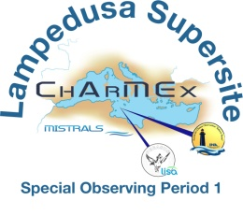
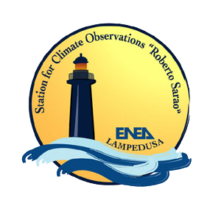
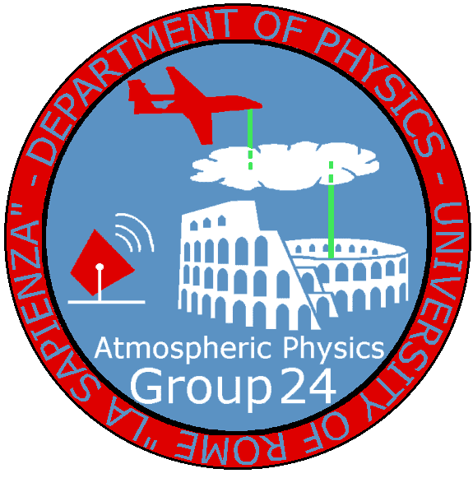
Radiative transfer simulations of the ATR-42 and Falcon 20 SW and LW radiation profiles above the ENEA Lampedusa supersite during the ChArMEx/ADRIMED SOP1a campaign
4° International Workshop ChArMEx, Trieste, 20-24 October 2014
Daniela Meloni
Laboratory for Earth Observations and Analyses, ENEA
with contributions from:

Slide 2
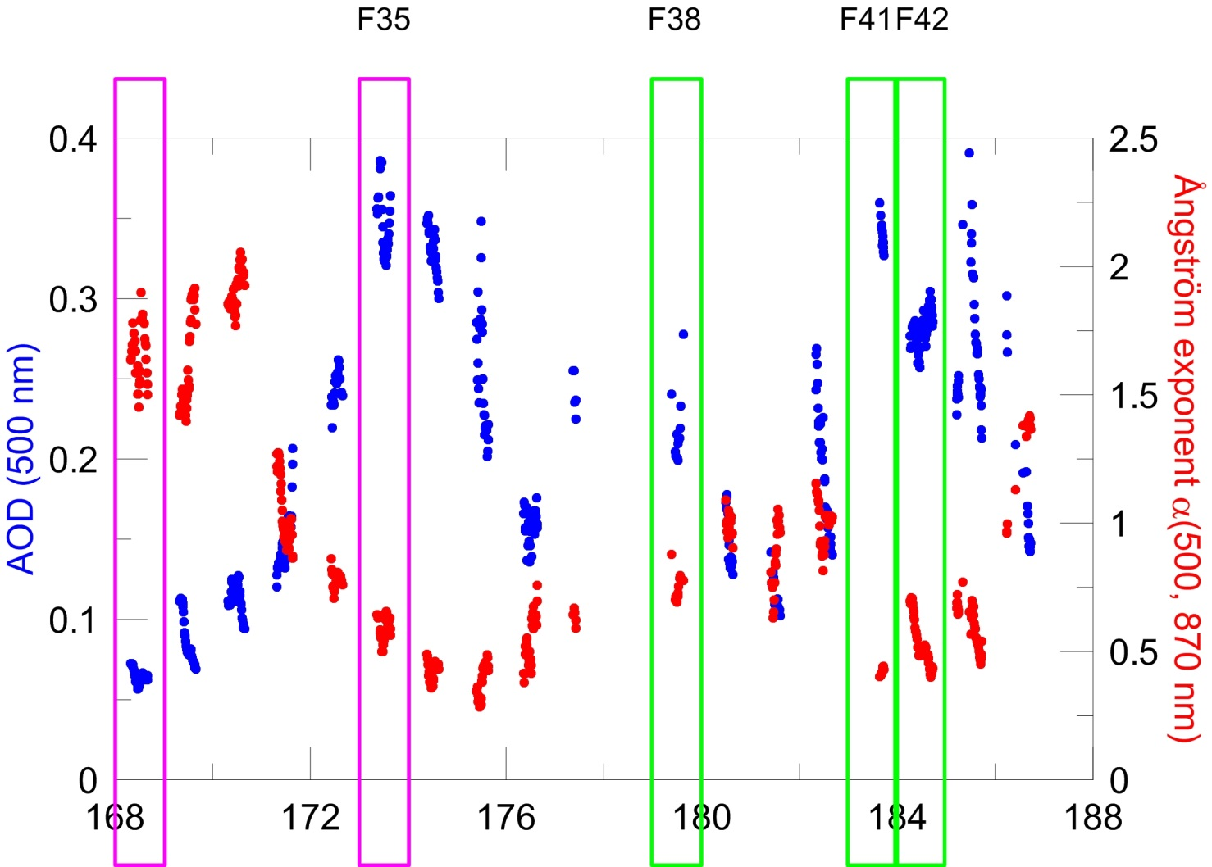
ATR-42 and Falcon 20 flights above Lampedusa:
22 and 28 June (landing and take off at Lampedusa airport), 2 and 3 July
17 June
22 June
28 June
2-3 July
DAY NUMBER

Slide 3
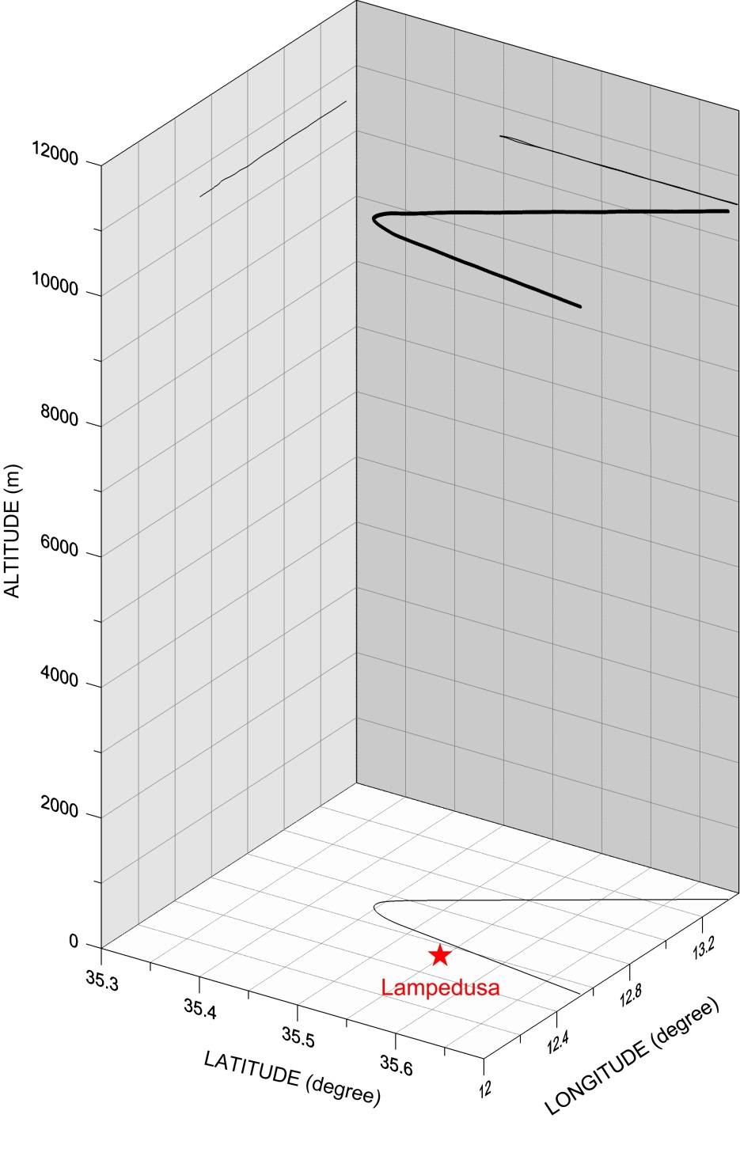
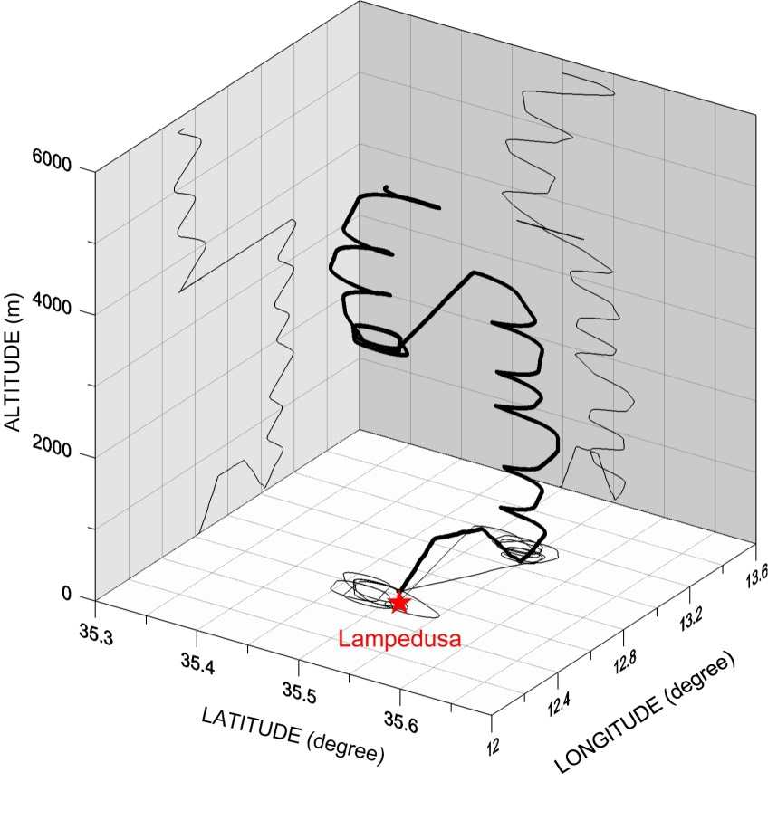
22 June – F35 (descent)
ATR-42
FALCON 20
AOD (500 nm)=0.38±0.02
α (500, 870)=0.53±0.03
TIME=10:23-11:26 UT
SZA=15° (top)-12° (bottom)

Slide 4
Airborne instruments
Type | Model | Measurement
Pyranometer | CMP22/PSP | SW↓ irradiance
Pyranometer | CMP22/PSP | SW↑ irradiance
Pyrgeometer | CGR4/PIR | LW↓ irradiance
Pyrgeometer | CGR4/PIR | LW↑ irradiance
IR radiometer (CLIMAT) | Cimel CE332 | Brightness temperature↑ (8.7, 10.6, 12 µm)
ATR-42
FALCON 20
ATR-42

Slide 5
Ground-based instruments
Type | Model | Measurement
Pyranometer | CMP21 | Global SW↓ irradiance
Pyranometer | PSP | Diffuse SW↓ irradiance
Pyrheliometer | CHP1 | Direct SW irradiance
Pyrgeometer | CGR4 | LW↓ irradiance
Pyrgeometer (PMOD/WRC) | CGR3 | WINDOW↓ irradiance (8-14 µm)
Pyrometer | KT 19 II | Sky Brightness Temperature (9.7-11.6 µm)

Slide 6
Methodology
RT simulations of surface and airborne radiation profiles feeding the model with all the available measurements of atmospheric composition and structure, geometry, surface parameters
AIM
To estimate reliable altitude-resolved aerosol radiative effects in the SW and LW regions.
Similar to the approach used for the Ground-based and Airborne Measurements of Aerosol Radiative Forcing (GAMARF) campaign [Meloni et al., 2014, submitted to JGR].

Slide 7
Radiative transfer model simulations
MODTRAN 5.3
INPUT
MODEL PARAMETER | DATA
p, T, RH profiles | ATR-42, radiosounding
Integrated water vapor | Microwave radiometer
Aerosol extinction profile, AOD | Lidar, Cimel/MFRSR
Aerosol optical properties | Cimel/ATR-42
Surface albedo - sea | Jin et al. [2011]
Surface albedo - Lampedusa | Mixture of sea [Jin et al., 2011] and barren/desert (MODTRAN)
Surface emissivity and temperature | MODIS/MODTRAN
Columnar O₃ | Brewer
Surface CO₂ | Picarro
O₃, CO₂ profiles | ATR-42/Mid-latitude standard atmos.

Slide 8
OUTPUT
Over the SEA (100-5800 m asl):
upward and downward SW irradiance profiles
upward and downward LW irradiance profiles
water-leaving brightness temperature (8.7, 10.6, 12 µm) profiles
Over LAMPEDUSA (55 m asl):
downward global, direct and diffuse SW irradiances
downward LW irradiance
downward WINDOW (8-14 µm) irradiance
sky brightness temperature (9.6-11.7 µm)
MODEL SIMULATIONS WITH AND WITHOUT AEROSOL:
Aerosol radiative forcing (ARF) and aerosol heating rate (AHR) profiles over the SEA

Slide 9
Aerosol optical properties: SW
AERONET retrieval of the aerosol size distribution, spectral refractive index, single scattering albedo and phase function (440, 500, 870, 1020 nm) closest in time to the flight
In situ/flight retrieval of size distribution and wavelength-independent refractive index, obtained combining the scattering coefficient from the nephelometer and the extinction coefficient from the CAPS (see Denjean/Formenti presentation)
3 LAYERS

Slide 10
Aerosol optical properties: LW
Size ditribution: AERONET (in situ)
Refractive index: OPAC (4-40 µm) [Hess et al., 1998]
Tunisian dust (6-14 µm) [Di Biagio et al., 2014]
Mie calculations

Slide 11
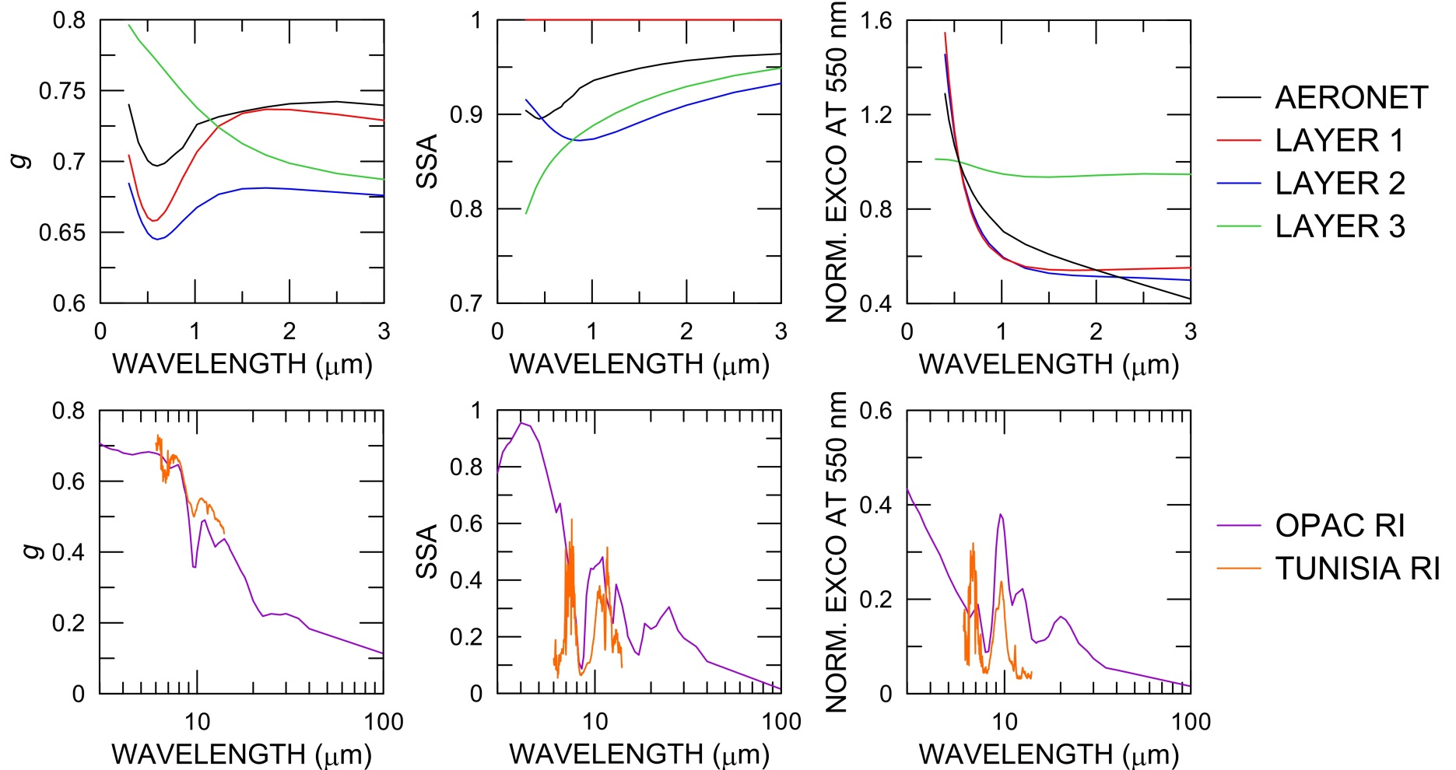
Results - 22 June – ATR-42
Aerosol optical properties
SW
LW

Slide 12
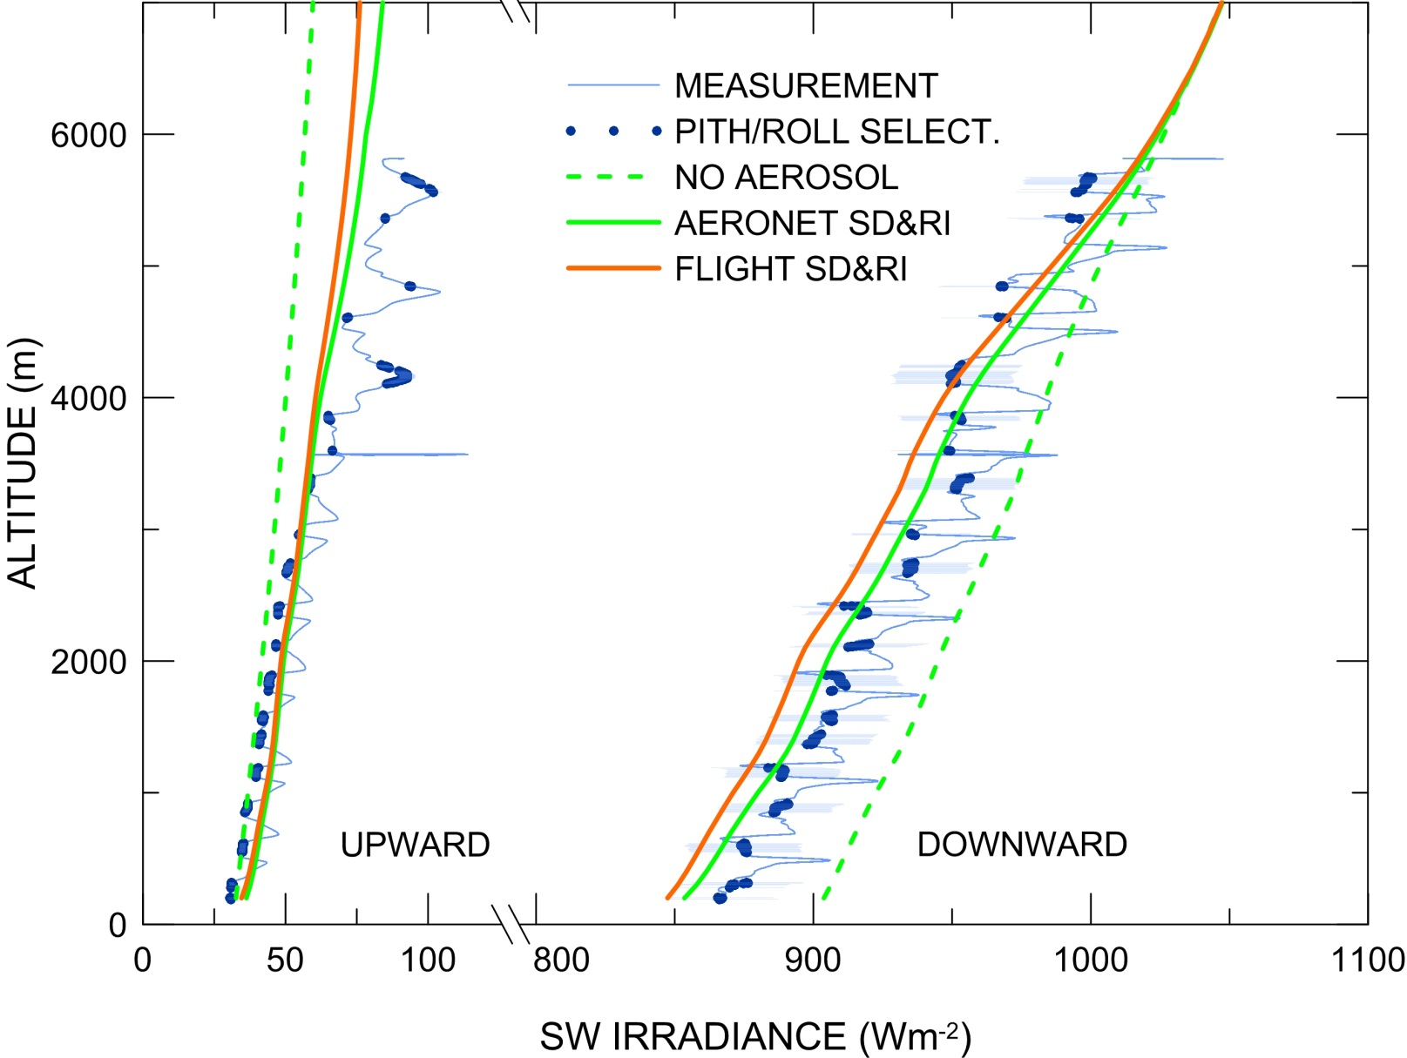
Results - 22 June – ATR-42
SW irradiance (SZA=27.5°)
Pitch angle < 1°
Roll angle < 1.5°

Slide 13
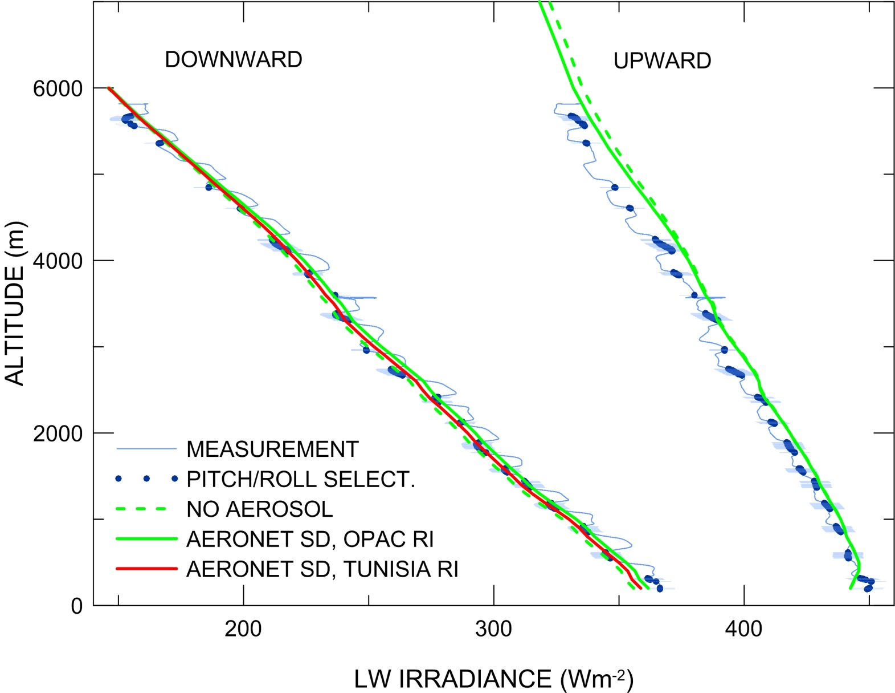
Results - ATR-42
LW irradiance

Slide 14
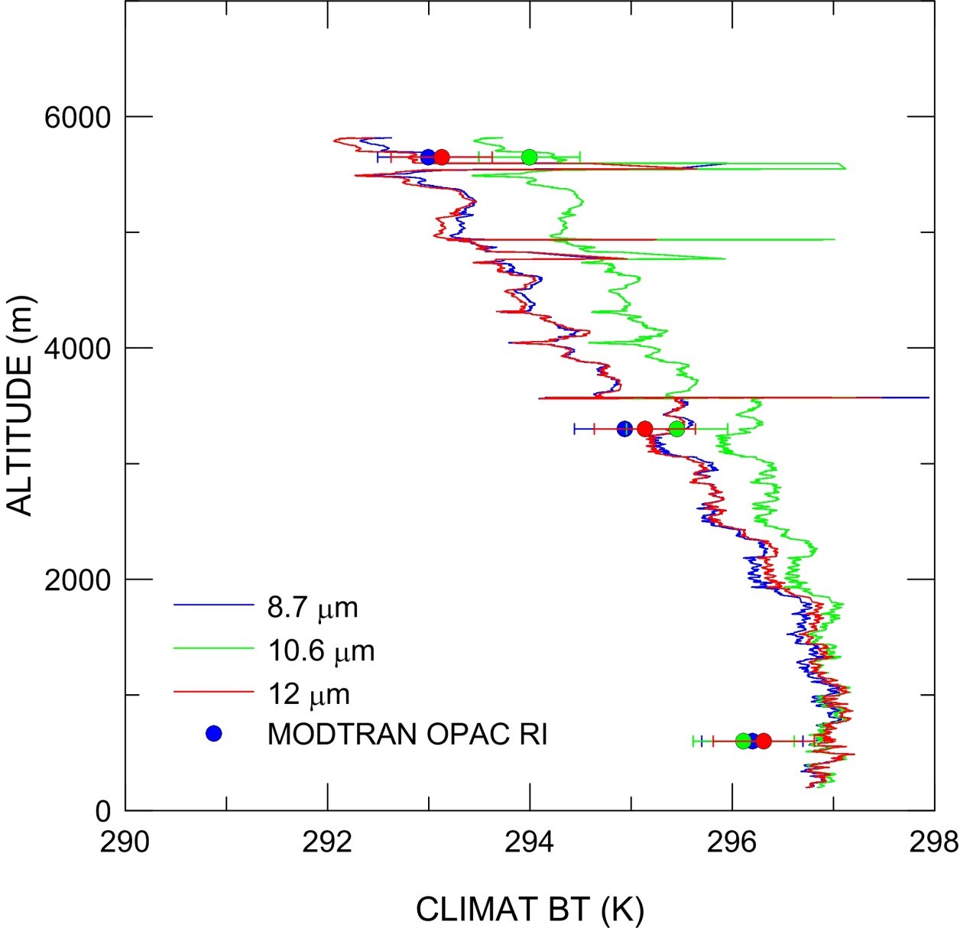
Results - ATR-42
CLIMAT brightness temperatures

Slide 15
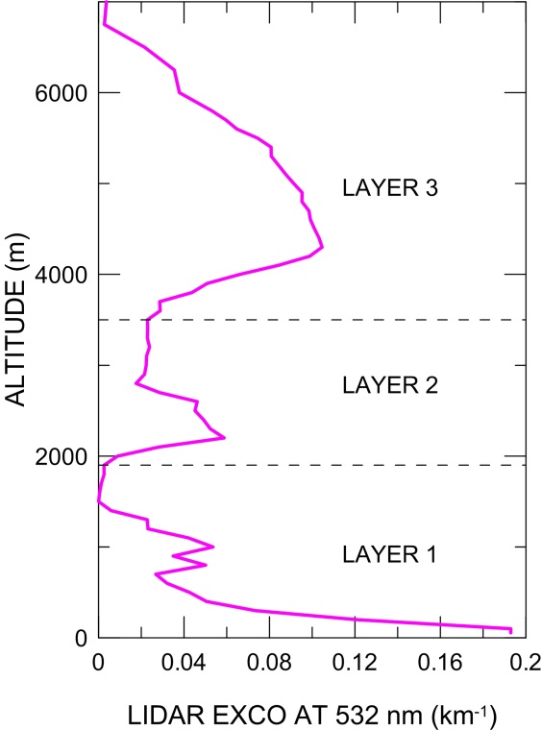
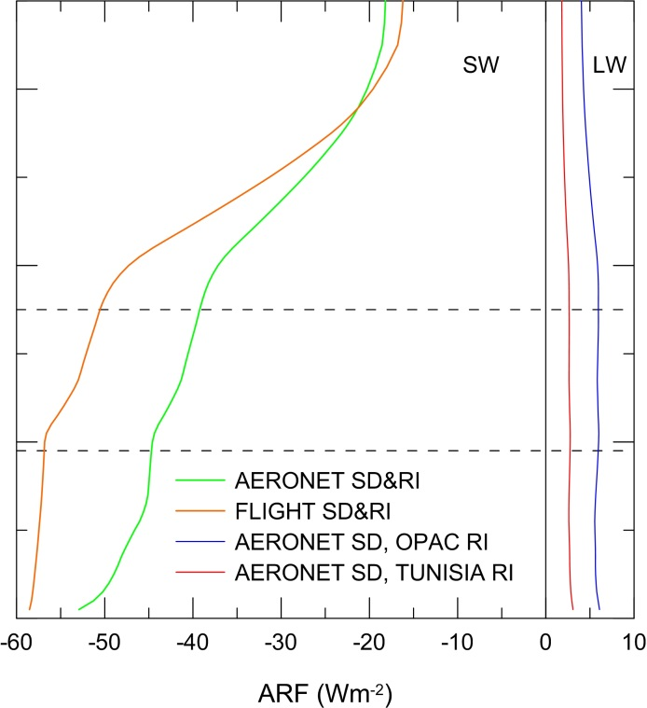
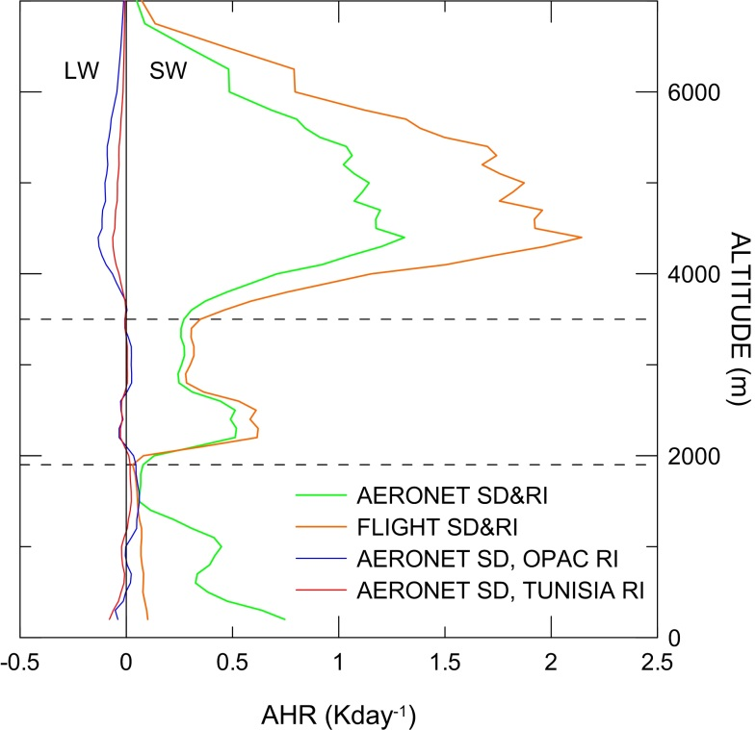
Results- ATR-42
ARF – AHR – Lidar profile
Largest ARF at surface, small LW contribution (relatively small columnar AOD)
AHR profile following the lidar-derived extinction profile
Largest AHR in LAYER 3 (large layer AOD)

Slide 16
Results
Surface irradiances
SZA=12.5±0.25°
 | MEASUREMENT (Wm⁻²) | UNCERT. (%) | MODEL AERONET (Wm⁻²) | DIFF. (%) | MODEL IN SITU (Wm⁻²) | DIFF. (%)
Diffuse SW↓ | 222.7 | ±4.0 | 244.7 | +9.8 | 253.2 | +13.7
Direct SW | 725.4 | ±2.0 | 713.2 | -1.7 | 692.8 | -4.4
Global SW↓ | 948.1 | ±4.5 | 957.9 | +1.0 | 946.0 | -0.2
 | MEASUREMENT | UNCERT. | MODEL OPAC | DIFF. | MODEL TUNISIA | DIFF.
LW↓ | 358.6 Wm⁻² | ±6 Wm⁻² | 361.6 Wm⁻² | +3.0 Wm⁻² | 358.5 Wm⁻² | -0.1 Wm⁻²
WINDOW↓ | 81.3 Wm⁻² | ±2 Wm⁻² | 87.7 Wm⁻² | +6.4 Wm⁻² | 84.5 Wm⁻² | +3.2 Wm⁻²
IR BT | 233.3 K | -3/0 K | 229.2 K | -4.1 K | 226.4 K | -6.9 K

Slide 17
Results
FALCON 20 irradiances at 10560±7 m
SZA=20.7°
 | MEASUREMENT | UNCERTAINTY | MODEL AERONET | DIFFERENCE
SW↓ | 1135.4 Wm⁻² | ±2.0% | 1149.3 Wm⁻² | +1.2%
SW↑ | 87.3 Wm⁻² | ±2.0% | 88.8 Wm⁻² | +1.7%
LW↓ | 40.5 Wm⁻² | ±6 Wm⁻² | 35.9 Wm⁻² | -4.6 Wm⁻²
LW↑ | 294.7 Wm⁻² | ±6 Wm⁻² | 289.9 Wm⁻² | -4.8 Wm⁻²

Slide 18
Conclusions
Observationally-constrained RT model simulations of surface and tropospheric SW and LW irradiance vertical profiles, and of surface and tropospheric infrared brightness temperatures.
reproducing the SW and LW fluxes at surface, within and above the dust layer allows a reliable estimate of the aerosol radiative effects;
reproducing the global SW irradiance alone does not guarantees that the single components (direct, diffuse) are fairly reproduced;
the characterization of the spectral vertical aerosol optical properties is a key point in estimating the aerosol radiative effect (ARF, AHR);
the simulation of the radiance/irradiance in the atmospheric window may help to better understand the dust optical properties in the infrared region.

Slide 19
Aerosol optical properties: SW
AERONET retrieval of the aerosol size distribution, spectral refractive index, single scattering albedo and phase function (440, 500, 870, 1020 nm) closest in time to the flight
WAVELENGTH | EXTINCTION COEFFICIENT | REFRACTIVE INDEX | SINGLE SCATTERING ALBEDO | PHASE FUNCTION
300-400 nm | AERONET (α) | 440 nm | MIE | MIE (HG)
440-1020 nm | AERONET (α) | AERONET | AERONET | AERONET
1020-2800 nm | AERONET (α) | 1020 nm | MIE | MIE (HG)

Slide 20
Aerosol optical properties: SW
In situ/flight retrieval of size distribution and wavelength-independent refractive index, obtained combining the scattering coefficient from the nephelometer and the extinction coefficient from the CAPS (see Denjean/Formenti presentation)
WAVELENGTH | EXTINCTION COEFFICIENT | REFRACTIVE INDEX | SINGLE SCATTERING ALBEDO | PHASE FUNCTION
300-2800 nm | MIE | In situ | MIE | MIE (HG)
3 LAYERS

