Slide 1
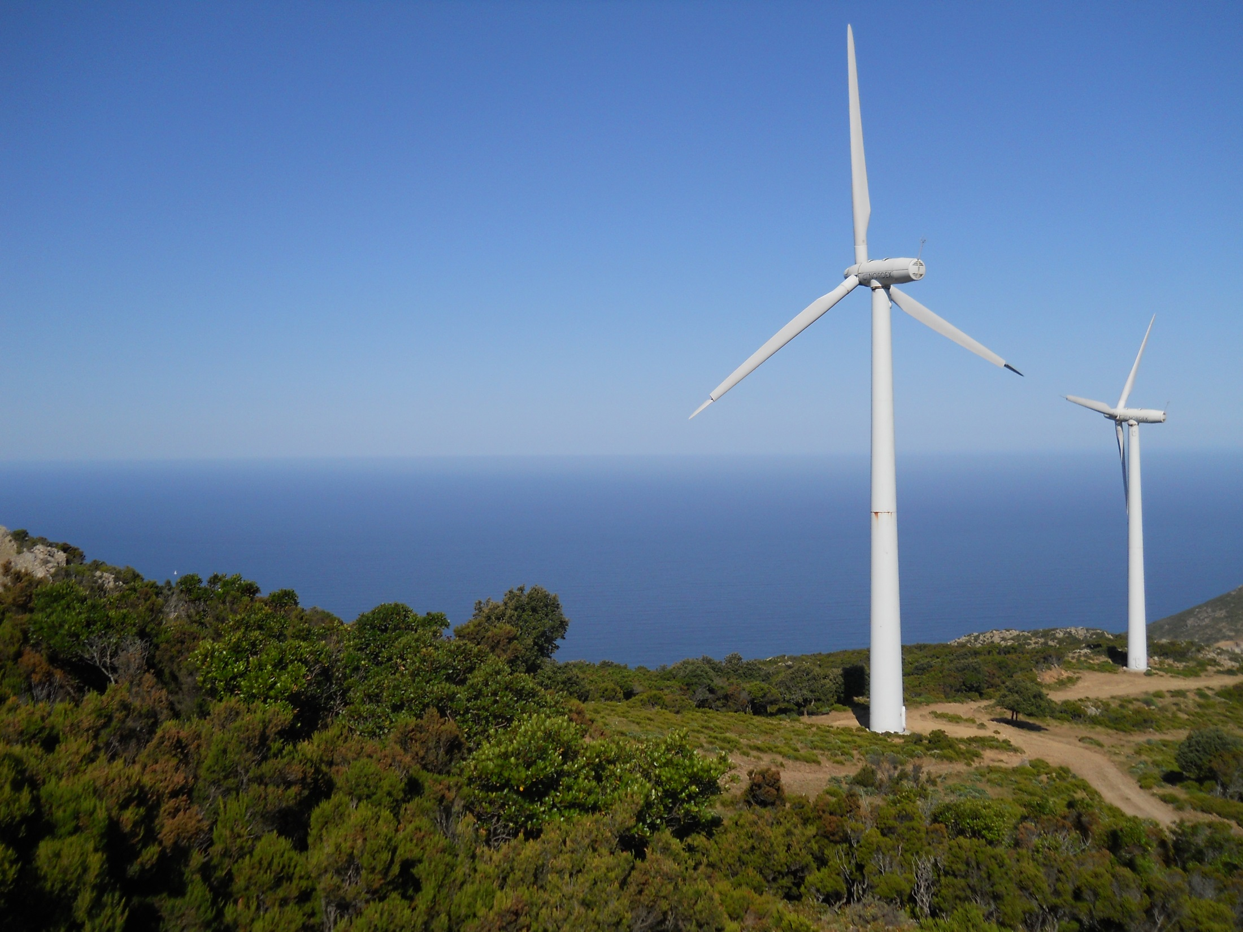


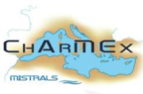


Total OH reactivity at Cape Corsica during summer 2013
Nora Zannoni
Valerie Gros, Roland Sarda-Esteve,
Sebastien Dusanter, Vincent Michoud, Vinayak Sinha

Slide 2
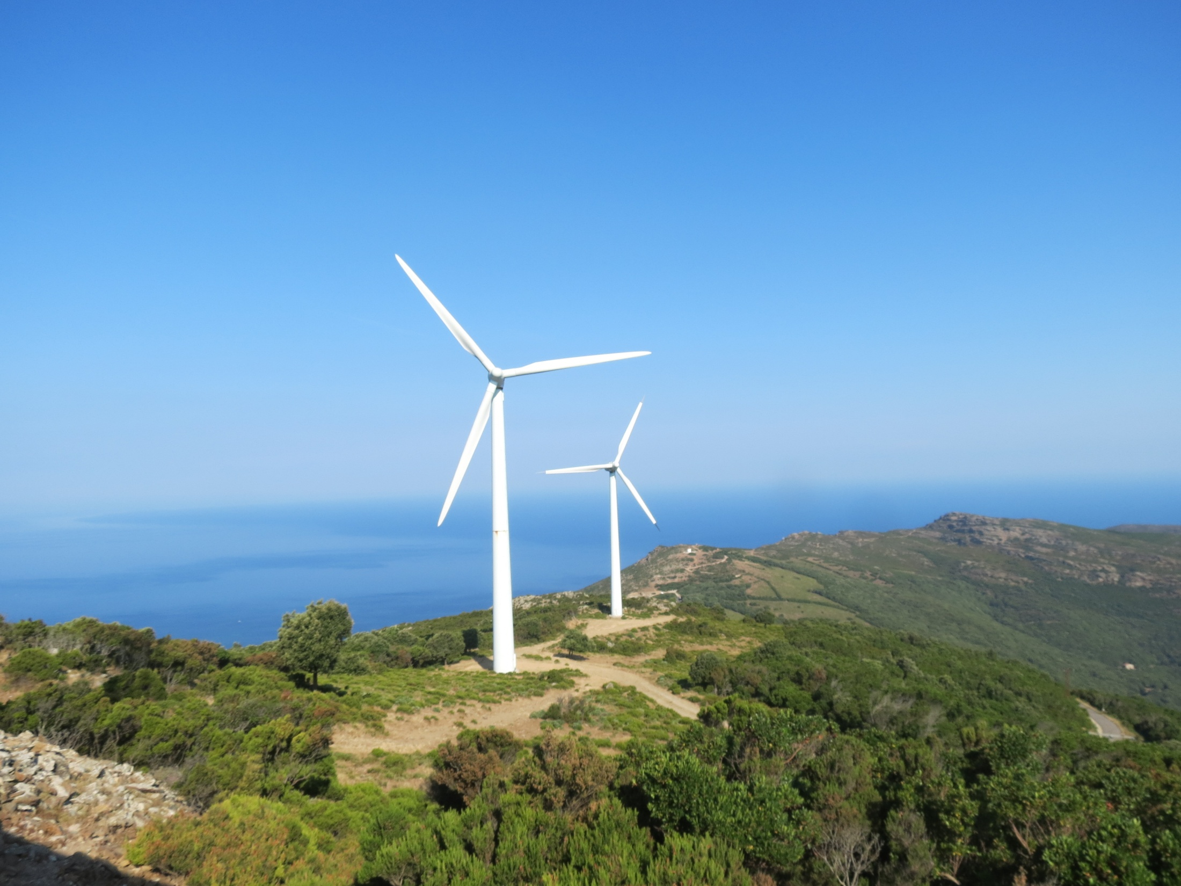
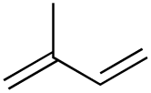

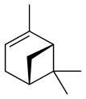
OH reactivity: meaning and importance
Total OH reactivity: OH loss for reactive compounds in atmosphere
Sources
Ozone
SOA
Sinks
∙OH
CH₄
CO
?
Total OH reactivity
OH budget
Unmeasured/ Unknown species

Slide 3
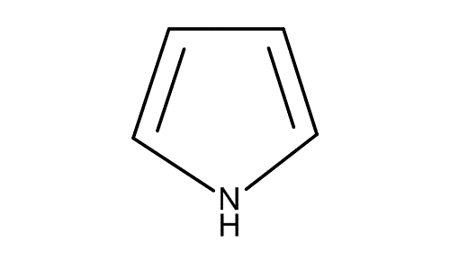
Measuring the Total OH reactivity:
The Comparative Reactivity Method (CRM)
(Sinha et al., 2008)
Glass reactor + PTR-MS
OH produced in situ
Pyrrole (m/z 68) reference compound
Competition between pyrrole and ambient reactive compounds
Pyrrole + ambient air
Pyrrole + zero air
C0
Lamp on
Wet N₂ in
C1
3 cm
To PTR-MS
C3
ambient air in
C2
Hg lamp
N₂ wet
N₂ dry
pump
14 cm

Slide 4
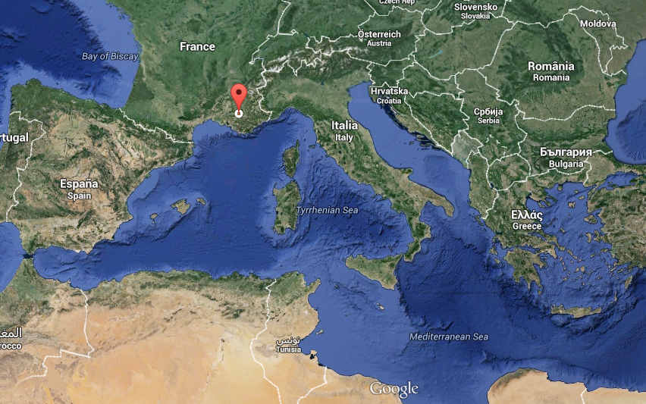
Site of study
Ersa- Cape Corsica

Slide 5
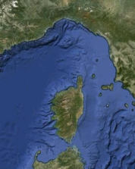
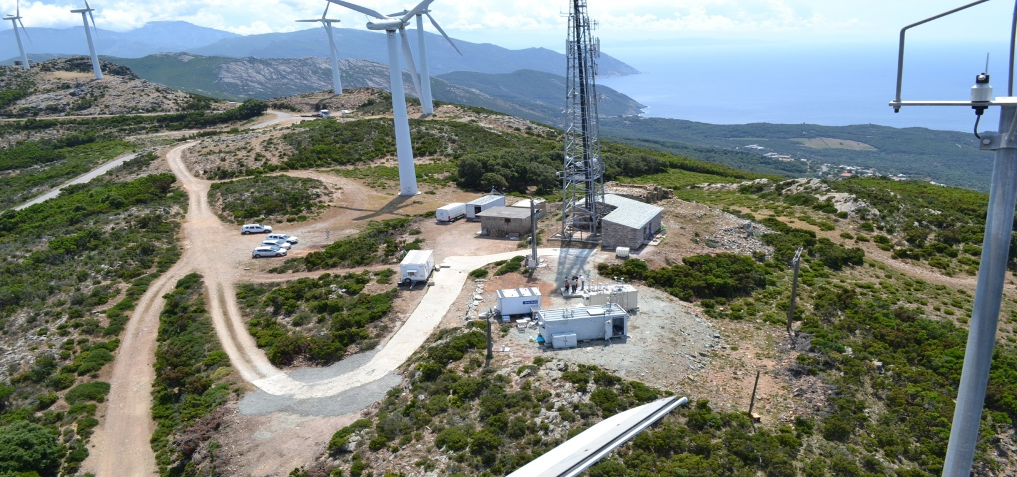
Cape Corsica monitoring station (42.97°N, 9.38°E, alt 533 m)
Goal: (i) Measure reactivity of air masses enriched in anthropogenic compounds and their
oxidation products;
(ii) Use missing reactivity as a tool for chemical closure
OH REACTIVITY
6 km
2.5 km
24/06/13
01/07/13
08/07/13
13/07/13
16/07/13
05/08/13
Installation
and tests
Plant experiment
Measurement campaign
Intercomparison with CRM MD
Courtesy of J.Sciare

Slide 6
Total OH reactivity
Total OH reactivity ranges between CRM LOD up to 20 s⁻¹
On average 5 s⁻¹ during the whole campaign
Diurnal profile
Peaks when temperature increases
Zannoni et al., in preparation + poster

Slide 7
Ancillary gas phase measurements
Species group | Species name
AVOCs (44) | methane, ethane, propane, n-butane, n-pentane, n-hexane, n-octane, n-nonane, n-undecane, n-dodecane, 2-methylpropane, 2-methylpentane, 2-methylhexane, 2,2- dimethylbutane, 2,2-dimethylpropane, 2,3- dimethylpentane, 2,4- dimethylpentane, 2,2,3-trimethylbutane, 2,2,4-trimethylpentane, 2,3,4- trimethylpentane, cyclohexane, ethylene, propylene, 1-butene, 2-methylpropene, 2-methyl-2-butene, 3-methyl-1-butene, 1,3-butadiene, trans-2-butene, cis-2-butene, 1-pentene, trans-2-pentene, cis-2-pentene, hexene, benzene, toluene, ethylbenzene, styrene, m-xylene, o-xylene, p-xylene, acetylene, 1-butyne, acetonitrile.
BVOCs (7) | isoprene, a-pinene, b-pinene, d-limonene, a-terpinene, b-terpinene, camphene.
OVOCs (15) | acetaldehyde, formic acid, acetone, acetic acid, mglyox, methyl ethyl ketone, propionic acid, ethyl vinyl ketone, butiric acid, nopinone, pinonaldehyde, methacrolein, methyl vinyl ketone, formaldehyde, methanol.
Others (3) | NO, NO_{2,} CO.
Daytime OH reactivity speciation
Nighttime OH reactivity speciation

Slide 8
Measured vs calculated reactivity
Transported air masses
origins
West Marine
East (Italy)
West Marine
South
East (Italy)
North (France)
South

Slide 9
Significant missing OH reactivity
West Marine
South

Slide 10
What can explain the missing OH reactivity?
Missing monoterpenes?

Slide 11
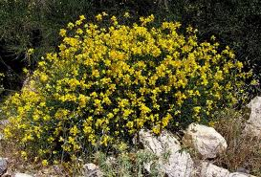
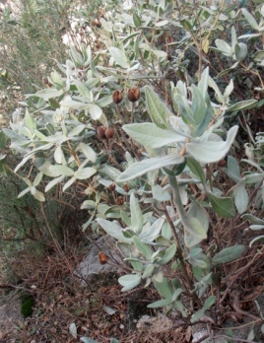
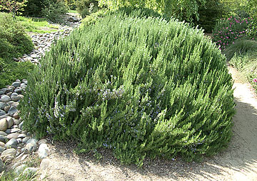
What can explain the missing OH reactivity?
Hypothetical influence of unmeasured monoterpenes expected for the Mediterranean
shrubland based on the missing monoterpenes concentration
Bracho-Nunez et al., 2011
…In part yes!

Slide 12
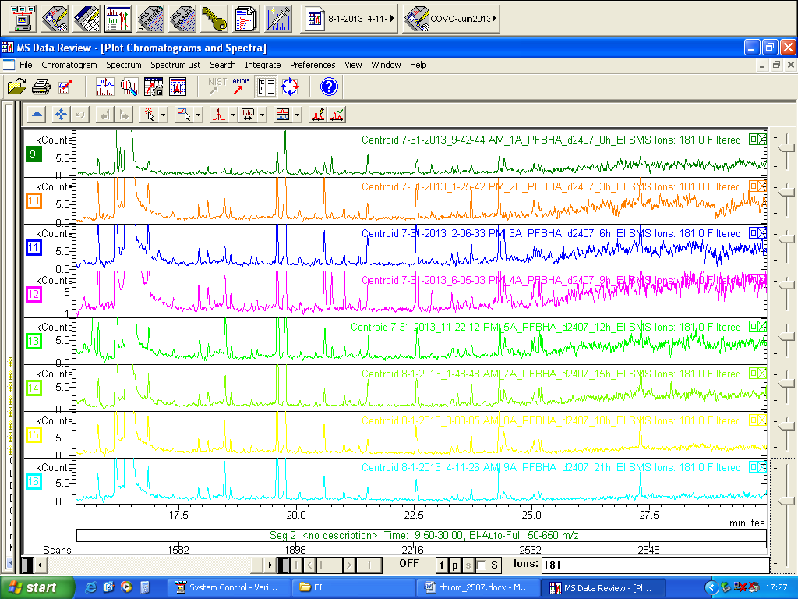
What can also explain the missing OH reactivity?
Chromatogram 24/07/13 mono and multifunctional carbonyls
0h
3h
6h
9h
12h
15h
18h
21h
Unmeasured OVOC’s? Probably also!
Courtesy of Agnes Borbon

Slide 13
Take home message(s):
- Total OH reactivity varied between LOD-20 s⁻¹
- Main influences from BVOCs
- Significant missing reactivity during 23-30/07:
-unmeasured MT
-OVOCs
-Research question not completely answered: few anthropogenic events and low loadings of anthropogenic pollutants
-Further investigate OVOCs

Slide 14
OH reactivity in biogenic environments:
High OH reactivity measured in the Mediterranean basin (even at a site not supposed to be “forested”)
Cape Corsica site very complex: budget not constrained, highest influence by BVOC’s…
...what about the OH reactivity at other remote and continental Mediterranean sites?

Slide 15

Acknowledgments:
LSCE: Bernard Bonsang, Cerise Kalogridis, Cyril Vuillemin, Eric Hamonou, Francois Dulac
Mines Douai: Stephane Sauvage, Vincent Michoud, Sebastien Dusanter, Nadine Locoge, Thierry Leonardis,
LAMP: Aurelie Colomb
LISA: Agnes Borbon
...and you for your attention!
ANY QUESTION?

Slide 17
Diurnal pattern
Diurnal pattern of total OH reactivity well resembles the one of total BVOC’s, with a maximum at 15.00

Slide 18
Species contributions for each period
West Marine
East (Italy)
West Marine
South
East (Italy)
North (France)
South

Slide 19
BVOC’s relative and absolute reactivity
BVOC | Day (%) | Night (%)
a-pinene | 7.69 | 20.73
b-pinene | 16.49 | 16.05
limonene | 12.03 | 11.36
camphene | 1.48 | 3.05
a-terpinene | 31.08 | 31.33
g-terpinene | 1.28 | 5.04
isoprene | 29.96 | 12.45

Slide 20
Atmospheric dynamics during ChArMEX

Slide 21
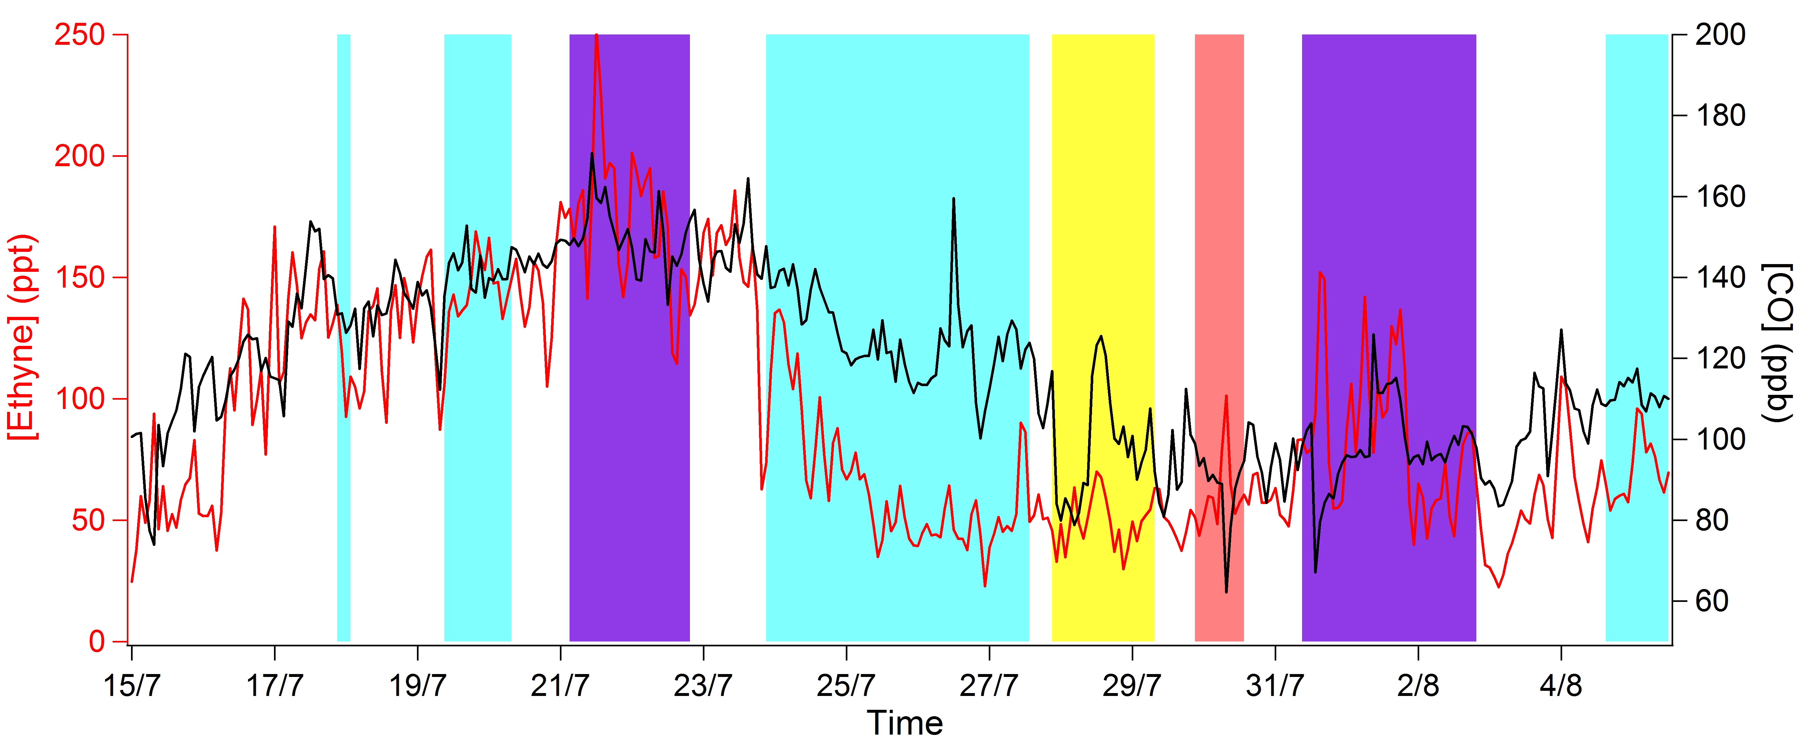
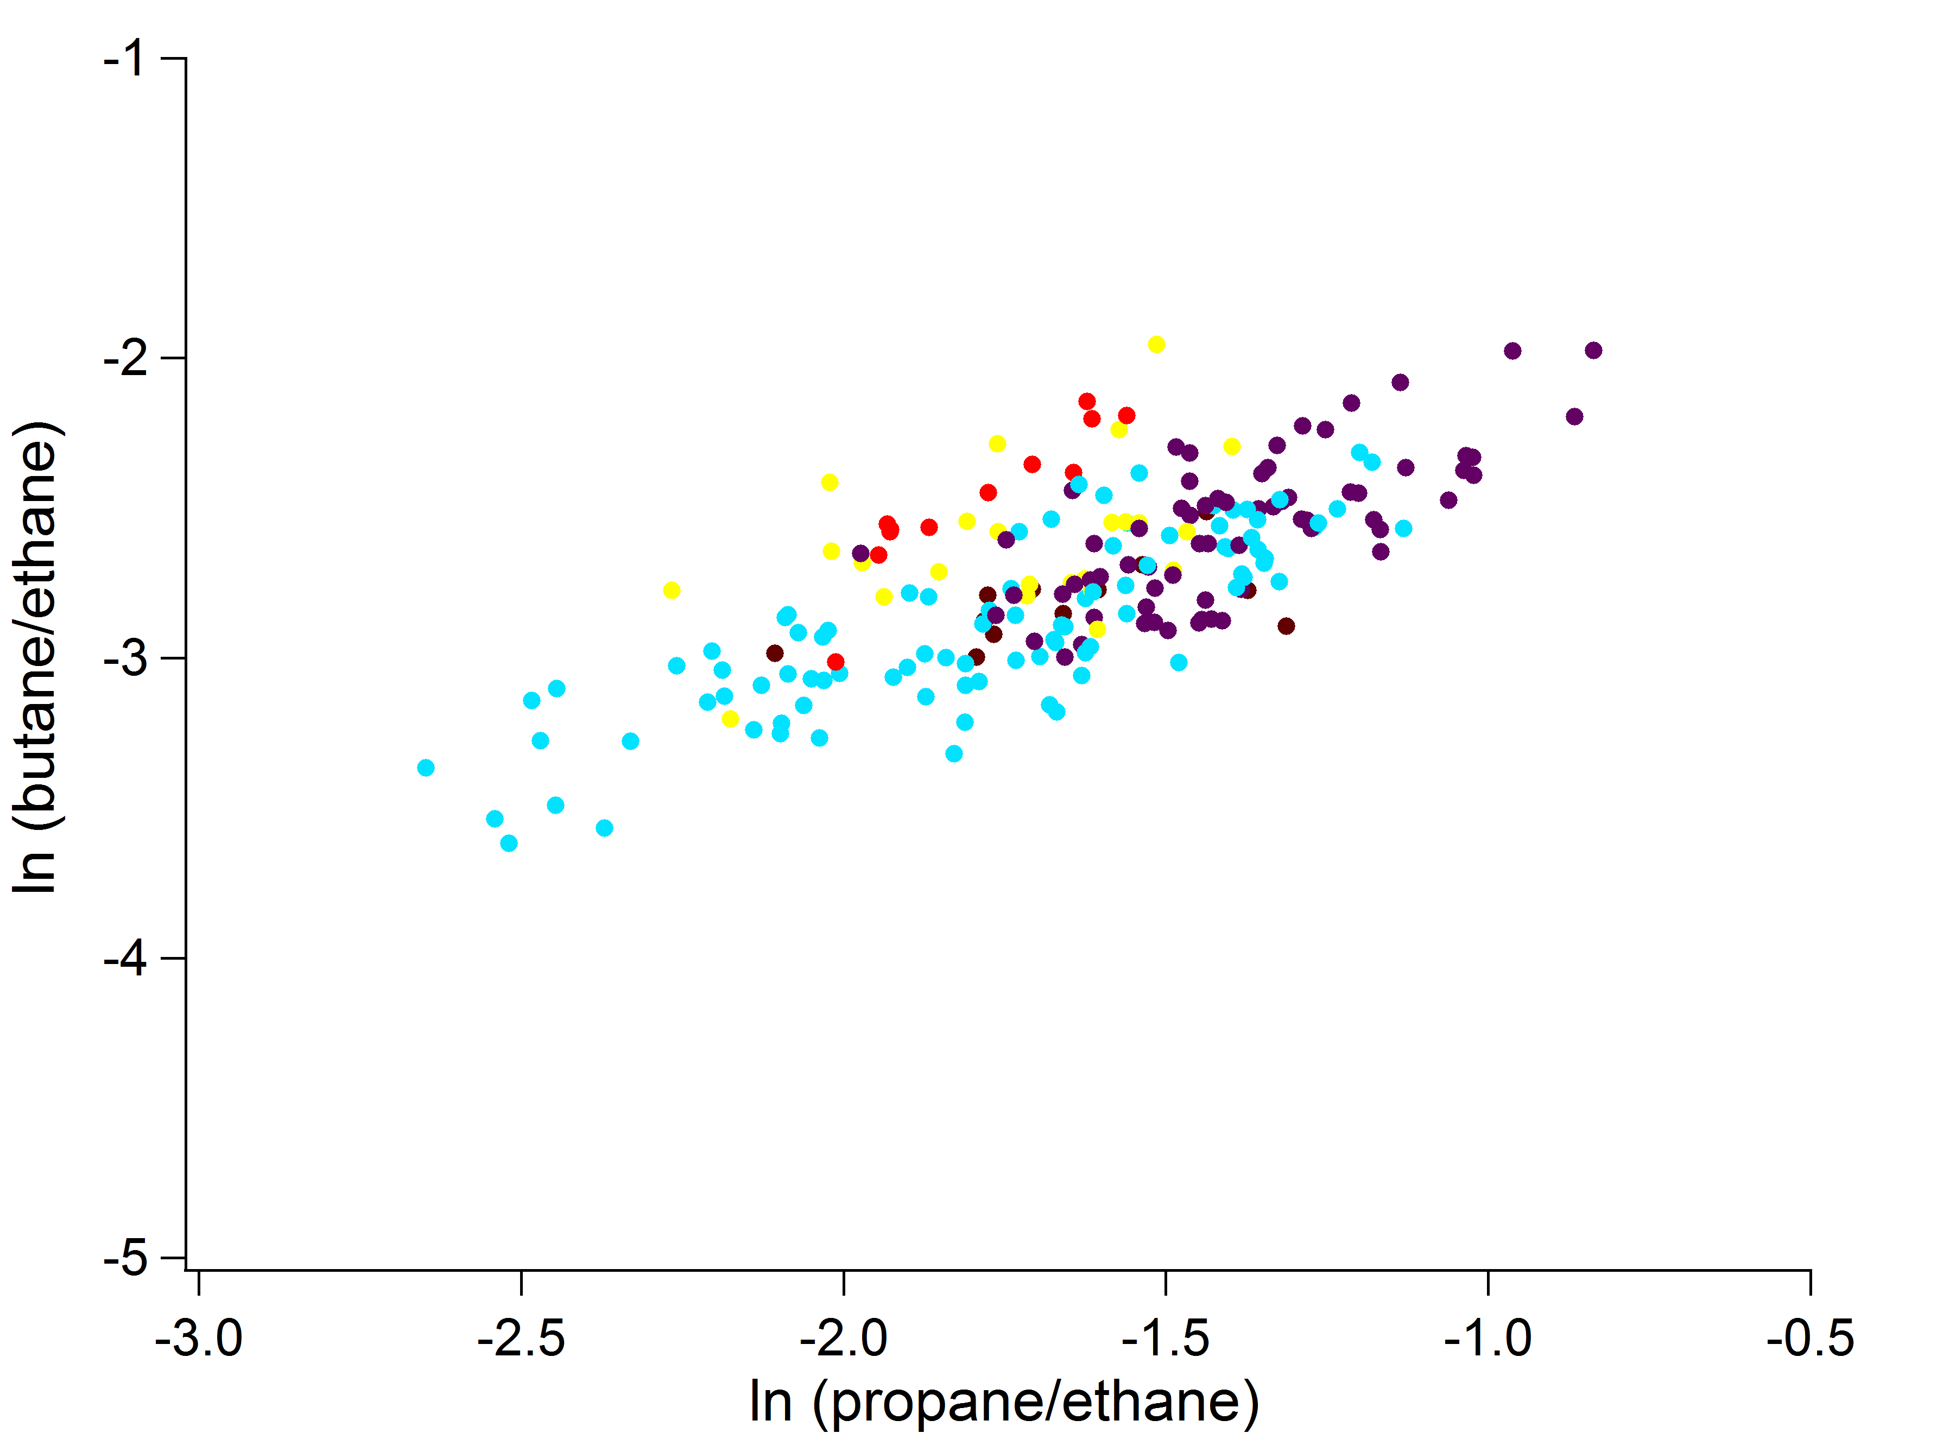
What can explain the missing OH reactivity?
North East
West
South
North-West
North west
South
North east (12-18h of processing)
OVOC’s? Probably also!
West (>36 h of processing)
Courtesy of Vincent Michoud
Notes:
Put graph vincent

Slide 22
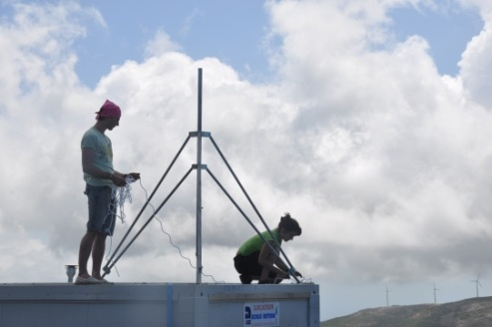
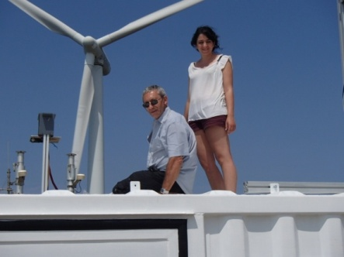
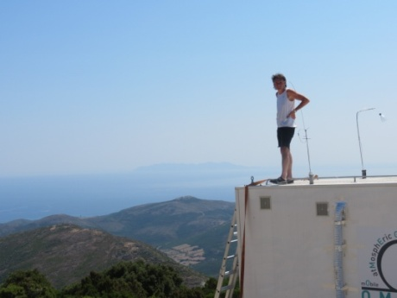
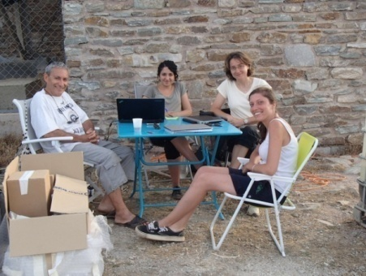
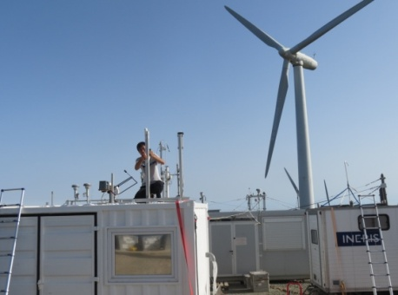
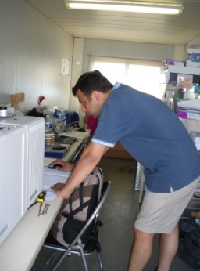
OH reactivity from gas phase measurements
Instrument | Measured species
GC-FID | AVOC’s C₂-C₁₃ a-pinene, b-pinene
PTR-TOF-MS | CH₃OH,CH₃CN, CH₃CHO, HCOOH, CH₃COOH, CH₃COCH₃, MVK+MACR, MGLYOX, MEK, CH₃CH₂COOH, EVK, CH₃CH₂CH₂-COOH, nopinone, pinonaldehyde
GC-MS | Limonene, camphene, a-terpinene, g-terpinene
NOx analyser | NO, NO₂
AEROLASER (Hantzsch method) | HCHO
Picarro | CH₄, CO

