Slide 1
Monsoon scale interactions
Swadhin Behera
JAMSTEC

Slide 2
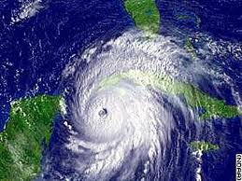
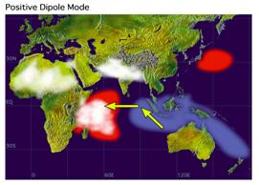
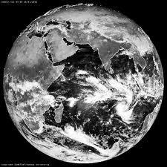
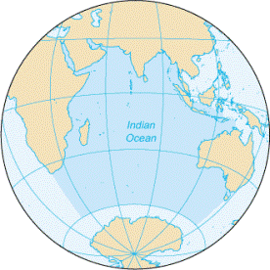
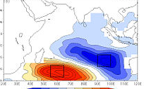
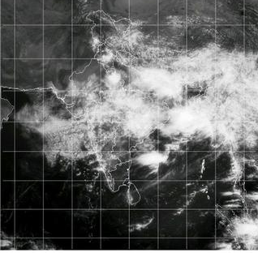
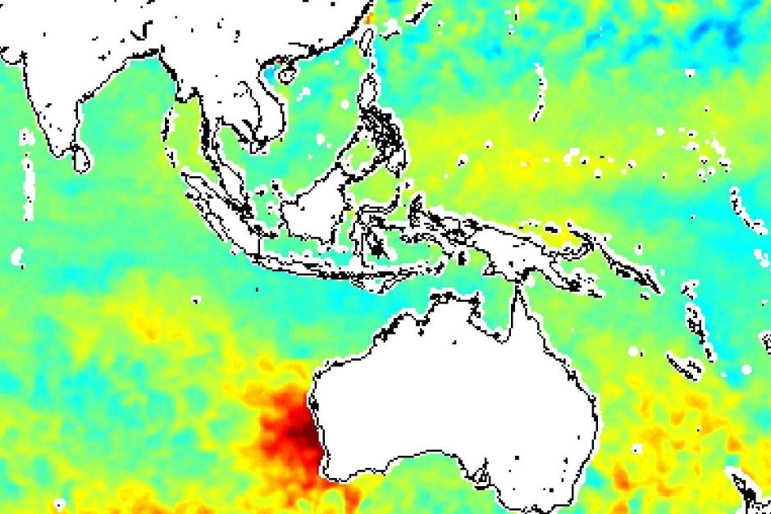
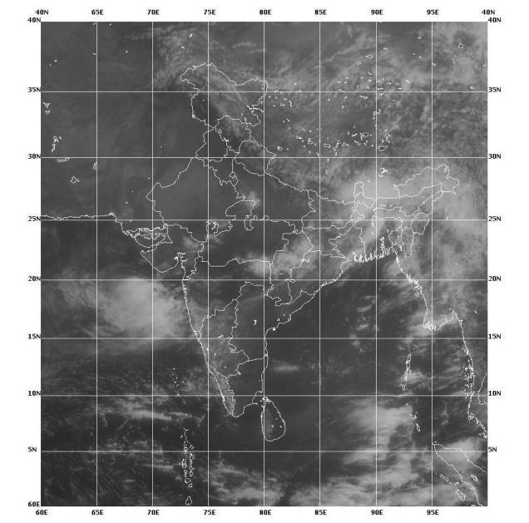
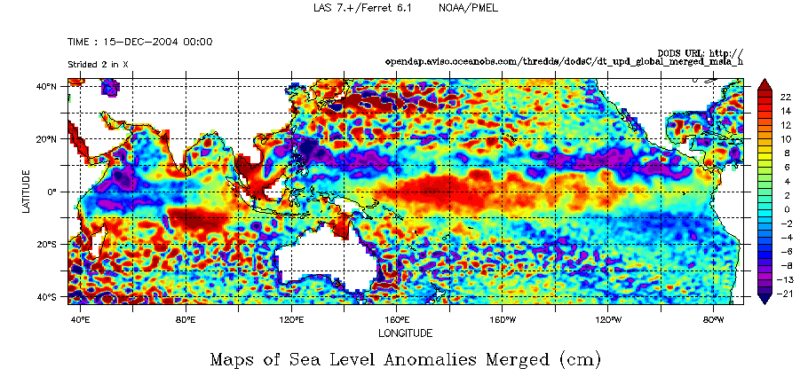
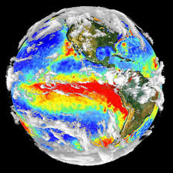
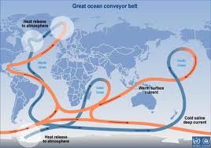
Indian Ocean Dipole
Cyclone
MJO/ISO
Indian Ocean Subtropical Dipole
Weather and climate variations linked to Indian monsoon
Active monsoon
Ningaloo Nino
Break monsoon
El Nino Modoki
El Nino
Indonesian Throughflow

Slide 3
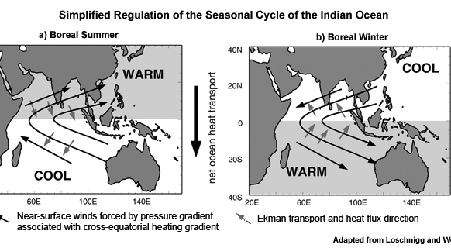
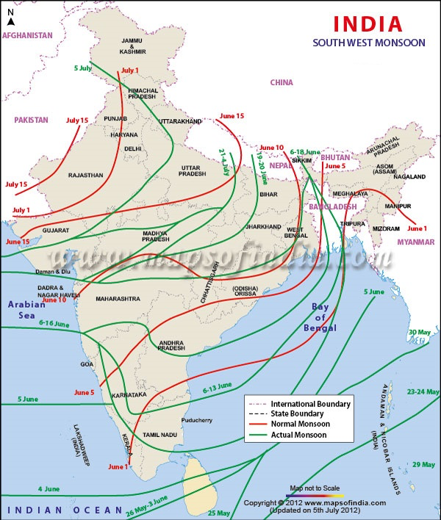

Slide 4
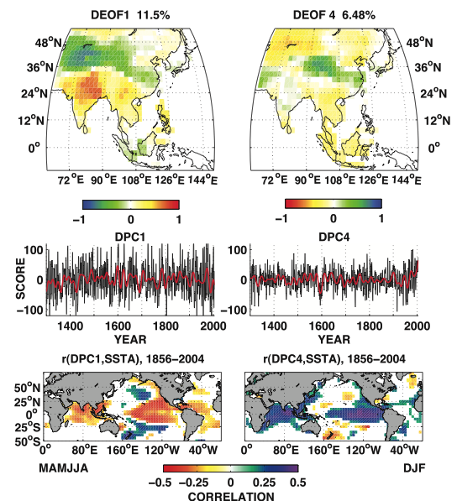
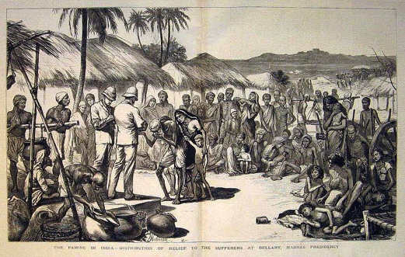
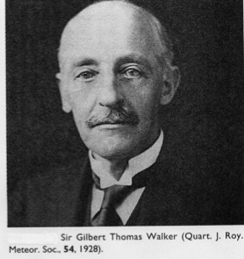
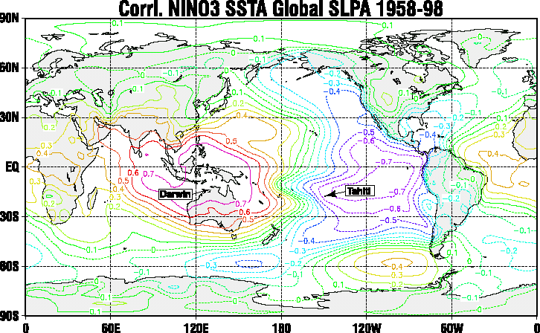

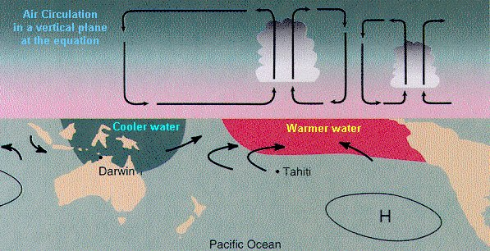
Mega-Droughts of 19th and 20th Century
Pan Pacific drought patterns during the Great Droughts of 1876-1878 and 1918-1919
Famines of India
Years No. of Est. Deaths in famines Millions
1850–1875 6 5
1875–1900 18 26
Discovery of Southern Oscillation & ENSO
Cook et al. 2010, Science
Notes:
(left) Spatiotemporal patterns of the MADA since 1300 C.E. Distinct empirical orthogonal function (DEOF) (25) analysis of the MADA since the late Medieval period reveals five distinct modes, two of which are shown here and the remainder in (1). Middle panels show the time series expansion (DPCs, distinct principal components) of the corresponding spatial modes in the top row. In the bottom row, Pearson correlations with SSTA (1) and DEOF/DPC1 are simultaneous with the monsoon and premonsoon season (MAMJJA), whereas the SSTA patterns for DEOF/DPC4 are for the previous winter (DJF) season. Only correlation values significant at 95% confidence are shown.
(right) Pan Pacific drought patterns during (A) the Great Drought (1876 to 1878) (18) and (B) the 1918 to 1919 ENSO event (30). During the Great Drought (A), PDSI values are strongly negative (terrestrial, brown-green colormap) over south and Southeast Asia and the Great Basin of North America. Pluvial conditions are reconstructed over the Mexican sector of the North American monsoon region, the Pacific Northwest, and the Tibetan Plateau. The post–World War I drought (B) shows pluvial conditions over southern North America and drought to the North, whereas in Asia drought dominates in India and Southeast Asia and southeastern China. Both trans-Pacific Basin drought patterns were associated with a strong El Nino event (°C, marine, blue-red colormap) with characteristic positive SST anomalies in the eastern equatorial Pacific (1); however, the 19th-century drought has strong positive anomalies over the tropical Atlantic and North Pacific anomalies characteristic of the positive phase of the PDO. The early– 20th-century drought shows cold anomalies in both the Atlantic and North Pacific.

Slide 5
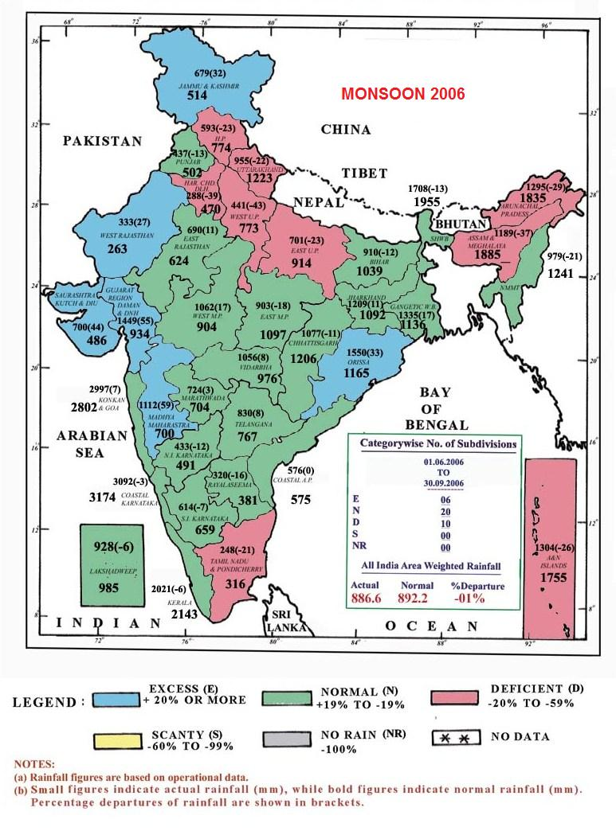
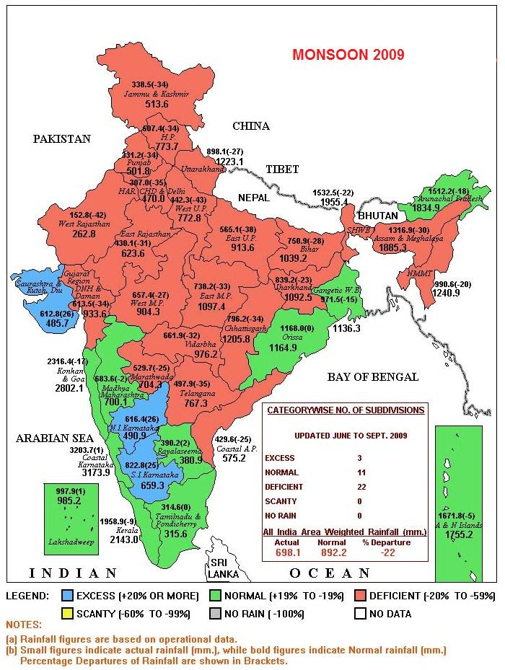
Seasonal Monsoon Rainfall in 2006 and 2009
Source: India Meteorological Dept.

Slide 6
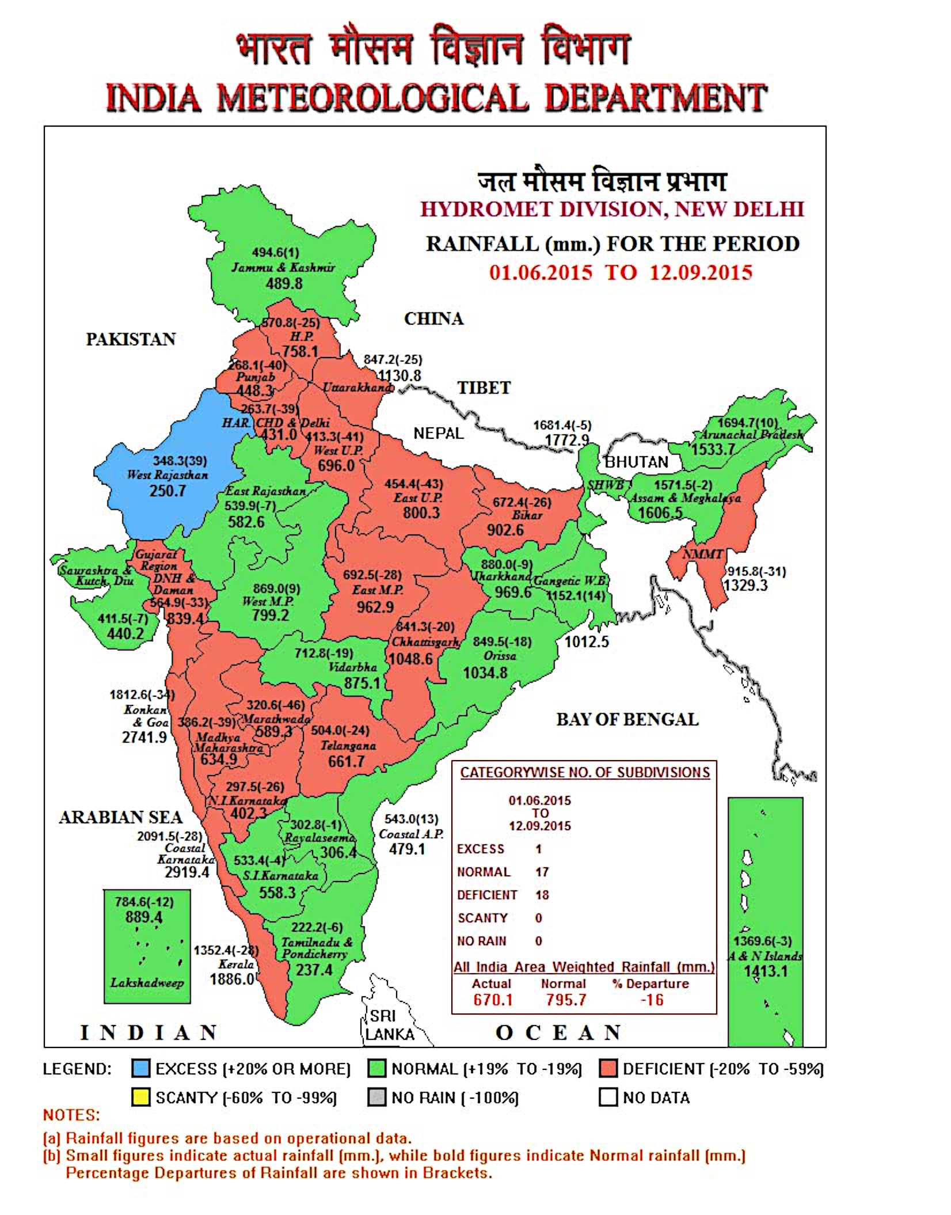

Slide 7
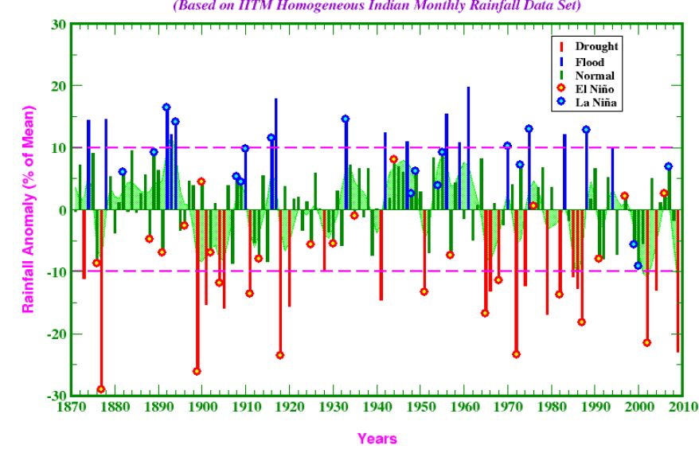

Slide 8
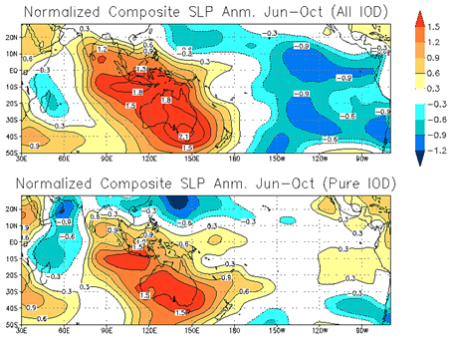
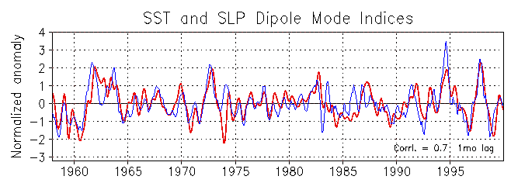
The Zonal Sea Level Pressure Gradient Caused by IOD and its role in Southern Oscillation and Indian summer monsoon rainfall: From Observation and NCEP-NCAR Reanalysis data
Behera and Yamagata 2003

Slide 9
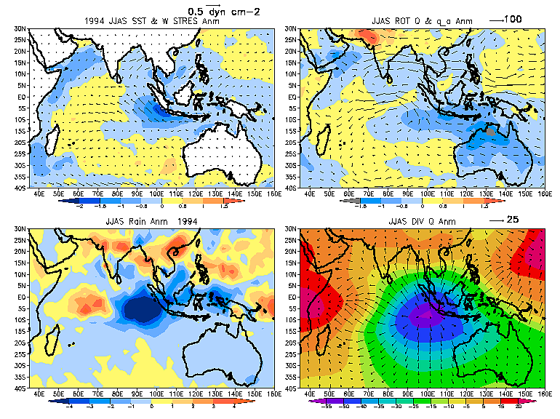
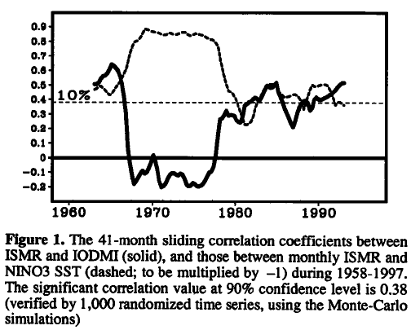
IOD influences the Indian summer monsoon rainfall.
Moisture transports from the eastern Indian Ocean strengthen the monsoon trough giving rise to abundant rainfall over India and several parts of Southeast Asia.
Behera et al. 1999
ISMR-Nino3 Inv. Correlation
IOD-ISMR relation became stronger when ENSO-ISMR relation became weaker
ISMR-IOD Correlation
Ashok et al. 2001

Slide 10
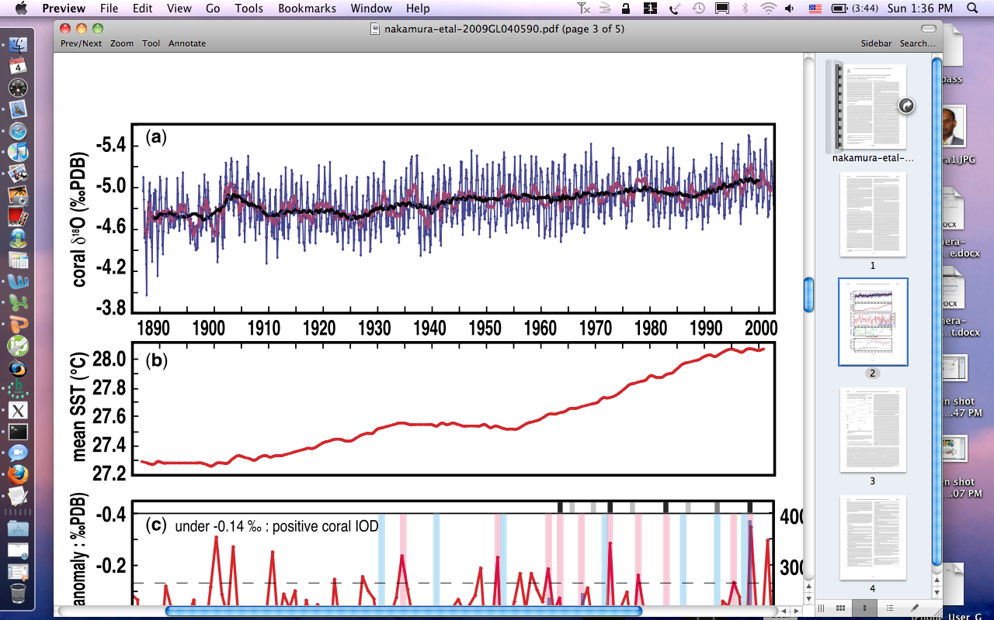
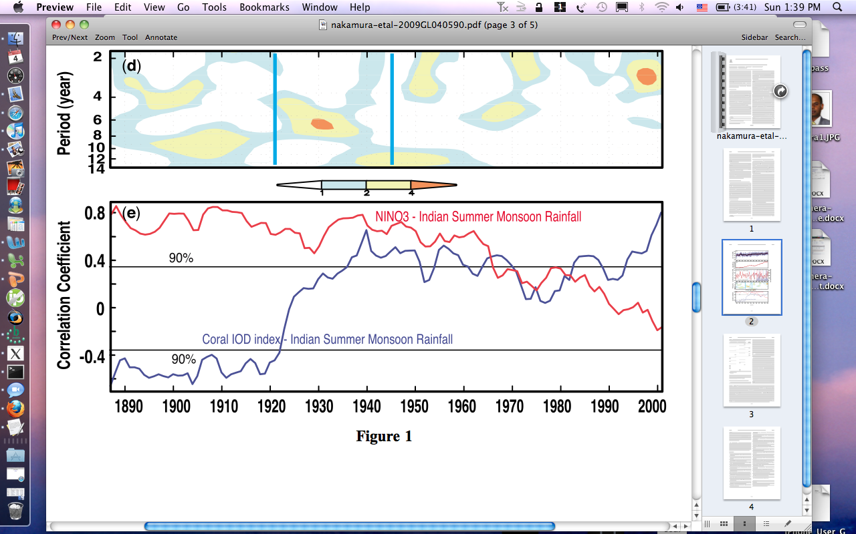
Change in IOD periodicity over the study period
the first half of 20th century 8-14y periodicity strong IOD with 7-8y periodicity in 1930s | mode shift around 1950s | the latter half of 20th century 2-3y periodicity strongest IOD from 1990s

Slide 11
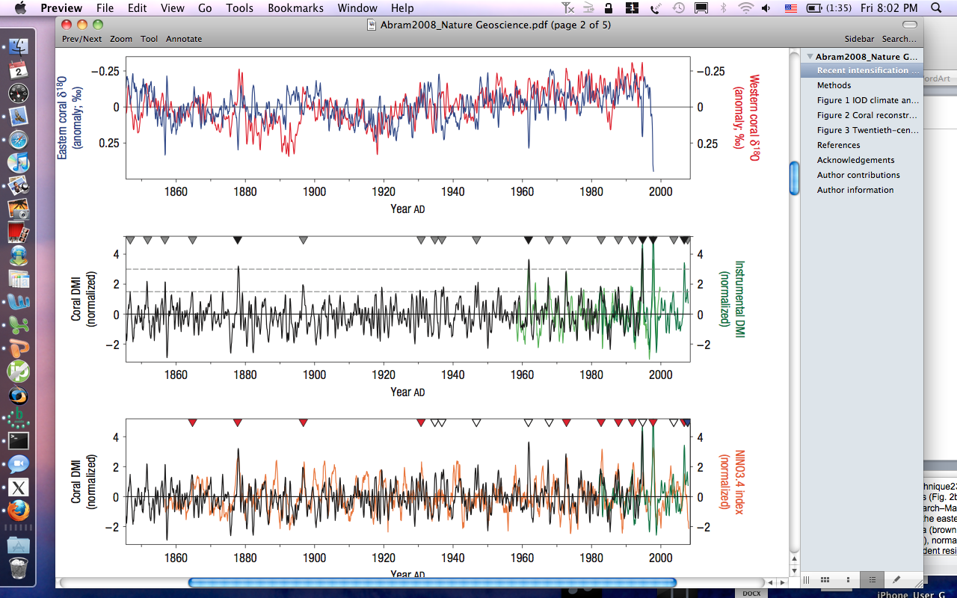
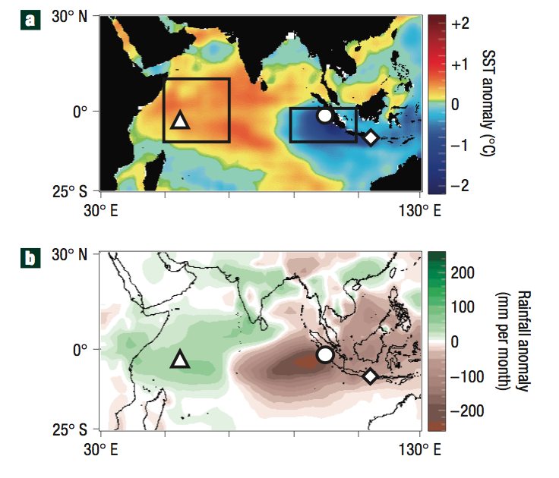
Historical IOD variability from Coral records ofother locations in eastern and western Indian ocean
Abram et al. 2009
Notes:
rSaji = 0.82, rReynoldsv2 = 0.92, rOLR = −0.87, p < 0.0001) (refs 1,21),
Nino (rannual = 0.44, rJuly–Nov. = 0.51, p < 0.0001; Fig. 2c),

Slide 12
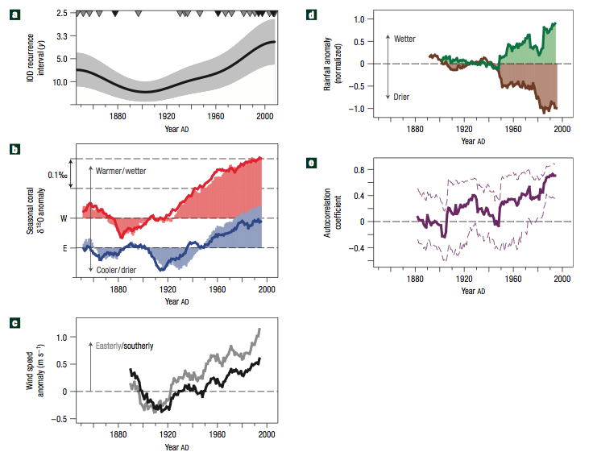
Twentieth-century intensification of the IOD
Strengthened upwelling in the eastern IOD sector implies that there has been an intensification of the southeasterly trade winds along the coast of Sumatra: This is consistent with theories that preferential greenhouse warming of landmasses will strengthen alongshore winds.
The influence of twentieth-century warming on long-term changes in the Walker circulation over the tropical Pacific may have also enhanced eastern IOD upwelling. Twentieth-century weakening of the Walker overturning cell has been accompanied by an eastward displacement of convection over Indonesia and shoaling of the thermocline in the Indo-Pacific Warm Pool.
Abram et al. 2008
Notes:
Figure 3 Twentieth-century intensification of the IOD. a, Occurrence rate of IOD events (black curve) using a Gaussian kernel technique23 with 90% confidence interval (shading) from 2000 bootstrap simulations. The triangles show moderate (grey) and strong (black) IOD events (Fig. 2b). b, 25 year moving averages of eastern (blue) and western (red) coral δ18O during the IOD season (July–November; lines) and non-IOD season (March–May; shading), relative to pre-1940 means. c, 25 year moving averages of IOD-season zonal (grey, inverted) and meridional (black) wind speed30 over the eastern IOD upwelling region (90–104◦ E, 0–10◦ S), relative to pre-1940 means. d, 25 year moving averages of IOD-season rainfall in western Indonesia (brown; five stations in 95–105◦ E, 0–10◦ S with >50 years coverage) and eastern Africa (green; 15 stations in 35–45◦ E, 5◦ N–5◦ S with >80 years coverage), normalized relative to the common 1910–1940 interval (Global Historical Climatology Network v2β). e, 25 year moving correlation between ENSO-independent residuals of the IOD and Asian monsoon (solid curve), with a 95% Monte Carlo confidence window (dashed curves). The twentieth-century increase in IOD occurrence rate (a) has been accompanied by an IOD-season strengthening of the eastern upwelling (b) and southeasterly wind speeds off Sumatra (c), divergent IOD-season rainfall trends across the tropical Indian Ocean (d) and strengthening of direct, positive IOD–monsoon interaction (e).

Slide 13
Mode shift in IOD
The mode shift in IOD variability is related more to the internal processes in the Indian Ocean. The warming trend in the western Indian Ocean has raised the mean SST to a threshold value that encourages tropical convections. This has favored the atmospheric convection to shift to the west.
Nakmura et al. 2009, GRL

Slide 14
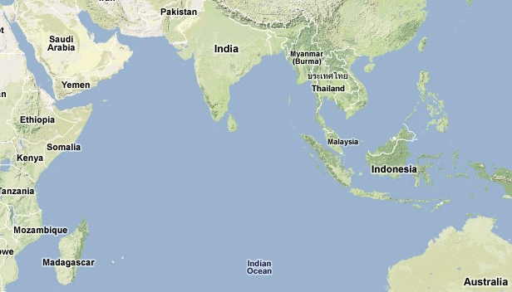
Schematic of the El Nino and pIOD influences

Slide 15
Historical records of SST Dipole Index and Rainfall Dipole Index
The 2006-08 consecutive positive IODs are rare events. Successive positive IOD events have evolved only in 1913 and 1914.
The 2007 IOD was associated with a La Nina, which is another rare event.
Behera et al. 2008;GRL

Slide 16
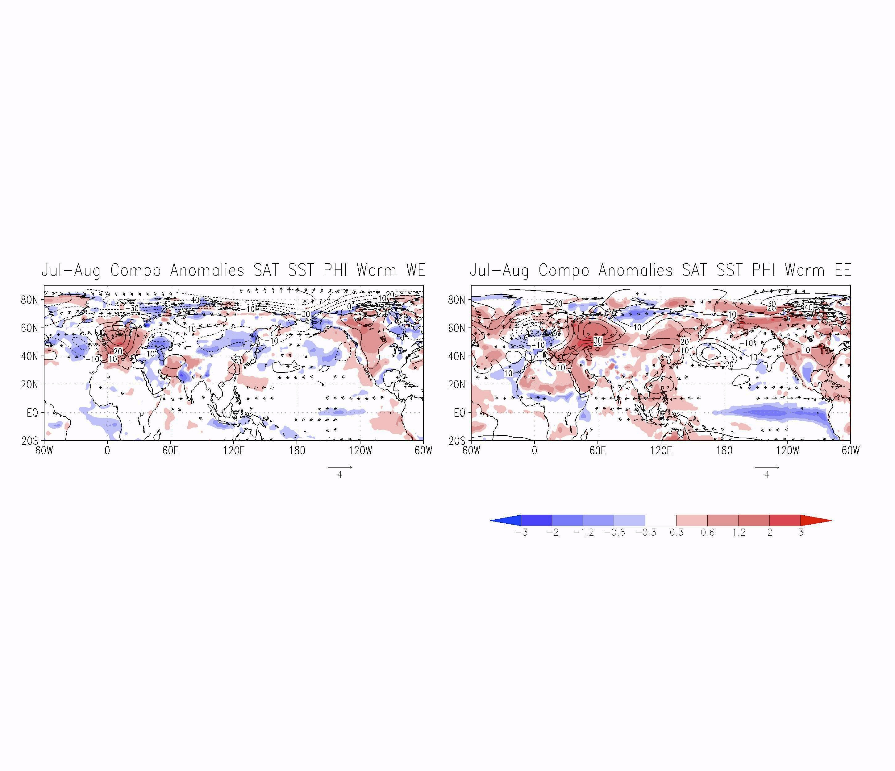
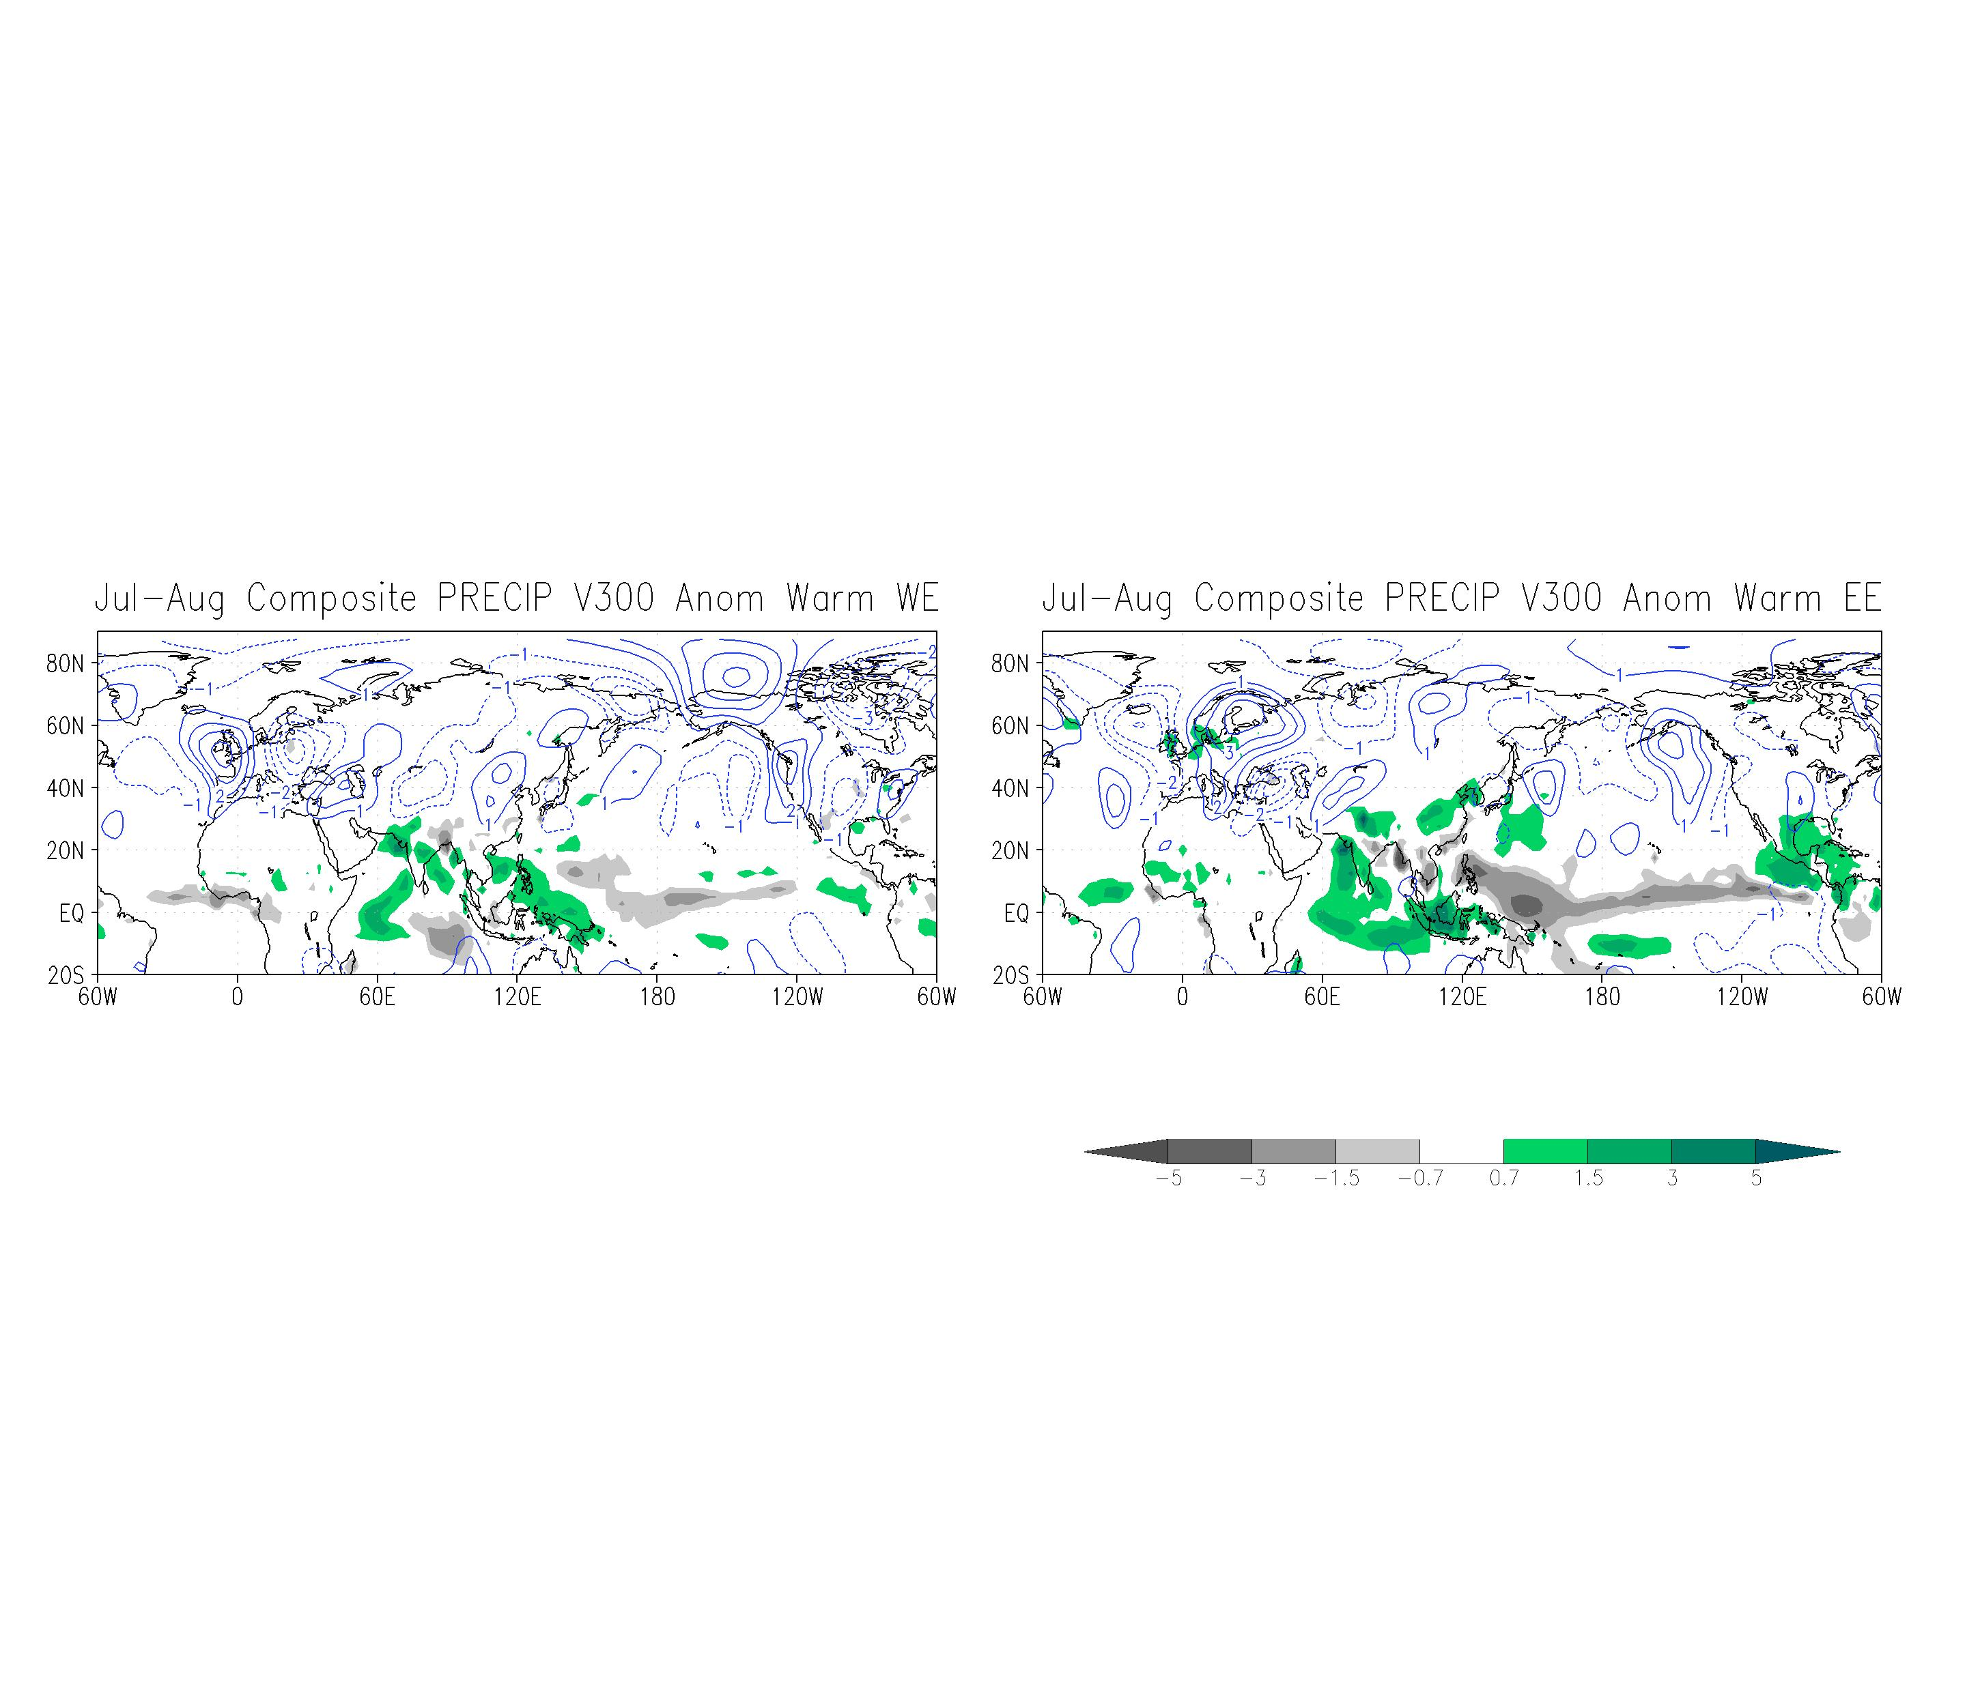
Western European Hot Summer Composites

Slide 17
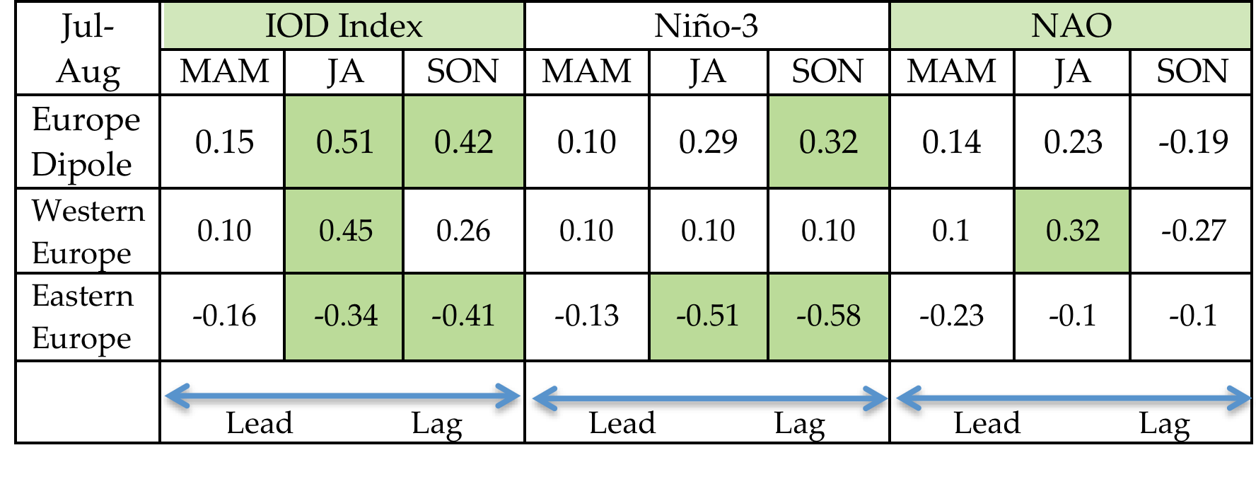
Relationship of the European Dipole Index with Other Climate Modes
Behera S.K, J.V. Ratnam, Y. Masumoto and T. Yamagata, (2012) Origin of Extreme Summers in Europe – The Indo-Pacific Connection, Climate Dynamics.

Slide 18
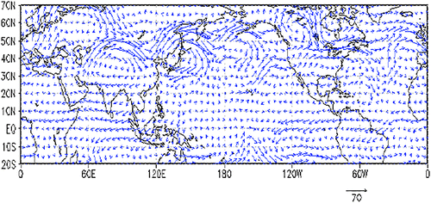
Pathway Connecting the Monsoonal Heating to the Rapid Arctic Ice Melt
Flow field (m s⁻¹) at the 300-hPa level (roughly 9 km MSL) for 5 Aug 2010, a single-day map during the Pakistan flood event.
Krishnamurti et al. 2015

Slide 19
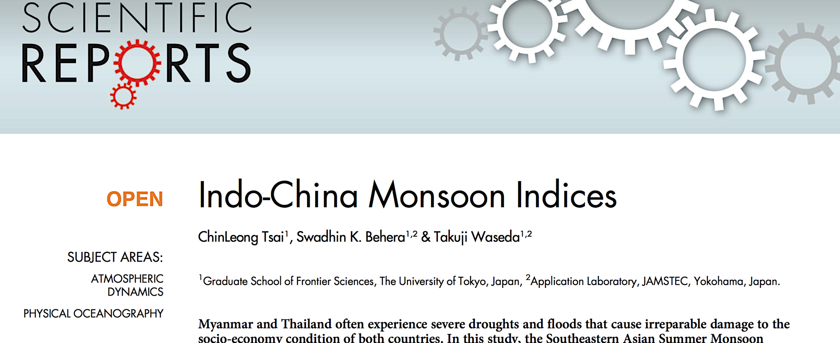
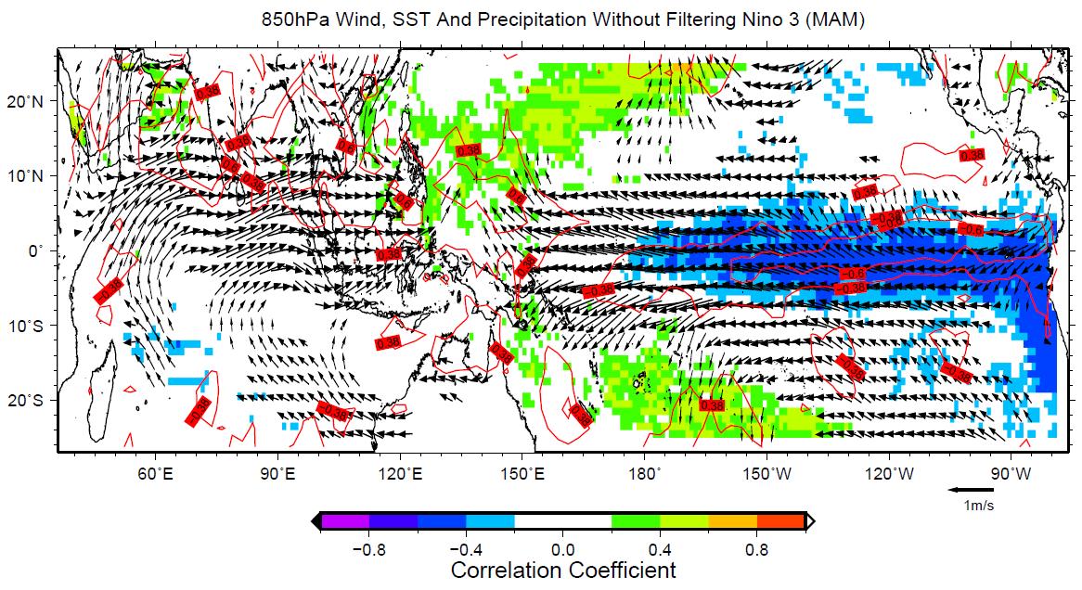

Slide 20




Slide 21
Temporal anomaly correlation between the observed JJAS rainfall and the ensemble means of the individual models. Correlations > 0.2 are shaded with negative correlations < -0.2 hatched or stippled.
Kulkarni et al. 2012

Slide 22
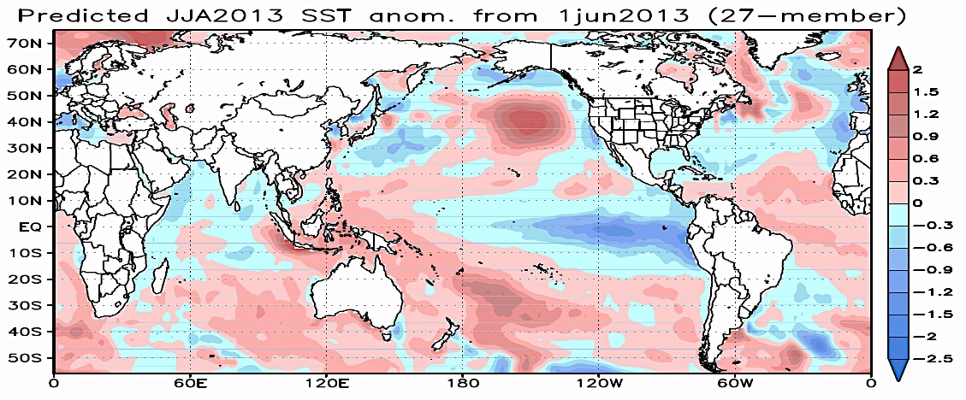
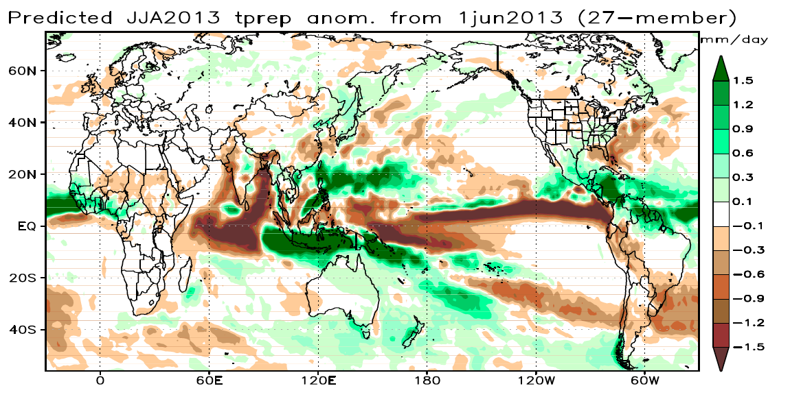
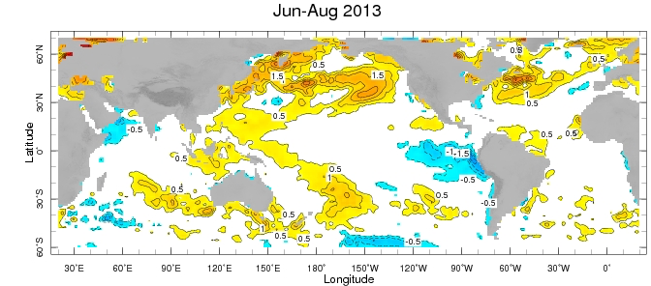
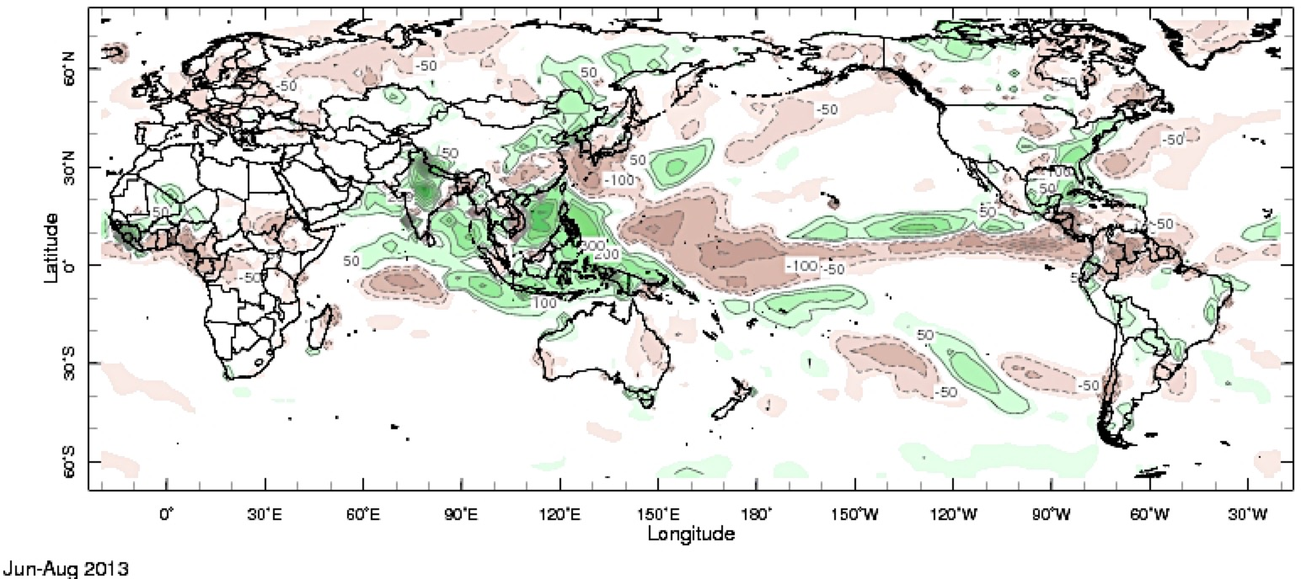
SINTEX-F SST & Rain Anomalies
SST
Predictions
Rain
Observations

Slide 23
ACC for 3-month leading forecast (SST&TEMP2 1984-2010)
DJF prediction from Nov. 1st
MAM prediction from Feb. 1st
JJA prediction from May 1st
SON prediction from Aug.1st
9~27 members

Slide 24
ACC for 3-month leading forecast (Precipitation 1984-2010)
DJF prediction from Nov. 1st
MAM prediction from Feb. 1st
JJA prediction from May 1st
SON prediction from Aug.1st
9~27 members

Slide 25
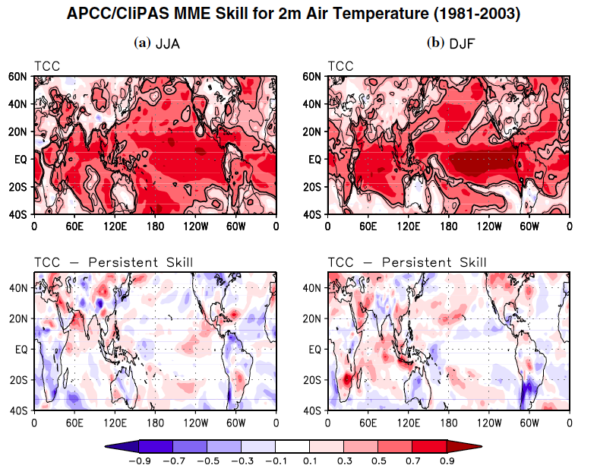
April Initiation
Oct. Initiation
Wang et al. 2009

Slide 26
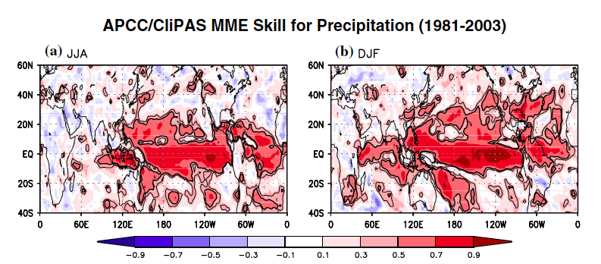
Wang et al. 2009

Slide 27
New Challenges in Regional Rainfall Predictions
Phase and amplitude of intra-seasonal oscillations and interactions with monsoon and other climate modes
Decadal change in the Indian Ocean and its influence on IOD predictions and IOD teleconnection.
Predictions of subtropical and mid-latitude climate modes and regional climate variations such as Benguela Nino, Ningaloo Nino ……
Improvements in model resolutions, processes and biases…

Slide 28
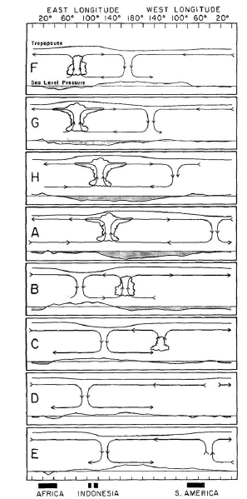
Fundamental Dynamics of MJO
Planetary scale selection
Li and Zhou (2009) suggested that it arises from nonlinear heating and PBL – free atmosphere coupling.
Why eastward propagation?
Hsu and Li (2012) indicated that it is attributed to the zonal asymmetry of PBL moisture.
What initiates MJO convection in WIO？
Zhao, Li, et al. (2013) suggested that it is caused by moisture advection due to downstream Rossby wave forcing/mid-latitude wave activity flux
MJO multi-scale feature？
Liu and Wang (2012) suggested that CCKW and W-propagating IGW are important for MJO amplification.
Zhou and Li (2010) and Hsu and Li (2011) showed that there are two-way interaction between MJO and synoptic-scale variability.
0day
5day
11day
16day
22day
Eastward
28day
34day
40day
From Madden and Julian (1972)

Slide 29
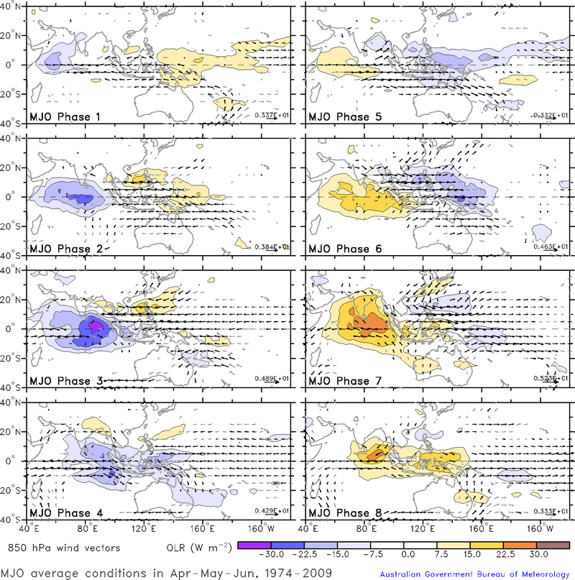
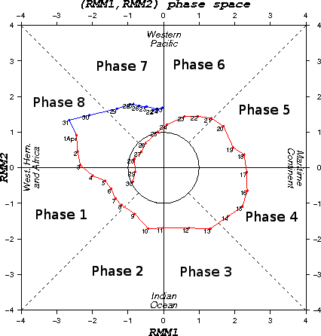
Blue shading of anomaly Outgoing Longwave Radiation (OLR) indicates active or enhanced tropical weather
Emperical Index of MJO (WH04)
Notes:
Wheeler and Hendon 2004, Blue indicate the regions of enhanced convection, and orange the regions of suppressed.
There are the eastward propagating of the large cloud system with the speed of 5 – 10 m/s.

Slide 30
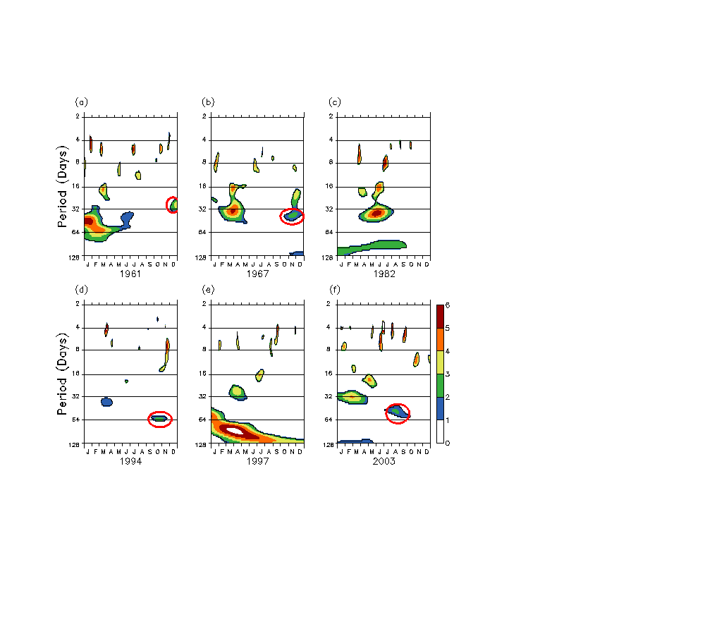
Intra-seasonal disturbances responsible for terminations of some of the IOD events
30-60 days Oscillations are observed in Equatorial Zonal Wind (70-90E and 5S-5N) prior to the termination of IOD
1961
1967
1982
1994
1997
2003
Absence of ISD activity
Rao and Yamagata 2004

Slide 31
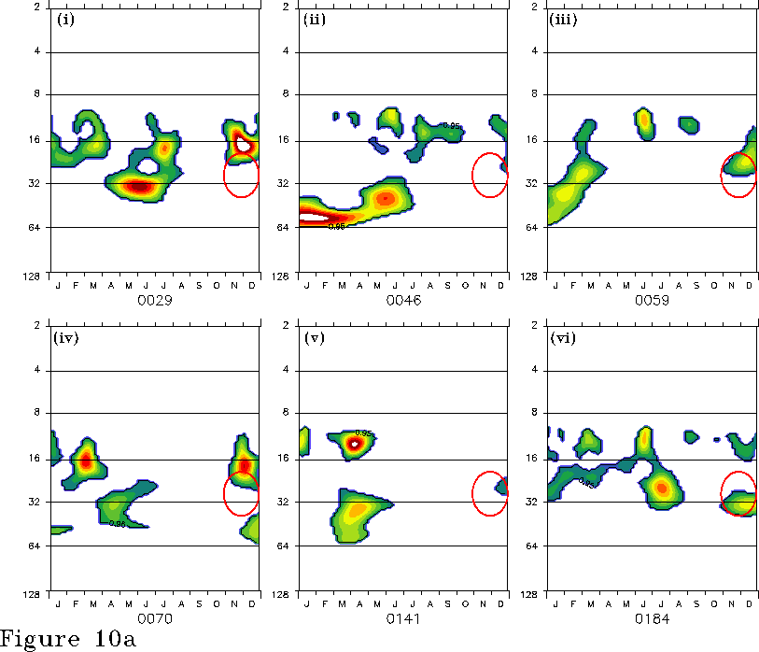
Terminations related to IODs In SINTEX-F
Rao et al. 2006

Slide 32
The termination process
Clear sky conditions in the eastern Indian Ocean
weakening/reversal of south easterlies along Sumatra/Java coast due to normal seasonal cycle
Sudden burst of westerly winds due to MJO
downwelling Kelvin wave
initial warming/ weakening of cooling due to incoming solar radiation
deepening of thermocline
deepening of thermocline
further warming
Pure/aborted
IOD events
IOD events
concurrent with ENSO
termination of IOD event

Slide 33
MJO vs BSISO
Boreal winter mode
30-60-day time scale, (RMM) index (Wheeler and Hendon 2004
Dominant eastward propagation along the equator
Madden-Julian Oscillation
(MJO)
Boreal Summer Intraseasonal Oscillation (BSISO)
Boreal summer mode
30-60-day & biweekly time scale
northward/northwestward propagation
Affecting monsoon onsets (Wang and Xie 1997), active/break phases of monsoon (Annamalai and Slingo 2001), monsoon seasonal mean (Krishnamurthy and Shukla 2007)
Possible source for seasonal climate predictability for precipitation and index (Lee et al. 2010, 2013) and extratropical atmospheric circulation (Ding and Wang; Lee et al. 2011)
From MJO working group website

Slide 34
Canonical Northward Propagating BSISO1 Mode
BSISO1, consisting of EOF1 and EOF2, represents the canonical northward and north-eastward propagating ISO over the ASM region during the entire warm season from May to October with quasi-oscillating periods of 30-60 days in conjunction with the eastward propagating MJO.
OLR (shading) and 850-hPa Wind
Spatial Characteristics: Rossby wave like pattern with a northwest to southeast slope. Out-of-phase relationship of convection between the ISM and WNPSM. Quadrupole pattern in EOF2.
Lee et al. (2013 Clim Dyn)

Slide 35
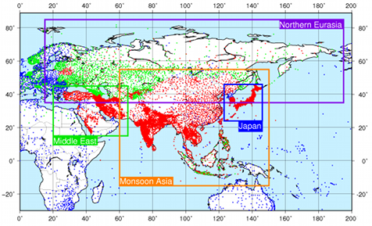
BSISO1 related to Extreme Rainfall Events
Data – APHRODITE’s Precipitation
Asian Precipitation- Highly-Resolved Observational Data Integration Towards Evaluation (APHRODITE)
Long-term daily gridded precipitation dataset for Asia based on a dense network of rain gauges
1951-2007
Resolution for Asia: 0.25ºx0.25º
This study uses the APHRODITE’s daily precipitation over Asia for 1981-2007 to investigate the BSISO impact on extreme rainfall over Asia
APHRODITE station distribution.
Source: http://www.chikyu.ac.jp/precip/products/index.html
Reference: Yatagai et al. 2012 Bull Am Meteorol Soc

Slide 36
BSISO2: The Asian Pre-Monsoon and Onset Mode
BSISO2, consisting of EOF3 and EOF4, captures the northward/northwestward propagating variability with periods of 10-30 days during primarily the pre-monsoon and monsoon-onset season that is not related with the eastward propagating MJO.
Spatial Characteristics: Elongated and front-like pattern with a southwest to northeast slope. In-phase relationship of convection between the ISM and WNPSM.
OLR (shading) and 850-hPa Wind
Lee et al. (2013 Clim Dyn)

Slide 37
BSISO2 Relationship with Monsoon Onset
68 % (70%) of the onset dates for the Indian monsoon (South China Sea) occurred in phases 2-4 of BSISO2 for 1981-2010.

Slide 38

BSISO2 Relation to Extreme Rainfall Events
Changes in probability of 90th extreme rainfall occurrence
The BSISO strongly modulates extreme rainfall occurrence in Asia.
The probability density function of May-August rainfall in East Asia is skewed toward large values in phases 5-7 of the BSISO2 life cycles, during which the probability of extreme rainfall events at the 75th (90th) percentile increases 30-50% (over 60%) relative to the non-BSISO periods.
Hsu et al. (2015 I J Climatol)

Slide 39

Prediction skill of large-scale MISO during JJAS season – CFS model
Abhilash et al. 2014
Notes:
The EOF1 and EOF2 could explain a combined variance of 23 % and is well separated from rest of the EOFs. The two principal components (MISO1 and MISO2) are obtained by projecting the daily data matrix with delayed embedding as defined earlier. For more information on MISO index method, Suhas et al. (2012 ) and Sahai et al. (2013 ) are referred.

