Slide 1
Beyond CMIP5 Decadal Predictions and the role of aerosols in the warming slowdown
Doug Smith, Martin Andrews, Ben Booth, Nick Dunstone, Rosie Eade, Leon Hermanson, Gareth Jones, Jeff Knight, Adam Scaife, Katy Sheen, Vikki Thompson

Slide 2
Contents
Results from high resolution decadal predictions
NAO a year ahead
Sahel rainfall
The signal to noise paradox
Recent slowdown in surface warming
Role of volcanic and anthropogenic aerosols

Slide 3
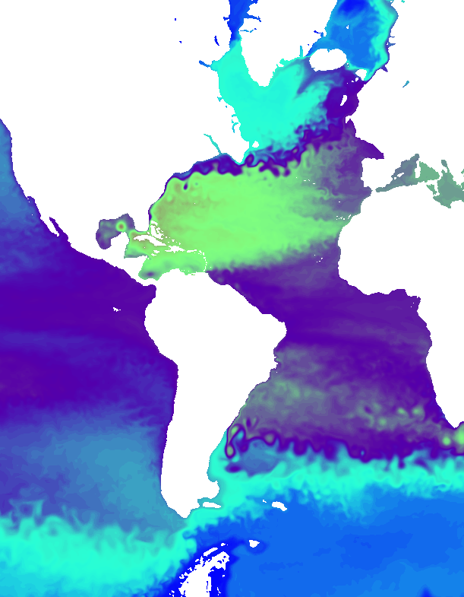
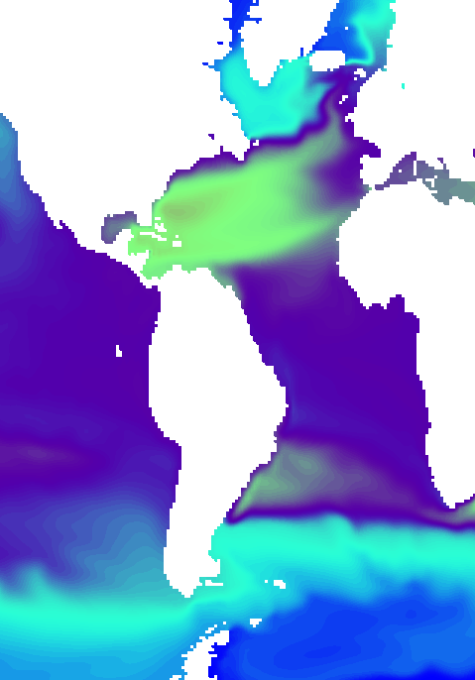
DePreSys3 - Higher resolution
ORCA ¼°
ORCA 1°
2 years of monthly
mean temperature
at 370m depth

Slide 4
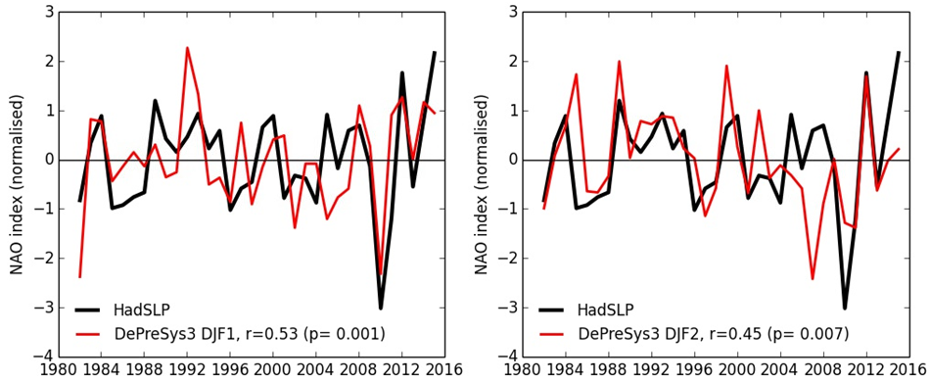
Predictions of North Atlantic Oscillation (NAO)
First winter: 1 month ahead
Second winter: 13 months ahead
Correlation 0.53
Correlation 0.45
Skill extended back to 1980 (35 years compared to 20 in GloSea5)
Skill in second winter (13 month lead time)
(Dunstone et al, submitted)

Slide 5
Second winter NAO drivers...
ENSO
DJF MSLP composites: Nov El Niño – La Niña
ENSO skilfully predicted in both first and second winters
Composites are similar in obs, first and second winters
ENSO appears to drive NAO in both first and second winters

Slide 6
Second winter NAO drivers...
North Atlantic
SST tripole
DJF MSLP composites: Nov warm – cold Atlantic SST
Skill only in first winter
Composites are similar in obs and first winter, but not second winter
Atlantic SSTs appear to drive NAO in first winter only

Slide 7
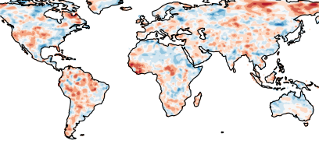
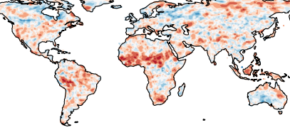
Sahel rainfall, years 2-5
AR5 model
Improved skill for Sahel rainfall
Atlantic temperatures shift tropical rainfall
Model now propagates information across the Sahel
More details in poster by Katy Sheen
Latest model

Slide 8
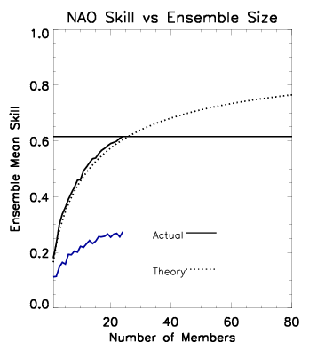
The signal to noise paradox
Model ensemble mean predicts the real world better than individual model members!
High skill despite low signal to noise in model → “the signal to noise paradox”
Robust signals: NAO and European rainfall
Model predicting real world
Model predicting itself
Can make skilful predictions
But need very large ensemble
More skill potentially available
Implications for measuring skill, attribution, role of internal variability
(Scaife et al 2014, Eade et al 2014)

Slide 9
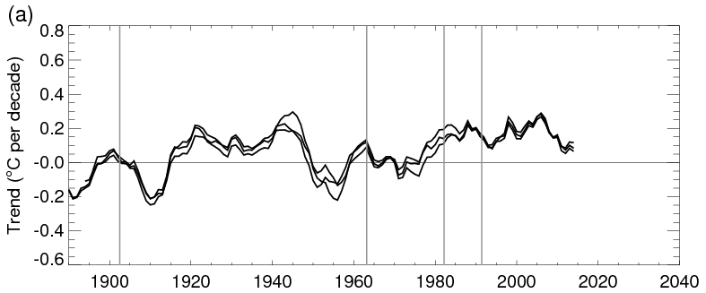
Slowdown in surface warming
Rolling 15 year trends in global near surface temperature
Recent decrease in 15 year trends seen in all observational datasets
...including the recent Karl et al study
There has been a slowdown in the rate of surface warming!
(Smith et al. submitted)

Slide 10
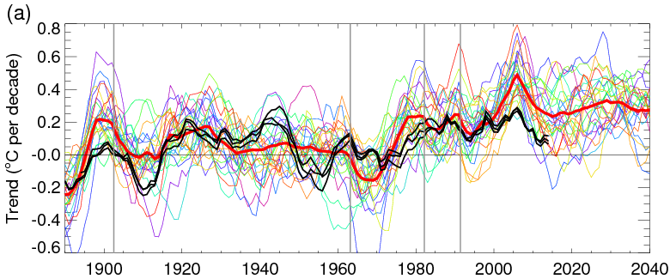
Slowdown in surface warming
Rolling 15 year trends in global near surface temperature
Recent decrease in 15 year trends is simulated by CMIP5 models
Externally forced
But models trends generally too large
(Smith et al. submitted)

Slide 11
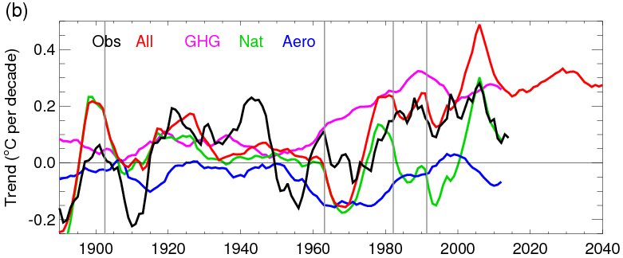
Slowdown in surface warming
Rolling 15 year trends in global near surface temperature
Partly due to recovery from eruption of Mount Pinatubo in 1991
global temperatures cooled in 1992
maximum trend starting from this cool year (1992-2006) followed by slowdown!
But also due to anthropogenic aerosols especially in most recent periods
(Smith et al. submitted)

Slide 12
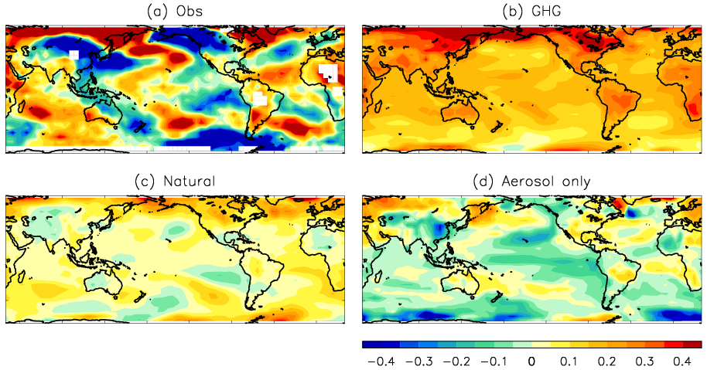
Surface temperature trend 1998-2012
Aerosol only simulations show a negative PDO trend pattern in the Pacific
(Smith et al. submitted)

Slide 13
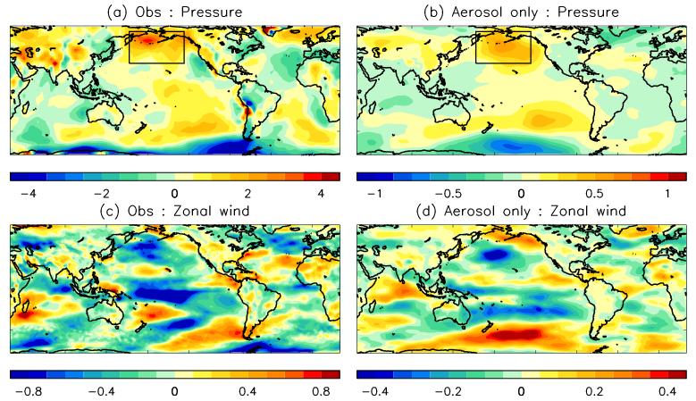
Trend in atmospheric circulation
(1998-2012)
Aerosol only simulations show a trends in Aleutian Low similar to obs
...and zonal winds
But model patterns are much weaker than obs
(Smith et al. submitted)

Slide 14
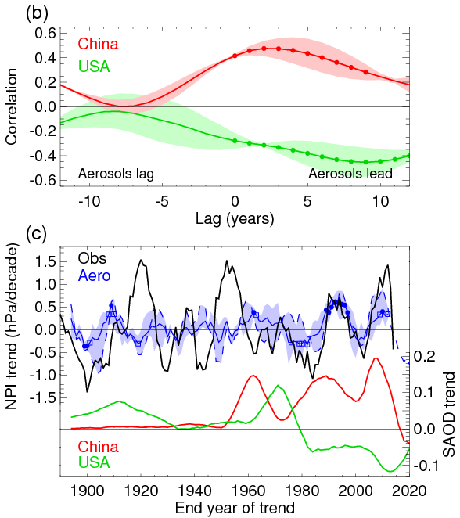
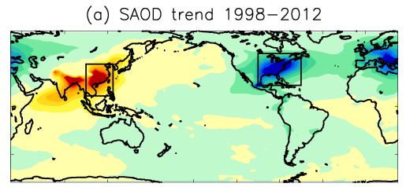
Impact of anthropogenic aerosols on Aleutian Low (NPI)
Lagged response of Aleutian Low (NPI) to aerosol emissions from China and USA
Timing of observed NPI changes since 1960 captured by models
Future Chinese aerosol reductions would promote a positive PDO and increased global temperatures
(Smith et al. submitted)

Slide 15
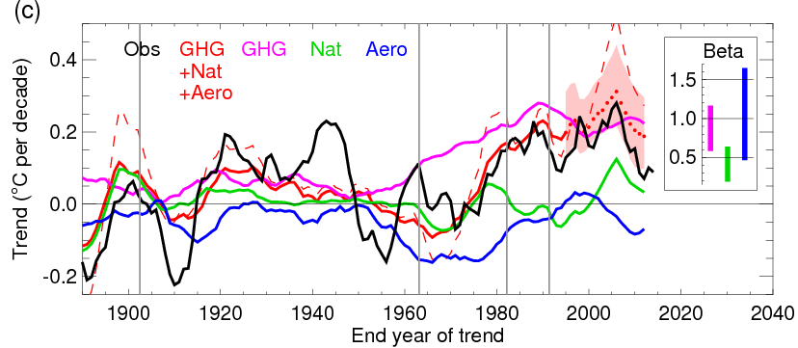
Slowdown in surface warming: recalibration of models
Detection and attribution analysis to obtain scaling factors (beta)
Use data before 1995
Scaling for Nat significantly less than one → models over-sensitive to volcanoes
Scaled projection (red dotted) in much better agreement with obs than unscaled (red dashed)
(Smith et al. submitted)

Slide 16
Summary
High resolution decadal predictions
Skill for NAO a year ahead
Sahel rainfall
But “signal to noise paradox”
Need mean of large ensemble
More skill available
Recent slowdown in surface warming
Partly the recovery from Mount Pinatubo
But also anthropogenic aerosols which drive negative PDO pattern
Model global temperature trends are too large mainly due to over sensitivity to volcanoes
But regional trends are weaker than obs: imperfect model response, or coincidence of internal variability?
Future reductions in aerosol emissions from China drive switch to positive PDO in model

Slide 17
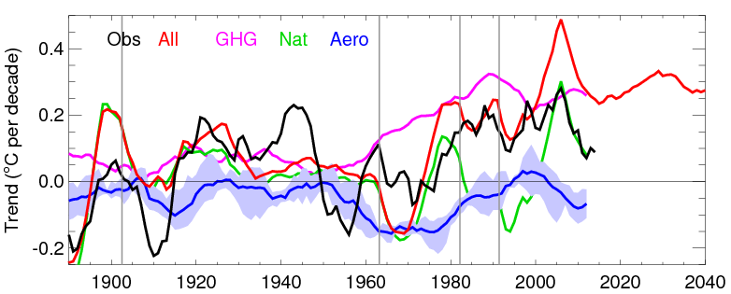
Slowdown in surface warming
Rolling 15 year trends in global near surface temperature
Blue shading shows range from aerosols diagnosed in different ways
Aero : All-NoAero : All-Nat-GHG-LU-Oz : Anthro-GHG-LU-Oz
(Smith et al. submitted)

Slide 18
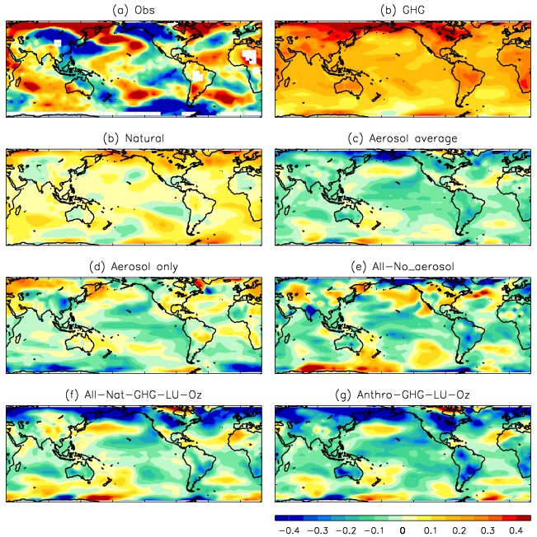
Surface temperature trend 1998-2012

Slide 19
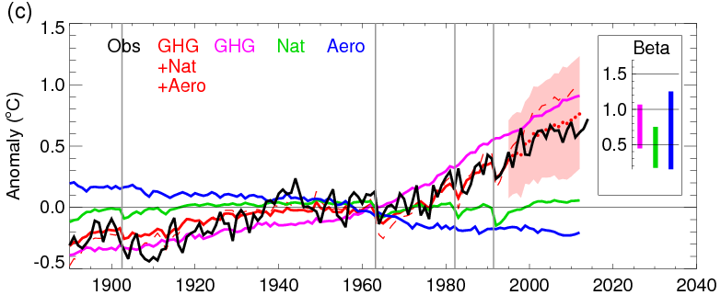
Slowdown in surface warming: recalibration of models
Detection and attribution analysis to obtain scaling factors (beta)
Use data before 1995
Scaling for Nat significantly less than one → models over-sensitive to volcanoes
Scaled projection (red dotted) in much better agreement with obs than unscaled (red dashed)
(Smith et al. submitted)

Slide 20
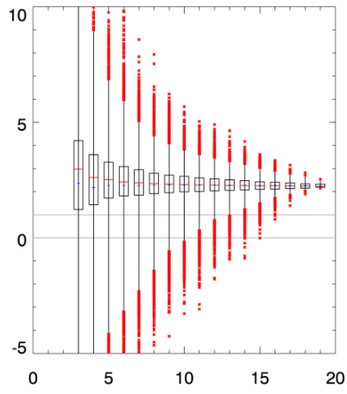
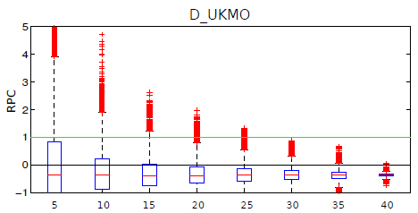
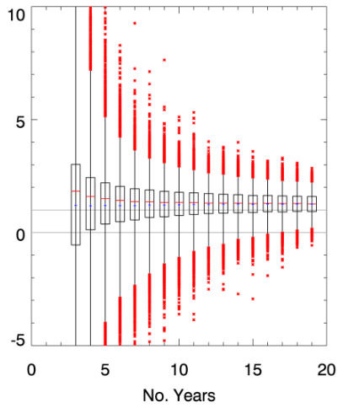
GloSea5
RPC sensitivity
24 members
GloSea3
(9 ensemble members)
9 members
Number of years
(Shi et al, 2015)

