Slide 1
https://code.visualstudio.com/Download
https://julialang.org/downloads/

Slide 2
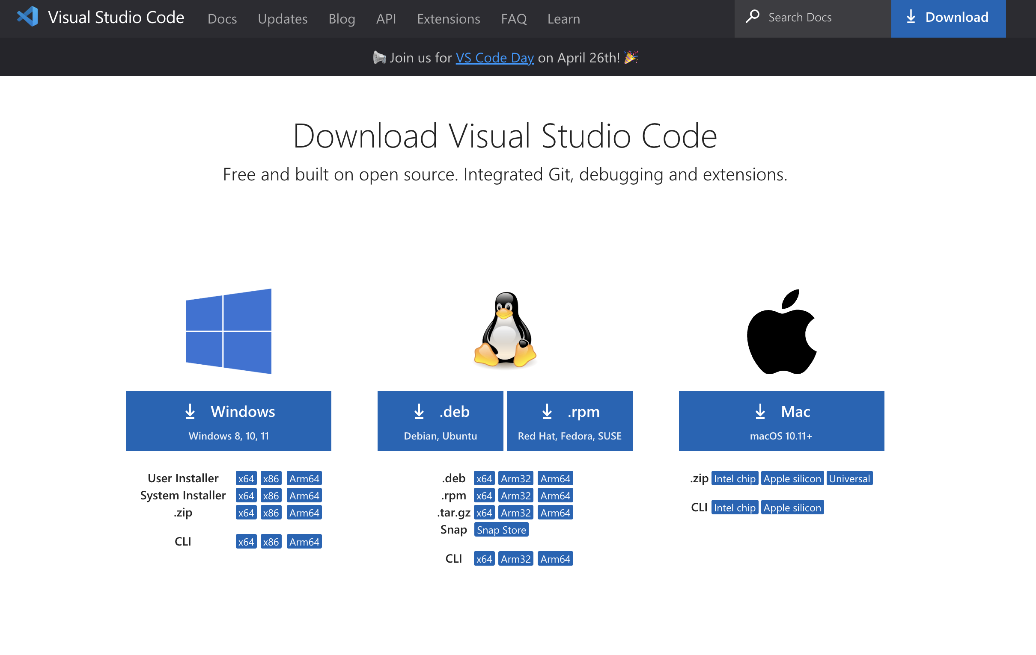

Slide 3
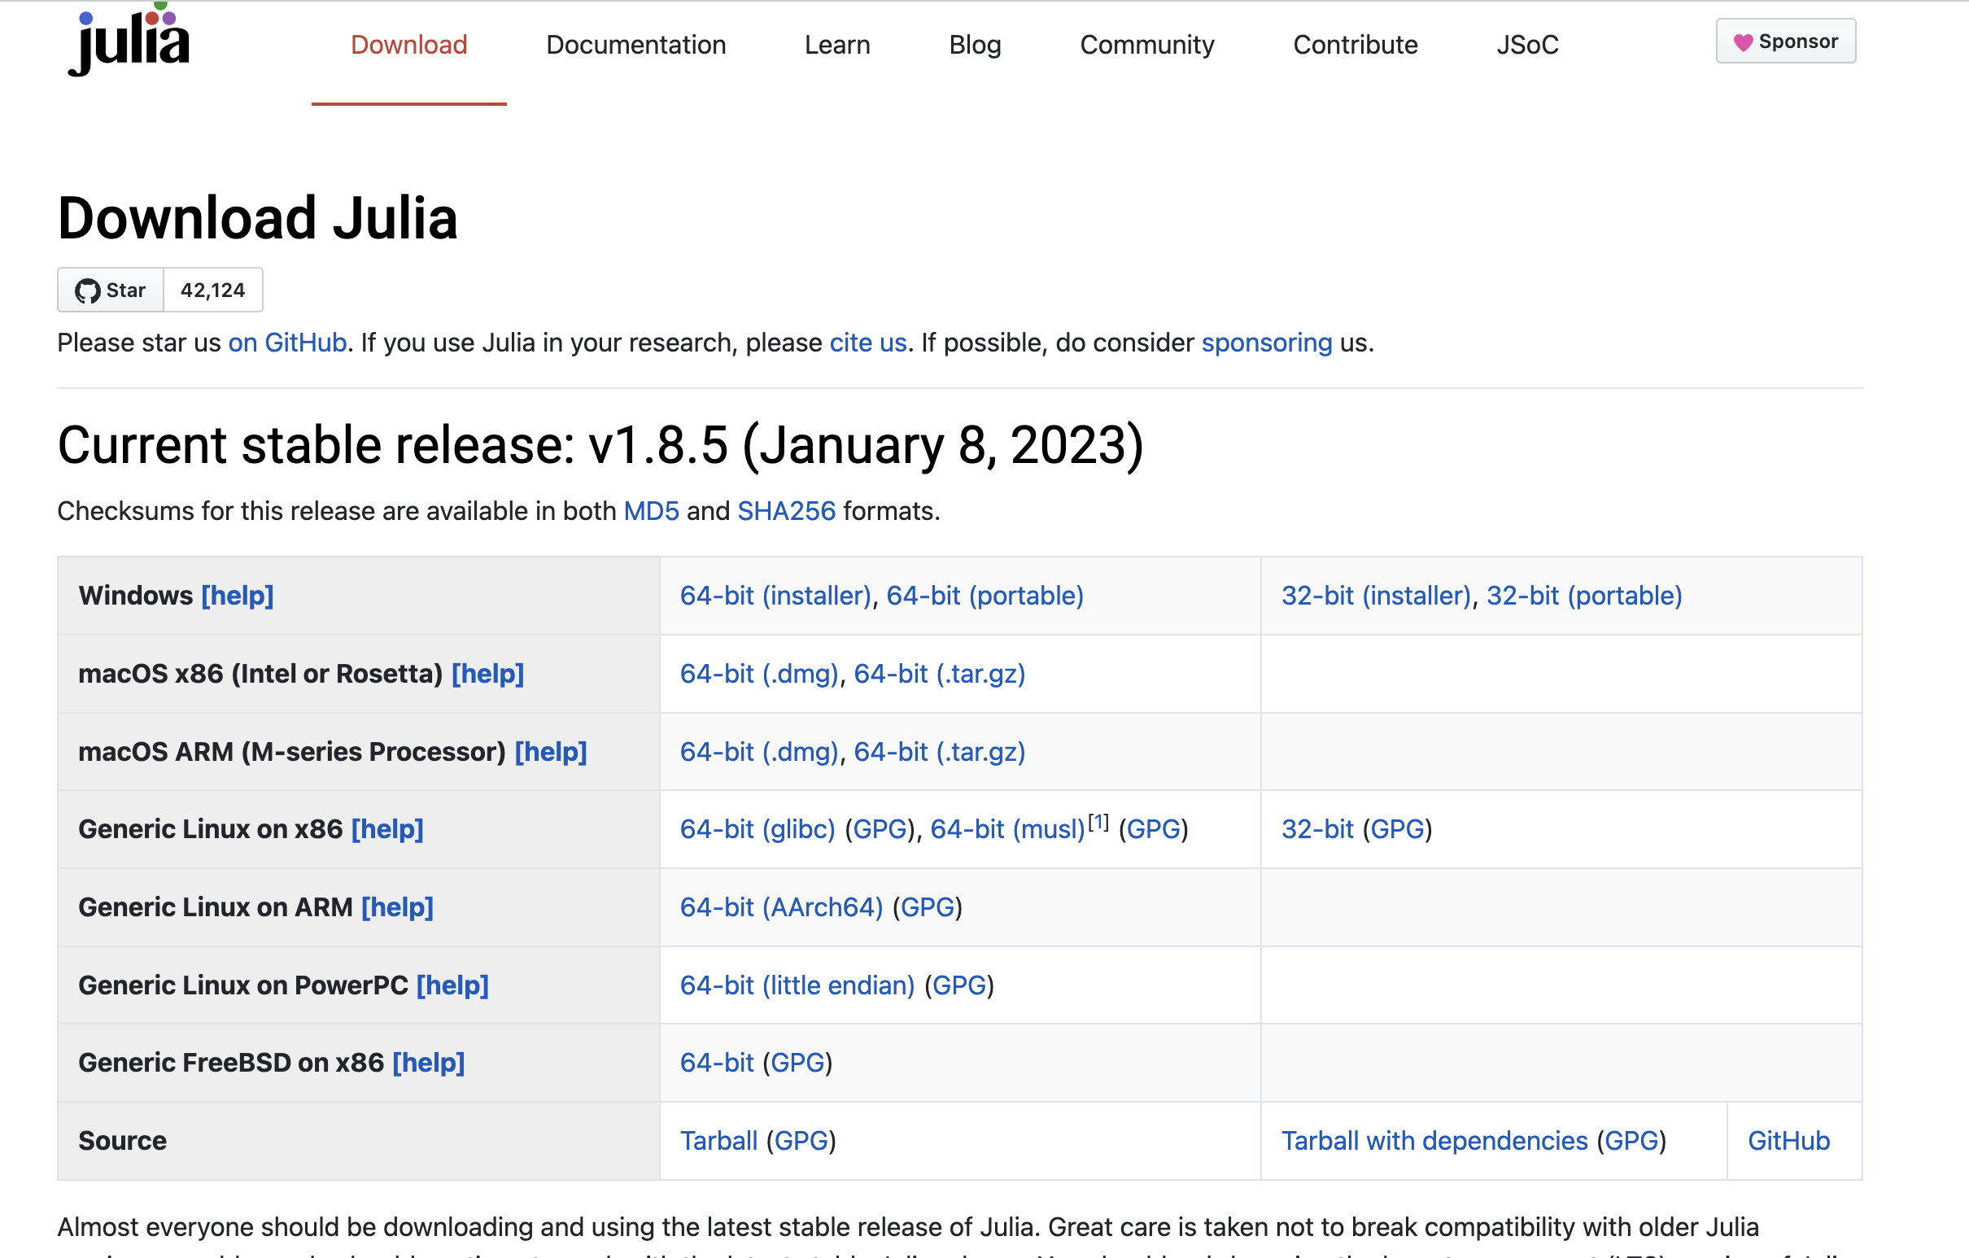

Slide 4
On Linux (Debian/Ubuntu)
Once the Julia archive is downloaded, go to the Downloads folder, open a terminal and type the following commands to install Julia
> tar zxvf julia-1.8.5-linux-x86_64.tar.gz > sudo mv julia-1.8.5 /usr/local > cd /usr/local/julia-1.8.5/bin/ > JULIAPATH=$(pwd) > echo 'export PATH=$PATH:$JULIAPATH' >> ~/.bashrc > source ~/.bashrc > julia

