Slide 1
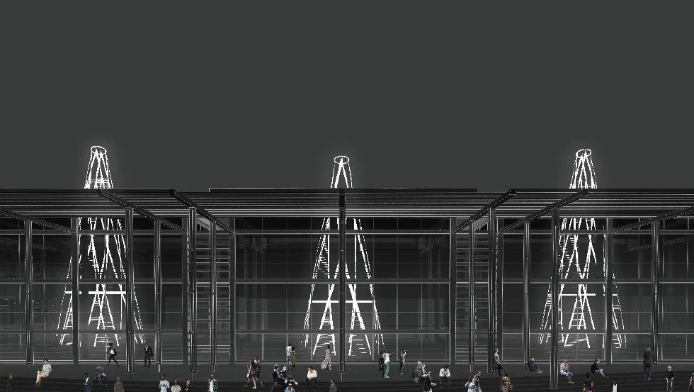
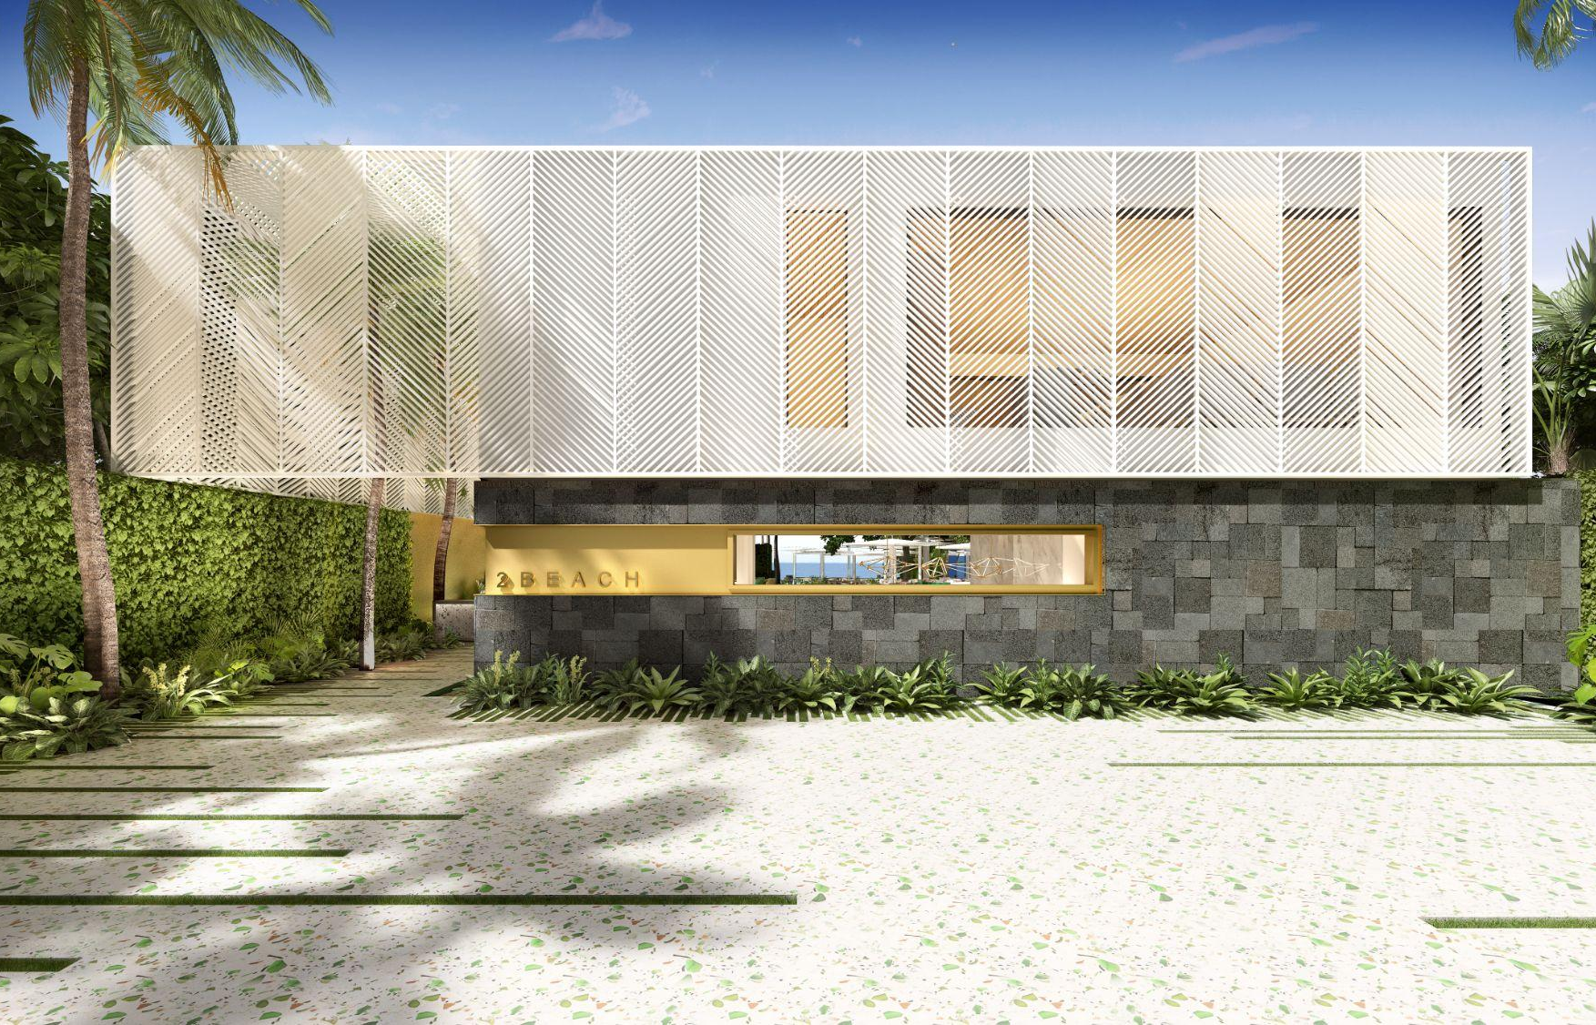
Ruth Nelson,
I was born in Grahamstown, South Africa.
I hold a Bachelor and Masters Degree in Architecture.
I worked for a few years as an architect in Cape Town and IN london gaining experience working across Africa, Mexico, the UK and China.
Masters in Research in Space Syntax from the University College London.
Mexico: data analytics consultant and lecturer.
PhD: TU Delft, TPM, Policy analysis, CUSP.

Slide 2
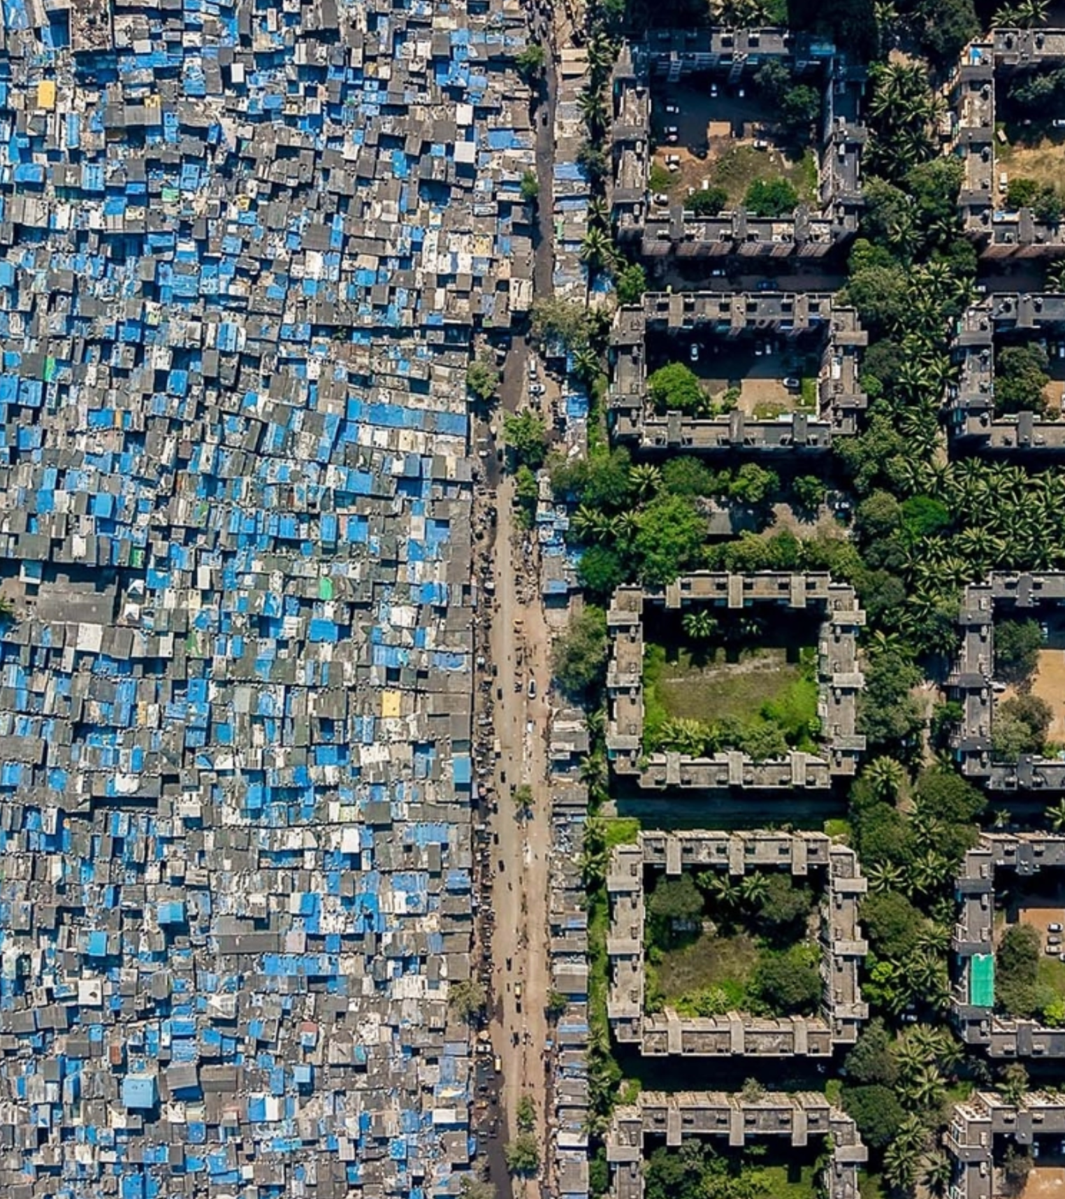
PhD topic
Inequality grown in most countries in the last three decades.
Inequality traditionally measured and studied from a economic perspective, there is growing recognition that inequalities exist as a result of urban, territorial, national and global processes, including through policy and planning at these different scales.
Deepen understanding of urban inequalities as a complex issue through connecting ideas around access with distribution and policy.
Developing a framework of recommendations. Move the discussion out of the domains of economists, to planners and policy makers.

Slide 3
Link to research
"Conceptualising urban inequalities as a complex socio-technical phenomenon"
Nelson, Warnier and Verma (2022)
Scan me!

