Slide 1
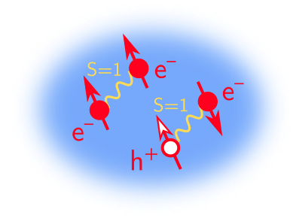


Fluctuating triplet and multiband pairing and a dissipative spin liquid
Mathias S. Scheurer
Fractionalization & Emergent
Gauge Fields in Quantum Matter
ICTP, Trieste
Wednesday, 12/06/2023
E
References:
Poduval & MS, arXiv:2301.01344.
Christos, Sachdev, MS, Nat. Commun. 14, 7134 (2023).
Shackleton & MS, arXiv:2307.05743.

Slide 2
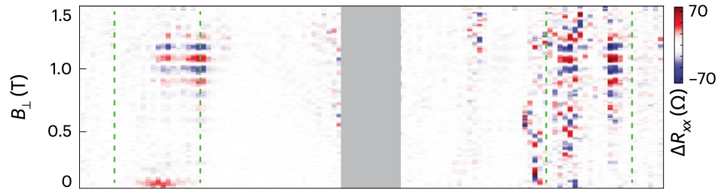
Twisted graphene near magic angle
Superconductivity & correlated insulator
Y. Cao et al., Nature 556, 80 (2018).
Y. Cao et al., Nature 556, 43 (2018).
“Dirac resets”
Zondiner et al., Nature 582, 203 (2020).
Wong et al., Nature 582, 198 (2020).
e.g., visible in microwave resonance
➢ antiparallel spins in the two valleys: $N=s{ τ}_{z}$
Morisette et al., Nature Physics
(2023).

Slide 3
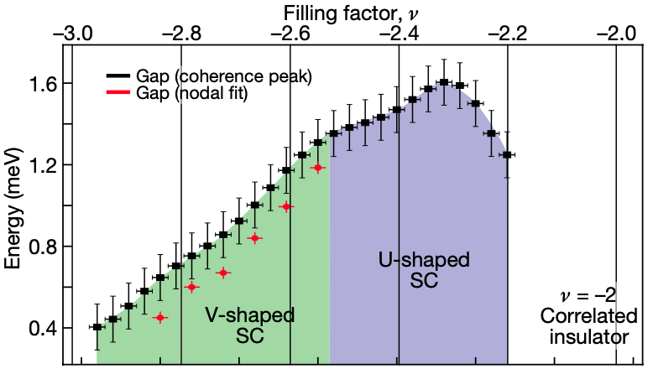
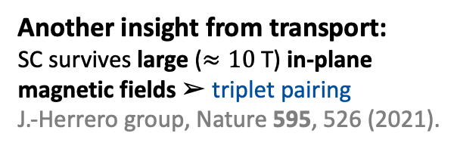
Twisted graphene near magic angle
STM experiments:
V-shape DOS ➢ nodal superconductor
Nadj-Perge group, Nature 606, 494 (2022).
Yazdani group, Nature 600, 240 (2021).
Another insight from transport:
SC survives large ($≈10$T) in-plane
magnetic fields ➢ triplet pairing
J.-Herrero group, Nature 595, 526 (2021).

Slide 4
Twisted graphene near magic angle
In (first part of) this talk:
Two possible explanations of U- to V-shaped DOS in superconductor

Slide 5
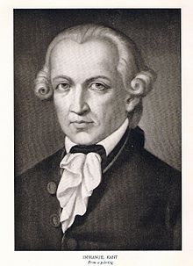

Vestigial pairing in a fluctuating magnetic triplet superconductor
Poduval & MS, arXiv:2301.01344.
DOS
What may I hope?
I. Kant
$$ω$$

Slide 6
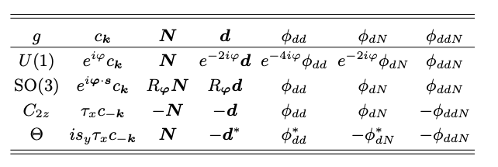
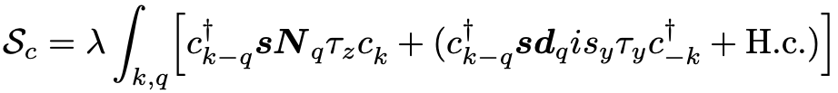

Model & Phase diagram
Poduval & MS, arXiv:2301.01344.
spin polarization
triplet SC (full gap)
T = 0: (mean-field)
Composite order parameters:

Slide 7

Model & Phase diagram
Poduval & MS, arXiv:2301.01344.
spin polarization
triplet SC (full gap)
T > 0:
Composite order parameters:
Integrate out fermions $→c_{1}<0$

Slide 8
Model & Phase diagram
Poduval & MS, arXiv:2301.01344.
spin polarization
triplet SC (full gap)
T > 0:
Composite order parameters:
Integrate out fermions $→c_{1}<0$

Slide 9
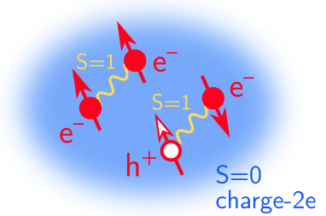
Model & Phase diagram
Poduval & MS, arXiv:2301.01344.
spin polarization
triplet SC (full gap)
T > 0:
Composite order parameters:
Integrate out fermions $→c_{1}<0$

Slide 10




Theory for phase (B)
Poduval & MS, arXiv:2301.01344.
Effective action
$→$ Higgs mechanism, ODLRO
Computation of spectral function
In matrix large-N limit as in Fitzpatrick et al., PRB 89, 165114 (2014)
$$Σ$$
$$N$$
$$d$$

Slide 11
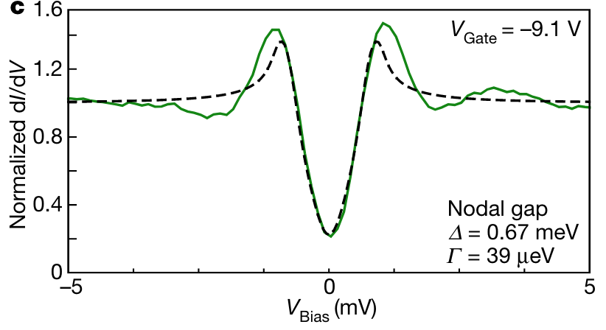
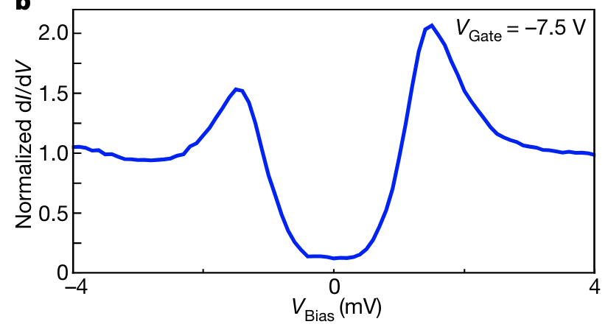



Density of states
Poduval & MS, arXiv:2301.01344.
Possible explanation for tunneling data
Nature 606,
494 (2022).
density of states
filling $υ$
energy $ω$
partial suppression although $\left\langle d\right\rangle ≠0$ full gapped

Slide 12
How to get nodal to gapped within a single state without fluctuations?
Christos, Sachdev, MS, Nat. Commun. 14, 7134 (2023).
E

Slide 13
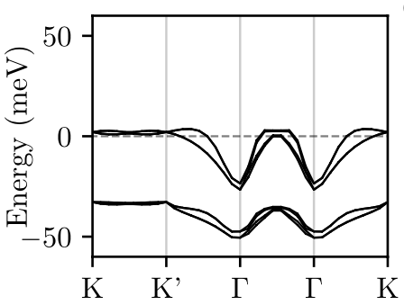



Possible superconducting states
Nat. Com. 14, 7134 (2023).
2 bands
$$↑$$
$$↑$$
Key symmetry:
$$↓$$
2 valleys

Slide 14

Possible superconducting states
Nat. Com. 14, 7134 (2023).
$$↑$$
$$↑$$
Key symmetry:
$$↓$$
@ T=0

Slide 15
Possible superconducting states
Nat. Com. 14, 7134 (2023).
$$↑$$
$$↑$$
Key symmetry:
$$↓$$
entirely band-off-diagonal
@ T=0

Slide 16
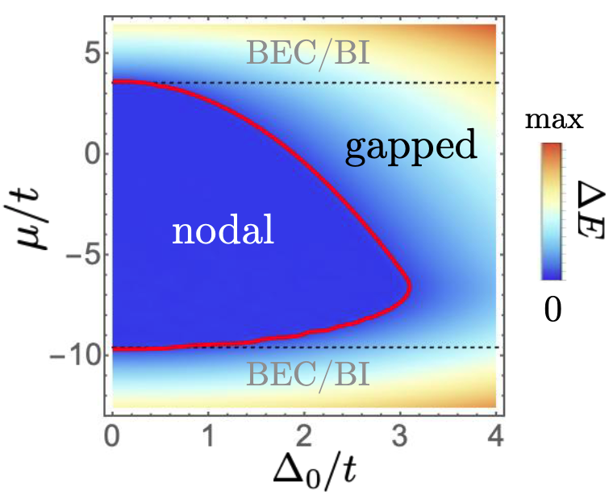
Band-off-diagonal pairing
Nat. Com. 14, 7134 (2023).
$$↑$$
$$↑$$
Key symmetry:
$$↓$$
–
for diagonal pairing

Slide 17

Band-off-diagonal pairing
Nat. Com. 14, 7134 (2023).
$$↑$$
$$↑$$
Key symmetry:
$$↓$$
–
for off-diagonal pairing
$$(\left|Δ\right|<Δ_{c})$$

Slide 18

Band-off-diagonal pairing
Nat. Com. 14, 7134 (2023).
$$↑$$
$$↑$$
Key symmetry:
$$↓$$
–
for off-diagonal pairing
$$(\left|Δ\right|>Δ_{c})$$

Slide 19

Band-off-diagonal pairing
Nat. Com. 14, 7134 (2023).
$$↑$$
$$↑$$
Key symmetry:
$$↓$$
arXiv:2303.14903

Slide 20
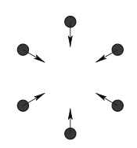


Band-off-diagonal pairing
Nat. Com. 14, 7134 (2023).
$$A_{1}$$
$$↑$$
$$↑$$
Key symmetry:
$$↓$$
Energetics?
➢ dominates for T-IVC
fluctuations
Prime candidate for insulator,
arXiv:2303.00024 (Yazdani)
➢ dominates for $A_{1}$phonon
Identified as strong phonon mode,
arXiv:2303.14903 (Yulin Chen);
arXiv:2303.15551 (A. Bernevig)
arXiv:2303.14903

Slide 21
Band-off-diagonal pairing
Nat. Com. 14, 7134 (2023).
$$A_{1}$$
Key symmetry:
(but energetically not natural)

Slide 22
An exactly solvable dissipative spin liquid
Shackleton & MS, arXiv:2307.05743.
fluxes / loops

Slide 23
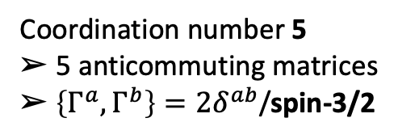
Model
Shackleton & MS, arXiv:2307.05743.
Lindblad master equation:
unitary
environment
with
“Doubled Hilbert space”:
Coordination number 5
➢ 5 anticommuting matrices
$➢ \left\{Γ^{a},Γ^{b}\right\}=2δ^{ab}$/spin-3/2

Slide 24





Model
Shackleton & MS, arXiv:2307.05743.
$${\hat{w}}_{j}$$
$$R$$
spin-liquid ground state
Yao, Zhang, Kivelson, PRL 102, 217202 (2009).
$${\hat{v}}_{j}$$
see also: Gidgu & Arovas, arXiv:2308.05245.
Introducing Majorana fermions,
$$L$$
the Linbladian becomes quadratic
with $ℤ_{2}$ gauge fields:
Interpretation of spectrum:
extensive number of symmetries $→$ strongly constrains finite
$→$ gap in sector = upper bound on relaxation time
A. MacDonald
Pablo’s papers:
Y. Cao et al., Nature 556, 80 (2018).
Y. Cao et al., Nature 556, 43 (2018).

Slide 25
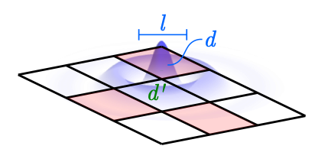
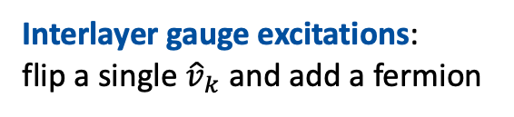

A few different sectors
Shackleton & MS, arXiv:2307.05743.
The steady-states contained in:
with we get
➢ stead-states $↔$ vacuum of $f$ $↔$ flux operators / loops on torus
➢ fermion gap = $4γ$ $↔$ pairs of $d$
Interlayer gauge excitations:
flip a single ${\hat{v}}_{k}$ and add a fermion
quantum Zeno

Slide 26
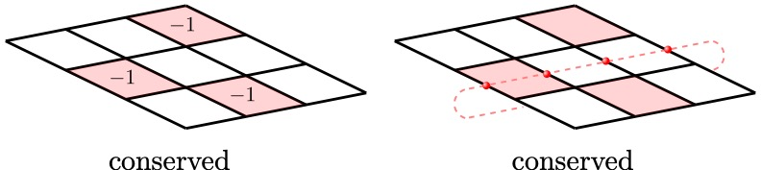
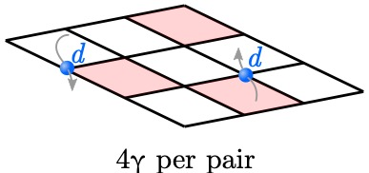
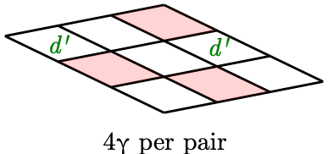
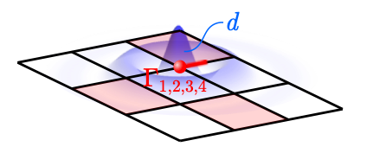
Overview spectrum
Shackleton & MS, arXiv:2307.05743.
fluxes / loops
➢ different time scales for different operator classes
see also numerics: Jin, Knolle, Knap,
PRL 130, 226701 (2023).
➢ non-trivial starting point of perturbative analysis
A. MacDonald
Pablo’s papers:
Y. Cao et al., Nature 556, 80 (2018).
Y. Cao et al., Nature 556, 43 (2018).

Slide 27


Conclusion
Shackleton & MS, arXiv:2307.05743.
Fluctuating magnetic triplet superconductor
Poduval & MS, arXiv:2301.01344.
➢ vestigial superconducting state with DOS mimicking nodal state
E
Band-off diagonal pairing
Christos, Sachdev, MS, arXiv:2303.17529.
➢ even trivial IR $A$ can have nodes
➢ favored by $A_{1}$ phonons and T-IVC fluctuations
Exactly solvable dissipative spin liquid
Shackleton & MS, arXiv:2307.05743.
➢ use extensive symmetries to classify operators
➢ with different thermalization time scales
➢ starting point for studying perturbations
Thank you!

