Slide 1
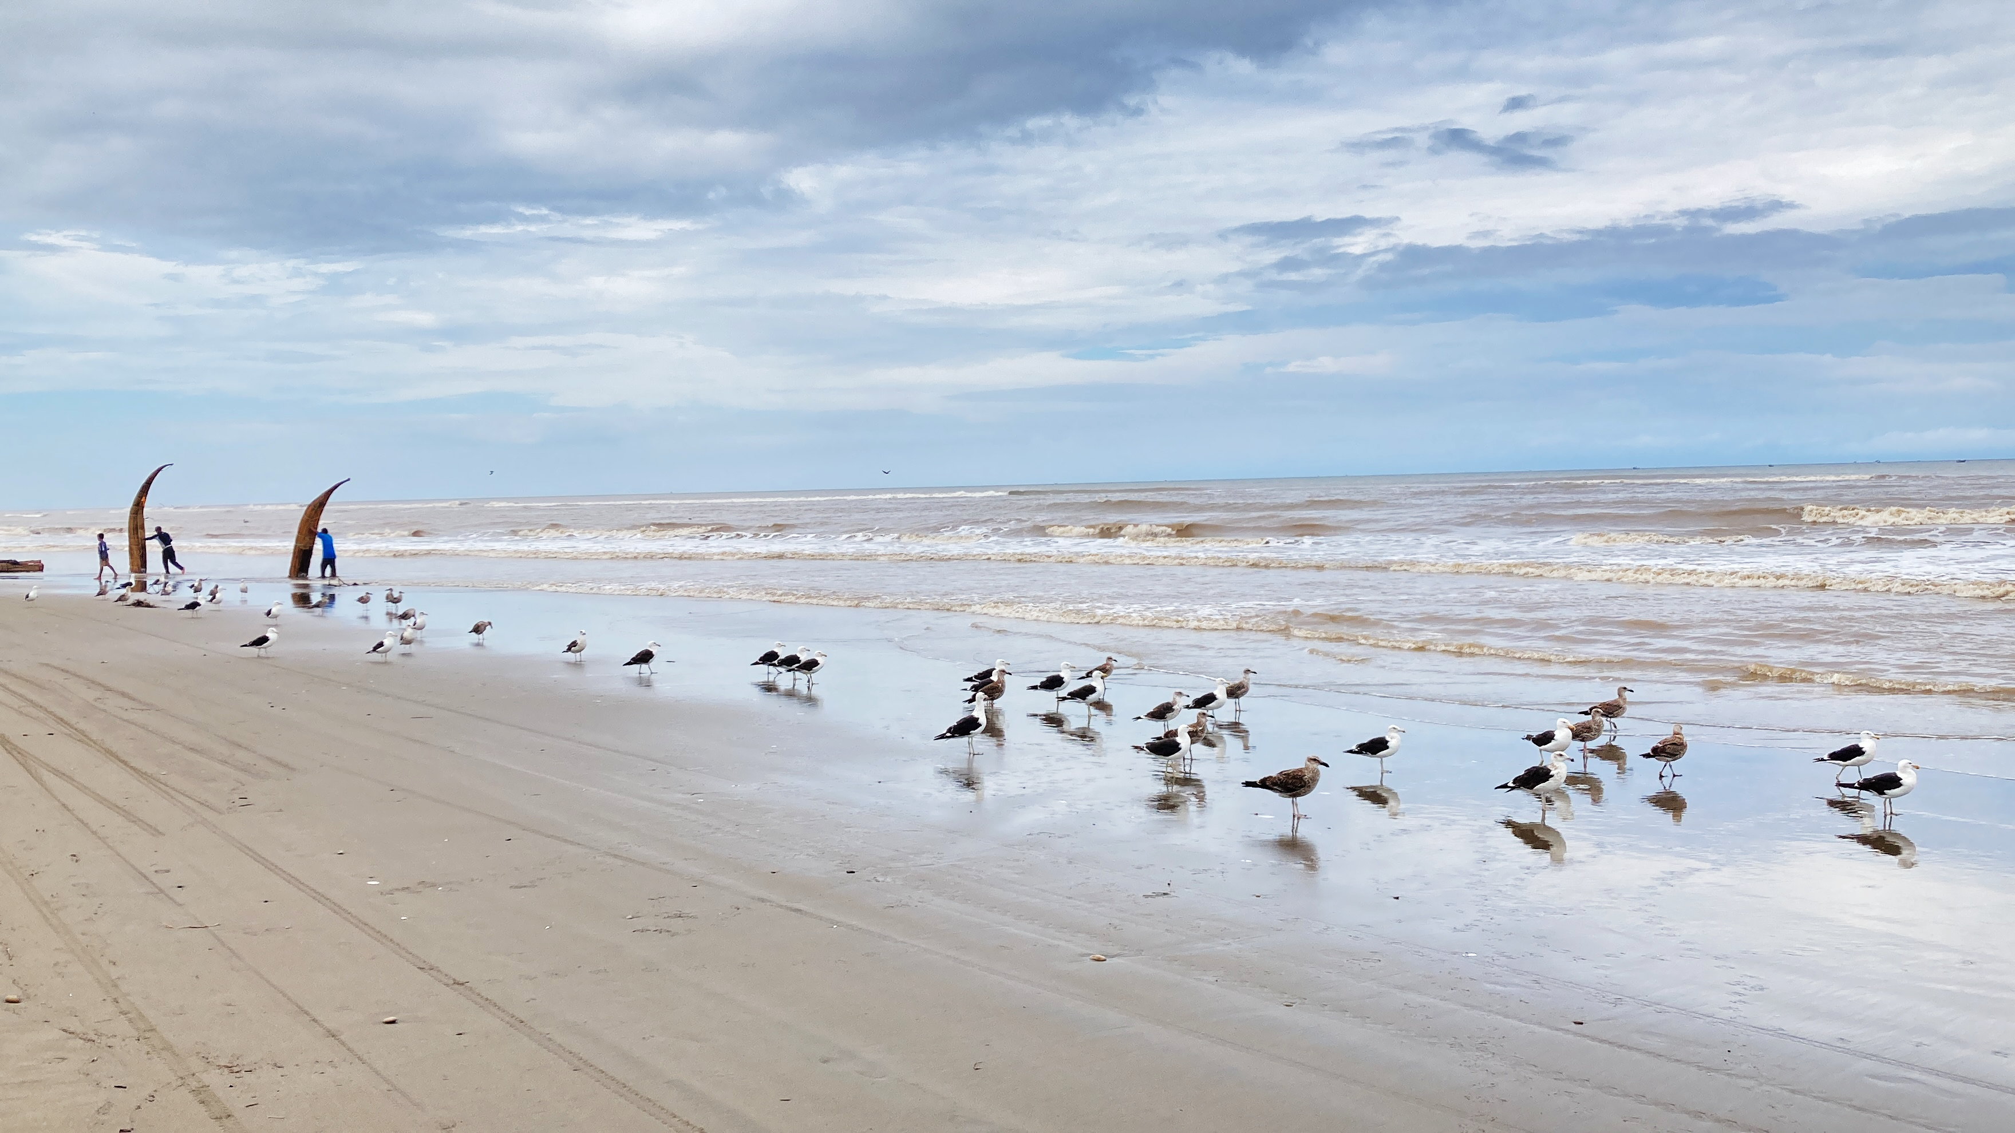

Anomalous warm conditions in the Pacific Ocean off Peru in the late summer of 2017
Credits, Roger Manay

Slide 2



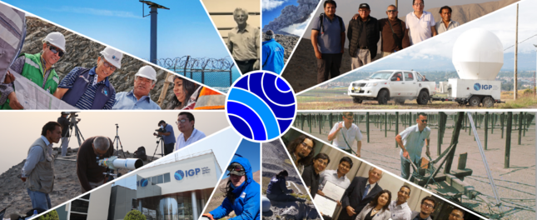

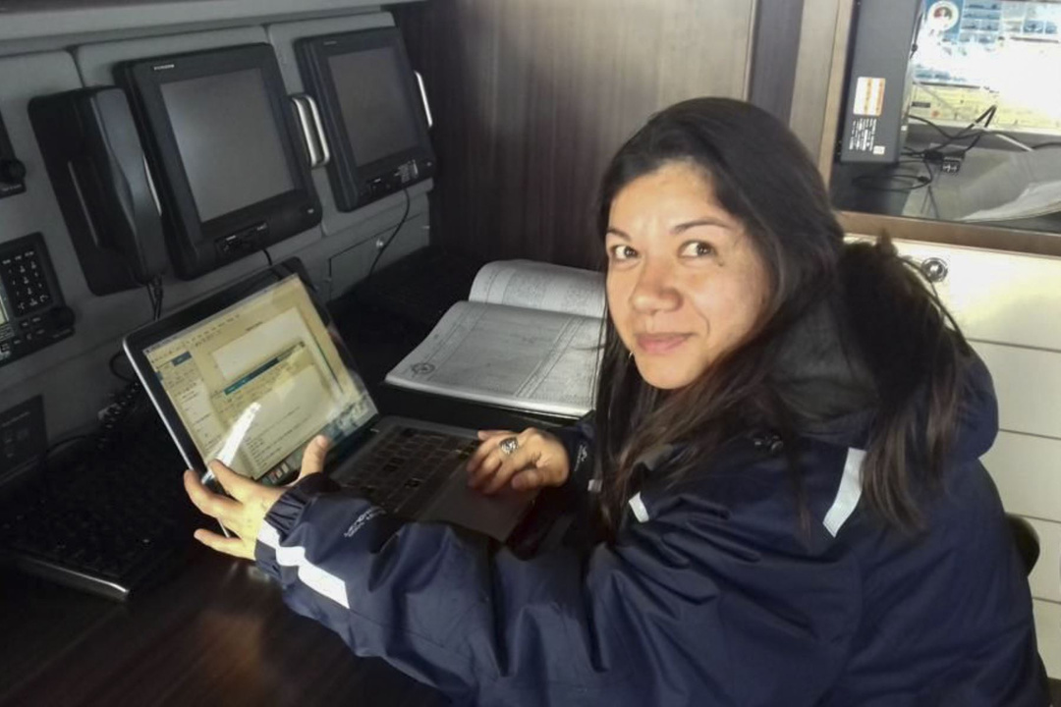
Brief info on IGP
101 years working for the Geophysical Sciences
Fiorela Castillón, MSc
Berlín Segura, MSc
"Blue ocean
team”
Atmosphere-hydrosphere sciences division
Ivonne Montes, PhD

Slide 3
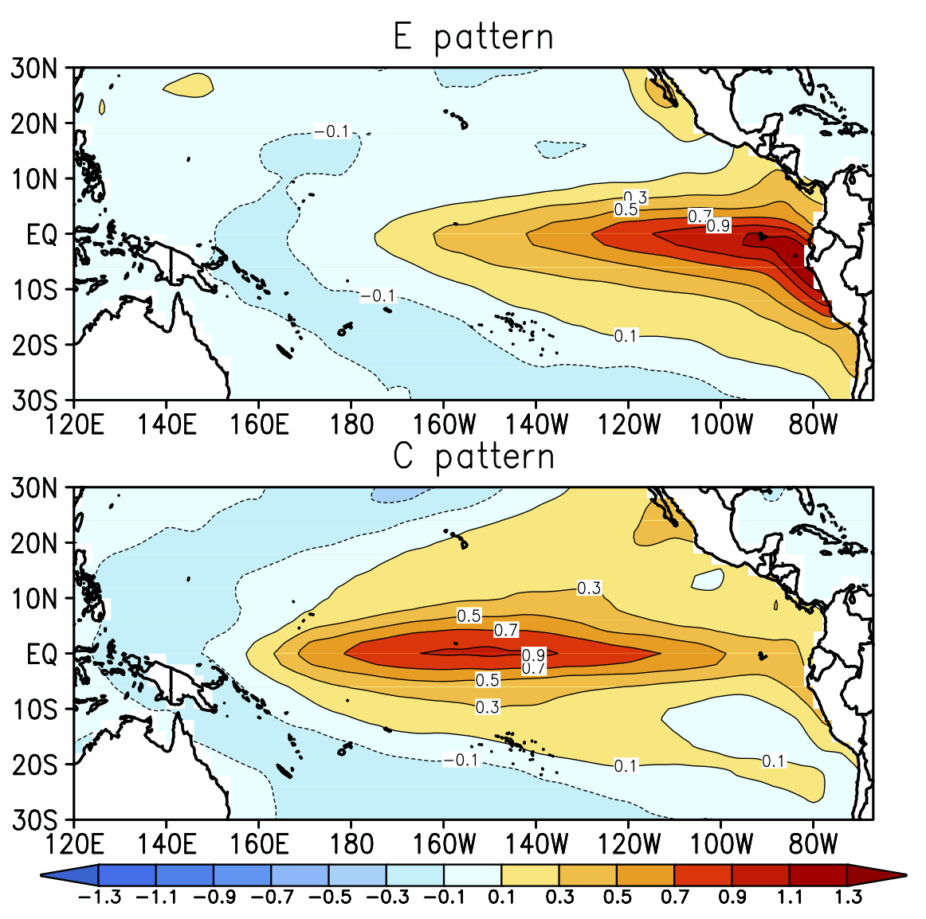
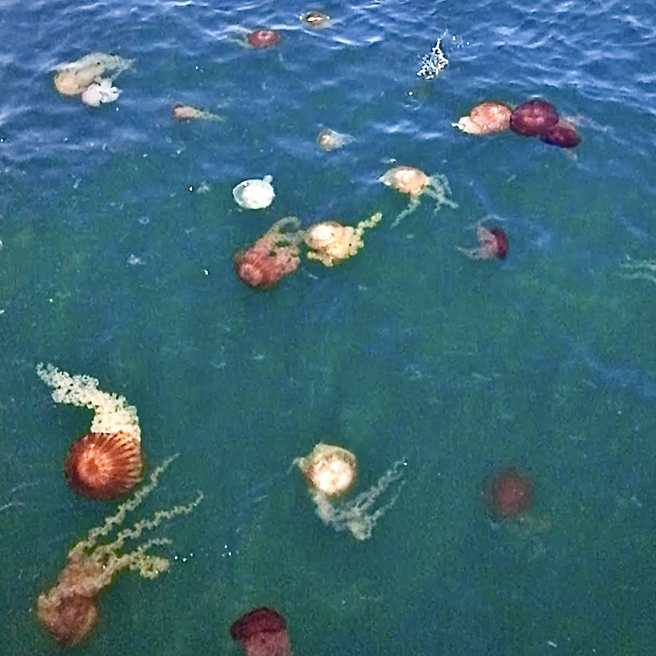
Warm conditions
Ecosystemic services:
biodiversity (regimen changes in fisheries, mortality in top predators), food, tourism, wheatear (high precipitations --> floods, landslides) are negative and positive
highly impacted.
Takahashi et al., 2011

Slide 4
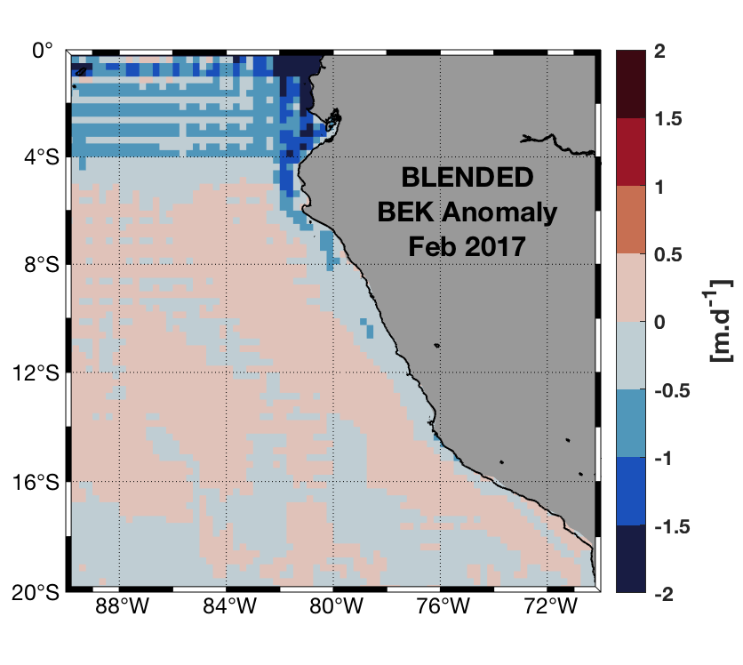
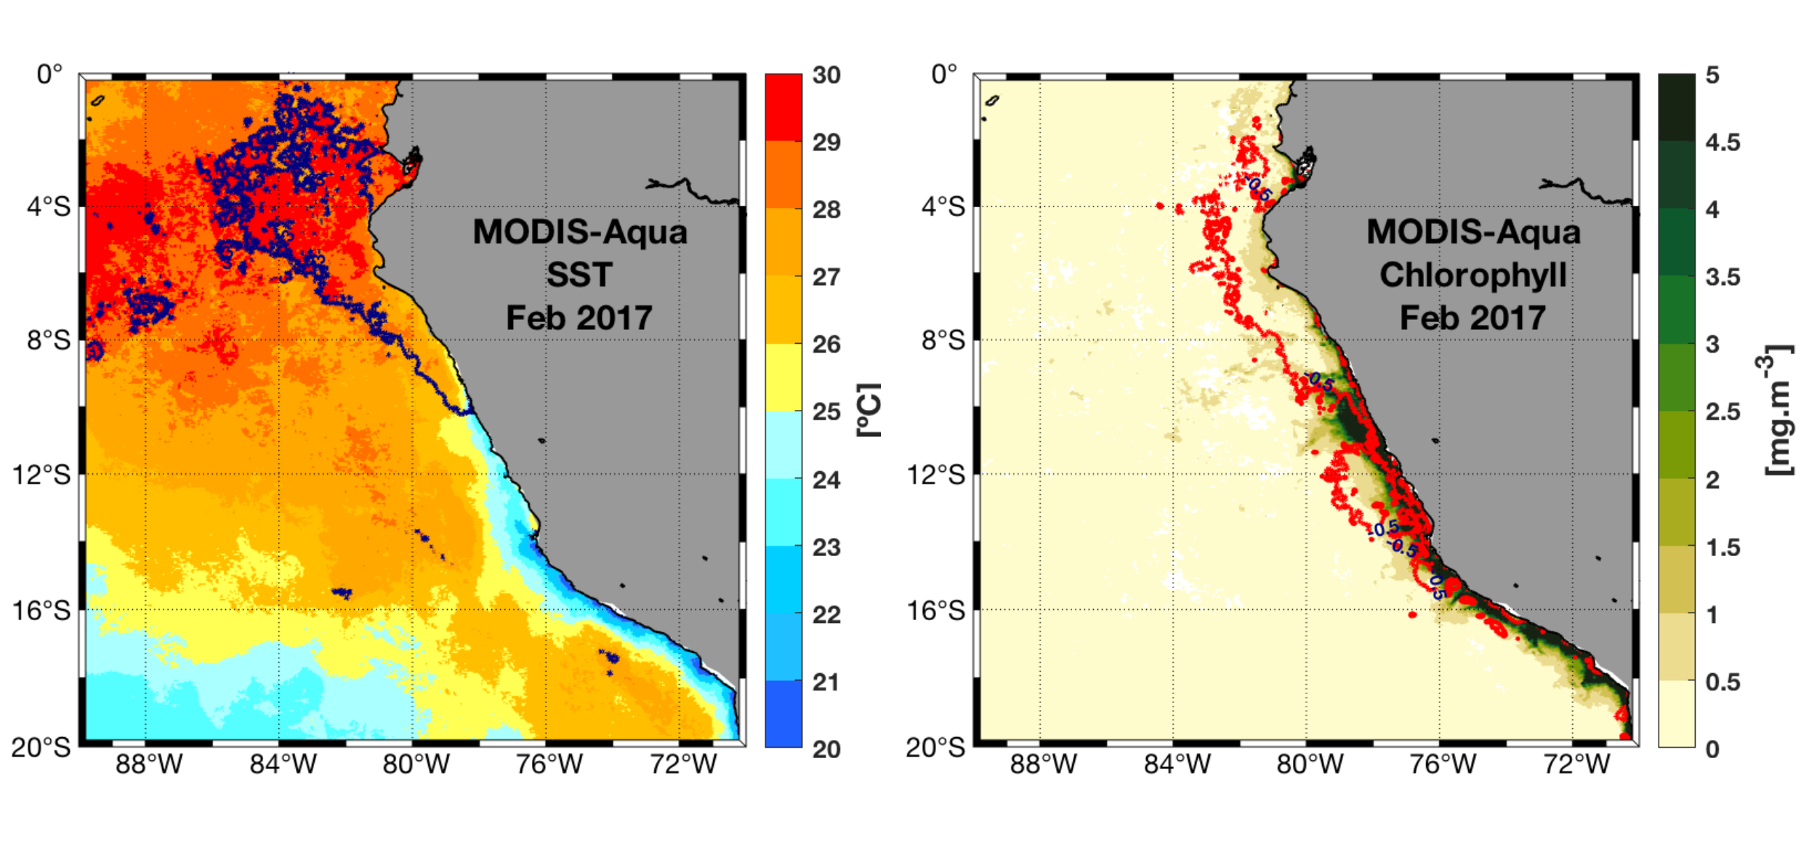
SST, CHL, Ekman pumping
February monthly mean in 2017 for sea surface temperature (left) and surface chlorophyll (center), and Ekman pumping anomalies (right) in color shading. Blue and red solid lines enclose areas with SST and Chl-a anomalies higher than 3º C and -0.5 mg.m-3, respectively.

Slide 5
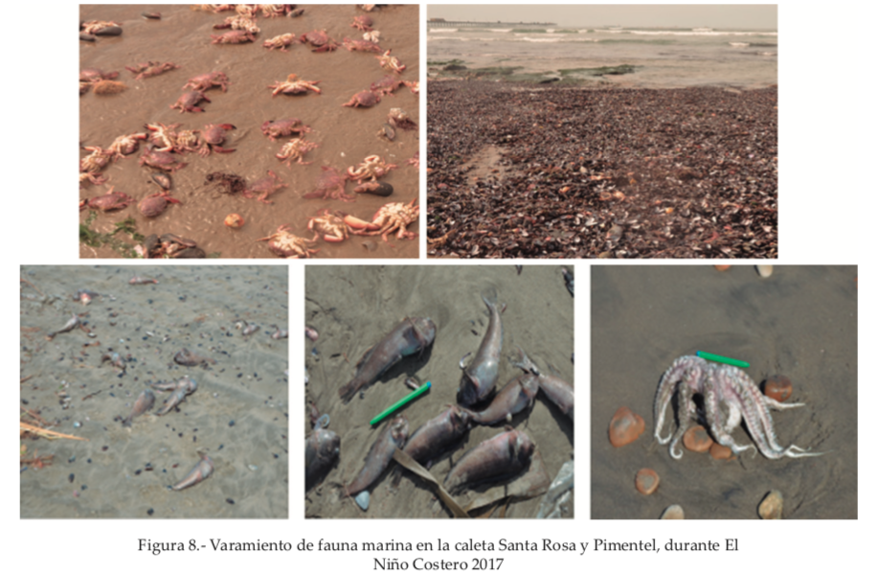
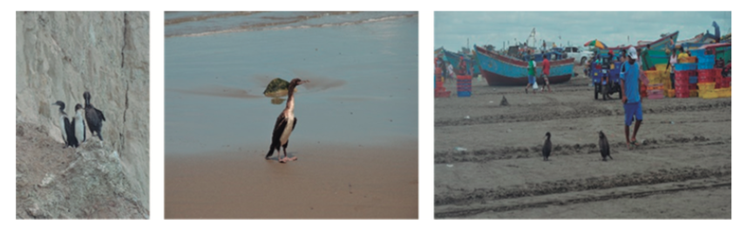
Ecological Impacts
Stranding of mollusks, fish and starvation of top predators on northern Peruvian beaches, during the coastal El Niño 2017. Taken and modified from: https://revistas.imarpe.gob.pe/index.php/boletin/issue/view/99

Slide 6
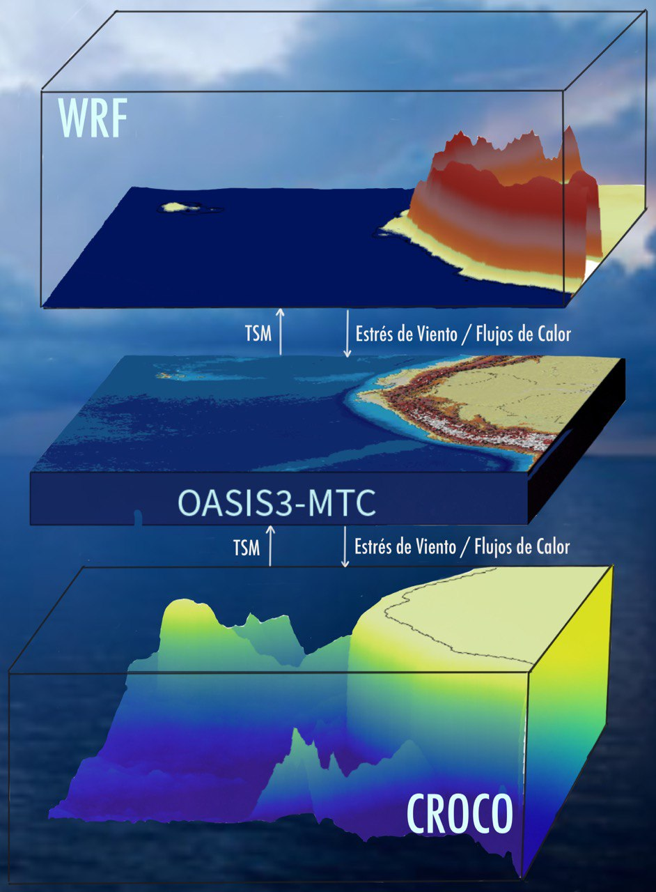
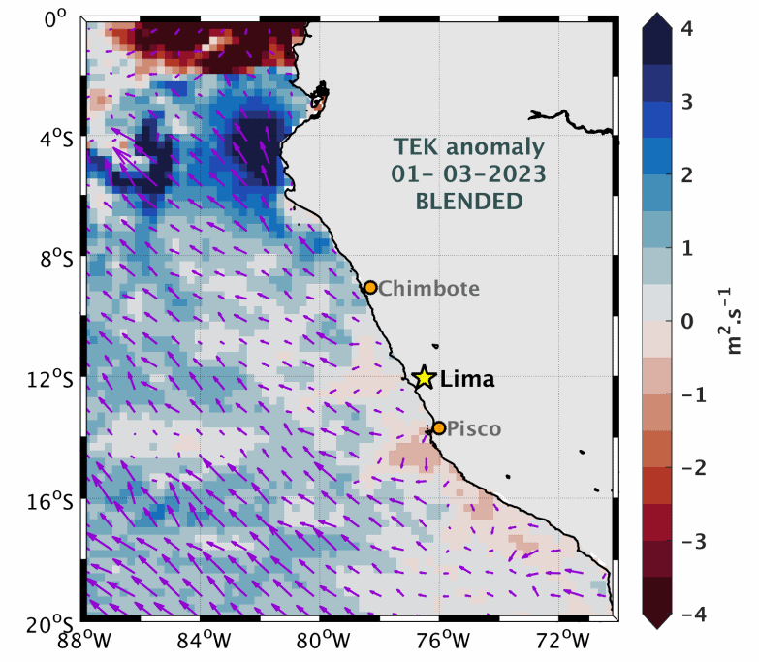
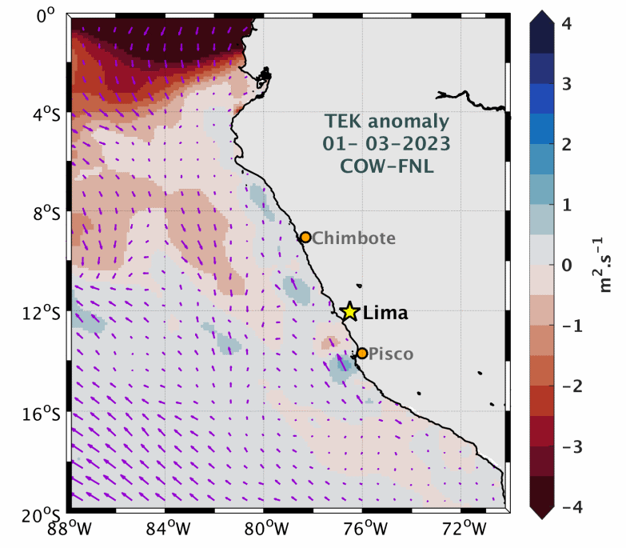
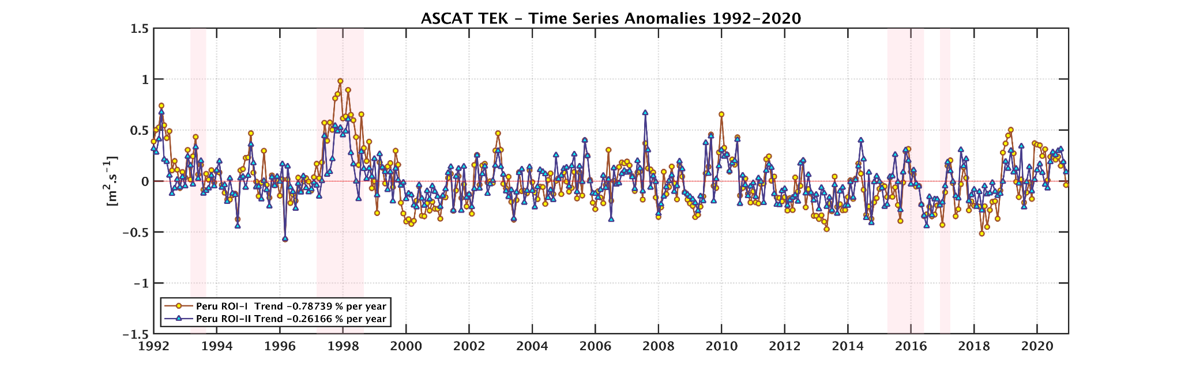
Future steps: forecasting

Slide 7
