Slide 1
Joint ICTP-IAEA Workshop on
Open-Source Nuclear Codes
for Reactor Analysis (smr 3865)
Group 2
Fylonych Yurii
Krpan Rok
Malatim Tariq
Sholudko Andrii
Choi Jiwon
KUTBAY Feride
Maroufi Bouchra

Slide 3
Exercise 1

Slide 4
Exercise 1 – Setting the case
constant/fluidRegion/phaseProperties:
"pump“
{
volumeFraction 0;
Dh 1;
momentumSource (0 0 -300000);
}
system/controlDict;
endTime 20;
deltaT 1e-3;
solveFluidMechanics true;
adjustTimeStep true;

Slide 5
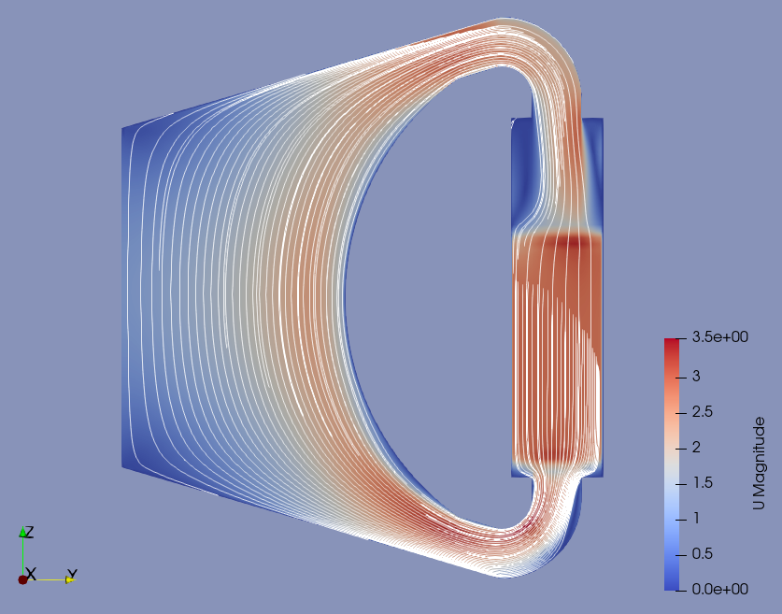
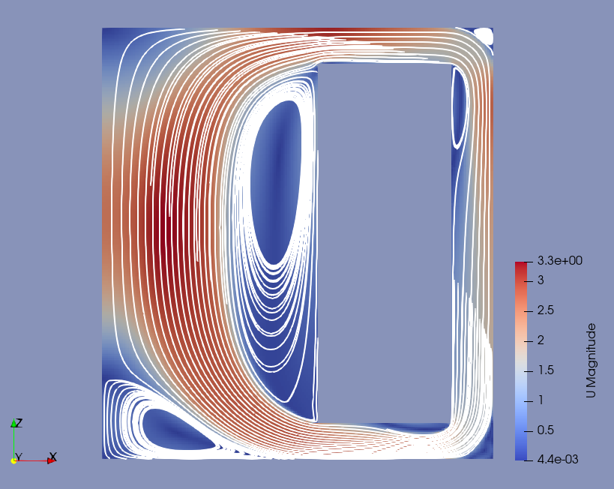
Exercise 1 - Results
GeN-Foam
Monday’s exercise - simpleFoam
L. Cattoni et al., Multiphysics Topology Optimization with Application to Molten Salt Fast Reactor, NENE 2021

Slide 6
Exercise 2

Slide 7
Exercise 2 – Setting the case
Starting from the previous case
Copy nuclear data to constant/neutroRegion
system/controlDict;
endTime 10;
deltaT 1e-1;
solveFluidMechanics false;
solveNeutronics true;
adjustTimeStep false;
liquidFuel true;
0/neutroRegion/defaultFlux + defaultFlux2:
front { type wedge; }
back { type wedge; }
"(bottomwall|topwall|reflector|hx)" { type fixedValue; value uniform 0; }
0/uniform/reactorState:
pTarget 20.0e+06;
Constant/neutroRegion/neutronicsProperties:
eigenvalueNeutronics true;

Slide 8
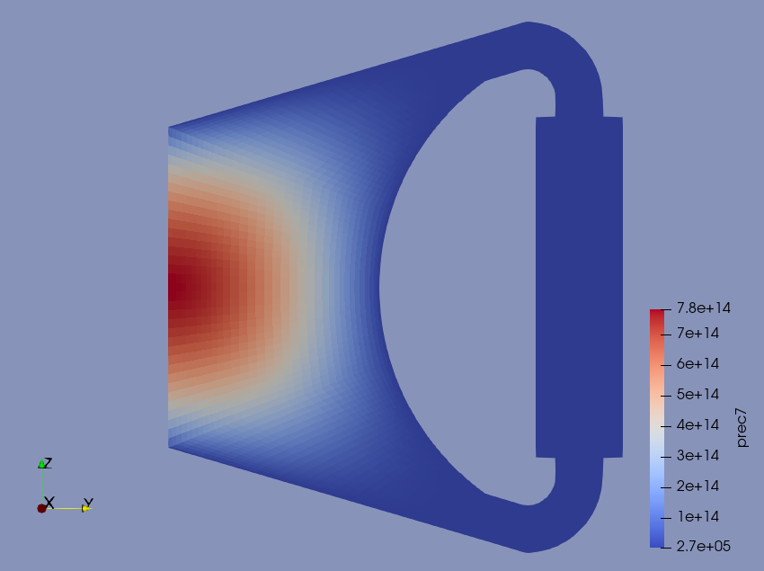
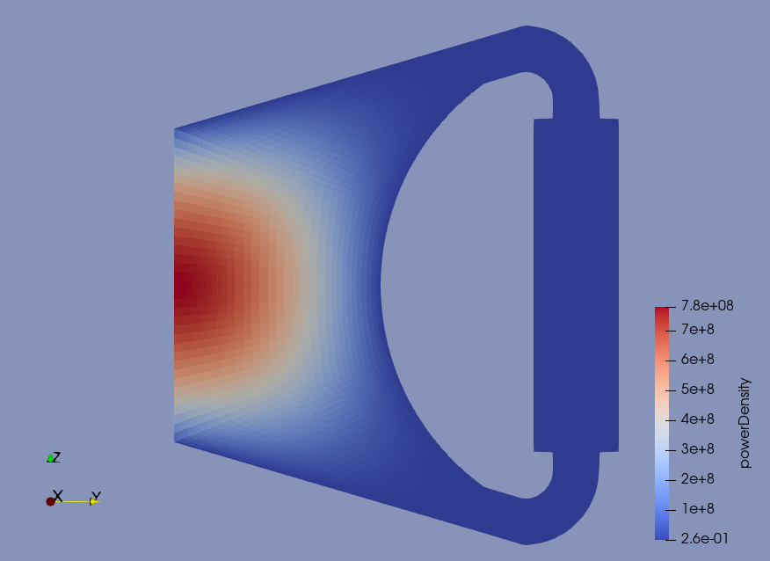
Exercise 2 - Results
kEff = 0.94390716
Precursor 7
Power density

Slide 9
Exercise 3

Slide 10
Exercise 3 – Setting the case
Starting from previous case
Copying results from Exercise 1 ($lastTimeStep/fluidRegion) to 0/fluidRegion
system/controlDict;
deltaT 1e-3;
solveFluidMechanics true;
solveNeutronics true;
adjustTimeStep true;
System/neutroRegion/fvSchemes:
divSchemes
{
default Gauss linear;
"div(facePhi_,angularFlux_)" Gauss upwind;
"div(phi_,precStar_)" Gauss upwind;
}

Slide 11
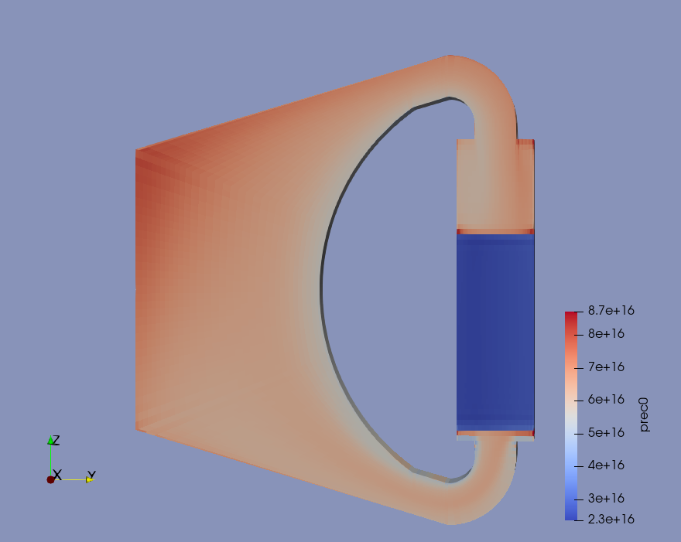
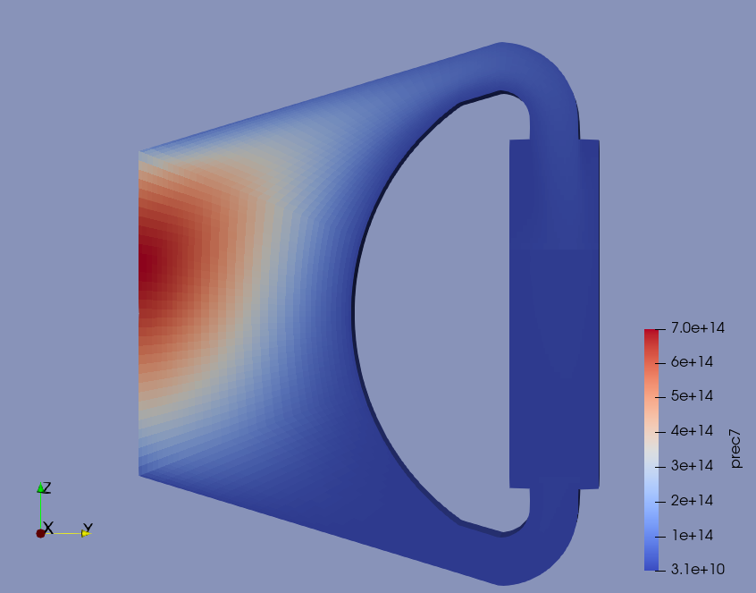
Exercise 3 - Results
kEff = 0.94196475
Precursor 0
Precursor 7

Slide 12
Exercise 4

Slide 13
Exercise 4 – Setting the case
Starting from previous case
system/controlDict;
endTime 180;
deltaT 1e-1;
writeInterval 10;
solveFluidMechanics false;
solveEnergy true;
solveNeutronics true;
adjustTimeStep false;
Constant/fluidRegion/phaseProperties:
"hx“
{
volumeFraction 0.6;
Dh 0.01;
powerModel
{ type fixedTemperature;
volumetricArea 200;
T 900;
} }
}

Slide 14
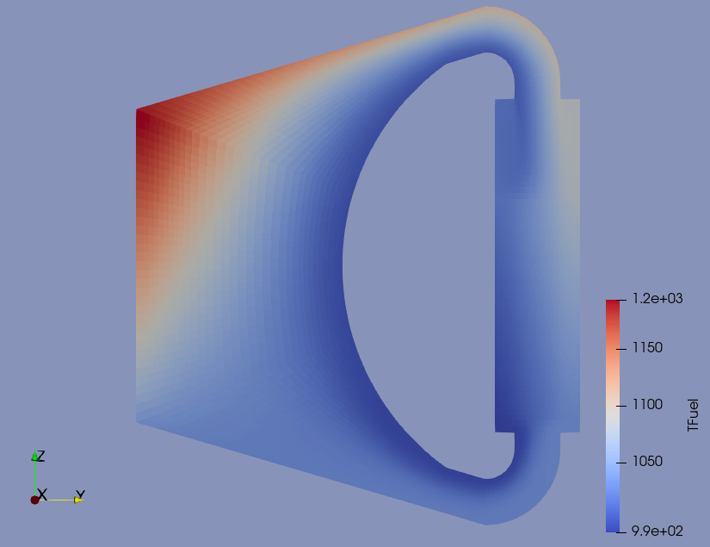
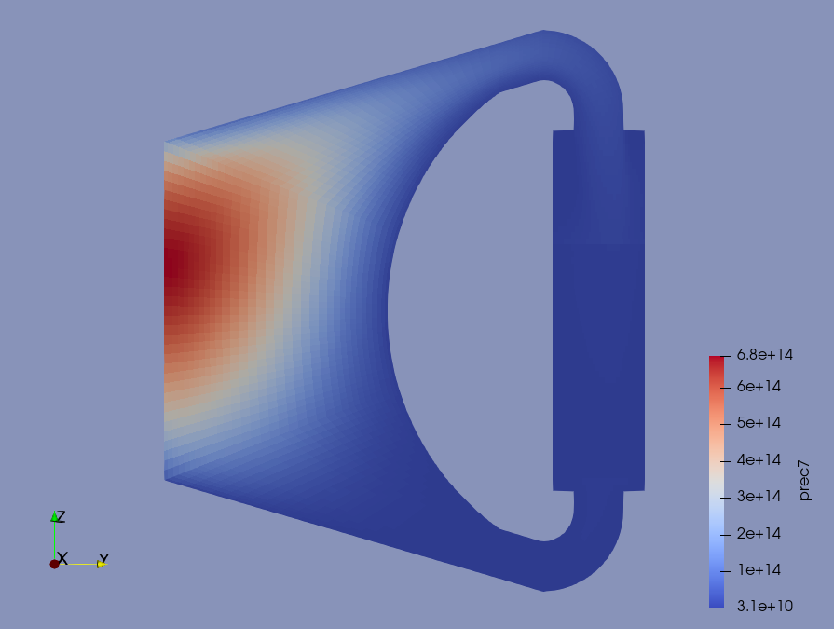
Exercise 4 - Results
kEff = 0.92740091 (in previous exercise 0.94196475)
T(fuel)
Precursor 7

Slide 15
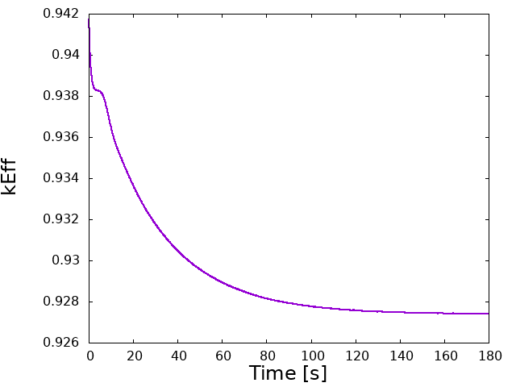
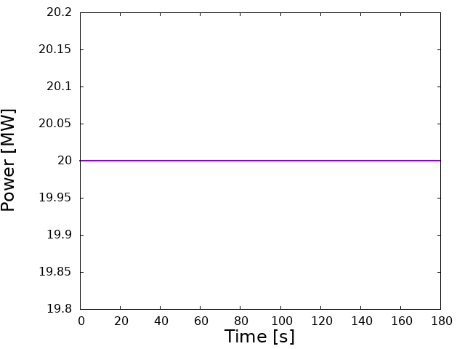
Exercise 4 - Results

Slide 16
Exercise 5

Slide 17
Exercise 5 – Setting the case
Starting from previous case (Exercise 4)
system/controlDict:
deltaT 1e-3;
solveFluidMechanics true;
solveEnergy true;
solveNeutronics true;
adjustTimeStep true;
system/fvSolution;
tightlyCoupled true;
constant/neutroRegion/neutronicsProperties:
eigenvalueNeutronics false;
0/uniform/reactorState:
keff 0.927701; // 0.92740091
$${Δk}_{eff}=\frac{1}{1−ρ}$$

Slide 18
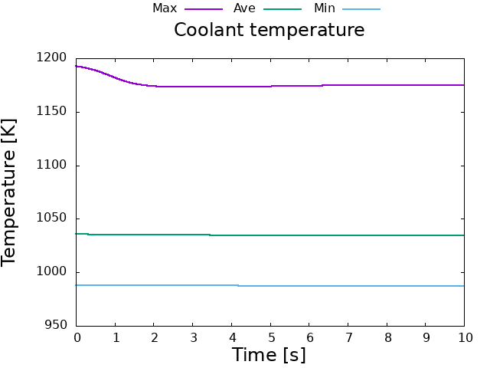
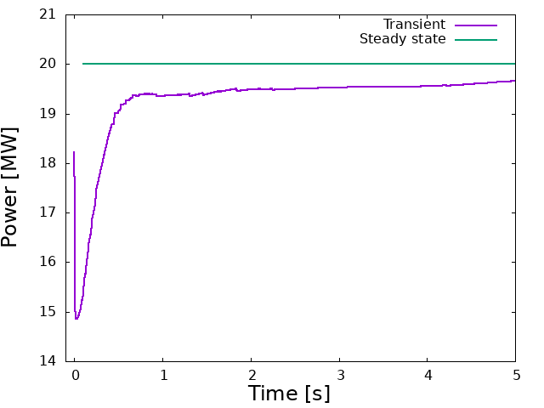
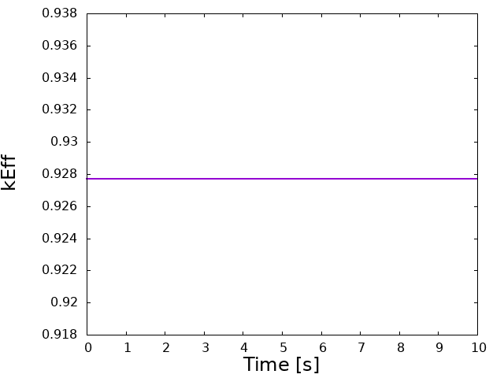
Exercise 5 - Results

Slide 19
Exercise 6

Slide 20
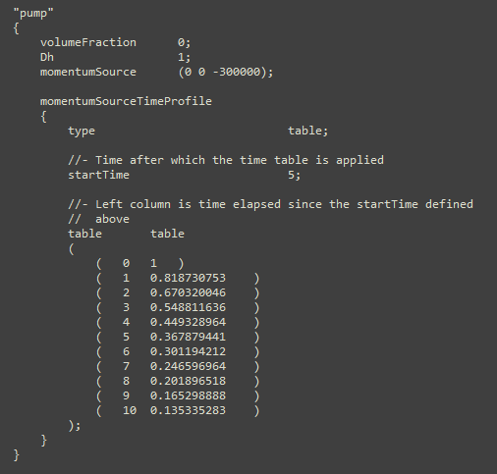
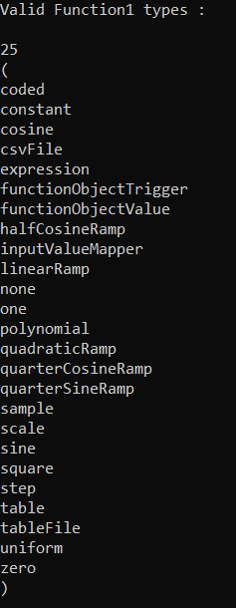
Exercise 6 – Setting the case
Starting from previous Exercise 4
system/controlDict:
endTime 25;
deltaT 1e-3;
solveFluidMechanics true;
solveEnergy true;
solveNeutronics true;
adjustTimeStep true;
constant/neutroRegion/neutronicsProperties:
eigenvalueNeutronics false;
constant/fluidRegion/phaseProperties:

Slide 21
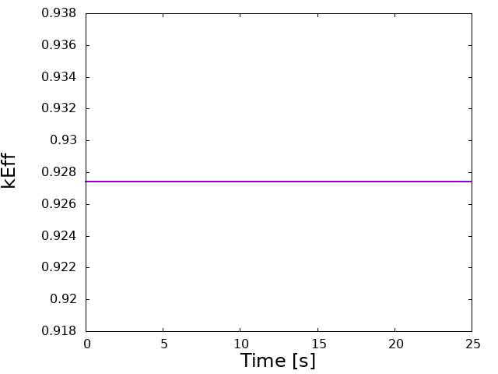
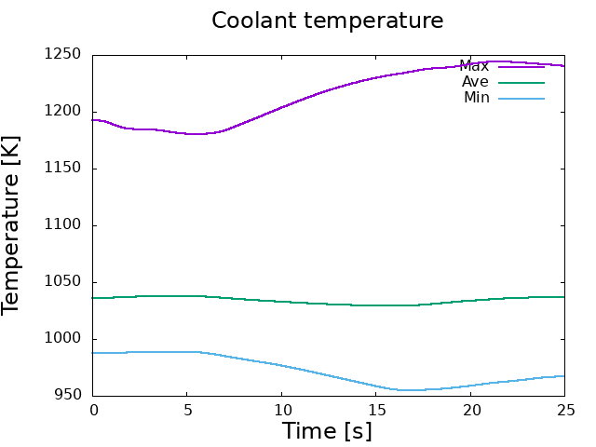
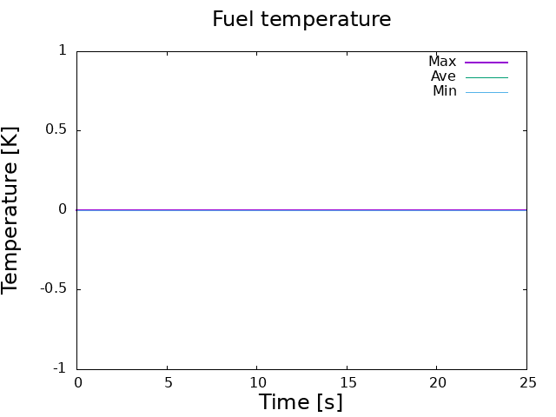
Exercise 6 - Results

Slide 22
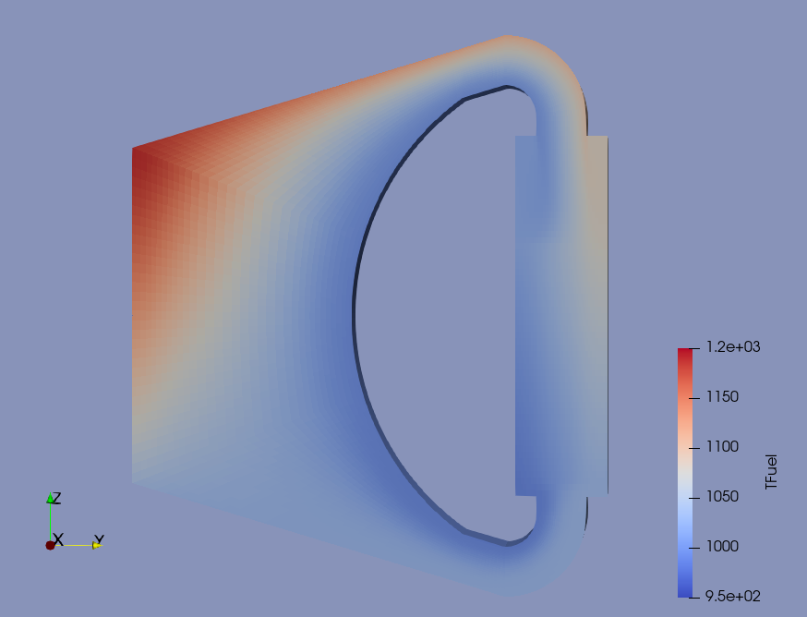
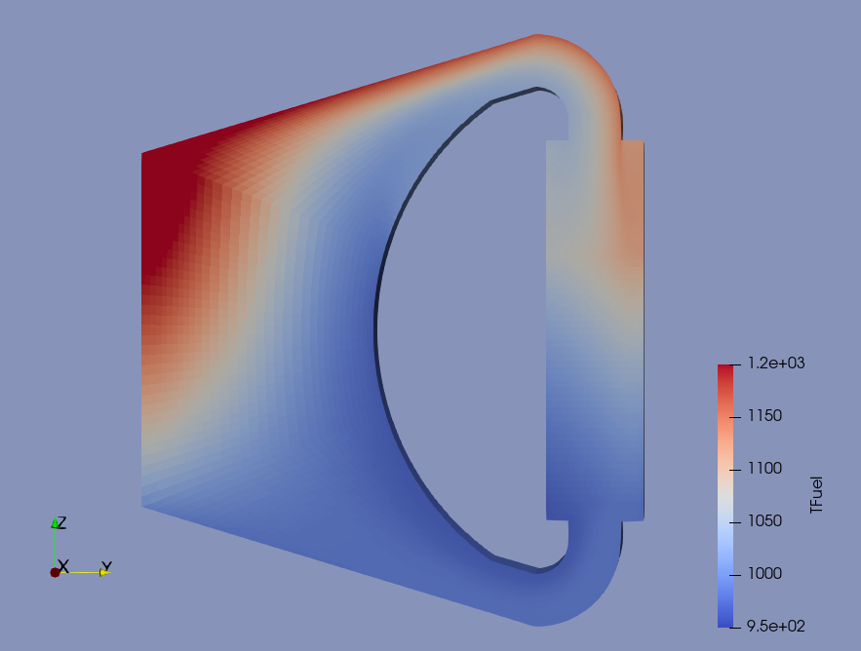
Exercise 6 - Results
T(fuel) @ t = 0 s
T(fuel) @ t = 20 s

Slide 24
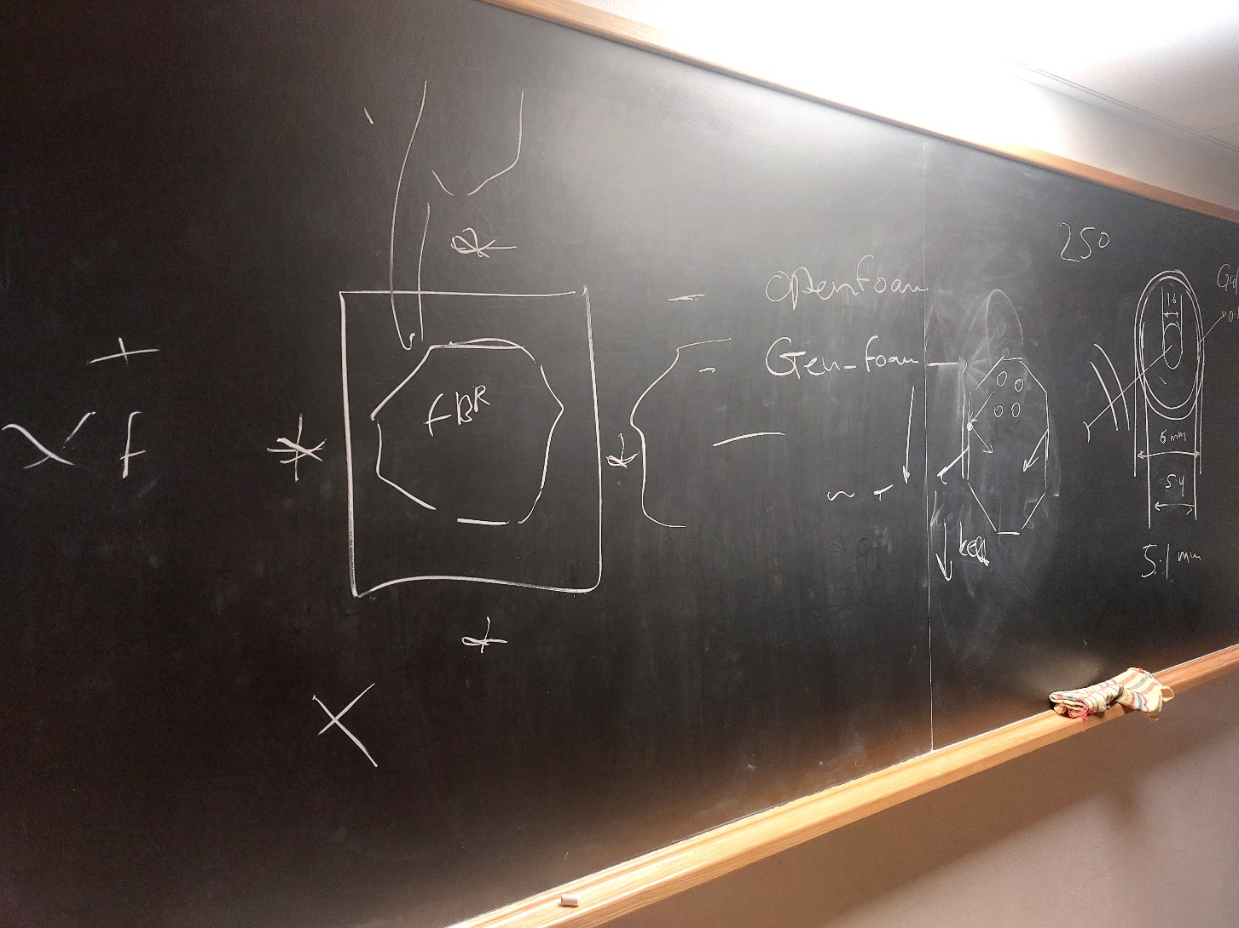
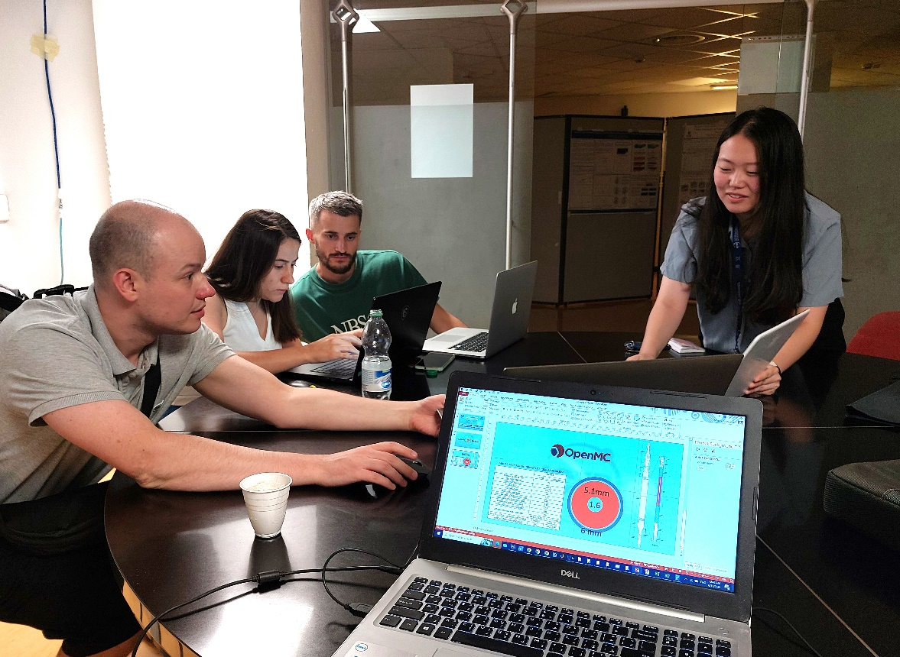
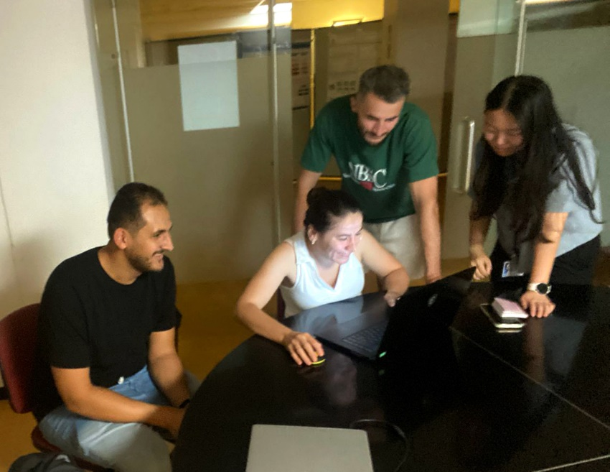

Slide 25
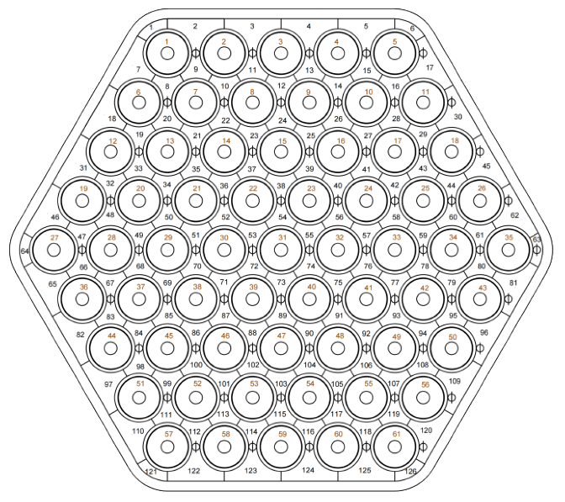
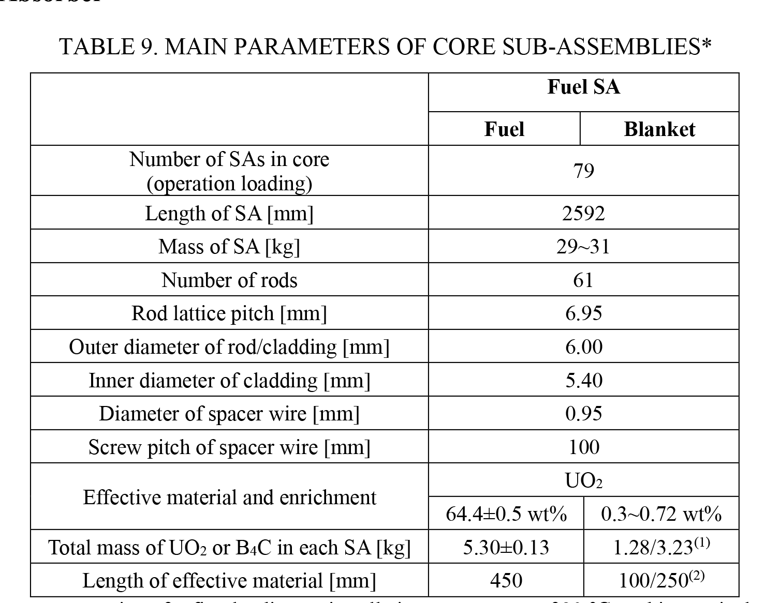
100
mm
0.15 mm
450
mm
5.1mm
250
mm
1.6
6 mm

Slide 26
Two cases
20 Cº
250 Cº
Inputs
Materials
Geometries
Setting

Slide 27
ISOTOPIC COMPOSITION OF STEEL MATERIALS (15-15TI)
Elem. | Rel. mass, w% | Isot | Natural abundance, % | ND, #/barn・cm
 |  |  |  | 20 ℃ | 250 ℃
Fe | 64.24 | Fe-54 | 0.05845 | 3.2138E-03 | 3.2006E-03
 |  | Fe-56 | 0.91754 | 5.0450E-02 | 5.0242E-02
 |  | Fe-57 | 0.02119 | 1.1651E-03 | 1.1603E-03
 |  | Fe-58 | 0.00282 | 1.5505E-04 | 1.5442E-04
Cr | 16.25 | Cr-50 | 0.04345 | 6.4906E-04 | 6.4639E-04
 |  | Cr-52 | 0.83789 | 1.2517E-02 | 1.2465E-02
 |  | Cr-53 | 0.09501 | 1.4193E-03 | 1.4134E-03
 |  | Cr-54 | 0.02365 | 3.5329E-04 | 3.5183E-04
Ni | 14.75 | Ni-58 | 0.68077 | 8.1775E-03 | 8.1437E-03
 |  | Ni-60 | 0.26223 | 3.1499E-03 | 3.1369E-03
 |  | Ni-61 | 0.011399 | 1.3693E-04 | 1.3636E-04
 |  | Ni-62 | 0.036346 | 4.3659E-04 | 4.3479E-04
 |  | Ni-64 | 0.009255 | 1.1117E-04 | 1.1071E-04
Mo | 2.2 | Mo-92 | 0.1453 | 1.5923E-04 | 1.5857E-04
 |  | Mo-94 | 0.0915 | 1.0027E-04 | 9.9856E-05
 |  | Mo-95 | 0.1584 | 1.7358E-04 | 1.7287E-04
 |  | Mo-96 | 0.1667 | 1.8268E-04 | 1.8192E-04
 |  | Mo-97 | 0.096 | 1.0520E-04 | 1.0477E-04
 |  | Mo-98 | 0.2439 | 2.6728E-04 | 2.6617E-04
 |  | Mo-100 | 0.0982 | 1.0761E-04 | 1.0717E-04
Mn | 1.5 | Mn-55 | 1 | 1.3051E-03 | 1.2997E-03
C | 0.06 | C-12 | 0.9893 | 2.3622E-04 | 2.3525E-04
 |  | C-13 | 0.0107 | 2.5549E-06 | 2.5444E-06
Ti | 0.35 | Ti-46 | 0.0825 | 2.8834E-05 | 2.8715E-05
 |  | Ti-47 | 0.0744 | 2.6003E-05 | 2.5896E-05
 |  | Ti-48 | 0.7372 | 2.5765E-04 | 2.5659E-04
 |  | Ti-49 | 0.0541 | 1.8908E-05 | 1.8830E-05
 |  | Ti-50 | 0.0518 | 1.8104E-05 | 1.8030E-05
Si | 0.45 | Si-28 | 0.92223 | 7.0629E-04 | 7.0338E-04
 |  | Si-29 | 0.04685 | 3.5880E-05 | 3.5732E-05
 |  | Si-30 | 0.03092 | 2.3680E-05 | 2.3583E-05
V | 0.2 | V-50 | 0.0025 | 4.6915E-07 | 4.6722E-07
 |  | V-51 | 0.9975 | 1.8719E-04 | 1.8642E-04
TOTAL MASSES OF FUEL AND BLANKET COMPONENTS IN A FUEL SA
Component | Mass, kg/SA
 | Fuel | Blanket
UO₂ | 5.28127 | 4.56629
U | 4.6460 | 4.01855
U-235 | 2.9820 | 0.0179
ISOTOPIC COMPOSITION OF FUEL AND BLANKET
Isotope | ND, #/barn·cm
 | 20 ℃ | 250 ℃
U-235 | 1.5062E-02 | 1.4948E-02
U-238 | 8.4052E-03 | 8.3417E-03
O-16 | 4.6934E-02 | 4.6580E-02

Slide 28
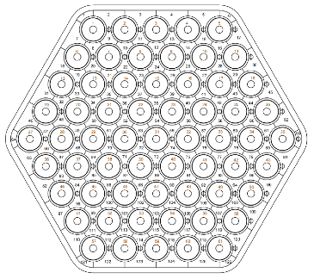
Two cases
20 Cº
250 Cº
Inputs
Materials
Geometries
Setting
1000
5000
k_{eff}
120
300
n
Power
FA & Pin
20
50
Reflection BC

Slide 29
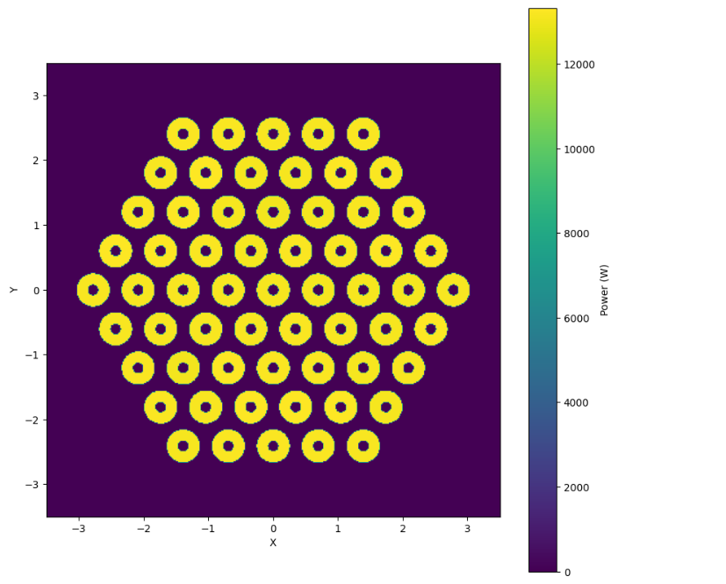
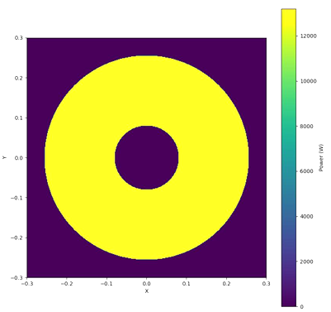
Two cases
20 Cº
250 Cº
Inputs
Materials
Geometries
Setting
K_{eff} =$\text{1.55641} \text{ +/− 0.00164}$

Slide 30
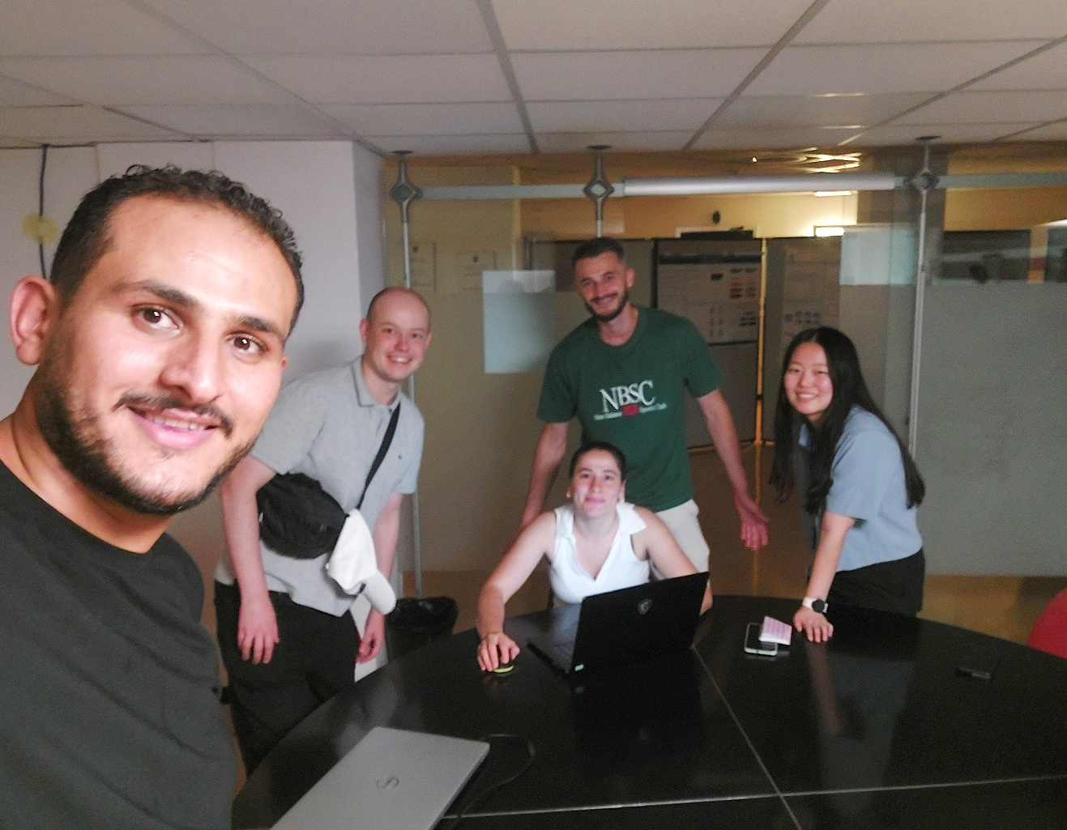
Thank you for
your attention

