Slide 1
Group Activities
Group 4
Shailja Tiwari, Berta Burger, Yuhang Niu, Lei Zhou, Fengrui Xiang
Joint ICTP-IAEA Workshop on Open-Source Nuclear Codes for Reactor Analysis. Trieste, Italy. 7th Aug 2023 – 11th Aug 2023

Slide 2
GeN-Foam Assignments
Joint ICTP-IAEA Workshop on Open-Source Nuclear Codes for Reactor Analysis. Trieste, Italy. 7th Aug 2023 – 11th Aug 2023

Slide 3
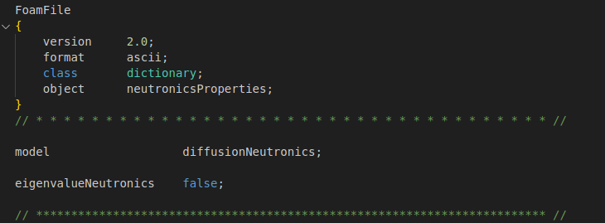
Assignment 5
Setting
Now we want to study the transient behavior of the reactor.
/constant/neutroRegion/neutronicsProperties

Slide 4
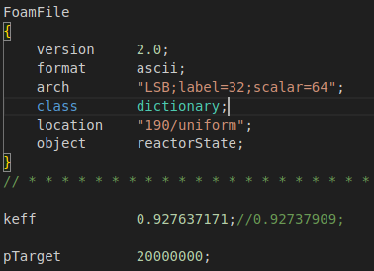
Assignment 5
Setting
Starting from the steady state of Exercise 4, run a transient with an increase of 30 pcm in reactivity.
/190/uniform/reactorState

Slide 5
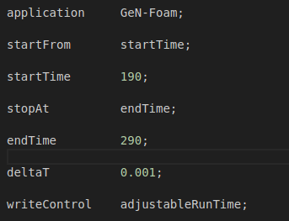
Assignment 5
Setting
We used the results of the previous simulation and run 100s.
We kept ‘solveFluidMechanics’ deactivated.
/system/controlDict

Slide 6
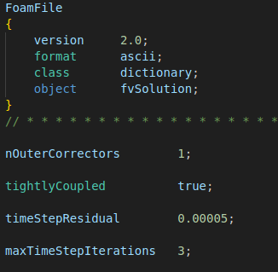
Assignment 5
Setting
We used tight coupling
/system/fvSolution

Slide 7
Assignment 5
Results
Power
Temperature

Slide 8
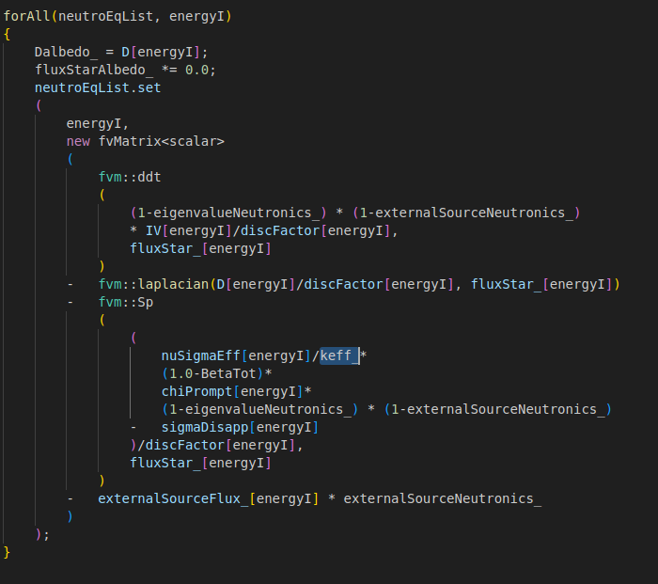
Assignment 5
Analysis
classes/neutronics/diffusion/include/createFluxMatrices.H

Slide 9
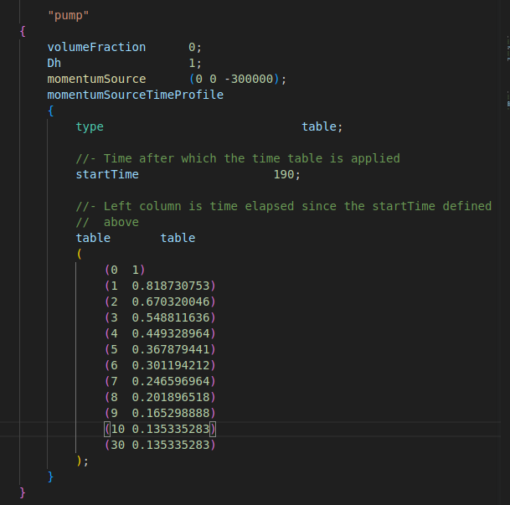
Assignment 6
Settings
Starting from the case of Exercise 4, run a transient with an exponential reduction in the pump momentum source with a time constant of 5 seconds, for 10 seconds. After 10 seconds, the reduction stops. But keep the transient going for 20 seconds.
/constant/fluidRegion/phaseProperties

Slide 10
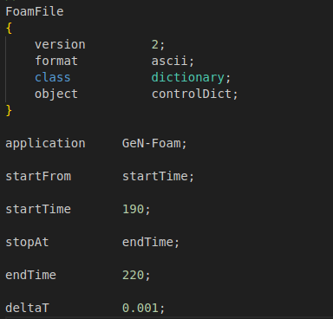
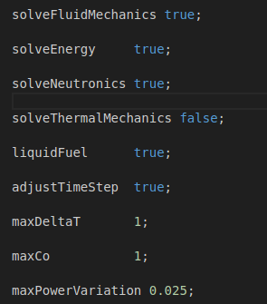
Assignment 6
Settings
We used the results of the assignment 4 and run 30s.
We switched on ‘solveFluidMechanics’ and ‘adjustTimeStep’.
/system/controlDict

Slide 11
Assignment 6
Results
k_{eff} variation
Average Temperature

Slide 12
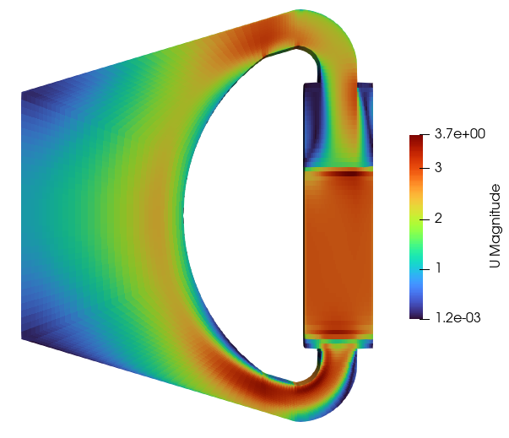
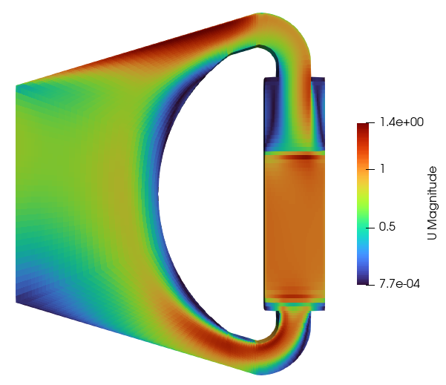
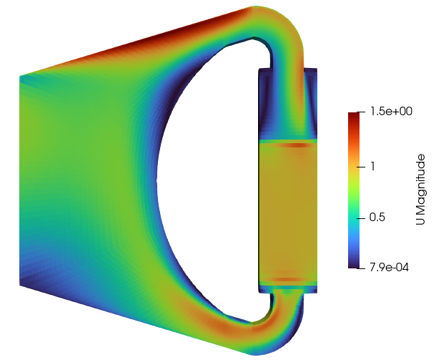
Assignment 6
Results
U (190s)
U (200s)
U (220s)

Slide 13
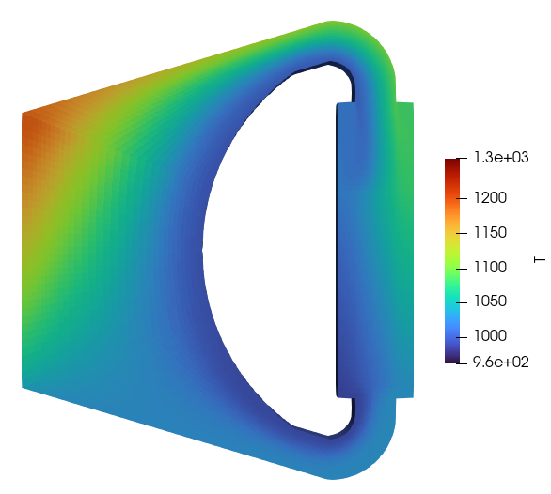
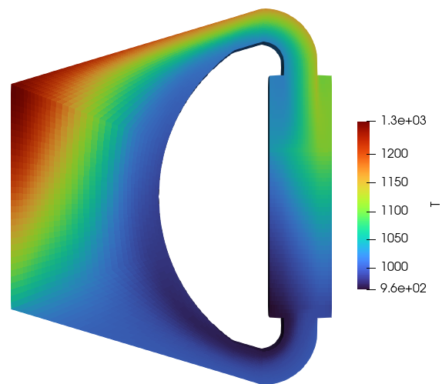
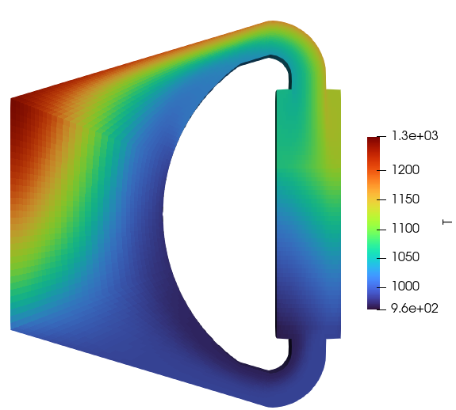
Assignment 6
Results
T (190s)
T (200s)
T (220s)

Slide 14
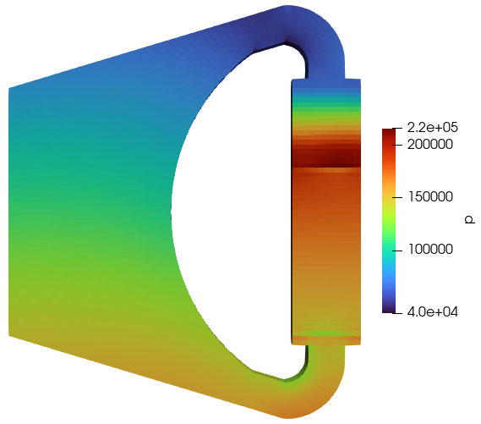
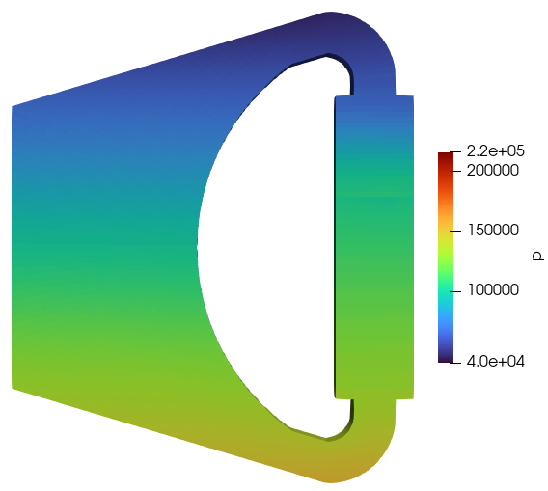
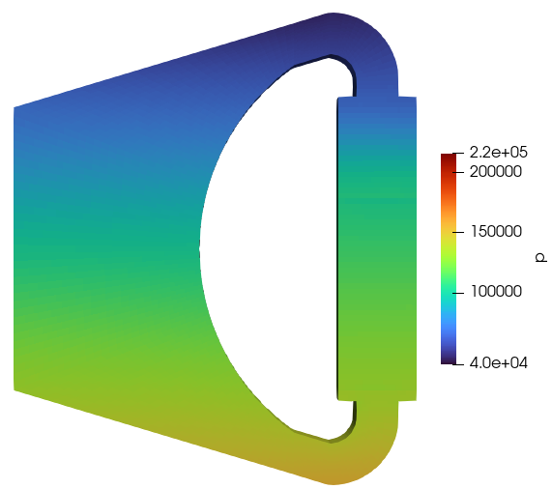
Assignment 6
Results
P (190s)
P (200s)
P (220s)

Slide 15
OpenMC Assignments
Joint ICTP-IAEA Workshop on Open-Source Nuclear Codes for Reactor Analysis. Trieste, Italy. 7th Aug 2023 – 11th Aug 2023

Slide 16
Task
we'll create a pin-cell of the fuel assembly with addition of water cell surrounding fuel pin to check n-flux with existing material compositions using OpenMC
We will calculate CFR fuel pin composition at higher temp 300 C and see the results of CFR SA fuel pin exercise

Slide 17
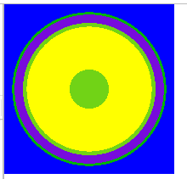
Task 1
For this example, we'll create a pin-cell of the CEFR fuel assembly with simplified material compositions. More accurate material compositions will be applied as part of the exercise at the end of the day.
UO2
Helium
Sodium
Stainless Steel
all at a temperature of 523.15 K.
The dimensions of our fuel pin will be as follows:
Fuel pin center hole radius = 0.08020 cm
Fuel outer radius = 0.0.25565 cm
Clad inner radius = 0.27112 cm
Clad outer radius = 0.30499 cm
Fuel pin pitch = 0.695 cm
Introduced a water layer outside Clad
coolantw_outer_radius = openmc.ZCylinder(r=0.315)

Slide 18
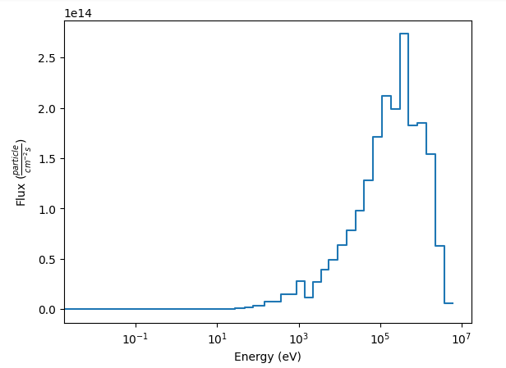
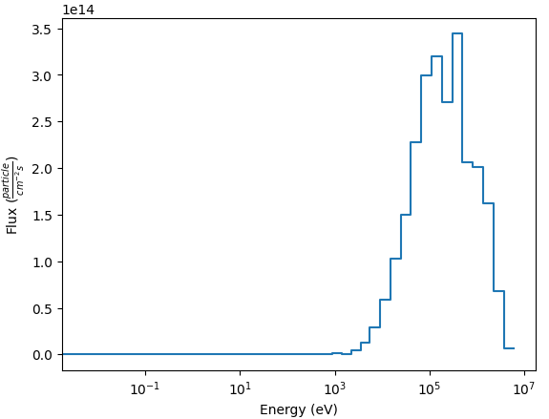
Change in keff and neutron spectrum
Task 1
with water layer
============================> RESULTS <============================
k-effective (Collision) = 1.00676 +/- 0.00445
k-effective (Track-length) = 1.00711 +/- 0.00435
k-effective (Absorption) = 1.00287 +/- 0.00615
Combined k-effective = 1.00563 +/- 0.00350
Leakage Fraction = 0.52429 +/- 0.00277
With original problem
============================> RESULTS <============================
k-effective (Collision) = 2.00489 +/- 0.00752
k-effective (Track-length) = 2.00193 +/- 0.00789
k-effective (Absorption) = 2.00574 +/- 0.00211
Combined k-effective = 2.00598 +/- 0.00184
Leakage Fraction = 0.00000 +/- 0.00000

Slide 19
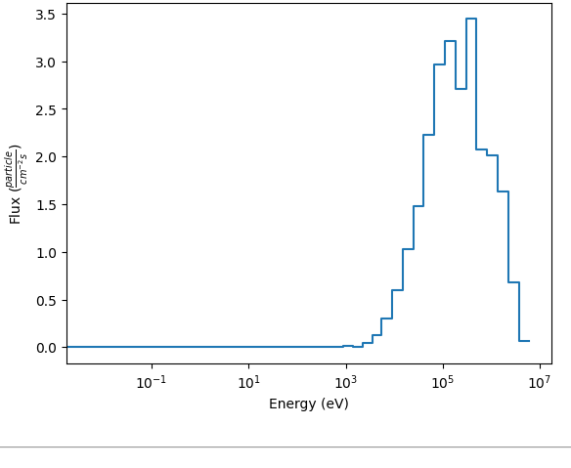
Task 2: CFR fuel pin composition at higher temp 300 C
Isotope | Mass density, g/cm^3
 | 20 C | 250 C | 300C | 350C
U235 | 5.89831812866023 | 5.853775E+00 | 5.844152E+00 | 5.834549E+00
U238 | 3.29148055882422 | 3.266624E+00 | 3.261254E+00 | 3.255895E+00
O16 | 1.2565205522629 | 1.247032E+00 | 1.244981E+00 | 1.242936E+00
Total | 10.4463192397474
ND, #/barn·cm
20 C | 250 C | 300 C | 350C
1.5112E-02 | 1.4998E-02 | 1.4973E-02 | 1.4949E-02
8.3267E-03 | 8.2638E-03 | 8.2502E-03 | 8.2367E-03
4.7308E-02 | 4.6951E-02 | 4.6874E-02 | 4.6797E-02
===========================> RESULTS <============================
k-effective (Collision) = 2.01534 +/- 0.00911
k-effective (Track-length) = 2.01070 +/- 0.00926
k-effective (Absorption) = 2.00597 +/- 0.00239
Combined k-effective = 2.00747 +/- 0.00194
Leakage Fraction = 0.00000 +/- 0.00000

Slide 20
Task 3
We calculate all the atom density and geometry expansion
Based on the provided single assembly exercise, we extend it to a small core with seven assemblies and a reflective boundary condition
We plot the each pins power and blanket power of the seven subassemblies, and also the flux
Seven subassemblies
single subassemblies

Slide 21
Task 3
Fuel
Isotope | Mass density, g/cm^3 |  | ND, #/barn·cm
 | 20 C | 250 C | 20 C | 250 C
U235 | 5.898318 | 5.853775 | 0.015112 | 0.014998
U238 | 3.291481 | 3.266624 | 0.008327 | 0.008264
O16 | 1.256521 | 1.247032 | 0.047308 | 0.046951
Total | 10.44632
Blanket
Isotope | Mass density, g/cm^3 |  | ND, #/barn·cm
 | 20 C | 250 C | 20 C | 250 C
U235 | 0.04104166 | 4.075977E-02 | 1.0517E-04 | 1.0445E-04
U238 | 9.172811006 | 9.109809E+00 | 2.3506E-02 | 2.3050E-02
O16 | 1.255874795 | 1.247249E+00 | 3.2182E-03 | 4.6943E-02
Total | 10.46972746

Slide 22
15-15Ti
Element | Relative mass, | Isotope | A, g/mol | Natural | Average atomic mass | Density |  | ND, #/barn·cm
 | w% |  |  |  |  | 20 | 250 | 20 ℃ | 250 ℃
 |  |  |  |  |  | 7.97 | 7.87 | 7.97 | 7.871827E+00
Fe | 64.24 | Fe-54 | 53.93960899 | 0.05845 | 55.8451444 | 5.119928 | 5.0568614 | 3.22711E-03 | 3.18736E-03
 |  | Fe-56 | 55.93493633 | 0.91754 |  |  |  | 5.06587E-02 | 5.00347E-02
 |  | Fe-57 | 56.93539284 | 0.02119 |  |  |  | 1.16993E-03 | 1.15552E-03
 |  | Fe-58 | 57.93327443 | 0.00282 |  |  |  | 1.55696E-04 | 1.53778E-04
Cr | 16.25 | Cr-50 | 49.94604183 | 0.04345 | 51.9961318 | 1.295125 | 1.27917182 | 6.51750E-04 | 6.43722E-04
 |  | Cr-52 | 51.94050623 | 0.83789 |  |  |  | 1.25684E-02 | 1.24135E-02
 |  | Cr-53 | 52.94064815 | 0.09501 |  |  |  | 1.42515E-03 | 1.40760E-03
 |  | Cr-54 | 53.93887916 | 0.02365 |  |  |  | 3.54750E-04 | 3.50380E-04
Ni | 14.75 | Ni-58 | 57.93534241 | 0.68077 | 58.6933471 | 1.175575 | 1.16109442 | 8.21131E-03 | 8.11016E-03
 |  | Ni-60 | 59.93078588 | 0.26223 |  |  |  | 3.16297E-03 | 3.12400E-03
 |  | Ni-61 | 60.93105557 | 0.011399 |  |  |  | 1.37492E-04 | 1.35799E-04
 |  | Ni-62 | 61.92834537 | 0.036346 |  |  |  | 4.38398E-04 | 4.32998E-04
 |  | Ni-64 | 63.92796682 | 0.009255 |  |  |  | 1.11632E-04 | 1.10257E-04
Mo | 2.2 | Mo-92 | 91.90680796 | 0.1453 | 95.9597885 | 0.17534 | 0.17318019 | 1.59885E-04 | 1.57916E-04
 |  | Mo-94 | 93.9050849 | 0.0915 |  |  |  | 1.00685E-04 | 9.94445E-05
 |  | Mo-95 | 94.90583877 | 0.1584 |  |  |  | 1.74300E-04 | 1.72153E-04
 |  | Mo-96 | 95.90467612 | 0.1667 |  |  |  | 1.83433E-04 | 1.81174E-04
 |  | Mo-97 | 96.90601812 | 0.096 |  |  |  | 1.05636E-04 | 1.04335E-04
 |  | Mo-98 | 97.90540482 | 0.2439 |  |  |  | 2.68382E-04 | 2.65077E-04
 |  | Mo-100 | 99.9074718 | 0.0982 |  |  |  | 1.08057E-04 | 1.06726E-04
…

Slide 23
15-15Ti
Element | Relative mass, | Isotope | A, g/mol | Natural | Average atomic mass | Density |  | ND, #/barn·cm
 | w% |  |  |  |  | 20 | 250 | 20 ℃ | 250 ℃
 |  |  |  |  |  | 7.97 | 7.87 | 7.97 | 7.871827E+00
…
Mn | 1.5 | Mn-55 | 54.93804391 | 1 | 54.9380439 | 0.11955 | 0.1180774 | 1.31047E-03 | 1.29433E-03
C | 0.06 | C-12 | 12 | 1 | 12 | 0.004782 | 0.0047231 | 2.39982E-04 | 2.37026E-04
Ti | 0.35 | Ti-46 | 45.95262772 | 0.0825 | 47.866745 | 0.027895 | 0.02755139 | 2.89532E-05 | 2.85966E-05
 |  | Ti-47 | 46.95175879 | 0.0744 |  |  |  | 2.61105E-05 | 2.57889E-05
 |  | Ti-48 | 47.94794198 | 0.7372 |  |  |  | 2.58719E-04 | 2.55532E-04
 |  | Ti-49 | 48.94786568 | 0.0541 |  |  |  | 1.89863E-05 | 1.87524E-05
 |  | Ti-50 | 49.94478689 | 0.0518 |  |  |  | 1.81791E-05 | 1.79552E-05
Si | 0.45 | Si-28 | 27.97692653 | 0.92223 | 28.0854987 | 0.035865 | 0.03542322 | 7.09216E-04 | 7.00480E-04
 |  | Si-29 | 28.97649466 | 0.04685 |  |  |  | 3.60287E-05 | 3.55849E-05
 |  | Si-30 | 29.97377014 | 0.03092 |  |  |  | 2.37782E-05 | 2.34853E-05
 |  |  |  | Total: |  |  |  | 8.60440E-02 | 8.49842E-02

Slide 24
316Ti
Element | Relative mass, | Isotope | A, g/mol | Natural | Average atomic mass | Density |  | ND, #/barn·cm
 | w% |  |  |  |  | 20 | 250 | 20 ℃ | 250 ℃
 |  |  |  |  |  | 7.98 | 7.88
Fe | 65.19 | Fe-54 | 53.939609 | 0.05845 | 55.845144 | 5.202162 | 5.1380825 | 3.27894E-03 | 3.23855E-03
 |  | Fe-56 | 55.934936 | 0.91754 |  |  |  | 5.14724E-02 | 5.08383E-02
 |  | Fe-57 | 56.935393 | 0.02119 |  |  |  | 1.18872E-03 | 1.17408E-03
 |  | Fe-58 | 57.933274 | 0.00282 |  |  |  | 1.58197E-04 | 1.56248E-04
Cr | 17 | Cr-50 | 49.946042 | 0.04345 | 51.996132 | 1.3566 | 1.3398896 | 6.82686E-04 | 6.74277E-04
 |  | Cr-52 | 51.940506 | 0.83789 |  |  |  | 1.31649E-02 | 1.30028E-02
 |  | Cr-53 | 52.940648 | 0.09501 |  |  |  | 1.49280E-03 | 1.47441E-03
 |  | Cr-54 | 53.938879 | 0.02365 |  |  |  | 3.71589E-04 | 3.67012E-04
Ni | 12.5 | Ni-58 | 57.935342 | 0.68077 | 58.693347 | 0.9975 | 0.9852129 | 6.96747E-03 | 6.88164E-03
 |  | Ni-60 | 59.930786 | 0.26223 |  |  |  | 2.68384E-03 | 2.65078E-03
 |  | Ni-61 | 60.931056 | 0.011399 |  |  |  | 1.16665E-04 | 1.15228E-04
 |  | Ni-62 | 61.928345 | 0.036346 |  |  |  | 3.71990E-04 | 3.67408E-04
 |  | Ni-64 | 63.927967 | 0.009255 |  |  |  | 9.47220E-05 | 9.35553E-05
Mo | 2.5 | Mo-92 | 91.906808 | 0.1453 | 95.959789 | 0.1995 | 0.1970426 | 1.81916E-04 | 1.79675E-04
 |  | Mo-94 | 93.905085 | 0.0915 |  |  |  | 1.14558E-04 | 1.13147E-04
 |  | Mo-95 | 94.905839 | 0.1584 |  |  |  | 1.98317E-04 | 1.95874E-04
 |  | Mo-96 | 95.904676 | 0.1667 |  |  |  | 2.08708E-04 | 2.06138E-04
 |  | Mo-97 | 96.906018 | 0.096 |  |  |  | 1.20192E-04 | 1.18711E-04
 |  | Mo-98 | 97.905405 | 0.2439 |  |  |  | 3.05363E-04 | 3.01601E-04
 |  | Mo-100 | 99.907472 | 0.0982 |  |  |  | 1.22946E-04 | 1.21432E-04
… | … | … | … | … | … | … | … | … | …

Slide 25
316Ti
Element | Relative mass, | Isotope | A, g/mol | Natural | Average atomic mass | Density |  | ND, #/barn·cm
 | w% |  |  |  |  | 20 | 250 | 20 ℃ | 250 ℃
 |  |  |  |  |  | 7.98 | 7.88
… | … | … | … | … | … | … | … | … | …
Mn | 1.75 | Mn-55 | 54.938044 | 1 | 54.938044 | 0.13965 | 0.1379298 | 1.53080E-03 | 1.51194E-03
C | 0.06 | C-12 | 12 | 1 | 12 | 0.004788 | 0.004729 | 2.40283E-04 | 2.37323E-04
Ti | 0.4 | Ti-46 | 45.952628 | 0.0825 | 47.866745 | 0.03192 | 0.0315268 | 3.31309E-05 | 3.27228E-05
 |  | Ti-47 | 46.951759 | 0.0744 |  |  |  | 2.98781E-05 | 2.95100E-05
 |  | Ti-48 | 47.947942 | 0.7372 |  |  |  | 2.96050E-04 | 2.92403E-04
 |  | Ti-49 | 48.947866 | 0.0541 |  |  |  | 2.17259E-05 | 2.14582E-05
 |  | Ti-50 | 49.944787 | 0.0518 |  |  |  | 2.08022E-05 | 2.05460E-05
Si | 0.6 | Si-28 | 27.976927 | 0.92223 | 28.085499 | 0.04788 | 0.0472902 | 9.46808E-04 | 9.35145E-04
 |  | Si-29 | 28.976495 | 0.04685 |  |  |  | 4.80986E-05 | 4.75061E-05
 |  | Si-30 | 29.97377 | 0.03092 |  |  |  | 3.17440E-05 | 3.13530E-05
 |  |  |  | Total: |  |  |  | 8.64962E-02 | 8.54308E-02

Slide 26
# | a_FU | Upper region boundary at 20 ℃, cm | Upper region boundary at 250 ℃, cm
1 | Head | 219.7 | 220.473
2 | Upper shield | 196.7 | 197.377
3 | Upper connector | 149.7 | 150.183
4 | Top end plug | 143.7 | 144.158
5 | Spring | 142.7 | 143.154
6 | Upper blanket | 137.2 | 137.631
7 | Fuel | 127.2 | 127.608
8 | Lower blanket | 82.2 | 82.495
9 | Lower gas plenum | 57.2 | 57.437
10 | Bottom end plug | 12.2 | 12.251
11 | Lower connector | 8.7 | 8.736

Slide 27
TABLE 3 (20)
Parameter | Fuel | Blanket | Source
Inner pellet radius (ri), cm | 0.08 | 0
Outer pellet radius (ro), cm | 0.255 | 0.255
Inner clad radius | 0.27 | 0.27
outer clad radius | 0.3 | 0.3
Total region height (h), cm | 45 | 35
Number of fuel pins (n) | 61 | 61
Total volume (V), cm3/SA | 505.5627613 | 436.142203
TABLE 3 (250)
Parameter | Fuel | Blanket | Source
Inner pellet radius (ri), cm | 8.0202E-02 | 0
Outer pellet radius (ro), cm | 2.5565E-01 | 2.555865E-01
Inner clad radius | 2.7112E-01 | 2.7112E-01
outer clad radius | 3.0124E-01 | 3.0124E-01
Total region height (h), cm | 45 | 35
Number of fuel pins (n) | 61 | 61
Total volume (V), cm3/SA | 508.1241449 | 438.1507643

Slide 28
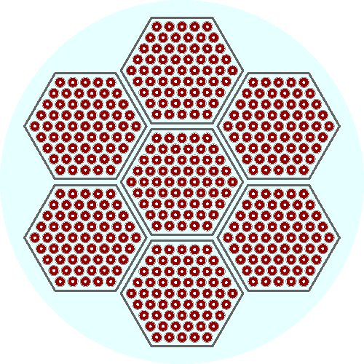
Task 3

Slide 29
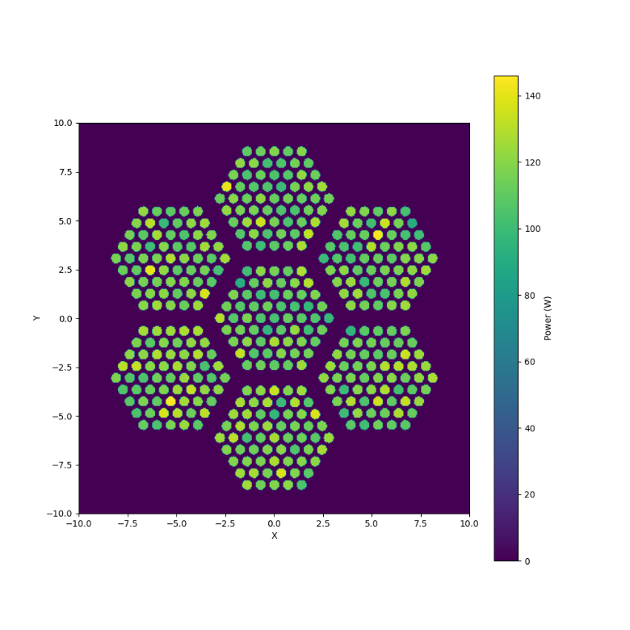
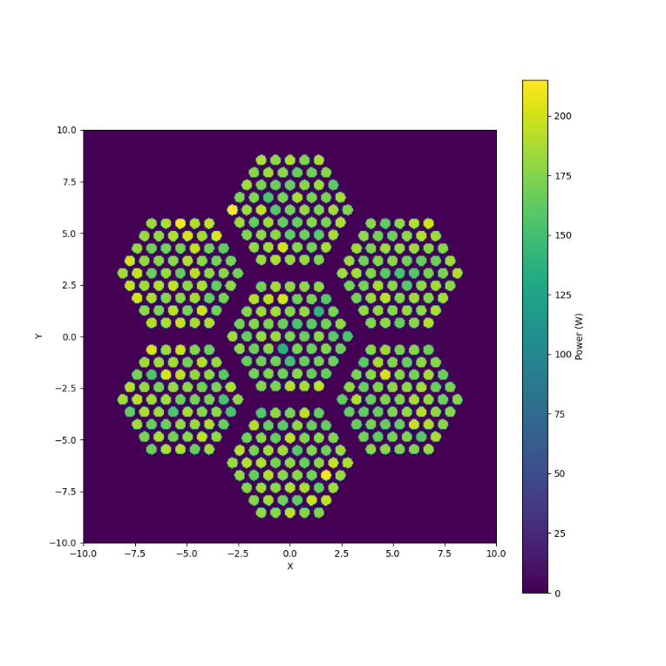
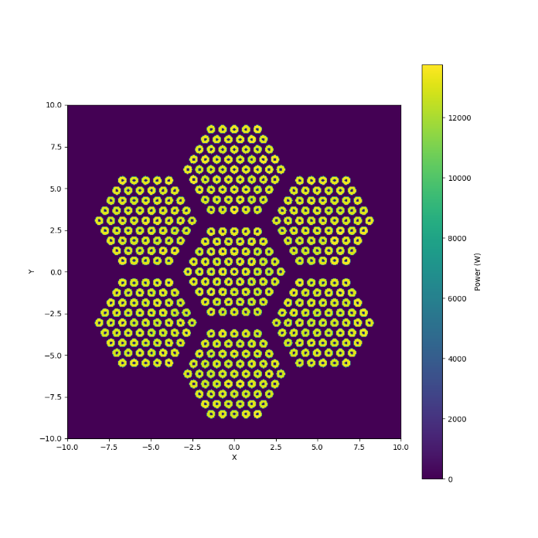
Task 3
Lower_Blanket
Fuel_pin
Upper_Blanket

Slide 30
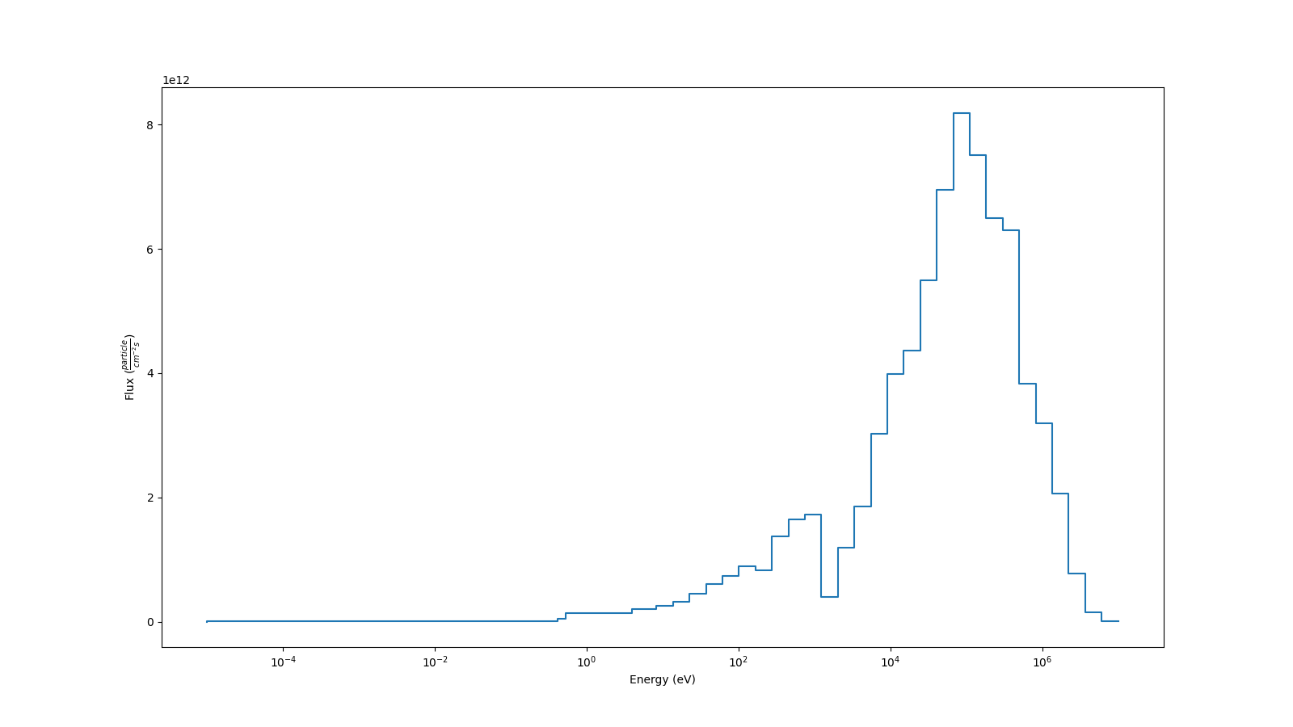
Task 3

Slide 31
Thanks
Joint ICTP-IAEA Workshop on Open-Source Nuclear Codes for Reactor Analysis. Trieste, Italy. 7th Aug 2023 – 11th Aug 2023

