Slide 1
ME-RER9154-2300641: Regional Workshop on Approaches to Ageing Management of Waste Packages in Storage
Workshop in perspective
Willie Meyer
Predisposal Specialist
Waste Technology Section
No copyright restrictions

Slide 2
Contents
IAEA mandate
2. Introduction
3. Possible future facilities
4. Waste form degradation influencing safety in facilities
5. Workshop contents

Slide 3
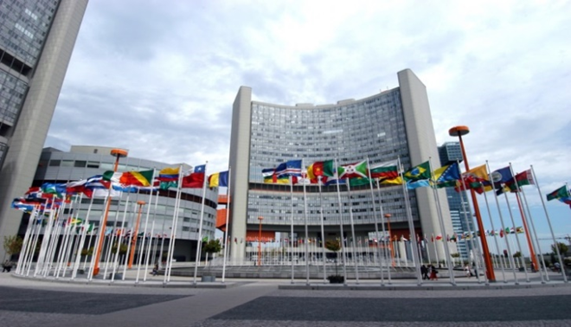
1. IAEA mandate
IAEA MANDATE:
To facilitate the exchange of information between member states
WTS KEY OBJECTIVE
Cost effective, fit-for-purpose solutions to safely manage radioactive waste (past, present & future) are key to ensuring the future sustainability of nuclear energy and nuclear applications.
Established in 1957
175 Member States
~2,560 multidisciplinary professional & support staff from more than 100 countries
Notes:
This comprehensive introduction to RWM is structured in 5 main parts.

Slide 4
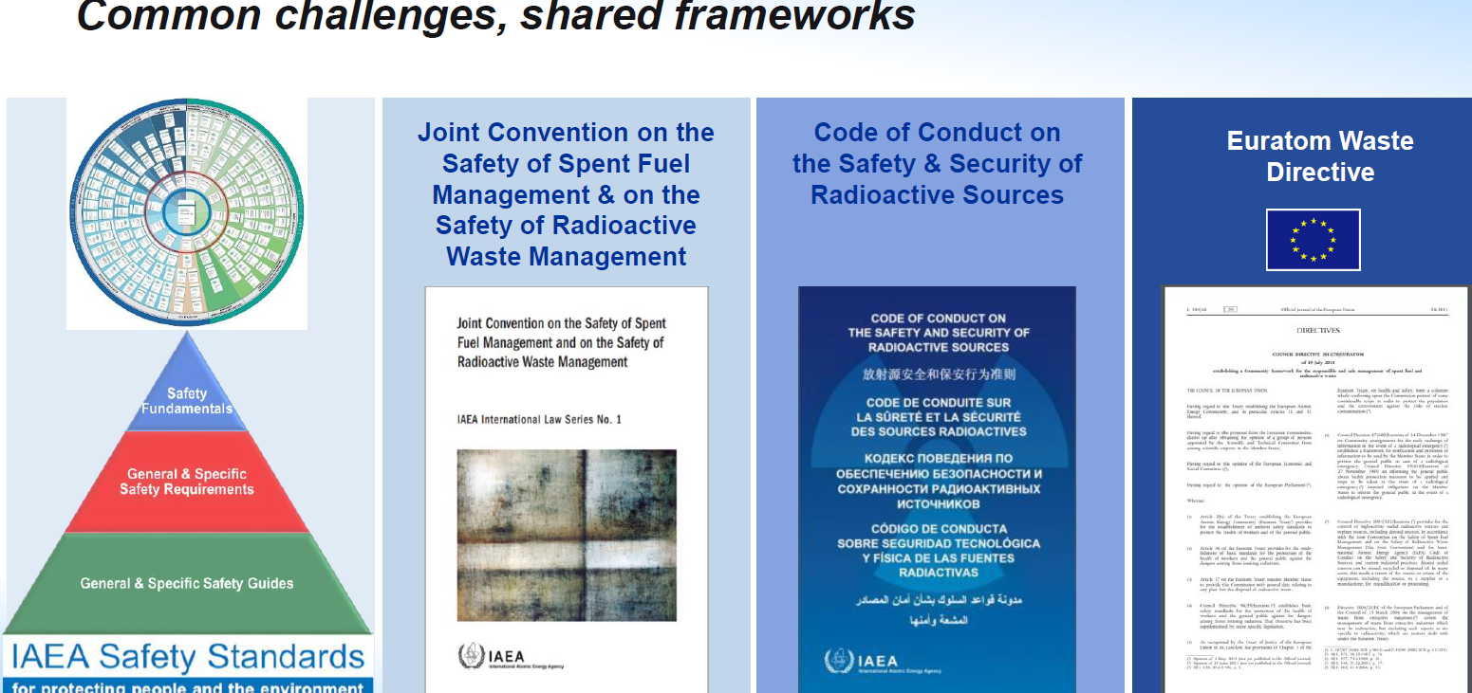
1. IAEA mandate

Slide 5
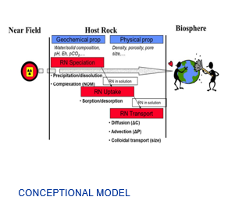
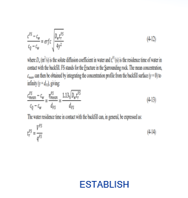
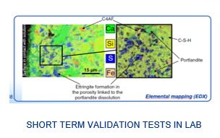
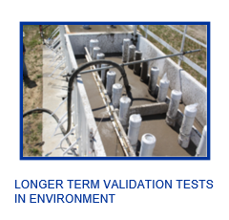
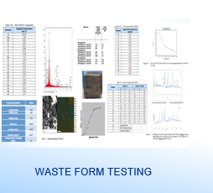
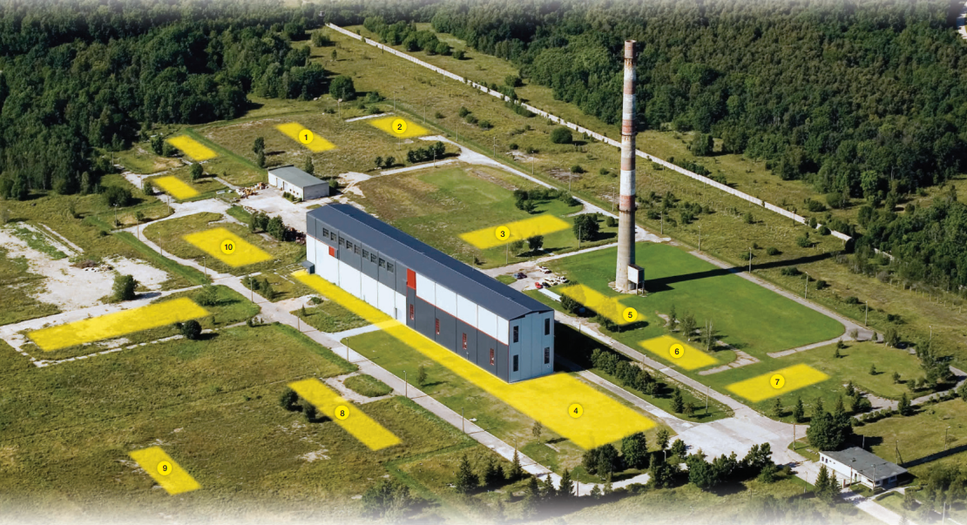
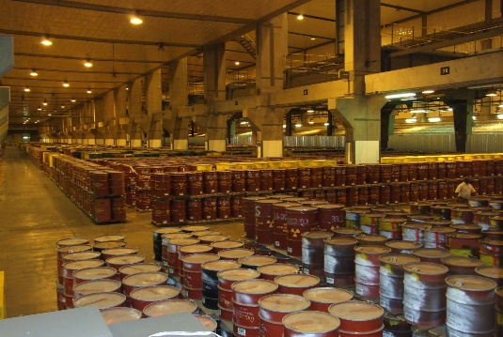
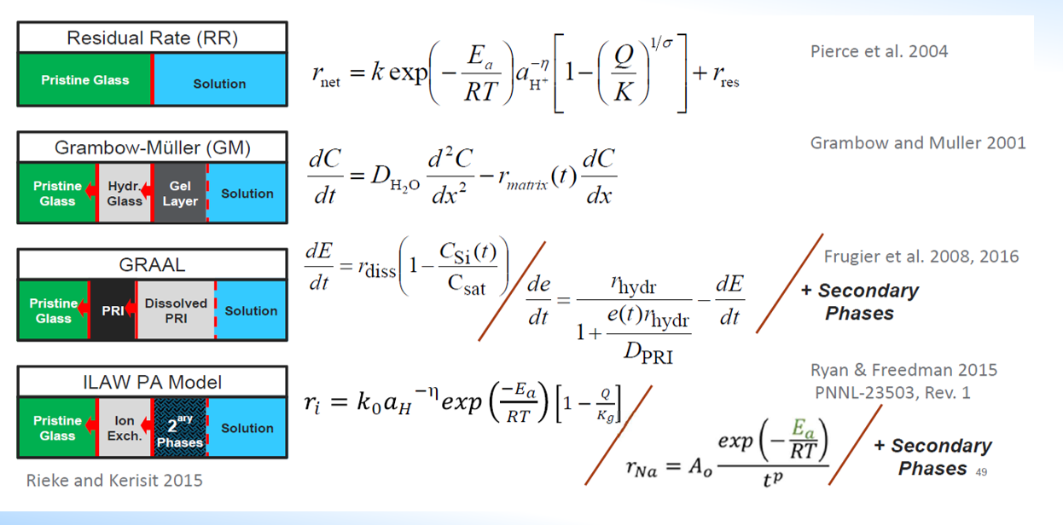
Durability: Qualification of waste packages
Ageing management of storage facilities and waste packages

Slide 6
2. Workshop
Purpose
The purpose of this event is to discuss and share experience on the use of computer codes (modelling) as an approach to ageing management (durability) of waste packages in storage/disposal facilities in different environmental conditions.

Slide 7
2. Workshop
Expected Outputs
As a result of the workshop, the participants will have knowledge regarding:
Basics of ageing management plan;
Conceptional information needed for modelling of waste form ageing;
Ageing (durability) determination of cementitious, vitrified and ceramic waste forms by modelling;
Use of different modelling codes to determine ageing of waste forms;
Knowledge in applicable ageing modelling in a ageing management program.

Slide 8
2. Workshop
Contents
The five-day regional workshop will include lectures, structured discussions and underpinned by modelling exercises designed to practice and reinforce approaches to ageing management of waste packages in storage. Examples of contents that are being planned (depending on availability of experts) of the five-day workshop are:
Day 1: Basics of ageing management plan;
Day 2: Ageing (durability) determination of cementitious, vitrified and ceramic waste forms
Day 3: Use of different modelling codes to determine ageing of waste forms;
Day 4: Use of different modelling codes to determine ageing of waste forms
Day 5: Final lectures and closing of workshop.

Slide 9
2. Workshop
Additional information
Poster sessions
Certificate of participation
Lecture materials
Software

Slide 10
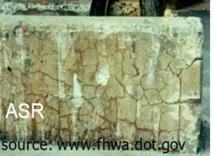
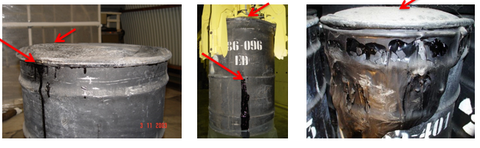
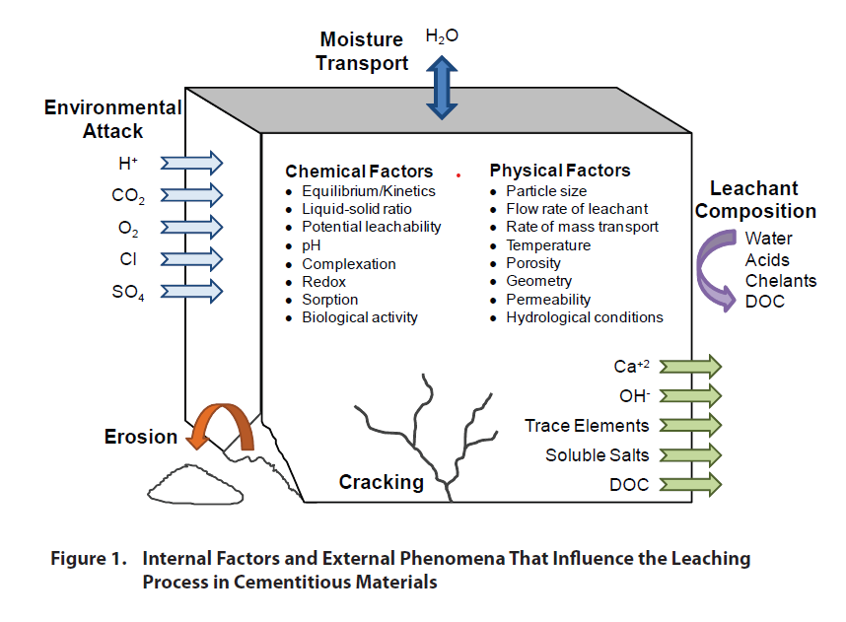
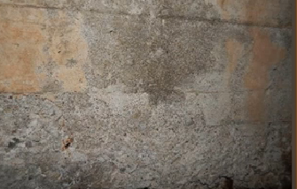
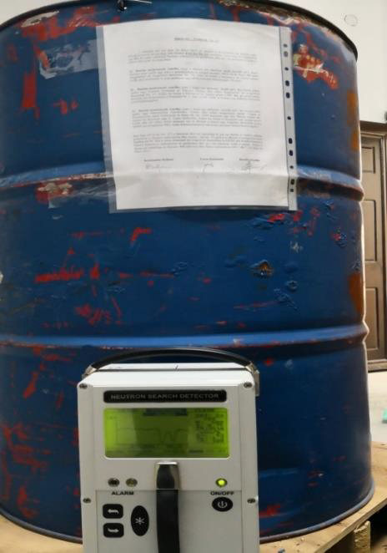
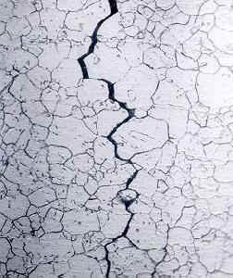
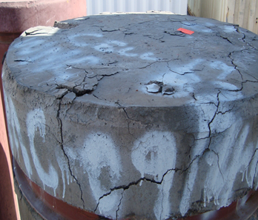

Slide 11
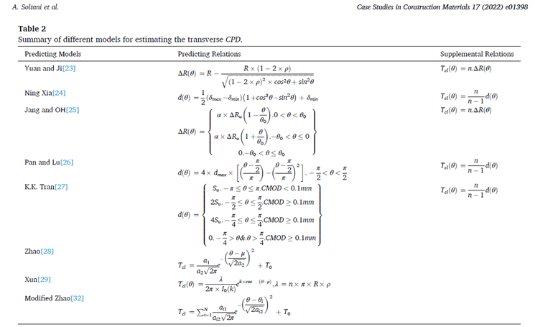
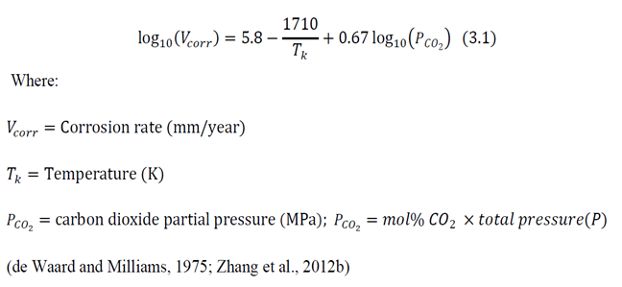
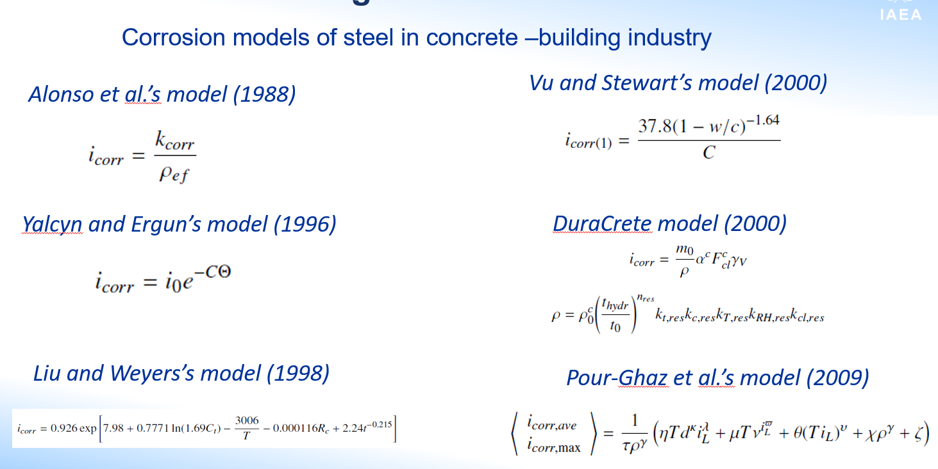
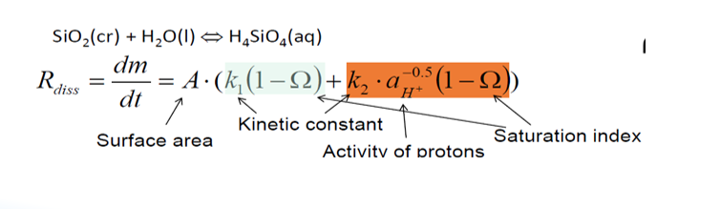
2. Workshop

Slide 12
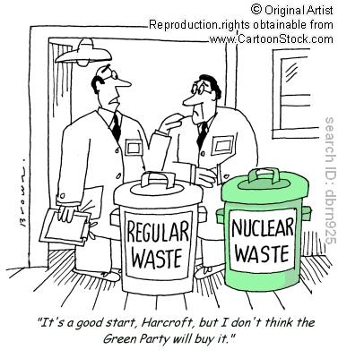
Thank you and
ENJOY THE MEETING!
IAEA AND WORKSHOP CONTENTS ARE ADVISORY INFORMATION
MEMBERS STATES DETERMINE THEIR OWN APPROACHES

Slide 13

Thank you!

Slide 14

30 Minutes Break
Meeting will resume at 11:20 (Vienna Time)

