Slide 1


Introduction to waste forms, and waste packages
Michael I. Ojovan,
Immobilisation Science Laboratory,
Department of Materials Science and Engineering, The University of Sheffield, UK
Department of Materials, Imperial College London, UK

Slide 2
Outline
Background
Wasteform selection
Wasteform options
Container
Conclusions

Slide 3
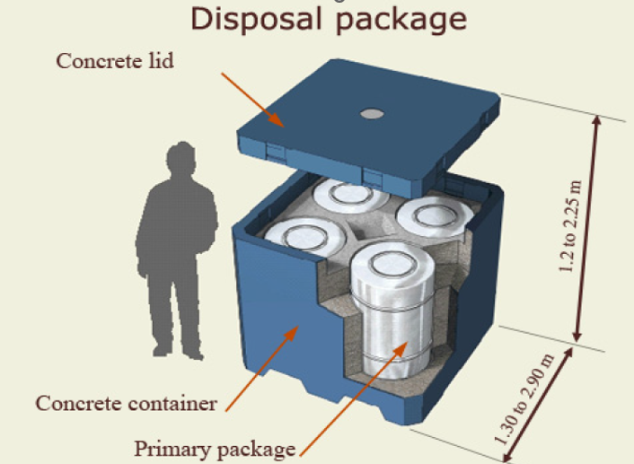
I. Background
Waste package. The product of conditioning that includes the wasteform and any container(s) and internal barriers (e.g. absorbing materials and liner), as prepared in accordance with requirements for handling, transport, storage and/or disposal.

Slide 4
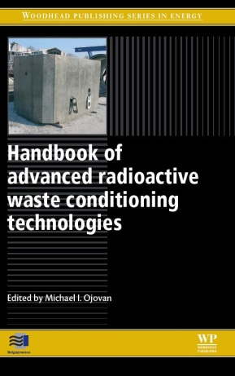
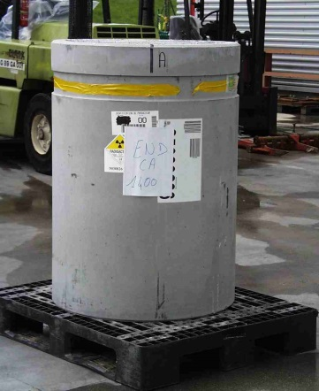
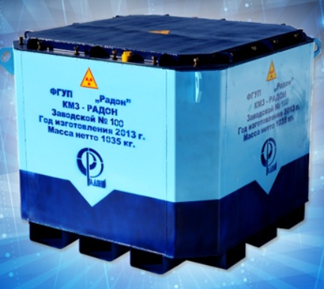
Conditioning. Those operations that produce a waste package suitable for handling, transport, storage and/or disposal.
    Conditioning may include the conversion of the waste to a solid wasteform, enclosure of the waste in containers and, if necessary, provision of an overpack.

Slide 5
Immobilisation. Conversion of waste into a wasteform by solidification, embedding or encapsulation.
    Immobilization reduces the potential for migration or dispersion of radionuclides during handling, transport, storage and/or disposal.
Wasteform. Waste in its physical and chemical form after treatment and/or conditioning (resulting in a solid product) prior to packaging.
The wasteform is a component of the waste package.
Wasteform = waste form

Slide 6
Waste Acceptance Criteria (WAC) typically prescribe and cover waste package features and properties, such as:
      • requirements for waste packages (e.g., surface dose rates, surface contamination, mass, leak tightness)
      • requirements for wasteforms (e.g., radionuclides content, composition and parameters of waste matrix and solidified waste, encapsulation material)
      • requirements for waste container (e.g., design features, mechanical stability, thermal resistance and also some additional features – shielding, corrosion protection, etc.)
      • limitations for activity – permissible activities of individual radionuclides, total activity, activity of selected critical radionuclides
      • radiological safety parameters – surface dose rates, surface contamination.

Slide 7
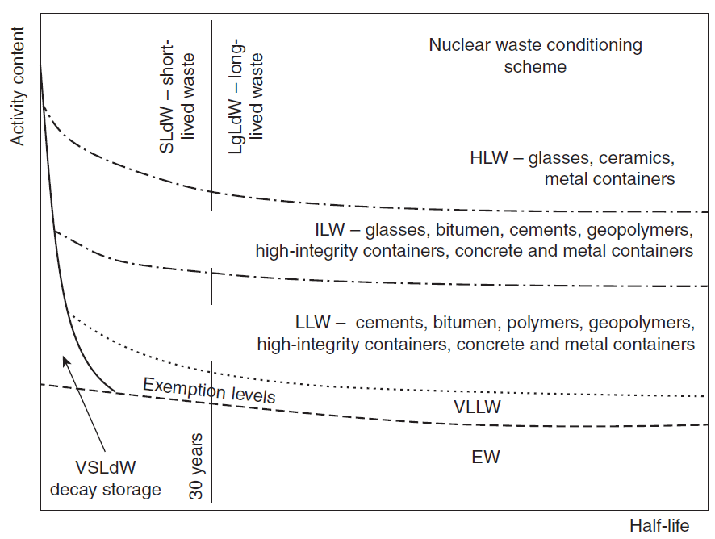
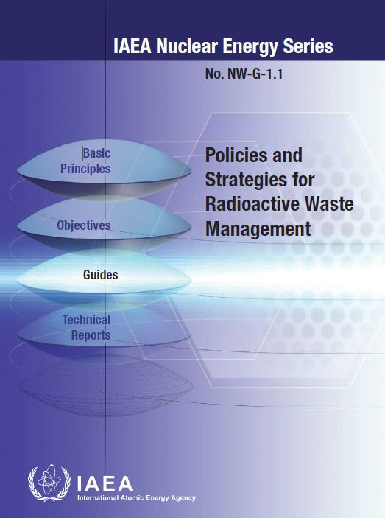
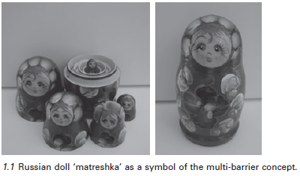
II. Wasteform selection

Slide 8
Selection of wasteform
The “wasteform” refers to the waste in its physical and chemical form after treatment and conditioning, resulting in a solid product prior to packaging.

Slide 9
Wasteforms can be homogeneous or heterogeneous, consisting of various materials and objects.
They may be in the solid state originally or solidified by using conditioning technologies.
Consider 5 examples below:

Slide 10
Homogeneous non-immobilized waste
I

Slide 11
High quality homogeneous wasteform
II

Slide 12
Heterogeneous waste with high quality embedding/encapsulation
III

Slide 13
Heterogeneous waste with low quality embedding/encapsulation
IV

Slide 14
No embedding/encapsulation
V

Slide 15
III. Wasteform options
The primary safety requirement applied to the wasteform (WF) is to confine and retain the radionuclides.
Typical requirements on wasteforms:
    — Basic (e.g. only solid or solidified waste, no free liquid)
    — Specific (e.g. stabilization (dispersion inhibition), heterogeneity, chemical restrictions)
    — With immobilization binder (e.g. glass, bitumen, polymer or cement)
    — Without immobilization binder (e.g. radioactivity and radionuclide restrictions)

Slide 16
The selection of a suitable wasteform (WF) typically requires extensive development work. In summary, typical research and development work includes the following:
  − Composition selection tests for immobilizing and coating materials;
  − Strength testing (e.g. tension, compression and impact);
  − Confinement properties (e.g. leach testing);
  − Thermal tests (e.g. freeze/thaw cycling and fire performance);
  − Radiation tests (e.g. radiation resistance testing);
  − Gas generation (radioactive and/or inactive) and dispersion analysis (e.g. cracking trials);
  − Degradation tests (e.g. corrosion, microbial activity, radiation damage).

Slide 17
Technology Readiness Level (TRL) – Assessing status of developments

Slide 18
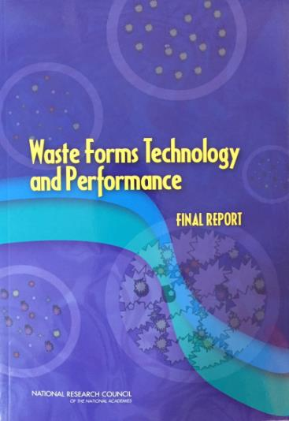
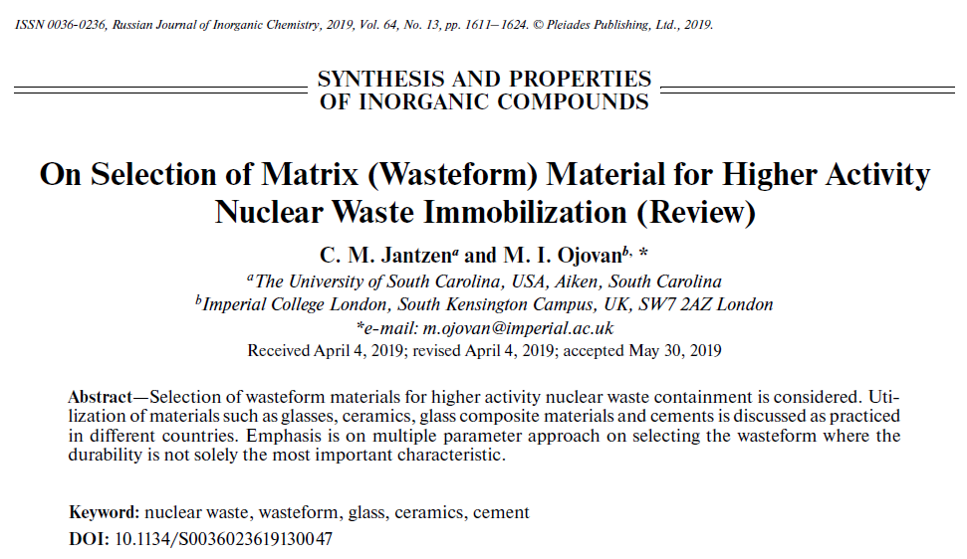
WF Important factors:
Waste loading;
Ease of production;
Durability;
Radiation stability;
Chemical flexibility;
Availability of natural analogues;
Compatibility with the intended disposal environment.

Slide 19
7 important factors to be considered when selecting a wasteform material:
Waste loading;
- able to accommodate a significant amount of waste (typically 25-45 weight %) to minimize volume.
Ease of production;
- accomplished under reasonable conditions.
Durability;
- low rate of dissolution to minimize the release of radioactive and chemical constituents.

Slide 20
Radiation stability;
- high tolerance to radiation effects from the decay of radioactive constituents.
Chemical flexibility;
- able to accommodate a mixture of radioactive and chemical constituents.
Availability of natural analogues;
- availability of natural mineral or glass analogues may provide important clues about the long-term performance.
Compatibility with the disposal environment.
- compatible with the near-field environment of the disposal facility.

Slide 21
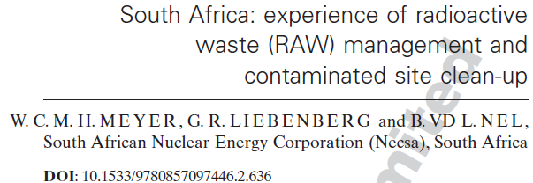
1. The waste form shall be passively safe without the possibility of internal corrosion of waste container caused by the waste form or the possibility of volume increase of the waste form due to formation of corrosion products.
2. Pre-treatment, treatment and immobilization actions should be aimed at providing passively safe waste forms.
3. The waste form does not contain or have the potential to generate hazardous or corrosive materials unless it is demonstrated that the encapsulating or immobilizing matrix of the waste form makes them passively safe.
4. If waste drums contain uranium metal, the following limitations are applicable:
    • items shall be dry (no water, oil or grease)
    • volume per item not less than 5 cm³.
    • surfaces of all items to be smooth
    • minimum thickness 10 mm.
21

Slide 22
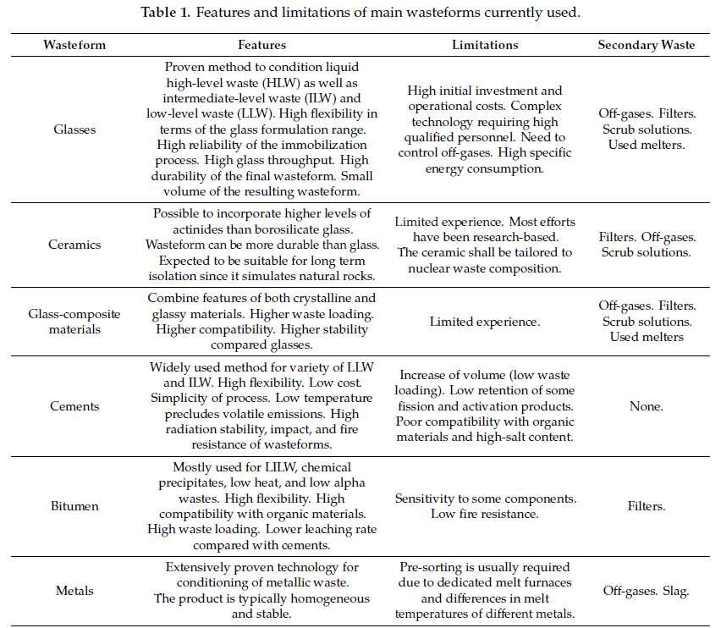

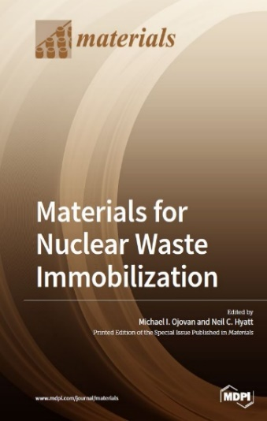

Slide 23
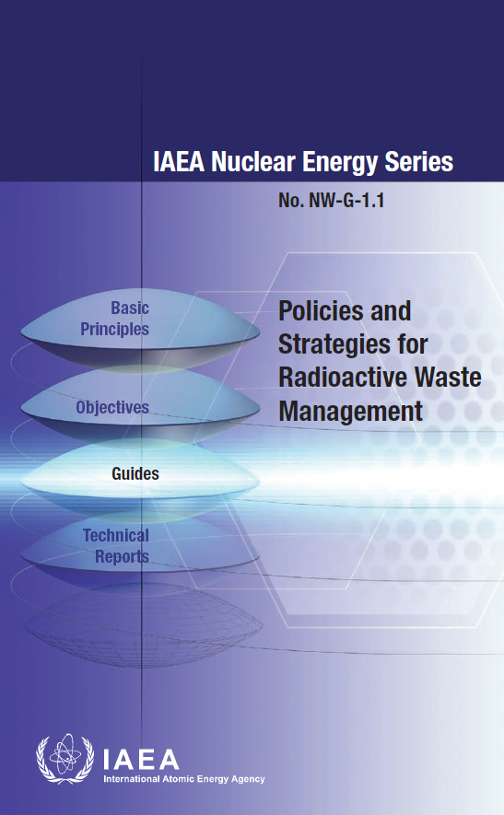
Conditioning technologies in practice depend on the class of waste processed

Slide 24
VLLW typically does not require immobilization, although some packaging could be used.
LLW is typically immobilized using cements,
although glasses provide better retention of contaminants, with very large volumes of LLW immobilized using vitrification in Hanford, USA.

Slide 25
ILW with a higher hazard than LLW can be immobilized using glasses, bitumen, cements and geopolymers. LLW and ILW can be packed in high-integrity metal and concrete containers.
The most hazardous waste such as HLW requires the most durable and reliable wasteforms, i.e. ceramics and glasses and containers such as stainless steel canisters for vitrified HLW and copper containers for spent nuclear fuel (SNF) declared as waste.

Slide 26
Cementitious wasteforms
Features | Limitations | Secondary waste
Widely used method for variety of LLW and ILW High flexibility Low cost Simplicity of the process Low temperature precludes volatile emissions High radiation stability, impact and fire resistance of wasteforms | Increase of volume (low waste loading) Low retention of some fission and activation products Poor compatibility with organic materials and at high-salt content | None (almost)

Slide 27
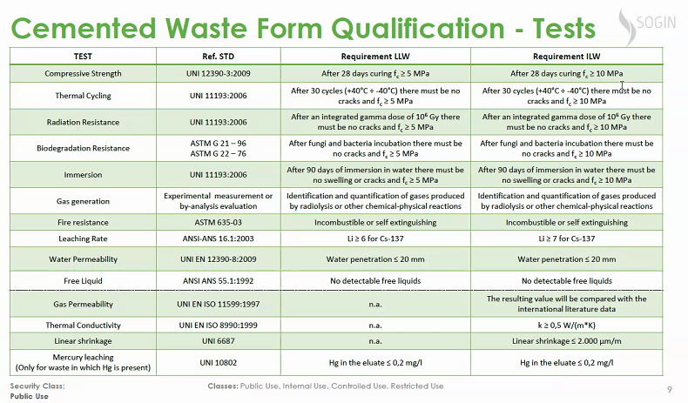

Slide 28
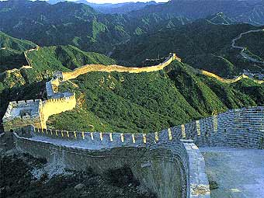

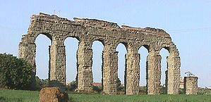
An old Roman law required not less than 200 years of ensured lifetime for aqueducts.
Cementitious wasteforms are expected to last for many hundred years

Slide 29
Wasteform | Features | Limitations | Sec. waste
Glasses | Proven method to condition liquid HLW as well as ILW and LLW. High flexibility in terms of the glass formulation range. High reliability of the immobilization process. High glass throughput. High durability of the final wasteform. Small volume of the resulting wasteform. | High initial investment and operational costs. Complex technology requiring high qualified personnel. Need to control off-gases. High specific energy consumption. | Off-gases. Filters. Scrub solutions. Used melters.
Ceramics | Possible to incorporate higher levels of actinides than borosilicate glass. Wasteform is more durable than glass. Expected to be suitable for long term isolation since it simulates natural rocks. | Limited experience. Most efforts have been research-based. The ceramic shall be tailored to nuclear waste composition. | Off-gases. Filters. Scrub solutions.
Glass composite materials GCM’s | Combine features of both crystalline and glassy materials. Higher waste loading. Higher compatibility. Higher stability compared glasses. | Limited experience. | Off-gases. Filters. Scrub solutions. Used melters

Slide 30
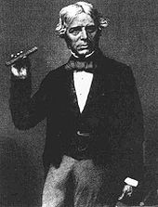
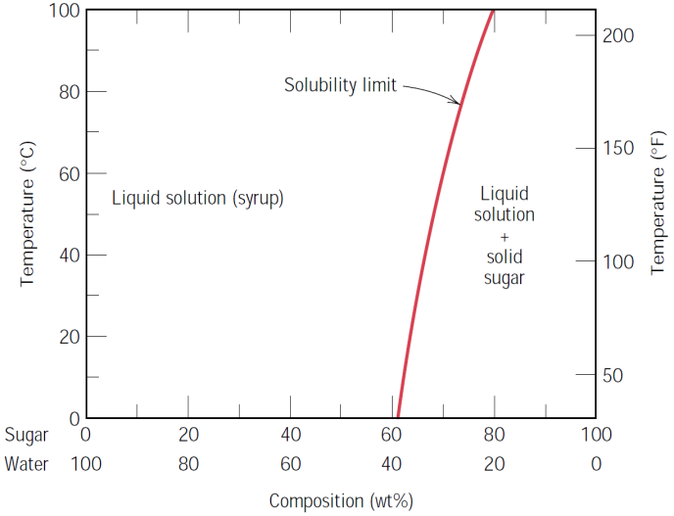
Stable liquid
Rapid cooling
Glass
Michael Faraday
1791-1867
Glass is a solution of different substances one in another.
The higher the temperature the higher the solubility.
Fast cooling avoids phase separation.

Slide 31

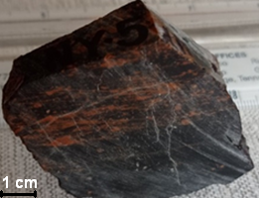
  The high chemical resistance of glass allows it to remain stable in corrosive environments for many millions of years at very low alteration of only ∼0.1 mm/10⁶ years.
U-containing vitreous sample taken from the sheet-like body of 145 Ma old volcanic glass of Field Novogodnee, Streltsovskaya caldera, Mongol-Priargunsky volcanic belt.
Poluektov, V.V.; Petrov, V.A.; Ojovan, M.I.; Yudintsev, S.V. Uranium Retention in Silica-Rich Natural Glasses: Nuclear Waste Disposal Aspect. Ceramics 2023, 6, 1152-1163. https://doi.org/10.3390/ceramics6020069
31

Slide 32
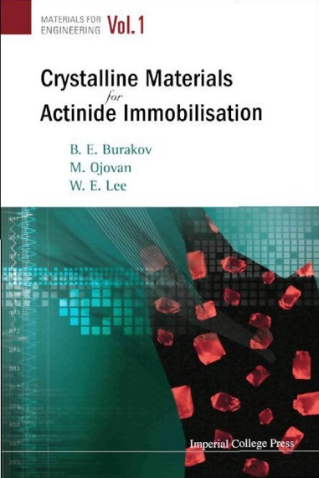
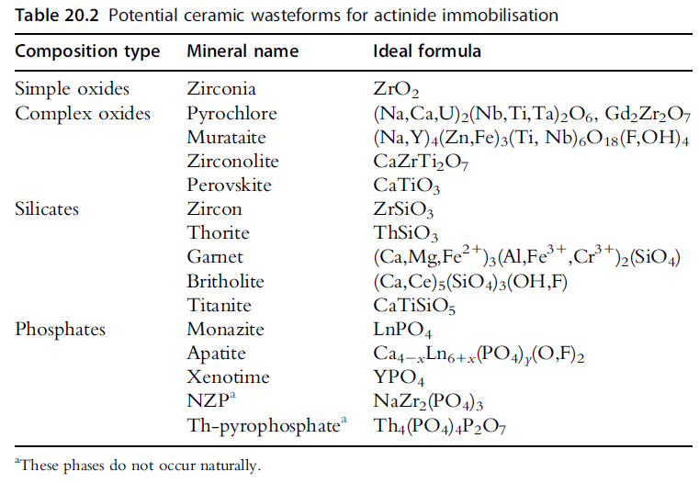
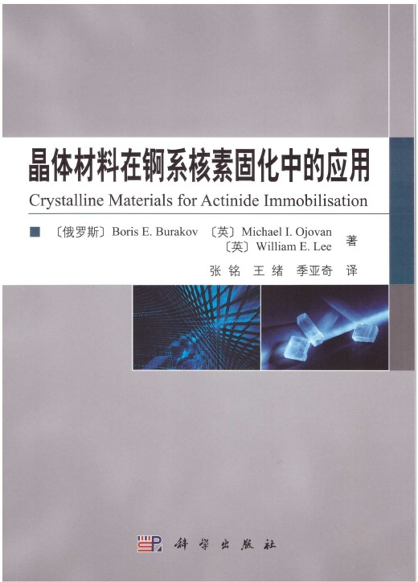
Crystalline ceramics are the most durable wasteforms

Slide 33
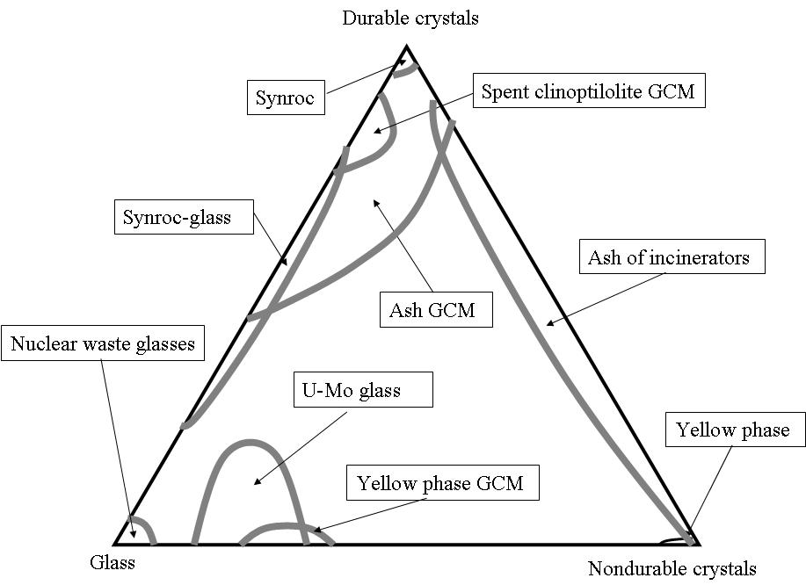
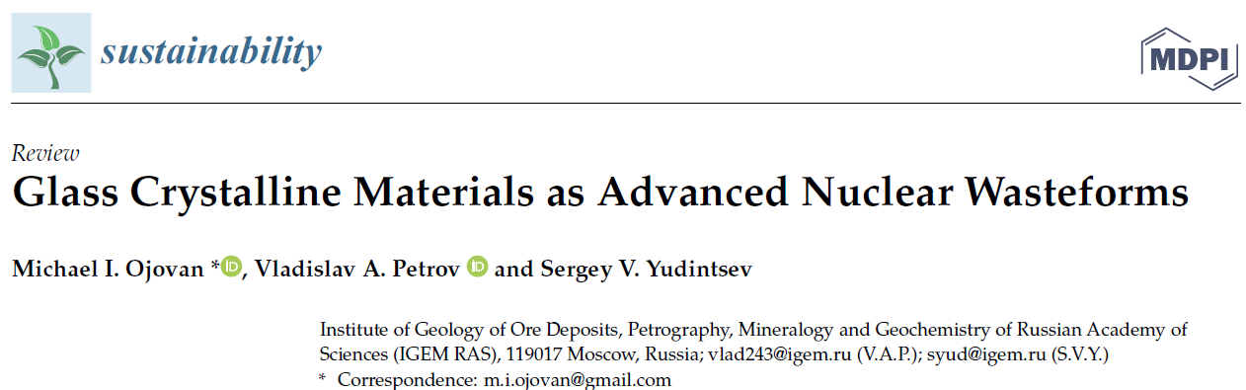
Glass composite materials containing both durable crystalline phases and vitreous phase combine advantages of crystals and glasses.

Slide 34
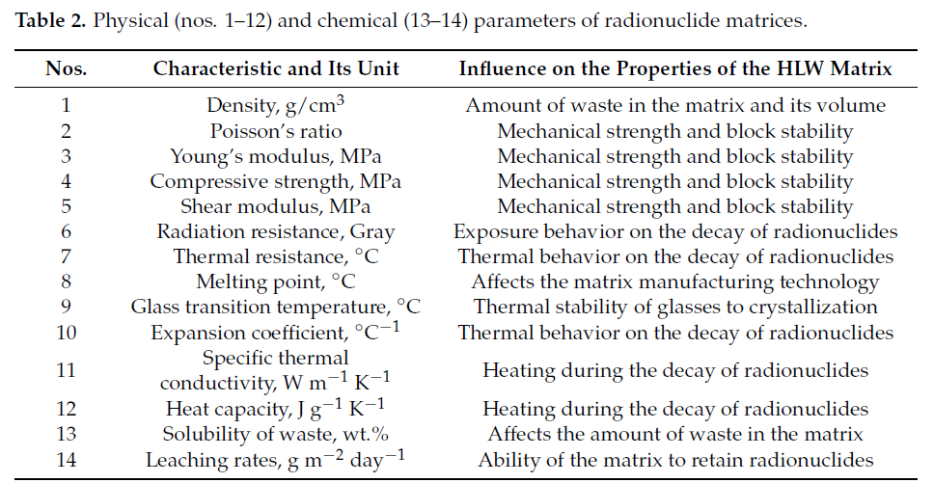
Yudintsev, S.V. et.al, Zirconolite Polytypes and Murataite Polysomes in Matrices for the REE—Actinide Fraction of HLW. Materials 2022, 15, 6091. https://doi.org/10.3390/ma15176091.

Slide 35
IV. Container
The waste container should:
1. Provide reliable containment of the radioactivity in the wastes for the required storage duration;
2. Protect the wasteform against external influences and impacts such as air, temperature and humidity changes;
3. Be of sufficient strength and corrosion resistance to provide robust integrity during the required storage period, including resisting impact damage;
Resist internal pressure from gas evolution due to decay and radiolysis; → see the next slide

Slide 36
The waste container should:
5. Have an exterior surface that minimizes the uptake of contamination and can be easily decontaminated;
6. Enable handling, retrieval, and transport from the storage facility.
7. Optionally, the container may also provide integral shielding to limit radiation dose to operators.

Slide 37
Factors considered in selecting the container material (a-j):
(a) Container durability
  (i) Mechanical properties (tensile and compressive strengths, abrasion resistance, ductility),
  (ii) Corrosion resistance (including coatings or lining requirements);
(b) Compatibility with the wastes or with the wasteform
  (i) During waste conditioning if the container is used as a process vessel,
  (ii) During the storage period,
  (iii) After closure of the repository;
(c) Environmental conditions
  (i) During interim storage,
  (ii) During final disposal;

Slide 38
Factors considered in selecting the container material are as follows:
(d) Weight and volume limitations;
(e) Shielding role;
(f) Transport requirements including fires and drop;
(g) Thermal properties (conductivity, specific heat, linear expansion, specific emissivity);
(h) Radiation stability;
Ease o f manufacture;
(j) Cost considerations and optimization.

Slide 39
When choosing a structural material for containers, it is necessary to take into account many factors, the main of which are: all kinds of corrosion from waste and the environment, radiation, heat, internal and external pressure, as well as impacts during transport operations under normal conditions and in emergency situations.
It is also necessary to take into account the optimization of the ratio between the protective properties and the cost of the container for various classes of radioactive waste (ALARA principle).

Slide 40
Reinforced concrete containers have the advantage of good resistance to radiation and corrosion.
Whilst they are somewhat permeable to groundwater, any liquid reaching the wastes will be at such a highly alkaline pH that the longer-lived radionuclides, in particular the actinides, will be in the form of species with very low solubilities, and their release will be very slow.
Concrete based on Portland cements is widely used for the manufacture of containers for LILW.
The density of concrete is 2.45 - 2.65 10³ kg/m³ although concrete with a density of 4.0 - 4.5 ∙ 10³ kg/m³ can be readily produced.
Typical strength is 68 - 75 MPa.

Slide 41
Polymers such as polyethylene and various composite designs have been proposed that take advantage of the desirable properties of polymers whilst at the same time providing greater mechanical strength.
Polyethylene is widely used as a neutron protection. Polyethylene is chemically resistant, durable, non-corrosive and easy to manufacture.
Low density of polyethylene (0.95 g/cm³) ensures low weight of packages, and high viscosity, flexibility and elasticity allow to withstand mechanical stress.
In addition, polyethylene has one of the best radiation resistances among polymers. The permissible radiation dose of polyethylene is up to 30 MGy.

Slide 42
Carbon steel is widely used as a container material. In many cases containers are in the form of 200 and 400 L drums in comparatively light gauge metal, usually of welded or folded shell construction.
Ring bands or ring flanges may be added to provide additional mechanical strength.
Larger steel boxes with capacities of up to 10,000 L or more are also used as containers. Typically, these containers might be fabricated from low carbon, hot rolled steel sheets.
When it is desirable to increase the radiation shielding, the mechanical strength and the long-term stability of waste packages, e.g. for disused sealed radioactive sources (DSRS) storage, carbon steel drums lined with concrete may be used.

Slide 43
Stainless steel is used both for the manufacture of containers and as lining in combination with other materials.
The corrosion rate of 304L steel in a maritime climate is conservatively less than 0.016 mm/year.
Good combination of machinability, mechanical properties and corrosion resistance, low ability to sorb radionuclides and good decontamination determines the widespread use of stainless steel as a structural material of containers, and due to the widespread use of stainless steel in various industries, the production of containers and the technology of their sealing (welding) are quite simple and well mastered.

Slide 44
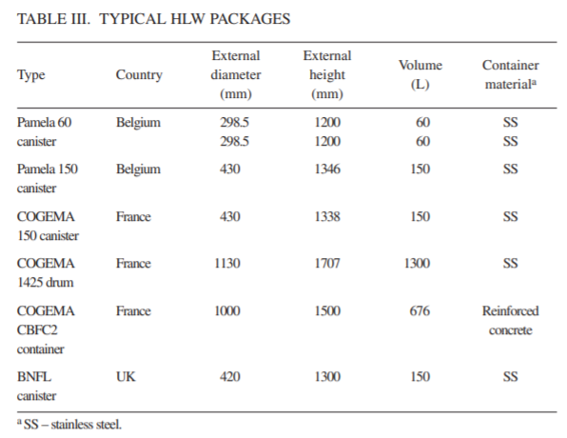
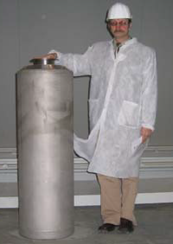
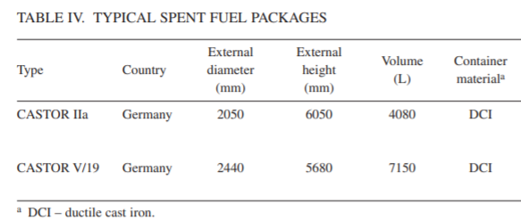
44

Slide 45

V. Conclusions
Cements are the basic LILW immobilising materials. Cementation is the world-wide accepted technology for LILW immobilisation.
Glasses are basic HLW immobilising materials. Vitrification is the world-wide accepted technology for the immobilization of HLW and is under deployment for LILW.
Crystalline ceramics are the most durable immobilising materials. Ceramication is under deployment stage while there is generic trend of using GCM (glass composite materials) for HLW and ILW immobilisation.
The waste container is designed to contain, physically protect, and/or radiologically shield the wasteform.
Thank you!

