Slide 1
ME-RER9154-2300641: Regional Workshop on Approaches to Ageing Management of Waste Packages in Storage
04. Ageing management planning
W. Meyer
WTS

Slide 2
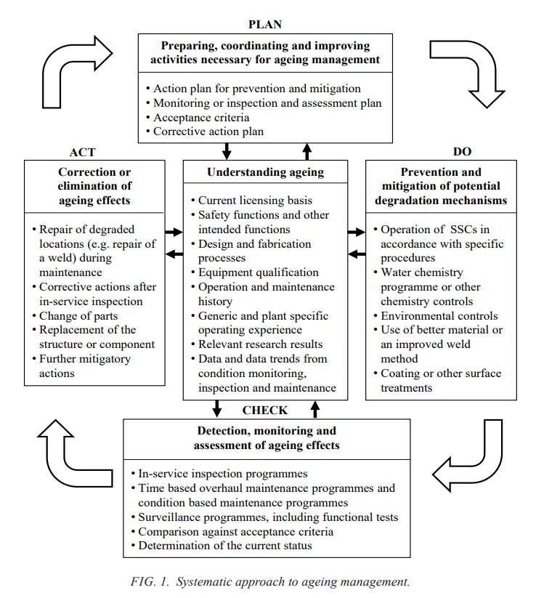
1. Introduction
Chapter 1
The methodology for AM
e.g. as shown in the Ageing Management Process Flow Diagram.
For effective execution of the AM programme a database must be
operated, which is capable of collecting, storing and analysing the information;
The AM programme must be regularly reviewed and updated;
The experience gained in connection with the ageing management of
components important to nuclear safety must be assessed;
There requirements for the ageing management of components important
to nuclear safety must be applied to spare components.

Slide 3
Contents
Introduction
Where do we start
Steps in establishing an ageing management plan for storage facilities
Ageing management of waste packages in storage/disposal
Summary
Notes:
This comprehensive introduction to RWM is structured in 5 main parts.

Slide 4
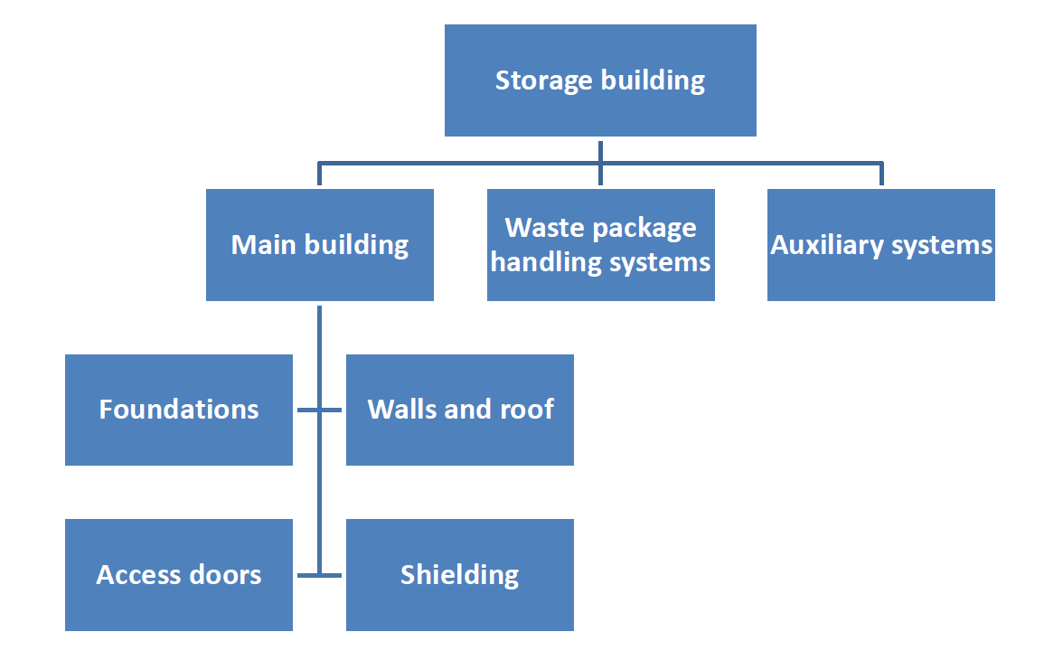
1. Introduction
The materials of construction and the waste itself will evolve with time;
➢the metal containers will tend to corrode;
➢the cementitious materials will undergo hydrationand conversion reactions leading to the formation of different mineral phases and the waste will undergo a variety of physical and chemical changes.

Slide 5
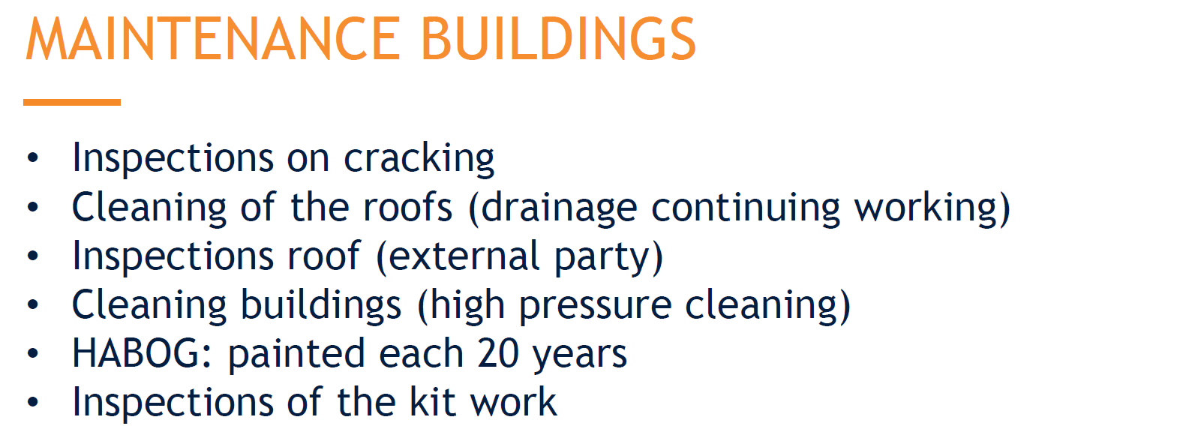
1. Introduction

Slide 6
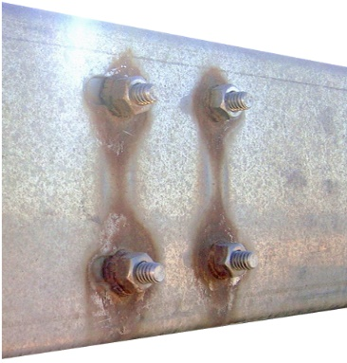
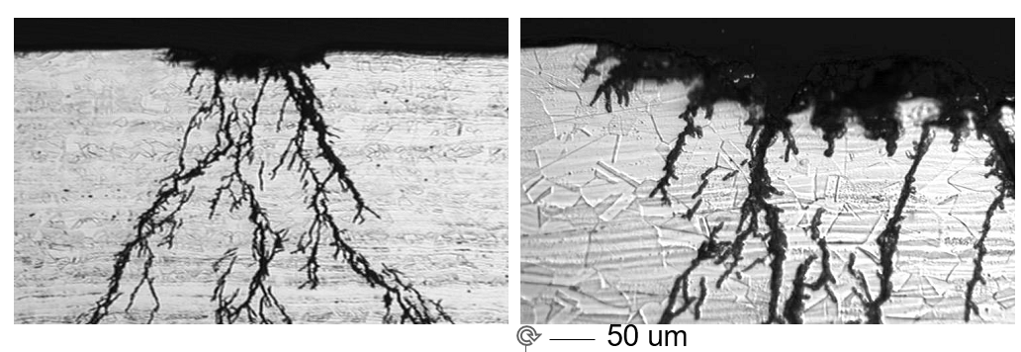

Corrosion encountered by metals in storage facilties
1. Introduction
Pitting
Atmospheric Stress Corrosion Cracking (ASCC)
Galvanic effects
Microbially Induced Corrosion
General corrosion
Crevice corrosion
Radiation induced corrosion

Slide 7
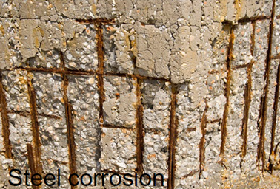
1. Introduction
The physical and chemical characteristics of the cement components may alter due to
1. Mineral leaching
sulphate attack
carbonation
chloride attack
alkali-silica reactions
radiolysis
the impact of corrosion products
Other degradation mechanisms exist, but these are the most relevant ones in this context.
Notes:
This comprehensive introduction to RWM is structured in 5 main parts.

Slide 8

1. Introduction

Slide 9
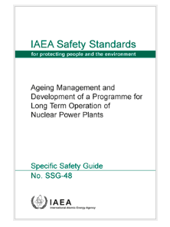
1. Introduction
The requirements from Nuclear Safety Authority
➢The licensee must establish an AM programme for the safety classified systems;
➢All potential ageing mechanisms of safety important components must be identified;
➢The potential consequences of potential ageing processes must be determined;
➢Activities aiming at preventing the occurrence of ageing mechanisms, mitigation of consequences must be determined and executed;
➢Monitoring, testing, sampling and inspection activities must be performed for the evaluation of ageing effects.

Slide 10
1. Introduction
The Ageing Management Planning is a key component of planning for long term storage of waste packages, irrespective of waste category or type.
A systematic methodology is applied in a step by step process to firstly determine the necessary actions and plan. Implementation of the plan then follows.
Ageing management (AM) requires predicting and controlling (i.e., detecting and mitigating) ageing degradation of components before primary functions are compromised.
The methodology for AM is a systematic step-by-step approach, as shown in the Ageing Management Process Flow Diagram.

Slide 11
3. Steps in establishing an ageing management plan
Steps of establishing a AM plan | Periodicity
Step 1 Identification of stakeholder and general background . | One time,
Step 2 Identification of asset’s critical components for AM evaluation. | One time, at in-service or current conditions. Updated if asset’s primary functions have changed.
Step 3 AM evaluation of the selected critical components. | One time, at in-service or current conditions. Updated if there is a change in understanding of aging or AM methods.
Step 4 Condition assessment of the WM asset with focus on the selected critical components. | One time, at in-service or current conditions. Updated on the basis of implementing the AM plan, i.e., inspection and assessment results.
Step 5 Identification of AM actions and indicators of AM plan effectiveness | At the establishment of the AM plan Updated periodically based on the relevant operating experience (OPEX) and R&D results.
Step 6 Implementation of the asset-specific AM plan. | On-going
Step 7 Performance review and continuous improvement of the asset-specific AM plan. | Improvement of AM plan based on annual self- assessment and/or any external/peer reviews.

Slide 12
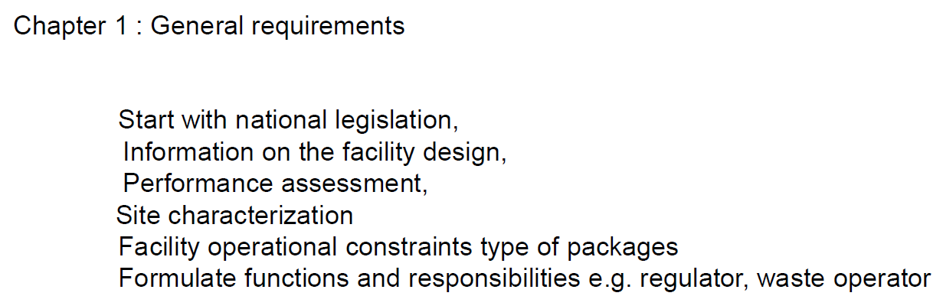
2. Where do we start
Step 1 (Section or Chapter 1)
Identification of stakeholder and general background

Slide 13
1. Introduction
Step 1 (Section 1 or Chapter 1 in document )
Identification of stakeholder and general background
The methodology used for this AMP (layout or parts of document)
e.g. examples of Ageing Management Process Flow Diagrams.

Slide 14
3. Steps in establishing an ageing management plan
Steps of establishing a AM plan | Periodicity
Step 1 Identification of stakeholder and general background . | One time,
Step 2 Identification of asset’s critical components for AM evaluation. | One time, at in-service or current conditions. Updated if asset’s primary functions have changed.
Step 3 AM evaluation of the selected critical components. | One time, at in-service or current conditions. Updated if there is a change in understanding of aging or AM methods.
Step 4 Condition assessment of the WM asset with focus on the selected critical components. | One time, at in-service or current conditions. Updated on the basis of implementing the AM plan, i.e., inspection and assessment results.
Step 5 Identification of AM actions and indicators of AM plan effectiveness | At the establishment of the AM plan Updated periodically based on the relevant operating experience (OPEX) and R&D results.
Step 6 Implementation of the asset-specific AM plan. | On-going
Step 7 Performance review and continuous improvement of the asset-specific AM plan. | Improvement of AM plan based on annual self- assessment and/or any external/peer reviews.

Slide 15
2. Where do we start
Step 2 (Section 2 or Chapter 2 in document )
Identification of possible critical components for AM evaluation.
3 main categories with 3 different strategies:
SSCs can be easily replaced (pipe, vessel, accessible equipment)
Ageing is dealt with during maintenance, preferably predictive or use periodic procedure for early detection of failure.
SSCs are not designed for being replaced (civil structure, non-accessible)
Ageing management programme with identification of life limiting features.
SSCs with obsolescence(I&C)
Provide spare parts or prepare a modification project for future replacement of SSCs

Slide 16
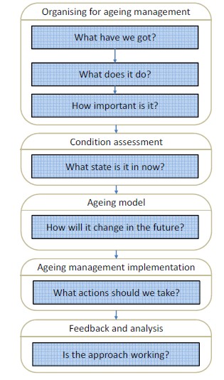
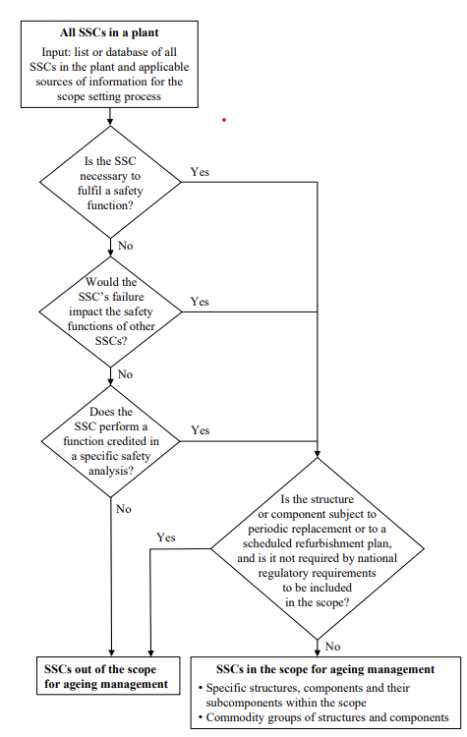

Slide 17
3. Steps in establishing an ageing management plan
Step 2 (Section 2 or Chapter 2 in document )
Step 2.1 Identification (information gathering) of possible critical components
The starting point of the screening process is the listing of the storage facility’s primary functions and components as described in the design documents.
Sorting and identification is based primarily on active, passive, long-lived and short-lived components that support the primary functions.
Active components are those that have moving parts or change their configuration or properties for instance:
Structures, piping components, ducting, pumps, fans, motors, miscellaneous process equipment, instrumentation, electrical components, valves, and tanks.
Passive components are those that have no moving parts, and whose configuration or properties do not change.
Long-lived components are those that are not replaced during the service life of the system
Short-lived components will be replaced during a specified time period, due either to planned maintenance or obsolescence/wear-out

Slide 18
3. Steps in establishing an ageing management plan
Step 2 (Section 2 or Chapter 2 in document )
Step 2.2 Produce a structure report / section of possible critical components (will be evaluated in next step)
To facilitate component evaluating in next round information should include:
  System level description of the asset:
    System or structure description of the asset;
    Functional requirements of the asset;
    Primary functions of the asset.
  Key interfacing systems
    identify support or supported systems which also may have to be verified.
  Applicable safety analysis, licensing conditions or supplemental analysis
  Identify system boundary for AM
    Use mark-up drawings clearly indicating portions of the structure, systems and electronic components (SSECs) contributing to the asset primary functions.
  Identify other interfacing systems and components, examples being:
    Electrical components and cables;
    Transformers;
    Sensors and actuators;
    Equipment supports.

Slide 19
3. Steps in establishing an ageing management plan
Steps of establishing a AM plan | Periodicity
Step 1 Identification of stakeholder and general background . | One time,
Step 2 Identification of asset’s critical components for AM evaluation. | One time, at in-service or current conditions. Updated if asset’s primary functions have changed.
Step 3 AM evaluation of the selected critical components. | One time, at in-service or current conditions. Updated if there is a change in understanding of aging or AM methods.
Step 4 Condition assessment of the WM asset with focus on the selected critical components. | One time, at in-service or current conditions. Updated on the basis of implementing the AM plan, i.e., inspection and assessment results.
Step 5 Identification of AM actions and indicators of AM plan effectiveness | At the establishment of the AM plan Updated periodically based on the relevant operating experience (OPEX) and R&D results.
Step 6 Implementation of the asset-specific AM plan. | On-going
Step 7 Performance review and continuous improvement of the asset-specific AM plan. | Improvement of AM plan based on annual self- assessment and/or any external/peer reviews.

Slide 20
3. Steps in establishing an ageing management plan
Step 3 (Section 3 or Chapter 3 in document )
Step 3.1 AM methodology in the evaluation of the selected critical components
Example of Ageing Management (AM) evaluation methodology for all components specified in Screening Report):
  1.Understanding of the ageing degradation processes;
  Component design and specifications
  Materials and material properties
  Service conditions
  Performance requirements
  Operation and maintenance histories
  Knowledge of the sites where degradation occurs
  2.Monitoring of ageing that is capable of detecting component degradation before failure;
  3.Timely mitigation of ageing and its effects (e.g., through maintenance, replacement or changes in operating conditions) to ensure that the required integrity and functional capability are maintained.
  4. Modelling
The findings and evaluation process used for the AM evaluation methodology for a selected component must be documented and uploaded onto a common database

Slide 21
3. Steps in establishing an ageing management plan
Step 3 (Section 3 or Chapter 3 in document )
Step 3.2 Result of evaluation of the selected critical components
Final report/section/chapter highlighting identified critical AM components should include:
1. List of all components specified in Screening Report that were evaluated;
  2. Describing of the ageing degradation processes of all components listed;
  3. Identified AM components

Slide 22
3. Steps in establishing an ageing management plan
Step 3 (Section 3 or Chapter 3 in document )
Step 3.3 Review of current methods for monitoring ageing of identified components
Step 3.1 Identification (information gathering) of asset's critical components
Step 3.2. Evaluation of critical components identified during information gathering of asset's components
Step 3.3 : Review of current methods for monitoring ageing of identified components
(What is currently done …..is it good enough ?)
Monitoring of ageing degradation of a specific component consists of a:
Continuous or periodic measurement of appropriate condition indicators
Trending and evaluation report of measured data including comparisons of the measured data with results of previous measurements on the same component
Functional parameters and condition indicators that are capable of detecting component degradation before failure

Slide 23
3. Steps in establishing an ageing management plan
Step 3 (Section 3 or Chapter 3 in document )
Step 3.3 Review of current methods for monitoring ageing of identified components (using literature)
3.3.1 Current monitoring of ageing methodology for identified critical components
Existing methods for inspection, surveillance and monitoring should be evaluated to before loss of the asset’s primary function. Methods to be reviewed include:
  periodic inspections (both visual and instrument aided),
  testing,
  on-line monitoring techniques (by instruments) and
  data evaluation methods.
The review should also include functional parameters and condition indicators that are capable of detecting component degradation before failure

Slide 24
3. Steps in establishing an ageing management plan
Step 3 (Section 3 or Chapter 3 in document )
Step 3.3 Review of current methods for monitoring ageing of identified components
3.3.1 Current monitoring of ageing methodology for identified critical components
3.3.2. Determine effectiveness of current ageing monitoring of identified AM components
Documented report of effectiveness of current ageing monitoring of identified AM components should include:
Existing methods for inspection, surveillance and monitoring per component and evaluation of the effectiveness for timely detection of ageing degradation;
Existing functional parameters and condition indicators used to detecting component degradation before failure and evaluation of the effectiveness for timely detection of ageing degradation;
Trending and evaluation report of measured data including comparisons of the measured data with results of previous measurements on the same component and evaluation of the effectiveness for timely detection of ageing degradation.

Slide 25
3. Steps in establishing an ageing management plan
Step 3 (Section 3 or Chapter 3 in document )
Step 3.3 Review of current methods for monitoring ageing of identified components(literature)
3.3.1 Current monitoring of ageing methodology for identified critical components
3.3.2 Determine effectiveness of current ageing monitoring of identified AM components
3.3.3 Review of maintenance and operational plan regarding component ageing
Evaluate maintenance and restoration methods and practices plan
The role of plant preventive maintenance programs is to preserve the required functional capability of asset’s critical components for operational and emergency use.
Preventive maintenance is affected by two types of maintenance:
  scheduled or time directed maintenance (refurbishment and periodic replacement of sub-components or altering of the operating conditions and practices affecting the rate of component degradation), and
  corrective or breakdown maintenance approach.
Critical components should be covered either by predictive maintenance or by scheduled maintenance
The corrective or breakdown maintenance approach may be preferred for components whose failure does not have significant impact on asset’s primary functions.
Preventive maintenance programs should be periodically reviewed and modified, based on operating experience and any new knowledge acquired, to ensure their effectiveness. Such a review, focused on a selected plant component, should also be conducted within the framework of AM evaluations.

Slide 26
3. Steps in establishing an ageing management plan
Step 3 (Section 3 or Chapter 3 in document )
Step 3.3 Review of current methods for monitoring ageing of identified components
3.3.1 Current monitoring of ageing methodology for identified critical components
3.3.2 Determine effectiveness of current ageing monitoring of identified AM components
3.3.3 Review of maintenance and operational plan regarding component ageing
Evaluate operating conditions and practices plan
Operating conditions and practices may have a substantial effect on the rate of component ageing degradation.
Studies on mitigation of ageing should therefore include a consideration of possible modifications of the operating conditions and practices, and an assessment of their impact on the component ageing.
In all cases of proposed changes in component operating conditions or practices, their potentially harmful side effects on other ageing mechanisms of the component or to the parent system should be evaluated.
Considered to mitigate ageing to make appropriate changes in the design of a component or the materials that are used in its fabrication. The utilization of new and innovative designs to minimize the costs of maintenance should be considered.

Slide 27
3. Steps in establishing an ageing management plan
Step 3 (Section 3 or Chapter 3 in document )
Step 3.3 Review of current methods for monitoring ageing of identified components ( using literature)
3.3.1 Current monitoring of ageing methodology for identified critical components
3.3.2 Determine effectiveness of current ageing monitoring of identified AM components
3.3.3 Review of maintenance and operational plan regarding component ageing
3.3.4: Documenting of the effectiveness of the current maintenance and operational plan
regarding component ageing
Information obtained in steps 3.3.1-3.3.3. should be documented to provide:
An assessment of the effectiveness of current maintenance and restoration methods and practices (including refurbishment and periodic replacement of parts and consumables) to control ageing degradation of the component;
Identification of appropriate operating conditions and practices that minimize the rate of ageing degradation of the component;
Next step : An evaluation of possible changes in design and materials of the component to control aging degradation of the component based on current environmental conditions

Slide 28
3. Steps in establishing an ageing management plan
Steps of establishing a AM plan | Periodicity
Step 1 Identification of stakeholder and general background . | One time,
Step 2 Identification of asset’s critical components for AM evaluation. | One time, at in-service or current conditions. Updated if asset’s primary functions have changed.
Step 3 AM evaluation of the selected critical components. | One time, at in-service or current conditions. Updated if there is a change in understanding of aging or AM methods.
Step 4 Condition assessment of the WM asset with focus on the selected critical components. | One time, at in-service or current conditions. Updated on the basis of implementing the AM plan, i.e., inspection and assessment results.
Step 5 Identification of AM actions and indicators of AM plan effectiveness | At the establishment of the AM plan Updated periodically based on the relevant operating experience (OPEX) and R&D results.
Step 6 Implementation of the asset-specific AM plan. | On-going
Step 7 Performance review and continuous improvement of the asset-specific AM plan. | Improvement of AM plan based on annual self- assessment and/or any external/peer reviews.

Slide 29
3. Steps in establishing an ageing management plan
Step 4 (Section 4 or Chapter 4 in document )
Step 4 Establish condition assessment report/section with focus on identified critical components under current operational conditions
The outcome of this Step is a system condition assessment report/section that:
  Establish ageing of critical components under current operational conditions
  Assess changes to the system since the last assessment and document the ageing assessment basis;
  Document component end-of-life;
  Identify an AM strategy;
  Propose an AM implementation plan. (Step 5)

Slide 30
3. Steps in establishing an ageing management plan
Steps of establishing a AM plan | Periodicity
Step 1 Identification of stakeholder and general background . | One time,
Step 2 Identification of asset’s critical components for AM evaluation. | One time, at in-service or current conditions. Updated if asset’s primary functions have changed.
Step 3 AM evaluation of the selected critical components. | One time, at in-service or current conditions. Updated if there is a change in understanding of aging or AM methods.
Step 4 Condition assessment of the WM asset with focus on the selected critical components. | One time, at in-service or current conditions. Updated on the basis of implementing the AM plan, i.e., inspection and assessment results.
Step 5 Identification of AM actions and indicators of AM plan effectiveness | At the establishment of the AM plan Updated periodically based on the relevant operating experience (OPEX) and R&D results.
Step 6 Implementation of the asset-specific AM plan. | On-going
Step 7 Performance review and continuous improvement of the asset-specific AM plan. | Improvement of AM plan based on annual self- assessment and/or any external/peer reviews.

Slide 31
3. Steps in establishing an ageing management plan
Chapter 1 Identification of stakeholder and general background
Chapter 2 Identification (information gathering) of asset's critical components
Chapter 3. Determine critical components from the System and Structure Report of the asset's components
3.1: Review of current methods for monitoring ageing of identified components
3.2: Review of current methods for monitoring ageing of identified components (modelling)
3.3: Determine effectiveness of current ageing monitoring of identified AM components
3.4: Review of maintenance and operational plan (Higher level policy document) regarding
component ageing
3.5: Documenting of the effectiveness of the current maintenance and operational plan (Higher
level policy document) regarding component ageing
Chapter 4: Establish condition assessment report with focus on selected critical components under
current operational conditions
Chapter 5: Identify AM actions to be included in current or new ageing management plan based on 2, 3 and 4

Slide 32
3. Steps in establishing an ageing management plan
Step 5 (Section 5 or Chapter 5 in document )
Step 5 Identify AM actions needed to be included into a current ageing management plan
Initially the licensee needs to review the AMP recommendations and decide on their cost effectiveness and long-term safety and reliability benefits.
Each AMP recommendation should therefore have an appropriate disposition provided: either it will be carried out, with the appropriate budget and schedule prepared, or it will not be carried out, with a detailed rationale to support the deletion from the program.
Effective implementation of the asset-specific AMP requires coordination and integration of relevant AM activities. Integrating all associated programs and activities relating to the understanding, control, monitoring and mitigation of asset’s ageing.
Each contributor can clearly see its role in the process, as well as the synergy of the team approach that stimulates creativity and amplifies the cumulative benefits of the individual contributions.
The closed loop of the generic AM process emphasizes the importance of performance review and continuous improvement of an SSEC specific AMP, based on the current understanding of SSEC ageing and on the results of assessment and peer reviews.

Slide 33
3. Steps in establishing an ageing management plan
Steps of establishing a AM plan | Periodicity
Step 1 Identification of stakeholder and general background . | One time,
Step 2 Identification of asset’s critical components for AM evaluation. | One time, at in-service or current conditions. Updated if asset’s primary functions have changed.
Step 3 AM evaluation of the selected critical components. | One time, at in-service or current conditions. Updated if there is a change in understanding of aging or AM methods.
Step 4 Condition assessment of the WM asset with focus on the selected critical components. | One time, at in-service or current conditions. Updated on the basis of implementing the AM plan, i.e., inspection and assessment results.
Step 5 Identification of AM actions and indicators of AM plan effectiveness | At the establishment of the AM plan Updated periodically based on the relevant operating experience (OPEX) and R&D results.
Step 6 Implementation of the asset-specific AM plan. | On-going
Step 7 Performance review and continuous improvement of the asset-specific AM plan. | Improvement of AM plan based on annual self- assessment and/or any external/peer reviews.

Slide 34
3. Ageing management plan
Step 6 (Section 6 or Chapter 6 in document )
Describing the Implementation of the asset-specific AM plan or a new AM plan
Section in document | Description
Asset primary functions | List
Asset critical components | Document
Understanding the predictability of asset’s ageing | Summary information on component materials, service conditions, stressors, degradation sites, ageing mechanisms and effects as well as appropriate condition indicators, and quantitative or qualitative models of relevant ageing phenomena.
Preventative actions to minimize/control aging degradation of the system | Service (i.e., environmental and operating) conditions and operating practices aimed at slowing down potential system degradation.
Monitoring ageing of the asset | Condition indicators/parameters monitored Inspection, testing, monitoring methods Assessment methods (including data analysis and trending). Acceptance criteria against which the need for corrective action is evaluated.
Mitigating ageing of the asset. | Maintenance, repair, replacement actions to correct detected degradation
Data collection and record keeping | Data to be collected to facilitate assessment of asset’s ageing. Record keeping practices to be followed.
Quality assurance | Confirmation process for ensuring that preventive actions are adequate and appropriate corrective actions have been completed and are effective. Suitable follow up assessments have been carried out as required.
Indicators of AMP effectiveness | Results oriented parameters/criteria to facilitate identification of AMP strengths and weaknesses and a continuous improvement process.
Summary sheet of the asset AMP | An executive summary of the AMP that highlights information useful for understanding and managing ageing, including materials, degradation sites, ageing stressors and environment, ageing concerns/ mechanisms/ effects, inspection/monitoring requirements and methods, and the appropriate mitigation methodologies.

Slide 35
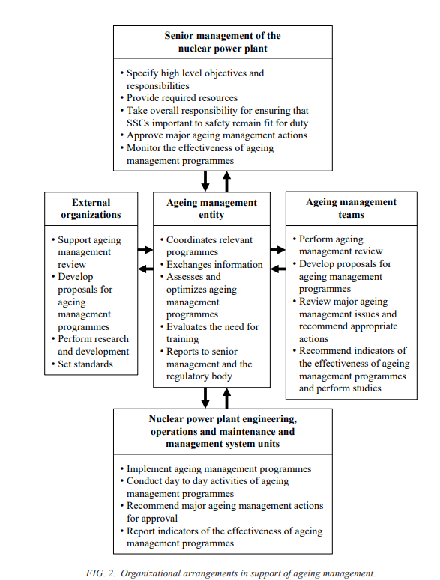
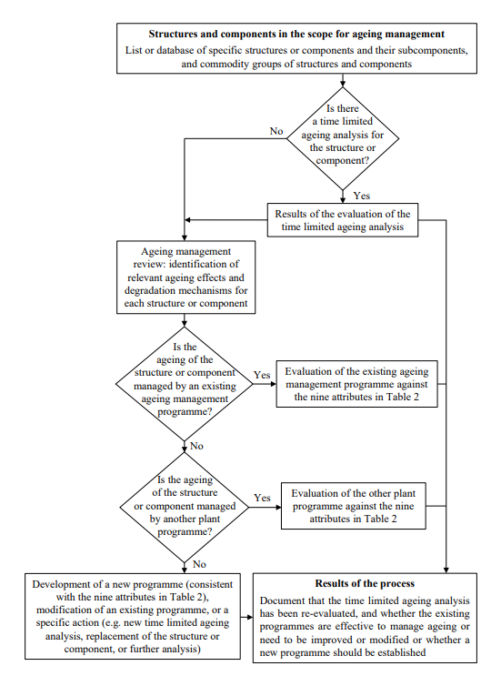
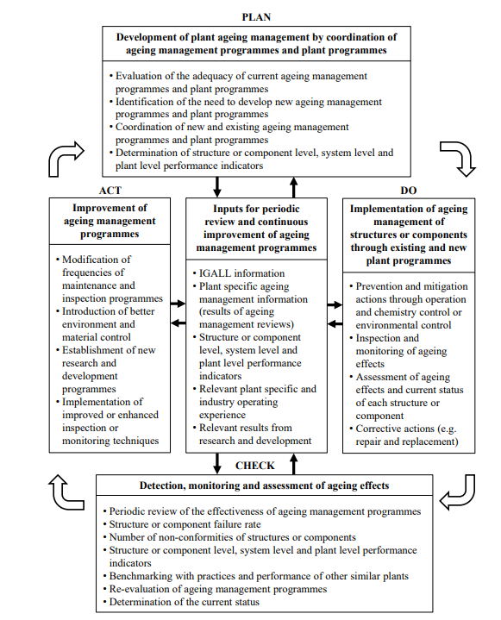
3. Steps in establishing an ageing management plan
Step 7 (Section 7 or Chapter 7 in document )
Describing the continuous improving ageing management plan (AMP)
DEFINE RESPONSIBILITY AND
REPORTING STRUCTURES
NEW SSC
REVIEW AMP

Slide 36
3. Steps in establishing an ageing management plan for facility
Chapter 1 Identification of stakeholder and general background
Chapter 2 Identification (information gathering) of asset's critical components
Chapter 3 Determine critical components from the System and Structure Report of the asset's components
3.1: Review of current methods for monitoring ageing of identified components
3.2: Result of evaluation of the identified critical components (incl. modelling)
3.3: Determine effectiveness of current ageing monitoring of identified AM components
3.4: Review of maintenance and operational plan (Higher level policy document) regarding
component ageing
3.5: Documenting of the effectiveness of the current maintenance and operational plan (Higher
level policy document) regarding component ageing
Chapter 4: Establish condition assessment report with focus on selected critical components under
current operational conditions
Chapter 5: Identify AM actions to be included in current or new ageing management plan
Chapter 6 Describing the Implementation of the asset-specific AM plan or a new AM plan
Chapter 7 Describing the continuous improving ageing management plan (AMP)

Slide 37
WHAT ABOUT THE WASTE PACKAGES ?

Slide 38
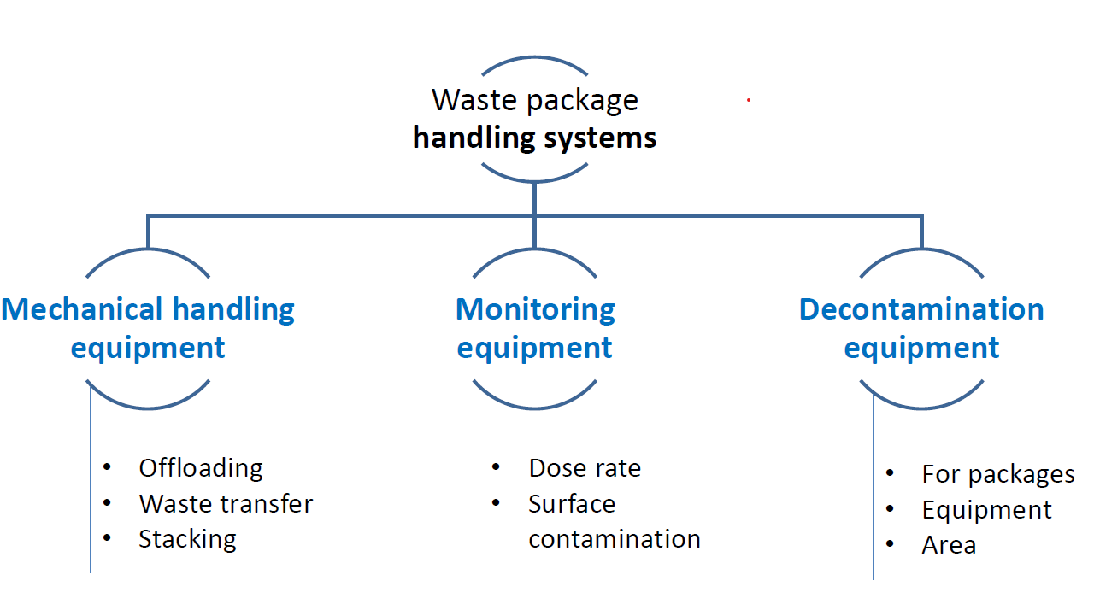
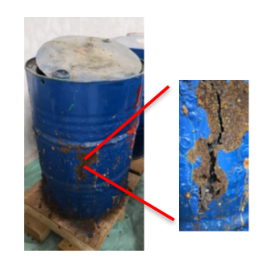
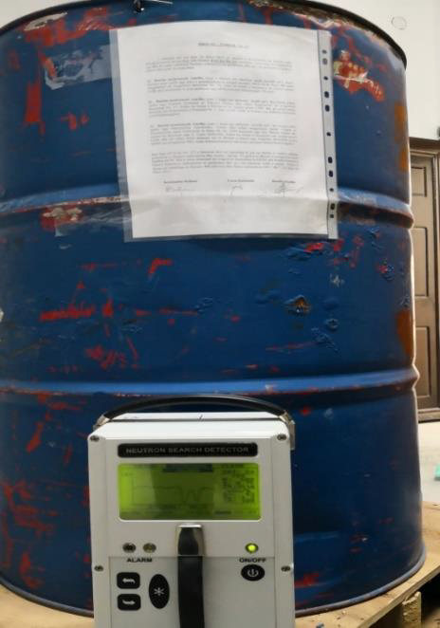
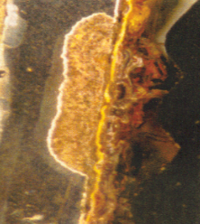

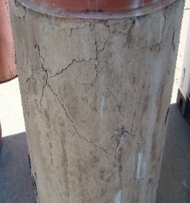
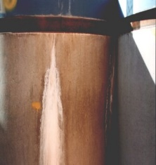
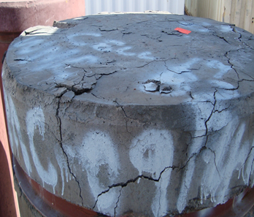
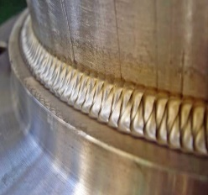
4. WHAT ABOUT THE WASTE PACKAGES ?
Presentation 7
Presentation 9

Slide 39
5. Ageing management of waste packages in storage/disposal
A monitoring strategy as part of ageing management plan for waste packages
Monitoring of critical parameters inside buildings
  Temperature & Humidity
  Specific enviromental (air) parameters depending on facility
      Humidity must be less than 60 % to avoid condensing water on conditioned waste packages and external corrosion => dryers
      Concentration of sulfides must be less than 0,75 mg/dm² * day to avoid external corrosion
      Concentration of chlorides must be less than 0,1 mg/dm² * day to avoid external corrosion
      Concentration of radon must be less than 200 Bq/m³ (based on legal requirements)

Slide 40
5. Ageing management of waste packages in storage/disposal
Long-term interim storage is becoming an important issue in countries where the implementation of disposal facilities is postponed.
The ability of a waste package to maintain its function over a specified period is affected by a number of key factors namely:
  the design of the waste container, including construction materials and manufacturing processes;
  the design and specifications of the conditioning process;
  the nature and rates of container and waste form degradation mechanisms (e.g. corrosion);
  the nature and rate of interaction between the waste container and the waste form;
  the defined storage and disposal facility conditions (e.g. temperature, humidity, groundwater chemistry, etc.).
Ageing management of container integrity in storage and disposal environments is essential to assure adequate performance.
Note that the longer the time scale (e.g. in the post-closure phase of a repository), the more important slow degradation mechanisms become.

Slide 41
5. Ageing management of waste packages in storage/disposal
Often, a conservative approach is taken in the safety assessment during disposal by not taking any credit for the waste package performance or limiting its credited duration.
The waste package or container must retain some degree of physical integrity over its intended storage life to ensure that the waste can be safely retrieved and transported to the designated facility at the end of the storage period.
Ageing management for waste containers and packages generally consists of a program of periodic monitoring and inspection. Remediation options include re-packaging, overpacking and repair of containers. The longer the storage period, the more likely that some remedial action will be required.
”Dummy” containers can be used within the store to allow external ageing to be assessed without moving waste packages.

Slide 42
5. Ageing management of waste packages in storage/disposal
A monitoring strategy as part of ageing management plan for waste packages
A monitoring policy/plan as part of ageing management plan for waste packages may be summarised as:
• Identification of potential degradation mechanisms which lead to changes in properties;
• Identification of monitoring techniques to detect such changes.
• Estimation of package durability based on degradation rate data or modelling;
• Determination of monitoring frequency as a fraction of the time between the point of detection of degradation and the expected time of waste package failure;
• Identification of a means of selecting a representative sample of packages to be monitored.
• • The potential for damaging waste packages during monitoring operations, including physical retrieval for inspection;
• The costs of monitoring;
• The practicalities of operating and maintaining monitoring equipment.

Slide 43
5. Ageing management of waste packages in storage/disposal
A monitoring strategy as part of ageing management plan for waste packages
-The frequency of such inspections should be derived from storage facility safety analyses
- Mechanisms to ensure that corrective action is taken for any deterioration of packages
- Chemical conditions (should also be monitored).
-Where high activity wastes are involved, required inspections may be performed remotely by camera, together with air and liquid effluent monitoring.
-Monitoring and inspection of waste package should preferably use non-destructive testing methods.
-Monitoring for instance: • Metal corrosion, • Chemical reactions, • Leakage, • Lifting feature deformation., • Swelling, • Cracks, • Condensation, .• Contamination.
A number of techniques are available, which could be used for monitoring the condition of waste packages within a store, including:
• Intensive visual inspection to detect corrosion, mechanical damage, penetrations and overpressure;
• Dose rate measurements;
• Radiography to determine contents of packages, void spaces, container wall thickness, presence of liquids, etc.;
• Scanning to measure the spatial distribution of gamma radiation and identify prominent gamma emitters;
• Modelling

Slide 44
5. Ageing management of waste packages in storage/disposal
Modelling as an input into a monitoring strategy as part of ageing management plan for metallic waste packages
Corrosion of metals (Presentation 07 )
Pitting
Atmospheric Stress Corrosion Cracking (ASCC)
Galvanic effects
Microbially Induced Corrosion
General corrosion
Crevice corrosion
Radiation induced corrosion

Slide 45
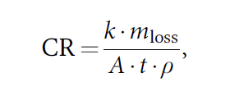

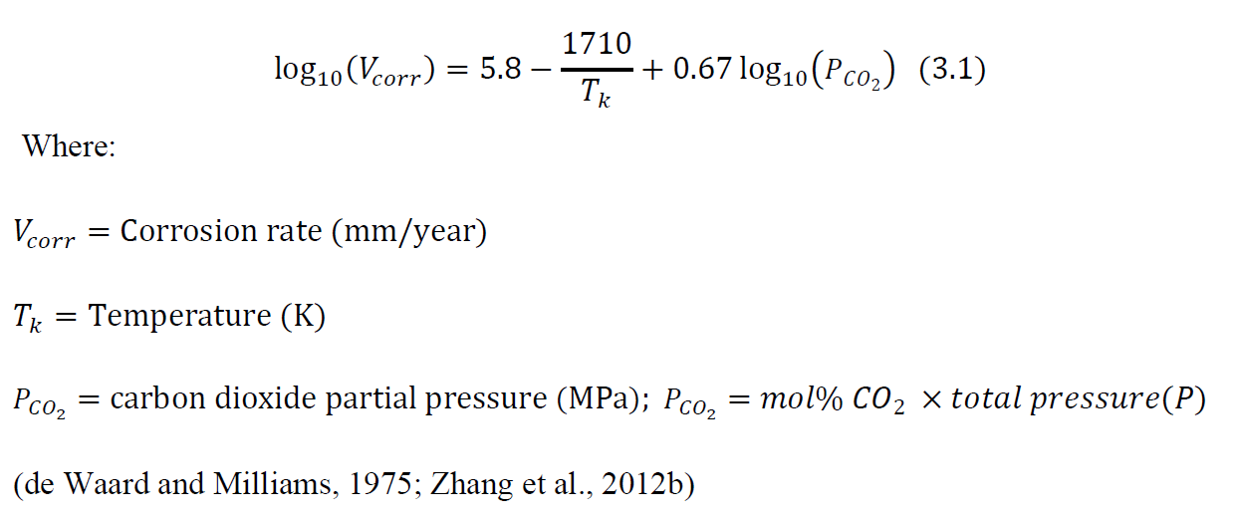
5. Ageing management of waste packages in storage/disposal
Modelling as an input into a monitoring strategy as part of ageing management plan for metallic waste packages
Corrosion of metals in air
Corrosion of metal inside cement
Corrosion of metal by CO₂:
Where:
k is a constant 8.76 x10⁴ so that CR is in [mm/y],
mloss is the mass loss [g] of the metal (m₀₋m_{f})
t [hours],
A is the surface area of the material exposed [cm2],
ρ is the density of the material [g/cm3]
ASTM, 2012; Kreysa & Schütze, 2007; Kutz, 2005).
Where
t_{c} is the time to onset of corrosion (y),
x_{c} is the thickness of concrete surrounding
the reinforcing steel (cm),
WCR is the water to cement ratio,
[Cl] is the chloride ion content of the water (parts per million)
(USDOE, 2006; Walton, 2007).
corrosionsource.com - Corrosion Rate Calculator
Corrosion of metal –practical

Slide 46
5. Ageing management of waste packages in storage/disposal
Modelling as an input into a monitoring strategy as part of ageing management plan for cementitious waste packages
The physical and chemical characteristics of the cementitious waste forms may alter due to (Presentation 09):
Mineral leaching
Sulphate attack
Carbonation
Chloride attack
Alkali-silica reactions
Radiolysis
The impact of corrosion products
8. Other degradation mechanisms exist, but these are the most relevant ones in this context.
Notes:
This comprehensive introduction to RWM is structured in 5 main parts.

Slide 47

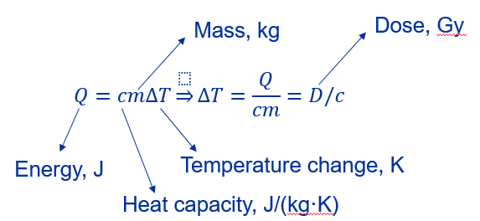

5. Ageing management of waste packages in storage/disposal
Modelling as an input into a monitoring strategy as part of ageing management plan for cementitious waste packages
1. Mineral (Calcium) leaching
3. Radiolysis
2. Sulphate and magnesium interaction
Modelling to be performed
Notes:
This comprehensive introduction to RWM is structured in 5 main parts.

Slide 48
5. Ageing management of waste packages in storage/disposal
At the anticipated end of the life of a store, one of several options must be carried out, including:
  Removal of the stored waste to a different facility (e.g. disposal, treatment, or another storage facility);
  Life-extension of the storage facility for another prescribed period of time; or
  Conversion of the storage facility into a disposal facility.
Ageing Management Planning allows operators to demonstrate packages and/or the storage facility can meet all 3 options as:
1. Ageing management (AM) requires predicting and controlling (i.e., detecting and mitigating) ageing degradation of components before primary functions are compromised.
2. Longer-term storage entails taking additional measures to ensure continuing satisfactory control and protection of the waste packages and the storage facility itself.
3. Ageing Management methodology involves a systematic program of monitoring, inspection and maintenance of the facility, as well as the waste packages.

Slide 49
6. Summary and Conclusion
Ageing management (AM) requires predicting and controlling (i.e., detecting and mitigating) ageing degradation of components before primary functions are compromised.
Longer-term storage entails taking additional measures to ensure continuing satisfactory control and protection of the waste packages and the storage facility itself.
Ageing Management methodology involves a systematic program of monitoring, inspection and maintenance of the facility, as well as the waste packages.

Slide 50
Thank you!
Notes:
Thank you!

