Slide 1
ME-RER9154-2300641: Regional Workshop on Approaches to Ageing Management of Waste Packages in Storage
07. Ageing of metal containers during storage (disposal)
W. Meyer
WTS

Slide 2
Contents
Introduction
Introduction to how materials corrode
3-11. Corrosion types
Assessing the corrosion rate (practical)
/Summary
Notes:
This comprehensive introduction to RWM is structured in 5 main parts.

Slide 3
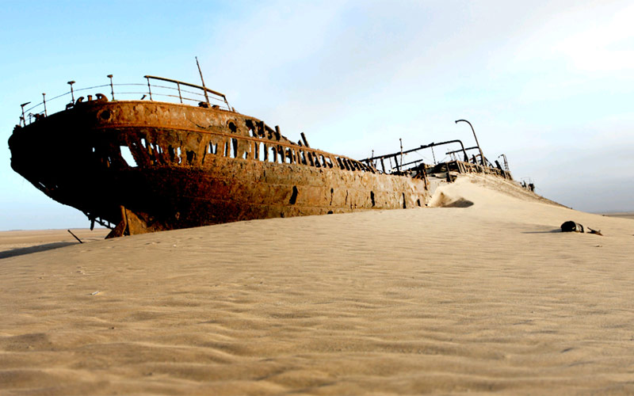
1. Introduction
CORROSION: Corrosion is the deterioration and loss of a material (typically a metal) and its critical properties due to chemical, electrochemical and other reactions of the exposed material surface with the surrounding environment.
Skeleton Coast (Namibia)

Slide 4
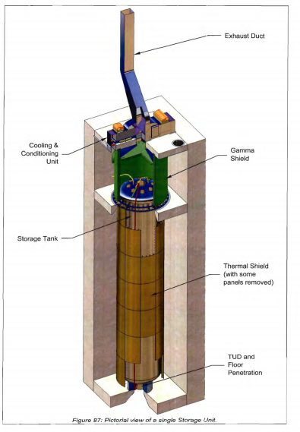
1. Introduction
Storage container for SF

Slide 5
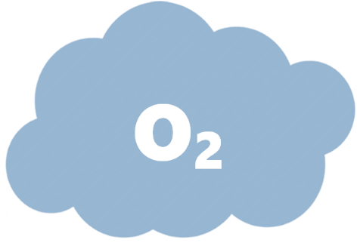
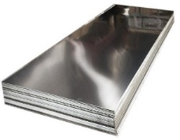
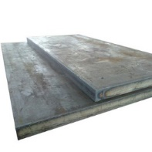
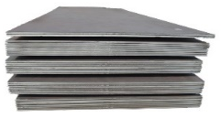

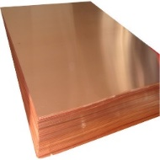

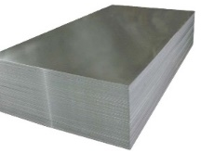





1. Introduction
Metal corrosion is due to the “preference” of metals to bond with oxygen to form metal oxides.
Notes:
An electrolyte is a substance that produces an electrically conducting solution when dissolved in a polar solvent, such as water. This includes most soluble salts, acids, and bases.

Slide 6

2. Forming of passive (protective) layer
Stage 1. Surface Hydroxylation
Could be water vapour in air or a solution of water.
H-O-H
Molecular water dissociates (splits) into OH⁻ and H⁺ when it comes into contact with a positively charged surface.
H-O-H
H-O-H
H-O-H
O
H
H-O-H
O
O
H
O
H
O
H
O
H
O
H
O
H
O
H
O
H
H
M⁺
This forms metal-oxygen or metal-hydroxide bonds at the metal surface.
M_{(s)}
Professor Claire Corkhill
Chair in Mineralogy and of Radioactive Waste Management
School of Earth Science
Notes:
The driving force for water dissociation is the formation of metal-oxygen or metal-hydroxyl bonds. (tendency for water dissociation increases with the number of lattice defects.)
Most polycrystalline materials used for engineering purposes are expected to adsorb water in dissociated form.
So, hydroxyl surface groups are generated and these act as sites for further water adsorption
This is very fast and happens in a fraction of a second.
The result is a surface that is less conducive to rapid recombination with water

Slide 7
2. Forming of passive (protective) layer
Stage 2. Adsorption & absorption of water
This thin layer of water is where corrosion reactions occur
H
H
H
H
H
H
H
H
O
O
O
O
O
O
O
O
H
H
H
H
H
H
The equivalent monolayer
H
H
O
O
O
O
O
O
O
O
H
H
H
H
H
H
H
H
Absorption: atoms, ions or molecules from a gas, liquid or dissolved solid are incorporated within a surface.
Professor Claire Corkhill
Chair in Mineralogy and of Radioactive Waste Management
School of Earth Science
Notes:
- The first layer of water has a high degree of ordering relative to the substrate because of its proximity to the surface. It is called the equivalent monolayer.
The second and third layers are more mobile with a higher degree of random orientation.
Aqueous films thicker than three monolayers possess the same properties as bulk water.
This water is the electrolyte!! And the equivalent monolayer is where the corrosion reactions occur.

Slide 8
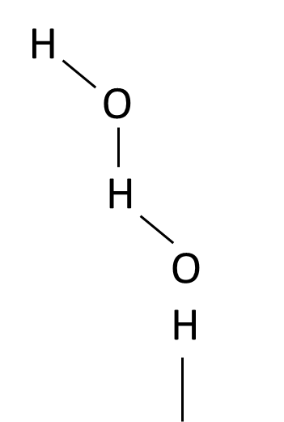
2. Forming of passive (protective) layer
Stage 3. Dissolution
Aqua-metal ion coordinates with counterions present the equivalent monolayer
The equivalent monolayer
Cathodic reaction:
½O_{2(g)} + H₂O + 2e → 2OH⁻
Zn²⁺
OH⁻
Anodic reaction:
Zn_{(s)} → Zn²⁺ + 2e
OH⁻
Dissolution: transformation of a solid into a solute (a dissolved component), forming a solution.
M_{(s)} → M²⁺_{(aq)} + 2e
2e
Zn_{(s)}
Hard | Intermediate | Soft
H⁺, Na⁺, Mn²⁺, Al³⁺, Cr³⁺, Fe³⁺, Ti⁴⁺ | Fe²⁺, Ni²⁺, Cu²⁺, Zn²⁺, Pb²⁺ | Cu⁺, Ag⁺
H₂O, OH⁻, O²⁻, SO₄²⁻, NO₃⁻, CO₃²⁻ | SO₃²⁻, NO²⁻ | H₂S
There may be other counterions present (e.g. if the electrolyte is open to the environment)
Many combinations are possible, but certain ones are more likely to occur.
Lewis Acids
Lewis Bases
Professor Claire Corkhill
Chair in Mineralogy and of Radioactive Waste Management
School of Earth Science
Notes:
As the metal ion leaves the lattice, it enters the water layer as a hydrated aquo-metal ion.
When a metal ion dissolves into the water layer, it coordinates with counterions that are present (in the case of last week’s Zn example, it coordinates with OH-).
There may be other species present (especially if the electrolyte is open to the environment).
In this case, the metal ion could pair with any of these species. Although many combinations are possible, certain ones are more likely to occur.
This is easily explained by the lewis acid / base concept. A lewis acid is an electron-pair acceptor, a lewis base is an electron-pair donator.
This table shows a selection of metal ions and their counterions. The hardness of a ion generally increases with its oxidation state, e.g. Fe3+ is a harder lewis acid than Fe2+.
A soft acid, such as Ag, will be more likely to coordinate with a reduced sulfur compound than with a sulfate ion.
Similarly, a hard acid, such as Al3+ is more likely to coordinate with oxygen or sulfate ions than reduced sulfur.
The broken bond left behind at the surface is immediately hydroxylated.
The dissolution of metal then forms a metal oxide.

Slide 9
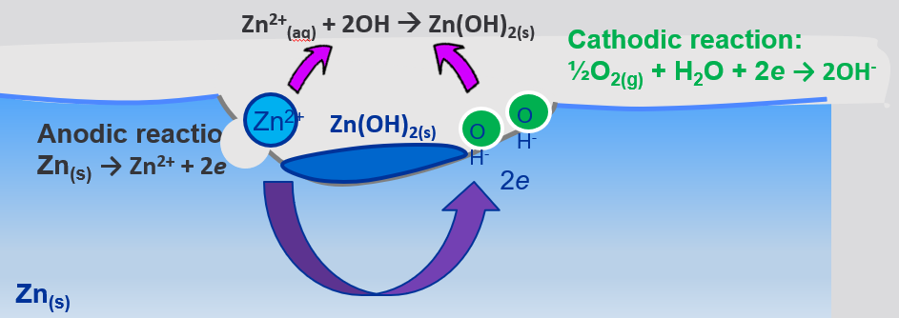
2. Forming of passive (protective) layer
Stage 4. Corrosion product nucleation
When the concentration of ion pairs in the water layer reaches saturation, the ion pairs will precipitate as solid products
Defect sites are often the location for corrosion products to accumulate
The corrosion products will eventually cover the entire surface.
Professor Claire Corkhill
Chair in Mineralogy and of Radioactive Waste Management
School of Earth Science
Notes:
When the concentration of ion pairs in the liquid layer eventually reaches supersaturation, the ion pairs will precipitate into a solid phase.
Defect sites are often the location for corrosion products to nucleate (we’ll do more on this later in the course).
With prolonged exposure to the water layer, the corrosion products will cover the entire surface.
Further formation of corrosion products requires that reactive species must be transported through the corrosion product layer
So long as the

Slide 10


2. Forming of passive (protective) layer
Stage 5. Continued dissolution & corrosion product formation
The equivalent monolayer
Zn²⁺_{(aq)} + 2OH⁻_{(aq)} → Zn(OH)_{2(s)}
Zn(OH)_{2(s)}
Passivating layer
Anodic reaction:
Zn_{(s)} → Zn²⁺ + 2e
Zn²⁺
OH⁻
OH⁻
Cathodic reaction:
½O_{2(g)} + H₂O + 2e → 2OH⁻
Number of monolayers
2e
Zn_{(s)}
RH (%)
Reactive species must be transported through the corrosion product layer
If the layer is thin & porous, the corrosion layer is not protective
If the layer is thick & dense, ions can’t be transported & the layer is protective
20% RH = 1 layer
60% RH = 3 – 5 layers
80% RH = 5 – 11 layers
Professor Claire Corkhill
Chair in Mineralogy and of Radioactive Waste Management
School of Earth Science
Notes:
Further formation of corrosion products requires that reactive species must be transported through the corrosion product layer
So long as the layer of corrosion products is thin or porous, the transport of ions is not significantly hindered. In this case, the corrosion products have poor protective ability.
Thicker and more dense films of corrosion products generally result in higher corrosion resistance because the transport of ions is restricted.

Slide 11
Corrosion encountered by metals in storage/disposal
3. Corrosion types
Pitting
Atmospheric Stress Corrosion Cracking (ASCC)
Galvanic effects
Microbially Induced Corrosion
General corrosion
Crevice corrosion
Radiation induced corrosion

Slide 12
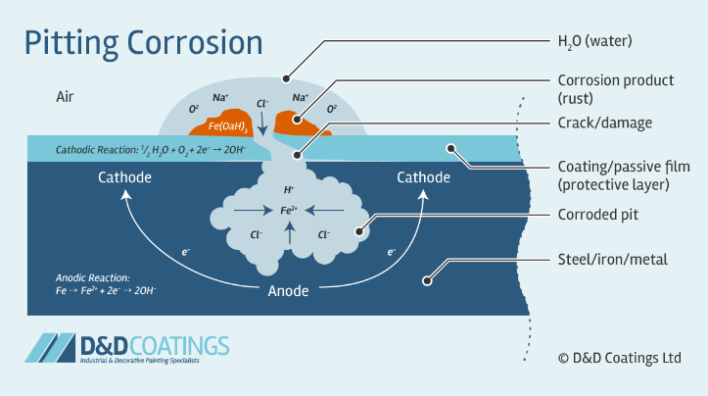

3. Pitting Corrosion
Pitting Corrosion
Pitting corrosion is a localized form of corrosion by which cavities or "holes" are produced in the material. Pitting is considered to be more dangerous than uniform corrosion damage because it is more difficult to detect, predict and design against. It is also influenced by temperature and chlorides of environment
Typically the surface protection layer or film becomes the cathode when it is damaged and cracked. A small area of metal is then exposed and becomes the anodic

Slide 13
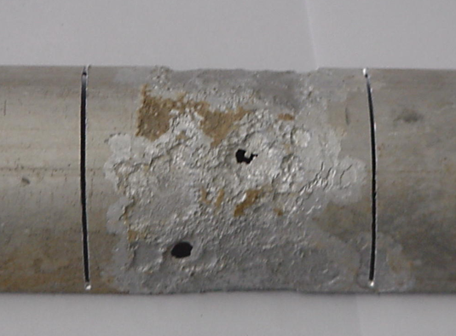
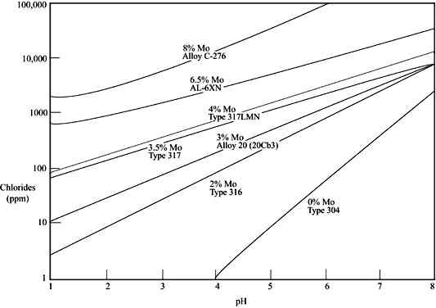
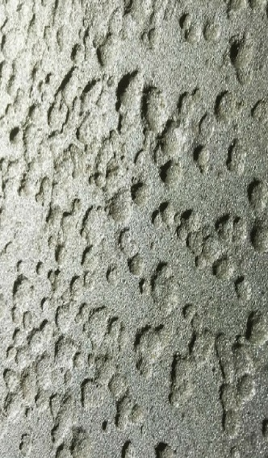
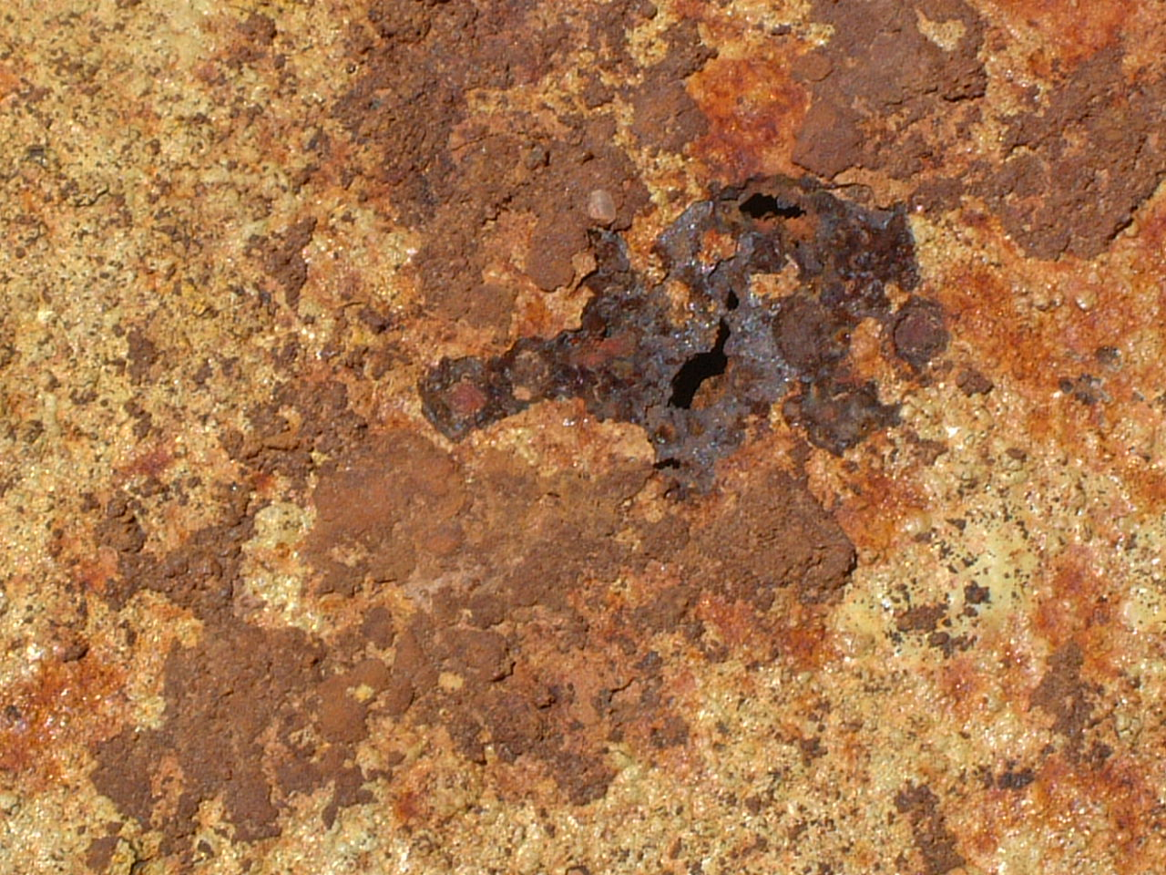
3. Pitting Corrosion
Pitting Corrosion
Pitting corrosion is a localized form of corrosion by which cavities or "holes" are produced in the material. Pitting is considered to be more dangerous than uniform corrosion damage because it is more difficult to detect, predict and design against. It is also influenced by temperature and chlorides of environment
Alloy | Critical Pitting Temp.
304L | 5-10°C
316L | 15-25°C
904L | 35-45°C
2205 | 45-55°C
254 SMO | 85-95°C
Down pipe at Vaalputs
Drum at Vaalputs
Source: Outokumpu Steel
Source: Allegheny-Ludlum Steel

Slide 14
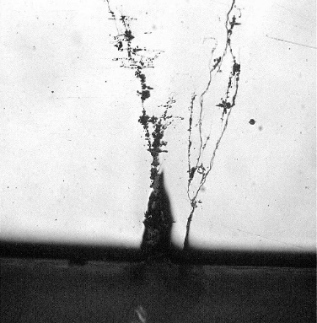
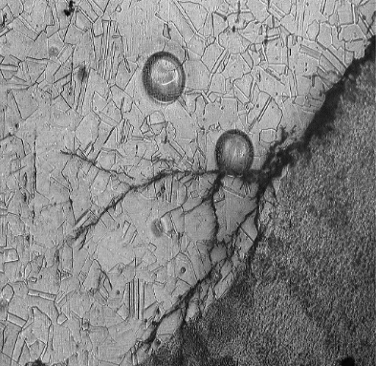
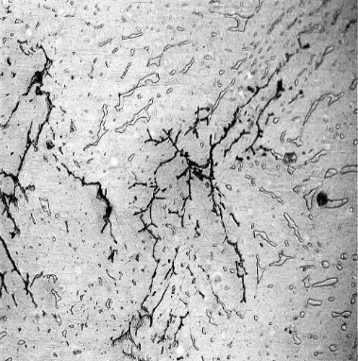
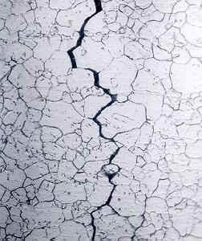
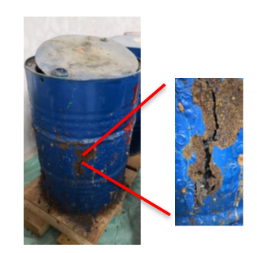
4. Stress Corrosion
Atmospheric Stress Corrosion Cracking (ASCC)
Example in South Africa
Externally initiated ASCC transgranular in nature on external 304L stainless steel plate and pipe-operating temperatures between 20° and 25°C in South Africa
Relative Humidity
Temperature
Salt concentration and salt type
RH determines the wetting range of the particular salt
  NaCl wets at >65%
  other salts such as ferric chloride wet at 35%
  Problem arises when mixtures of salts are present
  Salt mixtures may wet at lower RH’s than believed leading to possibility of early corrosion

Slide 15
4. Stress Corrosion
Atmospheric Stress Corrosion Cracking (ASCC)
Stress corrosion cracking (SCC) is the cracking induced from the combined influence of tensile stress and a corrosive environment, mechanical properties, and material variables. SCC usually occurs in certain specific alloy-environment-stress combinations like when welding and heat treatment introduce residual stresses
Factors influencing Atmospheric Stress Corrosion Cracking (ASCC)
Relative Humidity
Temperature
Salt concentration and salt type
RH determines the wetting range of the particular salt
  NaCl wets at >65%
  other salts such as ferric chloride wet at 35%
  Problem arises when mixtures of salts are present
  Salt mixtures may wet at lower RH’s than believed leading to possibility of early corrosion

Slide 16
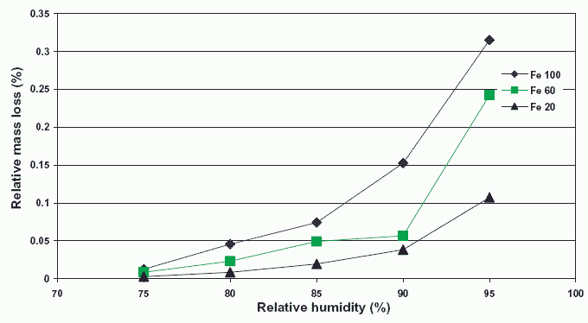
4. Stress Corrosion
Atmospheric Stress Corrosion Cracking (ASCC)
Factors influencing Atmospheric Stress Corrosion Cracking (ASCC)
Relative Humidity
Temperature
Salt concentration and salt type
RH determines the wetting range of the particular salt
  NaCl wets at >65%
  other salts such as ferric chloride wet at 35%
  Problem arises when mixtures of salts are present
  Salt mixtures may wet at lower RH’s than believed leading to possibility of early corrosion
Source: JP Cai, SB Lyon: Corrosion Science, Vol. 47, p.2956 (2005)

Slide 17
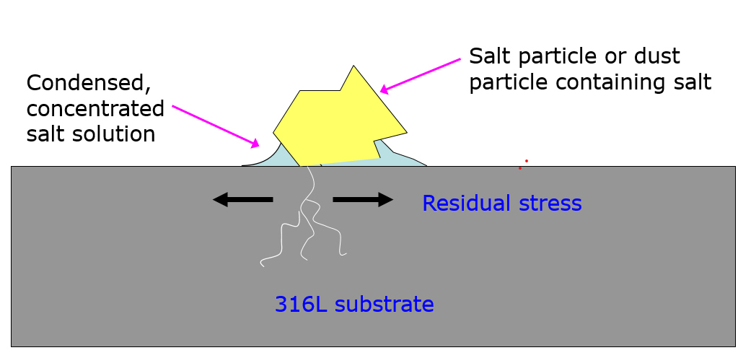
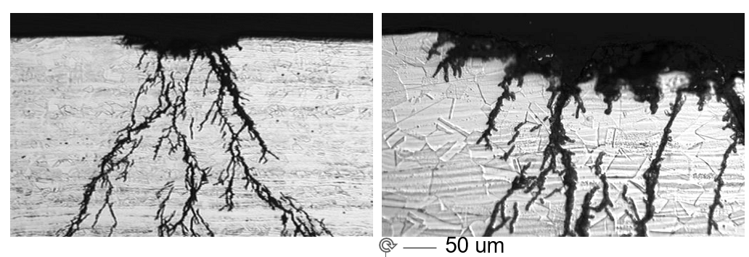
4. Stress Corrosion
Atmospheric Stress Corrosion Cracking (ASCC)
Factors influencing Atmospheric Stress Corrosion Cracking (ASCC)
Relative Humidity
Temperature
Salt concentration and salt type
RH determines the wetting range of the particular salt
  NaCl wets at >65%
  other salts such as ferric chloride wet at 35%
  Problem arises when mixtures of salts are present
  Salt mixtures may wet at lower RH’s than believed leading to possibility of early corrosion
Conditions:316L, salt deposits of MgCl₂ or CaCl₂ (e.g. from sea-salt aerosols) at 50°C, 35% RH, 22 weeks

Slide 18
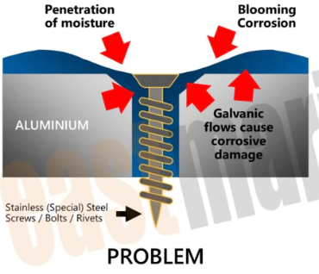
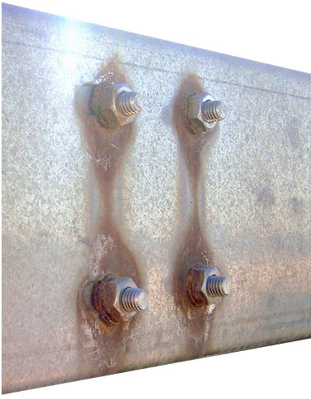
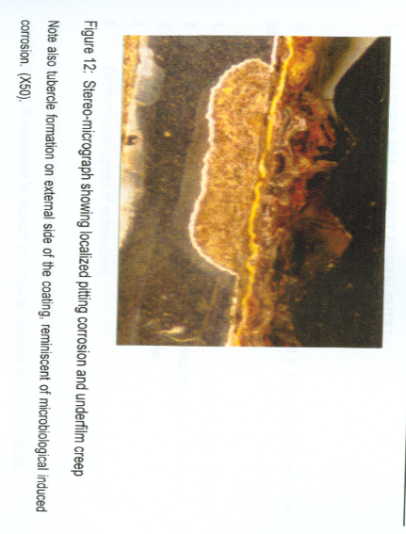
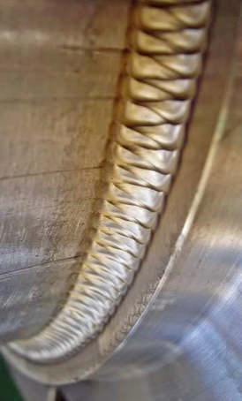
5. Galvanic Corrosion
Galvanic Corrosion
Galvanic corrosion (also called ' dissimilar metal corrosion' or wrongly 'electrolysis') refers to corrosion damage induced when two dissimilar materials are coupled in a corrosive electrolyte. It occurs when two (or more) dissimilar metals are brought into electrical contact
In the event of such contact, the less noble metal acts as an anode, and the more noble metal acts as a cathode. It is always the anode that corrodes.
Al flux to weld metal drum

Slide 19
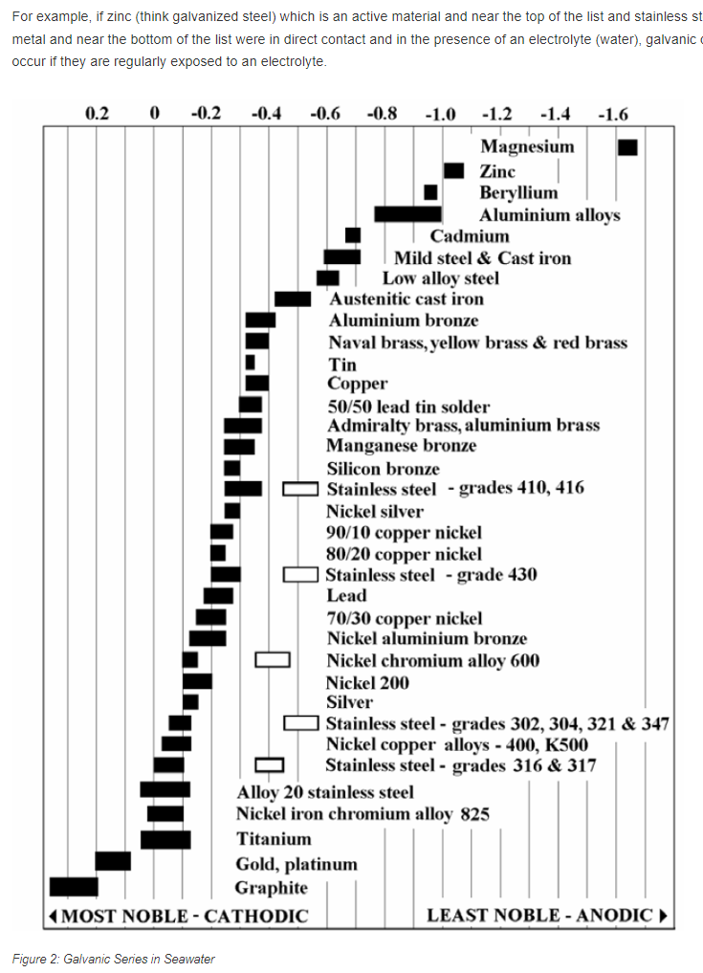
5. Galvanic Corrosion
Galvanic Corrosion

Slide 20
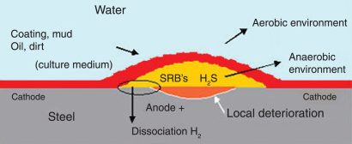
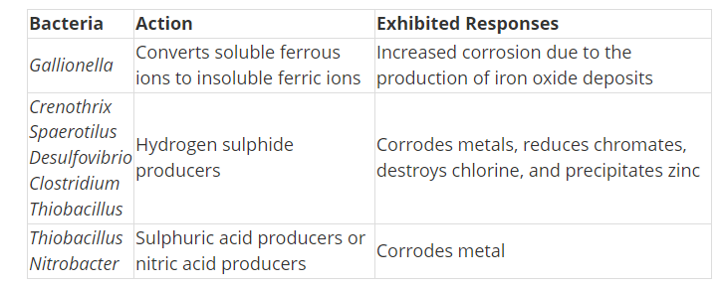
6. Microbially Induced Corrosion
Microbially Induced Corrosion
Microorganisms — whether they be microalgae, bacteria, or fungi — can cause microbiologically influenced corrosion, or MIC. Although they do not produce a unique type of corrosion, they can speed corrosion reactions or influence the mechanisms of corrosion to shift
Microbially induced corrosion (MIC) progresses in three stages: microbe attachment, growth of the initial pit and nodule, and maturation of nodule and pit

Slide 21
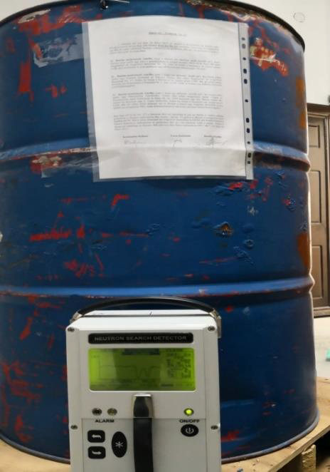
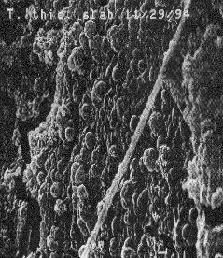
6. Microbially Induced Corrosion
Microbially Induced Corrosion
Bacteria can reduce metals in anaerobic conditions through dissimilatory processes
Extracted metals remain outside the cell to be reduced/ oxidised for cellular energetics
Fe(III) can be the dominant electron acceptor for microbial respiration in many subsurface environments
Bubble formation (due to bacteria forming hydrogen) and corrosion

Slide 22
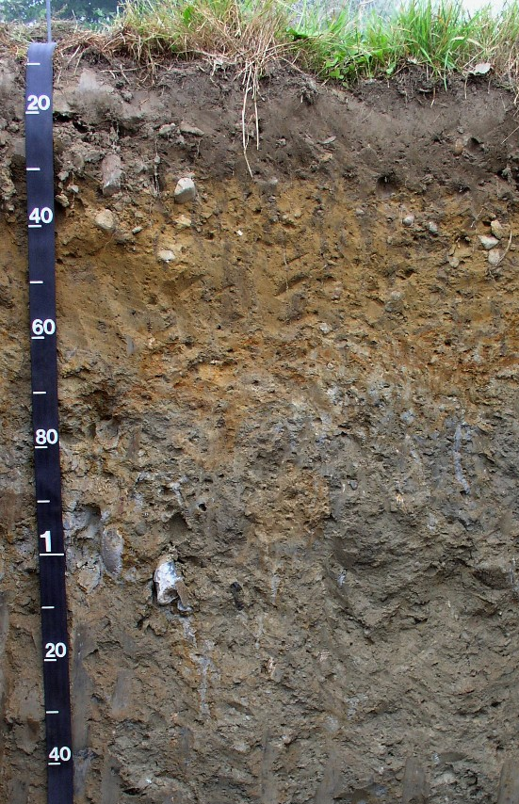
6. Microbially Induced Corrosion
Potential role of microbes?
Aerobic microbes
O₂ + 4H⁺ + 4e⁻ → 2H₂O
Anaerobic microbes
NO₃⁻ + 2H⁺ + 2e⁻ → NO₂⁻ + H₂O
Mn⁴⁺ + 2e⁻ → Mn²⁺
Fe³⁺ + e⁻ → Fe²⁺
SO₄²⁻ + 8H⁺ + 8e⁻ → S²⁻ + 4H₂O
Initial experiments show that microbes do not have a significant effect on glass corrosion
Crawford et al. In prep

Slide 23
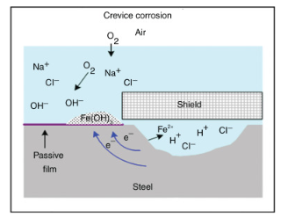
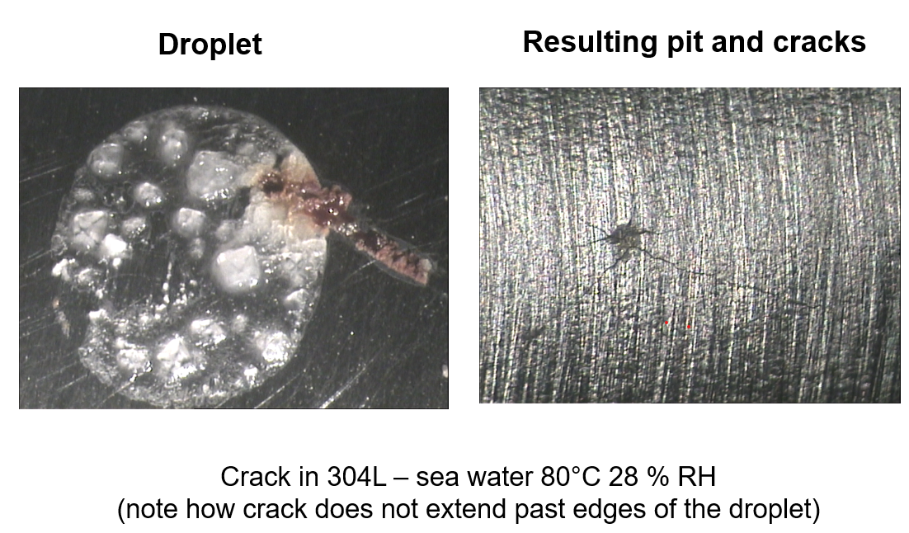
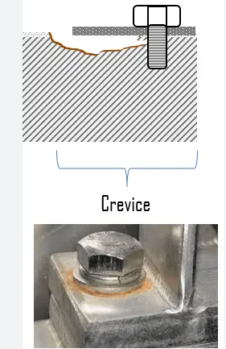
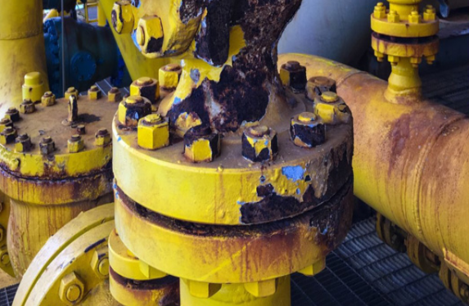
7. Crevice Corrosion
Crevice corrosion
Similar to pitting corrosion, crevice corrosion is initiated with the breakdown of stainless steel’s protective oxide film and continues with the formation of shallow pits. However, rather than occurring in plain sight, crevice corrosion—as its name implies—occurs in crevices.
When dust, sand and other corrosive substances are deposited on surfaces, they create an environment where water will accumulate and corrode the part. Local crevice corrosion will occur beneath soil/dust deposits on surfaces

Slide 24
8 CO₂ corrosion
Carbon dioxide corrosion often takes up the form of general (uniform) corrosion, which is characterised by an electrochemical reaction proceeding uniformly over the entire surface area of the metal. Corrosion is characterised by the following physical descriptions: horse shoe, ripple effect marks, comet tails and dinosaur footprints.
Figure 2-1. Diagram showing CO2 corrosion including the effect of O2
(Song et al., 2005)
(Kermani and Morshed, 2003)
(Newman, 2010)

Slide 25
Modelling

Slide 26
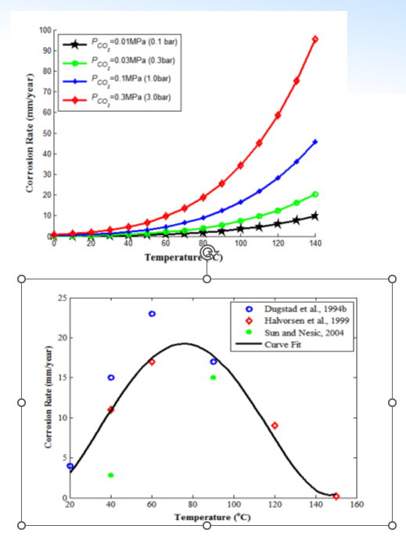
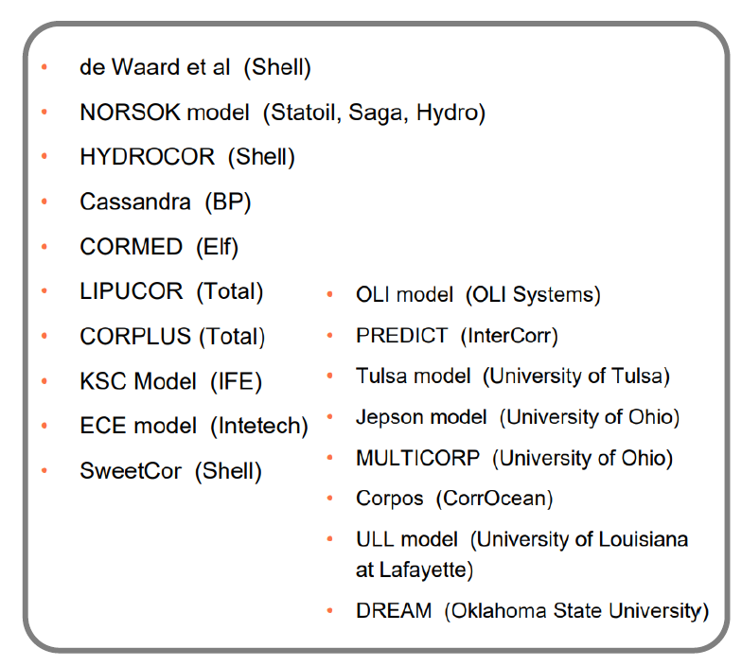
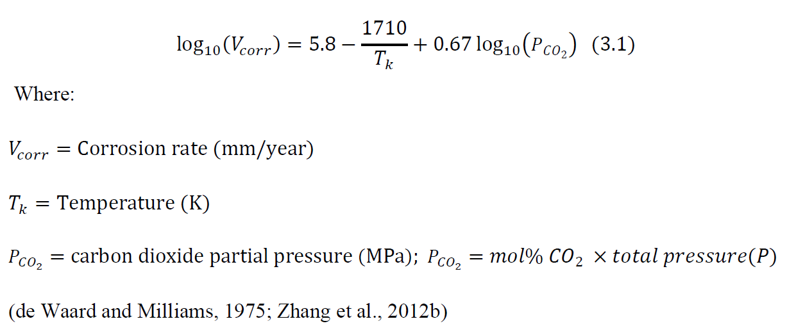
9 CO₂ corrosion
In an attempt to come up with a correlation capable of accurately predicting CO2 corrosion in metals, the de Waard-Milliams equation was formulated as follows:

Slide 27
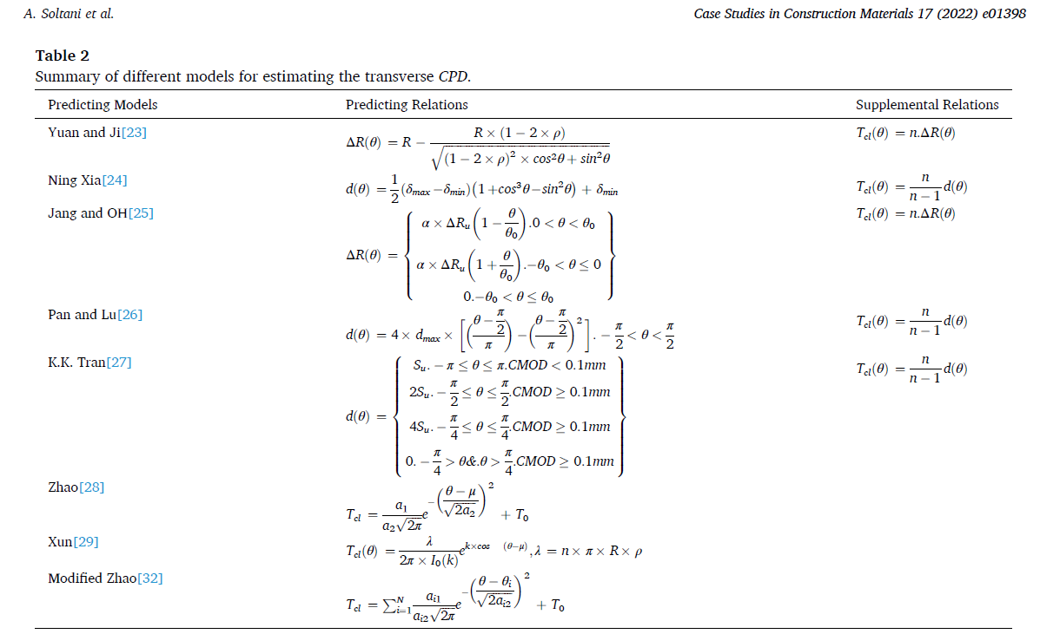

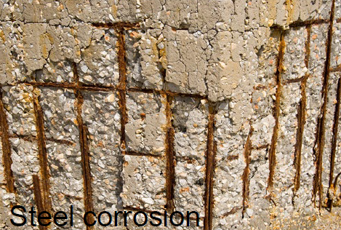
9 Chloride corrosion
The localized corrosion of metals in the vicinity of chloride ions, microcell corrosion, has attracted more scientific attention than carbonation-induced corrosion (macrocell corrosion)
Empirically by calculating the ratio of CP to the corroded rebar:
In this relation, Tcl, r, θ, ρ, Vrust, and Vcs are the total thickness of CP, steel rebar radius, angle in radians, corrosion percentage of steel rebars, the iron rust volume, and the corroded steel volume, respectively. The value of n = 1.9 was obtained from Eq.2,

Slide 28


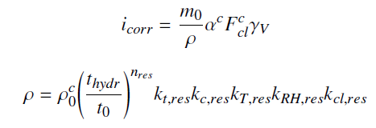



10 Assessing the corrosion rate
Corrosion models of steel in concrete –building industry
Vu and Stewart’s model (2000)
Alonso et al.’s model (1988)
Yalcyn and Ergun’s model (1996)
DuraCrete model (2000)
Liu and Weyers’s model (1998)
Pour-Ghaz et al.’s model (2009)

Slide 29

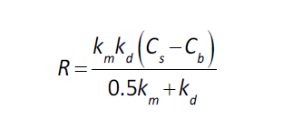
10 Assessing the corrosion rate
Corrosion models of steel in concrete –building industry
Empirical model
Where
t_{c} is the time to onset of corrosion (y),
x_{c} is the thickness of concrete surrounding the reinforcing steel (cm),
WCR is the water to cement ratio,
[Cl] is the chloride ion content of the water (parts per million
Because of limited data for corrosion or steel within the concrete, a conservative rate for reinforcement corrosion of 10⁻⁵ m/yr (10⁻² mm/y) is assumed
(USDOE, 2006; Walton, 2007).
where:
R is the FAC rate (gFe/cm².s) ,
km is the mass transfer coefficient (cm/s),
kd is the magnetite dissolution rate constant (cm/s),
Cs is the magnetite solubility (gFe/cm³) and
Cb is the concentration of iron in the bulk coolant (gFe/cm³).

Slide 30
11 Assessing the corrosion rate
Corrosion models for metals used in oil industry
NORSOK
The NORSOK standard is owned by Norwegian Oil Industry Association and Federation of Norwegian Manufacturing Industries. The program covers only calculation of corrosion rates where CO2 is the corrosive agent.
ECE (Electronic Chemical Engineering)
ECE program software calculates corrosion rate based on the modified model by (de Waard & Milliams 1975). In ECE, they develop corrosion prediction by involving several variables such as gas fugacity, formation of protective films, effect of ferrous ions, presence of oil, effect of condensing water, and effect of multiple phase.
Cassandra (DWM 93)
Cassandra is a model developed based on the experiences of (de Waard & Milliams 1975). The input includes pH, CO2 concentration, temperature, and water contaminant. This model has important aspects which influence rate of corrosion, namely corrosion inhibitor availability and corrosion risk categories. The model also accounts for the presence of acetate in water as acetic acid. The major input to the model are: CO2 mole %, temperature, total pressure, liquid velocity and water chemistry

Slide 31
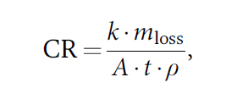
12 Assessing the corrosion rate
Corrosion of metal –practical
Corrosion of metals in air
Corrosion of metal inside cement
Corrosion of metal by CO₂:
Where:
k is a constant 8.76 x10⁴ so that CR is in [mm/y],
mloss is the mass loss [g] of the metal (m₀₋m_{f})
t [hours],
A is the surface area of the material exposed [cm2],
ρ is the density of the material [g/cm3]
ASTM, 2012; Kreysa & Schütze, 2007; Kutz, 2005).
Where
t_{c} is the time to onset of corrosion (y),
x_{c} is the thickness of concrete surrounding
the reinforcing steel (cm),
WCR is the water to cement ratio,
[Cl] is the chloride ion content of the water (parts per million)
(USDOE, 2006; Walton, 2007).
corrosionsource.com - Corrosion Rate Calculator

Slide 32
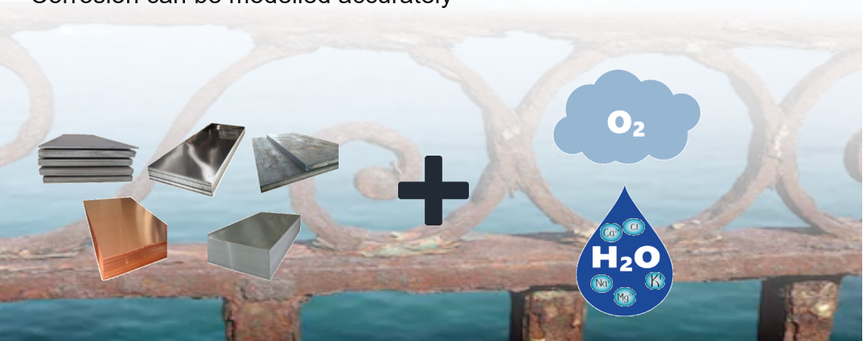
13. Summary
Metals corrode because they want to bond with oxygen to return to their original form of metal oxides.
The corrosion process occurs much faster in the presence of water, containing electrolytes.
Corrosion can be modelled accurately

Slide 33
Thank you!
Notes:
Thank you!

