Slide 1
ME-RER9154-2300641: Regional Workshop on Approaches to Ageing Management of Waste Packages in Storage
08. Storage and disposal conditions: Influence of environmental conditions on polymer containers during storage
W. Meyer
WTS

Slide 2
Content
Introduction
2. Liquid decay storage tanks
Liquid storage tanks before treatment
4. Storage of aqueous liquids
Storage of organic liquids
6. Replacing containers with organic liquids in storage
7. Example of treating/solidifying organic liquids in storage
8. General liquid compatibility for storage
9. New polymer container materials

Slide 3

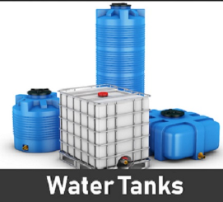
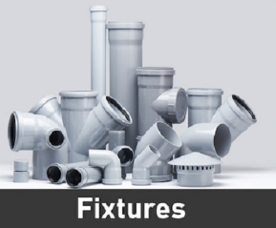

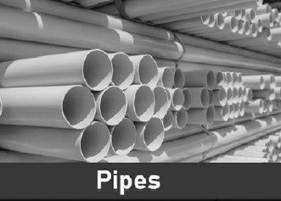

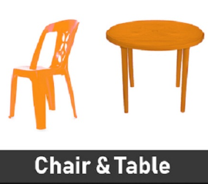
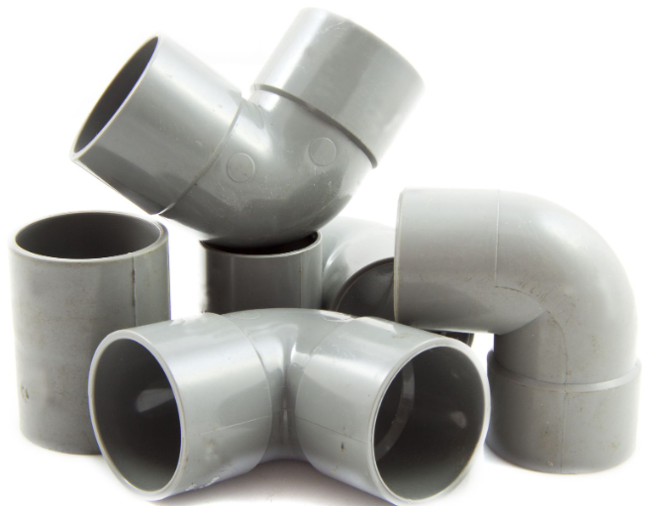
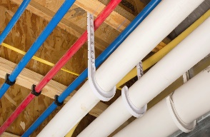
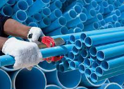
1. Introduction
Building Construction
Plumbing pipes, fixtures, manhole covers, manholes
Roofing
Wall panels for wall partitions or for dry wall
Electrical fixtures
Furniture like chairs, table etc
Shutters
Flooring
Waterproofing membranes
False ceiling panels
Sealants
Water tanks

Slide 4
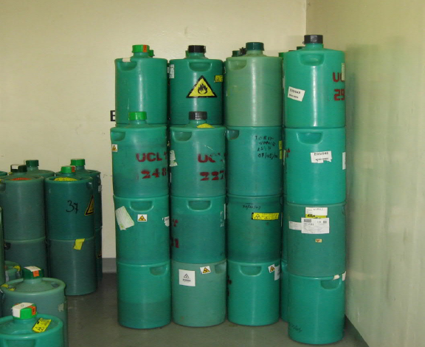
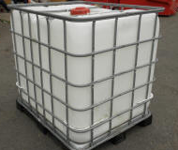
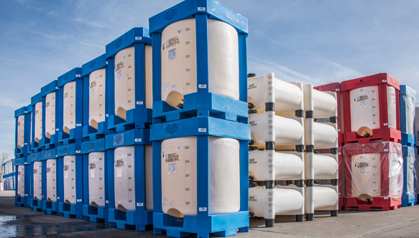
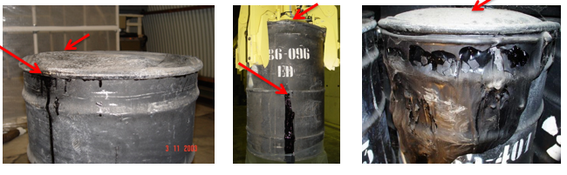
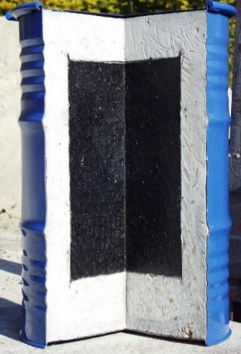
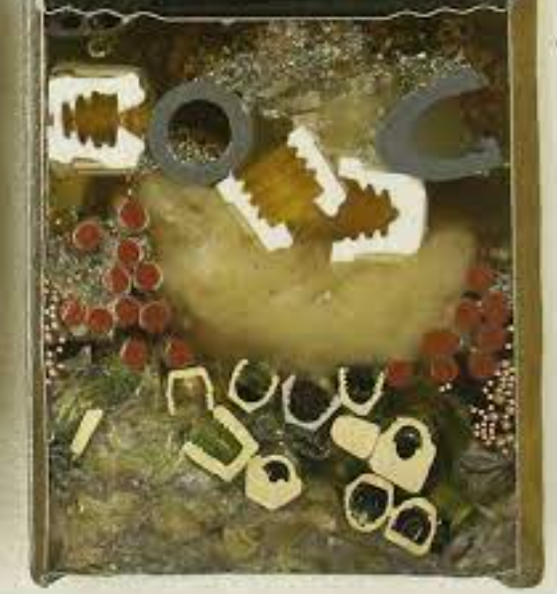
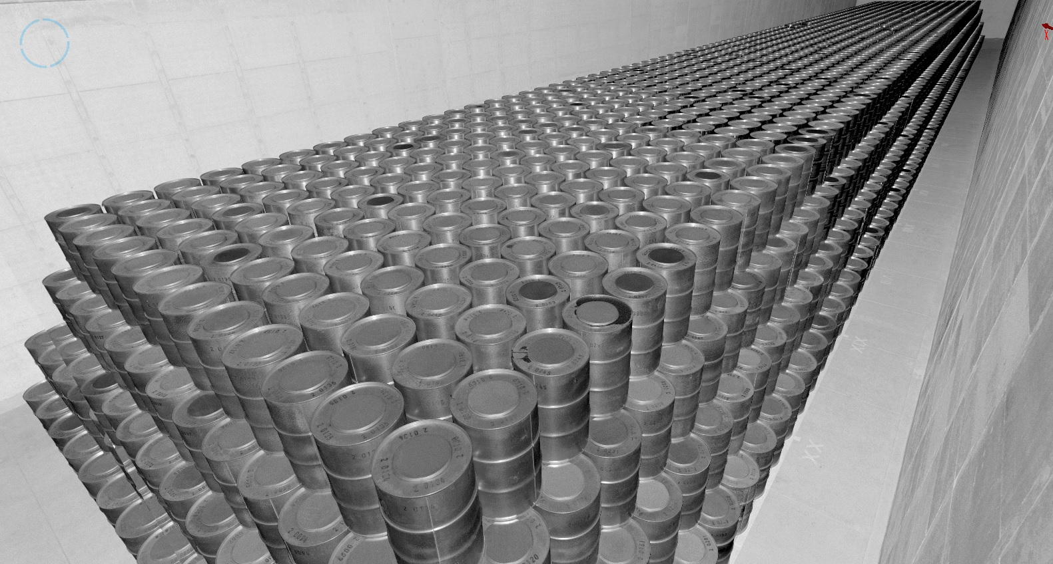
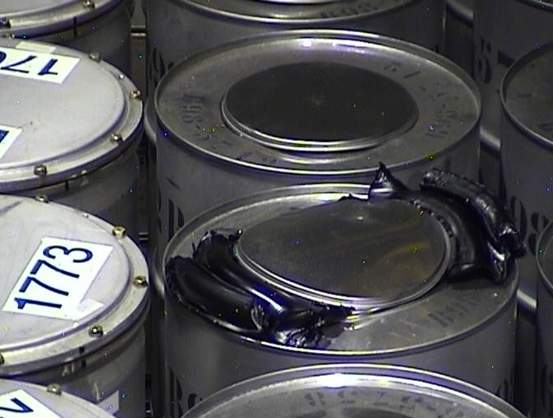
1. Introduction
Waste packages and waste forms

Slide 5
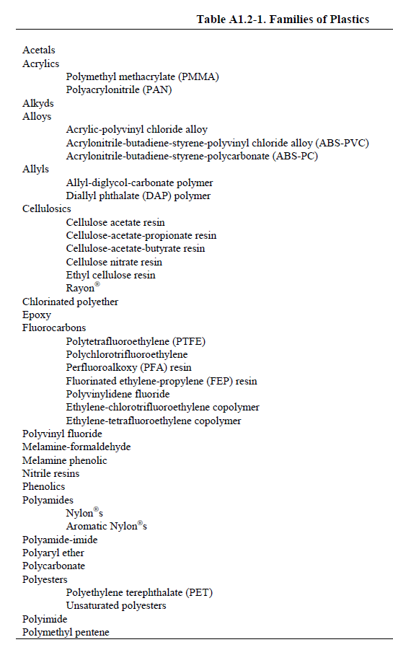
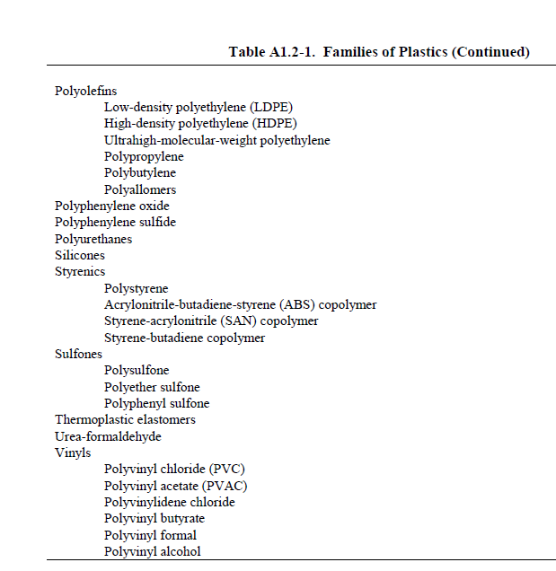
1. Introduction

Slide 6
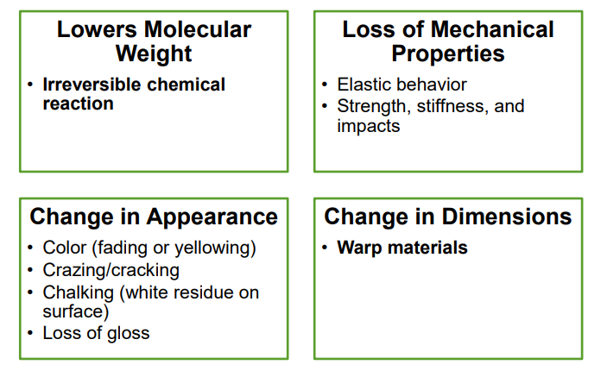
1. Introduction
The materials will evolve with time:
Fatigue and reduction of strength
Yellowing or discoloration
Cracking

Slide 7
2. Degradation
Degradation of polymers degradation
Chemical degradation
Chemical degradation refers exclusively to processes, which are induced under the influence of chemical reagent
Thermal degradation
Thermal degradation refers to the case where the polymer, at elevated temperatures, starts to undergo chemical changes
Biodegradation
Biologically initiated degradation also is strongly related to chemical degradation
Radiolytic degradation
When subjected to high energy radiation (e.g. gamma radiation) changes are observed on their molecular structure
Ozone degradation (Ozonolysis)
In the presence of oxygen peroxy radicals leads to the degradation of polymeric chains
Photodegradation
Photodegradation is degradation of a photodegradable molecule caused by the absorption of photons,
particularly those wavelengths found in sunlight, such as infrared radiation, visible light, and ultraviolet light
Mechanical degradation
This generally, refers to macroscopic effects brought about under the influence of shear forces.

Slide 8
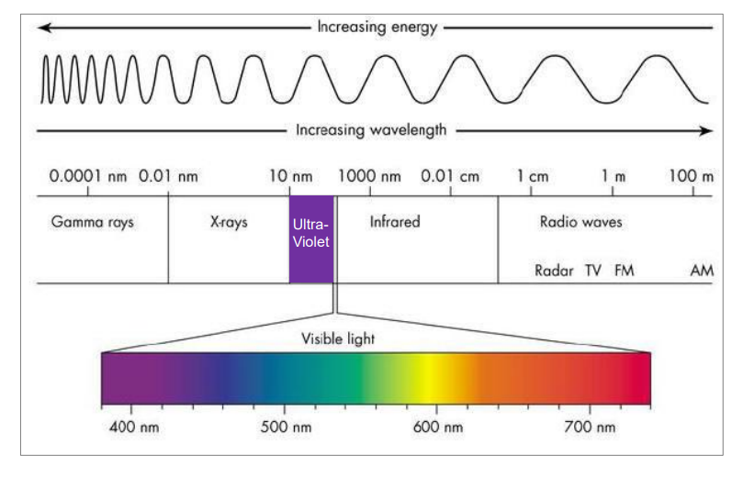
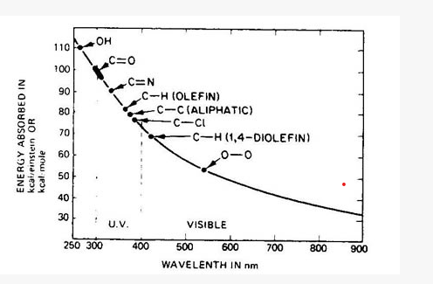
2. Degradation
Photodegradation
• UV-A (315nm – 400nm)
Long wavelength UV related to tanning and premature skin aging • Contributes to the degradation of many polymers
• UV-B (280nm – 315nm)
Shorter wavelength UV, and the most damaging. Prolonged exposure causes sunburn
Fortunately, much of UV-B is absorbed by our Ozone layer Most polymers are very sensitive to UV-B
UV-C (200nm – 280nm)
• Shorter still and contributes to degradation in some polymers • Used for germicidal applications
Materials Technology Limited (drb-mattech.co.uk)

Slide 9
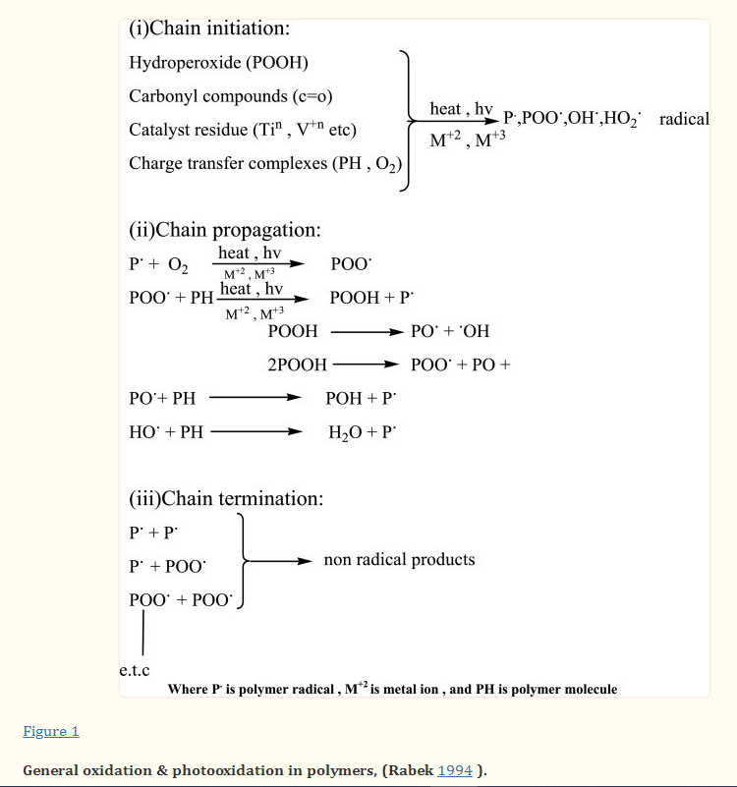
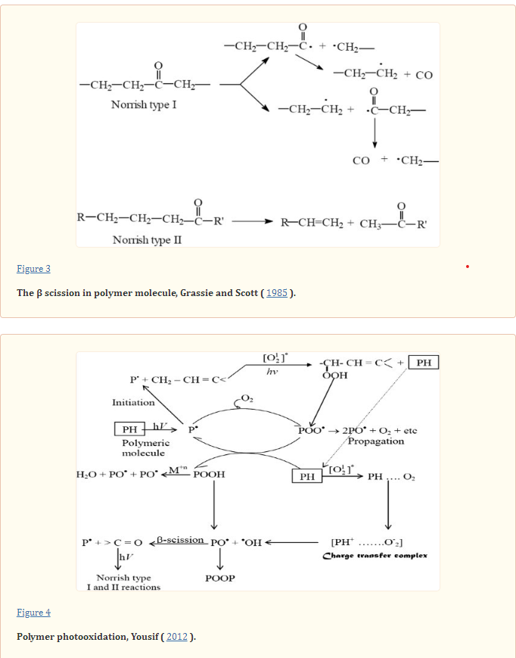
2. Degradation
Photodegradation
Photodegradation and photostabilization of polymers, especially polystyrene: review - PMC (nih.gov)

Slide 10
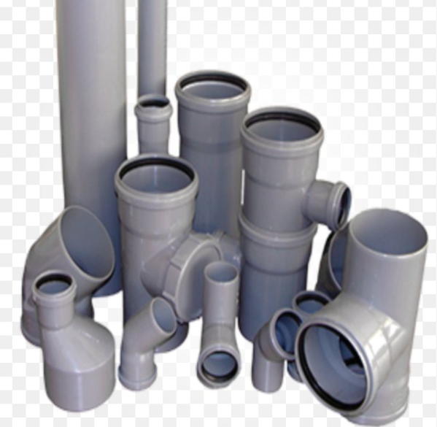
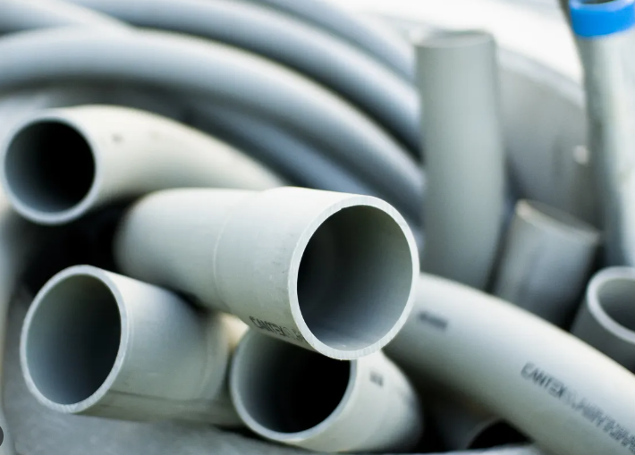
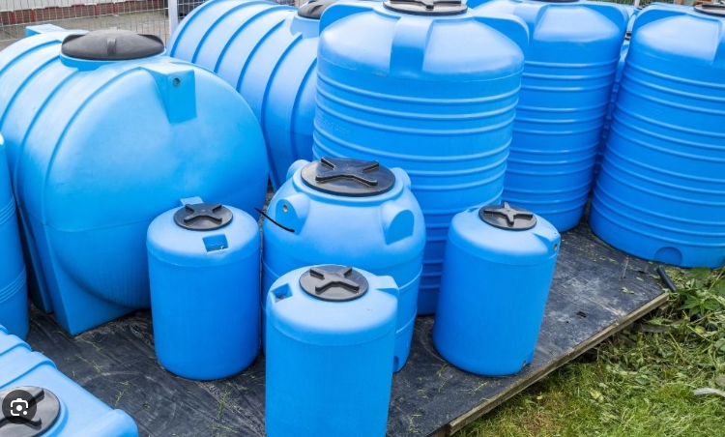
2. Degradation
Photodegradation
Effects of UV Radiation on Polypropylene
Polypropylene is highly susceptible to degradation by UV radiation in its base form (i.e. no pigment or additives). The material becomes brittle after prolonged exposure. In fact, basic polypropylene can lose up to 70% of its mechanical strength after 6 days worth of exposure to high-intensity UV radiation. It should be noted, however, that even with the additives, polypropylene will still degrade relatively quickly when exposed to sunlight for a prolonged period of time.
Even though polypropylene has great mechanical strength and is highly chemically resistant, it is not suited for prolonged exposure to sunlight it’s best to simply keep this material out of direct sunlight altogether.

Slide 11
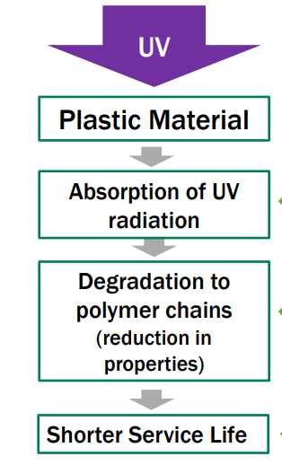
2. Degradation
Photodegradation
Examples of UV wavelength sensitivity by polymer
Polyethylene 300-340 nm
• Prone to yellowing and embrittlement
• UV stable grades greatly improve performance with many extended outdoor applications
Polypropylene 290-370nm
• Prone to yellowing and embrittlement
• UV stable grades have allowed expansion into a variety of outdoor applications including automotive
ABS 300-390nm
• Typically, unsuitable for outdoor applications without coating/paint
• UV stabilized grades are available for limited exposure applications
Polycarbonate 280-310nm
• Degrades with pronounced discoloration and increasing Haze
• UV resistant grades are available along with surface treatments for specific applications
Nylon 290-315nm
• Yellows significantly with embrittlement
• UV stable grades available, with carbon black formulations providing some of the best performance
PowerPoint Presentation (ulprospector.com)

Slide 12

2. Degradation
Photodegradation Modelling
Accumulative dosage model
where:
λmin and λmax are the minimum and maximum photolytically effective wavelengths (nm).
A(λ) is the absorbance of the sample at specified UV wavelength, (dimensionless).
Eo(λ) is the incident spectral UV radiation dose to which a polymeric material is exposed to (W m-2).
(λ) is the quantum yield, which is the number of times a specific event occurs per photon absorbed by the material
UV degradation model for polymers and polymer matrix composites (sciencedirectassets.com)

Slide 13
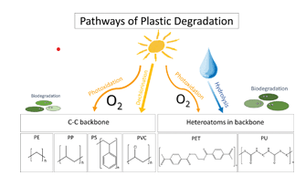
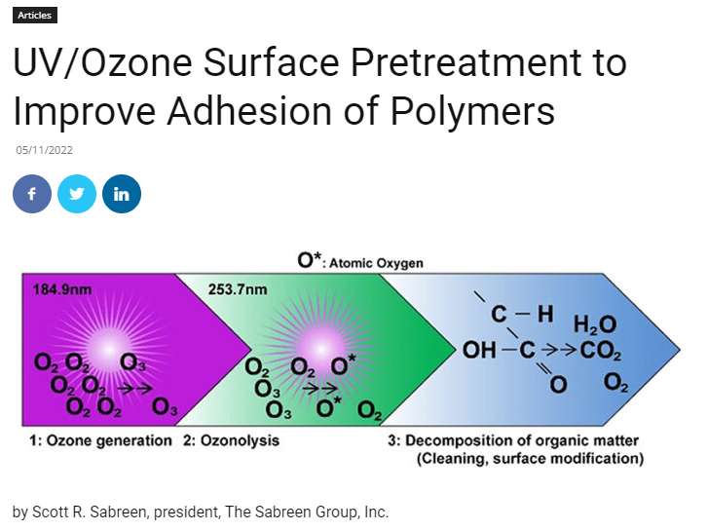
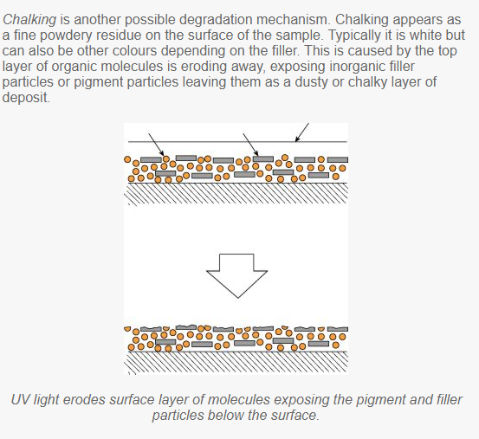
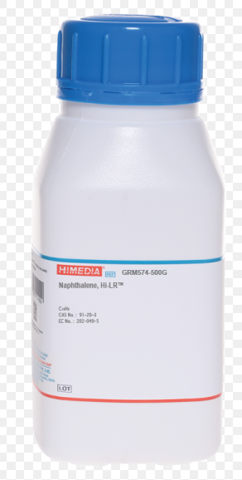
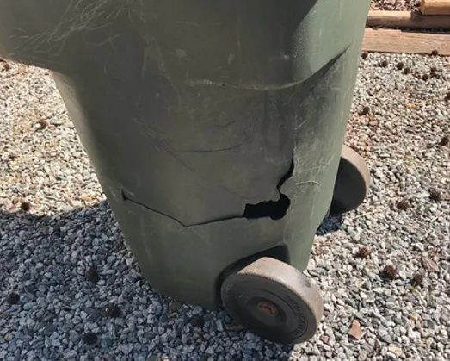
2. Degradation
Ozonolysis
UV/Ozone Surface Pretreatment to Improve Adhesion of Polymers » Plastics Decorating

Slide 14
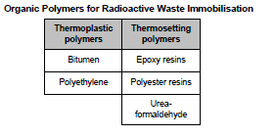
2. Degradation
Radiolysis
Predominant Processes in Irradiated Polymers
Crosslinking
Polyethylene, polypropylene, polystyrene, polyacrylates, polyamides, polyesters, rubbers, polysiloxanes, polymethylene, Chlorinated PE, PAN, Polyoxide
Scission
Polyoisobutylene, Polymethacrylates, Polyvinylidene chloride, cellulose, PTFE, PET, Polytrifluuoroethylene, cellulose acetate

Slide 15
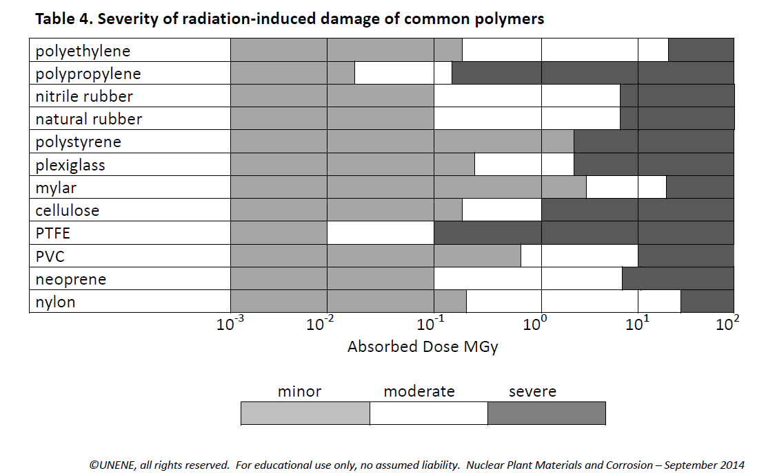
2. Degradation
Radiolysis

Slide 16
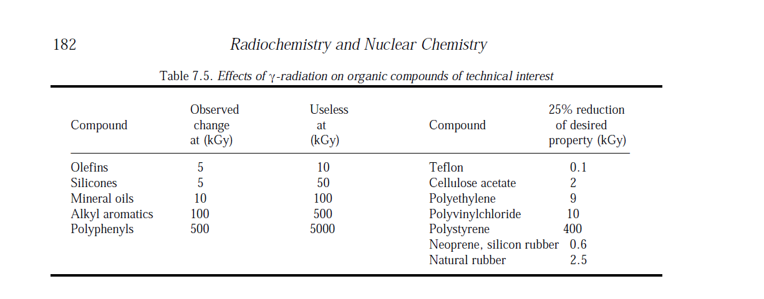
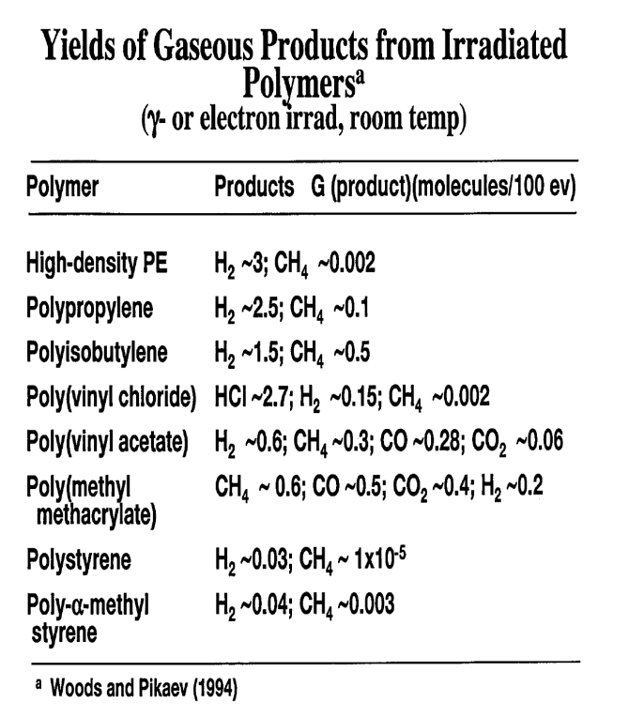
2. Degradation
Radiolysis-Polymers
The types of species produced radiolytically depend upon the chemical structure of the material through which the radiation is traveling. Some of the gases identified from the radiolysis are: H₂,
C0₂, CO, SO₂, O₂, CH₄, N₂, N₂O, and NO.
In order to relate the quantity of a species produced radiolytically to the amount of energy absorbed, a term arbitrarily called the G was defined.

Slide 17
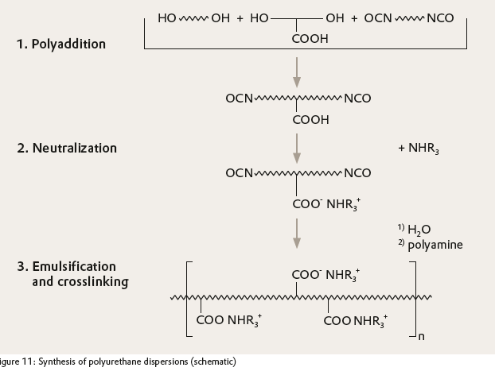
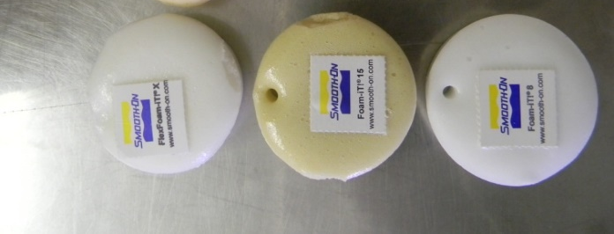

2. Degradation
Radiolysis
Poly Urethane samples
Non-irradiated samples
Radiated samples
Moulds tested with Co-60 radiation

Slide 18
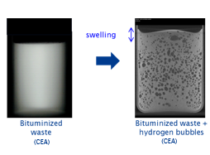
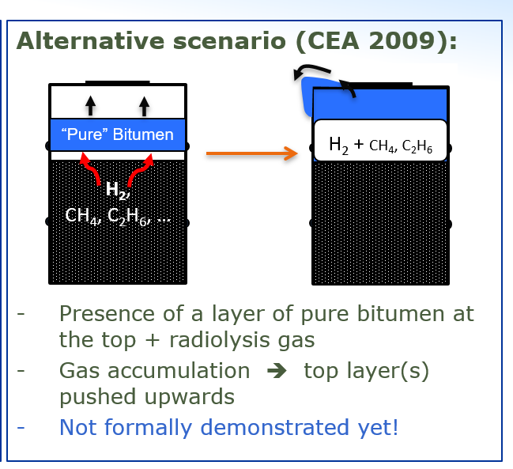
2. Degradation
Radiolysis-Bitumen

Slide 19
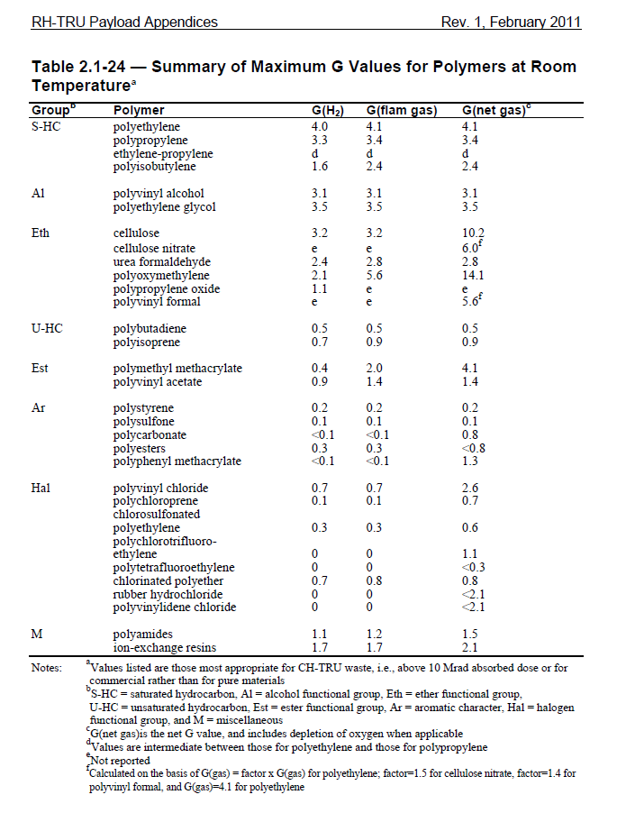
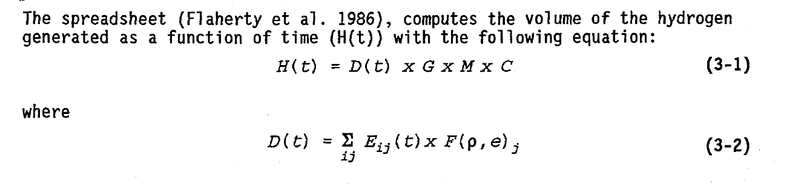
2. Degradation
Radiolysis-Polymers-modelling
D is the time dependent sum of energy emitted (E) for radionuclide i and radiation type j times
F which is the density and energy dependent fraction absorbed of radiation type j for all decay mechanisms up to time t.
M is the waste mass, and
G is the 6-factor. The G-factor is defined as the molecules of hydrogen generated per 100 eV energy absorbed.
C is a conversion factor based on the units of the equations.

Slide 20
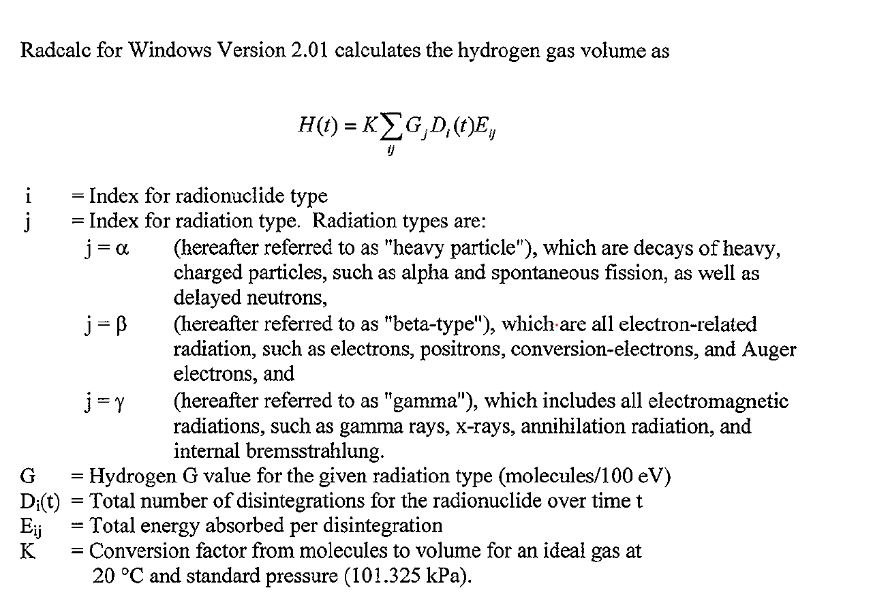
2. Degradation
Radiolysis-Polymers-modelling
Approval to use software – Thursday

Slide 21
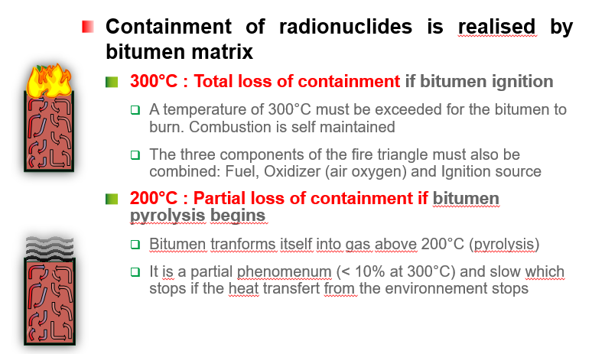
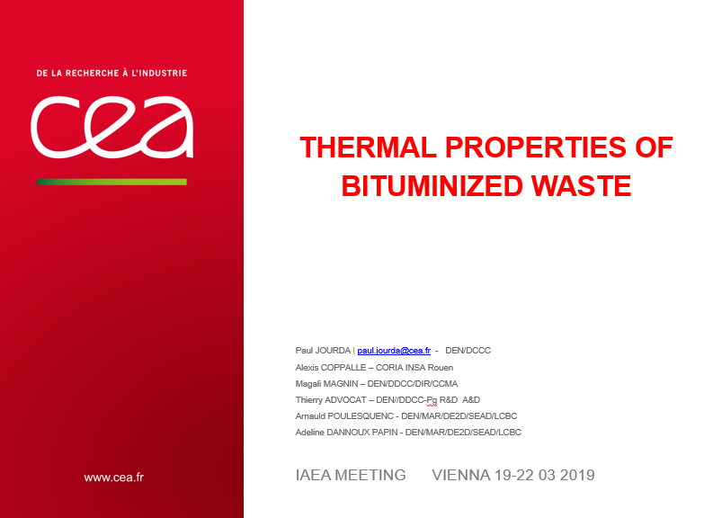
2. Degradation
Thermal degradation

Slide 22
4. Ageing management plan
Selection as part of ageing management plan
UV-resistant polymers: some considerations
For projects which require a UV-resistant plastic, consider these materials:
Acrylic
Available in a range of attractive colors, acrylic offers strength and stiffness.
Polyvinylidene fluoride (PVDF)
Flame-resistant and with fantastic chemical abrasion properties, PVDF is UV stable, it’s FDA-compliant and is a high purity engineering thermoplastic with a host of uses.
Polytetrafluoroethylene (PTFE)
With outstanding weathering resistance, PTFE remains stable – even at temperatures of up to 500F. A low-friction fluoropolymer, it offers great electrical insulating properties, which is why PTFE tubing is often used to protect optic fibers.
Unmodified types of plastics that are regarded as having unacceptable resistance to UV are POM (Acetal), PC, ABS and PA6/6. Other plastics such as PET, PP, HDPE, PA12, PA11, PA6, PES, PPO, PBT and PPO are regarded as fair

Slide 23
3. Ageing management
The requirements from Nuclear Safety Authority
➢The licensee must establish an AM programme for the safety classified systems;
➢All potential ageing mechanisms of safety important components must be identified;
➢The potential consequences of potential ageing processes must be determined;
➢Activities aiming at preventing the occurrence of ageing mechanisms, mitigation of consequences must be determined and executed;
➢Monitoring, testing, sampling and inspection activities must be performed for the evaluation of ageing effects.

Slide 24
3. Steps in establishing an ageing management plan
Step 2 (Section 2 or Chapter 2 in document )
Step 2.1 Identification (information gathering) of possible critical components
The starting point of the screening process is the listing of the storage facility’s primary functions and components as described in the design documents.
Sorting and identification is based primarily on active, passive, long-lived and short-lived components that support the primary functions.
Active components are those that have moving parts or change their configuration or properties for instance:
Structures, piping components, ducting, pumps, fans, motors, miscellaneous process equipment, instrumentation, electrical components, valves, and tanks.
Passive components are those that have no moving parts, and whose configuration or properties do not change.
Long-lived components are those that are not replaced during the service life of the system
Short-lived components will be replaced during a specified time period, due either to planned maintenance or obsolescence/wear-out
Something go wrong..then

Slide 25
3. Steps in establishing an ageing management plan for facility
Chapter 1 Identification of stakeholder and general background
Chapter 2 Identification (information gathering) of asset's critical components
Chapter 3 Determine critical components from the System and Structure Report of the asset's components
3.1: Review of current methods for monitoring ageing of identified components
3.2: Result of evaluation of the identified critical components (incl. modelling)
3.3: Determine effectiveness of current ageing monitoring of identified AM components
3.4: Review of maintenance and operational plan (Higher level policy document) regarding
component ageing
3.5: Documenting of the effectiveness of the current maintenance and operational plan (Higher
level policy document) regarding component ageing
Chapter 4: Establish condition assessment report with focus on selected critical components under
current operational conditions
Chapter 5: Identify AM actions to be included in current or new ageing management plan
Chapter 6 Describing the Implementation of the asset-specific AM plan or a new AM plan
Active components are those that have moving parts or change their configuration or properties
Chapter 7 Describing the continuous improving ageing management plan (AMP)

Slide 26
4. Ageing management plan
A monitoring strategy (as part of ageing management plan)
A monitoring policy/plan as part of ageing management plan may be summarised as:
• Identification of potential degradation mechanisms which lead to changes in properties;
• Identification of monitoring techniques to detect such changes.
• Estimation of package reliability based on degradation rate data;
• Determination of monitoring frequency as a fraction of the time between the point of detection of degradation and the expected time of waste package failure;
• Identification of a means of selecting a representative sample of packages to be monitored.
• The radiological doses associated with different monitoring operations;
• The costs of monitoring;
• The practicalities of operating and maintaining monitoring equipment.
Short-lived components will be replaced during a specified time period, due either to planned maintenance or obsolescence/wear-out

Slide 27
4. Ageing management plan
A monitoring strategy as part of ageing management plan
Monitoring
-The frequency of such inspections should be derived from storage facility safety analyses
- Mechanisms should be established to ensure that corrective action is taken for any deterioration of packages, package identification or cooling/monitoring systems identified during inspections.
-Chemical conditions (should also be monitored).
-Where high activity wastes are involved, required inspections may be performed remotely by camera, together with air and liquid effluent monitoring.
-Monitoring and inspection of waste package should preferably use non-destructive testing methods.
Monitoring for instance:
• Colour fading or yellowing
• Cracking
• Chalking (white residue on surface)
• Loss of gloss
, • Swelling
, • Release of gas
• Elastic behavious
.• Stiffness and strength.

Slide 28
6. Summary and Conclusion
Ageing management (AM) requires predicting and controlling (i.e., detecting and mitigating) ageing degradation of components before primary functions are compromised.
Longer-term storage entails taking additional measures to ensure continuing satisfactory control and protection of the waste packages and the storage facility itself.
Ageing Management methodology involves a systematic program of monitoring, inspection and maintenance of the facility, as well as the waste packages.
The longer the intended life of the facility, the more important such factors become.

Slide 29
Thank you!
Notes:
Thank you!

Slide 30
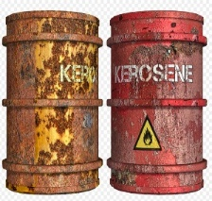
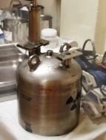
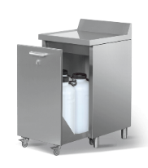

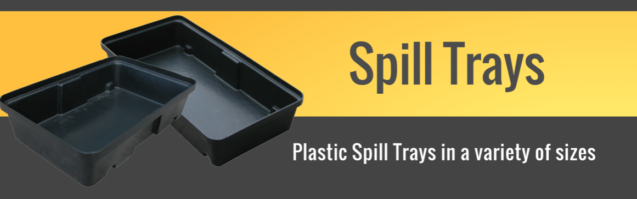
4. Storage of organic liquids in storage facilities
General Safety Recommendations
More rigorous inspections than for solid waste due to increased mobility and volatility of liquids.
Liquids must be stored in containers designed for liquid storage.
The chemical nature and other properties of the liquid will determine whether
the filled liquid containers must be stored inside special cupboards in the storage
facility.
Traceability (even for the smallest container: Ref no. link to analysis, date, etc.)
A good leakage collection system will be required to counter the possibility of leakage from drums or containers. (stainless steel drip tray, etc.)
Liquids should never be stored directly on the floor
Liquids should be stored below eye level and never on the top shelf of a storage unit.
Label Properly – All chemicals should be labelled with Material Safety Data Sheets (MSDS) so that those working with or handling these substances are aware of the chemical properties.

Slide 31
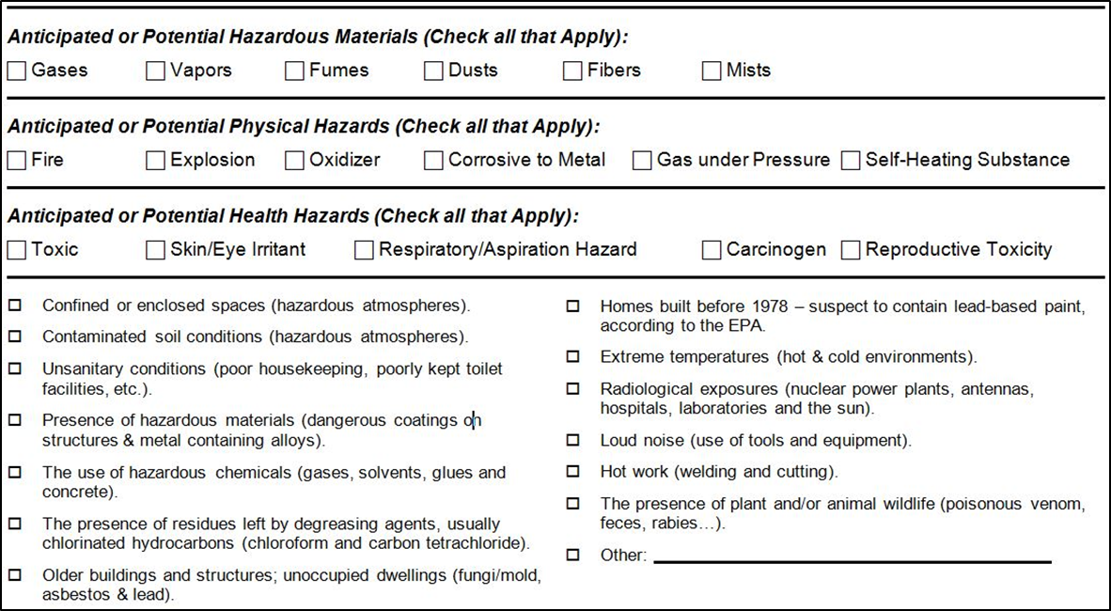
4. Ageing management plan
Hazard assessment documentation as part of ageing management plan
Ref:
OSHA 10-hour Outreach Training
PPT 10-H General Industry –Hazardous materials
Created by OTEC Outreaches Resources Workgroup
Source: Construction Safety Council
Notes:
Use as discussion and/or complete using a known hazardous material.
Checklist created by Construction Safety Council, used with permission.

Slide 32
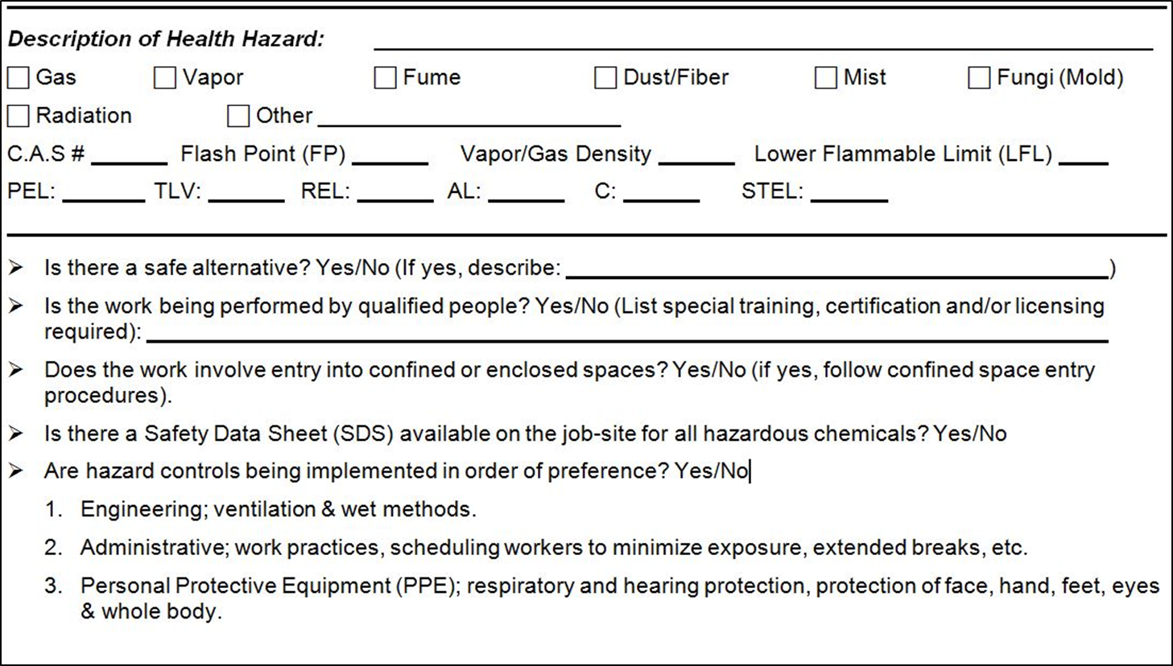
4. Ageing management plan
Hazard assessment documentation as part of ageing management plan
Ref:
OSHA 10-hour Outreach Training
PPT 10-H General Industry –Hazardous materials
Created by OTEC Outreaches Resources Workgroup
Source: Construction Safety Council
Notes:
Use as discussion and/or complete using a known hazardous material.
Checklist created by Construction Safety Council, used with permission.

Slide 33

4. Ageing management plan
Hazard assessment documentation as part of ageing management plan
Ref:
OSHA 10-hour Outreach Training
PPT 10-H General Industry –Hazardous materials
Created by OTEC Outreaches Resources Workgroup
Source: Construction Safety Council
Notes:
Use as discussion and/or complete using a known hazardous material.
Checklist created by Construction Safety Council, used with permission.

