Slide 1

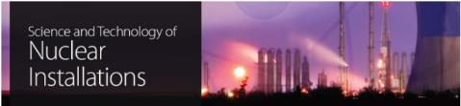
Role of radiation damage in wasteforms and packages
Michael I. Ojovan,
Immobilisation Science Laboratory,
Department of Materials Science and Engineering, The University of Sheffield, UK
Department of Materials, Imperial College London, UK

Slide 2
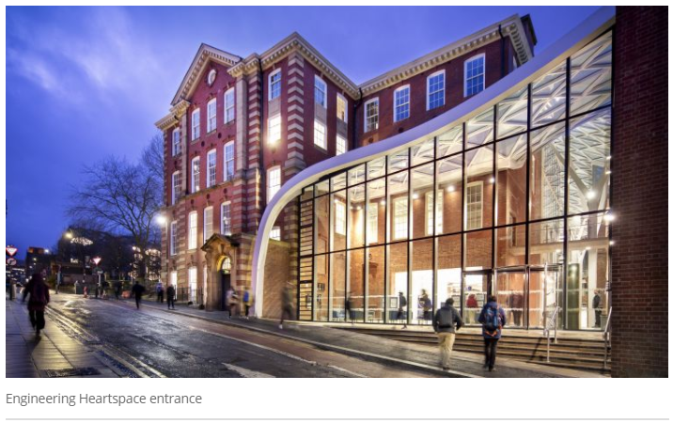
Outline
Basics
Cements
Glasses
Crystals
2

Slide 3
1. Basics
Behavior of materials (nuclear wasteforms, containers) under self-irradiation is not the same as of of pure undoped (simulant) materials under external irradiation (for example, by heavy ions).
The acceptable level of radionuclide loading into wasteforms (waste loading) is often not justified and may lead to unforeseen effects.
Destruction of materials with formation of separate non-durable phases of radionuclides under self-irradiation is possible.

Slide 4
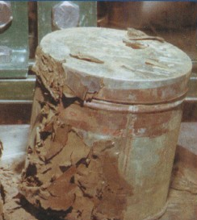
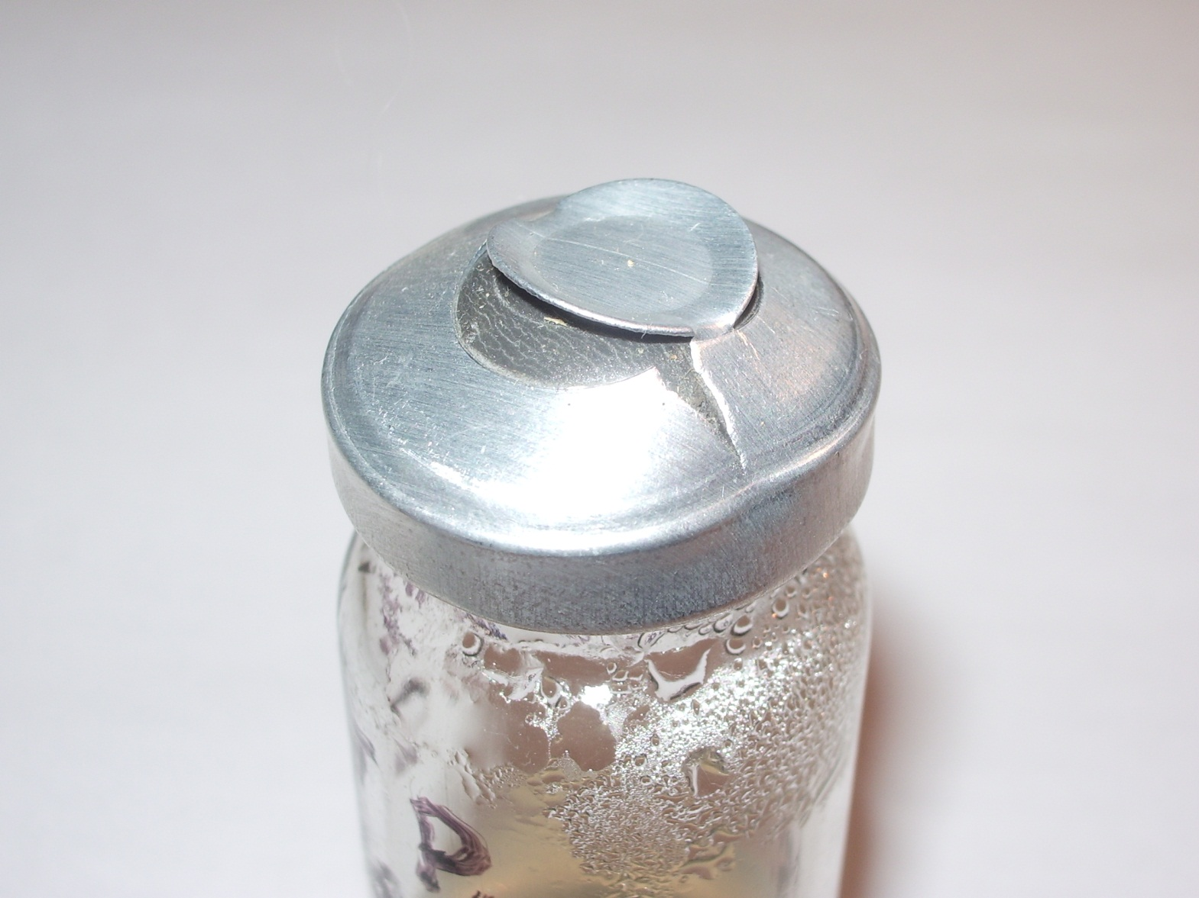
Self-corrosion of metallic can with PuO₂. Actinide Research Quarterly, LANL, 2004, 2-nd quarter, p.4
Gas release as a result of radiolysis after 6 years storage of La-monazite ceramic (La,Pu)PO₄ doped with 8.1 wt.% Pu-238 in water.
Courtesy B. Burakov.

Slide 5
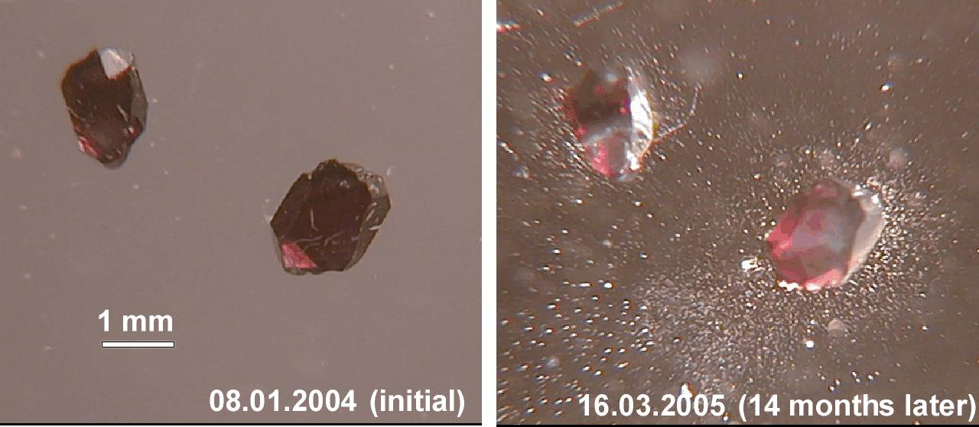
Self-irradiation affects the crystalline structure of materials which can become fully amorphous. Damage of crystalline structure under self-irradiation can be accompanied with essential decrease of chemical durability. Matrix swelling is possible. As a result of swelling crack formation (and mechanical destruction) is possible
Self-irradiation affects the glass structure and may potentially cause devitrification and decomposition.

Slide 6
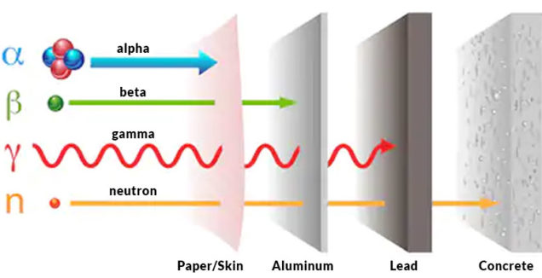
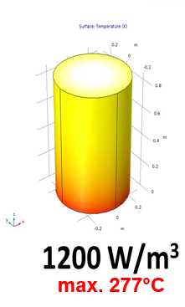
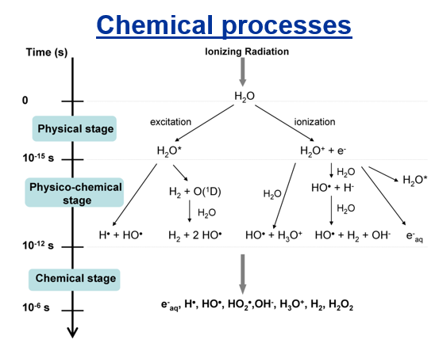
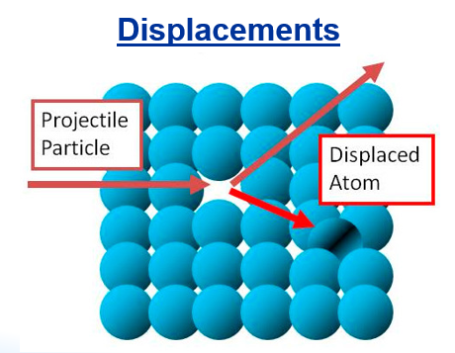
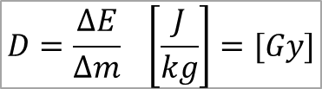
Absorbed dose (D) - the measure of the energy deposited in matter by ionizing radiation per unit mass.
$$D=\frac{∆E}{∆m} \left[\frac{J}{kg}\right]=[Gy]$$
6

Slide 7


Heat production
Mass, kg
Dose, Gy
$$Q=cm∆T\underset{⇒}{}∆T=\frac{Q}{cm}=D/c$$
1 Gy (100 rad) – thermal effect
Energy, J
Temperature change, K
Heat capacity, J/(kg·K)
For water
$$∆T=\frac{1Gy}{4200J/(kg∙K)}≈2.4∙{10}^{−4}K$$

Slide 8
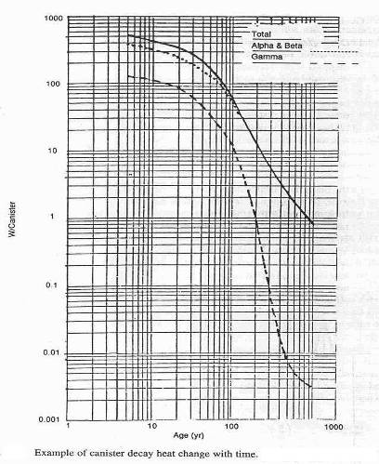
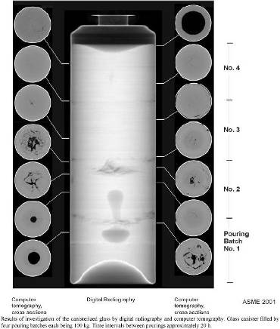
Non-USA commercial HLW glass in a repository have initial storage temperatures > 200 ºC.
USA Defence HLW glasses have initial temperatures in the Yucca Mountain repository ∼250 ºC.

Slide 9
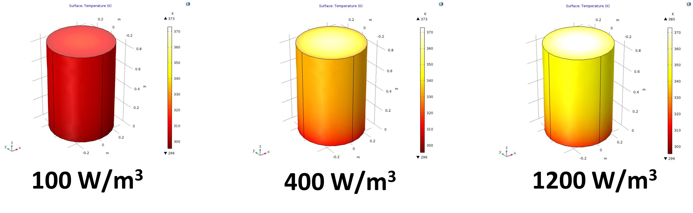
Heat production
COMSOL Multiphysics software package version 5.3a, the Heat Transfer module.
The drum – a 200 L cylinder with a diameter of 600 mm and a height of 850 mm with 1 mm steel cover
max. 42°C
max. 106°C
max. 277°C
Courtesy Vladimir Petrov, Lomonosov Moscow State University

Slide 10
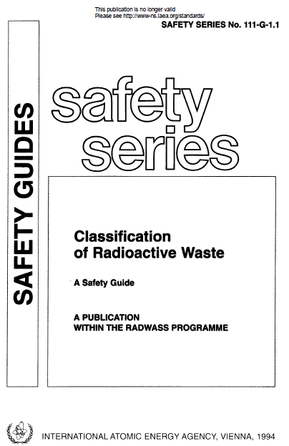
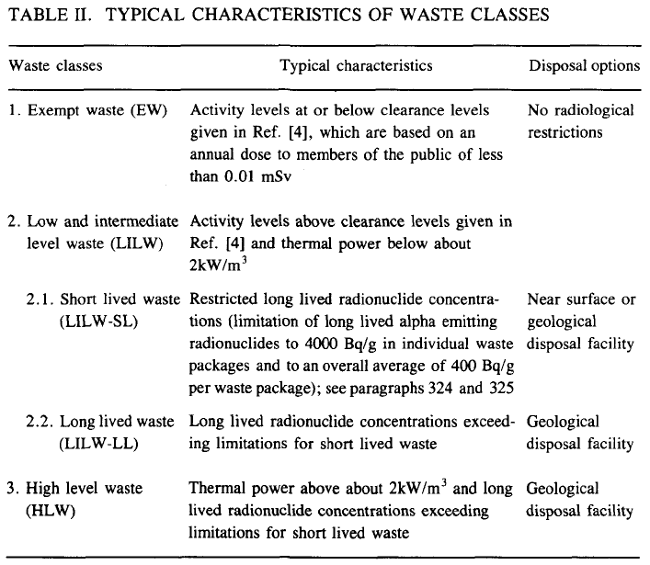

Slide 11
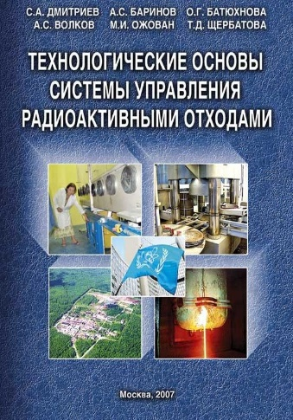
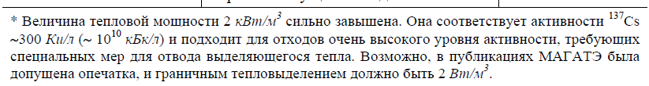

Slide 12
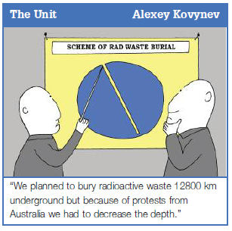
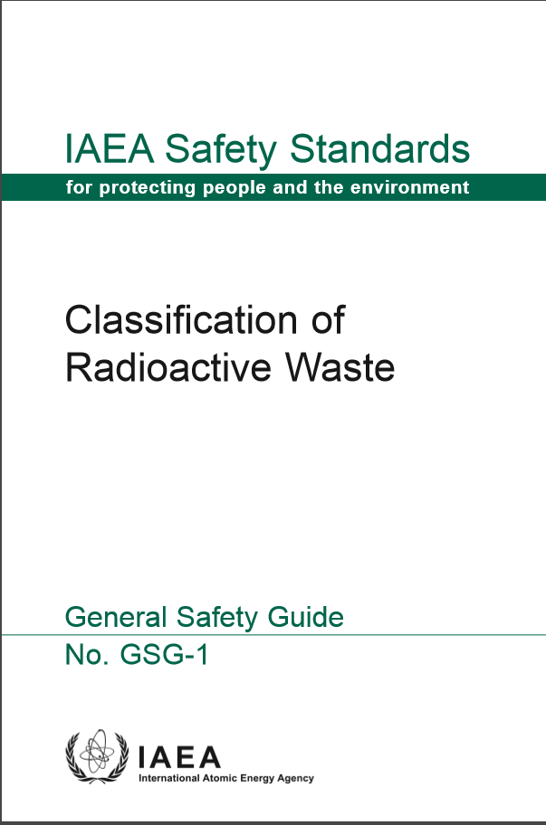
Mistake that can cause meltdown
The new GSG-1 specifies thermal problems starting with few W/m³ not 2 kW/m³

Slide 13
Chemical processes
The energy of emitted particles (β, α, γ) is ~100 000 times larger than energy of electron binding in atoms, and, thus, any chemical bond can easily be broken and atoms ionized.
The typical average energy of alpha-particles is ~4-6 MeV, whereas the average energy of chemical bonds ~dozens eV.
E.g. the largest electron binding energy have K-electrons of Pb ~88 keV.
Chemical radiation yield (G-value) - indicates the number of entities (e.g., free radicals or ions of a given type) which is formed or destroyed for each part of energy absorbed by the medium. [ions per 100 eV], [mol per J]
$$1 eV=1.6∙{10}^{−19} J$$
$$1 mole=6.02∙{10}^{23} ions$$
$$1 mol/J=9.6∙{10}^{6} ions/100eV$$

Slide 14
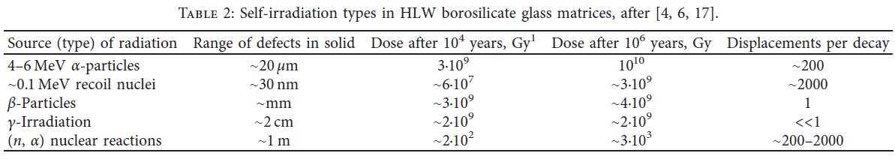

Slide 15
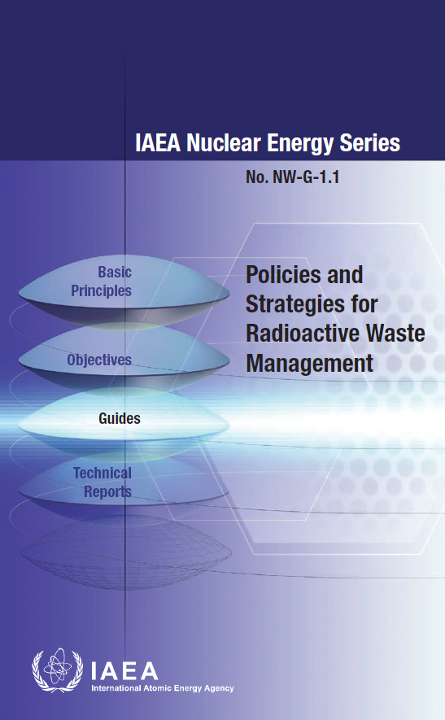
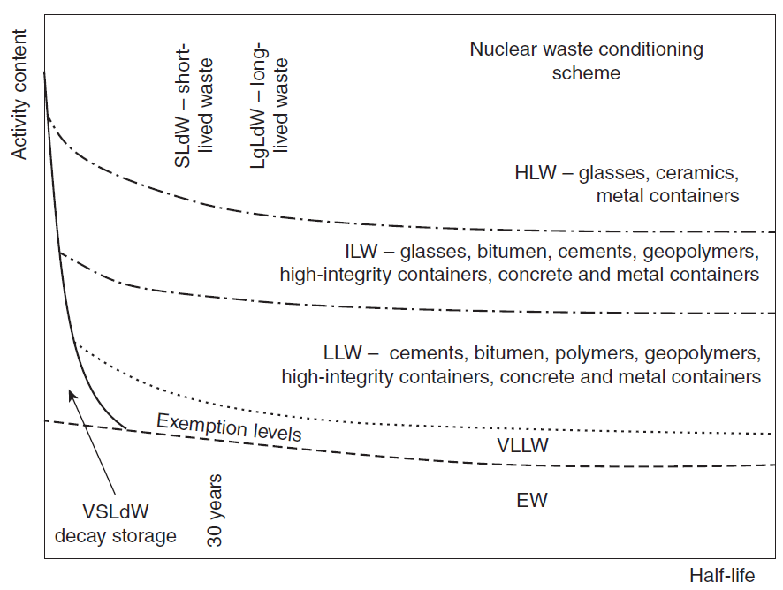
Conditioning technologies in practice depend on the class of waste processed

Slide 16
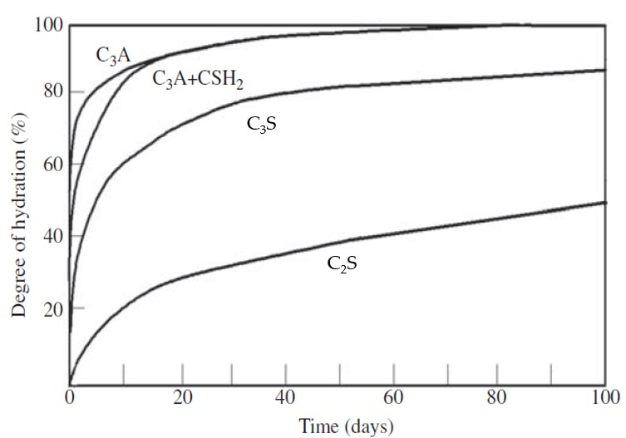
2. Cements
After 12 months a typical Portland cement comprises an aqueous phase, which is largely confined to filling pores less than 1μ in radius and a paste matrix, which is itself heterogeneous.
Development of the internal structure of hydrated cement occurs also after the concrete has set and continues for months (and even years) after placement. OPC will be hydrated by 95-98% within 12 months.

Slide 17
Phase composition of hydrated cements
Phase | Description | Notation
Crystalline
Ettringite | [Ca₃Al(OH)₆ 12H₂O]₂(SO₄)₃ 2H₂O | AF_{t}
Monosulphate | [Ca₂Al(OH)₆ 6H₂O]₂(OH), (0.5SO₄)]₂ | AF_{m}
Hydrogarnet | Ca₃Al₂(OH)₁₂ – Ca₃Al₂Si(OH)₈ | C₃AH₆ – C₃ASH₄
Portlandite | Ca(OH)₂ | CH
Amorphous
Calcium silicate hydro-gel | Molar ration Ca/Si 1.7 ± 0.1 | C-S-H

Slide 18
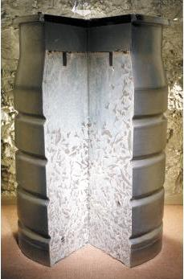
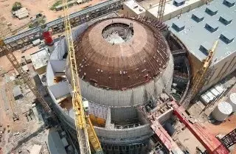
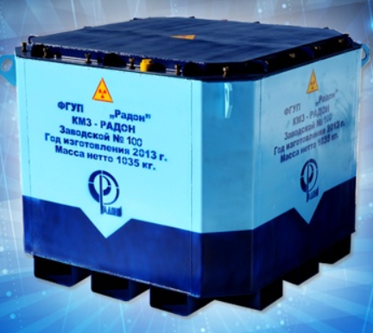
Hardened cement = Solids + Water
Cement solids: The most important is the tobermorite gel (CHS), which is the main cementing component of concrete. The remaining three phases are crystalline and correspond more closely to defined stoichiometry. Portlandite typically comprises 20-25% of the fully hydrated paste, whereas AFm and Aft phases comprise 5-10% of the paste.

Slide 19
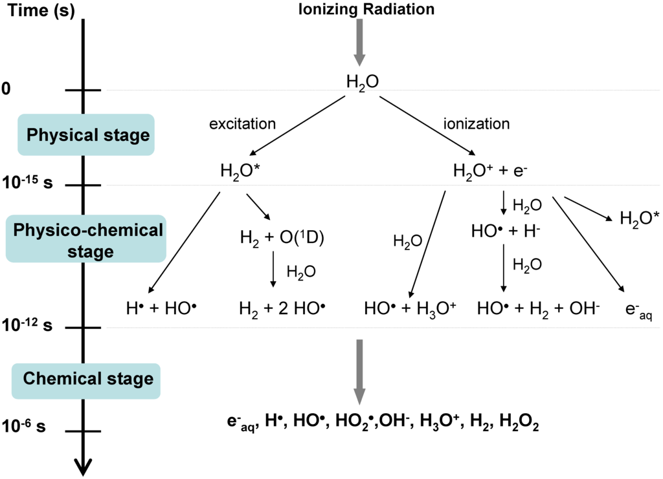
Chemical processes
19

Slide 20
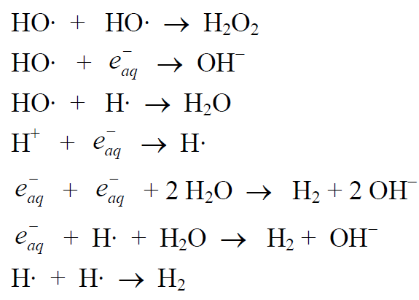
After ~10⁻¹² s the chemically reactive species are still located in the vicinity of the original H²O*, H²O·⁺ and e¯ species where they formed. As the diffusion proceeds species may come close enough together to react with each other. A variety of reactions are possible in the track of the charged particle.
Specie | D, (10⁻⁵ cm² s⁻¹) | R (Å)
OH | 2 | 2.4
e_{aq}¯ | 5 | 2.1
H₃O⁺ | 8 | 0.30
H | 8 | 0.42
Most of these reactions remove chemically reactive species from the system. With time (by ~ 10⁻⁶ s) all of the reactive species have diffused sufficiently far that further reactions are unlikely.

Slide 21
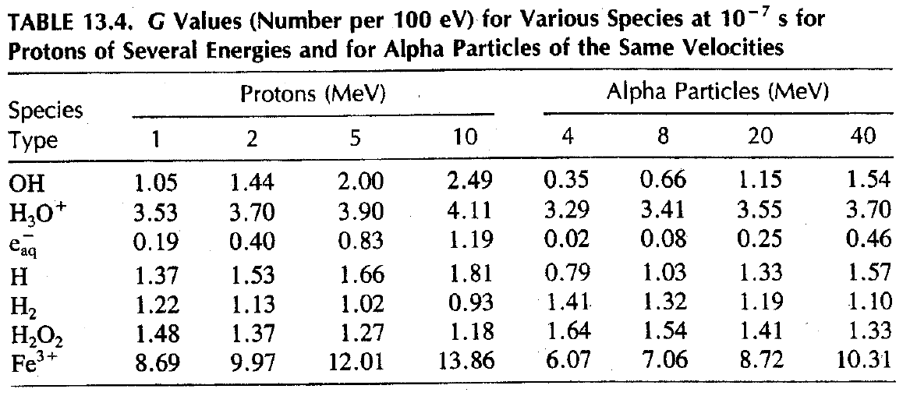
Radiation chemical yield (the G-value): the number of a particular species produced per 100 ev of energy loss.

Slide 22
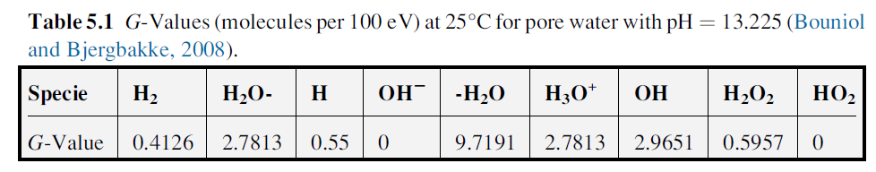
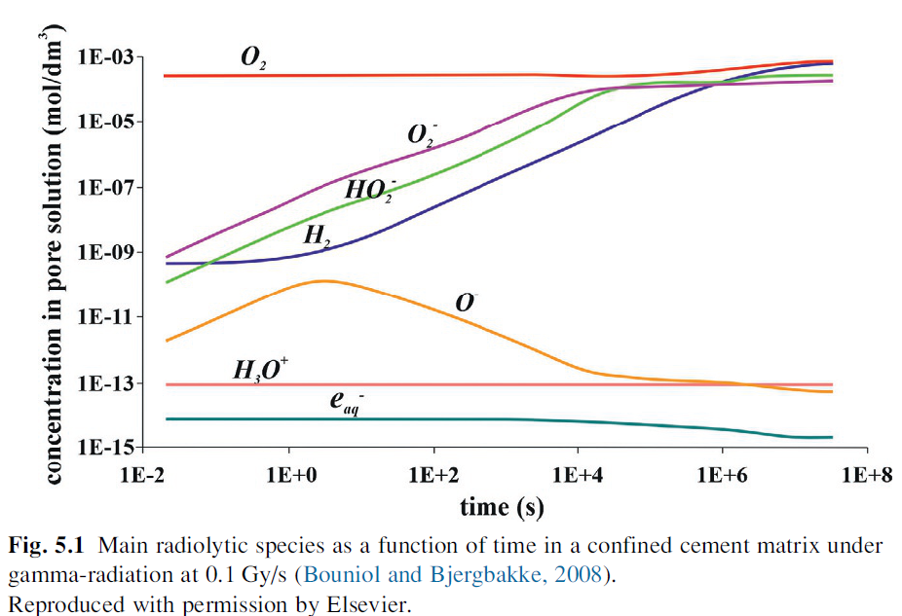
Chemical processes

Slide 23
The porosity of concrete vs dose of gamma radiation. (Vodák et al., 2005.)

Slide 24
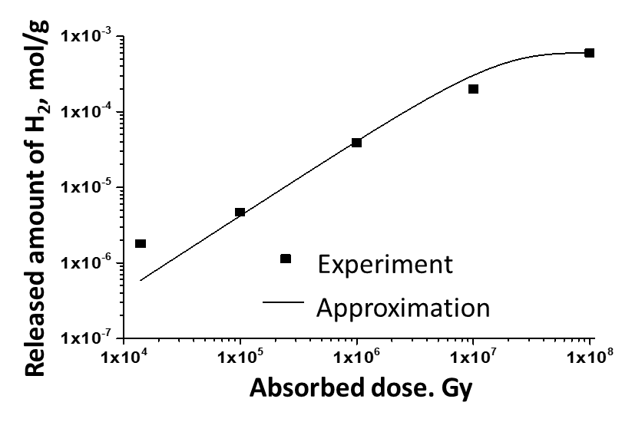
H₂ release
n∞ - amount of the hydrogen released at infinite dose, mol/g;
D – an absorption dose of irradiation, Gy;
k – rate constant, Gy⁻¹
Parameter | Values
n∞, mol/g | (5.0±0.1)·10⁻⁴
k, Gy⁻¹ | (5.6±0.2)·10⁻⁸
G(H₂), mol/J | (2.8±0.1)·10⁻⁸

Slide 25
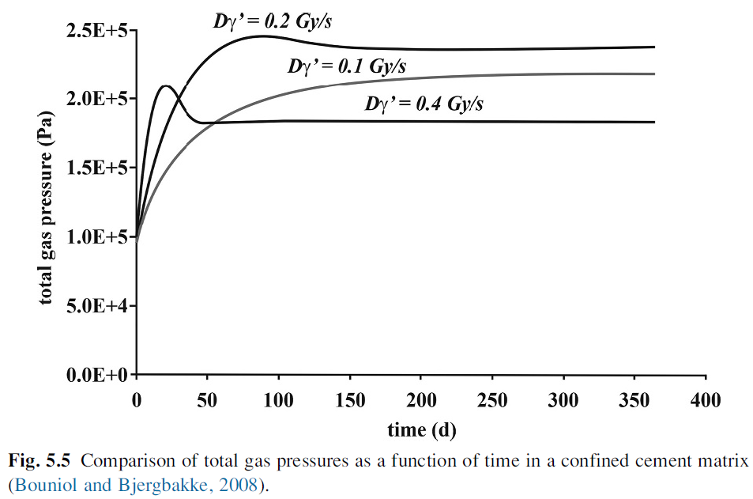

Slide 26
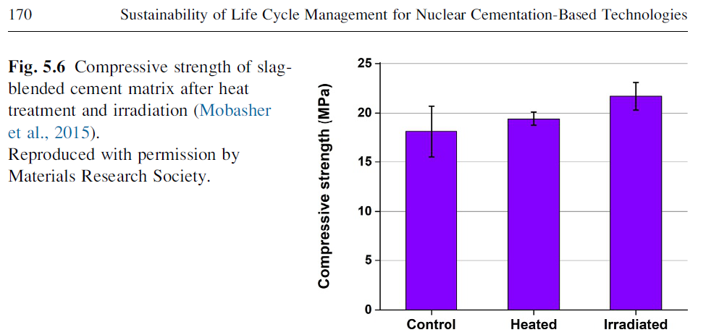
Compressive strength

Slide 27
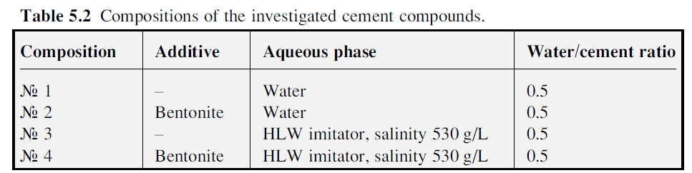
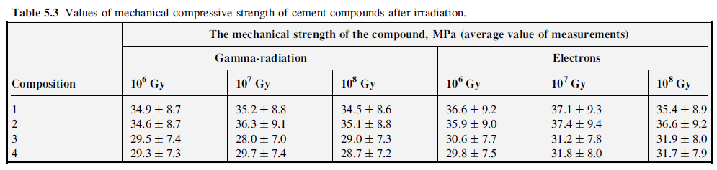
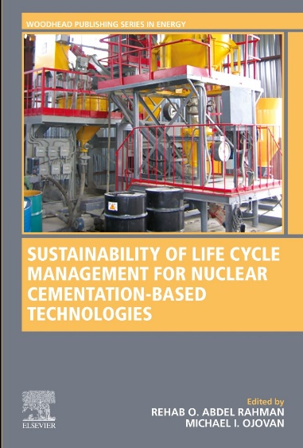
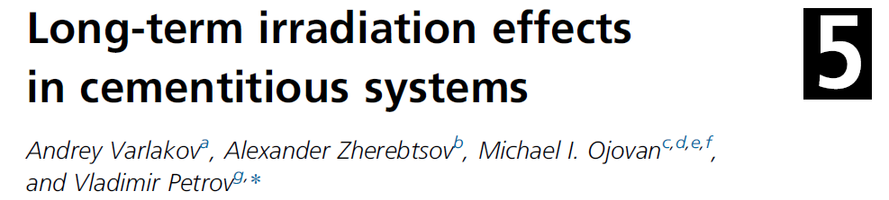

Slide 28
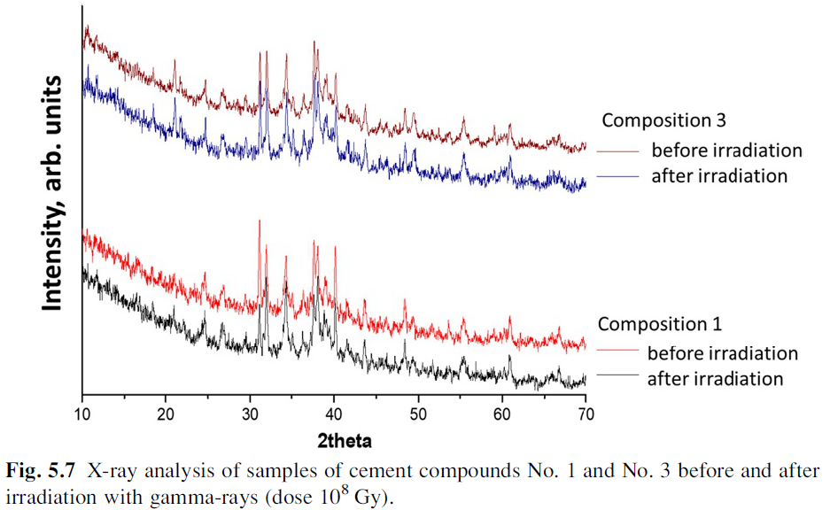
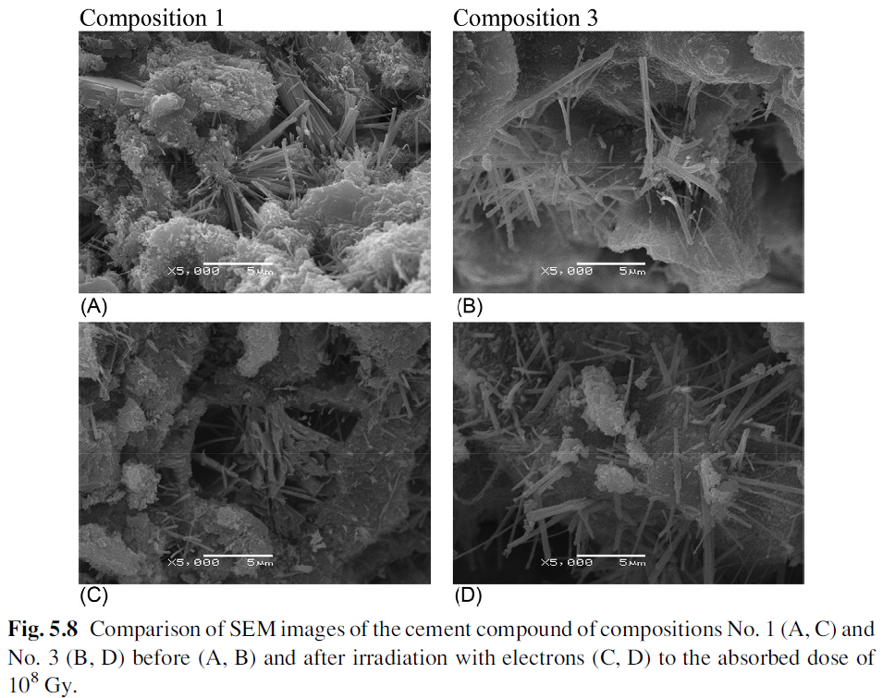

Slide 29
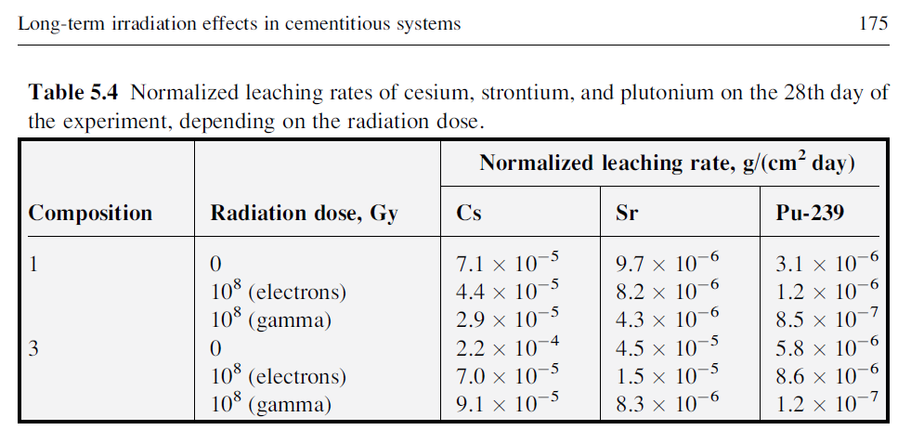

Slide 30
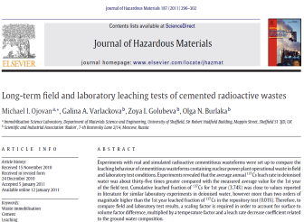
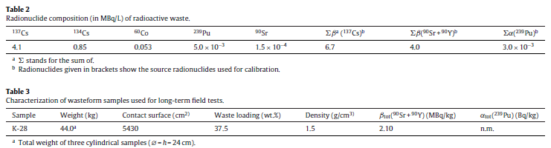
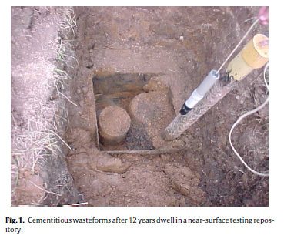
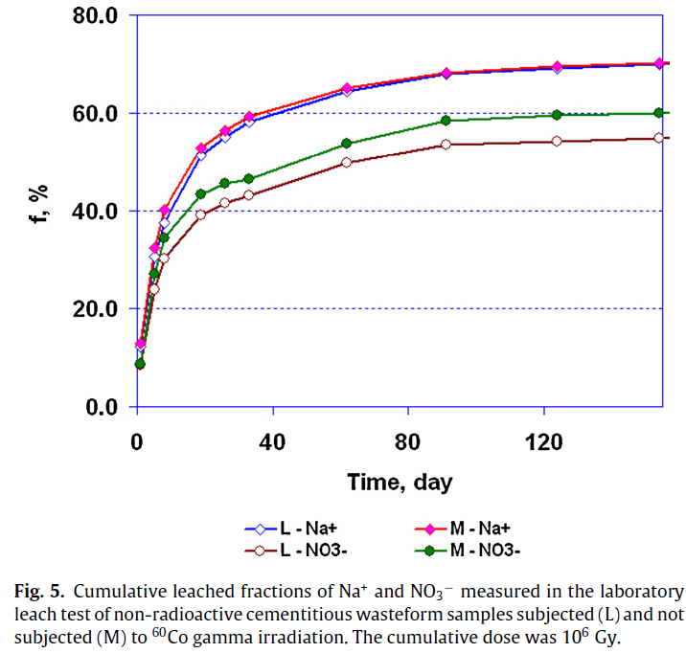
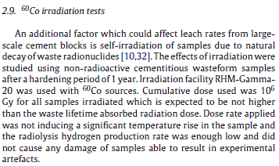

Slide 31
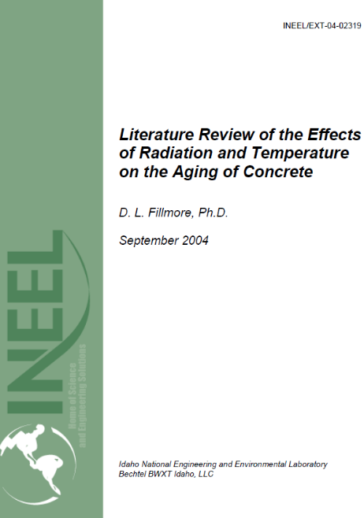
The effects of low doses, <10¹⁰ neutron/cm² or <10¹⁰ Gy gamma, of radiation over periods of less than 50 years do not seem to have a significant effect on the concrete. Longer-term exposure, over 100 years, has not been studied.
Wikipedia: … very high fluxes are necessary to displace a sufficiently high number of atoms in the crystal lattice of minerals present in concrete before significant mechanical damage is observed. https://en.wikipedia.org/wiki/Concrete_degradation

Slide 32
Conclusions on cements
Cements retain their mechanical properties, phase composition, structure and grain morphology after irradiation up to an absorbed dose of 10⁸ Gy (electrons) and 10¹⁹ α-particles/g.
The amount of the released hydrogen is low (max. 10⁻³ mol/g) and dependent on the irradiation dose.
Leaching of radionuclides is to some extent lower after irradiation.
Useful references:
D. L. Fillmore. Literature Review of the Effects of Radiation and Temperature on the Aging of Concrete. NEEL/EXT-04-02319, Idaho National Engineering and Environmental Laboratory Idaho Falls, Idaho 83415 (2004).
A. Varlakov, A. Zherebtsov, M.I. Ojovan, V. Petrov. Long-term irradiation effects in cementitious systems. Chapter 5 in: Sustainability of Life Cycle Management for Nuclear Cementation-Based Technologies. Elsevier, Woodhead Publishing, 654 p., pp.161-180 (2021). https://doi.org/10.1016/B978-0-12-818328-1.00016-2

Slide 33
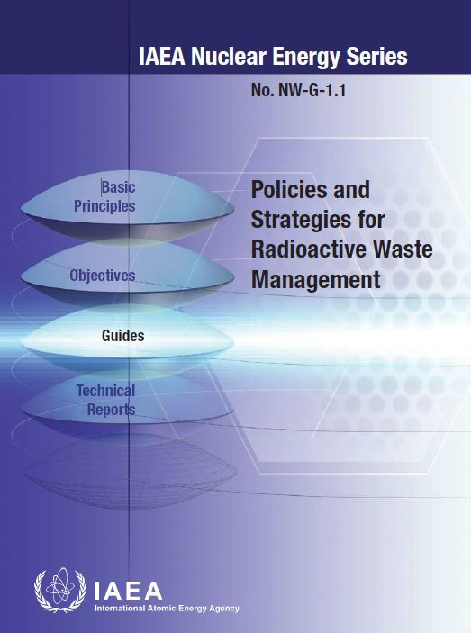
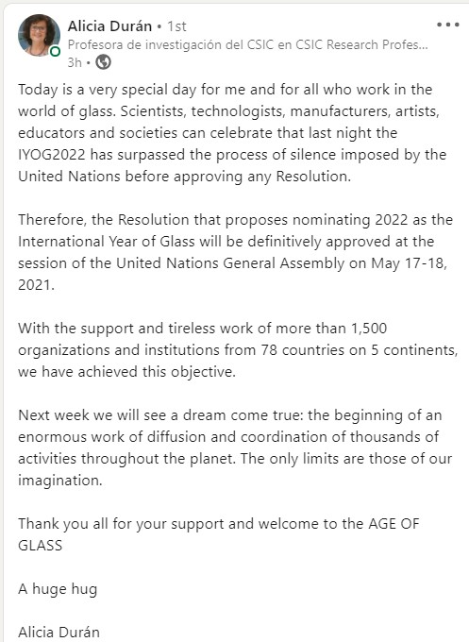
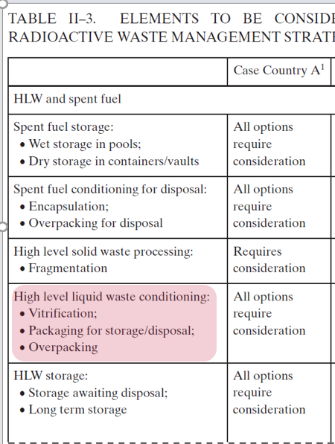

3. Glasses

Slide 34

Glasses are solid amorphous materials which transform into liquids upon heating through the glass transition. The solid-like behaviour of glasses is separated from the liquid-like behaviour at higher temperatures by the glass transition temperature, T_{g}.
Geometry of bonds
M.I. Ojovan. Glass formation., https://doi.org/10.1002/9781118801017.ch3.1, 11p., In Encyclopedia of Glass Science, Technology, History, and Culture. Richet, P., Conradt, R., Takada, A., Dyon, J. Eds., Wiley, Hoboken, NJ, 2021. 1568 p., https://onlinelibrary.wiley.com/doi/book/10.1002/9781118801017. Vol I, Chapter 3.1, pp. 249-259.

Slide 35

Vitrification is the world-wide accepted technology for the immobilization of high level radioactive wastes.
Glass can accommodate the wide range of constituents present in the waste.
The excellent durability of vitrified radioactive waste ensures a high degree of environmental protection.

Slide 36


Slide 37
Type of Glass | Major Structural Components |  | Comments
ABS = Alkali Borosilicate, e.g. NBS | (SiO₄)⁻⁴, (BO₄)⁻⁵, (BO₃)⁻³ and some (AlO₄)⁻⁵ and (FeO₄)⁻⁵ structural units to which alkali, alkaline earth, and waste species bond. | Atomic structure of a French nuclear waste glass: unshaded region shows formation of a (Na,Cs)₂MoO₄ cluster. | Ease of processing, melt temperatures 1150-1200 °C to minimize volatility; Cold cap production if feasible minimizes volatility; Most waste cations highly soluble in glass; Overall waste solubility 25-40 wt%; Made by Joule Heated Melting (JHM), Advanced JHM known as AJHM, Cold Crucible Induction Melting (CCIM) or Hot Isostatic Pressing (HIP).
37

Slide 38

AAP = Alkali aluminophosphate, e.g. NAP | (PO₄)⁻³and (AlO₄)⁻⁵ structural units to which alkali, alkaline earth, and waste species bond | Atomic structure of phosphate glass with P₄O₁₀ cage like structures which provides the basic building block for phosphate glass formers. | Melts at lower temperatures than silicate or borosilicate systems; Most cations readily incorporated; Accommodates >10 wt% sulfate; corrosive to materials of construction; tendency to devitrify; Durability comparable to borosilicate glass if alumina content is sufficient; Composition ~ 24-27 Na₂O, 20-24, Al₂O₃ + Me_{m}O_{n}, 50-52 P₂O₅ where Me_{m}O_{n} is an actinide or rare earth oxide; JHM, AJHM, CCIM.
38

Slide 39

Self-irradiation can directly affect durability of glasses used to immobilize HLW. The stability of glasses can also be indirectly affected by the radiolytic changes in contact water leading to decrease in its pH although this is unlikely to occur for disposal systems where the interaction of groundwater with glass is delayed to times when radiation dose rates are decreased to levels insignificant to cause such effects.
V.I. Malkovsky, S.V. Yudintsev, M.I. Ojovan, V.A. Petrov. The Influence of Radiation on Confinement Properties of Nuclear Waste Glasses. Science and Technology of Nuclear Installations, 2020, Article ID 8875723. 14 p. (2020), https://doi.org/10.1155/2020/8875723

Slide 40

Radiation effects need to be taken into account for materials immobilising HLW. The principal sources of radiation in HLW are decaying fission products such as ¹³⁷Cs and ⁹⁰Sr and actinide elements such as U, Np, Pu, Am, and Cm.
Beta-decay of fission products generates energetic β -particles, very low energy recoil nuclei, and γ -rays.
Alpha-decay of actinides produces α -particles (4.5 to 5.5 MeV), recoil nuclei (70 to 100 keV), and some γ -rays.

Slide 41

Immobilized radionuclides cause various sources of self-irradiation of vitrified HLW, including α-decay of minor actinides, β-decay of fission products, γ-radiation resulting from the decay of radionuclides, and (n, α) nuclear reactions.
Over a million years, the integral density of α-decays will amount 10¹⁹ events/g in vitrified defense HLW and
2 ×10²⁰ events/g in the commercial vitrified HLW.

Slide 42

Structural changes in vitreous radioactive wasteforms are largely due to cascades of atomic displacements of glass structural elements generated by recoil nuclei than collisions with α-particles.

Slide 43



The effect of β-radiation is associated, firstly, with collisions of electrons with the atoms of elements of vitreous matrix and breaking of bonds between them.
At the second, Ba²⁺ and Zr⁴⁺ forming instead of Cs and Sr have radii of 20% less than that of Cs⁺ (Ba²⁺) and 29% less than that of Sr²⁺ (Zr⁴⁺). Both these factors can affect properties and durability of borosilicate glasses in underground waters.
Neutrons formed in the decay reactions (spontaneous fission of minor actinides) gradually lose their kinetic energy and become thermal, then the (n, α) reaction occurs:

Slide 44

Irradiation affects wasteform through the interactions of the α -particles, β-particles, recoil nuclei, and γ-rays with the host phase.
Absorbed doses for non-U.S. commercial HLW glass are assessed about 10¹⁰ Gy for beta decay and about 2 10¹⁰ Gy for alpha decay.
Absorbed doses for defence HLW glass in the U.S. are assessed about 7 10⁸ Gy for beta decay and about 8 10⁸ Gy for alpha decay.

Slide 45

V.I. Malkovsky, S.V. Yudintsev, M.I. Ojovan, V.A. Petrov. The Influence of Radiation on Confinement Properties of Nuclear Waste Glasses.
Science and Technology of Nuclear Installations, 2020, Article ID 8875723. 14 p. (2020), https://doi.org/10.1155/2020/8875723

Slide 46

Various irradiation conditions were performed, i.e. gold-ion irradiation in a multi-energy mode (from 1 to 6.75 MeV), and Kr and Xe ion irradiations with energy of 74 and 92 MeV, respectively. In pile irradiation was performed to study the effect of alpha radiation from the nuclear reaction ¹⁰B(n,α)⁷Li.
2013
Conclusion: Irradiated structure is not exactly the one obtained by a rapidly quenched equilibrated melt, but rather a more disordered structure …. This phenomenological description of glass structure evolution under irradiation was called “irradiation disordering fast quenching”.

Slide 47


2014
Conclusion: Structural evolution induced by alpha decays would be driven by the reconstruction of the glass disorganized by displacement cascades of the recoil nuclei, freezing a glass structure with a higher fictive temperature (T_{g}).

Slide 48


Conclusion: Density changes are very small.

Slide 49


Leaching
ABS
The leaching rates of elements were increased at lower temperatures and remained almost unchanged at higher temperatures.
V.I. Malkovsky, S.V. Yudintsev, M.I. Ojovan, V.A. Petrov. The Influence of Radiation on Confinement Properties of Nuclear Waste Glasses. Science and Technology of Nuclear Installations, 2020, Article ID 8875723. 14 p. (2020), https://doi.org/10.1155/2020/8875723

Slide 50

NAP
Data for aluminophosphate glass used in Russia have showed that, after γ-irradiation with a dose of 6.2·10⁷ Gy, the leaching rates of elements were decreased approximately twice relatively to pristine samples.

Slide 51



Slide 52
Summary by ICTP-IAEA Workshop, Trieste, Italy, 2016
Ionizing radiation does not strongly affect the structure and properties of complex nuclear glass due to the positive effect of the glass chemical complexity on the defects formation and structural evolution.
Some specific effects like phase separation, bubble formation and important level of swelling were observed under irradiation in TEM with very high dose rate, but these effects were never observed under electron irradiation in accelerators at lower dose rate.
Alpha decay accumulation in nuclear glass induces slight changes of macroscopic properties (density and mechanical properties), there is no modification of the glass microstructure that remains homogeneous without any phase separation and crystallization.

Slide 53
Summary by ICTP-IAEA Workshop, Trieste, Italy, 2016
The final structure seems to be the result of the ballistic melting in recoil nuclei tracks and the subsequent a particles partial damage repair due to a thermal self-healing mechanism in the a particles tracks. It results in a new homogeneous glassy state, similar to that obtained by a very high quenching rate, with slightly modified macroscopic properties.
The lack of glass natural analogues samples containing actinides does not allow a validation of the effect of the slow rate accumulation of alpha decays and long time scale of aging.

Slide 54



K. Zheng et.al., Nature Communications, 1:24, 1 (2011).
However, in these tests, the irradiation dose rate is higher by many orders of magnitude compared to that characteristic of actual HLW.

Slide 55





Slide 56
Conclusions on glasses
Ionizing radiation does not significantly affect the structure and properties of nuclear waste glasses
Literature analysis shows practical absence or very weak effect of self-irradiation on characteristics of HLW glasses.
Useful references:
V.I. Malkovsky, S.V. Yudintsev, M.I. Ojovan, V.A. Petrov. The Influence of Radiation on Confinement Properties of Nuclear Waste Glasses. Science and Technology of Nuclear Installations, 2020, Article ID 8875723. 14 p. (2020), https://doi.org/10.1155/2020/8875723
W. J. Weber, R. C. Ewing, C. A. Angel et al., “Radiation effects in glass used for immobilization of high-level waste and plutonium disposition, Journal of Materials Research and Technology, 12, (8) 1946–1978 (1997).

Slide 57

4. Crystals
Materials 2019, 12, 2638; doi:10.3390/ma12162638

Slide 58


Slide 59

High-energy U recoils in ZrSiO₄
Molecular Dynamic Simulation of Zircon, damaged by a 50keV particle
Courtesy Kostya Trachenko, University of Cambridge / Queen Mary University of London

Slide 60


Radiation damage in iron
0.5 MeV recoil in Fe
Displaced atoms
Defect atoms
Simulate radiation damage in fusion reactors: ~1 Mev Fe recoil atoms from 14 MeV neutrons. Also relevant for nuclear fuels: fission products (many MeVs). Need up to 1 billion atoms in a MD box. The size of this system is about 0.2 micrometers – size where, for the first time, simulations and many experiments meet!
Courtesy Kostya Trachenko, Queen Mary University of London

Slide 61


Slide 62



Slide 63


Slide 64


Experiments with actinide-containing insulating wasteforms such as devitrified glasses containing ²⁴⁴Cm, Ti-pyrochlore, single-phase La-monazite, Pu-monazite ceramics, Eu-monazite and zircon single crystals containing ²³⁸Pu indicate that mechanical self-irradiation-induced destruction may not reveal itself for many years (even decades).
W.J. Weber, R.P. Turcotte, L.R. Bunnell, F.P. Roberts, J.H. Westsik Jr. Radiation effects in vitreous and devitrified simulated waste glass. In “Ceramics in Nuclear Waste Management”, Ed. T.D. Chikalla , J.E. Mendel, CONF-790420, National Technical Information Service, Springfield, VA, 294-299 (1979).
M.I. Ojovan, B.E. Burakov, W.E. Lee. Radiation-induced Microcrystal Shape Change as a Mechanism of Wasteform Degradation. Journal of Nuclear Materials, 501C (2018) 162-171.

Slide 65

W.J. Weber, R.P. Turcotte, L.R. Bunnell, F.P. Roberts, J.H. Westsik Jr.
Radiation effects in vitreous and devitrified simulated waste glass.
In “Ceramics in Nuclear Waste Management”, Ed. T.D. Chikalla , J.E. Mendel, CONF-790420, National Technical Information Service, Springfield, VA, 294-299 (1979).
1979
6 10¹⁵ α-decays/g
2.4 10¹⁷ α -decays/g
Partially devitrified glass (30 wt.% crystals) at different doses of self-irradiation (2 wt.% ²⁴⁴Cm)
Note that devitrified glasses are not the same as GCM’s deliberately synthesised to immobilise nuclear waste.

Slide 66

Recent extended experiments with actinide doped crystalline wasteforms have shown significant mechanical damage with crystal cracking within a decade of storage.
Principal features of ceramics and crystals doped with ²³⁸Pu . Summary by Boris Burakov, ICTP-IAEA Workshop, Trieste, Italy, 2016
Sample, formula of main phase | Bulk Pu content and distribution, wt. % el. | ²³⁸Pu content, wt.% el. | Density, g/cm³ |  | Mechanical state
 |  |  | Initial | At highest dose
Ti-pyrochlore ceramic (Ca,Gd,Hf,Pu,U)₂Ti₂O₇ | 10.5 inhomogeneous from 3.4 to 26.8 | 8.7 | 4.8 | 4.3 | visually observed cracks at dose 2.6 x 10²⁴ α-decay/m³
Zircon/zirconia ceramic (Zr,Pu)SiO₄/(Zr,Pu)O₂ | 5.7 homogeneous | 4.7 | 4.4 | no data | no cracks observed at dose 5.3 x 10²⁵ α-decay/m³
Single-phase cubic zirconia ceramic Zr_{0.79}Gd_{0.14}Pu_{0.07}O_{1.93} | 12.2 homogeneous | 9.9 | 5.8 | 5.8 | no cracks observed at dose 1.3 x 10²⁶ α-decay/m³
Single-phase La-monazite ceramic La_{0.9}Pu_{0.1}PO₄ | 9.9 homogeneous | 8.1 | 4.7 | No data | visually observed macro-cracks at dose 1.0 x 10²⁶ α-decay/m³
Pu-monazite ceramic PuPO₄ | 65.2 homogeneous | 7.2 | 4.9 | no data | visually observed macro-cracks. Full destruction of ceramic pellet into separate pieces at dose 4.2 x 10²⁴ α-decay/m³
Zircon single crystal Zr_{0.977}Pu_{0.023}SiO₄ | 3.3 inhomogeneous from 1.9 to 4.7 | 2.4 | no data | no data | Increase of visually observed cracks from dose 2.0 x 10¹⁷ to 2.2 x 10¹⁸ alpha-decay/g. Cracking stopped at dose 5.1 x 10¹⁸ α-decay/g
Eu-monazite single crystal Eu_{0.937}Pu_{0.063}PO₄ | 6.0 homogeneous | 4.9 | no data | no data | Particle formation at dose 1.1 x 10¹⁸ α-decay/g. Formation of polycrystalline separated thin bubble-like pieces on the surface at dose 5.2 x 10¹⁸ α-decay/g

Slide 67

II. Pu-monazite, PuPO₄
containing
7.2 wt. % ²³⁸Pu
is very unstable under self-irradiation.
Strong swelling was seen and even breaking into separate pieces.
10¹⁶ α-decays/g
2 10¹⁷ α-decays/g
51 10¹⁷ α-decays/g
22 10¹⁷ α-decays/g
51 10¹⁷ α-decays/g
I. Zircon (Zr_{0.977}Pu_{0.023})SiO₄ containing 2.4 wt.% ²³⁸Pu

Slide 68
Single crystals Eu-monazite, (Eu_{0.937}Pu_{0.063})PO₄ with
4.9 wt.% ²³⁸Pu.
7 years after synthesis at accumulated dose
52∙10¹⁷ α-decay/g

Slide 69
Polycrystalline Pu-monazite underwent metamictisation, cracked into separate pieces. ²³⁸Pu-doped zircon single crystal examined over a 7-year period developed matrix cracking. Formation of tiny clusters near the crystals was also observed, possibly arising from fracture of the crystal surface under self-irradiation.
These processes could be caused by the radioactive decay-induced strong electrical fields in the wasteforms.
A mechanism to be accounted for …
It has been earlier observed that inhomogeneous distribution of actinides in non-conducting host materials may lead to mechanical destruction due to accumulation of electric charge.
I.A. Sobolev et.al., Diffusional instability of solid surfaces. Phys. Chem. Mech. Surfaces, 3 (12), 3529-3540 (1985);
M.B. Kachalov net.al., Role of inhomogeneities in the fracturing of matrices with radioactive waste. At. Energ., 63, 782-784 (1987);
M.I. Ojovan, P.P. Poluektov. Surface self-diffusion instability in electric fields. Mat. Res. Symp. Proc., 648, P.3.1.1-6. (2001).

Slide 70

Homogeneity
There is a critical size of radioactive clusters in non-conducting matrices so that the matrix material can be damaged if clusters are larger than the critical size.
The wasteform should be as homogeneous as possible and even electrically conductive to avoid potential damage caused by electrical charges induced by radioactive decay.
M.I. Ojovan, B.E. Burakov, W.E. Lee. Radiation-induced Microcrystal Shape Change as a Mechanism of Wasteform Degradation. Journal of Nuclear Materials, 501C (2018) 162-171.

Slide 71

Conclusions on crystals
Ceramic waste-forms for nuclear waste immobilization are investigated in different countries with a focus on improving environmental safety during storage, transport and disposal.
Inorganic compounds, having structural analogues with natural minerals, are being studied as most perspective materials for the immobilization of radioactive waste.
Radiation effects shall be taken into account and the radioactive waste loading limited to avoid significant radiation damage such as the radiation-induced amorphization.
Thank you!

