Slide 1
Introduction to
Waste Form Modeling
Vicky Freedman
Senior Technical Advisor
Los Alamos, NM, USA

Slide 2
Outline
Model purpose
Why model?
  Potential applications
  Goals and requirements
Types of models
Performance assessment
Tool selection

Slide 3
Purpose of a Model
Simulate a real system
Simplify a real but complex system
Diagnose a problem
Identify underlying principles and relationships among different variables
Predict, predict, predict
Test hypotheses and scenarios – “what-ifs”

Slide 4
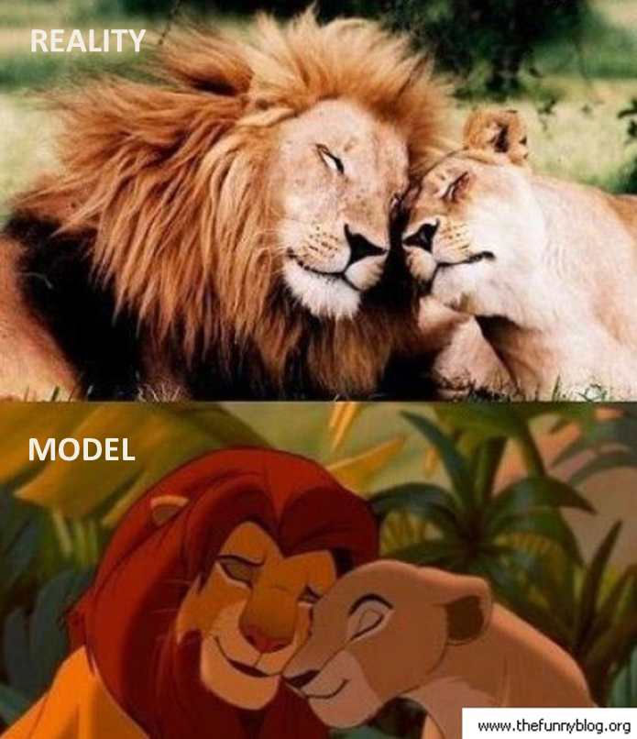
What is a Model?
A tool for understanding the system and its behavior; a representation of a real system or process
Conceptual Site Model (CSM)
  Qualitative
  A description (narrative or picture) that describes the system
  Hypothesis for how a system operates

Slide 5
What is a Model?
Hypothesis can be expressed quantitatively as a mathematical model
Mathematical models are abstractions that represent processes as equations, physical properties as coefficients in the equations, and measures of state in the system as variables
Predictive model
  Quantitative
  Set of mathematical equations, involving one or more partial differential equations
    Analytical
    Numerical
    Analytic Element Methods

Slide 6
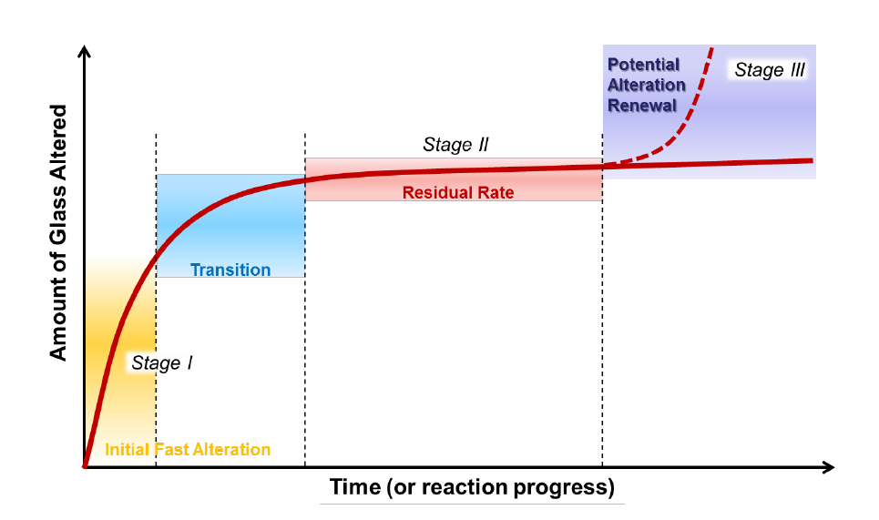
Modeling Goals
  Predict release of contaminants in near-field environments
  Simulate transport of contaminants in far-field environments
  Support laboratory measurements to determine waste form properties, contaminant releases, and degradation rates
Provide technical basis that supports safe operation of the repository
Answer a specific question regarding site management and/or operations
Communicate plans and potential impacts to regulators and stakeholders
Toxicity screening
Inform policy analysis
General Schematic of the Stages of the Glass-Water Reaction (Vienna et al. 2013)

Slide 7
Definitions
Code or simulator
  Analytical or numerical tool used to simulate subsurface flow and transport
Conceptual site model (CSM)
  Site descriptions that includes major features, events, and processes (FEPs
Model = Code + CSM
  CSM translated to the analytical or numerical model framework

Slide 8
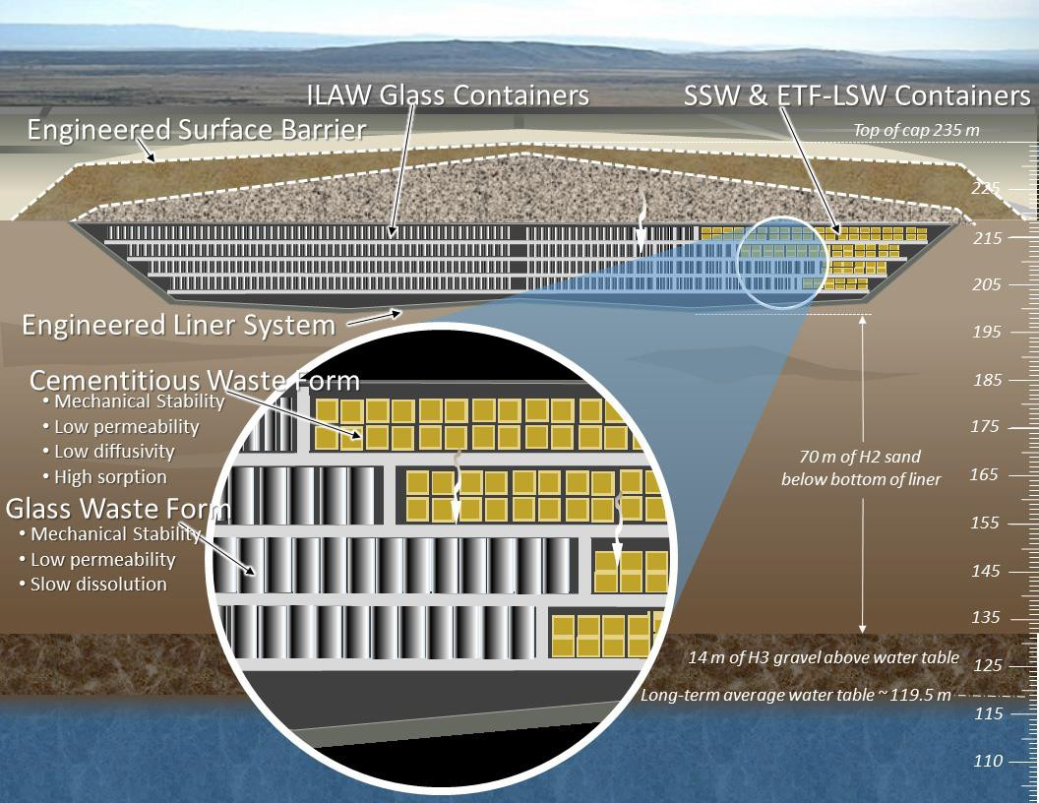
Waste Form Modeling CSMs
Near-surface disposal for LLW
  Engineered channels or vaults constructed on ground surface or up to a a few tens of meter below ground surface
Deep geological disposal
  Engineered tunnels, vaults or silos in a deep geological formation (100s of meters) below ground surface
Deep borehole disposal
  Kilometers deep rather than 100s of meters, providing further isolation from groundwater (more easily located closer to power plants)
Near surface Integrated Disposal Facility at Hanford, WA, USA

Slide 9
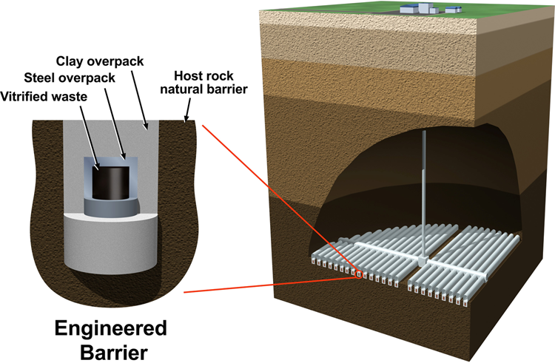
Waste Form Environment CSMs
Radionuclides can be placed into a stable matrix such as cement, bitumen or glass
Waste package is the combination of the waste form and any surrounding containment components
  Concrete containers and casks
  Stainless steel or other metal containers, such as vessels for vitrified wastes. (c) The engineered barriers also include any overpack on the waste container (e.g. steel or concrete multipackage containers for
Backfill material emplaced immediately around the waste packages (e.g., cement, bentonite)
Repository mass backfill (e.g., mixture of crushed rock and clay)
Geological disposal of vitrified radioactive waste (Thorpe et al. 2021)

Slide 10
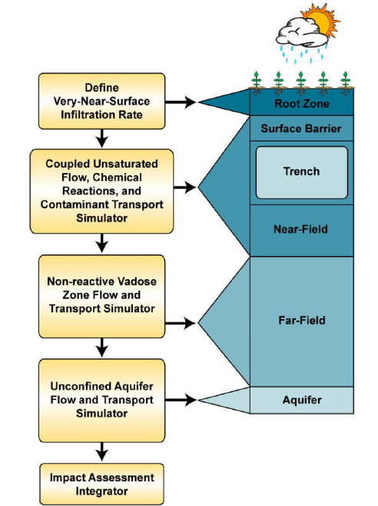
Near-Field and Far-Field
Environments
Near-field
  Waste form encapsulation and containers
  Engineered Barriers put into place
    Within the repository, where wastes may be placed in metal drums and immobilized with cement or bitumen backfill
    Drums are placed in larger concrete or steel containers for handling, with voids backfilled with cement mortar
    Containers are then stacked in the disposal tunnels or caverns and any voids backfilled with cement mortar
Far-field
  Host rock beneath and downgradient of repository, where leachate interacts
Processes in Near-field and Far-field environments (Ryan and Freedman 2016)

Slide 11
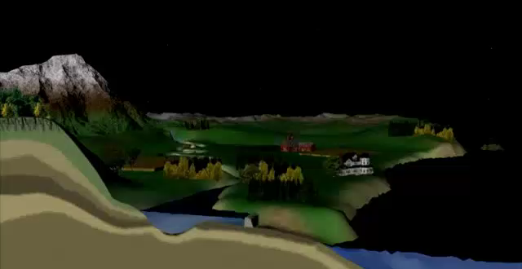
Hydrological System
A number of individual systems
  Atmosphere
  Surface water
  Watershed
  Vadose zone
  Groundwater
Contaminant transport can occur across individual systems

Slide 12
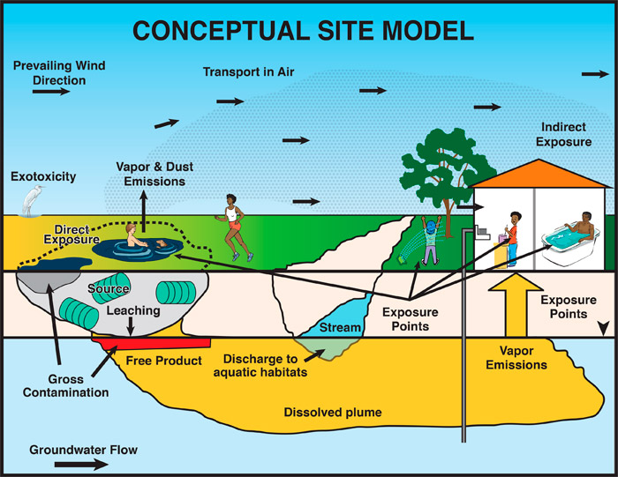
Contaminant Transport

Slide 13
Models of Environmental Systems
Human Health/Ecological
Vadose Zone
Groundwater
Fate and Transport
Exposure
Calculate the flow of water in the unsaturated zone, often accounting for multiphase flow
Calculate the flow of water in the saturated zone. In the absence of contaminant transport, used for water supply.
Calculate the movement of contaminants in the environment. Further classified into Subsurface Water Quality Models, Surface Water Quality Models, and Air Quality Models
Estimate the dose of a contaminant to human and ecological receptors
Provide a statistical relationship between a dose of a chemical and an adverse human health effect

Slide 14
Waste Form Degradation Modeling
Vadose Zone
Fate and Transport
Calculate the movement of contaminants in the environment. Further classified into Subsurface Water Quality Models, Surface Water Quality Models, and Air Quality Models
Calculate the flow of water in the unsaturated zone, often accounting for multiphase flow

Slide 15
Types of Models
Empirical
Models
Physics-based Models
Conceptual
Models
Based on mathematical equations and known mechanisms
Executed deterministically or stochastically
Qualitative, text and pictures
Based on observation, mechanism unknown

Slide 16
Types of Models
Steady-state
Transient
Mixed
Long-term average;
A mathematical construct that doesn’t seem to exist in nature
Time-varying stresses, boundaries, etc.
Steady-state for pre-development condition, transient there-after

Slide 17
Types of Models
Distributed
Lumped
Parameters are dependent on space and time
Parameters are constant over an area

Slide 18
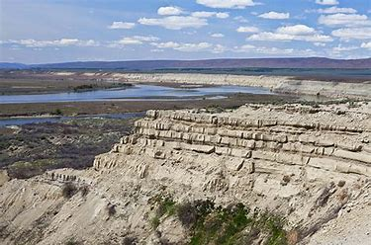
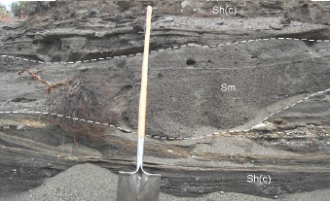
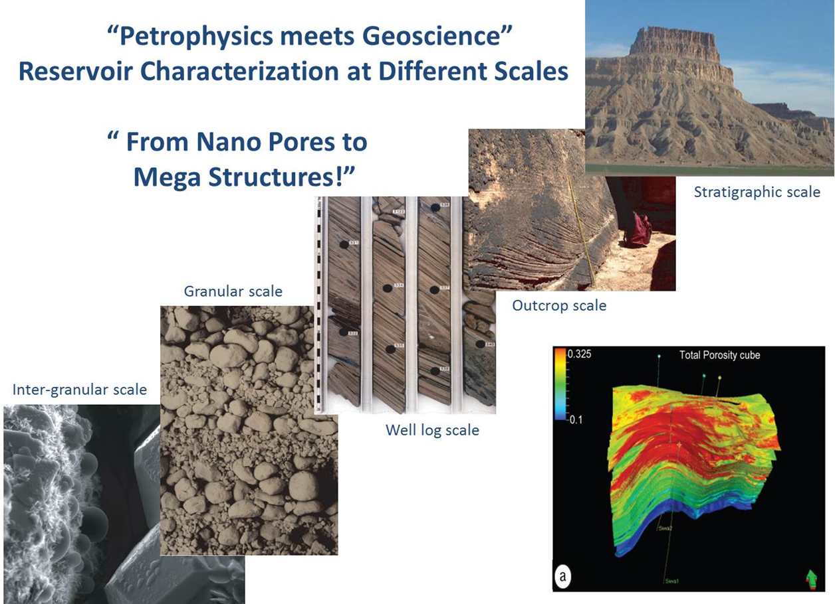
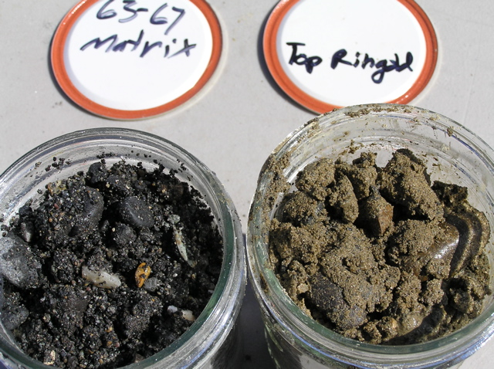
Model Scale
Variability that is pertinent to flow and transport occurs across orders of magnitude from micrometers up to hectometers
There are models and methods appropriate to each scale
“Upscaling” is a common requirement to obtain scale-appropriate parameters
micrometer
hectometer

Slide 19
Model Dimensions
0 Dimensions
1 Dimension
2 Dimensions
3 Dimensions
Black box or com­partmental models solely balance inputs and outputs (e.g., geochemical “bucket” models)
Flow and transport only occur in a single direction, often permitting an analytical solu­tion
Neglect flow and transport in either the horizontal or vertical direction. They yield predictions in two dimensions, averaged in the third dimension.
Closely approximate natural (and engineered) conditions, but are complex, and often limited by the availability of site-specific data
0D
1D
2D
3D

Slide 20
Analytical Models
Flow, Chemistry, and Transport
Cost Effective
Simplified
Limitations
Analytical equations provide continuous solution over the domain
Empirical
Site-specific
Homogeneous
Isotropic
Simple geometry
Steady-state
Equilibrium

Slide 21
Numerical Models
Flow, Chemistry, and Transport
Simple to Complex
Higher Cost
Limitations
Discrete solution over the domain; represent the domain using a discrete set of points
Need to weigh benefits of model against the cost of modeling; higher data requirements
Generally dictated by data and computational constraints
Equilibrium (steady) and transient impacts; can capture controlling factors; can be bused for time-varying and longer-term predictions

Slide 22
Analytical Element Models
Flow, Chemistry, and Transport
Simplified
Low Cost
Limitations
Superimposition of analytic solutions (groundwater modeling approach); hybrid of analytical and numerical models, solving equations analytically without discretization
Minimal data requirements, similar to analytical approach
Homogeneous
Isotropic
Simple 2D geometry
Steady-state, 2D solution; No chemistry

Slide 23
Model Framework
The model framework is defined as the system of governing equations, parameterization and data structures that represent the formal mathematical specification of a conceptual model (EPA, 2009)

Slide 24
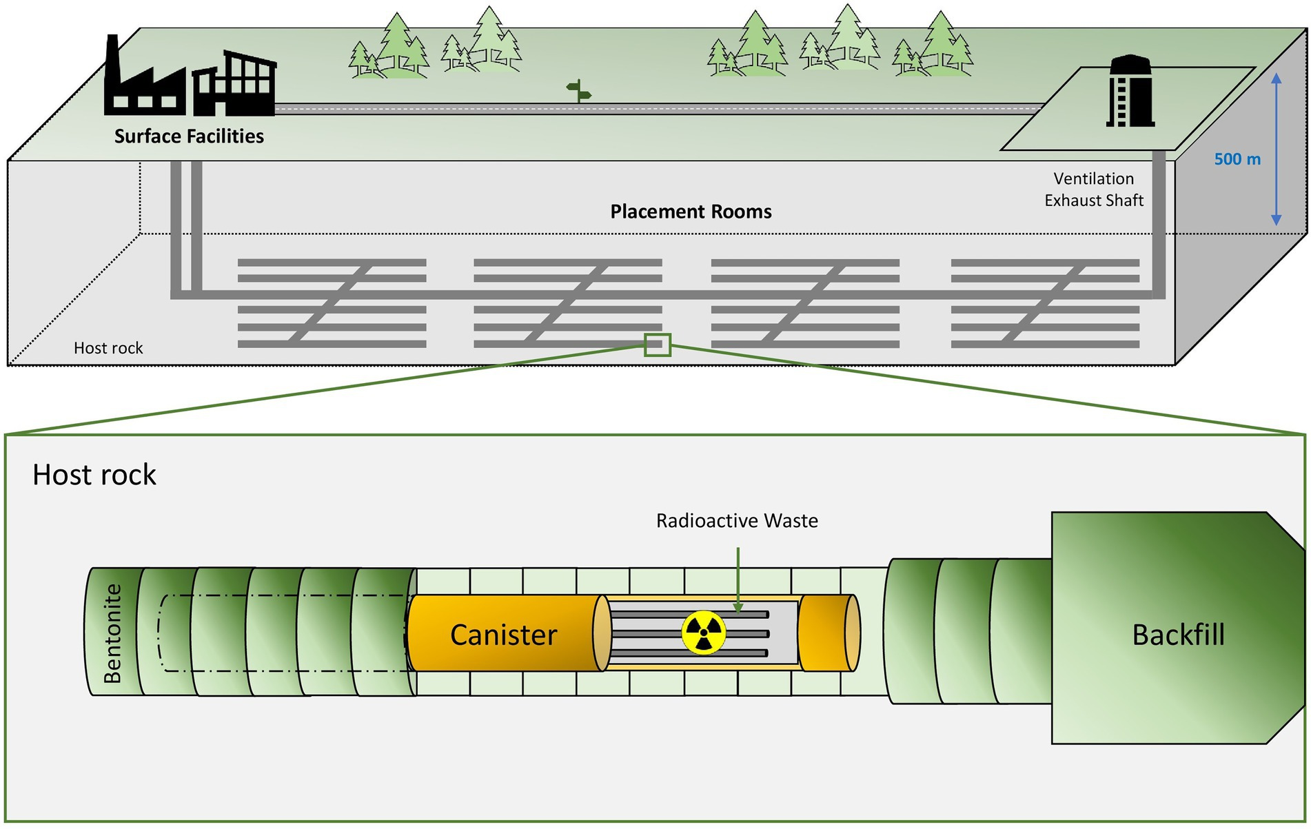
Modeling Objectives
How do the effects of retardation, solubility-controlled reactions, or decay affect contaminant transport?
What are the effects of recharge
on contaminant transport?
Questions that need to be answered drive model configuration
What are the effects of the canister and potential chemical reactions that may impact contaminant transport?
Geologic Repository Diagram (Ruiz-Fresneda et al. 2023)
What is the waste form release rate for key contaminants?

Slide 25
CSM Representation
Define system of interest and how model will be used
Scope
  What is being modeled? Waste form release rate? Contaminant transport in the vadose zone and/or groundwater?
  What are the processes that need to be represented?
    Explicit representation or simplification?
Scale
  At what time scale are the processes occurring?
  At what spatial are the processes occurring?
What types of models (or combinations of models) are needed?

Slide 26
Performance Assessment
Use of mathematical models to simulate the long-term behavior of engineered and geologic barriers in a nuclear waste repository
Methods of uncertainty analysis are used to assess effects of parametric and conceptual uncertainties
Can refer to the process, model, or collection of models used to estimate future doses to human receptors
Geologic Repository Diagram (Ruiz-Fresneda et al. 2023)

Slide 27
Model Workflow
Performance assessments generally executed with discrete models that are designed as modules with defined interfaces
  Waste form release
  Vadose zone fate and transport
  Groundwater fate and transport
  Atmospheric fate and transport
  Dose
Each model may be a separate code, where output from one code serves as input to another code

Slide 28
Modular Approach
Radiological Risk Assessment
The concentrations from each model are used to determine lifetime cancer risk from all radionuclides in all exposure pathways
Atmospheric Fate and Transport
For near-surface disposal facilities, the potential release of gaseous contaminants needs to be identified.
Groundwater Fate and Transport
Any contaminants reaching the water table are simulated in a groundwater flow and transport model
Vadose Zone Fate and Transport
For near-surface disposal facilities, the release of key contaminants into the vadose zone is simulated
Waste Form Release
Identify the loading and waste form release rates

Slide 29
Exposure, Dose and
Risk Assessment

Slide 30
Characterizing Risk
Risk Assessment
4
Combines information obtained from dose-response relationship and exposure assessment to describe the carcinogenic risk associated with expected human exposures
Risk
Assessment
Dose Assessment
3
You can simply impress your audience and add a unique zing.
Dose Assessment
Exposure Assessment
2
Exposure Assessment
Process of identifying group(s) of individuals at risk using the various routes (pathways) of exposure and their magnitude, frequency, and duration
Environmental Modeling
Environmental Modeling
1
Concentration estimates in air, water, soil, etc. are identified at compliance points and used to support exposure assessments

Slide 31
Modular Approach
Radiological Risk Assessment
The concentrations from each model are used to determine lifetime cancer risk from all radionuclides in all exposure pathways
Atmospheric Fate and Transport
For near-surface disposal facilities, the potential release of gaseous contaminants needs to be identified.
Groundwater Fate and Transport
Any contaminants reaching the water table are simulated in a groundwater flow and transport model
Vadose Zone Fate and Transport
For near-surface disposal facilities, the release of key contaminants into the vadose zone is simulated
Waste Form Release
Identify the loading and waste form release rates

Slide 32
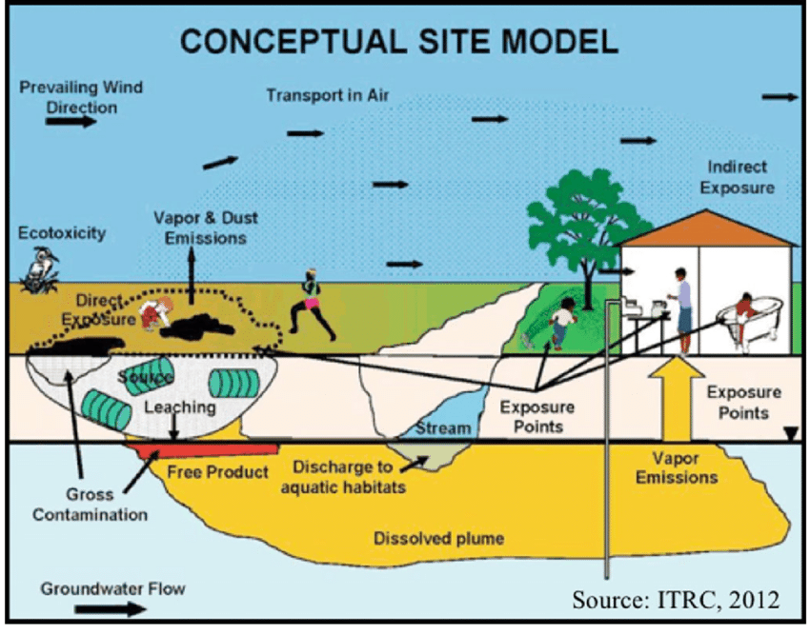

Slide 33
Characterizing Risk
Risk Assessment
4
Combines information obtained from dose-response relationship and exposure assessment to describe the carcinogenic risk associated with expected human exposures
Risk
Assessment
Dose Assessment
3
You can simply impress your audience and add a unique zing.
Dose Assessment
Exposure Assessment
2
Exposure Assessment
Process of identifying group(s) of individuals at risk using the various routes (pathways) of exposure and their magnitude, frequency, and duration
Environmental Modeling
Environmental Modeling
1
Concentration estimates in air, water, soil, etc. are identified at compliance points and used to support exposure assessments

Slide 34




Exposure Pathway: Soil
Consumption
Vegetables, fruits, and grains grown in the contaminated soil
Milk and meat obtained from livestock that eat pasture grass grown in the contaminated soil
Direct Consumption
Ingestion of contaminated soil
Inhalation
Inhalation of radionuclides from contaminated surface soil suspended in the air
External Exposure
External exposure to contaminated soil

Slide 35
Exposure Pathway: Groundwater
Consumption
Use of water for agricultural purposes, such as watering of livestock; irrigation of vegetables, fruits, and grains; and irrigation of pasture grass consumed by livestock
Direct Consumption
Direct ingestion of water from the contaminated source

Slide 36
Exposure Pathway: Surface
Water
Consumption
Use of water for agricultural purposes, such as watering of livestock; irrigation of vegetables, fruits, and grains; and irrigation of pasture grass consumed by livestock
Direct Consumption
Direct ingestion of water from the contaminated source
Consumption of aquatic foodstuffs (such as fish) obtained from the contaminated source
External Exposure
External exposure to the contaminated source during such activities as swimming, boating, and residence along contaminated shorelines

Slide 37
Exposure Pathway: Air
Consumption
ingestion of radionuclides incorporated into foodstuffs (vegetables, fruits, grains, meat, and milk) due to deposition of airborne particles
Direct Consumption
Ingestion of contaminated soil and foodstuffs due to deposition of airborne particles
Inhalation
Inhalation of airborne radionuclides in the source compartment
Inhalation and external exposure to airborne radionuclides in the source compartment
External Exposure
External exposure to airborne radionuclides in the source compartment
Exposure to radionuclides deposited on vegetation and the ground surface

Slide 38
Exposure Scenarios
Identifies estimates of exposure, dose, and risk and includes facts, data, assumptions, inferences, and professional judgment about how the exposure takes place; e.g.
  Resident Farmer
  Residential Tap Water
  Inadvertent Human Intruder
  Subsistence Fishing Native
  Construction Worker
  Indoor Worker
Exposure Pathways in the Risk Assessment Information System Resident Tap Water Scenario
(https://rais.ornl.gov/tools/rais_rad_risk_guide.html)

Slide 39


Radiation Human Health Assessment Approaches
Risk
Risk is calculated directly by assigning a unit of risk for every unit of exposure (Cancer Slope Factor) and multiplying by the total exposure.
Risk = Exposure X Cancer Slope Factor
(slope factors exist for each radionuclide and route of exposure
Dose is calculated by multiplying a dose conversion factor by the total intake/exposure. The calculated dose can also be multiplied by a probability coefficient to arrive at a risk value.
Dose = Exposure X Dose Conversion Factor
(each radionuclide has unique DCF)
DOSE

Slide 40
Code Selection Considerations
Flow type
  Porous media
  Fracture flow
  Density-dependent
Flow regime
  Unsaturated
  Saturated
  Multiphase
Flow objectives
  Downstream compliance points
  Fluxes to surface water
Geochemical reactions
  Precipitation and dissolution
  Surface complexation
  Ion exchange
  Aqueous complexation
Solute Transport
  Reactions with porous media
  Reactions w/other solutes/contaminants
  Sources
Reactive Transport
  Level of detail for relevant reactions
Multiphase Flow
  Atmospheric transport
  Heat transport
Surface water interactions
Combinations of models

Slide 41
Model Workflow and Performance
Sensitivity Analysisis
Uncertainty Quantification
Calibration
Validation
Adjustment of parameters based on measured data
Adjustment of parameters based on measured data
Uncertainty in input data and impact on predictions
Confirmation of predictive power using independent data
1
2
3
4

Slide 42
Uncertainty
Two sources of uncertainty
  Aleatory uncertainty
    Randomness in the physical system
    Probabilistic treatment
  Epistemic uncertainty
    Lack of system knowledge but can be reduced
    Expert knowledge evaluation
Both types of uncertainty are treated probabilistically
Uncertainties need to be analyzed to support decision-making
Model outputs are distributions (not deterministic point values)

Slide 43
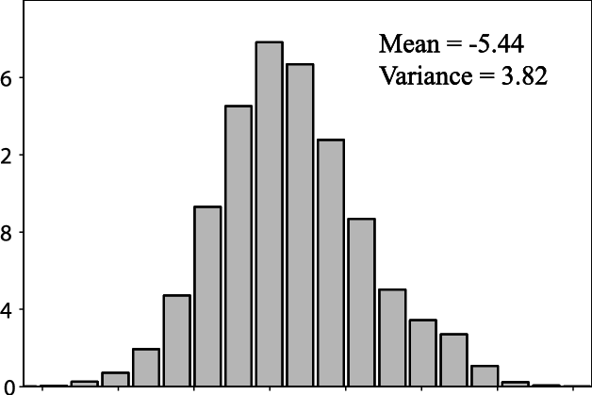
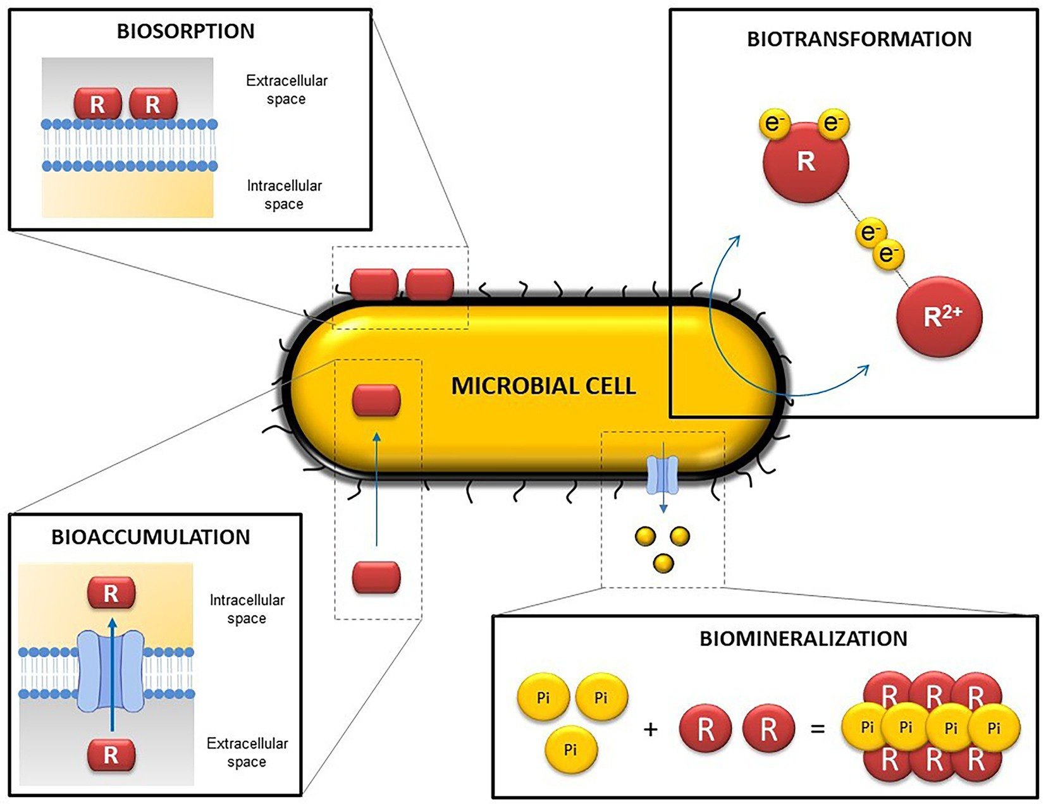
Epistemic Uncertainty
Example
parameter
distribution
Parameter
  Uncertainty in the values of the parameters used in the model (e.g.; waste form corrosion rate, permeability)
  Generally characterized using probability distributions for parameter values
Model
  Uncertainty in the how the mathematical model represents the system (e.g.; waste form fracturing, rubbelization)
  Predicting system behavior for conditions that differ from those in which data were collected (e.g.; glass dissolution)
Completeness
  Recognition of the limitations of the modeling
  Translates into uncertainty associated with risk
Potential microbial influence in repositories
(Ruiz-Fresneda et al. 2023)

Slide 44
Shortcomings and Limitations
Obligation to acknowledge and document to the extent practical the limitations and assumptions underlying any model application:
  Assumptions and limitations of the selected code
  Limitations stemming from the available data
  Assumptions made regarding model design
Communication of “reliability”:
  Absolutes are problematic
  Uncertainty and sensitivity analyses can be informative but rarely quantitatively dependable

Slide 45
Waste Form Modeling and Performance Assessment
Quality of the performance assessment will depend on
  Level of knowledge of the site
  Degree to which models capture actual physical and chemical processes
  Time over which extrapolations are made
  Proper evaluation of health risks attending implementation of the repository
Challenge is in generating a performance assessment that meets the needs of decision makers charged with protecting human health and the environment

Slide 46
Summary
Modeling is a tool for understanding the system and its behavior
  Performance assessment modeling compartmentalizes each system and provides linkages between systems
CSM
  Hypothesis describing processes and relationships
  Technical basis for a mathematical model
Mathematical models are abstractions that represent processes as equations, physical properties as coefficients in the equations, and measures of state in the system as variables
Need to be selective in identifying processes represented in each component of the performance assessment modeling
Clear objectives are needed!

Slide 47
References
BSC (Bechtel SAIC Company) 2005. The Development of the Total System Performance Assessment-License Application Features, Events, and Processes. TDR-WIS-MD-000003 REV 02. Las Vegas, Nevada: Bechtel SAIC Company
Hwang, Y.S; Kang, C.H.; and Soo, E.J. 2006. Development of the KAERI FEP, Scenario, and Assessment Method Database for Permanent Disposal of HLW in Korea. Progress in Nuclear Energy Volume 48, Issue 2 pp 165-172. Daejeon, South Korea: Korea Atomic Energy Research Institute.
Jones, R.H. 2011, Features, Events, and Processes for the Disposal of Low Level Radioactive Waste - FY 2011 Status Report, Revision 0, Prepared for U.S. Department of Energy Used Fuel Disposition Campaign, FCRD-USED-2011-000297
Freeze, G.; and Swift, P. 2010. Comprehensive Consideration of Features, Events, and Processes (FEPs) for Repository Performance Assessments. PSAM 10 Conference Proceedings. Seattle, Washington: International Association for Probabilistic Safety Assessment and Management.
Freeze, G., Mariner, P., Blink, J.A., Caporuscio, F.A., Houseworth, J.E., and Cunnane, J.C. 2011. Disposal System Features, Events, and Processes (FEPs): FY11 Progress Report. SAND2011-6059P, Sandia National Laboratories, Albuquerque, New Mexico.
Kuhlman, K.L. 2011. Hydrogeology and WIPP Compliance – 11658. Waste Management Symposia, February 27 – March 3, 2011, Phoenix, Arizona.
Ryan, J. and V. Freedman. 2016. A Strategy for Maintenance of the Long-Term Performance Assessment of Immobilized Low-Activity Waste Glass, PNNL-23503, Rev. 1, Pacific Northwest National Laboratory, Richland, Washington.
Ruiz-Fresneda, M.A. M.F. Martinez-Moreno, C. Povedano-Priego, M. Morales-Hidalgo, M.L. Merroun. 2023. Impact of microbial processes on the safety of deep geological respositories for radioactive waste. Frontiers in Microbiology, Vol.14, https://doi.org/10.3389/fmicb.2023.1134078.
SNL (Sandia National Laboratories) 2008. Features, Events, and Processes for the Total System Performance Assessment: Analysis. ANL-WIS-MD-000027 REV 01. Las Vegas, Nevada: Sandia National Laboratories, Albuquerque, New Mexico.
Vienna, J.D., et al., Current Understanding and Remaining Challenges in Modeling Long-Term Degradation of Borosilicate Nuclear Waste Glasses. International Journal of Applied Glass Science, 2013. 4(4): p. 283-294.

Slide 48
Gunalchéesh, Háw'aa, T’oya̱xsut ‘nüüsm

Slide 49
Backup Slides

