Slide 1
Laboratory Testing of Cement-based Materials to Support Durability Modelling
Angélique ROUSSELET
French Alternative Energies and Atomic Energy Commission (CEA), Paris-Saclay Centre
TC Regional Workshop on Approaches to Ageing Management of Waste Packages in Storage
Joint ICTP-IAEA Workshop on Degradation Modelling of Disposed Radioactive Wasteforms
18th – 22nd September 2023, Trieste (Italy)

Slide 2
INTRODUCTION
Durability is the ability to maintain desired performances within a specified time frame.
Durability can be impacted by several processes:
Loss of performances of waste packages
Internal causes
AAR
DEF
Waste/matrix interaction
Radiolysis
External causes
Unsaturated
medium
Saturated medium

Slide 3
INTRODUCTION
Unsaturated
medium
Saturated
medium
Gas transport:
Drying
Atmospheric carbonation
Hydrogen transfer
Aqueous transport:
Leaching of radionuclide
Leaching of the cement material
Reaction with ions from the environment

Slide 4
INTRODUCTION
Acquisition of experimental data (laboratory testing)
Understanding the phenomenology
Modelling experimental data

Slide 5
CONTENT
Leaching in pure water
Sulphate attack
Case study : interaction with Callovo-Oxfordian groundwater

Slide 6
LEACHING IN PURE WATER
1

Slide 7
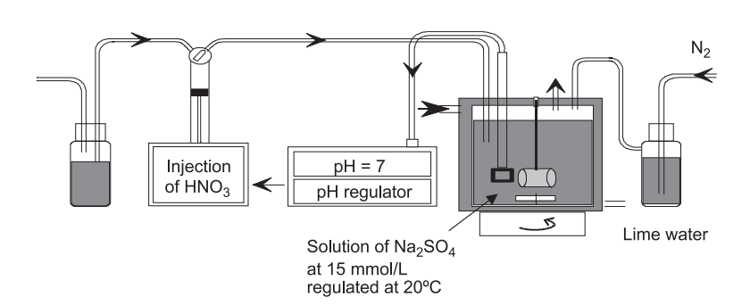
LEACHING IN PURE WATER
Experimental set-up
Control of the composition of the leaching solution:
pH: automatic titration to maintain a constant pH (7)
Renewal of the leaching solution
Protection from atmospheric CO₂
Control of the temperature
Unidirectional diffusion (lateral coating of the sample).
Pure water
Adapted from Planel et al. (2006) Cem.Conc.Res., 36:137-143.

Slide 8
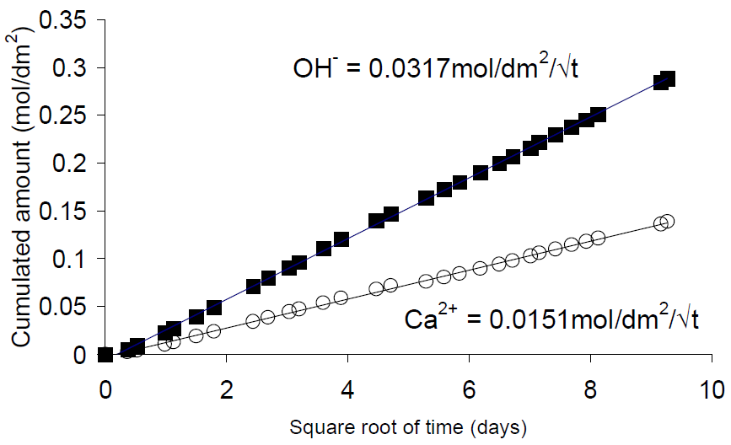
LEACHING IN PURE WATER
The cumulated amount of OH⁻ is calculated from the volumes of acid added to maintain the constant pH of 7 :
Chemical analysis of the leachate:
Leaching of a CEM I cement paste at 25°C
$$Q({OH}^{−})=\frac{V_{{HNO}_{3}}×C_{{HNO}_{3}}}{S}$$
$$with$$
$$Q\left({OH}^{−}\right):cumulated amount of {OH}^{−}$$
$$in mol/dm²$$
$$V_{{HNO}_{3}}:volume of acid added in dm3$$
$$C_{{HNO}_{3}}:concentration of acid in mol/l$$
$S$ : exposed surface of the sample in dm²
Cumulated amounts of other aqueous species (Ca, Si, Al, etc.) are determined thanks to the renewal of the leachate.
Peycelon et al. (2006) REGC, 10:1107-1125.

Slide 9
LEACHING IN PURE WATER
Cumulated amounts are proportional to the square root of time
typical of a process controlled by diffusion (2nd Fick law)
$\frac{∂C}{∂t}=D\frac{∂^{2}C}{{∂x}^{2}}$
OH⁻ is leached two times faster than [Ca²⁺]
coherent with the dissolution of portlandite :
Chemical analysis of the leachate:
Leaching of a CEM I cement paste at 25°C
$${Ca(OH)}_{2}={Ca}^{2+}+2 {OH}^{−}$$
Peycelon et al. (2006) REGC, 10:1107-1125.

Slide 10
LEACHING IN PURE WATER
Evolution of the mineralogy:
Pure water is a strong decalcifying agent of cement-based materials :
Visible zonation translating the progressive decalcification of the altered zones
1
2
3
4
5
Mainguy et al. (2000) Cem.Concr.Res 30:83-90.
1 . Superficial layer (enriched in aluminium and silicon) | 2. CSH | 3. CSH Ettringite | 4. CSH Ettringite Monosulfoaluminate | 5. Unaltered material CSH Ettringite Monosulfoaluminate Portlandite

Slide 11
LEACHING IN PURE WATER
Simplified modelling
Leaching of OPC materials in pure water is modelled considering the evolution of calcium only (since all major hydrates contain calcium (CH, CSH, AFm, AFt).
Inputs :
Initial concentration in the solid phase of Ca and Si
Initial porosity and coefficient of diffusion
Outputs :
Depth of degradation
Quantities of leached calcium

Slide 12
LEACHING IN PURE WATER
Simplified modelling
Resolution of the mass balance equation for calcium only:
$$\frac{∂ωC_{Ca}}{∂t}=div\left(D_{e}.\vec{grad}(C_{Ca})\right)−\frac{∂ωS_{Ca}}{∂t}$$
Dissolution of Ca in the solid phase
Diffusion of Ca governed by Fick’s law
$$where C_{Ca} is the concentration of Ca in the liquid phase$$
$$S_{Ca} is the concentration of Ca in the solid phase$$
$$D_{e} is the coefficient of diffusion of the material$$
$$ω is the porosity of the material$$

Slide 13
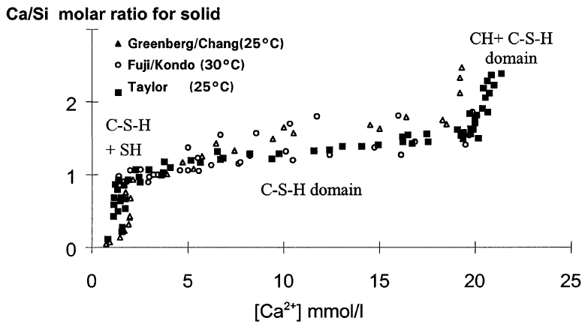
LEACHING IN PURE WATER
Simplified modelling
Relation between C_{Ca} and S_{Ca} is based on experimental data.
[Ca²⁺]=21mmol/l
Threshold due to portlandite dissolution
2<[Ca²⁺]<21mmol/l
Decalcification of C-S-H phase + progressive dissolution of AFm & AFt
[Ca²⁺]<2mmol/l
Solid phase is constituted of silica gel
Faucon et al. (1998) Cem.Concr.Res., 28:847-857.

Slide 14
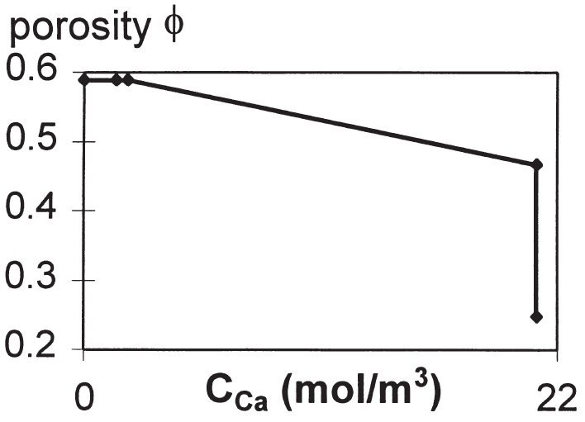
LEACHING IN PURE WATER
Simplified modelling
The evolution of porosity is linked to mineralogy.
Increase of porosity due to the progressive dissolution of hydrates (AFm+AFt)
Mainguy et al. (2000) Cem.Concr.Res., 30:83-90.
Increase of porosity due to the dissolution of portlandite
Initial porosity

Slide 15
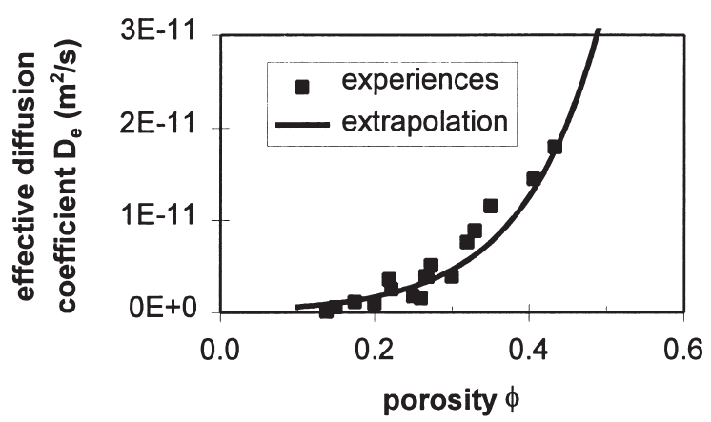
LEACHING IN PURE WATER
Simplified modelling
An empirical relation is established between porosity and coefficient of diffusion.
Based on the determination of De in OPC pastes presenting different porosities (due to different w/c).
$$D_{e}=exp\left(9.95ω−29.08\right)$$
Mainguy et al. (2000) Cem.Concr.Res., 30:83-90.

Slide 16
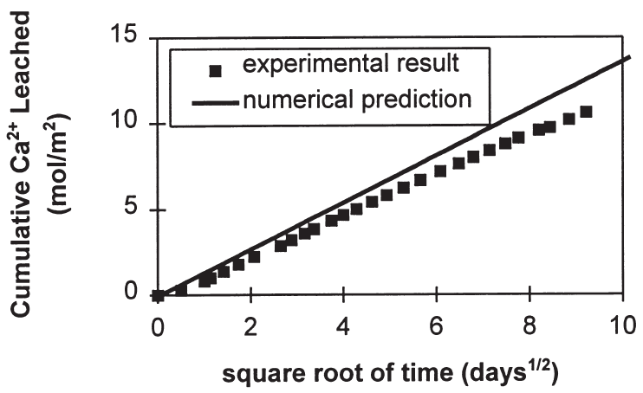
LEACHING IN PURE WATER
Simplified modelling
Outputs:
No detail on the phase assemblage.
Depth of degradation (mm) | 3 months | 6 months
Experiment | 1.45 | 2.1
Model | 1.4 | 2.0
Mainguy et al. (2000) Cem.Concr.Res., 30:83-90.

Slide 17
LEACHING IN PURE WATER
Reactive transport modelling
Hydrodynamic processes
Chemical reactions
Diffusion
and
Advection
Dispersion
Dissolution
and
Precipitation
Aqueous reactions
Redox reactions
Sorption
Etc.

Slide 18
LEACHING IN PURE WATER
Reactive transport modelling
Leaching of OPC materials in pure water is modelled considering the all the elements (Ca, Si, Al, SO₄²⁻).
Hydrodynamic processes
Chemical reactions
$$\frac{∂ωC_{mob}}{∂t}=div\left(D_{e}.\vec{grad}(C_{mob})\right)−\frac{∂ωC_{immob}}{∂t}$$
$$where C_{mob} is the mobile concentration of the element$$
$C_{immob} is the immobile$ $concentration of the element$

Slide 19
LEACHING IN PURE WATER
Reactive transport modelling
Clogging
Opening
Variation of porosity calculated with the evolution of the mineralogy.
Variation of De calculated with an empirical relation.
Example : modified Archie’s law
$$D_{e}\left(ω\right)=D_{e}\left(ω_{0}\right).{\left(\frac{ω−ω_{c}}{ω_{0}−ω_{c}}\right)}^{a}$$
$$with$$
$$D_{e} :effective diffusion coefficient in m^{2}/s$$
$$ω_{0} :porosity of the material at t=0$$
$$D_{e}\left(ω_{0}\right)={10}^{−12} m^{2}/s$$
$$ω_{0}=0.2$$
$$ω_{c}=0.01$$
$$ω_{c} :critical porosity$$
a : empirical fitting parameter

Slide 20
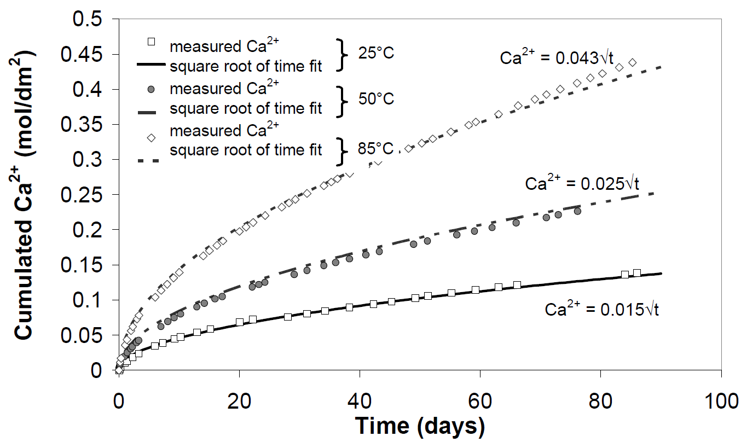
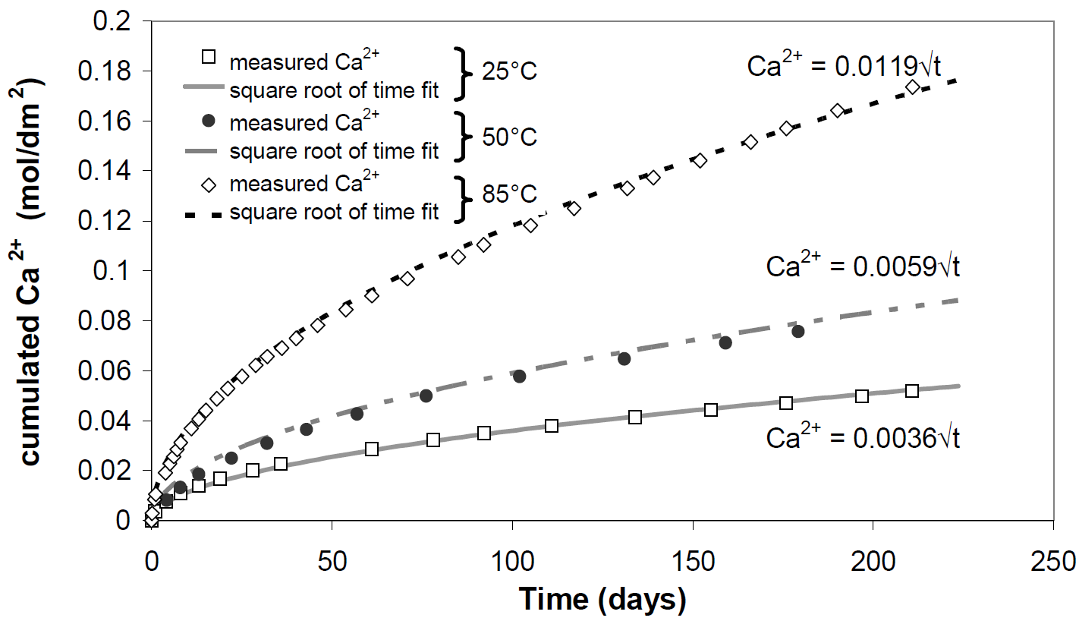
LEACHING IN PURE WATER
Peycelon et al. (2006) REGC, 10:1107-1125.
Modelling the leachate composition:
85°C
Comparison between experimental data and model.
Possibility to take into account the effect of temperature.
50°C
25°C
CEM I
Amount of Ca²⁺ released (mol/dm²/days^{1/2})
85°C
Cement | 25 °C |  | 50 °C |  | 85°C
 | Exp. | Mod. | Exp. | Mod. | Exp. | Mod.
CEM I | 0.0150 | 0.0152 | 0.028 | 0.027 | 0.046 | 0.045
CEM V | 0.0036 | 0.0031 | 0.0059 | 0.0057 | 0.0118 | 0.0126
50°C
25°C
CEM V

Slide 21
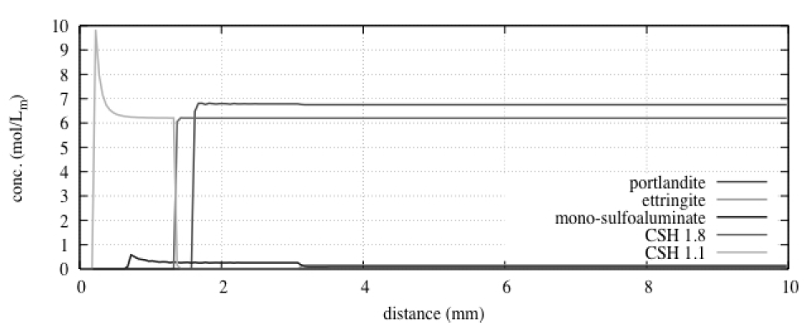
LEACHING IN PURE WATER
van der Lee et al. (2008) ConMod’08
Altered zone
Constant diffusion coefficient
Modelling the mineralogical evolutions:
2
1
Unaltered zone
Impact of the opening of the porosity in the degraded zones :
Input and fitting parameters (Archie’s law) :
De(ω₀) = 10⁻¹¹m²/s
ω₀ = 0.2
α = 2.8
Decalcification of C-S-H :
CSH1.8 → CSH1.1
Altered zone
Variable diffusion coefficient
2
1
Unaltered zone

Slide 22
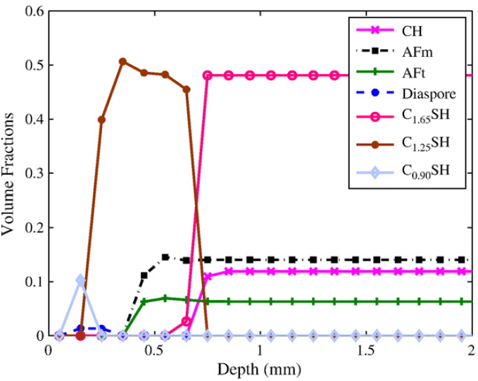
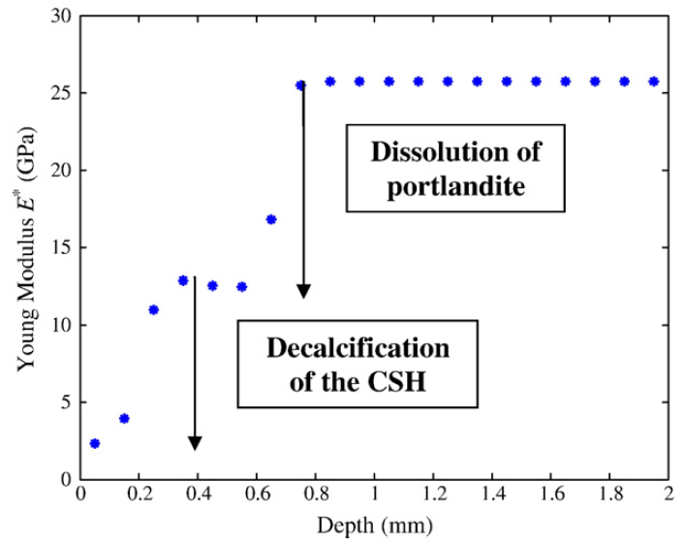
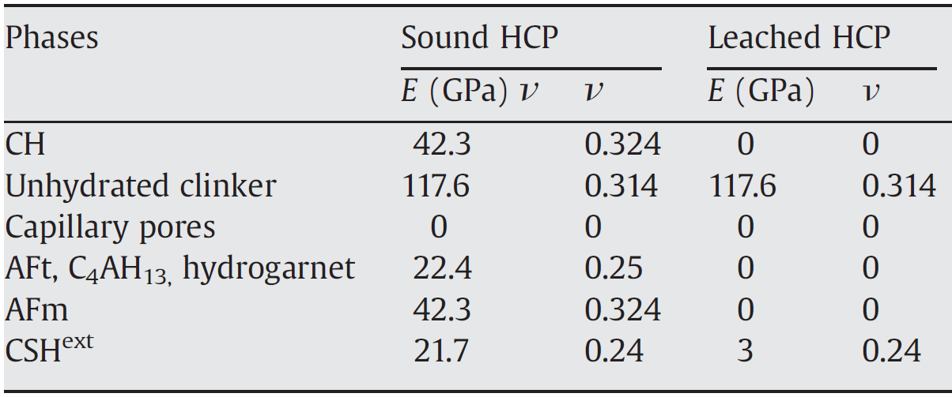
LEACHING IN PURE WATER
Altered zone
Simulated mineral composition of a CEM I paste (w/c=0.4) leached for 50 days.
Chemo-mechanical modelling:
Modelling the evolutions of Young modulus E using experimental data on the different phases.
Unaltered zone
Stora et al. (2009) Cem.Concr.Res., 39:763-772.
Altered zone
Simulated evolution of the Young modulus
Input
Unaltered zone

Slide 23
SULPHATE ATTACK
2

Slide 24
SULPHATE ATTACK
Two phenomena at play:
Leaching from the material
Mass transport of corrosive agents into the material
Description of the general process:
Sodium sulfate
$${Na}_{2}{SO}_{4}$$
Monosulfate
$$C_{4}A\overline{S}H_{12}$$
Tricalcium
aluminate
$$C_{3}A$$
Ca²⁺
Portlandite
$${Ca(OH)}_{2}$$
Calcium aluminate phases
Gypsum
$$C\overline{S}H_{2}$$
Ettringite
$${C_{6}{A\overline{S}}_{3}H}_{32}$$
SO₄²⁻

Slide 25
SULPHATE ATTACK
Experimental set-up :
Planel et al. (2006) Cem.Conc.Res., 36:137-143.

Slide 26
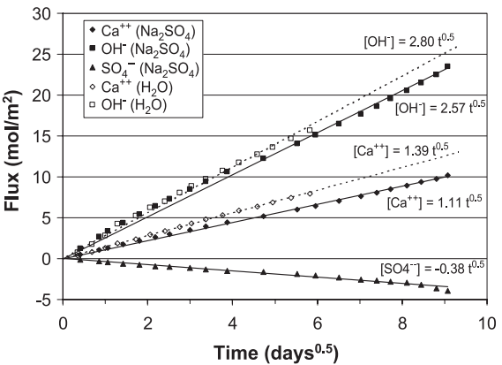
SULPHATE ATTACK
Chemical analysis of the leachate:
Planel et al. (2006) Cem.Conc.Res., 36:137-143.
Diffusion of sulphate ions in the material (negative flux)
Fluxes of OH⁻ are similar for leaching in H₂O and Na₂SO₄
Lower flux of Ca²⁺ in Na₂SO₄
Ca²⁺ consumption

Slide 27
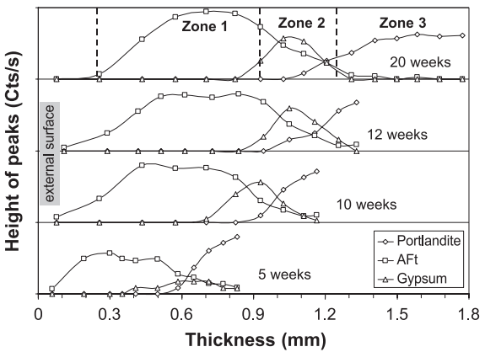
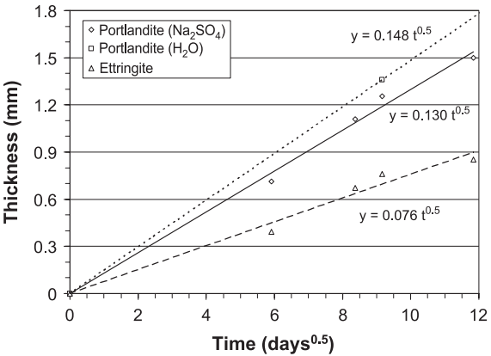
SULPHATE ATTACK
Mineralogy of the leached zone
Reaction of SO₄²⁻ with Ca²⁺ and Al(OH)₄⁻ to precipitate ettringite and gypsum,
Dissolution and precipitation fronts evolve as the square root of time (diffusion).
Planel et al. (2006) Cem.Conc.Res., 36:137-143.

Slide 28
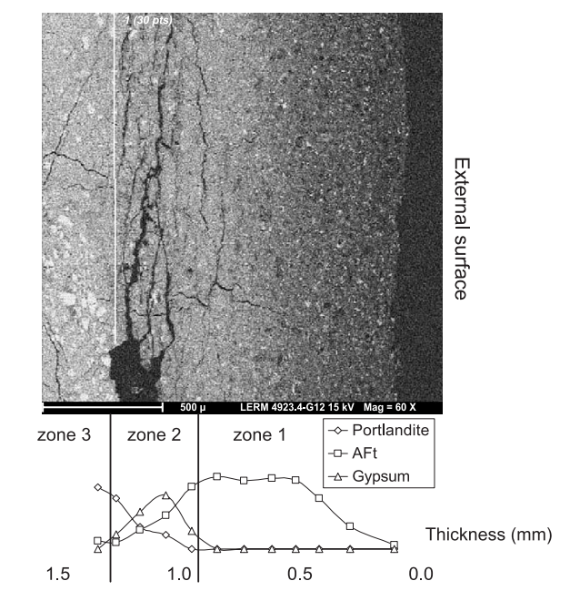
SULPHATE ATTACK
Planel et al. (2006) Cem.Conc.Res., 36:137-143.
(SEM)
Solid characterisation
Cracking due to internal pressure induced by mineral precipitation
No cracks in zone 1 (interface with the leachate)
Precipitation of ettringite, total dissolution of portlandite
Major cracks in zone 2
Formation of gypsum & ettringite, presence of portlandite
(XRD)

Slide 29
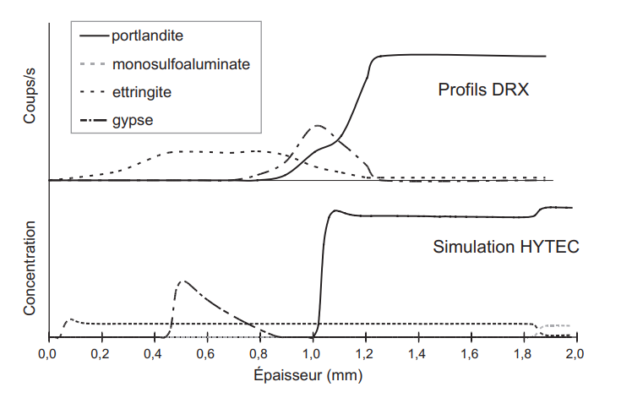
SULPHATE ATTACK
Modelling the mineralogical evolutions :
Chemical-transport modelling of the evolution of the mineralogy of the cement paste
Experimental
(XRD)
Counts
Planel (2002) Ph.D. Thesis
Model
(HYTEC)
Depth (mm)

Slide 30
SULPHATE ATTACK
From a chemical model to a mechanical model…
Planel (2002) Ph.D. Thesis
Cracking patterns
Numerical simulation of tensile damage with finite elements (CASTEM).
The internal pressure is estimated according to the mineral volume variation :
external surface
$$σ^{sp}=k.\left(V_{sp}−f.\left(1−V_{pp}\right)\right)$$
$$with$$
$$σ^{sp}:tensile strain$$
$$k, f :fitting parameters$$
$$V_{sp} :volume of secondary phases$$
$$V_{pp} :volume of primary phases$$
Time

Slide 31
CASE STUDY : CALLOVO-OXFORDIAN GROUNDWATER
3

Slide 32
Case study : COx groundwater
COx pore water composition :
 | Na | K | Ca | Mg | Sr | Cl | S | Si | Fe | Al | TIC*
mmol/l | 45.6 | 1 | 7.4 | 6.7 | 0.2 | 41 | 15.6 | 0.2 | 0.03 | 4.7.10⁻⁶ | 3.3
T (°C) | pH
25 | 7.1
*TIC : Total Inorganic Carbon
In the groundwater, TIC is imposed by a P_{CO2} 30 times higher than atmospheric pressure.
Expected phenomena :
Leaching (pH = 7.1)
Sulphate attack
Other reactants : CO₃²⁻, Mg²⁺

Slide 33
Case study : COx groundwater
COx pore water composition :
 | Na | K | Ca | Mg | Sr | Cl | S | Si | Fe | Al | TIC*
mmol/l | 45.6 | 1 | 7.4 | 6.7 | 0.2 | 41 | 15.6 | 0.2 | 0.03 | 4.7.10⁻⁶ | 3.3
T (°C) | pH
25 | 7.1
*TIC : Total Inorganic Carbon
In the groundwater, TIC is imposed by a P_{CO2} 30 times higher than atmospheric pressure.
Parameters to control in an experimental set-up :
Temperature
Composition of the solution :
Renewal of the leachate
P_{CO2}

Slide 34
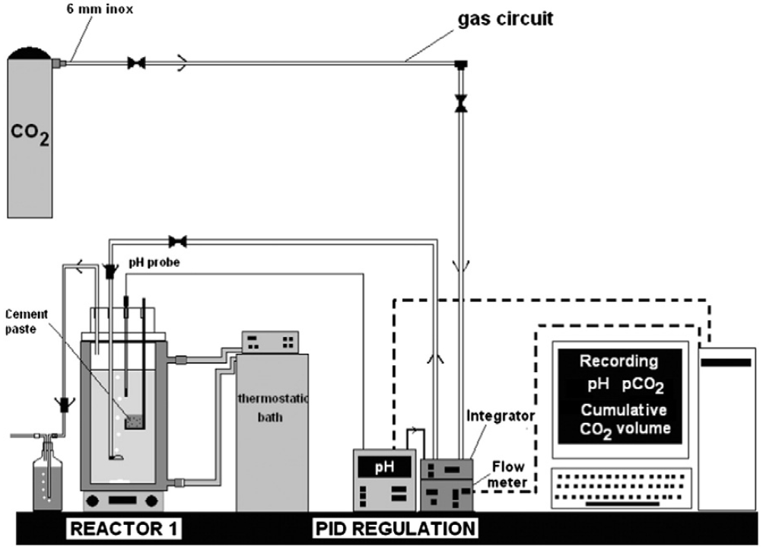
Case study : COx groundwater
Experimental test in controlled conditions :
Control of the composition of the leaching solution :
pH=7.1 and concentration in carbonates are maintained by controlling the flow of CO₂.
Renewal of the leaching solution to maintain the concentrations in other elements approximatively constant and avoid accumulation of leached species.
Dauzères et al. (2014) Cem.Concr.Res., 58:76-88.

Slide 35
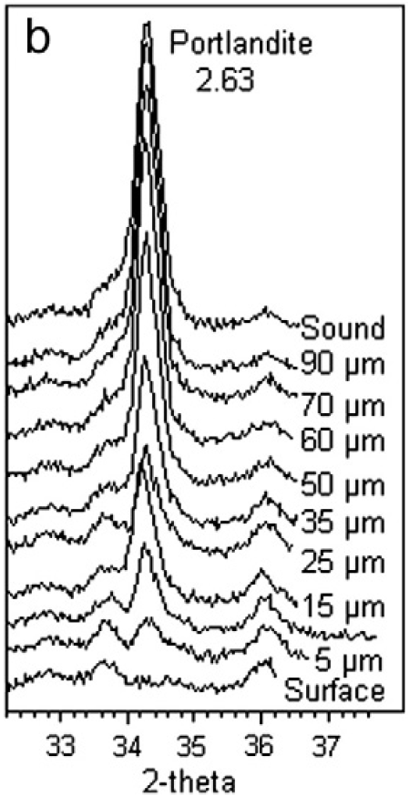
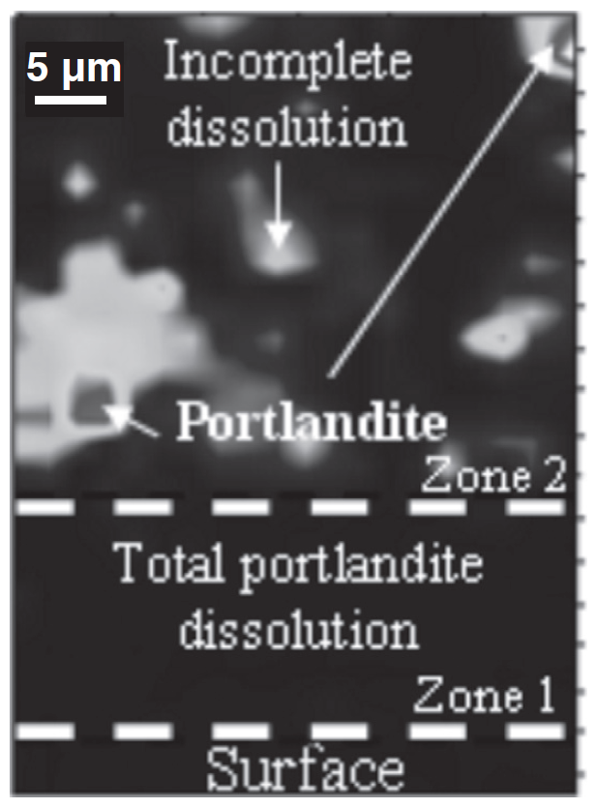
Case study : COx groundwater
Results :
Leaching :
dissolution of portlandite
XRD
2D Raman mapping of portlandite
Dauzères et al. (2014) Cem.Concr.Res., 58:76-88.

Slide 36
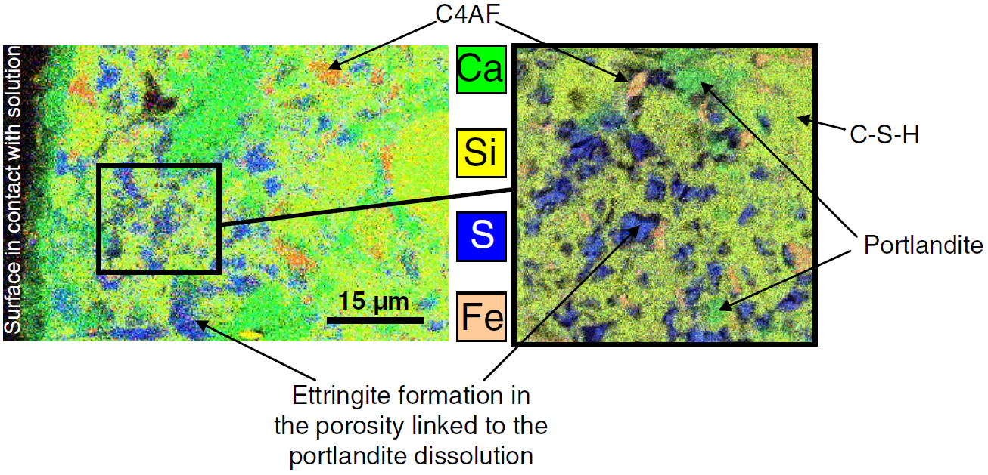
Case study : COx groundwater
Results :
Sulphate attack :
Precipitation of ettringite in the degraded zone
Dauzères et al. (2014) Cem.Concr.Res., 58:76-88.
Elemental mapping (EDX)

Slide 37
Case study : COx groundwater
Results :
Action of carbonates and magnesium:
Formation of a dense and magnesium-rich calcite crust on the surface of the sample.
Dauzères et al. (2014) Cem.Concr.Res., 58:76-88.
Raman mapping
of calcite
XRD
Elemental mapping (EDX)

Slide 38
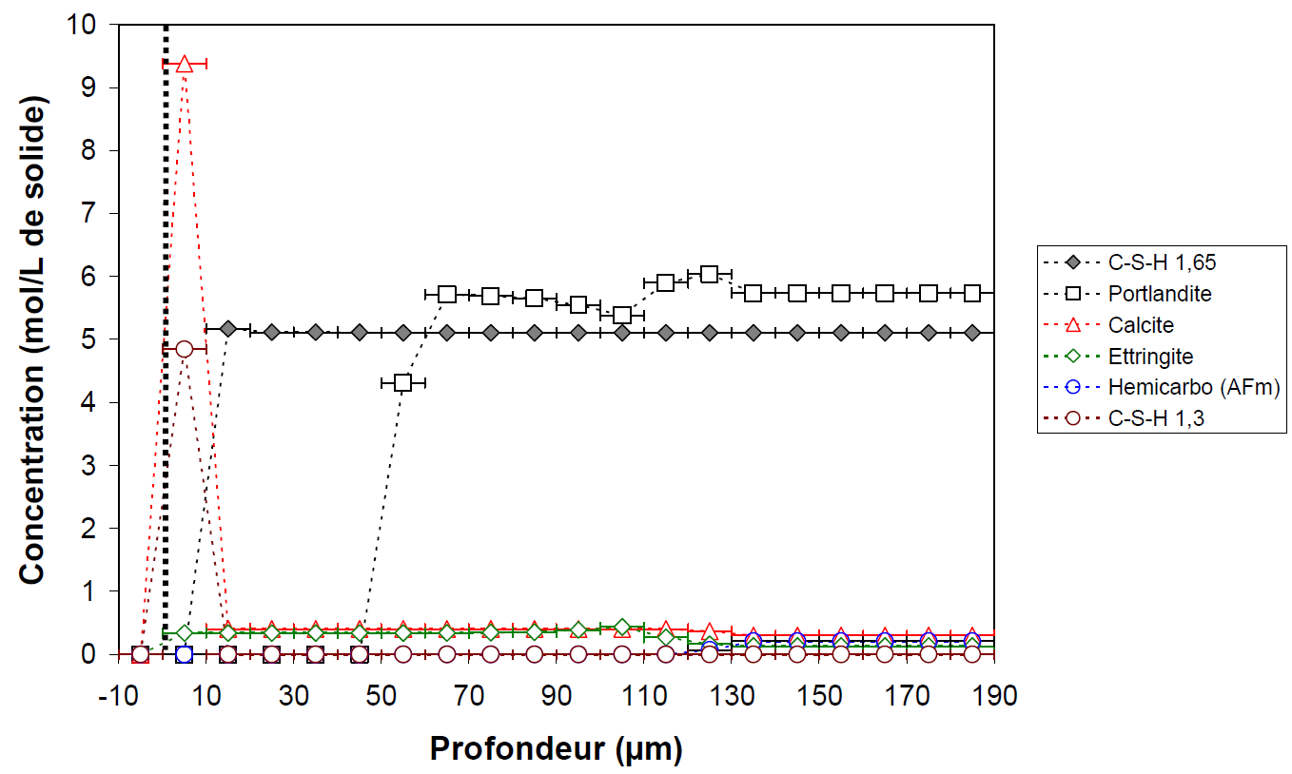
Case study : COx groundwater
Adapted from Dauzères (2010) Ph.D. Thesis
Modelling the mineralogical evolutions :
Calcite
precipitation
Modelling at 5 months
Sound core
Model in agreement with experimental results.
Portlandite
dissolution
C-S-H decalcification
(mol/l)
Ettringite precipitation
Depth (µm)

Slide 39
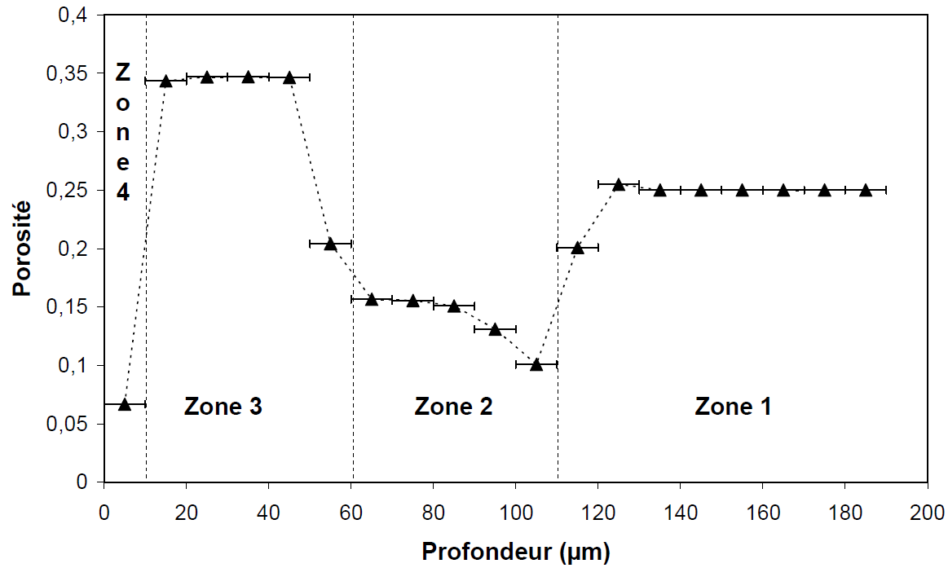
Case study : COx groundwater
Effect of chemical transformation on porosity :
j
k
l
m
CaCO₃
No Ca(OH)₂
Ettringite precipitation
Sound core
j
Dense calcite crust : low porosity (ω=0.06)
Modelling at 5 months
Competing effects : porosity opening (total dissolution of portlandite) vs. clogging (ettringite precipitation)
→ Overall, porosity opening
k
ω
l
Adapted from Dauzères (2010) Ph.D. Thesis
Ettringite precipitation : porosity clogging
m
Sound core (ω₀=0.25)
Depth (µm)

Slide 40
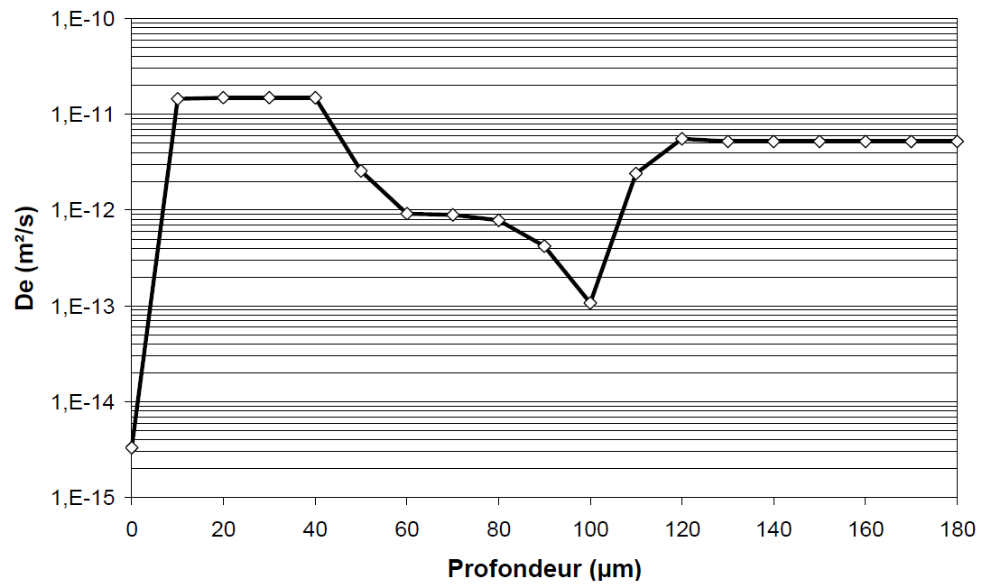
Case study : COx groundwater
Impact on ionic transport in the material :
j
k
l
m
CaCO₃
No Ca(OH)₂
Ettringite precipitation
Sound core
Using an empirical law (such as modified Archie’s law)
De(ω₀) = 6.10⁻¹²m²/s
ω₀ = 0.25
α = 3.5
Modelling at 5 months
Adapted from Dauzères (2010) Ph.D. Thesis
Depth (µm)

Slide 41
SUMMURY
Adaptive experimental set-up to test in different environments.
Control of different experimental parameters (temperature, geometry, composition of the leaching solutions) to facilitate modelling.
Identification of the fundamental mechanisms of alteration of the material.
01
Acquisition of experimental data
02
Modelling the experiment
Fitting of parameters on the experimental data :
Coefficient of diffusion,
Relation between porosity and the coefficient of diffusion,
Etc.
Ensuring the validity of the input data used for modelling (thermodynamics database, initial chemical modelling of the material)

Slide 42
Angélique ROUSSELET
angelique.rousselet@cea.fr
CEA, Paris-Saclay Centre
DES/ISAS/DRMP/S2CM/LECBA
TC Regional Workshop on Approaches to Ageing Management of Waste Packages in Storage
Joint ICTP-IAEA Workshop on Degradation Modelling of Disposed Radioactive Wasteforms
18th – 22nd September 2023, Trieste (Italy)

