Slide 1
Introduction to Atmospheric Transport Modeling
Vicky Freedman
Senior Technical Advisor
Los Alamos, NM, USA

Slide 2
Outline
Atmospheric transport processes
Atmospheric model applications
Types of atmospheric models
Atmospheric modeling demonstration

Slide 3
Atmospheric Processes

Slide 4
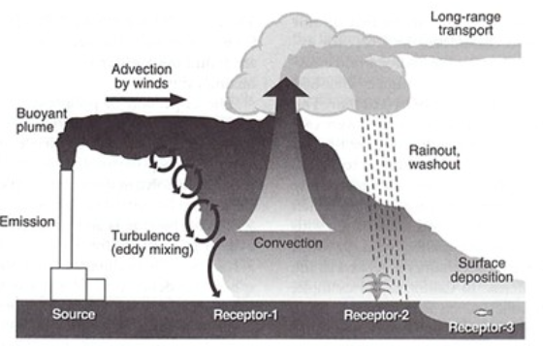
Atmospheric Transport and Dispersion
Dispersion processes
  Diffusion
  Advection
  Convection
Turbulent diffusion results in eddies
Convection is driven by buoyancy
Advection = wind

Slide 5
Wind Speed and Direction
Highest pollution levels occur in the morning
  Stable atmosphere
  Low wind speeds
  Boundary layer is shallow
Receptors most at risk or down-wind of source releases
  Prevailing wind direction is important for short-term exposures
  Long-range transport can occur over continental land masses

Slide 6
Atmospheric Stability
Class | Description
A | Extremely unstable
B | Moderately unstable
C | Slightly unstable
D | Neutral Conditions
E | Slightly Stable
F | Moderately Stable
Stability is a qualitative term describing the vertical motion of a parcel of air
Stability classification is derived from the combination of wind speed, solar radiation, and cloud cover
Vertical mixing depends on stability / turbulence

Slide 7
Atmospheric Modeling Applications

Slide 8
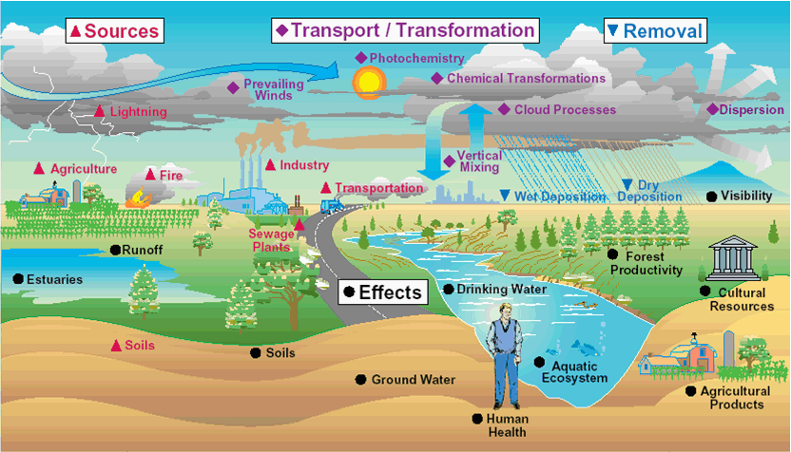
Air Quality Modeling Uses
Air quality modeling helps to estimate the relationship between sources of air pollution and their effects on ambient air quality
  Identify source contributions
  Design effective air quality strategies
Predicts impact from new or proposed emissions sources
Simulates ambient pollutant concentrations under different air quality policy scenarios
Tracks trends
Assesses compliance
Transport Pathways Conceptual Model

Slide 9
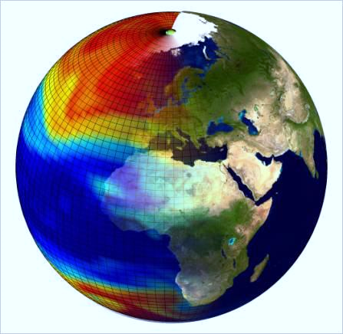
Atmospheric Transport Modeling
Mathematical representation of the conceptual model
  Sets of equations to describe and quantify contaminant transport
Atmosphere is highly reactive system with coupled biogeochemical and physical processes
  Simplified representation complex system
Models identify physical, chemical, and biological impacts at different spatial and temporal scales

Slide 10
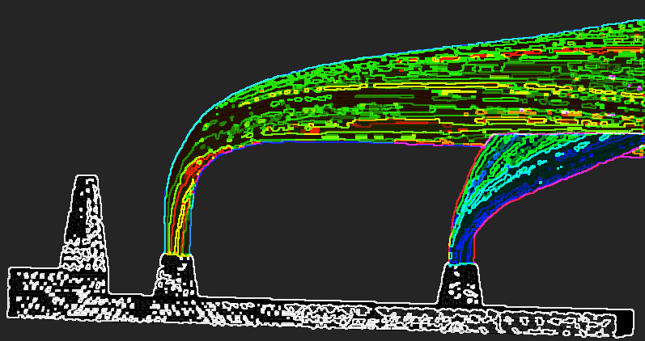
How Are Air Quality Models Used?
Estimate exposure to pollutants​
Identify current pollutant source contributions
Design effective pollution reduction strategies​
Estimate future source contributions and concentration impacts to demonstrate compliance

Slide 11
Model Classification by Objectives
Dispersion models
  Estimate pollutants at ground-level receptors (transport models)
Photochemical models
  Estimate regional air quality and account for chemical reactons
Receptor models
  Estimate contribution of multiple sources to receptor location
Screening models
  Determine if additional modeling is needed (conservative)

Slide 12
Basic Inputs
Emission Characteristics | Source Characteristics | Location Characteristics | Meteorological Characteristics
Pollutant | Source types (e.g.; point, line, area, volume) | Location (urban vs. rural | Temperature
Pollutant characteristics | Source dimensions | Terrain (simple vs. complex) | Wind speed
Distribution of source(s) | Volume emission rates | Surface roughness | Wind direction
Emission rates | Temperature | Interfaces of land & water | Atmospheric disturbance (turbulence)
 | Moisture content | Existing (background pollutant levels) | Solar radiation
 | Presence of buildings or other infrastructure |  | Cloud cover
 |  |  | Moisture

Slide 13
Types of Atmospheric Models

Slide 14
Types of Atmospheric Transport Models
Box
  Simplest forms of pollutant dispersion modelling
  Analytical solution
Gaussian
  Pollutants are emitted at continuous rate and spread is normally distributed in space
  Analytical solution of the advection-diffusion equations
  Analytical solution
Eulerian
  Fixed grid (region is divided into array of cells)
  Solution of the advection-diffusion equation using some numerical technique
Lagrangian
  Trajectory (single emission or “puffs”)
  Hypothetical air parcel concept with no explicit treatment of transport

Slide 15
Dimensionality
Box model
  Zero-dimensions where concentrations are a function of time (C(t))
Column model
  One-dimension with vertical homogeneity and concentrations are a function of height and time (C(z,t))
Two- and three-dimensional model
  Multiple dimensions used to estimate lateral and vertical mixing (C(x,y,z,t))

Slide 16
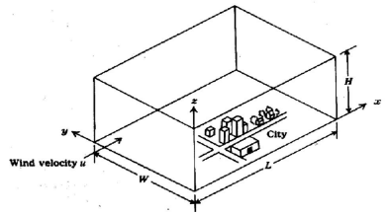
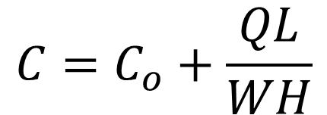
Box Models
Simple box of set dimensions
All emissions released and evenly distributed into the box
Few data inputs required
Simple but of limited accuracy
C_{o} = Initial concentration
Q = mass flux
L = length of area
W = width of area
H = height of area
U = wind velocity
$$C=C_{o}+\frac{QL}{WH}$$
Vyankatesh B et al. 2014

Slide 17
Box Model Use
Not commonly used in regulatory settings due to simplicity
Screening-level only
Retained usage in small, enclosed spaces
EKMA (Empirical Kinematic Modelling Approach)
  Mostly used for ozone-NOx-VOCs relationships in simple settings

Slide 18
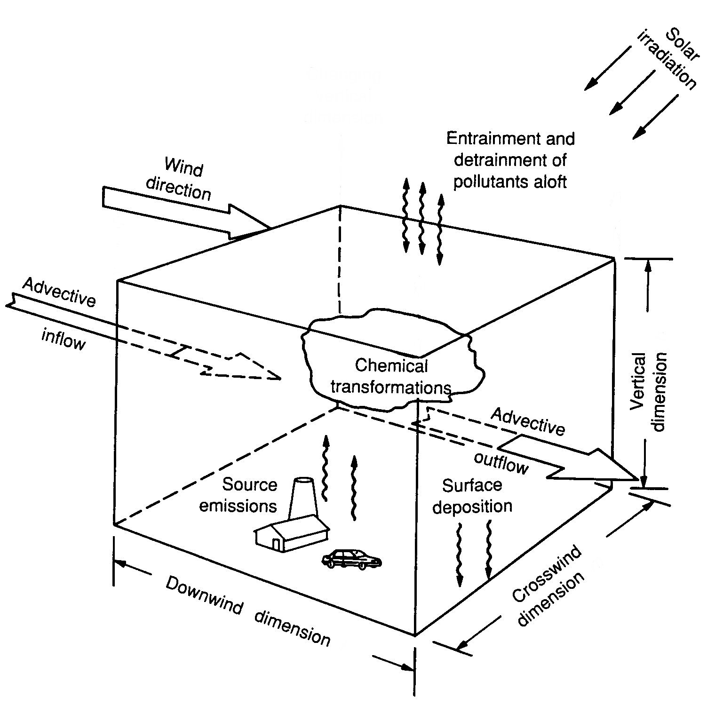
Eulerian Models
Area is divided into a number of grid cells, both horizontally and vertically
Average pollutant concentration within each cell is calculated at each time based on its previous air quality and that of adjacent grids
Accounts for meteorological conditions
Can account for removal of the constituent particles through deposition or chemical reactions
Figure from http://irina.colorado.edu/lectures/Lec29.htm

Slide 19
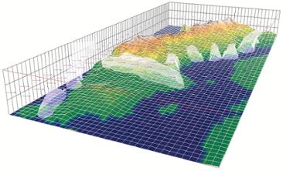
Eulerian Model Usage
Predicts species concentrations at defined points in space and time
  Atmospheric chemical reactions
  Photolysis
  Deposition
  Particle modeling & visibility
Defined geographical and temporal domain
Variable timeframes
PANACHE (https://www.fluidyn.com/)
The Air Pollution Model (TAPM)(https://www.cmar.csiro.au/research/tapm/docs/tapm_v4_user_manual.pdf)
MATCH - transport and chemistry model
https://www.smhi.se/en/research/research-departments/meteorology/match-transport-and-chemistry-model-1.6831

Slide 20
Lagrangian Models
Simulate a number of “puffs” of pollutants emitted from the source usually at regular intervals
Most common is a “Gaussian puff” model, where each puff follows a Gaussian distribution as it moves downwind and expand
Puffs are 3D elements that expand in all dimensions (x, y and z) over time
Each puff is treated independently and have varying rates of dispersion and move in various directions, allowing for more

Slide 21
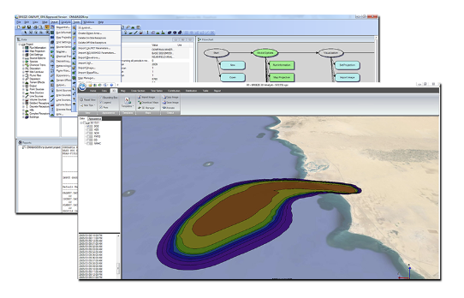
Lagrangian Usage
CALPUFF
Complex topography or flow patterns (e.g., recirculation of the pollutants)
Temporal variation in emissions or meteorology
Longer distances and timeframes (up to several years long)
Numerically efficient
Facilitates evaluation of source-receptor
CALPUFF for long-range (>80 km) atmospheric emissions
https://www.trinityconsultants.com/software/dispersion/calpuff#:~:text=CALPUFF%20is%20a%20multi%2Dlayer,effects%20and%20longer%20range%20effects.

Slide 22
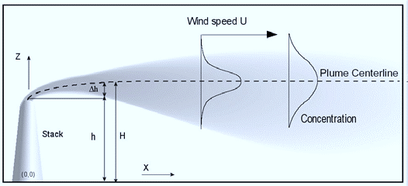
Gaussian Plume Models
Plume dispersion in lateral & horizontal planes and characterized by a Gaussian distribution
Assumptions
  Constant wind velocity
  Homogenous turbulence
  Non-reactive pollutant
  Continuous, point-pollutant source
Predicts concentrations at selected downwind receptor locations
  No chemical changes
  Concentration directly proportional to mass released
Steady-state and 2D (plume expands in y and z coordinate directions

Slide 23
Gaussian Plume Models
z
Δh = plume rise
h = stack height
Actual pattern of dispersion depends on atmospheric conditions prevailing during release
Major meteorological factors that influence dispersion of pollutants
  Atmospheric stability (& temperature)
  Mixing height
  Wind speed & direction
H = effective stack
height
¤
Δh
H = h + Δh
H
h
x
y

Slide 24
Gaussian Model Limitations
Not suitable if the pollutant is reactive in nature
Fails to comprehensively incorporate turbulence
Unable to predict concentrations beyond radius of approximately 20 km
For greater distances, wind variations, mixing depths and temporal variations become predominant

Slide 25
Sources of Error in Gaussian Models
Emissions
  Source strength
  Time variation in flux term
  Plume rise after emission
Meteorology
  Wind speed and direction variation
  Mixing depth and dispersion parameters
Physical Representation
  Sources are not points
  Actual spread is not gaussian
  Diffusivity coefficients independent of height

Slide 26
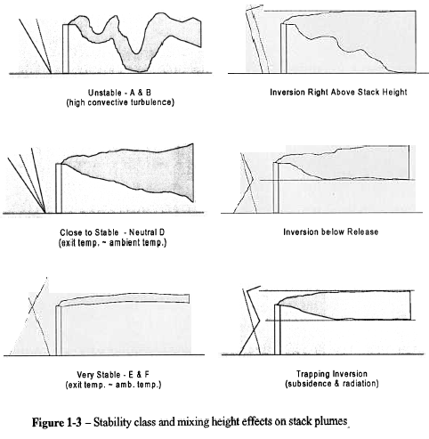
Atmospheric Effects

Slide 27
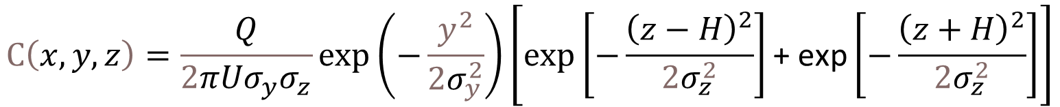
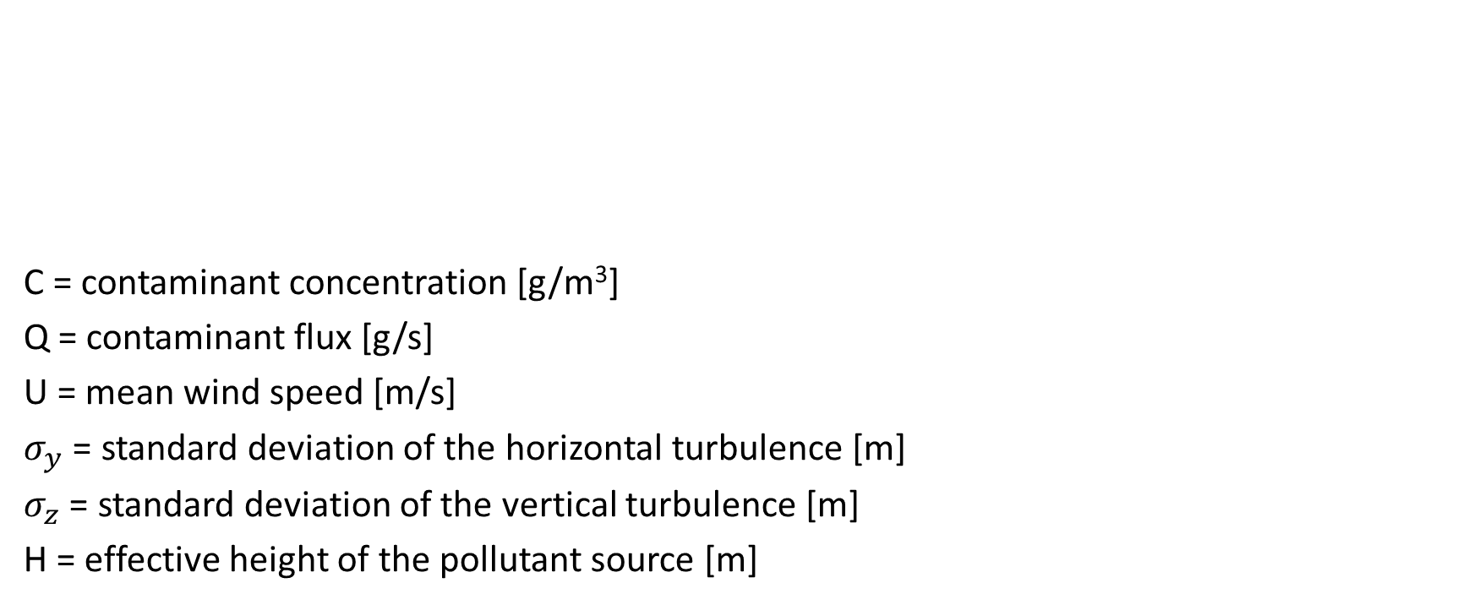
Gaussian Model
C = contaminant concentration [g/m³]
Q = contaminant flux [g/s]
U = mean wind speed [m/s]
$σ_{y}$ = standard deviation of the horizontal turbulence [m]
$σ_{z}$ = standard deviation of the vertical turbulence [m]
H = effective height of the pollutant source [m]
$$C\left(x,y,z\right)=\frac{Q}{2π{Uσ}_{y}σ_{z}}\exp\left(−\frac{y^{2}}{2σ_{y}^{2}}\right)\left[exp\left[−\frac{{\left(z−H\right)}^{2}}{2σ_{z}^{2}}\right]\text{+} \text{exp}\left[−\frac{{\left(z+H\right)}^{2}}{2σ_{z}^{2}}\right]\right]$$

Slide 28
Gaussian Usage
AERMOD
  US EPA approved
  Suitable for ground or elevated sources
  Simple and complex terrain
  Wind speed > 0
CTMDPLUS
  Complex Terrain Dispersion Model Plus Algorithms for Unstable Situations
  Also suitable for stable and neutral conditions
https://www.epa.gov/scram/air-quality-dispersion-modeling-preferred-and-recommended-models#aermod

Slide 29
Modeling Demonstration

Slide 30
1. Atmospheric Stability Class
Measure of the atmosphere tendency to cause buoyant vertical movement
Function of the atmospheric lapse rate (change in temperature with altitude)
  A plume is thermally buoyant if the lapse rate is high
  If lapse rate is low, thermal buoyancy/vertical movement is limited
Inputs
  Wind speed (m/s)
  Time of day
  Day-time insolation

Slide 31
1. Atmospheric Stability Class
Daytime insolation |  |  | Night-time conditions
Surface wind speed (m/s) | Strong | Moderate | Slight | Thin overcast or > 4/8 low cloud | <= 4/8 cloudiness*
< 2 | A | A - B | B | E | F
2 - 3 | A - B | B | C | E | F
3 - 5 | B | B - C | C | D | E
5 - 6 | C | C - D | D | D | D
> 6 | C | D | D | D | D
*Clear conditions (0/8 cloud coverage) constitute a perfectly sunny sky, while a "few" clouds (1/8 to 2/8 coverage) represent mostly sunny conditions. "Scattered" clouds (3/8 to 4/8 cloud coverage) correspond to a partly cloudy or partly sunny sky, with "broken" clouds (5/8 to 7/8 cloud coverage) describing a partly cloudy or partly sunny (5/8 coverage) to mostly cloudy (6/8 to 7/8 coverage) sky

Slide 32
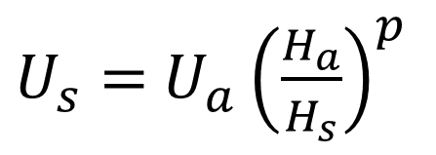
2. Wind Speed at Stack Height
$U_{s}=$ $U_{a}{\left(\frac{H_{a}}{H_{s}}\right)}^{p}$
Pasquill Stability Category | Rural Wind Profile Exponent | Urban Wind Profile Exponent | Rural Temperature Gradient | Urban Temperature Gradient
A | 0.07 | 0.15 | 0.0 | 0.0
B | 0.07 | 0.15 | 0.0 | 0.0
C | 0.10 | 0.20 | 0.0 | 0.0
D | 0.15 | 0.25 | 0.0 | 0.0
E | 0.35 | 0.30 | 0.020 | 0.020
F | 0.55 | 0.30 | 0.035 | 0.035
U_{s} = wind speed at stack height (m/s)
U_{a} = wind speed at anemometer height (m/s)
H_{a} = anemometer height (m)
H_{s} = stack height (m)
p = exponent dependent on stability class and environment classification (ISC3 1995)
ISC3 User Guide (U.S. EPA 1995

Slide 33
3. Plume Rise
Function of thermal buoyancy and momentum
Thermal buoyancy is a function of temperature and density differences between the gas emission and ambient air
Momentum is a function of the mass and velocity of the gas exiting the stack

Slide 34
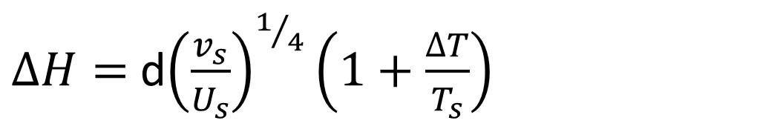

3. Plume Rise
Davidson-Bryant Equation
$∆H=$ d${\left(\frac{v_{s}}{U_{s}}\right)}^{1/4}\left(1+\frac{∆T}{T_{s}}\right)$
$∆$H = plume rise above stack (m)
d = diameter or stack (m)
v_{s} = stack gas exit velocity (m/s)
U_{s} = wind speed (m/s)
ΔT = stack gas temperature – ambient temperature (K)
T_{s} = stack gas temperature (K)

Slide 35
4. Calculate Dispersion Parameters
Dispersion is normally distributed in the lateral directions
Dispersion parameters σy and σz are the standard deviations in the y and z directions respectively
In Gaussian dispersion model, dispersion is dependent on atmospheric stability and distance downwind from the source release

Slide 36
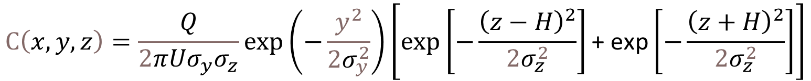
5. Calculate Downwind Concentration
Distance (Y) in m from the source release
Height (Z) in m above the ground
$$C\left(x,y,z\right)=\frac{Q}{2π{Uσ}_{y}σ_{z}}\exp\left(−\frac{y^{2}}{2σ_{y}^{2}}\right)\left[exp\left[−\frac{{\left(z−H\right)}^{2}}{2σ_{z}^{2}}\right]\text{+} \text{exp}\left[−\frac{{\left(z+H\right)}^{2}}{2σ_{z}^{2}}\right]\right]$$

Slide 37
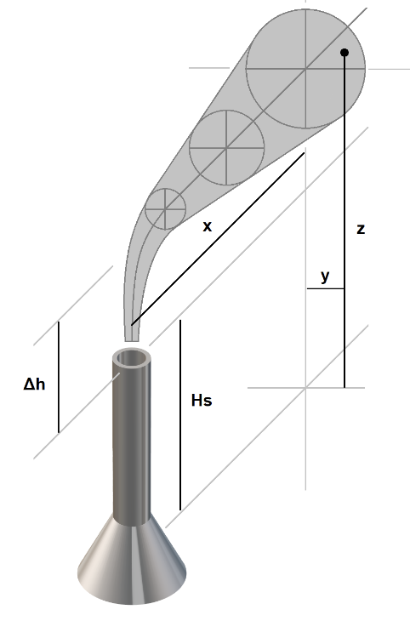
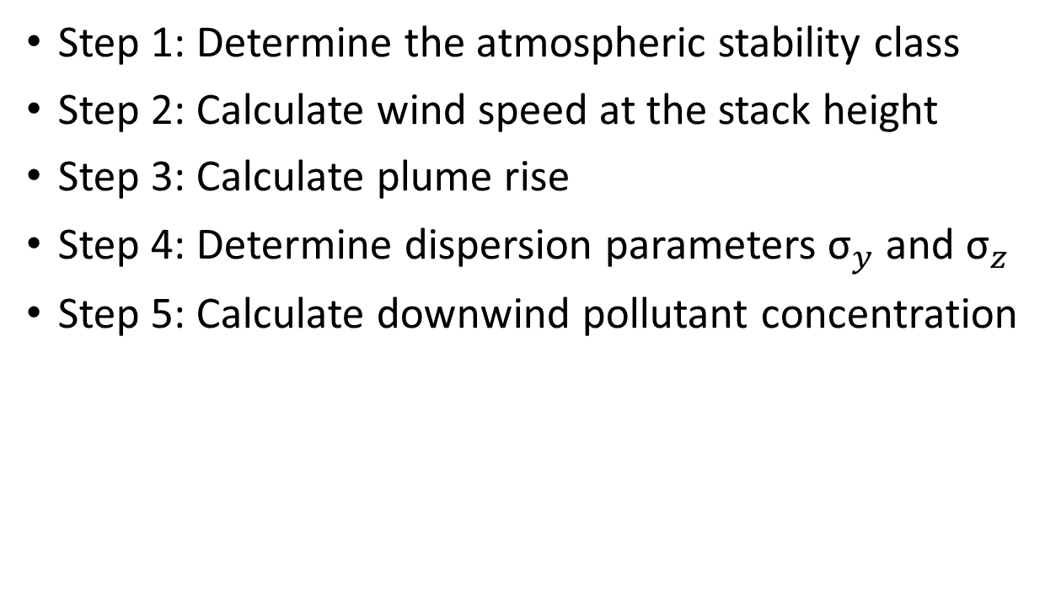
Gaussian Air Dispersion Model
Step 1: Determine the atmospheric stability class
Step 2: Calculate wind speed at the stack height
Step 3: Calculate plume rise
Step 4: Determine dispersion parameters ${\text{σ}}_{y}$ and ${\text{σ}}_{z}$
Step 5: Calculate downwind pollutant concentration
https://www.wkcgroup.com/tools-room/online-air-dispersion-model/

Slide 38
References
Martinez, J.; Maxwell, C.; Javitz, H.; Bowol, R. 1983. Evaluation of the Empirical Kinetic Modeling Approach (EKMA); NTIS: Springfield, VA.
Vyankatesh, Y, B Arjun, and Y Sonali. 2014. Prediction of Air Pollution Concentration Using a Fixed Box Model. Researcher 6(5): 89 – 92.
U.S. Environmental Protection Agency. 1995. User’s Guide for the Industrial Source Complex (ISC3) Dispersion Models, Volume 1 – User Instructions. EPA-454/B-95-003a
WKC. https://www.wkcgroup.com/tools-room/online-air-dispersion-model/

Slide 39
Gunalchéesh, Háw'aa, T’oya̱xsut ‘nüüsm

