Slide 1
1D Solute Transport

Slide 2
Contaminant (Solute) Transport Modeling
Groundwater flow
Calculates both heads and flow
Solute transport
Requires information on flow
Calculates concentrations

Slide 3
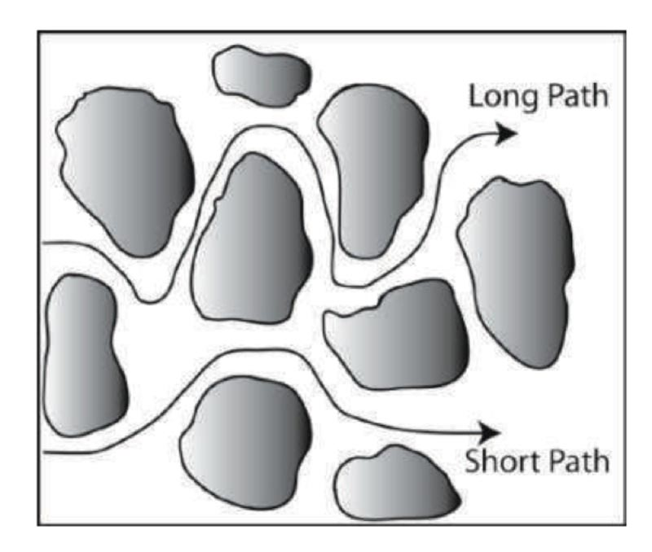
Solute Transport
Advection is the transport process where solutes flow with the bulk fluid phase (same velocity as the fluid phase)
Molecular diffusion is driven by concentration gradient
Effective diffusion in porous media is based on diffusion coefficients in water (~10⁻⁹ m²/s) and a formation factor due to a resistance to flow relative to pure water
Steefel and Maher, 2009

Slide 4
Solute Transport
Dispersion describes the mixing of a solute due to fluctuations around the average velocity
Defined as the product of the average fluid velocity and dispersivity
Longitudinal dispersivity D_{L} in the principle flow direction is typically higher than D_{T} in the direction transverse to the main flow
Dispersion is a scale-dependent process with larger dispersivity values observed at larger spatial scales
Steefel and Maher, 2009

Slide 5
Advection-Dispersion Equation (ADE)
Dispersive Transport
Advective Transport
Sink Source Mixing
Sorption, Decay, etc.
Ability of a chemical to sorb to soil particles is measured by its sorption partition coefficient, K_{D}

Slide 6
Domenico Solution
Analytical solution to the advection-dispersion partial-differential equation
Programmed into a Microsoft Excel spreadsheet
Error and complementary error functions
https://www.gov.uk/government/publications/remedial-targets-worksheet-v22a-user-manual

Slide 7
Hydraulic Parameters

Slide 8
Hydraulic Conductivity and Permeability
Permeability (k) is a measure of the properties of the medium
Hydraulic conductivity (K) is a measure of flow through a porous media that considers the properties of the medium and the fluid
K= hydraulic conductivity (L/T)
k = intrinsic permeability (L²)
ρ = density of water (M/(L³)
g = acceleration of gravity (L²/T)
μ = dynamic viscosity (M/LT)

Slide 9
Hydraulic Parameters

Slide 10
Porosity and Permeability
Porosity (n) and permeability (k) are both properties of rocks and soil
Porosity is a measurement of space between rock
Total porosity = Total void space
Effective porosity = Void space that contributes to fluid flow
May be reasonable to assume they are equal
Fine-grained sediments may have high total porosity, but lower effective porosity

Slide 11
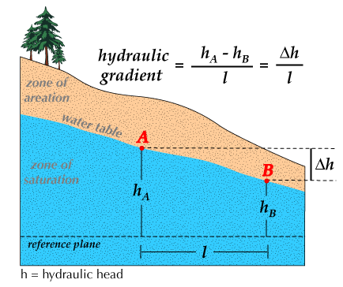
Hydraulic Gradient
Hydraulic gradient is the driving force that causes groundwater to move in the direction of maximum decreasing total head
Expressed in consistent units (L/L)

Slide 12
Groundwater Velocity (v)
Average velocity of groundwater is the Darcy equation divided by the porosity (calculated)
Velocity of conservative solute is equal to the groundwater flow velocity

Slide 13
Transport Parameters

Slide 14
Dispersivity
Longitudinal and transverse dispersivity are measure for describing the mixing processes of solutes in porous media
Scale-dependent
Transverse dispersivity assumed to be 10% of longitudinal dispersivity

Slide 15
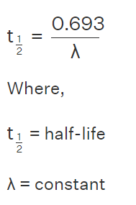
Radioactive Decay
λ is the constant of proportionality or decay constant
Dependent on the radionuclide
Database link: Decay data search (lu.se)

Slide 16
Spreadsheet Calculation

Slide 17
Domenico Solution Assumptions
1D groundwater velocity
Homogenous aquifer properties
Finite source
Steady state source
Longitudinal and transverse dispersion
Sorption – contaminant is retarded relative to groundwater flow
Radioactive decay
Molecular diffusion is neglible (due to concentration gradient)

Slide 18
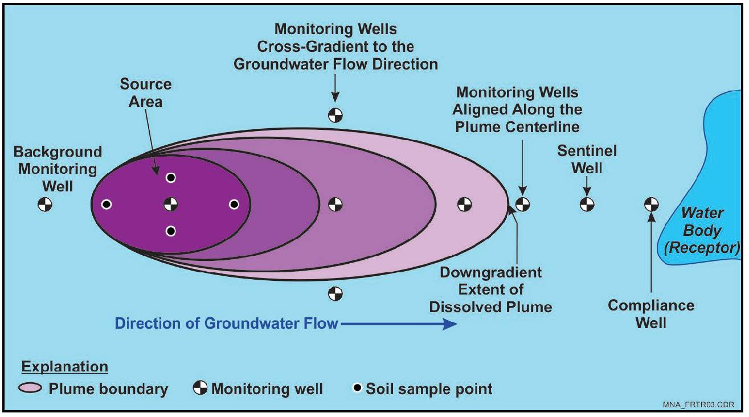
Domenico Solution Output
Estimated concentration along centerline
Measured concentration must be along centerline of plume
https://frtr.gov/matrix/Monitored-Natural-Attenuation/

Slide 19
Calibration and Sensitivity Analyses
Calibrate to output by adjusting input parameters
Execute sensitivity analysis to identify model sensitivities and assess impacts of uncertainty in parameters

Slide 20
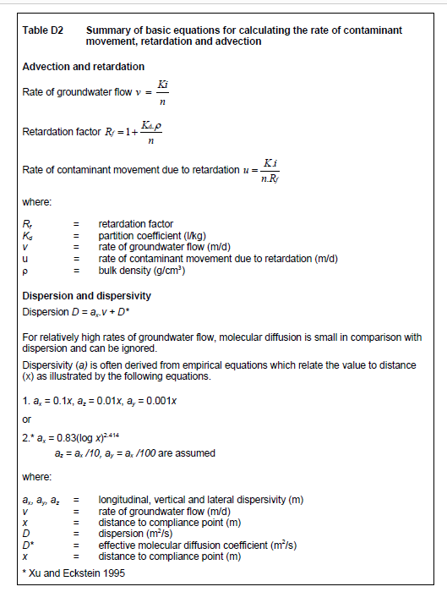
Domenico Solution
p. 109, Remedial Targets Methodology

Slide 22
Gunalchéesh, Háw'aa, T’oya̱xsut ‘nüüsm

