Slide 1
Cement Chemistry Modelling
Angélique ROUSSELET
French Alternative Energies and Atomic Energy Commission (CEA), Paris-Saclay Centre
TC Regional Workshop on Approaches to Ageing Management of Waste Packages in Storage
Joint ICTP-IAEA Workshop on Degradation Modelling of Disposed Radioactive Wasteforms
18th – 22nd September 2023, Trieste (Italy)

Slide 2
INTRODUCTION
Modelling the chemistry of cement materials:
Two approaches:
Microstructure modelling
Thermodynamic modelling
Both approaches can require some input data which can be calculated:
Degree of hydration of cement
Alkali concentrations and pH of the pore solution

Slide 3
CONTENT
Input parameters
Degree of hydration
Alkali concentrations and pH
Microstructure modelling of the cement paste
Powers & Brownyard model
Jennings & Tennis model
Thermodynamic modelling
Equilibrium constant method
Gibbs energy minimization
Long-term behaviour of cement materials

Slide 4
Input parameters
1

Slide 5
INPUT PARAMETERS
Calculating the degree of hydration
Degree of hydration = weight fraction of cement and individual clinker phases which have fully reacted at a given time.
Two common kinetic models are available for cement materials:
Use of an Avrami type equation
Parrott & Killoh model of hydration
Both models rely on empirical data.

Slide 6
INPUT PARAMETERS
Avrami type equation
$$F=1−exp\left(−k_{2}{(t−k_{3})}^{k_{1}}\right)$$
The equation describes how solids transform from one phase into another at constant temperature.
It’s use for Portland cement was introduced by Dalziel & Gutteridge (1986).
Fraction of reacted phase, F, is a function of time, t.
Parameters $k_{1}$, $k_{2}$ and $k_{3}$ are fitted on a set of experimental data.

Slide 7
INPUT PARAMETERS
Parrott & Killoh model
A set of empirical equations is used to describe the different mechanisms involved in hydration:
Degree of hydration:
Rate of nucleation and growth:
Rate of diffusion:
Rate of secondary shell formation:
$$α(t)=α(t−1)×∆t×R(t−1)$$
$$R\left(t\right)=\frac{K_{1}}{N_{1}}×(1−α(t))×{(−\ln\left(1−α(t)\right))}^{(1−N_{1})}$$
$$R\left(t\right)=K_{2}×\frac{{(1−α(t))}^{2/3}}{1−{(1−α(t))}^{1/3}}$$
$$R\left(t\right)=K_{3}×{(1−α(t))}^{N_{3}}$$
At each time step t, the lowest value of R (controlling rate) is selected for the calculation of $α$.

Slide 8
INPUT PARAMETERS
Parrott & Killoh model
A critical value of degree of hydration is introduced in order to translate the observation that the rate of hydration is reduces at later ages and for materials of low $w_{0}/c_{0}$.
Critical degree of hydration :
If
If
$$α_{crit}=1.333×w_{0}/c_{0}$$
$${α_{tot}>α}_{crit} , then α\left(t\right)=α\left(t−1\right)+∆t×R(t−1)×{\left(1+4.444{×w}_{0}/c_{0}−3.333α(t−1)\right)}^{4}$$
$${α_{tot}<α}_{crit} , then α\left(t\right)=α\left(t−1\right)+∆t×R(t−1)$$
The impact of the relative humidity is also taken into account using the following factor :
$${\left(\frac{rh−0.55}{0.45}\right)}^{4}$$

Slide 9
INPUT PARAMETERS
Parrott & Killoh model
Empirical constants for Portland cement at ambient temperature for each clinker phases:
 | K₁ | N₁ | K₂ | K₃ | N₃
C3S | 1,5 | 0,7 | 0,05 | 1,1 | ,3,
C2S | 0,5 | 1,0 | 0,006 | 0,2 | 5,0
C3A | 1,0 | 0,85 | 0,04 | 1,0 | 3,2
C4AF | 0,37 | 0,7 | 0,015 | 0,4 | 3,7
Parrott & Killoh (1986)

Slide 10
INPUT PARAMETERS
Alkali concentrations and pH
The model was developed for Portland cement (Taylor, 1987).
It relies on empirical data and takes into account the sorption of alkalis by cement hydrates.
Inputs :
Initial water to cement ratio ($w_{0}/c_{0}$)
Global degree of hydration
Experimental of calculated
Outputs :
Alkali and hydroxyl concentrations in pore solution
pH of the pore solution

Slide 11
INPUT PARAMETERS
Alkali concentrations and pH
Quantity of alkalis released by the cement
$$n_{released}=n_{pore solution}+n_{sorbed}$$
Quantity of alkalis released by the cement
𝑛_𝑟𝑒𝑙𝑒𝑎𝑠𝑒𝑑=𝑛_(𝑝𝑜𝑟𝑒 𝑠𝑜𝑙𝑢𝑡𝑖𝑜𝑛)+𝑛_𝑠𝑜𝑟𝑏𝑒𝑑
Alkalis in the pore solution
$$n_{pore solution}=C×V_{pore solution}$$
Alkalis in the pore solution
𝑛_(𝑝𝑜𝑟𝑒 𝑠𝑜𝑙𝑢𝑡𝑖𝑜𝑛)=𝐶×𝑉_(𝑝𝑜𝑟𝑒 𝑠𝑜𝑙𝑢𝑡𝑖𝑜𝑛)
Alkalis taken up by cement hydrates
$$n_{sorbed}=b×P×C$$
Alkalis taken up by cement hydrates
𝑛_𝑠𝑜𝑟𝑏𝑒𝑑=𝑏×𝑃×𝐶
$$V_{pore solution}= V_{initial water}−V_{reacted water}$$
The volume of reacted water is fitted empirically.
𝑉_(𝑝𝑜𝑟𝑒 𝑠𝑜𝑙𝑢𝑡𝑖𝑜𝑛)= 𝑉_(𝑖𝑛𝑖𝑡𝑖𝑎𝑙 𝑤𝑎𝑡𝑒𝑟)−𝑉_(𝑟𝑒𝑎𝑐𝑡𝑒𝑑 𝑤𝑎𝑡𝑒𝑟)
The volume of reacted water is fitted empirically.
1/ Binding factors, b, are determined empirically.
2/ The ratio of relevant hydration products, P, is fitted empirically.

Slide 12
INPUT PARAMETERS
Alkali concentrations and pH
Alkalis are present in the clinker in:
Sulphate phases
These alkalis are considered readily soluble.
By default, assumption that 35% of the total Na₂O content and 70% of the total K₂O content.
Hydraulic phases
By default, a distribution of alkalis typical of Portland clinker is assumed.
Hydration degree is applied to each hydraulic phases.
Distribution of alkalis in the hydraulic phases of a Portland clinker provided by Taylor.
Weight fractions | Na₂O | K₂O
C3S | 0.44 | 0.29
C2S | 0.17 | 0.41
C3A | 0.36 | 0.27
C4AF | 0.03 | 0.03
Total | 1 | 1
Taylor (1987) Adv.Cem.Res., 1:5-17.

Slide 13
INPUT PARAMETERS
Alkali concentrations and pH
The empirical equation of Dalziel & Gutteridge (1986) is employed to determine the degree of reaction of hydraulic phases.
The D&G equation is also employed to fit the weight fraction of reacted water ($V_{pore solution})$ and the quantity of hydrates relevant for alkali sorption ($P$).
 | k₁ | k₂ | k₃
Reacted water | 0.25 | 0.69 | 0.90
P | 0.25 | 0.56 | 0.90
Taylor (1987) Adv.Cem.Res., 1:5-17.

Slide 14
INPUT PARAMETERS
Alkali concentrations and pH
Following other empirical equations, a value of pH can be determined :
$$\left[{SO}_{4}^{2−}\right]=0.06×{\left(\left[K^{+}\right]+\left[{Na}^{+}\right]\right)}^{2}$$
$$\left[{OH}^{−}\right]=\left[K^{+}\right]+\left[{Na}^{+}\right]−2×\left[{SO}_{4}^{2−}\right]$$
$$pH=14+log⁡\left(\left[{OH}^{−}\right]\right)$$
Caution : the empirical parameters were fitted for an average Portland cement
C3S (60 wt%), C2S (15 wt%), C3A (8 wt%), C4AF (10 wt%)

Slide 15
Microstructure modelling
2

Slide 16
MICROSTRUCTURE MODELLING
Microstructure models are volumetric models.
Principle : cement hydrates can only form if they have enough space to do so.
Several models have been developed after the pioneer work of Powers.
Different models :
Simplified Powers (requires minimal input parameters)
Extensive Powers
Jennings & Tennis

Slide 17
MICROSTRUCTURE MODELLING
Fundamentals of the Powers & Brownyard model
cp
cp
The initial volume of water (w₀) and cement (c₀) is equal to the volume of the hardened cement paste (hcp).
The hardened cement paste is constituted of :
Unreacted cement (unreact)
Hydration products (hp)
Contain hydrates and gel porosity
Capillary space (cp)
Gel por.
Total por.
W₀
Hydrated products
Hydrates
Hydrates
C₀
unreact
t=0
Hardened cement paste

Slide 18
MICROSTRUCTURE MODELLING
Fundamentals of the Powers & Brownyard model
Model based on extensive experimental work on the quantification of water:
Evaporable
water
Free water in capillary space
Gel water retained by hydrated products
Non evaporable water
Water chemically bound within cement hydrates
Water retained after P-drying.
Water only removed by ignition.
Constitute a measure of degree of hydration
Water removed by P-drying
Adsorption
isotherms

Slide 19
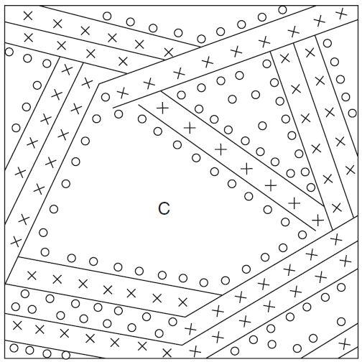
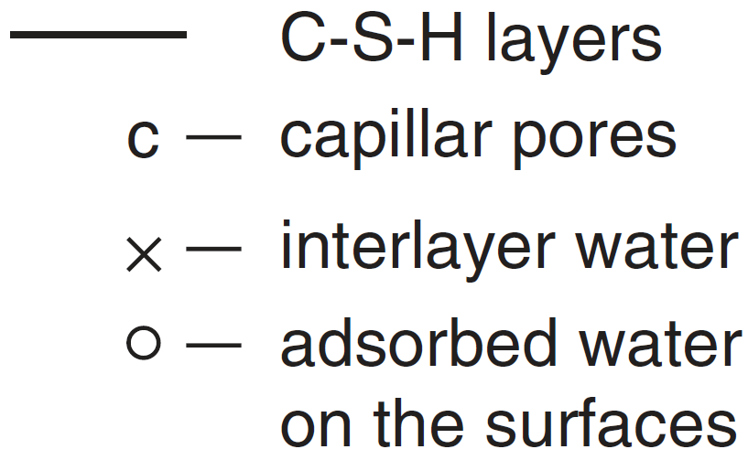
MICROSTRUCTURE MODELLING
Fundamentals of the Powers & Brownyard model
Hydrated products:
Individual hydrates (CH, C-S-H, AFm, AFt, etc.) are not considered.
Include hydrates (h) and gel porosity (gp).
Gel porosity or gel water is mostly due to the properties of the C-S-H phase :
Non chemically bound water adsorbed on C-S-H or contained in the (nano)porosity of C-S-H.
Kurdowski (2014) Cement & Concrete Chemistry, ISBN 978-94-007-7944-0.

Slide 20
MICROSTRUCTURE MODELLING
Fundamentals of the Powers & Brownyard model
Unreacted cement:
Depends on the degree of hydration of the cement.
In Powers’ original work, the degree of hydration considered was determined experimentally, but it can also be calculated.
Capillary space:
Remnant of the initially water-filled space:
Unreacted water (free water) present in the paste porosity,
Chemical shrinkage.

Slide 21
MICROSTRUCTURE MODELLING
Simplified Powers
Developed and applicable only for Portland cement.
Inputs :
Initial water to cement ratio ($w_{0}/c_{0}$)
Global degree of hydration
Outputs :
Volume of hydrated products and gel porosity
Volume of capillary space (& total porosity)

Slide 22
MICROSTRUCTURE MODELLING
Simplified Powers
Volume of hardened cement paste
$V_{hcp}=\frac{1}{ρ_{c}}+\frac{w_{0}}{c_{0}}×\frac{1}{ρ_{w}}$ = 0.317$+ \frac{w_{0}}{c_{0}}$
$ρ_{c}=$ 3.15 kg/l
Volume of unreacted cement
$V_{unreact}=\frac{1−α}{ρ_{c}}$ = 0.317 ($1−α$)

Slide 23
MICROSTRUCTURE MODELLING
Simplified Powers
Evaporable water as a function of total water content for different pastes (different $w_{0}/c_{0}$ and curing time) in saturated conditions.
Break at $w_{tot}/c_{0}=0.44$ ($w_{0}/c_{0}=0.38$ )
$w_{0}/c_{0}>0.38$ : the paste has reached maximum hydration
0,38 is therefore a critical value later referred to as (w/c)*
$${w_{evap}}/{c_{0}}=0.482×{w_{tot}}/{c_{0}}$$
$${w_{evap}}/{c_{0}}={w_{tot}}/{c_{0}}−0.227$$

Slide 24
MICROSTRUCTURE MODELLING
Simplified Powers
Volume of hydration products
$V_{hp}=α\left(\frac{1}{ρ_{c}}+{\left(\frac{w}{c}\right)}^{∗}×\frac{1}{ρ_{w}}\right)$ = 0.697 $α$
Capillary space
Gel por.
Volume of gel porosity experimentally determined to be 28% of the volume of hydrated products:
Hydrates
$$V_{gp}=0.28×V_{hp}$$
Unreacted cement
Volume of capillary space
$$V_{cp}=V_{hcp}−V_{hp}−V_{unreact}$$

Slide 25
MICROSTRUCTURE MODELLING
Extensive Powers
Distinction between the volume of free water and the volume left due to chemical shrinkage:
Cp = fw + shr
Inputs :
Cement composition
Initial water to cement ratio ($w_{0}/c_{0}$)
Global degree of hydration
Outputs :
Volume of hydrated products and gel porosity
Volume of capillary space
Chemical shrinkage

Slide 26
MICROSTRUCTURE MODELLING
Extensive Powers
Shr.
Cap. Vol.
The change of volume due to hydration is taken into account via the densities of reacted water.
Density of non evaporable water ($ρ_{ne}$) and gel water ($ρ_{gp}$) are lower than 1.
Quantities of non evaporable and gel water were experimentally fitted to the composition of the clinkers.
fw
W₀
Gel por.
Hydrated products
Hydrated cement
C₀
C
t=0
Hardened cement paste

Slide 27
MICROSTRUCTURE MODELLING
Extensive Powers
Volume of hydrated products
Weight fractions of non evaporable and gel water:
$$V_{hp}=\frac{αc_{0}}{ρ_{C}}+\frac{w_{ne}}{ρ_{ne}}+\frac{w_{gp}}{ρ_{gp}}$$
$$\frac{w_{ne}}{c}=0.187x_{C3S}+0.158x_{C2S}+0.665x_{C3A}$$
$$+0.213x_{C4AF}$$
$ρ_{ne}$ & $ρ_{gp}$ are determined experimentally.
$$\frac{w_{gp}}{c}=0.147x_{C3S}+0.216x_{C2S}+0.745x_{C3A}$$
$$+0.258x_{C4AF}+0.261x_{C\overline{S}}$$
$$ρ_{ne}≠ρ_{gp}≠ρ_{w}$$
$$ρ_{ne}=1.39 kg/l$$
$x_{n}$ : weight fraction of phases in the clinker
$w_{n}$ : weight of reacted water
$c$ : weight of reacted cement
$$ρ_{gp}=1.11 kg/l$$
$$ρ_{w}=1.00 kg/l$$

Slide 28
MICROSTRUCTURE MODELLING
Extensive Powers
Shr.
Volume of free water
Free water
$$V_{fw}=w_{0}−\frac{w_{ne}}{ρ_{ne}}−\frac{w_{gp}}{ρ_{gp}}$$
Gel por.
Hydrates
Volume due to shrinkage
Unreacted cement
$$V_{Shr}=V_{0}−V_{hp}−V_{unreact}−V_{fw}$$

Slide 29
MICROSTRUCTURE MODELLING
Jennings & Tennis
Access to the volume fractions of individual hydrates.
Inputs :
Initial water to cement ratio ($w_{0}/c_{0}$)
Degrees of hydration of individual phases
Cement composition
Outputs :
Volume of C-S-H, C-S-H gel porosity, CH and AFm
Volume of capillary space (& total porosity)

Slide 30
MICROSTRUCTURE MODELLING
Jennings & Tennis
Calculates the volumes of individual hydrates using a set of chemical reactions:
Hydration of calcium silicate phases
$$C3S+5,3H→C−S−H+1,3CH$$
$$C−S−H=C1.7SH4$$
$$C2S+4,3H→C−S−H+0,3CH$$
Hydration of aluminate and ferrite phases
$$C3A+12H+C\overline{S}H2→C4\overline{S}H14$$
The model assimilates the AFt phase to the AFm phase because of their similar densities (1,77 and 1,99 respectively).
(AFm)
$$3C4AF+110H+12C\overline{S}H2→4C6\left(A,F\right)\overline{S}H32+2\left(A,F\right)H3$$
(AFt)

Slide 31
MICROSTRUCTURE MODELLING
Jennings & Tennis
Volume of portlandite (CH):
$$V_{CH}=ν_{CH}^{C3S}\frac{M_{CH}}{ρ_{CH}M_{C3S}}×α_{C3S}c_{0}\frac{{wt\%}_{C3S}}{100}+ν_{CH}^{C2S}\frac{M_{CH}}{ρ_{CH}M_{C2S}}×α_{C2S}c_{0}\frac{{wt\%}_{C2S}}{100}$$
$$where$$
$$ν_{CH}^{C3S}and ν_{CH}^{C2S}are the stoechiometric coefficients of CH formation by hydration of$$
$C3S and C2S respectively (i.e$ 1.3 and 0.3)
$M_{i}$ are the molecular weight of compounds i
$ρ_{i}$are the specific weight of compounds i
$α_{i}$ are the individual degree of hydration of phase i
${wt\%}_{i}$ are the weight percentage of compounds i in the cement

Slide 32
MICROSTRUCTURE MODELLING
Jennings & Tennis
Volume of AFm:
Volume of C-S-H (excluding gel porosity):
$$V_{AFm}=ν_{AFm}^{C3A}\frac{M_{AFm}}{ρ_{AFm}M_{C3A}}×α_{C3A}c_{0}\frac{{wt\%}_{C3A}}{100}+ν_{AFm}^{C4AF}\frac{M_{AFm}}{ρ_{AFm}M_{C4AF}}×α_{C4AF}c_{0}\frac{{wt\%}_{C4AF}}{100}$$
$$V_{CSH,dry}=ν_{CSH}^{C3S}\frac{M_{CSH,dry}}{ρ_{CSH,dry}M_{C3S}}×α_{C3S}c_{0}\frac{{wt\%}_{C3S}}{100}+ ν_{CSH}^{C2S}\frac{M_{CSH,dry}}{ρ_{CSH,dry}M_{C2S}}×α_{C2S}c_{0}\frac{{wt\%}_{C2S}}{100}$$

Slide 33
MICROSTRUCTURE MODELLING
Jennings & Tennis
Capillary space :
Calculated by taking into account the increase of volume of each anhydrous phases due hydration.
Increase of volume, $∆_{i}$, is calculated based on the hydration reactions.
Phases | $∆$ (cm³/g)
C3S | 0.437
C2S | 0.503
C3A | 0.397
C4AF | 0.136
$$V_{cp}=V_{w0}−\sum_{i}{α_{i}c_{0}\frac{{wt\%}_{i}}{100}∆_{i}}$$
Gel porosity:
Based on new experimental data on C-S-H.
$$V_{gp}={0,219 V}_{CSH,dry}$$

Slide 34
MICROSTRUCTURE MODELLING
Jennings & Tennis
Output
Capillary
volume
Gel por.
CSH
AFm
Unreacted cement
CH

Slide 35
Thermodynamic modelling
3

Slide 36
THERMODYNAMIC MODELLING
Two approaches are available to compute the thermodynamic equilibrium of a system
Resolution of mass action equations : “equilibrium constant method”
Geochemical codes : PHREEQC (freeware), EQ3/6 (freeware), CHESS, MINTEQ (freeware).
Minimization of the Gibbs free energy of the system
Geochemical codes: GEMS (freeware), web application CemGEMS (free)
Both approaches lead to similar results but require different inputs:
No a priori assumptions on the phase assemblage and pH of the pore solution is needed with the minimization of the Gibbs free energy.

Slide 37
THERMODYNAMIC MODELLING
Two approaches are available to compute the thermodynamic equilibrium of a system
Both approaches rely on the same thermodynamic data :
$$∆_{r}G^{0}=−RTln(K)$$
$${where ∆}_{r}G^{0} is Gibbs free energy of the reaction$$
$$K is the thermodynamic constant of equilibrium of the reaction$$
$$T is the temperature$$
$$R is the gas constant$$
Relies on an extensive set of thermodynamic data for solid, liquid and gaseous phases.

Slide 38
THERMODYNAMIC MODELLING
Thermodynamic database
Must be as complete and as accurate as possible.
Exemple : Thermoddem database (thermoddem.brgm.fr)
Thermodynamic constant K (solubility)
Temperature dependence of K

Slide 39
THERMODYNAMIC MODELLING
Thermodynamic database
Exemple of species needed in the database for atmospheric carbonation of portlandite:
Must be as complete and as accurate as possible.
Aqueous species to consider:
Exemple : Thermoddem database (thermoddem.brgm.fr)
Gaseous species to consider:

Slide 40
THERMODYNAMIC MODELLING
Equilibrium constant method
Requires a priori knowledge of the conditions (pH of equilibrium) and final phase assemblage.
Example : Determination of the phase assemblage of a Portland cement with CHESS using the thermoddem database.
Without exclusions to the database
With exclusions to the database
Jaffeite (calcium silicate hydroxide)
Calcite
Monocarboaluminate
Jennite (crystalline C-S-H)
Ettringite
Clinochlore (chlorite)
Portlandite
Calcite
Monocarboaluminate
C1.6SH
Ettringite
Hydrotalcite

Slide 41
THERMODYNAMIC MODELLING
Equilibrium constant method
Modelling the phase assemblage of a Portland cement paste with Vminteq 4.0
Inputs:
Ca²⁺, H₄SiO₄, Al³⁺, SO₄²⁻, CO₃⁻ concentrations calculated from cement composition and its degree of hydration.
Na⁺, K⁺, pH calculated
Selection of possible phases allowed to precipitate
Outputs:

Slide 42
THERMODYNAMIC MODELLING
Results expressed as volume of minerals per volume of cement material:
Equilibrium constant method
Modelling the phase assemblage of a Portland cement paste with Vminteq 4.0
 | Volume (%)
Unreacted cement | 8.3
C1.6SH | 36.5
Portlandite | 18.4
Ettringite | 4.0
Monocarboaluminate | 3.9
Hydrotalcite | 1.3
Calcite | 1.0
Porosity | 26.6
Outputs:

Slide 43
THERMODYNAMIC MODELLING
GEMS approach
Modelling with CemGEMS web application (https://cemgems.org/)
Outputs :
Phase assemblage (C-S-H, CH, AFm, AFt, etc.)
Porosity
Composition of the pore solution
Kinetics of hydration
Inputs:
Detailed cement composition.

Slide 44
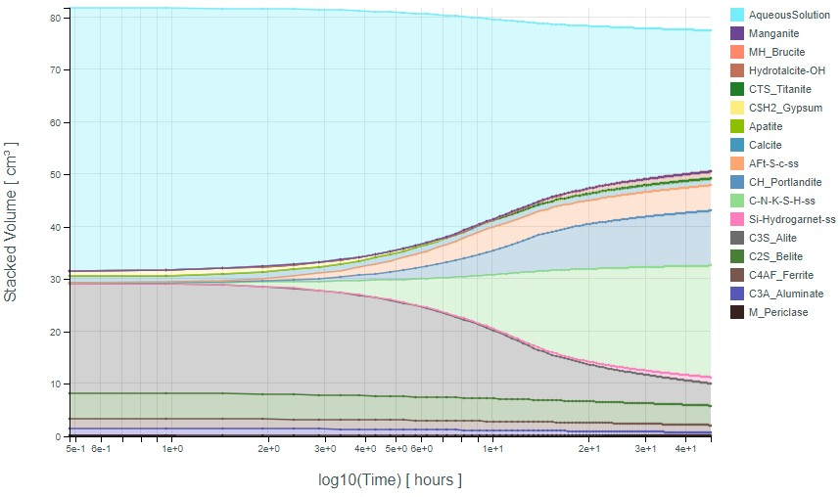
THERMODYNAMIC MODELLING
Results expressed as volume of minerals per volume of cement material:
GEMS approach
Modelling with CEMGEMS web application
 | Volume (%)
Unreacted cement | 7.7
C1.6SH | 32.4
Portlandite | 16.3
Ettringite | 6.8
Monocarboaluminate | 0.6
Hydrotalcite | 2.4
Calcite | 1.5
Porosity | 29.0
Pore water
AFt
CH
C-S-H
C3S
C2S

Slide 45
THERMODYNAMIC MODELLING
Modelling long-term behaviour of waste forms and packages
Two approaches:
Mixing tank:
Evolution with time of the total quantities of hydrated cement and encapsulated waste.
No spatial resolution
Reactive transport modelling:
Spatial resolution
Hydrodynamic processes are accounted for (diffusion, advection)

Slide 46
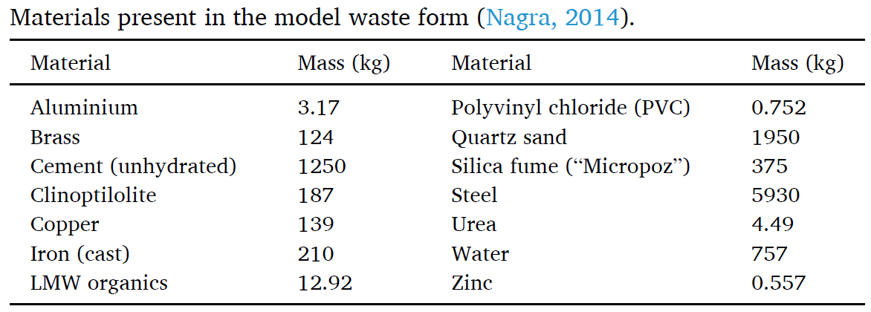
THERMODYNAMIC MODELLING
Mixing tank approach
Waste form from decommissioning of nuclear power plant was chosen as a model waste form.
Composition:
Cement + Water + Additions (silica fumes, clinoptilolite) + Sand (quartz)
Organic waste
Metallic waste
Wieland et al. (2020) Appl.Geochem., 115:104539.

Slide 47
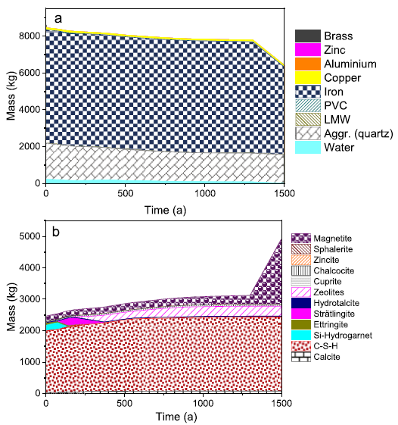
THERMODYNAMIC MODELLING
Mixing tank approach
Kinetics laws are used to model:
Degradation of organic matter (gas production and aqueous product of degradation)
Metal corrosion
Dissolution of quartz sand for neutral and alkaline conditions
Thermodynamic calculations to model chemical evolutions due to the degradation of waste.
Wieland et al. (2020) Appl.Geochem., 115:104539.

Slide 48
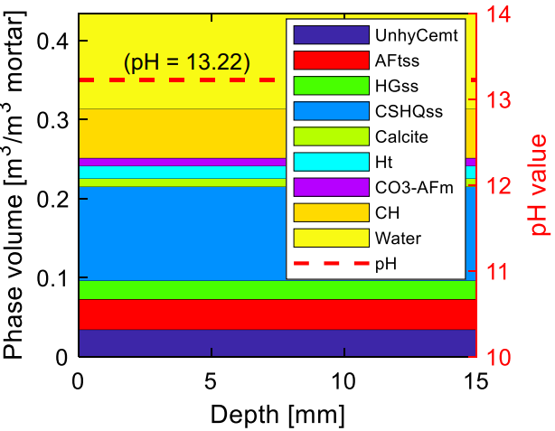
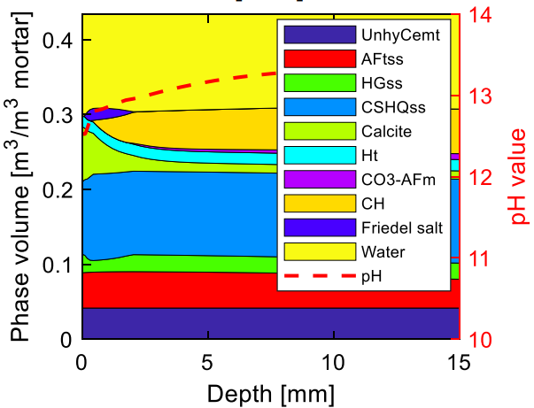
THERMODYNAMIC MODELLING
Reactive transport modelling
Spatial resolution.
Hydrodynamic processes (diffusion, dispersion and permeability of the material, advection).
Chloride ingress within a Portland cement mortar at 180d.
Sharmilan et al. (2022) Cem.Concr.Res., 159:106861.

Slide 49
Angélique ROUSSELET
angelique.rousselet@cea.fr
CEA, Paris-Saclay Centre
DES/ISAS/DRMP/S2CM/LECBA
TC Regional Workshop on Approaches to Ageing Management of Waste Packages in Storage
Joint ICTP-IAEA Workshop on Degradation Modelling of Disposed Radioactive Wasteforms
18th – 22nd September 2023, Trieste (Italy)

