Slide 1

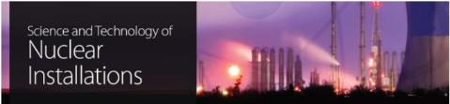
Case Studies: Waste Form Ageing and Degradation (Field Tests)
Michael I. Ojovan,
Immobilisation Science Laboratory,
Department of Materials Science and Engineering, The University of Sheffield, UK
Department of Materials, Imperial College London, UK

Slide 2
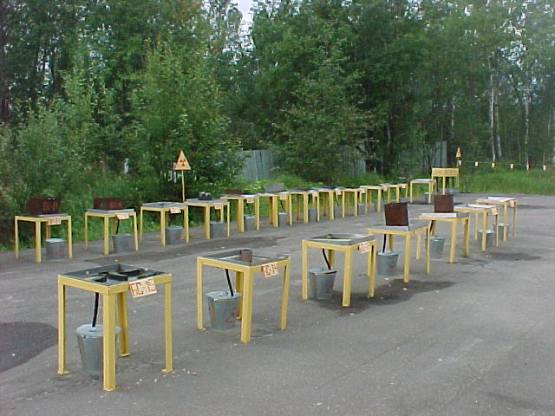
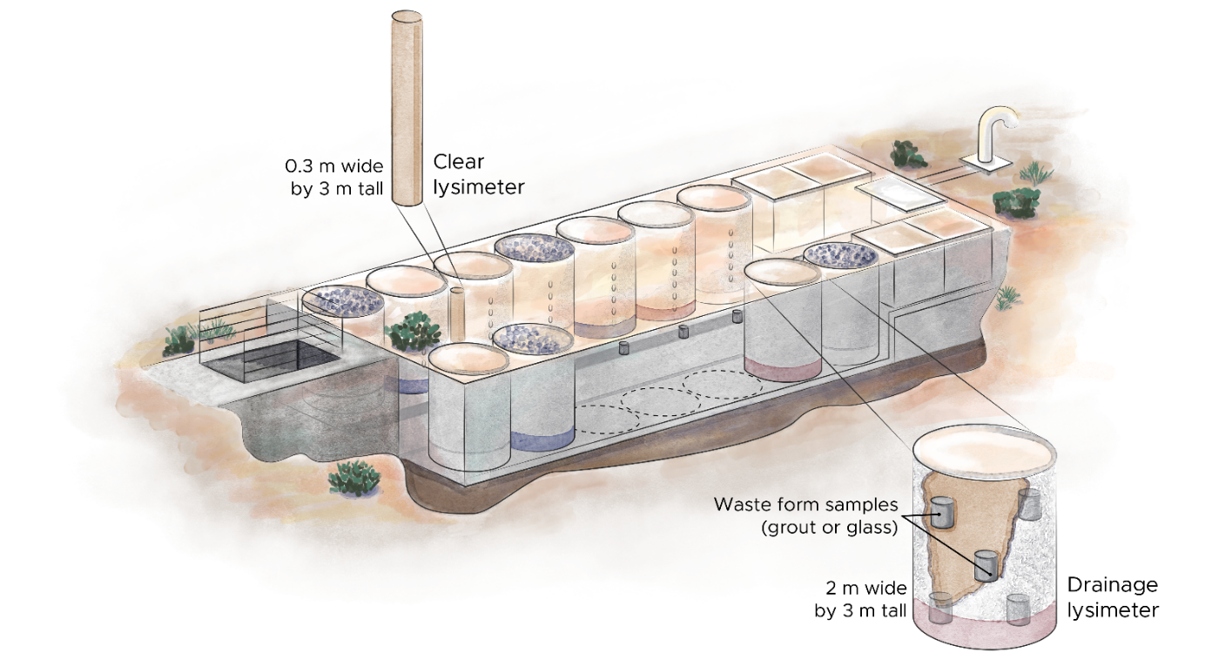
Outline
  Background
  Durability testing
  Field (natural) tests
  Testing of cements
  Testing of glasses
  Testing of bitumen
  Testing of ceramics
  Conclusions

Slide 3
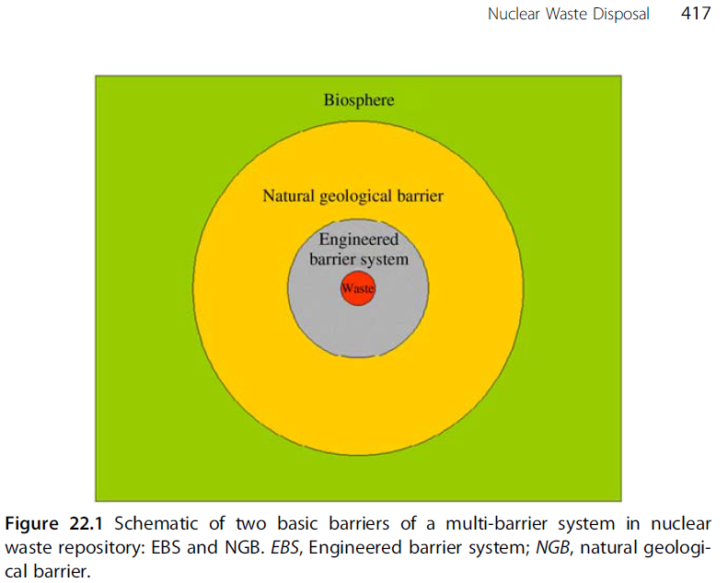
I. Background
Natural evolution scenario is usually considered as the reference scenario for geological disposal, it describes the projected state of the natural and engineered barriers due to the presence of most probable features, events and process (FEPs). In natural evolution scenario, the performance of the waste package could be compromised due to different chemical, thermal, mechanical, hydraulic, biological, and radiological processes that take place over thousands of years, leading to radio-contaminant and chemical elements releases from the waste package.

Slide 4
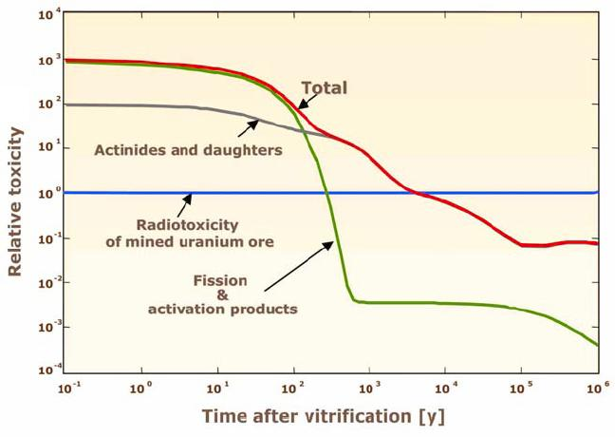
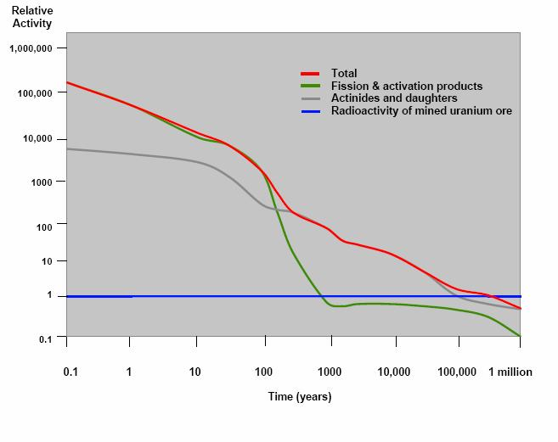
Relative Toxicity of HLW
N. Chapman, A. Dansie, C. McCombie. Artifact to analogue: archeology of arid environments points to management options for Yucca Mountain. Radwaste solutions, 14 (2), 22-31 (2007).
Notes:
Several comments on HLW and geological timescales, then on timeframes for LLW

Slide 5
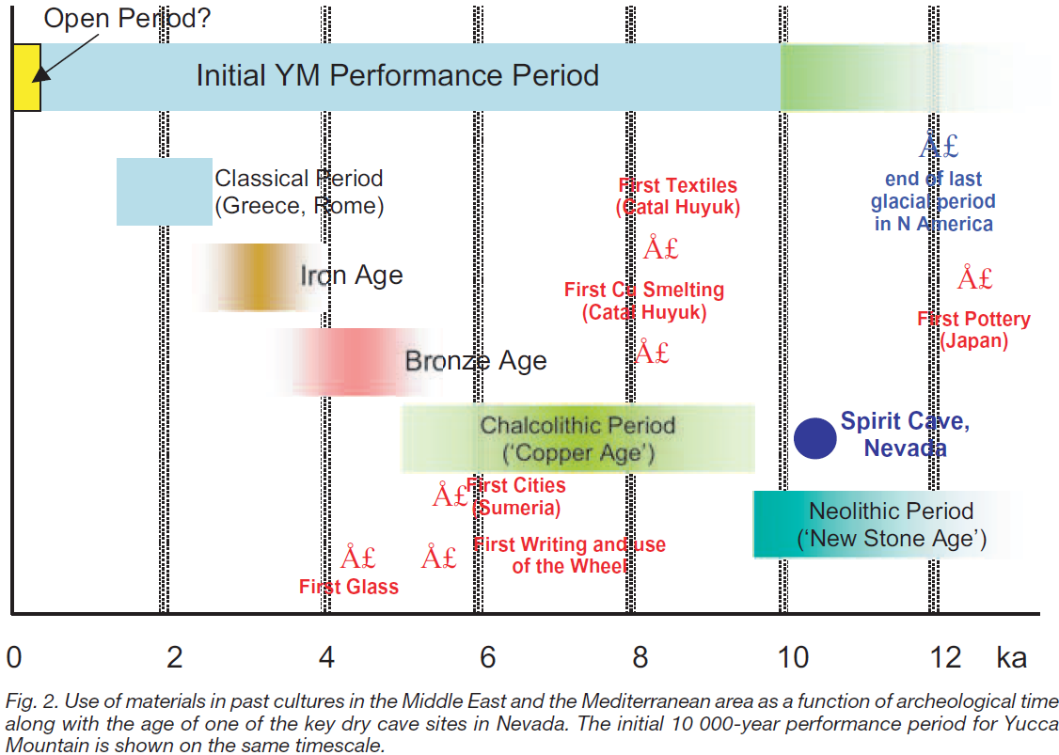
N. Chapman, A. Dansie, C. McCombie. Artifact to analogue: archeology of arid environments points to management options for Yucca Mountain. Radwaste solutions, 14 (2), 22-31 (2007).

Slide 6
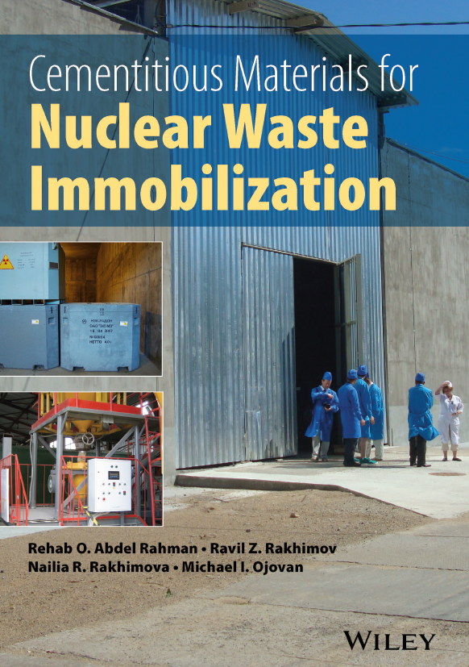
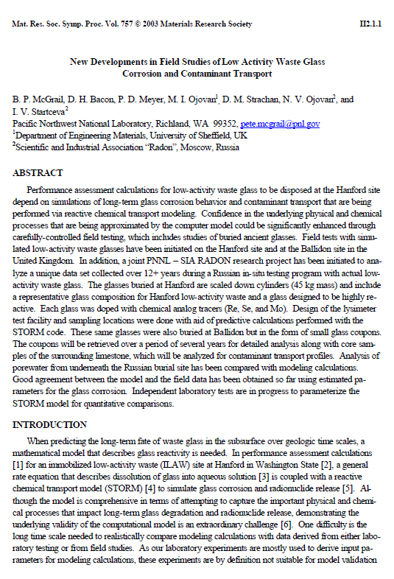
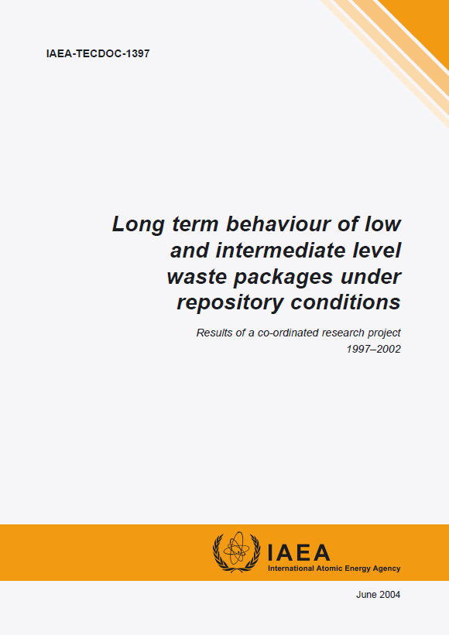
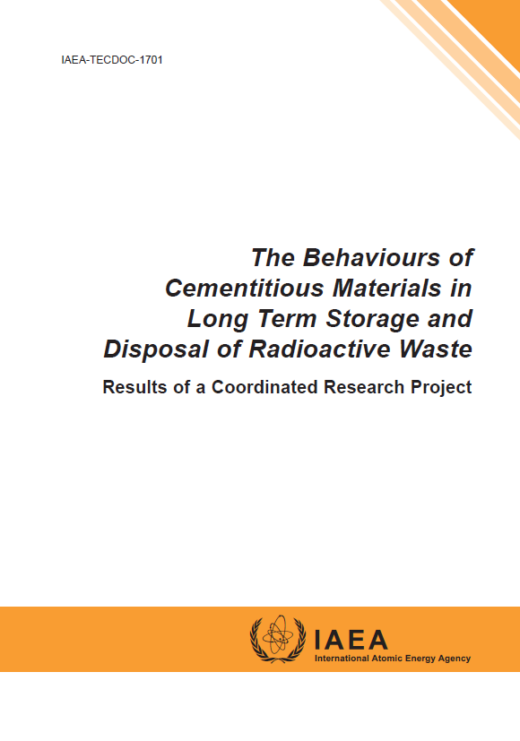
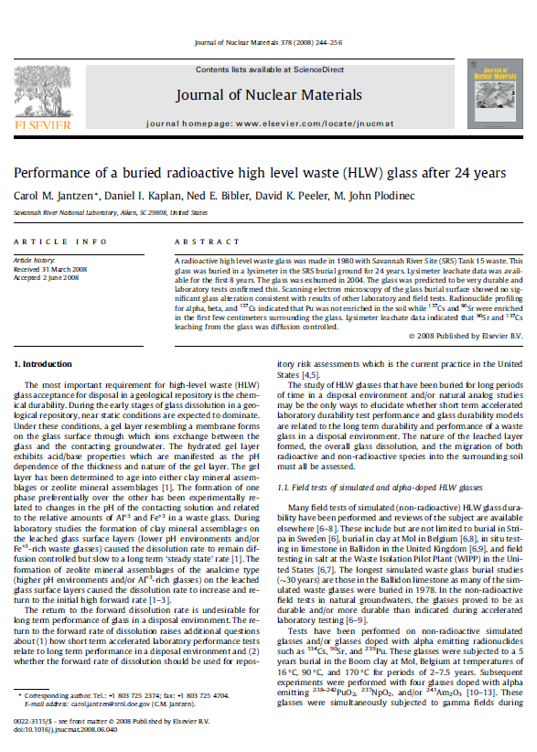
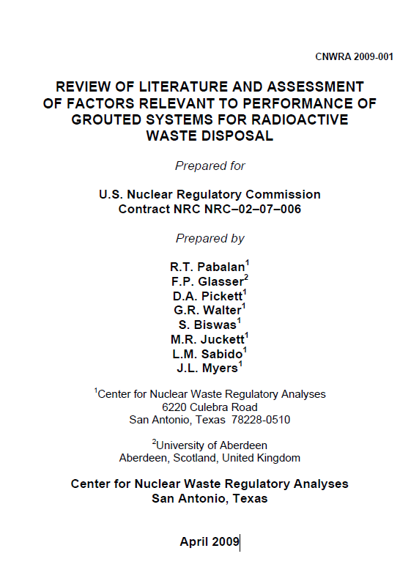
2004
2013
Notes:
The IAEA paid a lot of attention to long term behaviour. My focus is on Natural Tests

Slide 7
II. Durability testing
Accelerated testing
  Laboratory based
  Controlled environment
  Possibly not representative of real conditions
Long term testing
  Takes a long(!) time
    Continuity can be an issue
  Possibly less controlled environment
  May be more representative of real conditions

Slide 8
The evolution of the properties of wasteforms in a repository is often extrapolated from conventional laboratory timescales to extended periods more typical of natural processes.
The validity of the models used for such extrapolation can be tested by comparison of such predictions with observations of analogous geological or archaeological samples. Field (natural) tests thus can be useful in validation of performance assessment models.
No standard test procedures exist to evaluate the performance of cemented waste in real disposal conditions. Moreover, no single test would probably be sufficient to project long-term durability under the complex conditions of a disposal site.

Slide 9
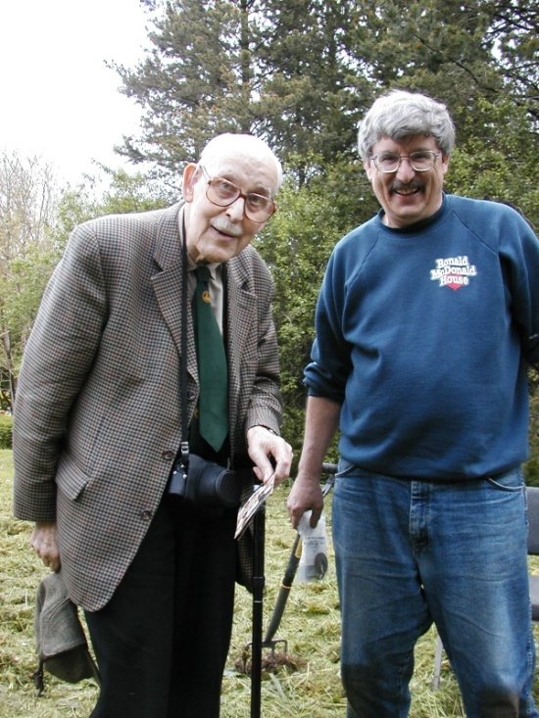
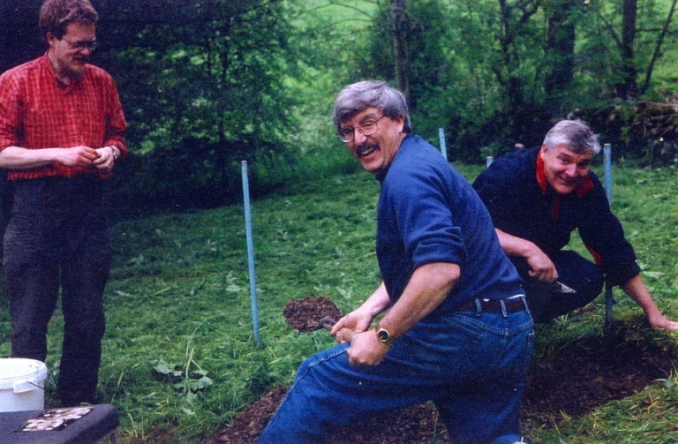
III. Field (natural) tests
UK: Understanding the behaviour of archaeological glasses can offer important insights into the long term behaviour of all glasses
  Hence even the original Ballidon experiment has some relevance to wasteform (glass) performance
Although the experiment is simple maintaining long term continuity is a challenge
  People also age (& die)
    Prof Roy Newton died aged 90 in 2003
Roy Newton
George Wicks
Russell Hand
Jim Smedley
George Wicks

Slide 10
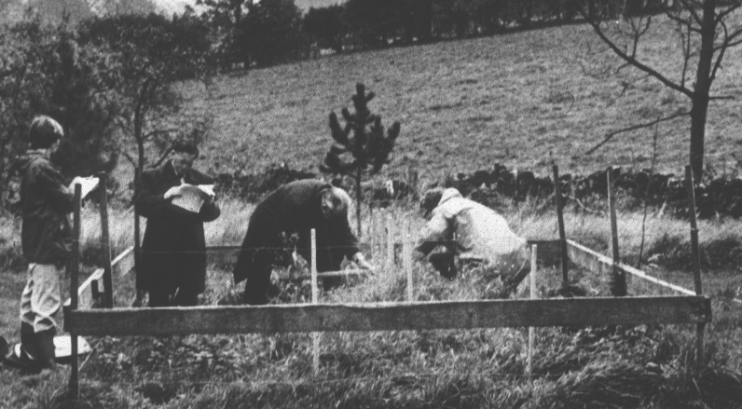
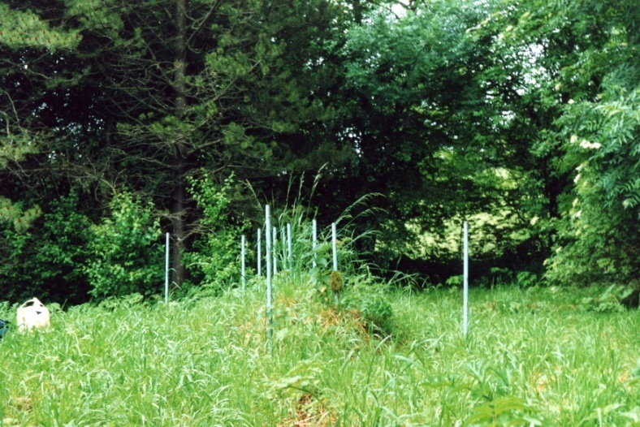
UK Ballidon glass burial site
Ongoing glass burial site
  Archaeological related experiment started in 1970
    Samples buried for 2^{n} years where 0 ≤ n ≤ 9
    i.e. 1, 2, 4, 8, 16, 32, 64, 128, 256, 512 years
  Simulant nuclear waste glasses buried at Ballidon since 1986 + 2002
Very simple experiment
  Exhume and analyse samples
Ballidon, 1978
Ballidon, 2004

Slide 11
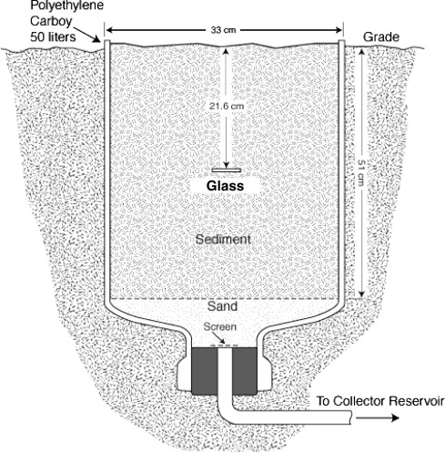
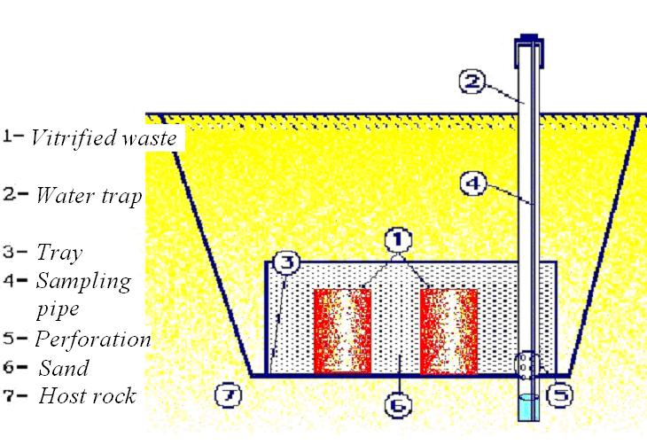
Field tests – more complicated case
Capture water
  Measure what is being removed from the wasteform
K26 burial, Russia
Lysimeter, US

Slide 12
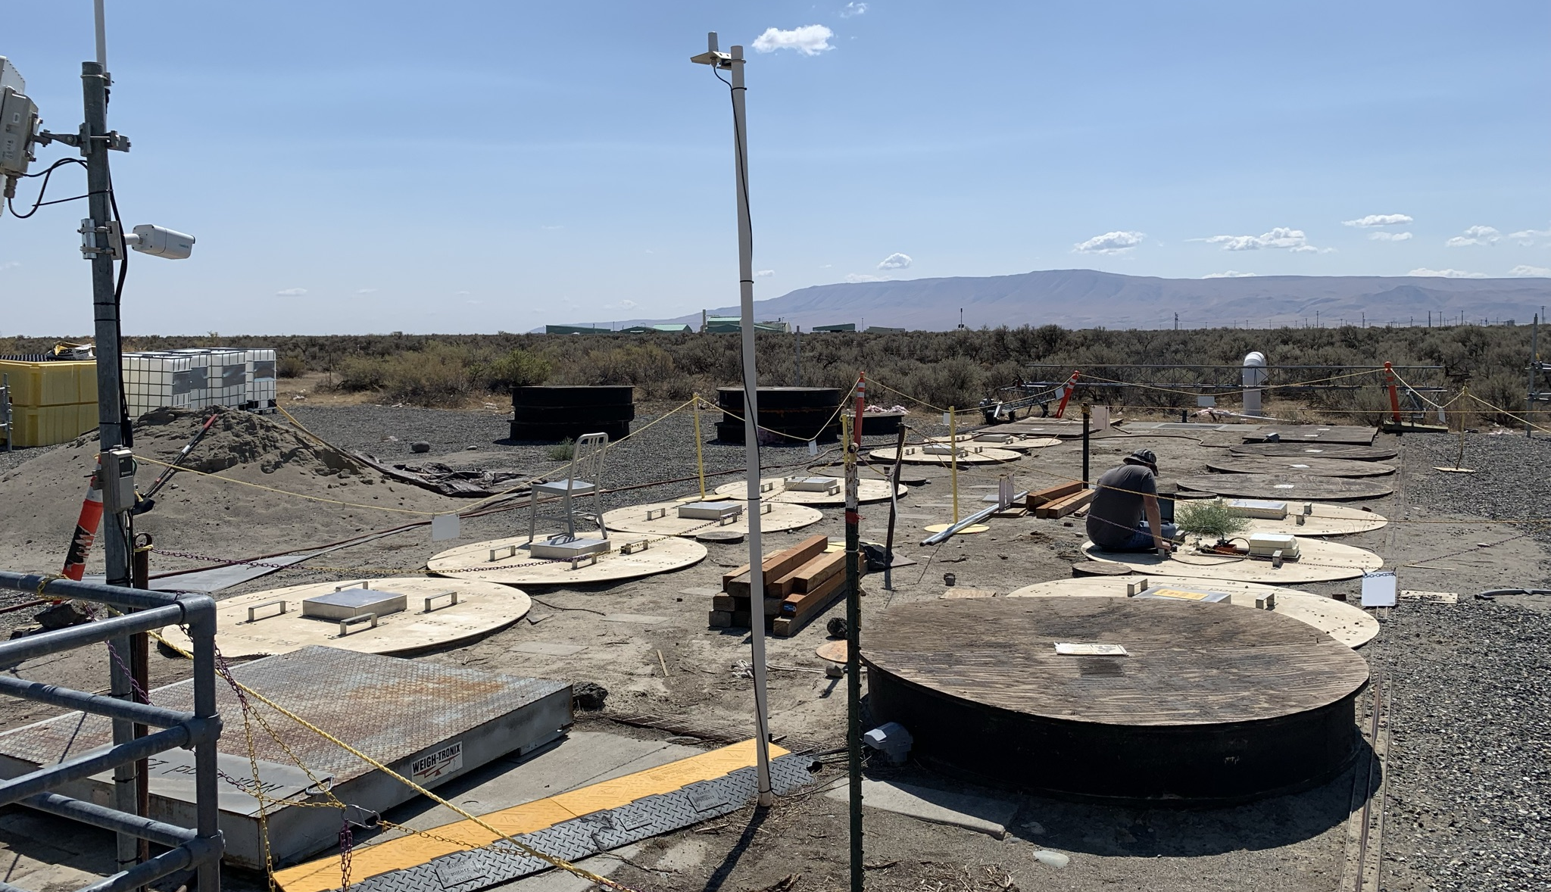

IDF Test Platform:
Lysimeter Experiment of Low-Level Waste Forms
Models are used to predict waste form performance over lifetime of disposal.
Lysimeter tests place waste forms in as close to real disposal conditions and monitor their behavior over time.
Allows for generation of site-specific data and model verification.
IDF Test Platform Site
Facility Schematic

Slide 13
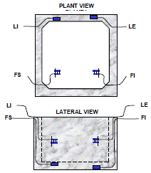
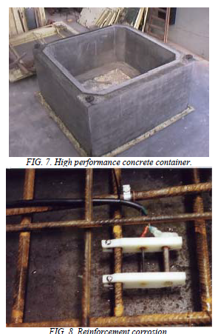
Argentina
The Argentina project focused on studies relating to wasteform performance in terms of ¹³⁷Cs, ⁶⁰Co, and ³H releases, microbially-mediated gas generation from stabilized waste, and corrosion-induced degradation of carbon steel and concrete containers. Tests to evaluate clay based backfill are also underway. Results indicate that the clay used as backfill has a high retention capacity for ¹³⁷Cs. Tests on carbon steel container materials indicate a corrosion rate of 0.1 mm/yr. Tests on the various waste package components are continuing. More data need to be generated before meaningful extrapolation can be made to predict waste package performance over time.

Slide 14
Canada
Several broad areas of research that impinge on issues relating to the long-term performance of LILW packages under anticipated disposal conditions are being investigated as part of the Ontario Hydro Technologies project in Canada. Work has focused on assessment of wasteform performance, definition of vault chemical conditions in the presence of cementitious materials, and establishment of source terms for safety-relevant radionuclides present in both reactor operational and decommissioning waste. The potential for gas generation from both corrosion and microbial degradation of waste package components was evaluated. Calculations were performed to estimate the type and magnitude of gases likely to be generated under disposal conditions and their impact on repository performance and integrity was assessed.
Studies at AECL Chalk River are focusing specifically on the development of performance criteria for wasteforms that arise from the treatment of liquid LILW. A cementitious binder has been selected for solidification of the liquid wastes. Both physical and chemical properties are being evaluated to assess the durability and leaching requirements for waste forms.

Slide 15
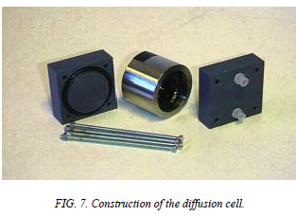
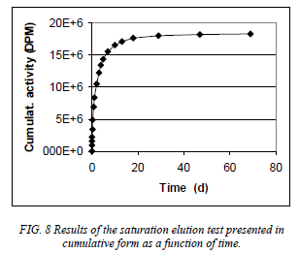
Finland
Evaluation of bituminized ion exchange wasteforms is the focus of the Finnish project, with particular emphasis on the water uptake and swelling processes. In addition, cementitious engineered barrier materials are being studied to assess their retardation properties for ¹³⁷Cs and ⁹⁰Sr, both representing major radionuclide constituents of the bituminized waste.

Slide 16
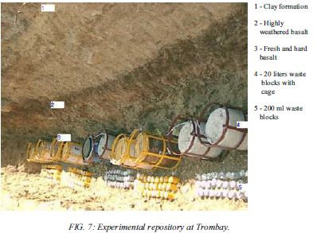
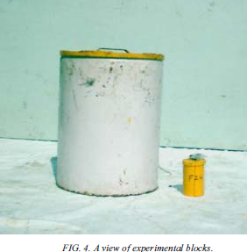
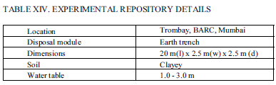
India
The Indian project is addressing several areas of R&D relating to LILW package performance under actual disposal conditions:
full-scale field testing of wasteforms and waste packages;
stabilization of heat-generating spent sealed sources and evaluation of the resultant wasteform;
service life of reinforced concrete, based on degraded concrete samples retrieved from disposal facilities; and
retention of ²³⁹Pu and ²⁴¹Am in vermiculite and bentonite-based backfill materials.

Slide 17
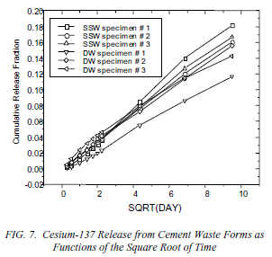
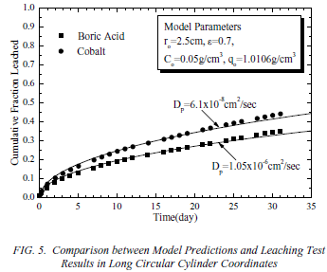
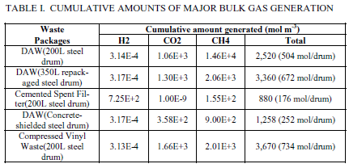
Republic of Korea
In the Korean project, studies are underway to demonstrate compliance of waste packages with the waste acceptance criteria established by the national regulatory body. Various types of waste packages, including carbon steel drums, high integrity containers, and concrete-lined drums, are currently in use at the Korean Nuclear Power Plants (NPPs). In addition, paraffin based wasteforms are being generated at the NPPs. Most of the work completed to date has focused on potential gas generation in the waste packages. The principal gas-generating mechanisms being considered include metal corrosion, microbial activity in organic materials, and radiolysis in paraffin-based waste forms. Leaching studies on both simulated and actual paraffin- and cement-based wasteforms are also underway.

Slide 18
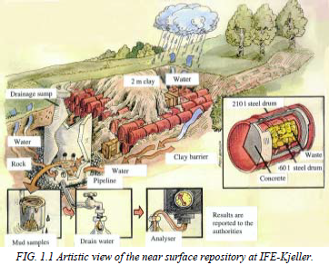
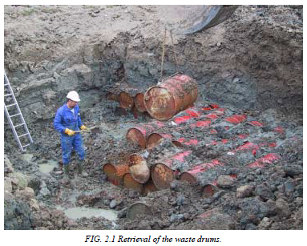
Norway
This work comprises the results of investigations conducted in connection with the cessation of a near surface LILW repository at Kjeller, Norway. The nearly 1000 drums in the repository were retrieved in the autumn of 2001 after 31 years of storage within the clay barrier. The repository contained 80 GBq Pu, 2.5 GBq U and more than 1 TBq each of ⁹⁰Sr and ¹³⁷Cs. Studies of the integrity of the clay barrier showed that with two minor exception no contamination were present outside of the repository. Typically the radioactive species that had leaked from the few damaged drums were contained in the 2 cm of clay closest to the drum surface. Investigations of the physical condition of one waste drum subjected to 23 years of repository storage showed that little or no degradation had taken place either in the concrete shielding or in the inner steel container material. Except from 20 drums set aside for further studies, the whole inventory of the near surface repository have now been transferred to the KLDRA-Himdalen repository and storage site.

Slide 19
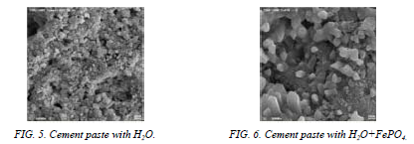
Romania
In the Romanian project, experiments are underway to assess the durability of cement based wasteforms prepared with admixtures of bentonite and volcanic tuff. The effect of the presence of various complexing agents on the mechanical strength of the waste form is also being studied. Tests are underway to evaluate the effect of mineral additives on wasteform permeability.

Slide 20
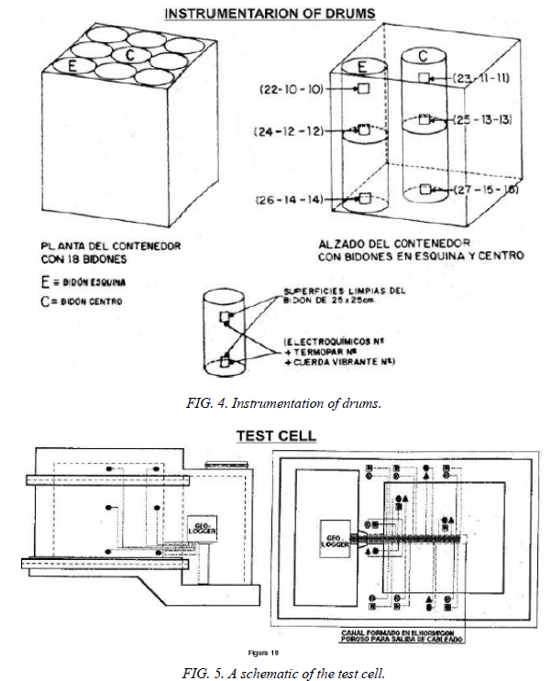
Spain: cements (whole package including the wasteform)
The Spanish project involves an assessment of the long-term behaviour of concrete containers, with particular emphasis on methodologies to estimate container lifetime. The concrete containers, instrumented with a series of sensors, are being studied under repository conditions, and monitored over time. The main parameters being monitored to assess concrete durability include temperature, deformation, electrical resistivity, corrosion potential, corrosion rate, and the availability of oxygen at the reinforcement.
20

Slide 21
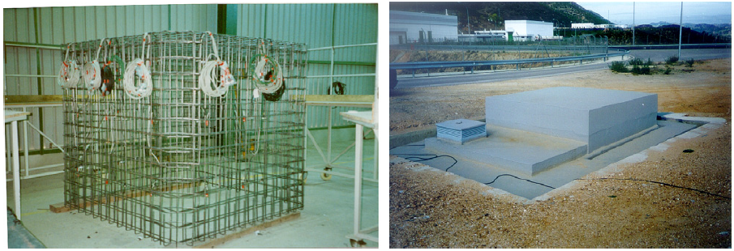
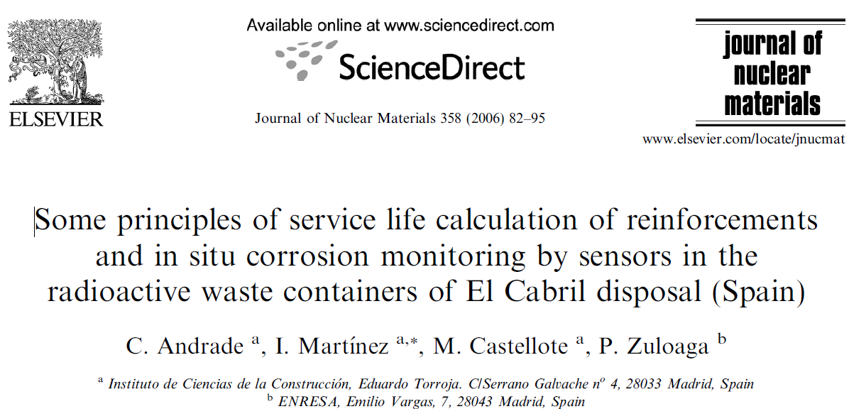
C. Andrade, I. Martınez, M. Castellote, P. Zuloaga. Some principles of service life calculation of reinforcements and in situ corrosion monitoring by sensors in the radioactive waste containers of El Cabril disposal (Spain). Journal of Nuclear Materials 358 (2006) 82–95. doi:10.1016/j.jnucmat.2006.06.015
21

Slide 22
Russia
The Russian Federation project involves field testing of pilot- and full-scale waste packages subjected to repository conditions for a period of up to 12 years. The waste packages consist of cemented, bituminized and vitrified wasteforms placed in carbon steel containers. The field testing is focusing on evaluation of the leaching behaviour of the wasteforms and corrosion degradation of steel containers. The experimental results, based on 12 years of field testing, have been used to develop a model that represents the leaching behaviour of the waste forms studied. The model can be used to extrapolate long-term wasteform behaviour in order to predict radionuclide releases over repository time-scales.

Slide 23
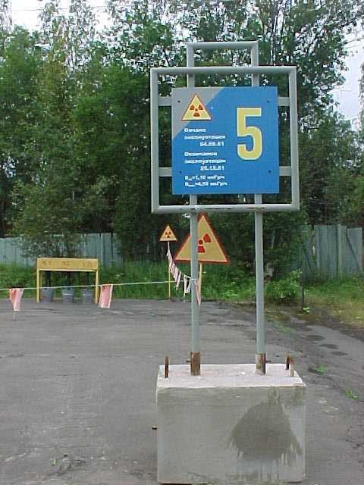
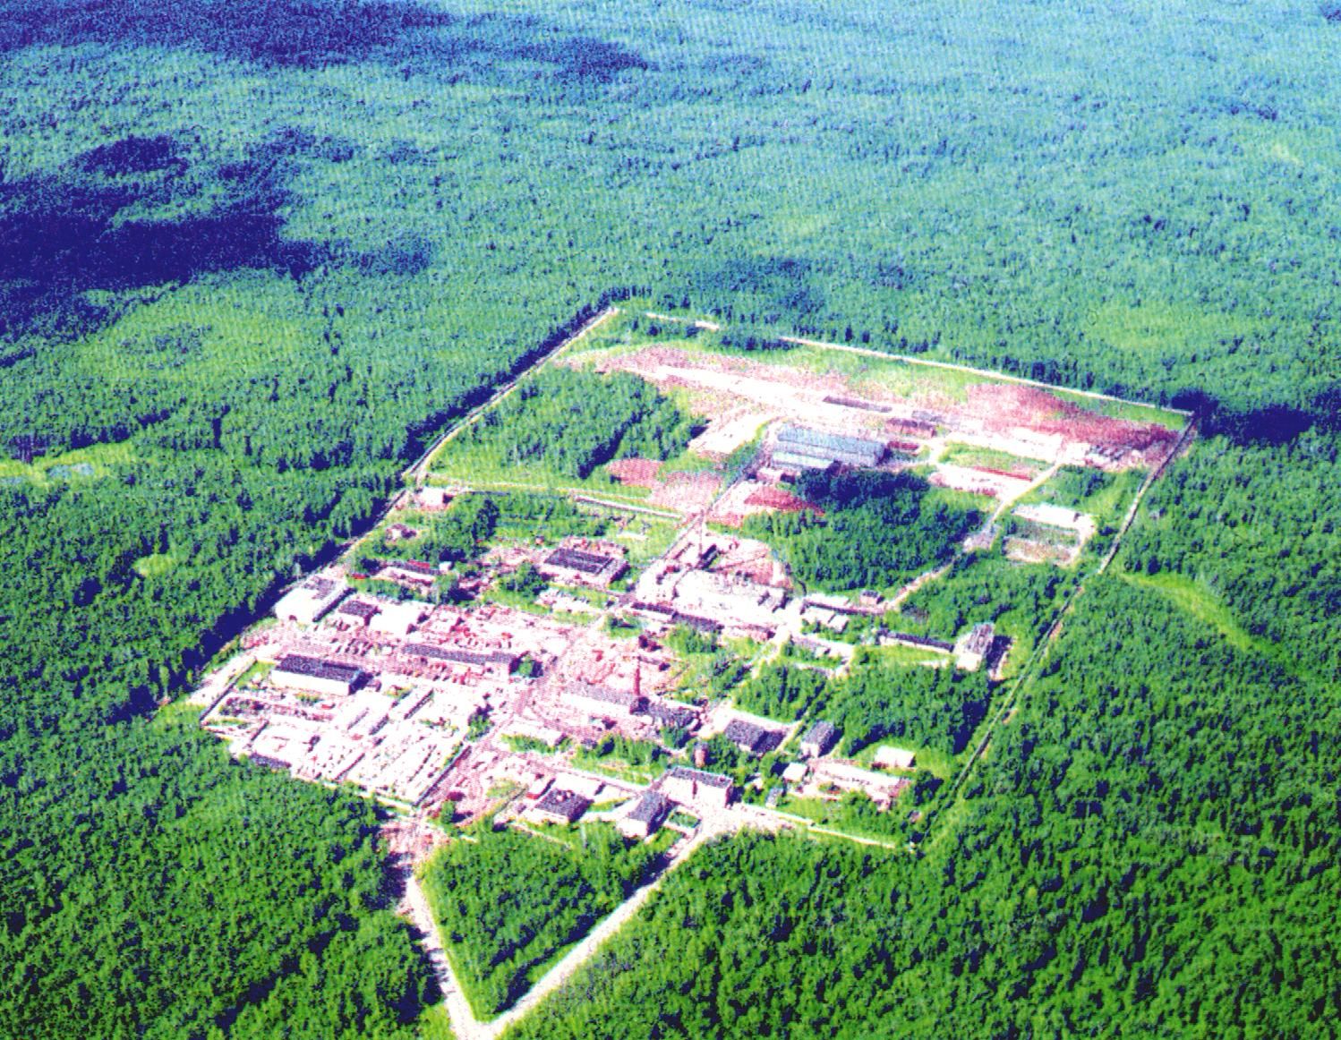

Testing area
Nuclear waste immobilisation plant (LILW)
(vitrification, bituminization, cementation)
Industrial site of FSUE RADON, Moscow Region

Slide 24
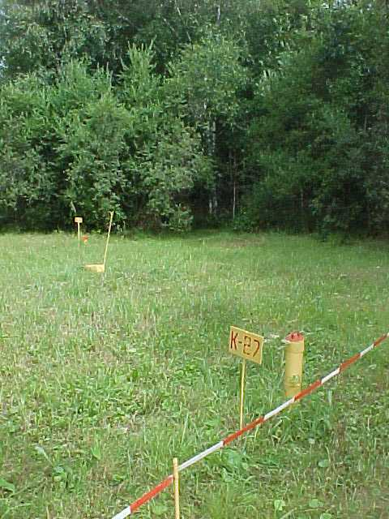
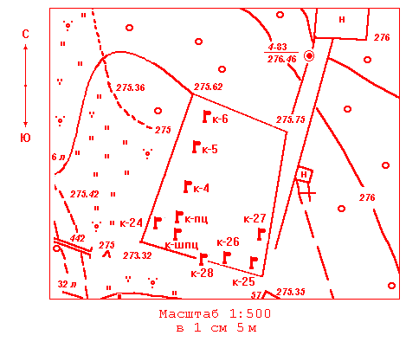
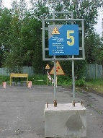
NSDF tests
Open tests
Open area.
Field tests: Repository and Open

Slide 25
Lithological Cross Section of Disposal/Storage Area

Slide 27
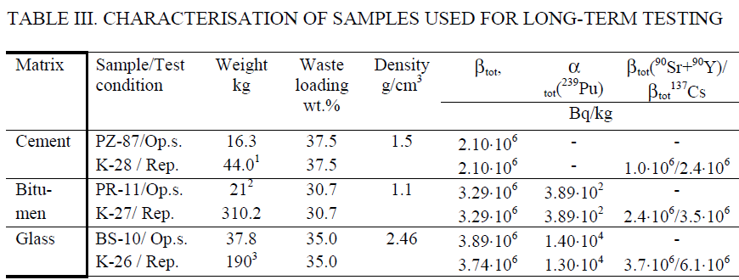
Wasteforms: Cement, Bitumen, Glass
Shallow Ground experimental Repository and Open Area Tests
Phenomenological Approach for Behaviour Prediction

Slide 28
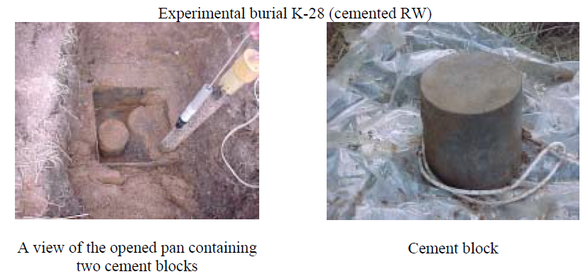

Slide 29
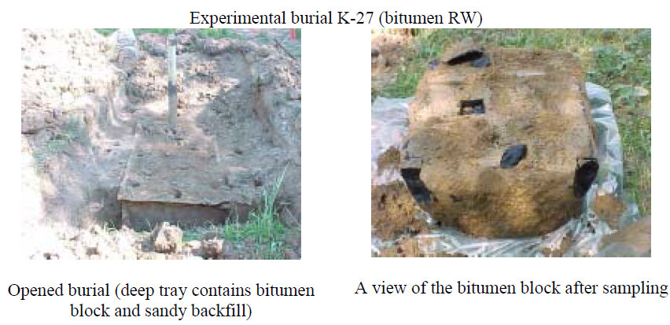

Slide 30
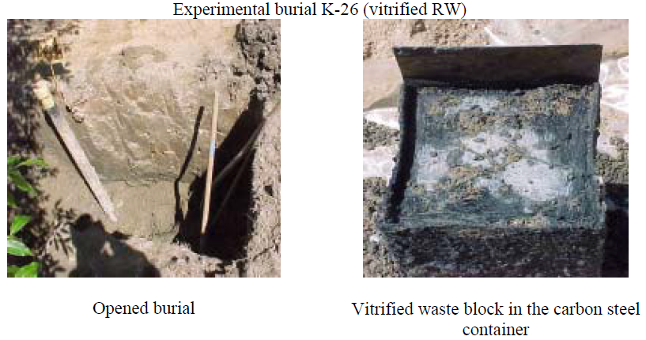

Slide 31
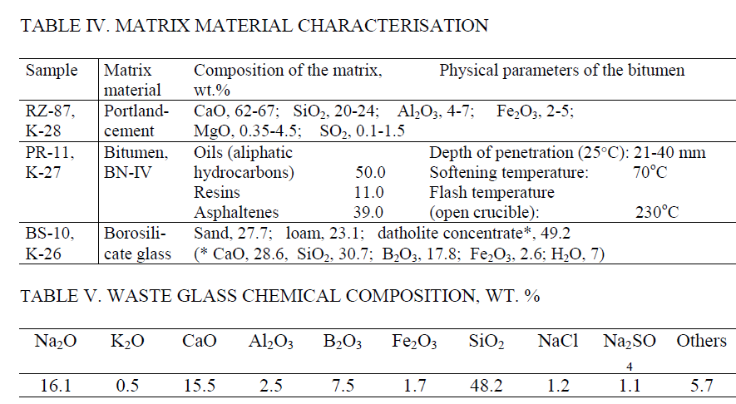

Slide 32


Slide 33
IV. Testing of cements
Cementitious wasteforms in the form of three cylindrical samples (∅=h=24 cm) were placed for long-term testing in a shallow-ground repository. Stainless steel trays holding cementitious wasteforms were placed at a depth of 1.7 m which is below the soil’s freezing depth (0.7 m). Pure coarse sand was used to backfill the cemented blocks in the tray to facilitate infiltration of water to the blocks and to isolate them from direct contact with the host rock.
The space outside the containers was filled with host loamy soil from the land surface. The stainless steel tray was supplied with a water trap and a tube for water extraction by pumping.

Slide 34
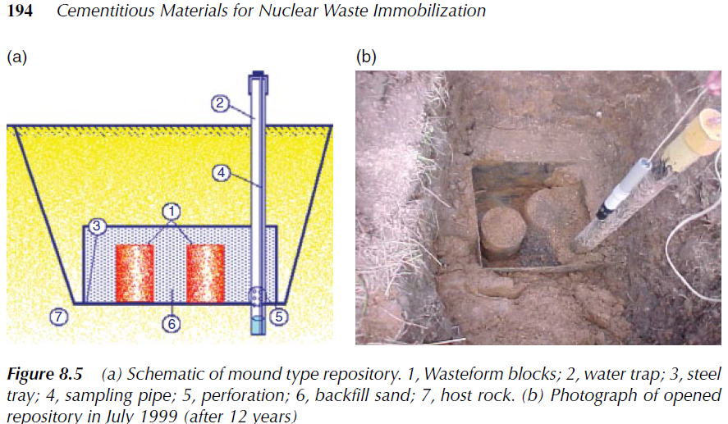

Slide 35
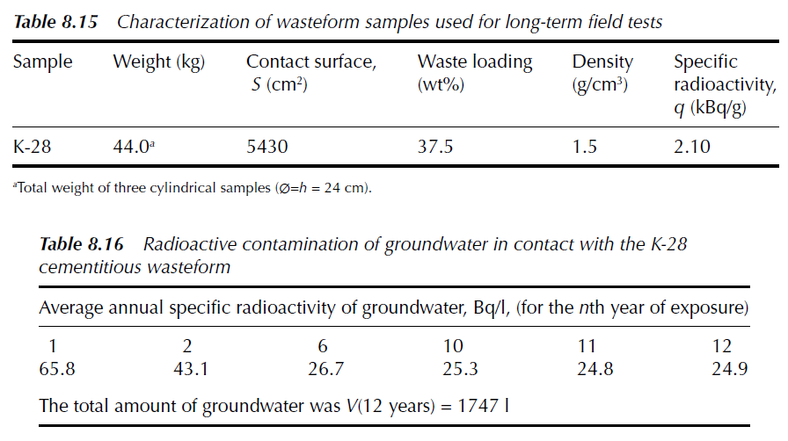

Slide 36



The amount of radionuclides leached from the cementitious wasteform A(t) (Bq) was calculated using:
The normalized mass loss of radionuclides, NL (g/cm2), was obtained from:
where S (cm2) is the cementitious wasteform–water contact surface area and q (Bq/g) is the specific radioactivity of wasteform. The average normalized leaching rate, NR (g/cm2day), was then calculated using:

Slide 37
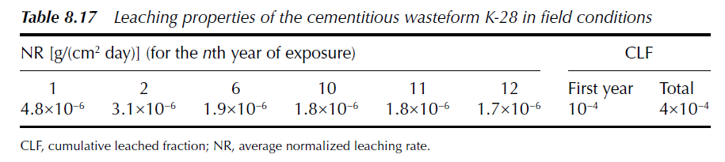
Conclusions on cements: Releases of radionuclides in repository conditions were at least 100 times lower than
In laboratory leach tests. These differences are due to the limited contact with percolating water, lower average temperature and partly due to the retention of radionuclides on the contacting host formation.

Slide 38
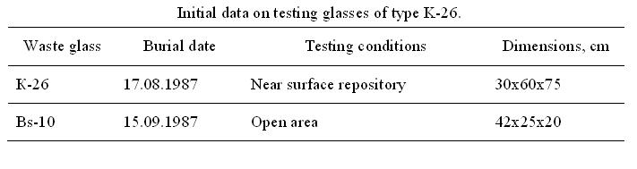

V. Testing of glasses

Slide 39


Slide 40

Field tests: repository setup

Slide 42


Field Tests: 1999 opening repository

Slide 43



Field Tests: 1999 sample collection

Slide 44



Leaching behaviour: groundwater
Groundwater chemistry altered from (HCO₃⁻Ca²⁺)- type to a (HCO₃⁻Na⁺ K⁺)- type, while being numerically higher than the background only by a factor of 1.3

Slide 45

Both at the initial and final stages of the testing period, the activity release rates per unit area of contact surface were greater at the open site (Bs-10). 14 years field testing data for glass Bs-10 averaged in a dissolution rate r_{Bs-10} ≈ 0.42 μ/y and caesium interdiffusion coefficient D_{Cs} ≈ 1.8 10⁻²⁰ m²/s. This value for diffusion coefficient is consistent with reported data on the leaching behaviour of alkali-borosilicate glasses

Slide 46




Slide 47
The experimental data for K-26 glass revealed that glass dissolution played an insignificant role at this stage of the tests. Hence the leaching behaviour of glass K-26 is still controlled by interdiffusion and ion exchange, consistent with the results of McGrail on the major role of ion-exchange in leaching of low-level vitrified wastes.

Slide 48



Slide 49

Corrosion mechanisms of glass Bs-10 (open area)
Currently the corrosion of Bs-10 occurs via both ion-exchange and hydrolysis.
This glass will be corroded by almost pure hydrolysis presumably after ∼40 years.

Slide 50
Corrosion mechanisms of glass K-26 (repository)
Corrosion of K-26 at the 4.5 ºC temperature of the disposal environment occurs almost entirely through ion-exchange. This will occur for more than 30 years followed by an intermediate regime, where both mechanisms will play an important role.
Since the waste radionuclides are short-lived (e.g. ¹³⁷Cs) ion-exchange will remain important for the release of radionuclides until their decay below the exemption levels (about 260 years)

Slide 51





An altered layer has been formed at the glass surface that had been contacting with the repository environment.
Surface analysis

Slide 52


Surface analysis: SEM/EDS II
Scientific Basis for Nuclear Waste Management, Kalmar, Sweden, 15-18 June 2003

Slide 53


Slide 54


Slide 55


Slide 56

Conclusions on glass
The corrosion mechanisms of the same high-sodium content radioactive waste borosilicate glass in field conditions depend on the environment conditions.
In open area tests at relative higher temperatures after 14 years the glass is corroded via both ion-exchange and hydrolysis.
In burial conditions at relative lower temperatures after 14 years the glass is corroded only via ion-exchange and this mechanism will remain significant until almost complete decay of ¹³⁷Cs in the glass.

Slide 57



VI. Testing of bitumen
Bitumen block retrieved from the repository K-27 was in good physical condition. Visually, no cracks or fractures could be detected. Four samples of the bitumen material were split off from the corner and upper middle parts of the bitumen block during the repository opening. Thermo-physical, physical, and radiometric characteristics were determined for the bitumen samples (Tables XII, XIII).

Slide 58

The noticeable fractional increase in asphaltenes (from initial 39 wt.% to 43-51 wt.%) had occurred to the end of 12yr testing period. From Table XIX it can be seen that a significant proportion of radioactivity associated with the bitumen originates from the asphaltene fraction. Saturated hydrocarbons retain only trace amounts of the radioactivity.

Slide 59

Cumulative leached fraction
CLF = A_{leached}/A_{initial}
References:
M.I. Ojovan, W.E. Lee. An Introduction to Nuclear Waste Immobilisation, 2nd Edition, Elsevier, Amsterdam, 362 p. (2014).
J. Sercombe, B. Gwinner, C. Tiffreau, B. Simondi-Teisseire, F. Adenot. Modelling of bituminized radioactive waste leaching. Part I: Constitutive equations. J. Nucl. Mater. 349 96–106 (2006).
M.I. Ojovan, N.V. Ojovan, Z.I. Golubeva., I.V. Startceva, A.S. Barinov. Aging of the bitumen waste form in wet repository conditions. Mat. Res. Soc. Symp. Proc., 713, 713-718 (2002).
K.P. Zakharova, O.L. Masanov. Bituminization of liquid radioactive wastes. Safety assessment and operational experience. At. Energy, 89, 135-139 (2000).
IAEA TRS 352. Bituminization processes to condition radioactive wastes. IAEA, Vienna (1993).

Slide 60


VII. Testing of ceramics
Clearly, leach tests performed in distilled and deionised water do not give an understanding of the behaviour of ceramic wasteforms under conditions of geological disposal. Underground water which is an aqueous solution saturated with different ions from the host rock may contact actinide-bearing wasteforms!

Slide 61


Slide 62
VIII. Conclusions
Field tests exposing wasteforms to disposal-like environments might result in quite different data compared with laboratory testing. A much smaller weathering and release rate is typical compared with laboratory data mainly because of processes which occur differently in field tests.
Various factors may be responsible for an increased apparent durability of wasteforms in field conditions such as groundwater composition, temperature and groundwater flow rate changes, as well as transport limitations and interactions between wasteform and backfill/hosting formation.

