Slide 1
Eastern Africa Capacity Building Workshop on Space Weather and Low-latitude Ionosphere
3 - 12 october 2023
Bsc, Malindi, kenya
Claudio Cesaroni – claudio.cesaroni@ingv.it
03/10/2023

Slide 2

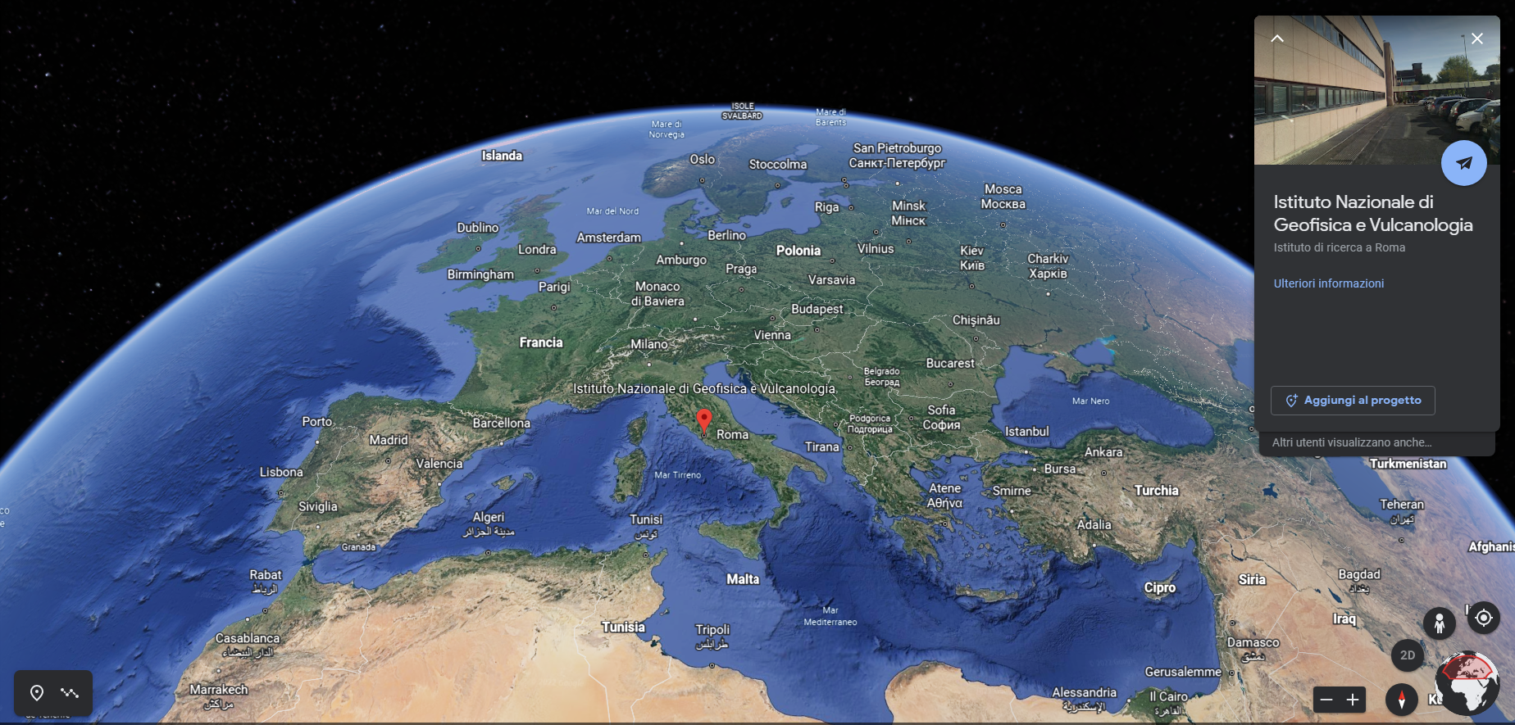
Istituto Nazionale di Geofisica e Vulcanologia
INGV was founded in 2000 (Law n.381 of 29 Sep. 1999) through a process of merging, reorganizing and rationalizing the entire national research network that revolves around:
- the assessment and mitigation of seismic and volcanic risk,
- the investigation of geophysical, seismic and volcanic phenomena, and
- the understanding of the mechanisms that control the evolution our planet.
INGV is composed (as for April 2021) by:
833 personnel units with permanent contracts,
90 personnel units with temporary contracts
+ 195 other units (research grants, collaborators and cooperating scientists).
Summing up to 1118 personnel units (scientists, technicians, administratives).

Slide 3
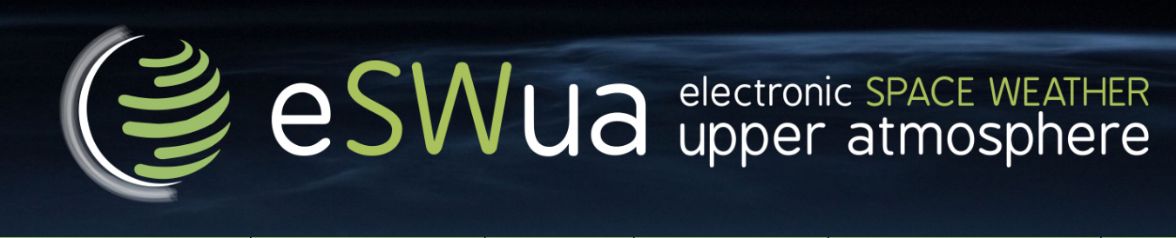
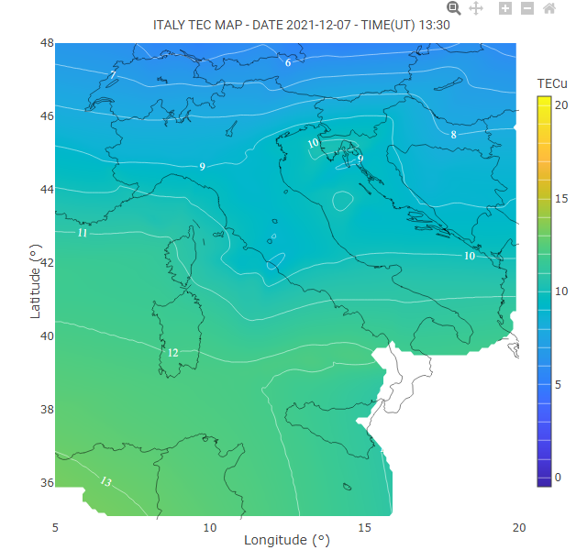
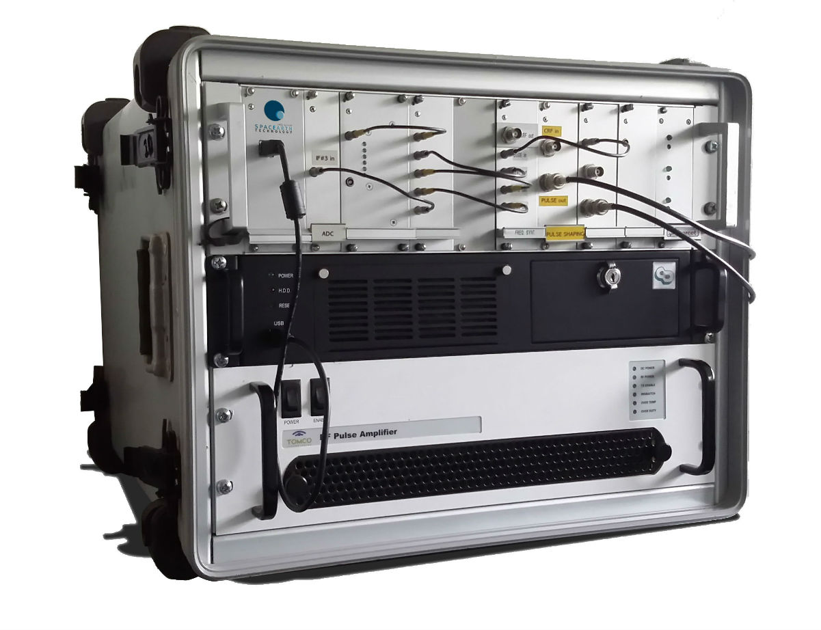
Upper Atmosphere Physics and radiopropagation group
The group manages the instruments and infrastructure related to research and services on Ionosphere and Space Weather
About 20 people (scientists, engineers, technician…) led by C.Cesaroni
Main research topics:
Ionospheric physics
HF radio communication
Space Weather
Ionospheric modelling
Ionospheric scintillation
Total Electron Content (TEC)
Termosphere-Ionosphere coupling
Automatic ionogromas scaling
Ionospheric turbolence
Litosphere_Atmosphere-Ionosphere coupling

Slide 4


ASI – INGV collaboration
In 2017 Italian Space Agency and Istituto Nazionale di Geofisica e Vulcanologia (INGV) signed a framework agreement (valid for 5 years) to collaborate in fields of common interest including:
Research on geophysical phenomenon;
Development of innovative geophysical monitoring systems;
Development of innovative systems for Earth Observation, Space geodesy and telecommunications;
Research activities in the field of Sun-Earth interaction and monitoring system for Space Weather;
Research and development of Earth Observation system for seismic and volcanic risk management;
Research for new Earth Observation space missions;
….

Slide 5
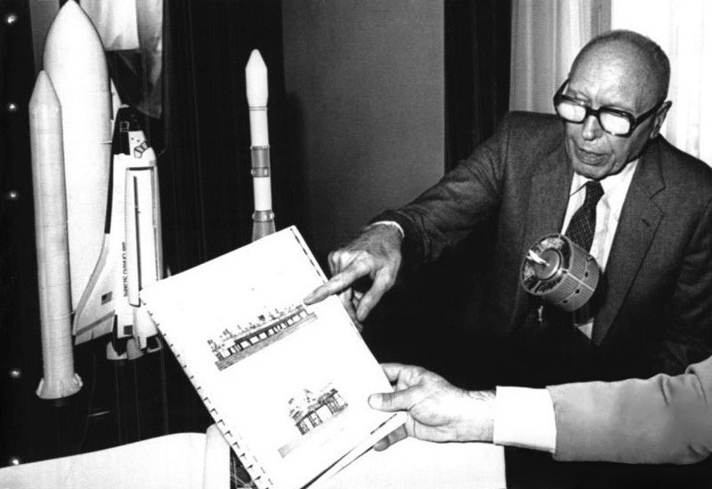
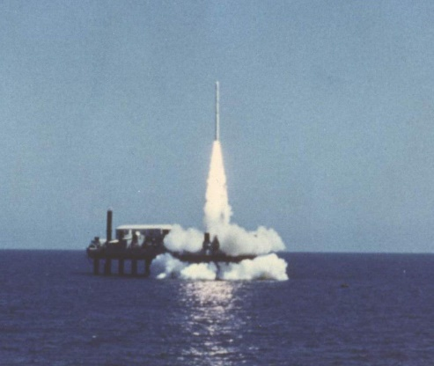
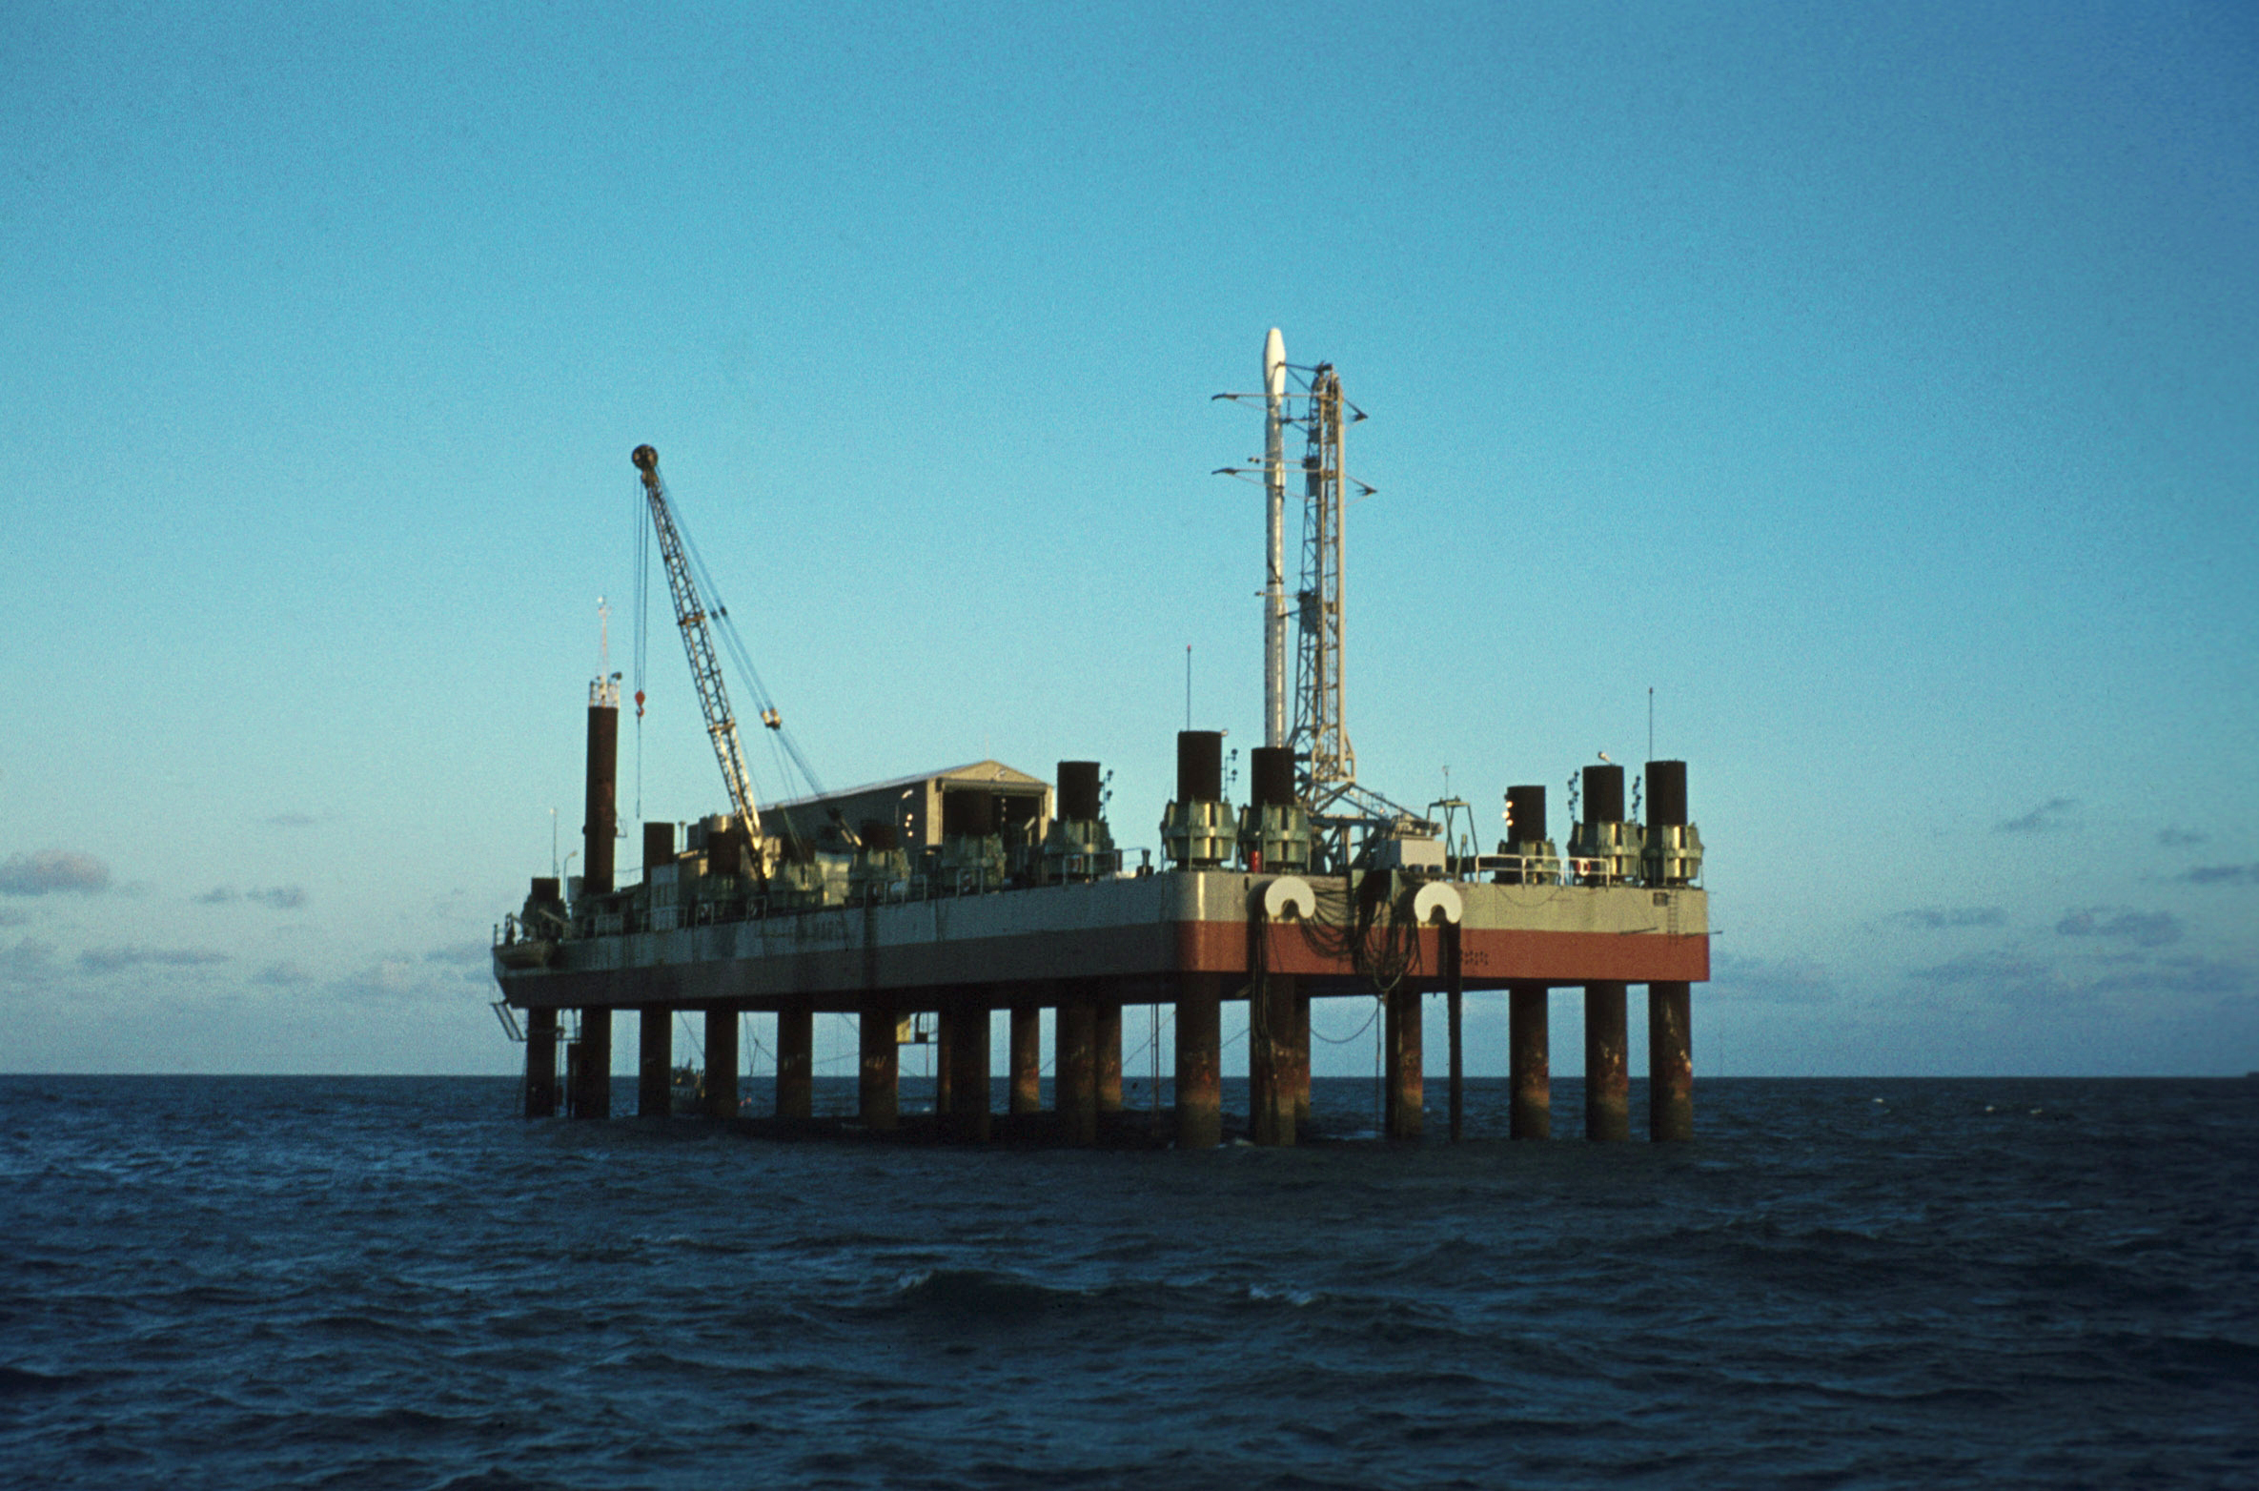
Luigi Broglio – Malindi Space Center
The Luigi Broglio – Malindi Space Center (BSC) is an Italian-owned spaceport near Malindi, Kenya, named after its founder and Italian space pioneer Luigi Broglio. Developed in the 1960s through a partnership between the University of Rome La Sapienza's Aerospace Research Centre and NASA, the BSC served as a spaceport for the launch of both Italian and international satellites.
List of launches carried out at Broglio Space Center
Number of launches: 27 (9 with NASA Scout Launcher): 100% success.
Primarily sounding rockets including the Nike Apache, Nike Tomahawk, Arcas and Black Brant launchers
N° | Launch vehicle | Satellite
1 | Scout SV 153 | SM 2, San Marco 2 (IT), 26 Dec. 1967
2 | Scout SV 175 | UHURU, Small Astronomic Satellite (USA), 12 Dec.1970
3 | Scout SV 173 | SM 3, San Marco 3 (IT), 24 April 1971
4 | Scout SV 163 | SS 1, Small Scientific Satellite (USA), 15 Nov. 1971
5 | Scout SV 170 | SAS 2, Small Astronomic Satellite (USA), 15 Nov. 1972
6 | Scout SV 190 | SM 4, San Marco 4 (IT), 18 Feb. 1974
7 | Scout SV 187 | UK 5, United Kingdom 5 (UK), 15 Oct. 1974
8 | Scout SV 194 | SAS 3, Small Astronomic Satellite (USA), 8 May 1975
9 | Scout SV 206 | SM 5, San Marco 5 (IT), 25 March 1988

Slide 6
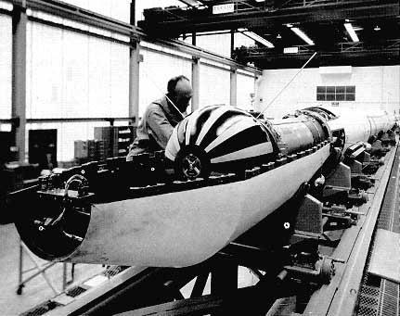
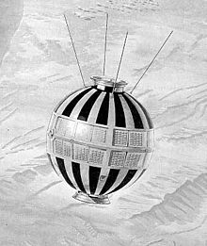
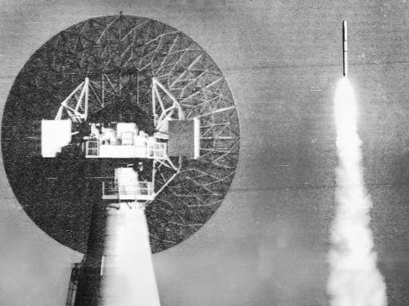
The San Marco project
San Marco I was launched on a U.S. four-stage solid propellant Scout booster from Wallops Island by an all-Italian crew on 15 December 1964. It was put into a 206 km x 820 km orbit, slightly more elliptical than the planned 215 x 680 km orbit, with an inclination of 37.79 degrees and a period of 95 minutes.
The air-drag experiment operated as planned until 30 December 1964 when transmissions were terminated to allow the ionospheric experiment to operate. It operated for the scheduled two weeks and was turned off, at this point the batteries were nearly exhausted.

Slide 7
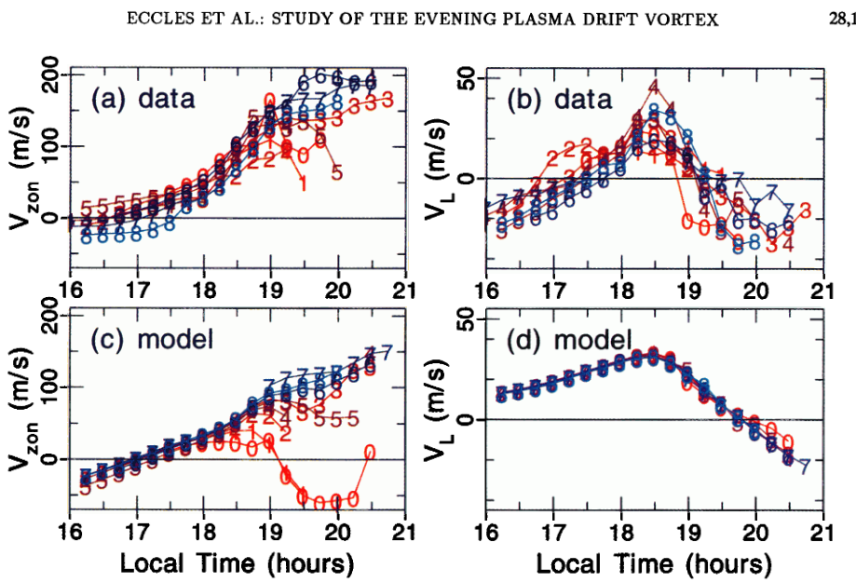
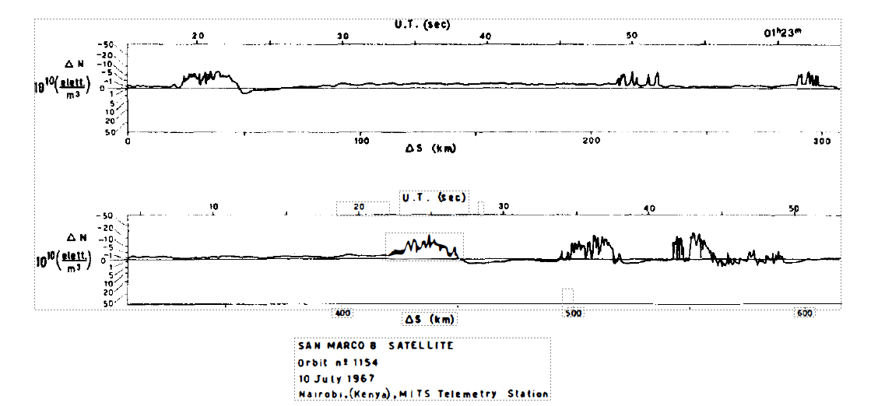
Ionospheric studies exploiting San Marco satellites data
Eccles, J. V., Maynard, N., & Wilson, G. (1999). Study of the evening plasma drift vortex in the low‐latitude ionosphere using San Marco electric field measurements. Journal of Geophysical Research: Space Physics, 104(A12), 28133-28143.
Checcaoci, P. F. (1969). Direct detection of ionospheric irregularity. Journal of Atmospheric and Terrestrial Physics, 31(8), 1131-1133.

Slide 8
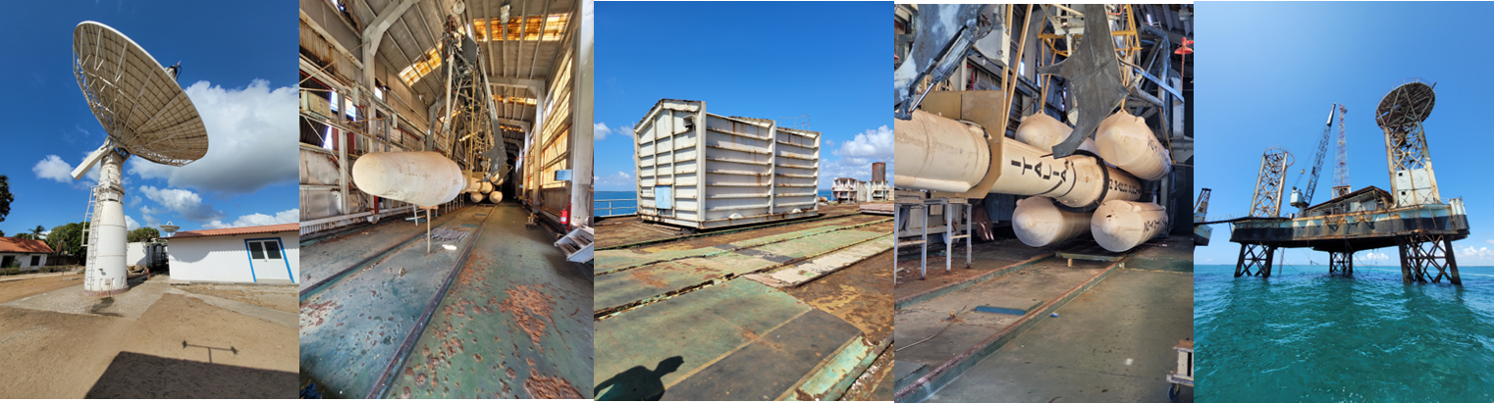
Role of the Italian Space Agency (ASI)
The Luigi Broglio Space Centre (BSC) is managed by the Italian Space Agency since 2004 based on the inter-government agreement initially signed by Italy and Kenya in 1995.
At present, the main activities carried out at BSC include:
- Support to the operations of several scientific and operational programs (ESA, NASA, CNES, CLTC, Space X) by using ground based remote sensing facilities;
Scientific and technological research in the fields of space and aerospace;
Scientific and technological cooperation with Kenyan institutions (e.g. KSA, Universities) for different activities including training

Slide 9
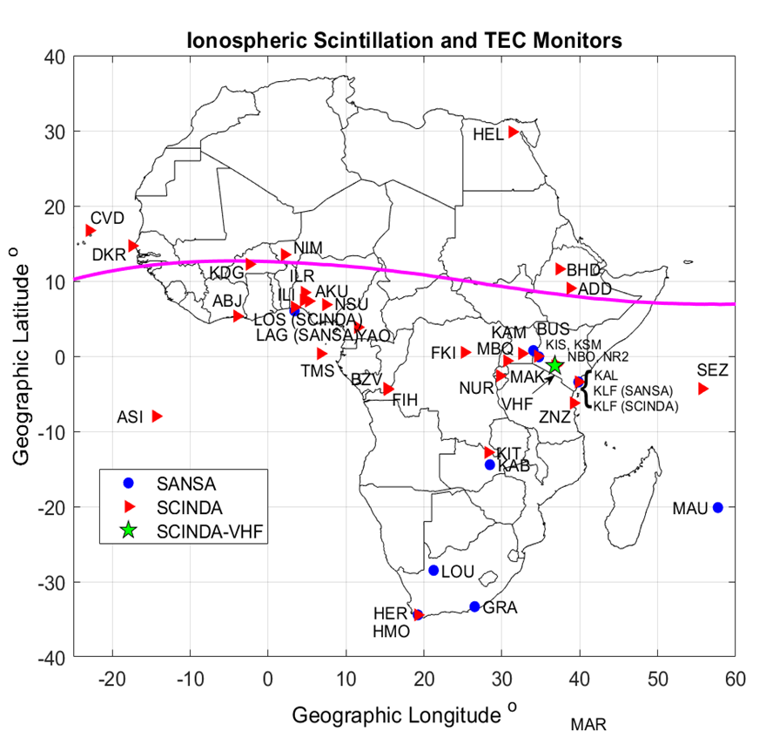
Some SCINDA stations are not working anymore.
NORISK project
New Observatory for Real-time Ionospheric Sounding over Kenya (NORISK) is a 3 years project (KOM 12 November 2021) with the following objectives:
O1. Design and development of a new ionospheric observatory in BSC;
O2. Development of models and algorithms for the low-latitude ionospheric monitoring and research by exploiting data from the new observatory;
O3. Training of a new generation of Space Weather scientists in Eastern Africa.
Only 4 ionosondes are currently installed in the african continent. Only 2 of them are operational.
Baki et al., The Status of Space Weather Infrastructure and Research in Africa, submitted

Slide 10
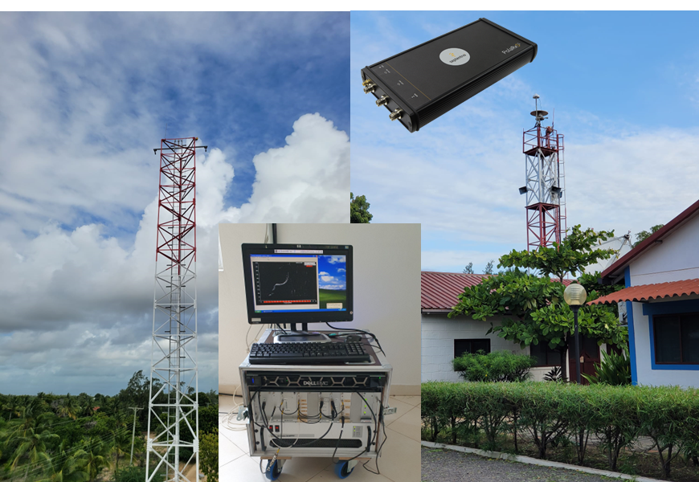
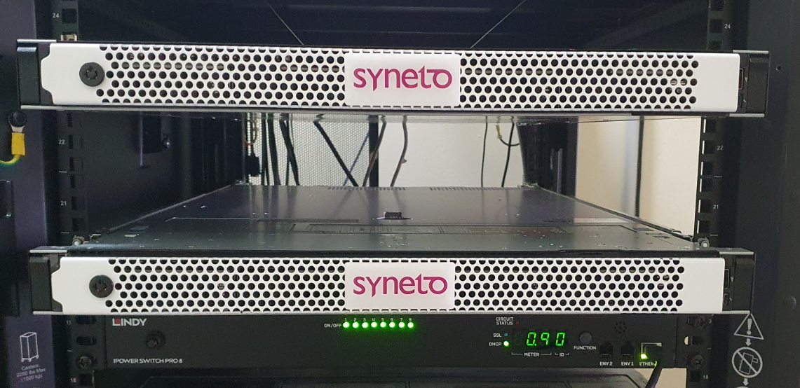
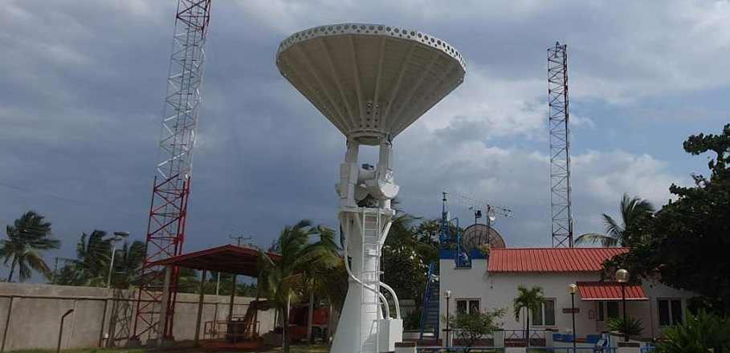
New ionospheric observatory in Luigi Broglio Malindi Space Center (Kenya)
AIS ionosonde
The new ionospheric observatory includes an ASI ionosonde and a professional GNSS receiver for scintillation monitoring.
Visit to the ionosonde scheduled on Thrusday!

Slide 11
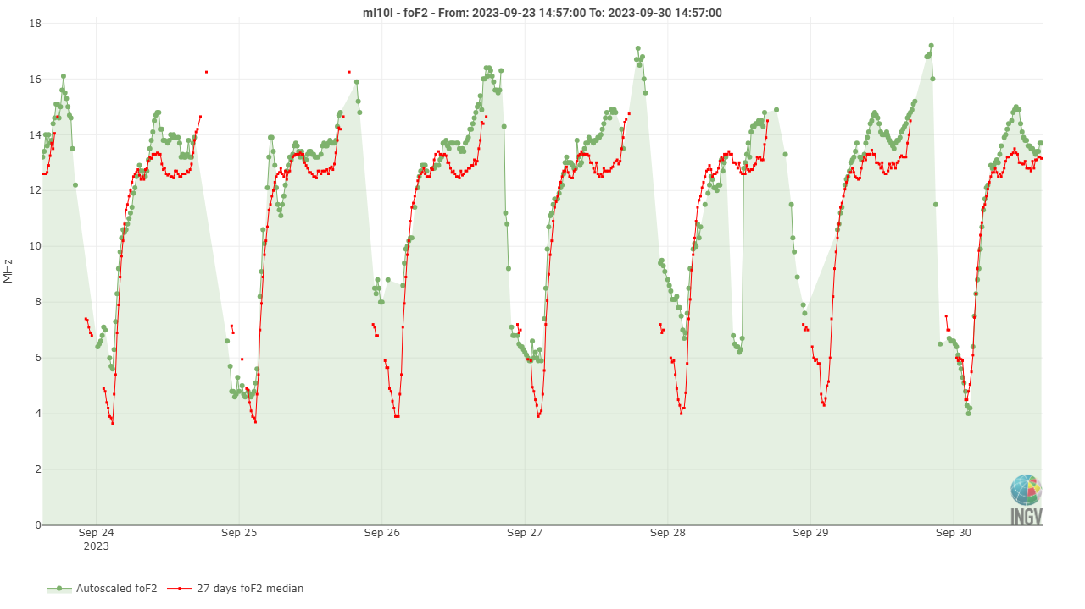
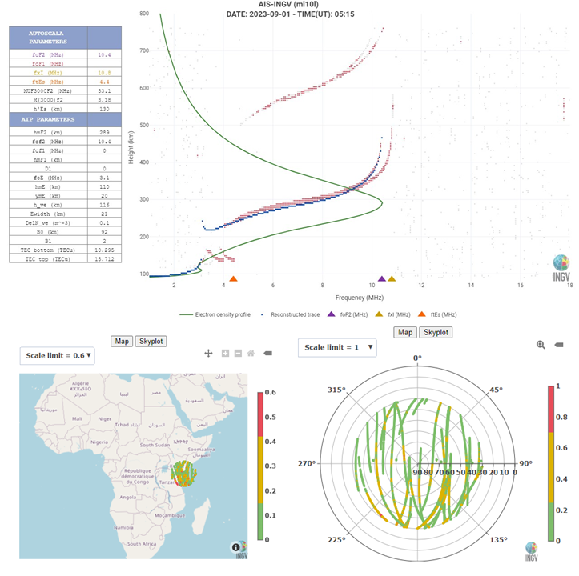

New ionospheric observatory in Luigi Broglio Malindi Space Center (Kenya)
http://www.eswua.ingv.it/
http://norisk.rm.ingv.it/

Slide 12
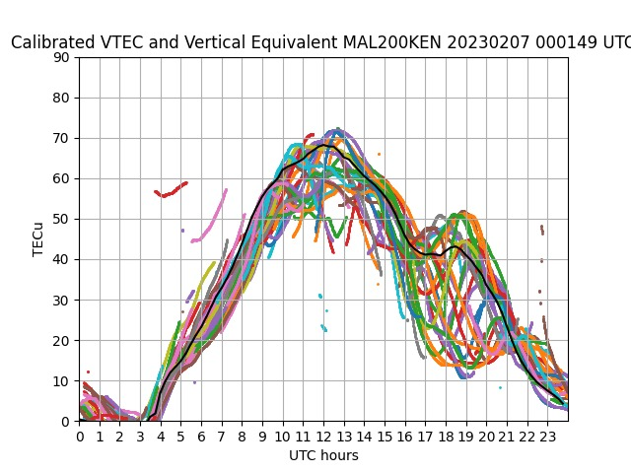
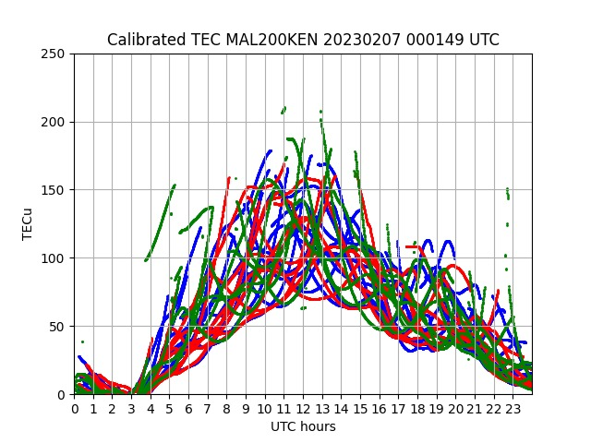
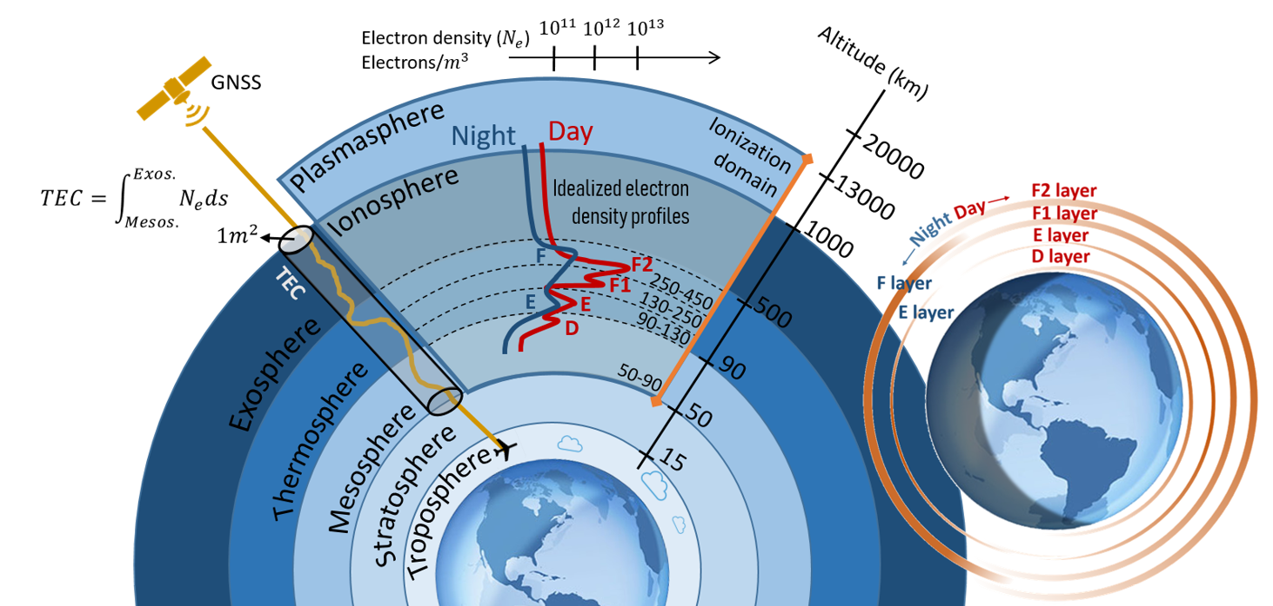
Data processing, ionopheric modelling and products development
Given the dispersive nature of the ionosphere, it is possible to retrieve the Total Electron Content (TEC) by using GNSS signals at 2 different frequencies.
Unfortunately, the TEC estimated from GNSS code and phase measurements suffers from the so-called Differential Code Biases.
In the frame of NORISK we are developing a new algorithm based on the technique introduced by Ciraolo et al., 2007 in order to minimize the impact of the DCBs.

Slide 13
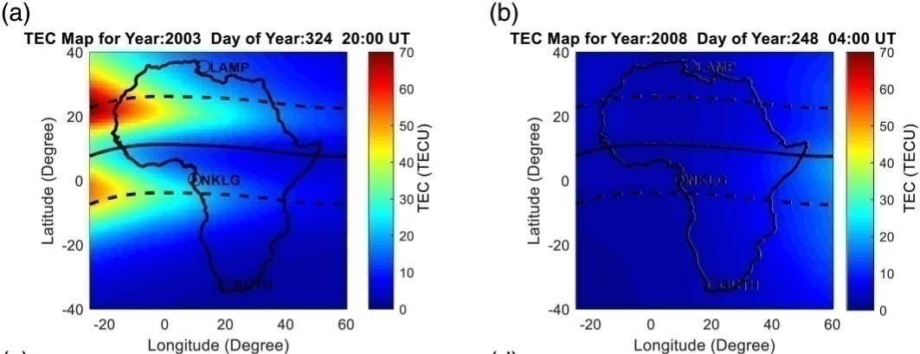
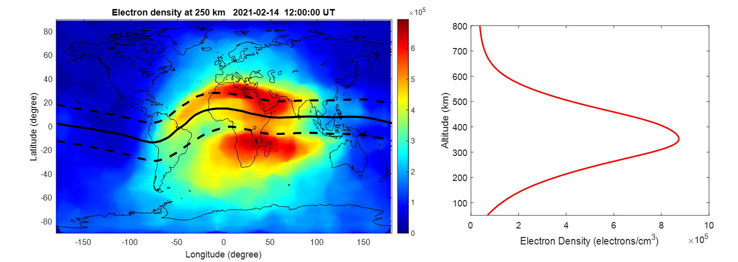
Data processing, ionopheric modelling and products development
Ingesting data from the recently installed Malindi ionosonde into the AfriTEC (Okoh et al 2019, 2020) and 3D-NN (Habarulema et al., 2021) models, as a way of utilizing sparse 3D data in the African region to improve ionospheric modelling accuracy in the region
AfriTEC, 3D-NN Model
Electron Density measurements from Malindi ionosonde
Improved Accuracy for Real-Time Applications

Slide 14
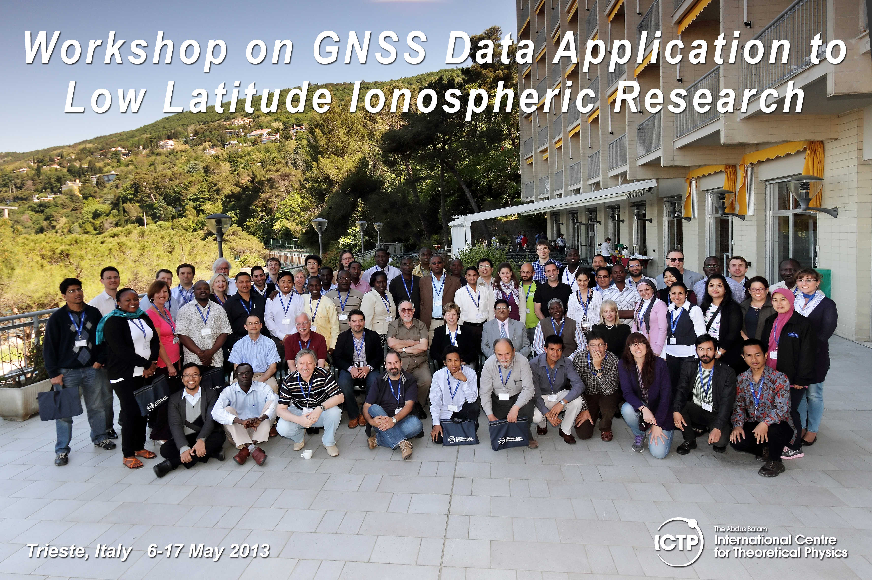
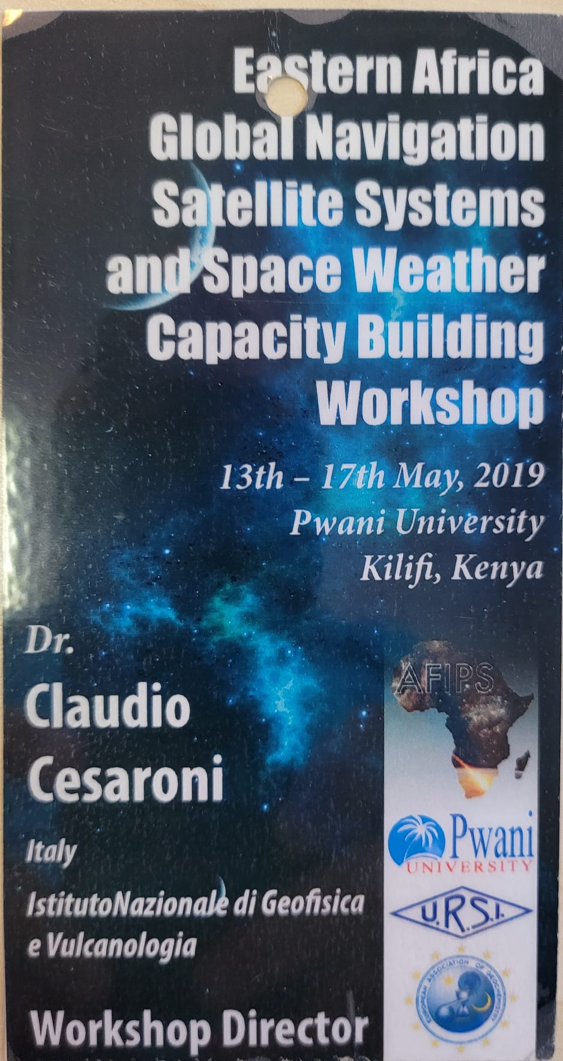



Training for Space Weather scientists
NORISK foresees the organization of 2 capacity building workshops for Eastern Africa young scientists:
Capacity buuilding workshop @ BSC, Malindi, Kenya (2023)
Capacity building workshop @ ICTP, Trieste, Italy (2024)

Slide 15
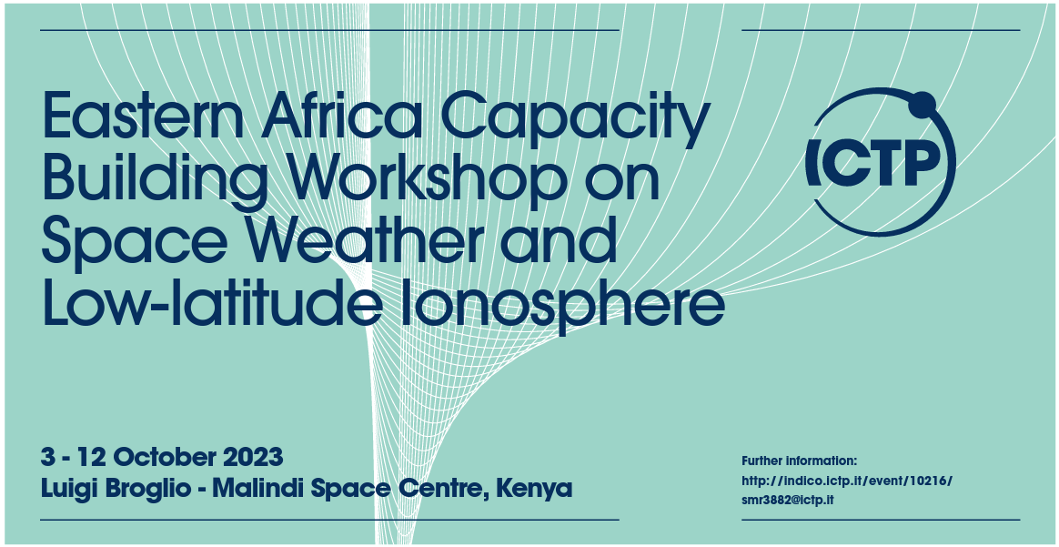




Training for Space Weather scientists
NORISK foresees the organization of 2 capacity building workshops for Eastern Africa young scientists:
Capacity buuilding workshop @ BSC, Malindi, Kenya (2023)
Capacity building workshop @ ICTP, Trieste, Italy (October 2024) – More information to come!
C. CESARONI, INGV, Italy
S. GADIMOVA, UNOOSA, Austria
K. GROVES, Boston College, USA
B. NAVA, ICTP, Italy
J.O. OLWENDO, Pwani University, Kenya
G. SANTILLI, ASI, Italy

Slide 16
Thanks for your attention!
Questions?

