Slide 1
High Frequency (HF) vertical ionospheric soundings
Michael Pezzopane (Piece of bread)
michael.pezzopane@ingv.it
Istituto Nazionale di Geofisica e Vulcanologia, 00143, Rome, Italy

Slide 2
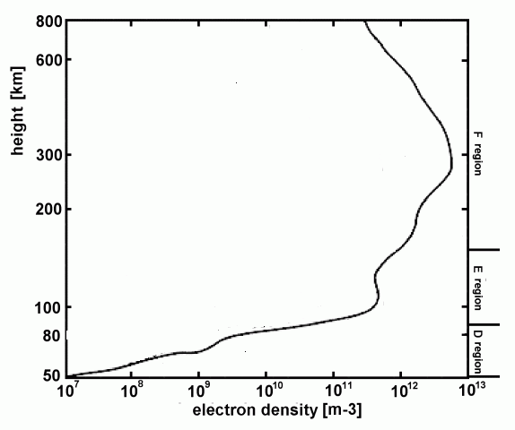
The terrestrial ionosphere
Region of the atmosphere where the ion and electron density reaches values as to influence the refraction index of radio waves (3kHz – 30MHz).
The ionospheric plasma is mainly due to the photoionization of atmospheric gases caused by the UV and X electromagnetic radiation coming from the Sun.
It is a very low-density plasma immersed in the geomagnetic field (magnetoplasma).
500 km
Thermopause
Stratopause
50 km

Slide 3
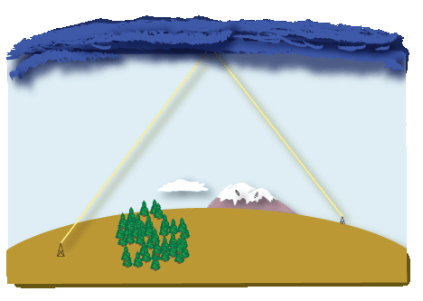
The terrestrial ionosphere
It affects the electromagnetic wave propagation and then its study is important for Earth-Earth, satellite-Earth, and satellite-satellite communication purposes.
The ionosphere acts as a big electromagnetic mirror that refracts and reflects signals transmitted from the Earth towards the ground.
This makes it possible radio connections between sites on the terrestrial surface that cannot see each other because of both the Earth’s curvature and obstacles, like for instance mountains.

Slide 4
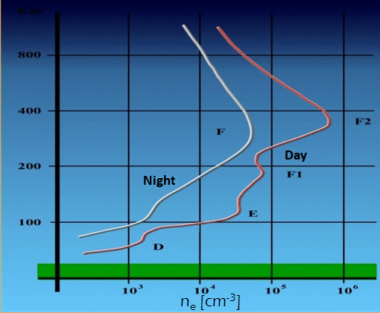
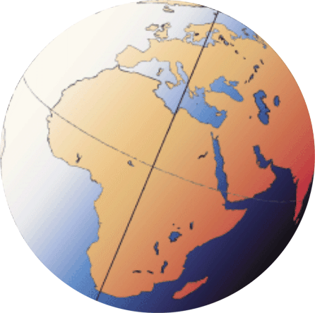
The terrestrial ionosphere
D region: between 60÷90 km of altitudes and mainly responsible for the radiowaves absorption.
km
E region: between 90÷150 km of altitudes and reflects medium and long radiowaves (λ > 100 m).
F region: between 150÷400 km of altitudes and reflects the short radiowaves (λ < 100 m).
Notes:
4

Slide 5
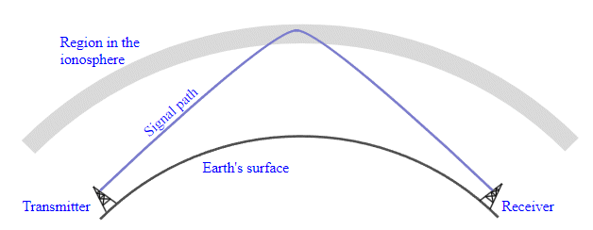
Possible Ionospheric Propagations: Oblique and Vertical
Vertical propagation
Oblique propagation
Rx
Tx
We will focus
on this method
Increasing the transmitted frequency, in the oblique case we go farther, in the vertical case we go higher. Anyhow, there will be a value of the frequency beyond which the signal penetrates the ionosphere without being reflected.

Slide 6
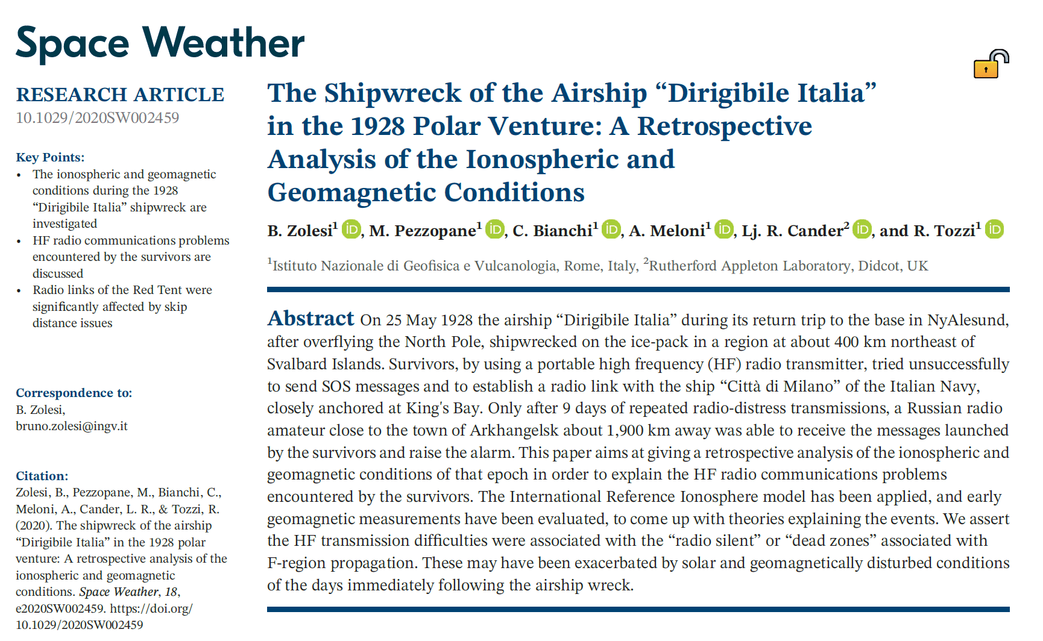
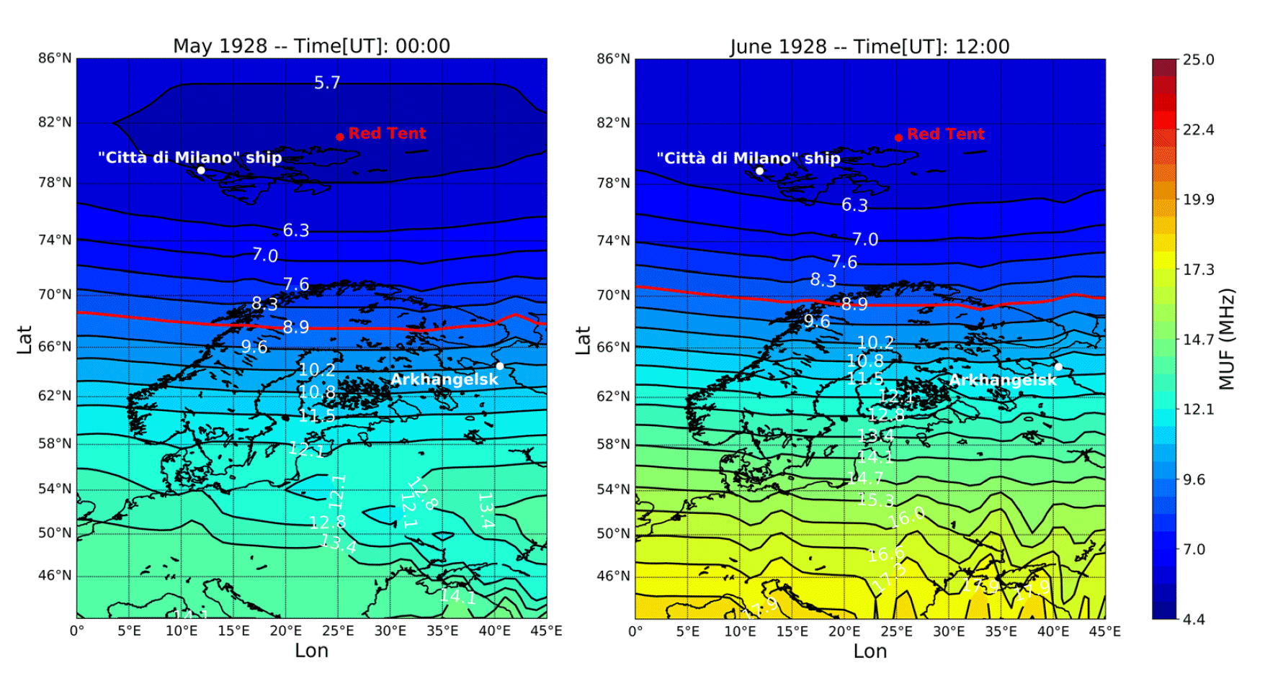
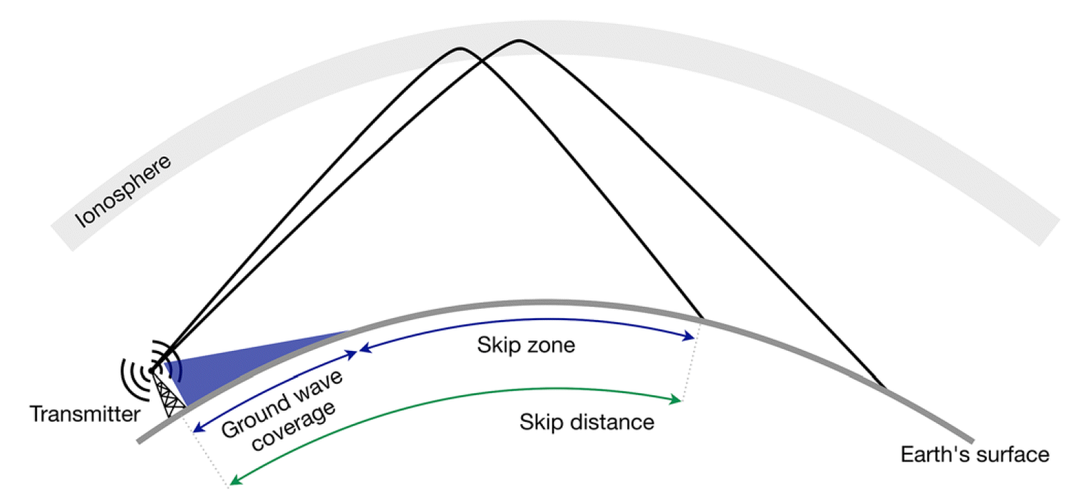
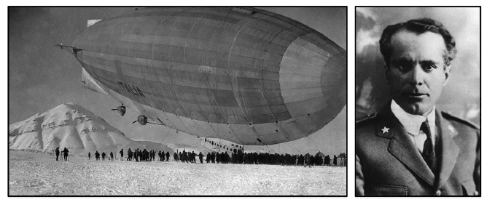
Importance of the chosen frequency for oblique propagation: the case of the « Dirigibile Italia » airship
Survivors, by using a portable high frequency (HF) radio transmitter, tried unsuccessfully to send SOS messages and to establish a radio link with the ship “Città di Milano” of the Italian Navy, closely anchored at King's Bay. Only after 9 days of repeated radio‐distress transmissions, a Russian radio amateur close to the town of Arkhangelsk about 1,900 km away was able to receive the messages launched by the survivors and raise the alarm.

Slide 7
The Plasma Frequency
N is the electron density per unit volume, m the electron mass, e the electron charge and ε0 the electric permittivity of the free space.
f_{N} is called plasma frequency and represents the frequency with which the electrons oscillate around the ions if displaced from their equilibrium position, for instance because of the the perturbing electric field E of the electromagnetic wave propagating through the ionospheric plasma.
A plasma can be considered neutral over temporal scales greater than the corresponding oscillation period τ>>1/ω_{N}.

Slide 8
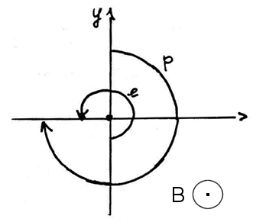
The Gyrofrequency
The gyrofrequency is the angular frequency of the circular motion of a charged particle in the plane perpendicular to the magnetic field defined by the following relation:
H is the magnetic field, μ0 the magnetic permeability of the free space, q the charge of the particle, and m the mass of the charged particle.

Slide 9
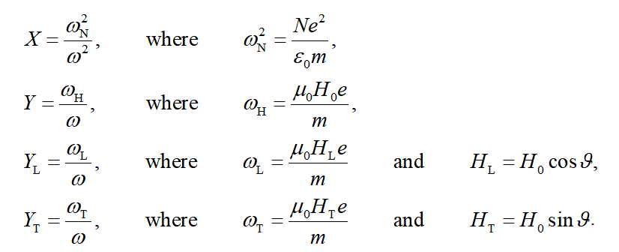
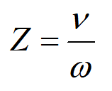
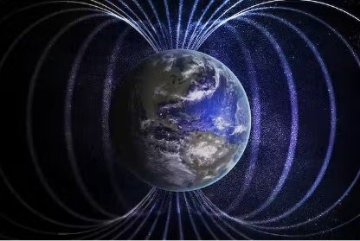
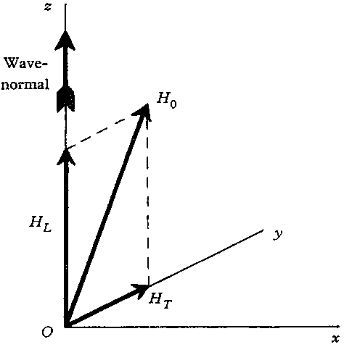
The magnetoionic theory -> the Altar-Appleton equation
The magnetoionic theory is concerned with the propagation of electromagnetic waves through a magnetoplasma.
Specifically, the reflection of the wave occurs when the ionospheric refractive index is equal to 0 → n = 0.
Altar-Appleton
equation

Slide 10
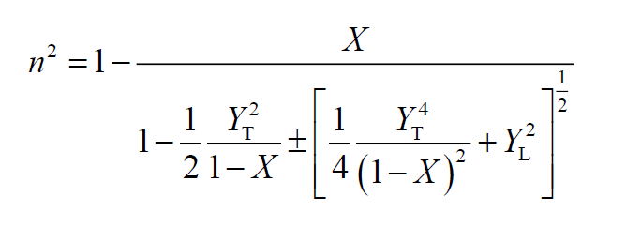
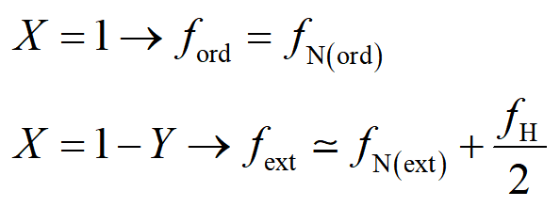
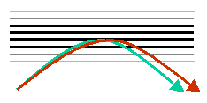
The Altar-Appleton equation neglecting collisions→ reflection conditions
→
After transmitting through a magnetoionic medium an electromagnetic wave with a certain polarisation, two waves propagate through it; these two waves have the same frequency, different phase velocity and different polarisation. This phenomenon is called magnetoionic birefraction of the electromagnetic wave into the magnetoplasma.
Simply speaking, a wave with a generic polarisation can be thought as the resultant of two waves;
if the wave propagates through an isotropic medium the two components are indiscernible;
if the wave propagates through an anisotropic medium (as it is the case of a magnetoionic medium) the two components are instead observable.

Slide 11
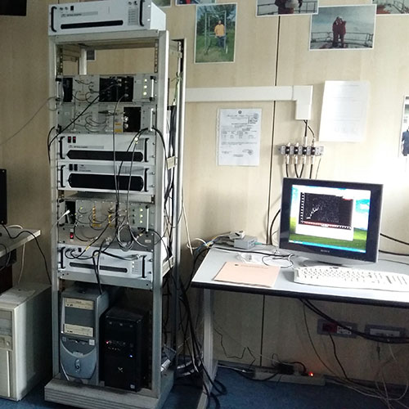
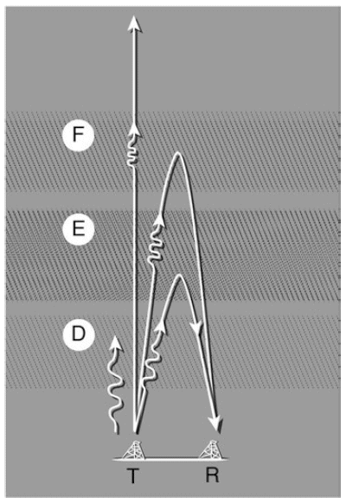
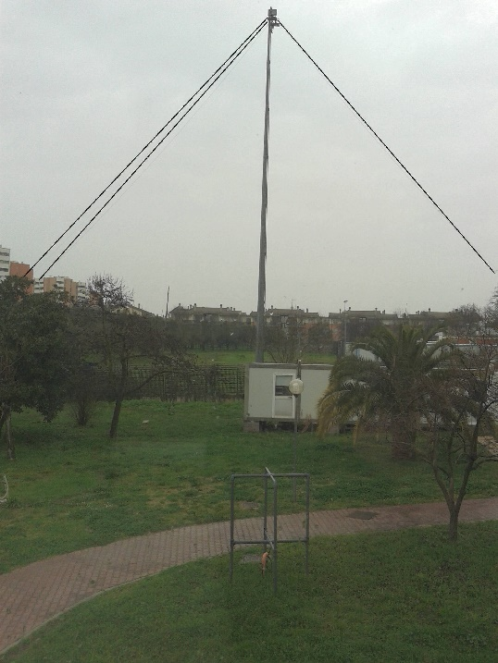
Vertical Ionospheric Soundings - Ionograms
f>fNmax
km
f≤fNmax
MHz

Slide 12
How the Ionogram trace varies along the day
km

Slide 13
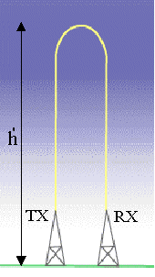
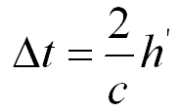
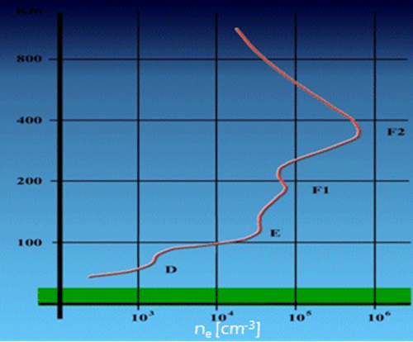
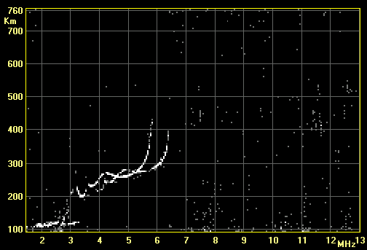
Correspondence vertical electron density profile – ionogram trace
Radiowaves of variable frequency are transmitted vertically towards the atmosphere. The ordinary mode of the transmitted wave is reflected from the ionosphere when the transmitted frequency matches the electron plasma frequency:
Depending on the reflection height there will be a definite time delay according to the relation:
The experimental trace is then a plot of the virtual height of reflection vs the transmitted frequency, which is called ionogram.
km
ordinary
extraordinary

Slide 14
Correspondence vertical electron density profile – ionogram trace
km
km
500
Day
400
Night
300
F2 layer
NmF2
200
NmF1
F1 layer
100
NmE
E layer
10²
10³
10⁴
10⁵
Ne (cm-3)

Slide 15
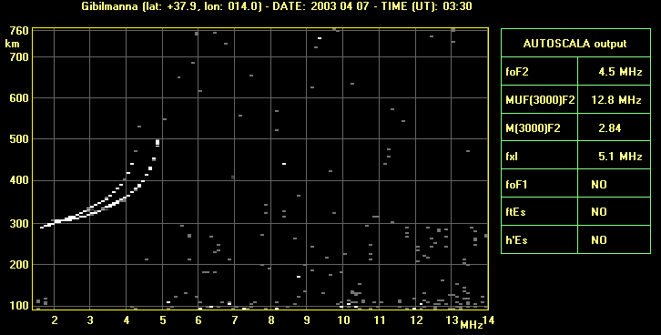
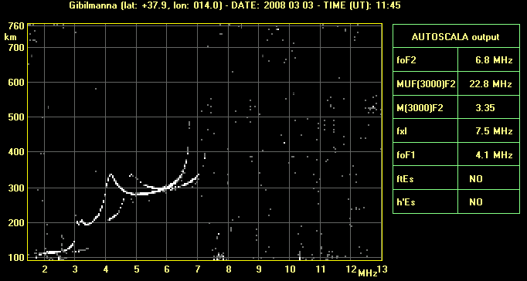
Daytime and Nighttime ionograms
Nighttime ionogram
Daytime ionogram

Slide 16
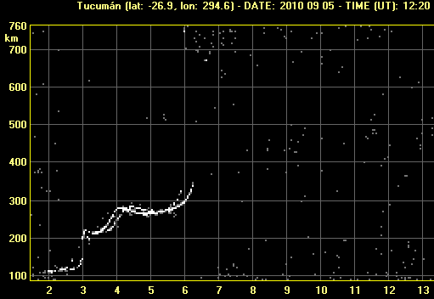
Why electron density maxima of the profile correspond to ionogram cusps?
foF2
NmF2
foF1
foE
NmF1
NmE
From the analysis of an ionogram several important characteristics (like the critical frequencies and the heights of the different ionospheric layers) can be found, that have a significant role in the studies concerning ionospheric physics, space weather and related phenomena.

Slide 17
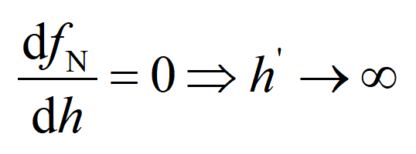
Why electron density maxima of the profile correspond to ionogram cusps?
NmF2
NmF1
NmE
km
foF2
foE
foF1

Slide 18
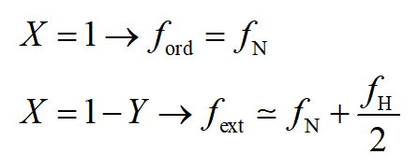
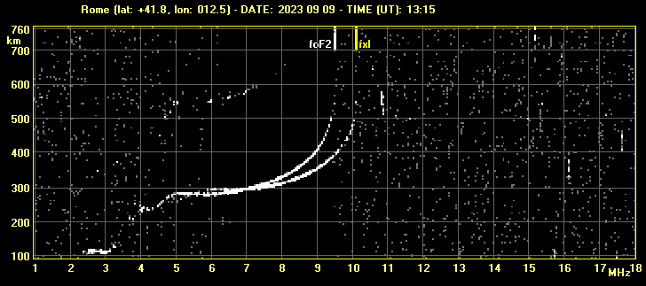
Influence of the geomagnetic field on the ionogram trace

Slide 19
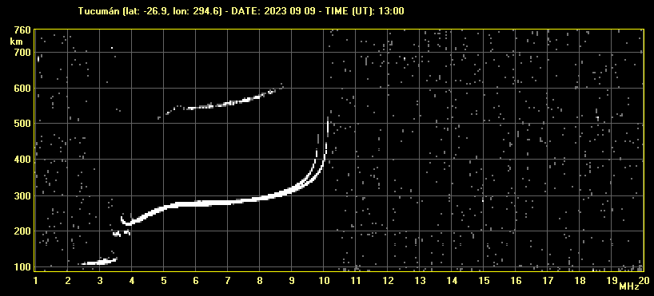
Influence of the geomagnetic field on the ionogram trace

Slide 20
Importance of ionogram interpretation
foF2
foF1
foE
h’F2
h’F1
h’E
From the analysis of one ionogram several important characteristics (like the critical frequencies and the heights of the different ionospheric layers) can be found, that have a significant role in the studies concerning ionospheric physics, space weather and related phenomena.

Slide 21
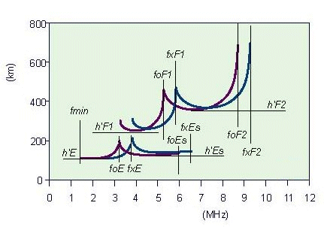
The ionogram scaling
The necessary work to obtain the ionospheric characteristics from an ionogram is called “ionogram interpretation or ionogram scaling”.
Till a few decades ago this interpretation was performed only manually by expert operators with a ruler and a pencil.
Now, luckily, there are softwares that help the operators to accomplish this demanding (but valuable) work.
During the hands-on session you will try to become an IONOGRAM SCALER!!!!

Slide 22
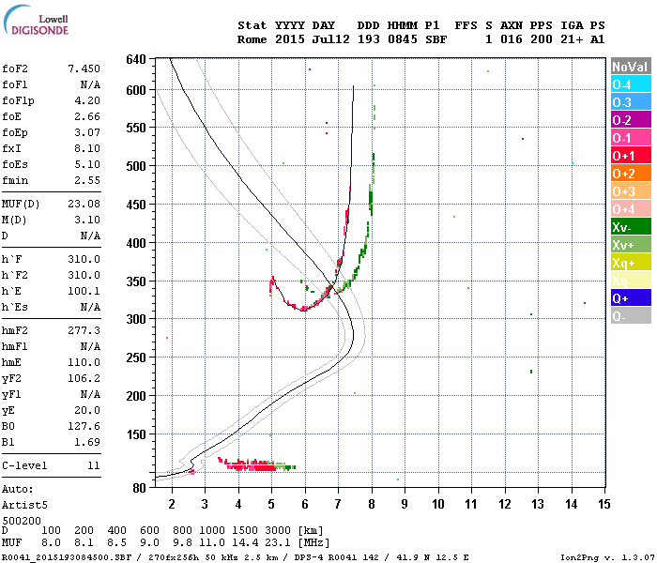
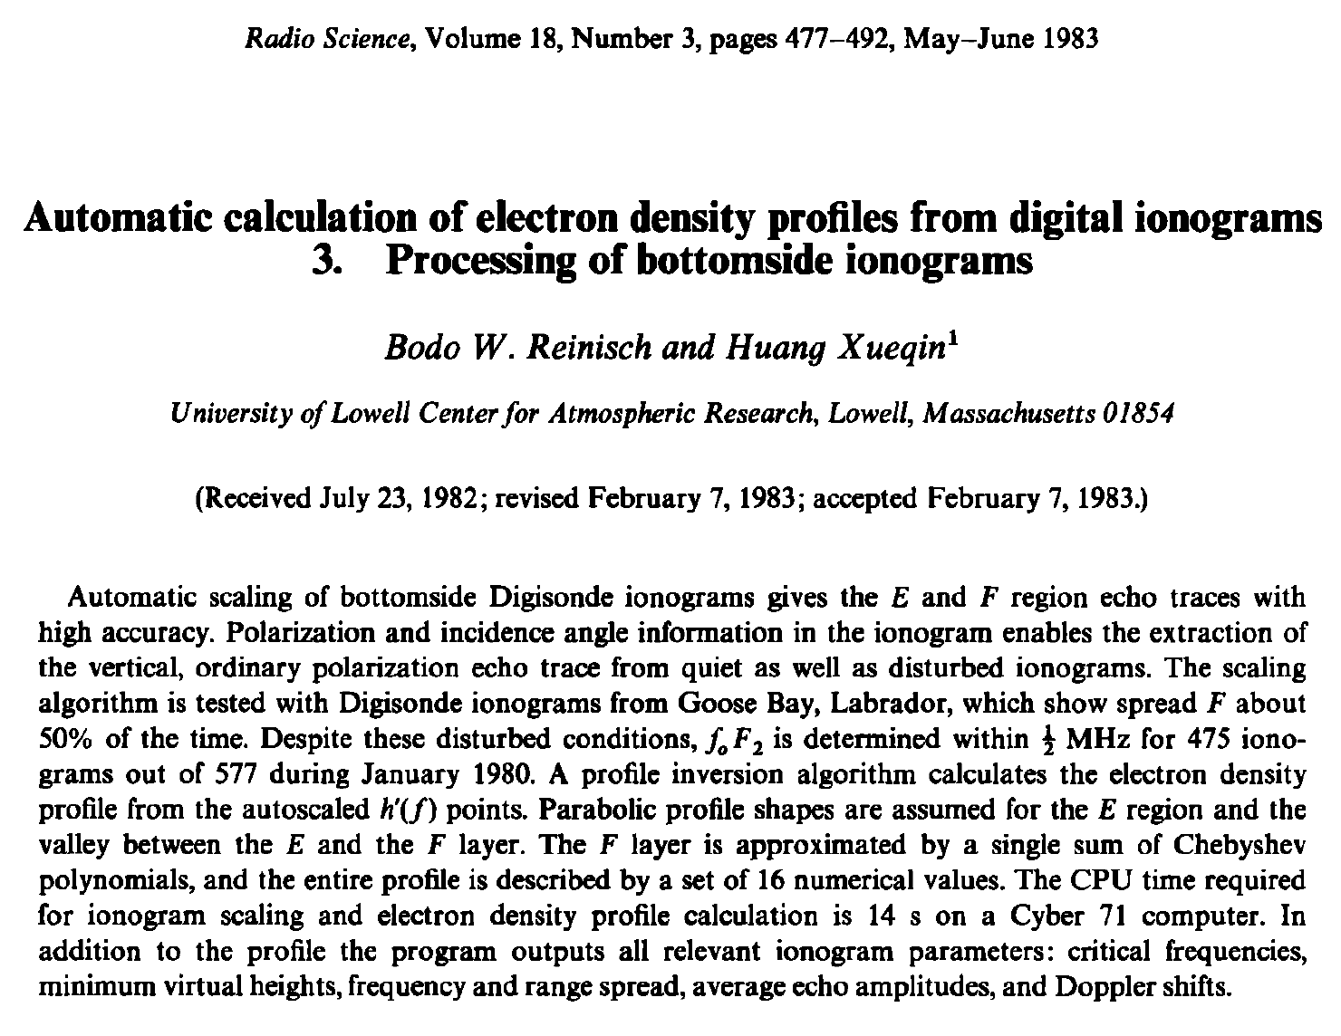
Autoscaling of an ionogram
In the last decades, the importance of having real time ionospheric data for space weather purposes has greatly increased. For this reason since 80s much work has been performed to develop computer programs able to automatically scale the ionograms giving as output the standard ionospheric characteristics along with an estimate of the electron density profile.
Though much progress has been made, still today a significant effort is invested in upgrading these programs in order to improve their reliability.

Slide 23
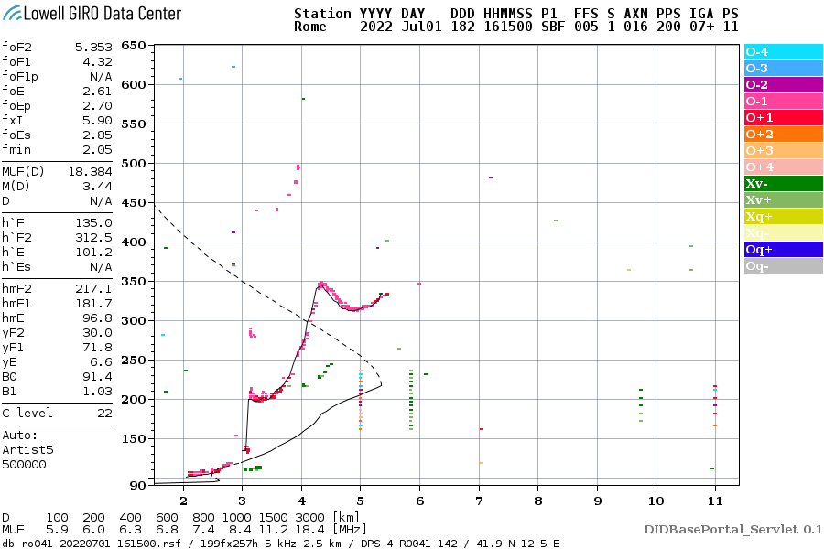
Autoscaling of an ionogram

Slide 24
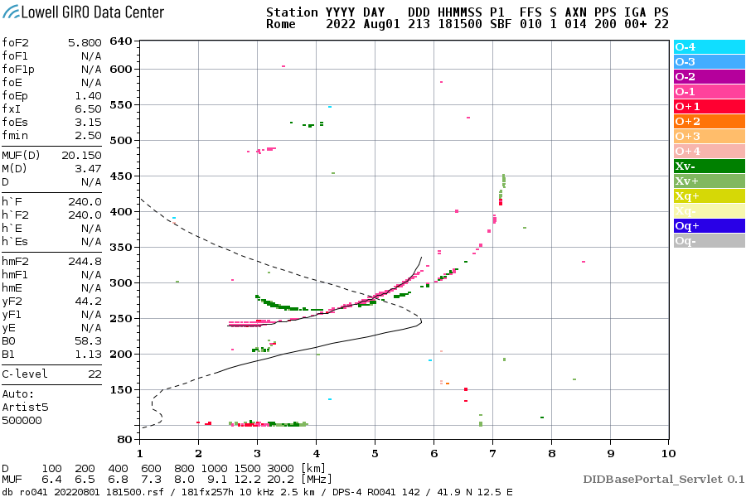
Autoscaling of an ionogram

Slide 25
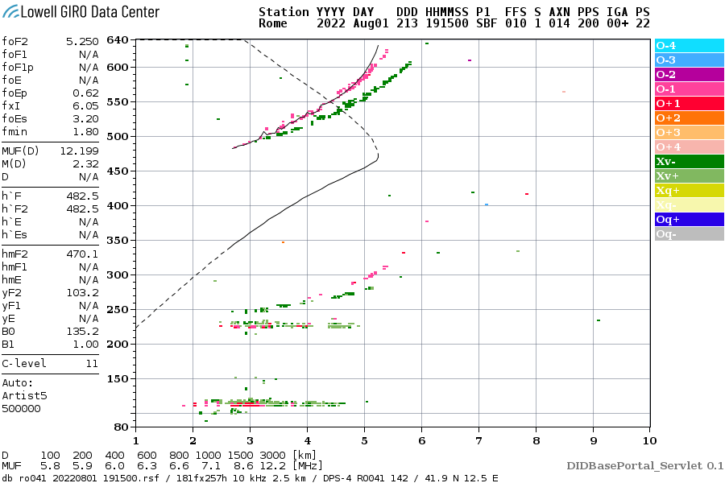
Autoscaling of an ionogram

Slide 26
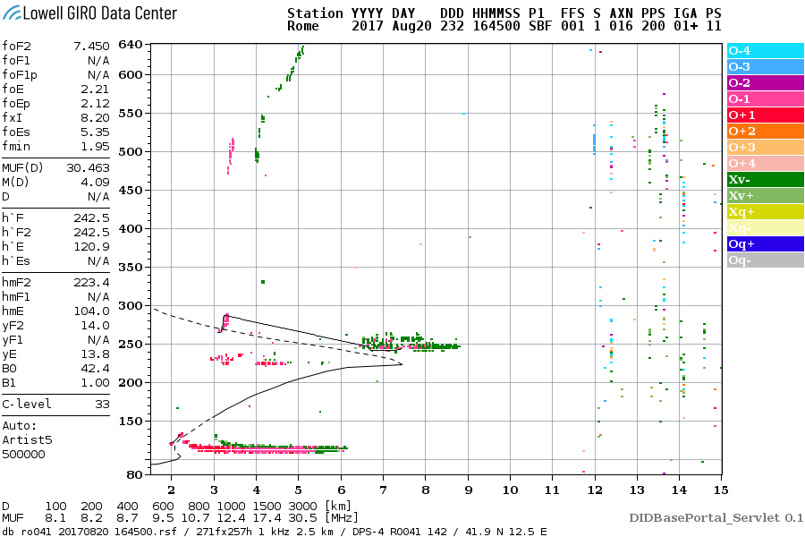
Autoscaling of an ionogram

Slide 27
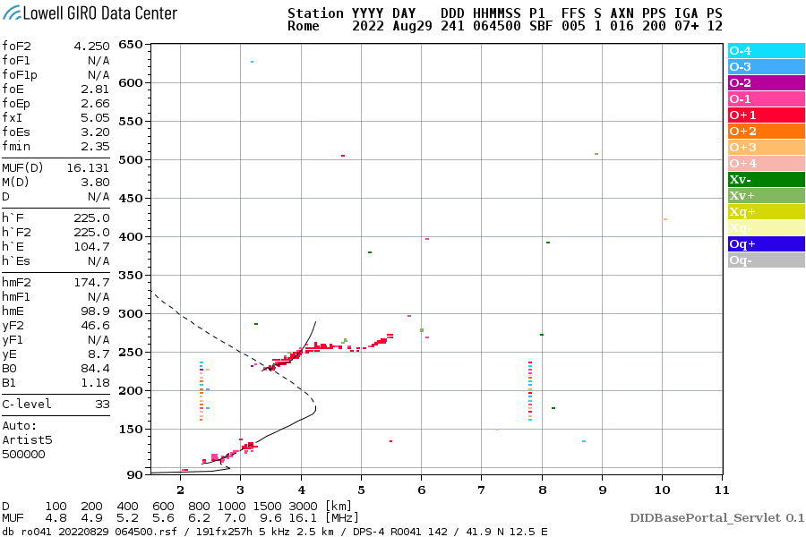
Autoscaling of an ionogram

Slide 28
Autoscaling of an ionogram

Slide 29
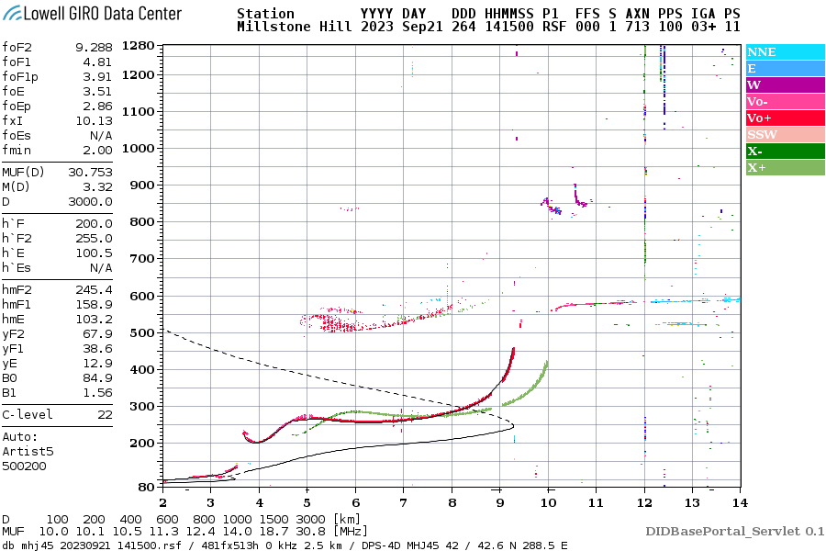
Autoscaling of an ionogram

Slide 30
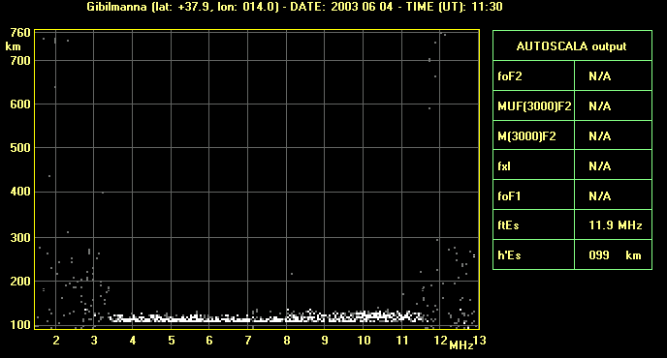
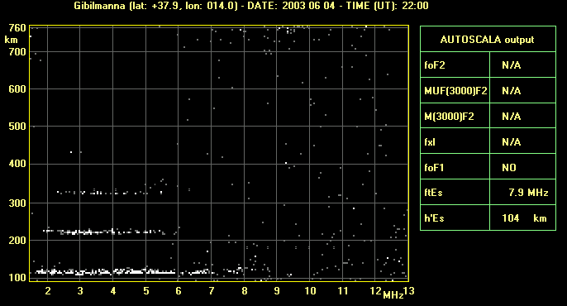
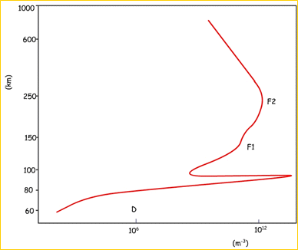
Different types of ionograms
Sporadic E layer

Slide 31
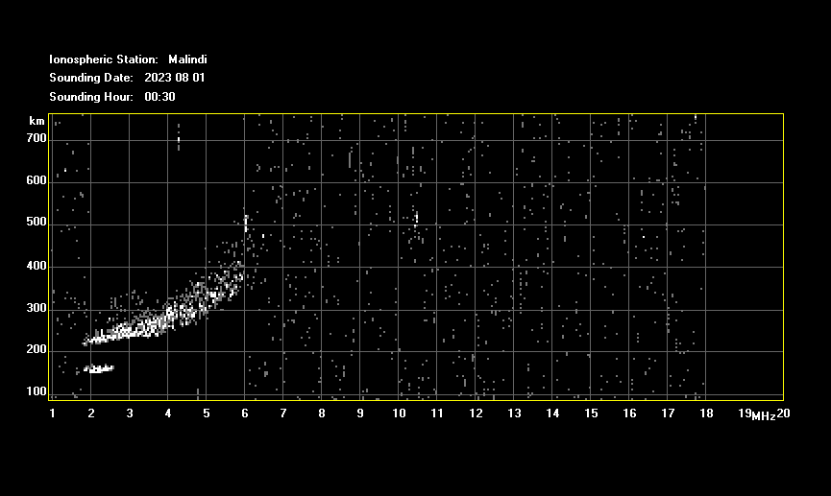
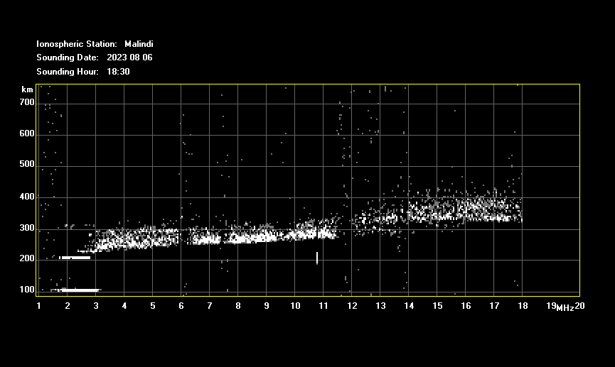
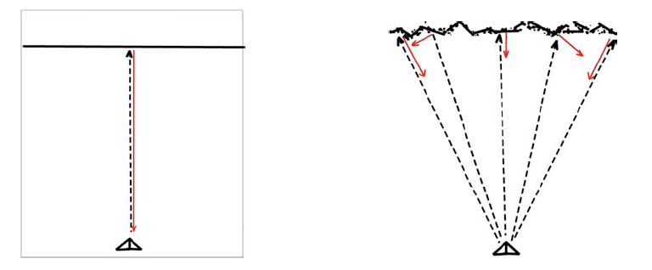
Different types of ionograms
Spread F
flat reflector
Notes:
Presence of plasma irregularities that causes the reflection of the same frequency at different heights and so with different delay times. Consequently, the trace is not defined, spread.

Slide 32
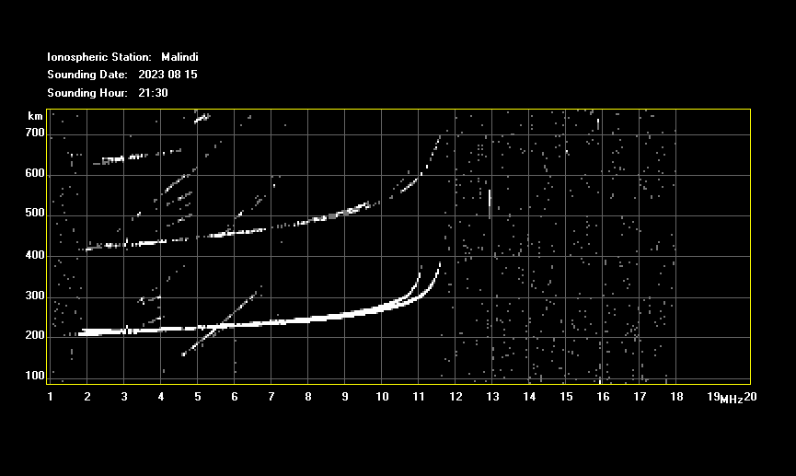
Different types of ionograms
Multiple reflections

Slide 33
Importance of ionosonde stations
They are essential for monitoring the ionospheric plasma in real time for Space Weather purposes and to better understand the ionospheric storm dynamics at different latitudes.
INGV Ionospheric portal→http://eswua.ingv.it/
Rome – March 2015 event
positive phase
negative phase

Slide 34
Importance of ionosonde stations
They are essential for monitoring the ionospheric plasma in real time for Space Weather purposes and to better understand the ionospheric storm dynamics at different latitudes.
INGV Ionospheric portal→http://eswua.ingv.it/
Rome and Malindi – September 2023 event
positive phase
negative phase

Slide 35
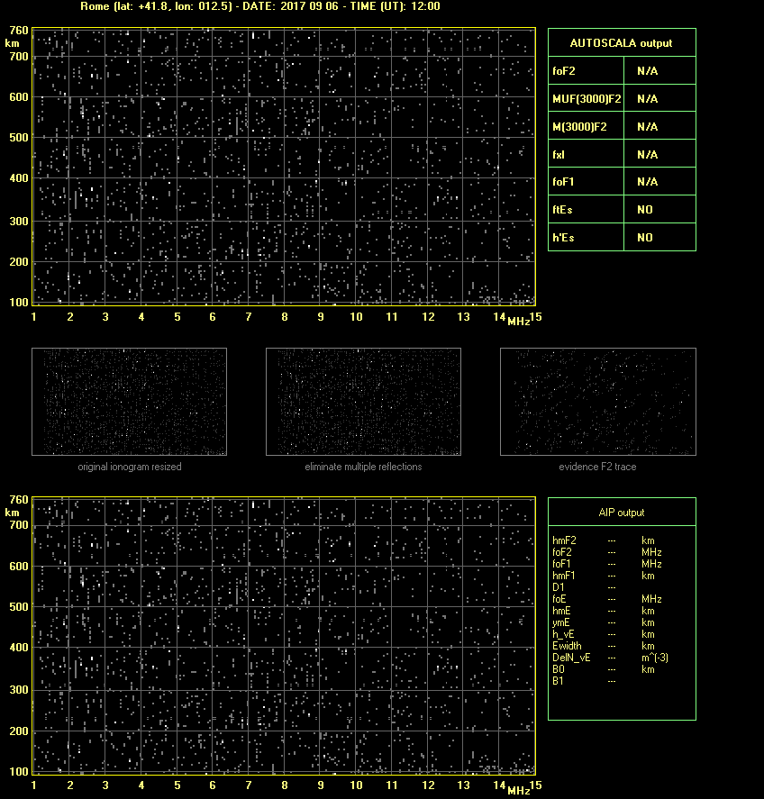
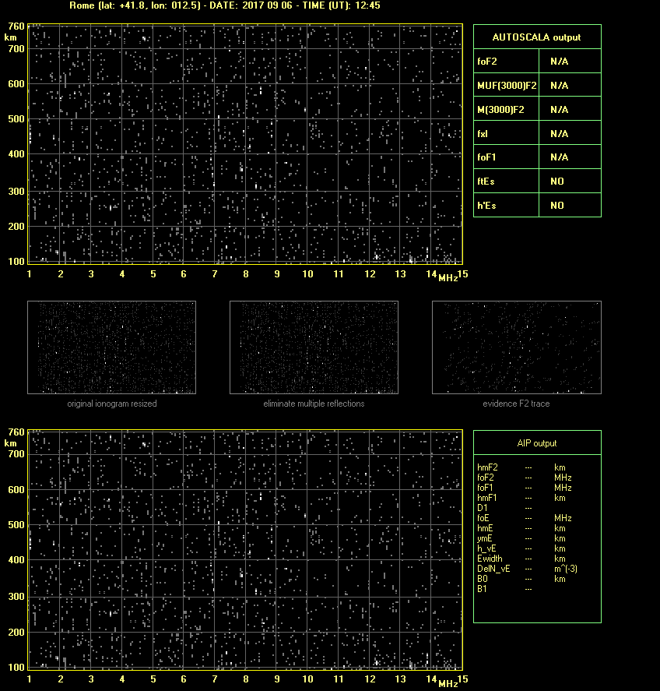
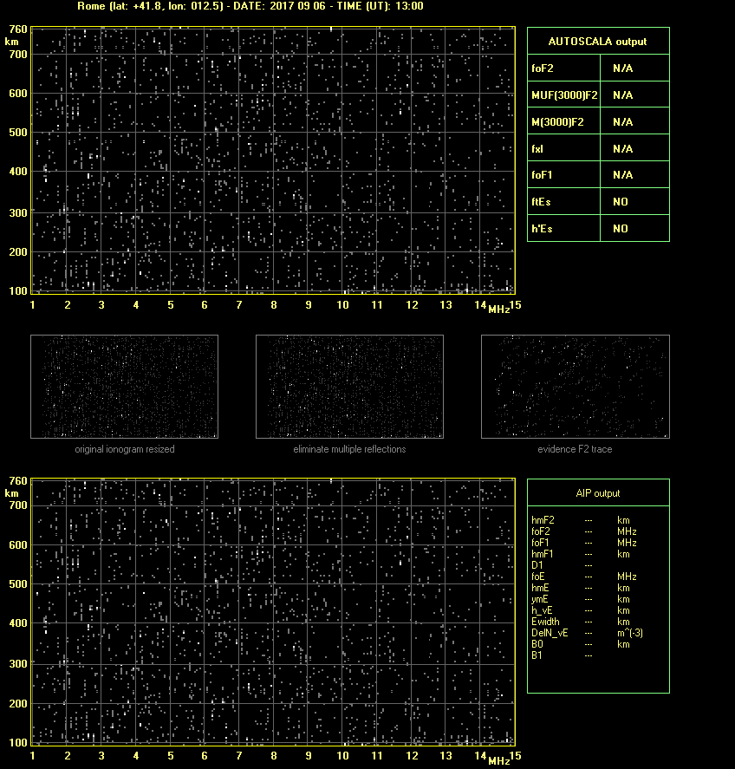
Importance of ionosonde stations
normal propagation
ionosphere
absorption
Two solar flares occurred on 6 September 2017 at 08:57 UT (X2.2) and at 11:53 UT (X9.3)
Notes:
The study and the real-time monitoring of the ionosphere are important for Space Weather purposes. During a solar flare, if this is enough energetic and occurs on the Sun side towards the Earth, some of the released X rays penetrate the terrestrial atmosphere till the lower altitudes of the ionosphere, causing an increase of ionization and then an increase of the absorption suffered by the electromagnetic wave.

Slide 36
Importance of ionosonde stations
INGV Ionospheric portal→http://eswua.ingv.it/
Rome - September 2017 event
Absorption of the signal transmitted by the ionosonde from about 9 UT to 13:30 UT!!!

Slide 37
Importance of ionosonde stations
NmF2
NmF1
NmE
km
foF2
foE
foF1

Slide 38
Conclusion
AIS-INGV - August 2007
Tucuman

Slide 39
Conclusion
Now the Australian Space Weather Forecasting Centre→https://www.sws.bom.gov.au/
AIS-INGV + Autoscala

Slide 40
Hands-0n session –> Scaling of foF2 from Malindi ionograms
It only runs under the Windows system

Slide 41
Hands-0n session –> Scaling of foF2 from Malindi ionograms
Ionospheric characteristic → foF2
Ionospheric station → Malindi
Ionograms from August 2023: days 06, 07, 08, 09, 12 and 13
Time resolution: 15 minutes (maximum 96 ionograms per day)
Step 1: scaling of foF2 for all the ionograms of the day
Step 2: plot of the foF2 values (Excel? Python? Matlab? Choose the way you prefer)
Step 3: COMPARISON BETWEEN YOUR RESULTS AND MINE!!!
Team 1 → 06 August 2023
Team 2 → 07 August 2023
Team 3 → 08 August 2023
Team 4 → 09 August 2023
Team 5 → 12 August 2023
Team 6 → 13 August 2023

Slide 42
Thank you!!

Slide 43
Backup slides

Slide 44
The Ionosphere: some physical characteristics
Why is the ionosphere characterized by electron density maxima?
The existence of the ionospheric layers is due to the fact that the density of atoms that can be photoionized decreases with the height while the intensity of the radiation increases; these two opposite effects produce a maximum in the vertical electron density profile. To this maximum one makes it correspond an ionospheric layer.

Slide 45
The Ionosphere: some physical characteristics
Why is the ionosphere characterized by different layers?
Since the different molecolar species present in the atmosphere are vertically stratified, and react differently to the solar radiation, the vertical electron density profile is characterized by several relative maxima and minima that identify different ionospheric layers; one makes the main layers correspond to the ionospheric regions.

Slide 46
Vertical Ionospheric Soundings: ionogram cusps
Frequenze critiche→Cuspidi dello ionogramma
since μ’=1 at the base h₀ of the ionosphere
In the absence of magnetic field and collisions, the refraction index is μ²=1-(f²_{N}/f²) and μμ’=1; then also μ’ is function of f_{N}.

Slide 47
Sporadic E layer
The most accredited theory today for the explanation of the formation of sporadic E layers is the windshear theory, i.e. it is believed that these layers are created by the drift vxB, where v refers to the speed of the zonal neutral wind. Ion dynamics at typical E-region heights are dominated by collisions. When there are zonal neutral winds towards W and towards E (or better still towards W but slower), the presence of a B causes an accumulation of ions to be created in the central zone which gives rise to an E and therefore an accumulation of electrons.

Slide 48
Importance of ionosonde stations
They are essential for monitoring the ionospheric plasma in real time for Space Weather purposes and to better understand the ionospheric storm dynamics.

