Slide 1
Hands-on on ionogram scaling
Visit to the Malindi Ionosonde
Michael Pezzopane – Claudio Cesaroni
michael.pezzopane@ingv.it, claudio.cesaroni@ingv.it
Istituto Nazionale di Geofisica e Vulcanologia, 00143, Rome, Italy

Slide 2
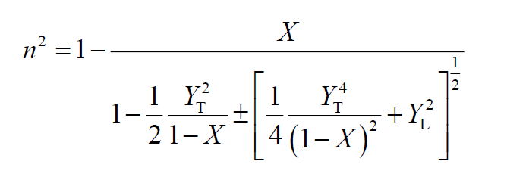
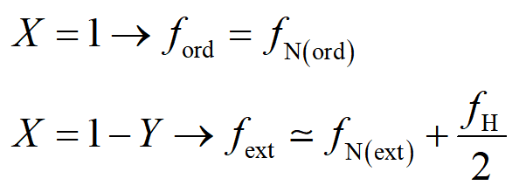
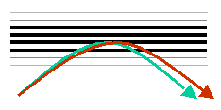
The Altar-Appleton equation neglecting collisions→ reflection conditions
→
After transmitting through a magnetoionic medium an electromagnetic wave with a certain polarisation, two waves propagate through it; these two waves have the same frequency, different phase velocity and different polarisation. This phenomenon is called magnetoionic birefraction of the electromagnetic wave into the magnetoplasma.
Simply speaking, a wave with a generic polarisation can be thought as the resultant of two waves;
if the wave propagates through an isotropic medium the two components are indiscernible;
if the wave propagates through an anisotropic medium (as it is the case of a magnetoionic medium) the two components are instead observable.

Slide 3
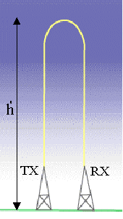
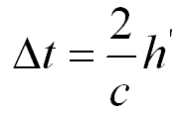
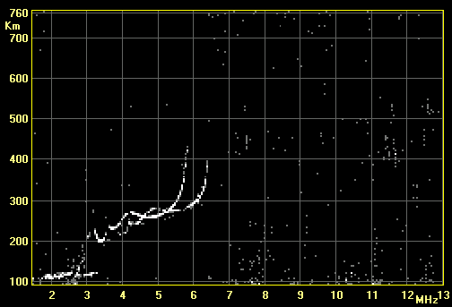
Correspondence vertical electron density profile – ionogram trace
Radiowaves of variable frequency are transmitted vertically towards the atmosphere. The ordinary mode of the transmitted wave is reflected from the ionosphere when the transmitted frequency matches the electron plasma frequency:
Depending on the reflection height there will be a definite time delay according to the relation:
The experimental trace is then a plot of the virtual height of reflection vs the transmitted frequency, which is called ionogram.
km
ordinary
extraordinary

Slide 4
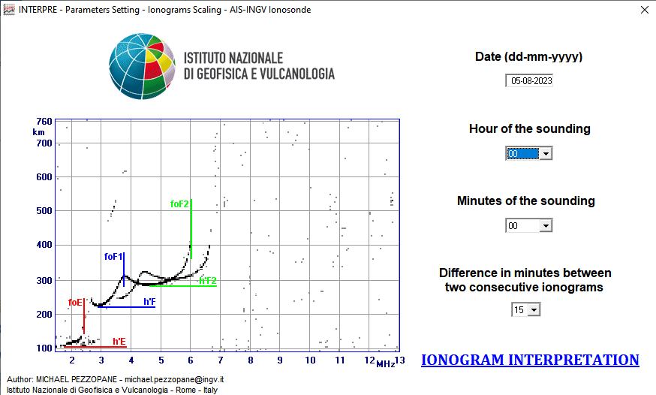
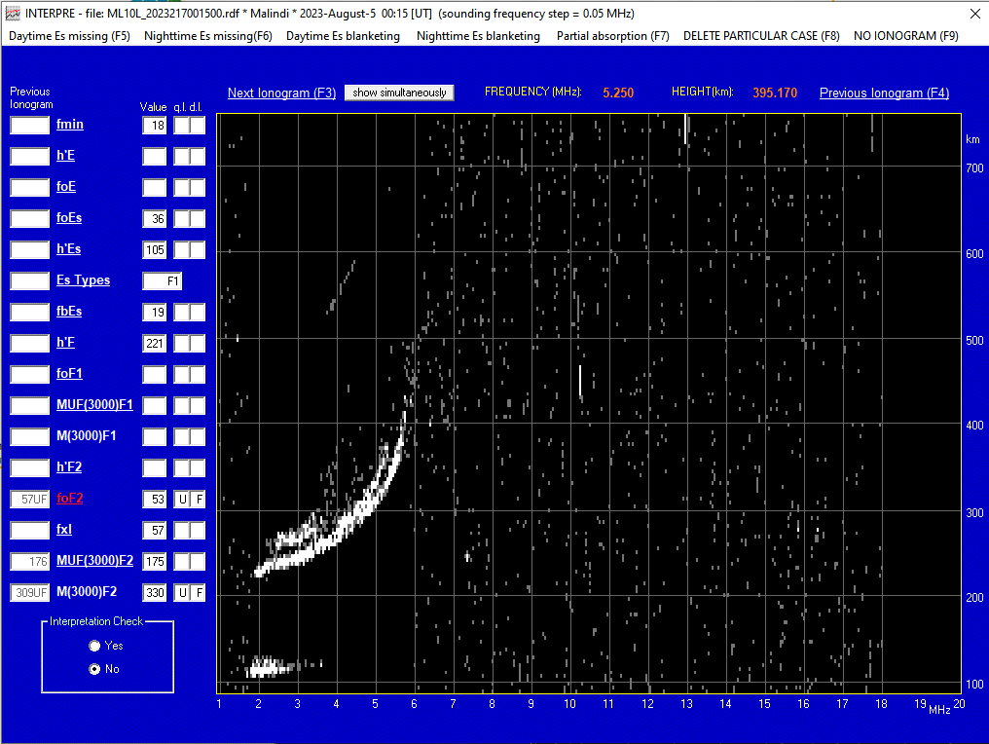
The Interpre software
It only runs under the Windows system

Slide 5
The Interpre software
Interpre_Manual.pdf

Slide 6
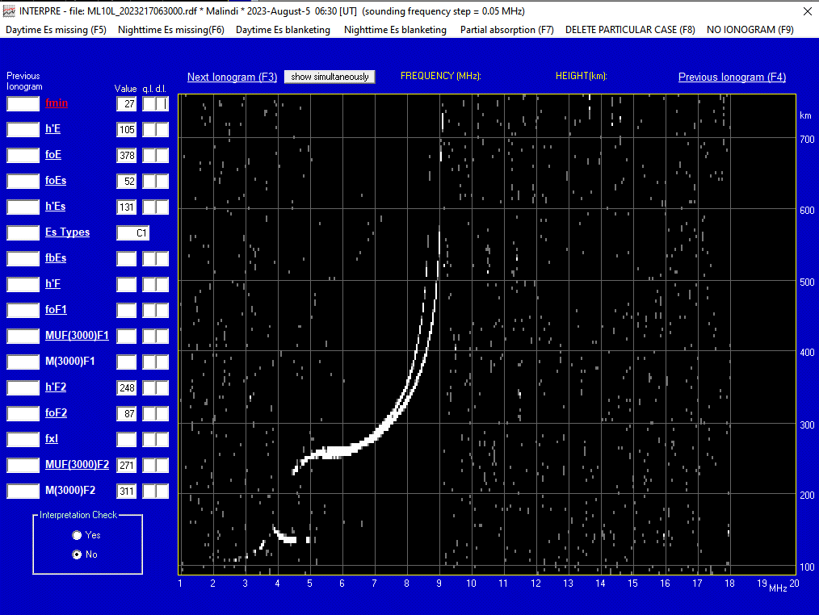
The Interpre software
2.7 MHz

Slide 7
3.78 MHz

Slide 8
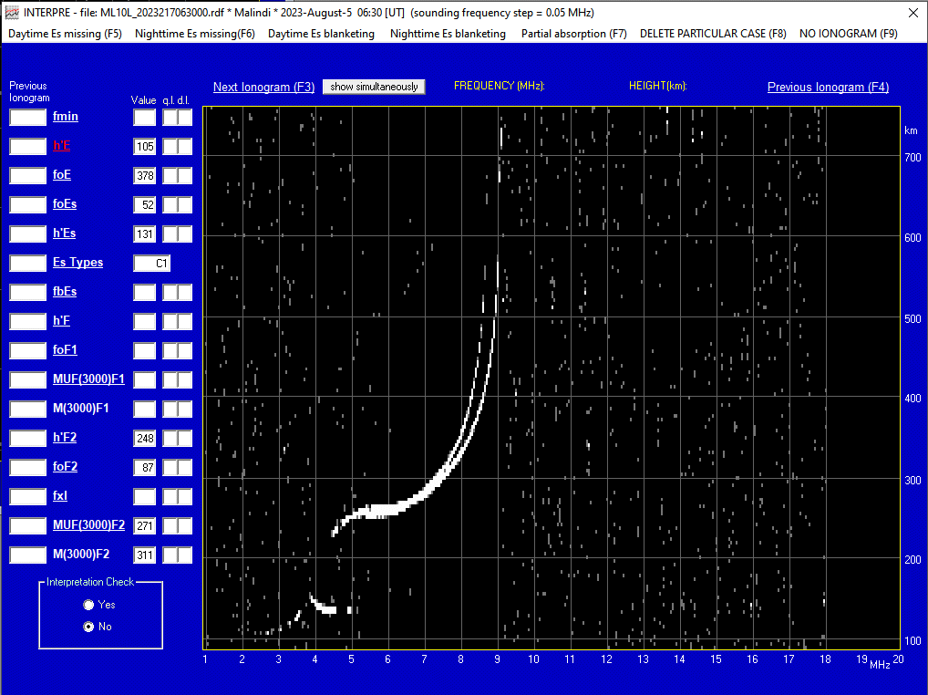
105 km

Slide 9
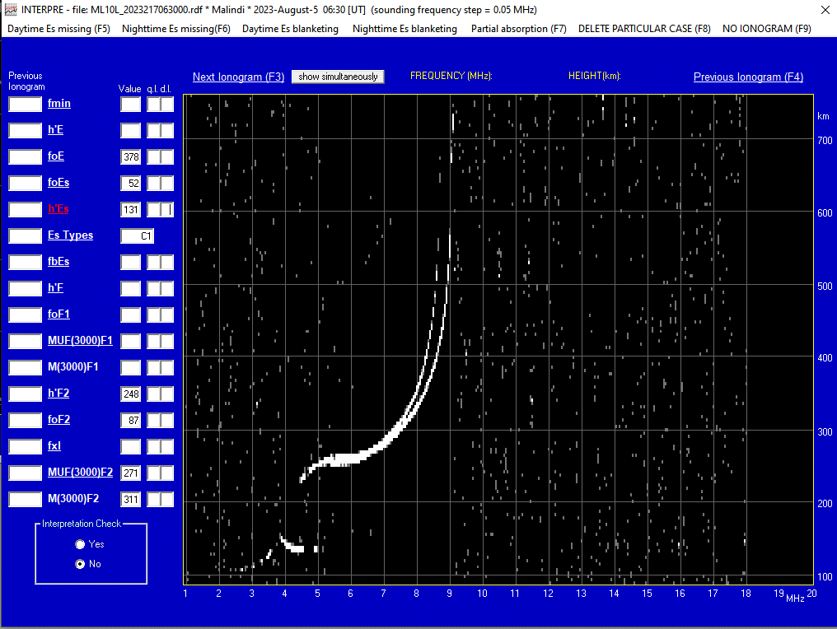
131 km

Slide 10
5.2 MHz

Slide 11
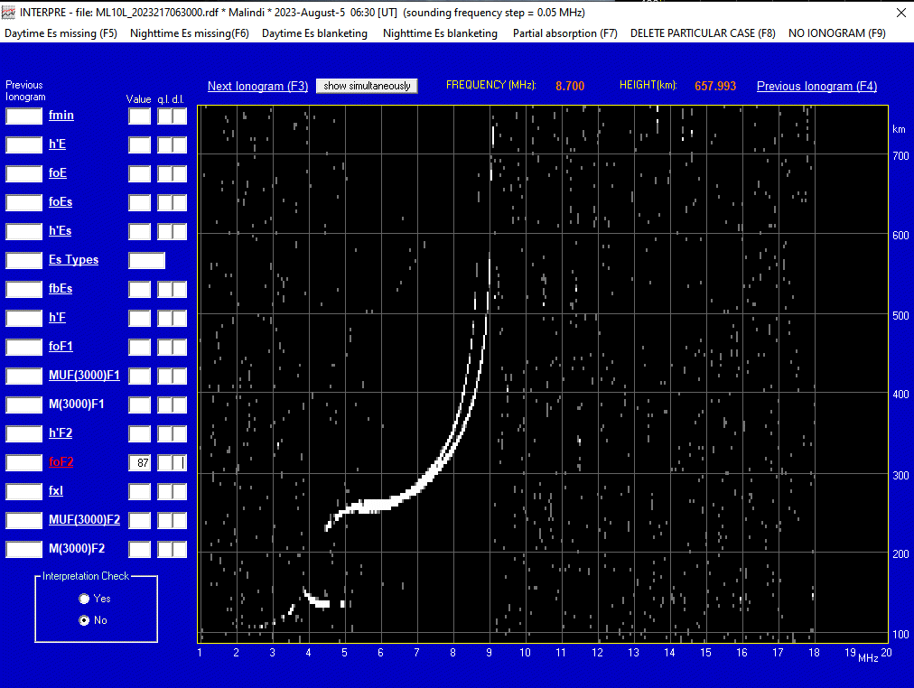
8.7 MHz

Slide 12
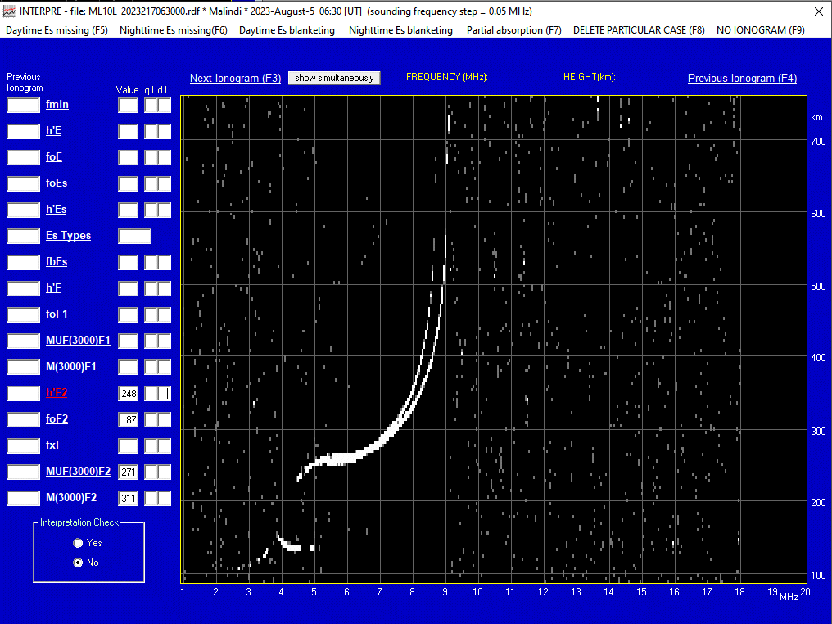
248 km

Slide 13
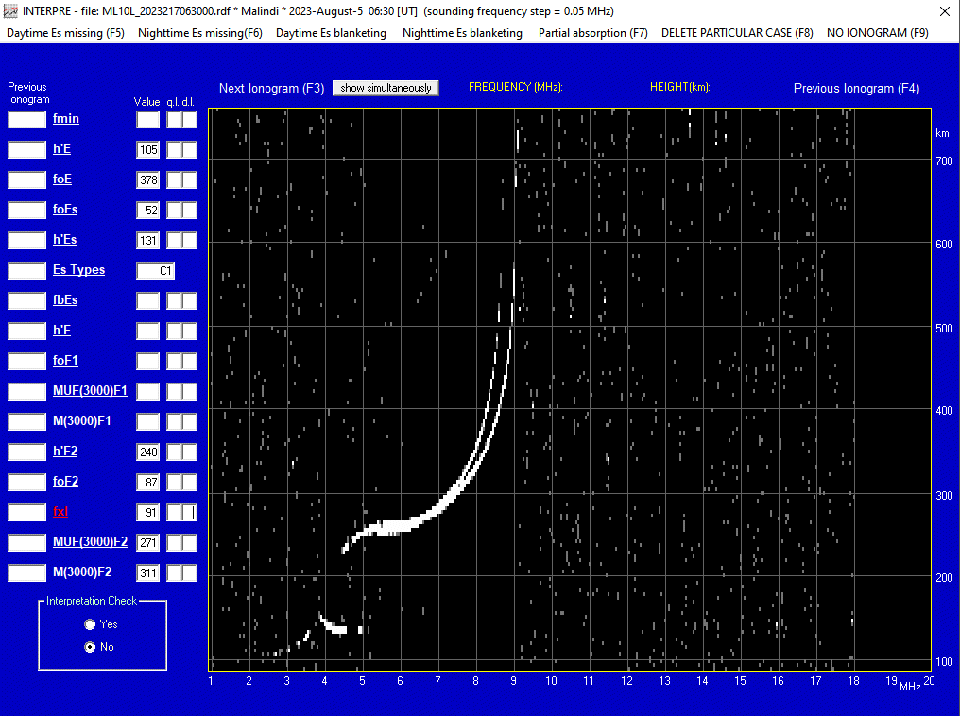
9.1 MHz

Slide 14
The Interpre software – qualifying and descriptive letters
There are ionospheric effects or equipment malfunctionings that can make it difficult to obtain a reliable value. In this case qualifying (q.l.) and descriptive letters (d.l.) are used along or in place of the numerical value.

Slide 15
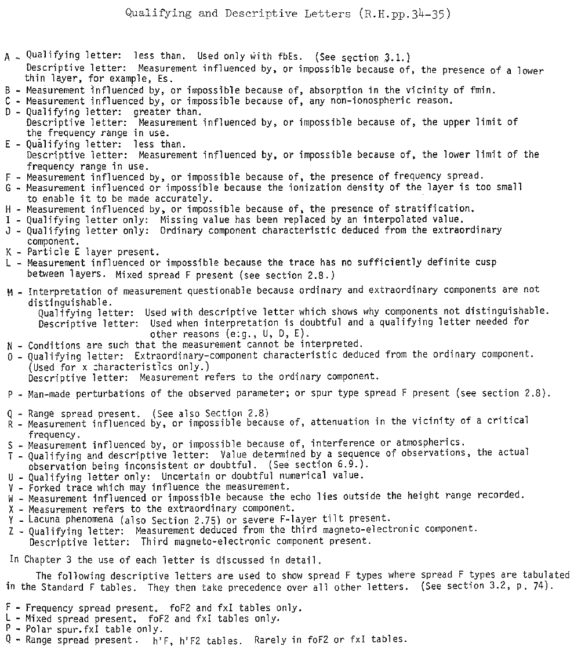
The Interpre software – qualifying and descriptive letters
Manual_of_Ionogram_Scaling.pdf

Slide 16
The Interpre software – qualifying and descriptive letters
The most used descriptive letters are:
A measurement influenced by, or impossible because of, the presence of a sporadic Es layer
C measurement influenced by, or impossible because of, any non-ionospheric reason
F measurement influenced by, or impossible because of, the presence of spread-F echoses
R measurement influenced by, or impossible because of, attenuation close to the critical frequency
S measurement influenced by, or impossible because of, interference
X measurement refers to the extraordinary component
The most used qualifying letters are:
D greater than
J ordinary-component characteristic deduced from the extraordinary component
U uncertain or doubtful value

Slide 17
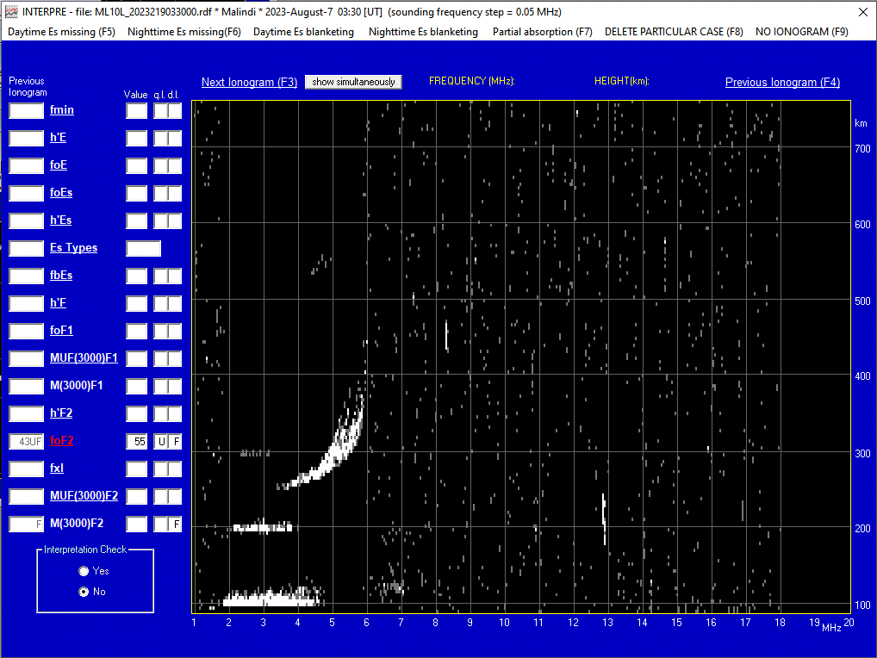
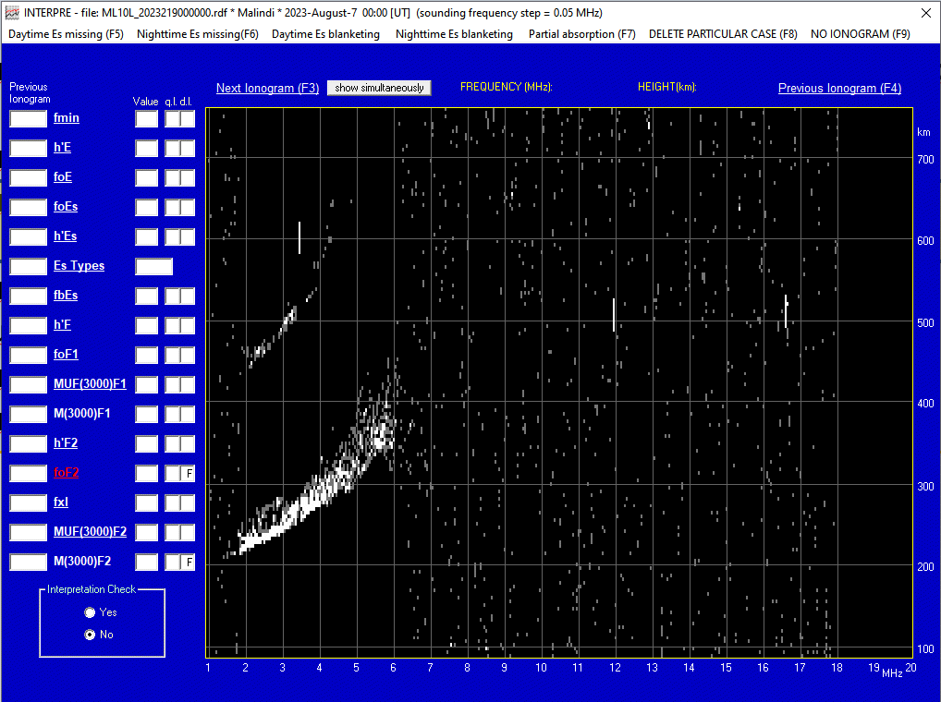
The Interpre software – qualifying and descriptive letters
The most used descriptive letters are:
A measurement influenced by, or impossible because of, the presence of a sporadic Es layer
C measurement influenced by, or impossible because of, any non-ionospheric reason
F measurement influenced by, or impossible because of, the presence of spread-F echoses
R measurement influenced by, or impossible because of, attenuation close to the critical frequency
S measurement influenced by, or impossible because of, interference
X measurement refers to the extraordinary component
This is a case you will see often!!!
The most used qualifying letters are:
D greater than
J ordinary-component characteristic deduced from the extraordinary component
U uncertain or doubtful value

Slide 18
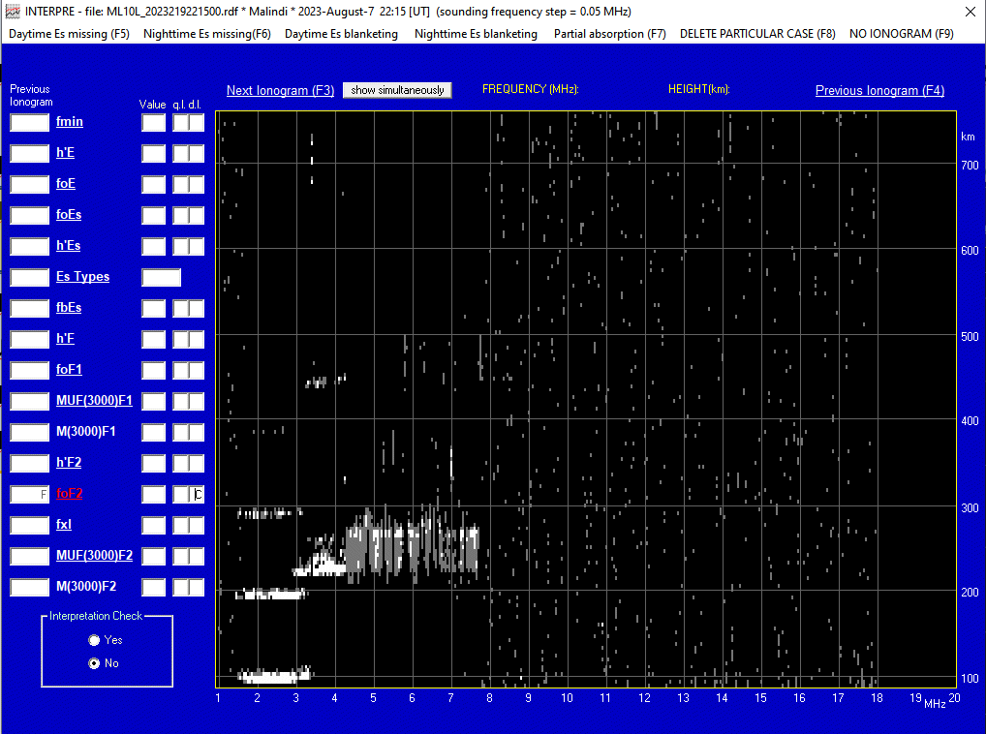
The Interpre software – qualifying and descriptive letters
The most used descriptive letters are:
A measurement influenced by, or impossible because of, the presence of a sporadic Es layer
C measurement influenced by, or impossible because of, any non-ionospheric reason
F measurement influenced by, or impossible because of, the presence of spread-F echoses
R measurement influenced by, or impossible because of, attenuation close to the critical frequency
S measurement influenced by, or impossible because of, interference
X measurement refers to the extraordinary component
The most used qualifying letters are:
D greater than
J ordinary-component characteristic deduced from the extraordinary component
U uncertain or doubtful value

Slide 19
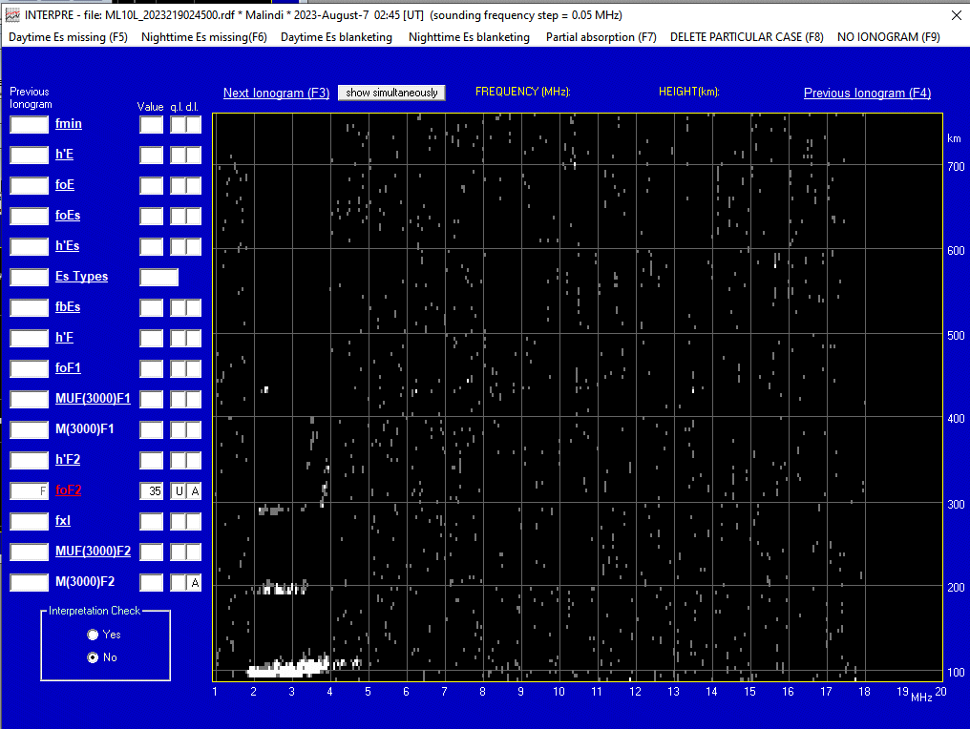
The Interpre software – qualifying and descriptive letters
The most used descriptive letters are:
A measurement influenced by, or impossible because of, the presence of a sporadic Es layer
C measurement influenced by, or impossible because of, any non-ionospheric reason
F measurement influenced by, or impossible because of, the presence of spread-F echoses
R measurement influenced by, or impossible because of, attenuation close to the critical frequency
S measurement influenced by, or impossible because of, interference
X measurement refers to the extraordinary component
The most used qualifying letters are:
D greater than
J ordinary-component characteristic deduced from the extraordinary component
U uncertain or doubtful value

Slide 20
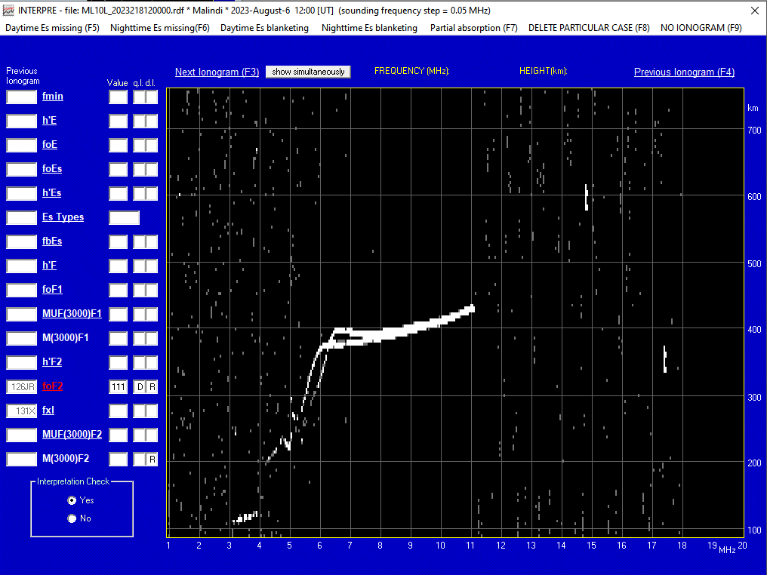
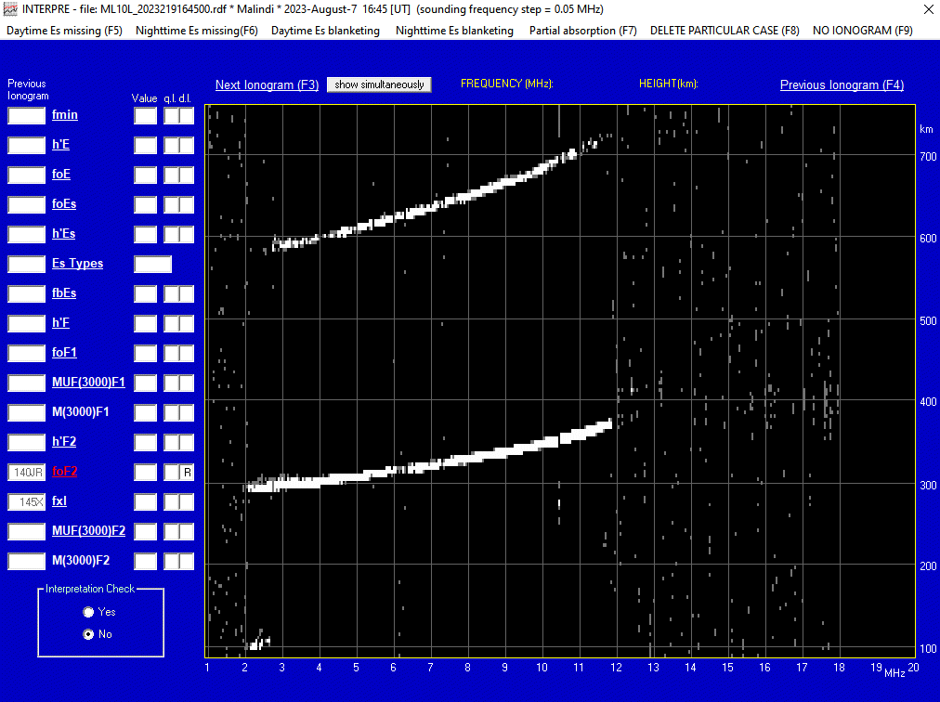
The Interpre software – qualifying and descriptive letters
The most used descriptive letters are:
A measurement influenced by, or impossible because of, the presence of a sporadic Es layer
C measurement influenced by, or impossible because of, any non-ionospheric reason
F measurement influenced by, or impossible because of, the presence of spread-F echoses
R measurement influenced by, or impossible because of, attenuation close to the critical frequency
S measurement influenced by, or impossible because of, interference
X measurement refers to the extraordinary component
The most used qualifying letters are:
D greater than
J ordinary-component characteristic deduced from the extraordinary component
U uncertain or doubtful value

Slide 21
The Interpre software – qualifying and descriptive letters
The most used descriptive letters are:
A measurement influenced by, or impossible because of, the presence of a sporadic Es layer
C measurement influenced by, or impossible because of, any non-ionospheric reason
F measurement influenced by, or impossible because of, the presence of spread-F echoses
R measurement influenced by, or impossible because of, attenuation close to the critical frequency
S measurement influenced by, or impossible because of, interference
X measurement refers to the extraordinary component
The most used qualifying letters are:
D greater than
J ordinary-component characteristic deduced from the extraordinary component
U uncertain or doubtful value

Slide 22
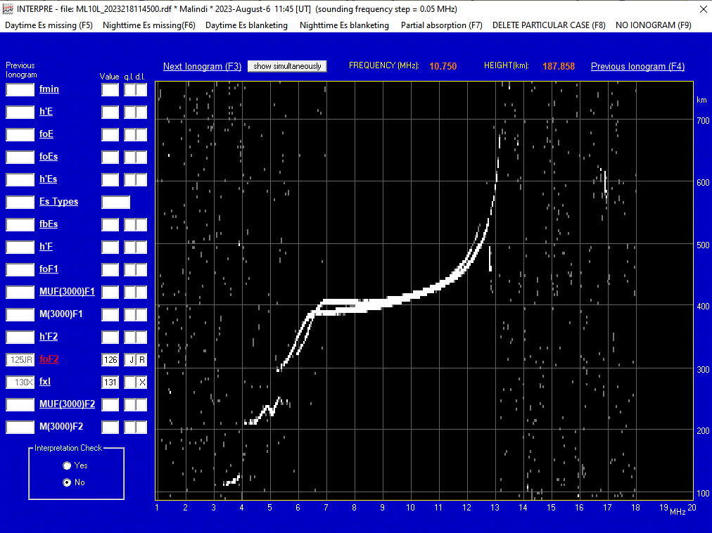
Qualifying and descriptive letters – some examples
If foF2 is partially absent and identifiable with difficulty, but fxI is instead clearly identifiable without letters:
Step 1) fxI is scaled normally;
Step 2) to have a value for foF2 the cursor has to be moved near fxI and once there, after clicking, the software automatically puts a X as descriptive letter for fxI and a J as qualificative letter for the value of foF2 which will be calculated from the value of fxI taking into account the value of the girofrequency of the sounding site.
This is a case you will see often!!!

Slide 23
Exercise – Scaling of foF2 from Malindi ionograms
Ionospheric characteristic → foF2
Ionospheric station → Malindi
Ionograms from August 2023: days 06, 07, 08, 09, 12 and 13
Time resolution: 15 minutes (maximum 96 ionograms per day)
Step 1: scaling of foF2 for all the ionograms of the day
Step 2: plot of the foF2 values (Excel? Python? Matlab? Choose the way you prefer)
Step 3: COMPARISON BETWEEN YOUR RESULTS AND MINE!!!
Team 1 → 06 August 2023
Team 2 → 07 August 2023
Team 3 → 08 August 2023
Team 4 → 09 August 2023
Team 5 → 12 August 2023
Team 6 → 13 August 2023

Slide 24
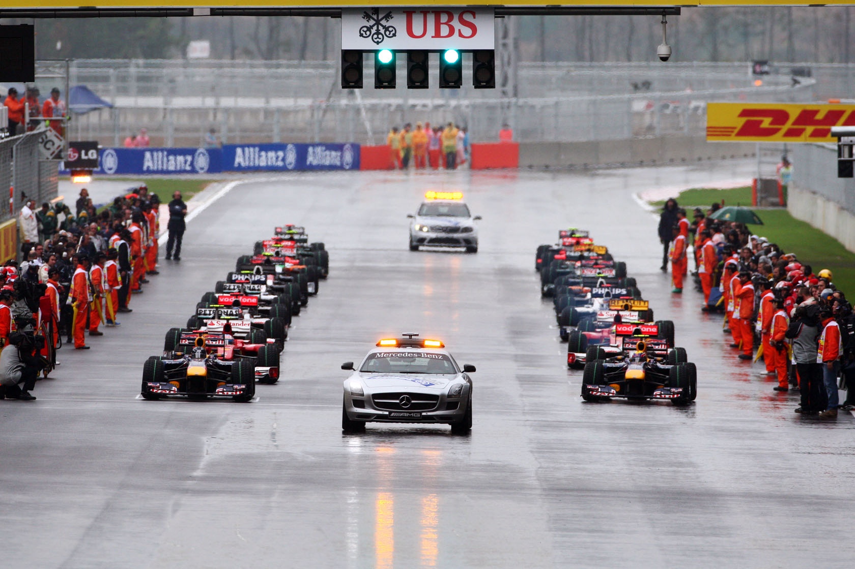
Exercise – Scaling of foF2 from Malindi ionograms
Let’s start!!!

